Slide 1


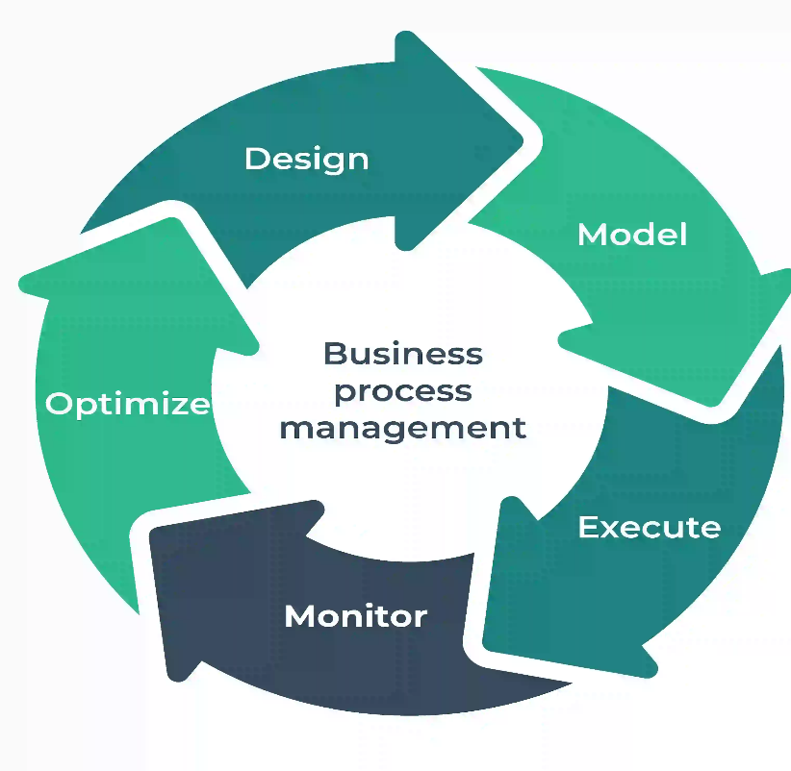
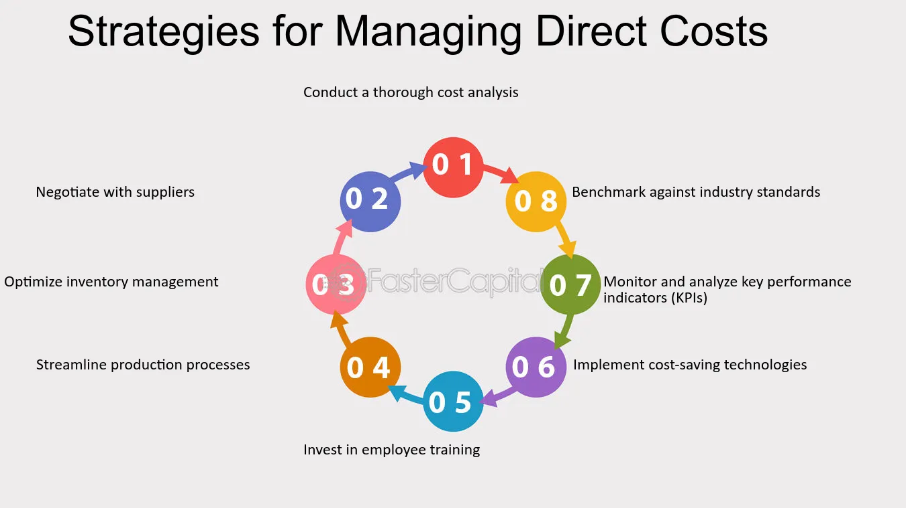
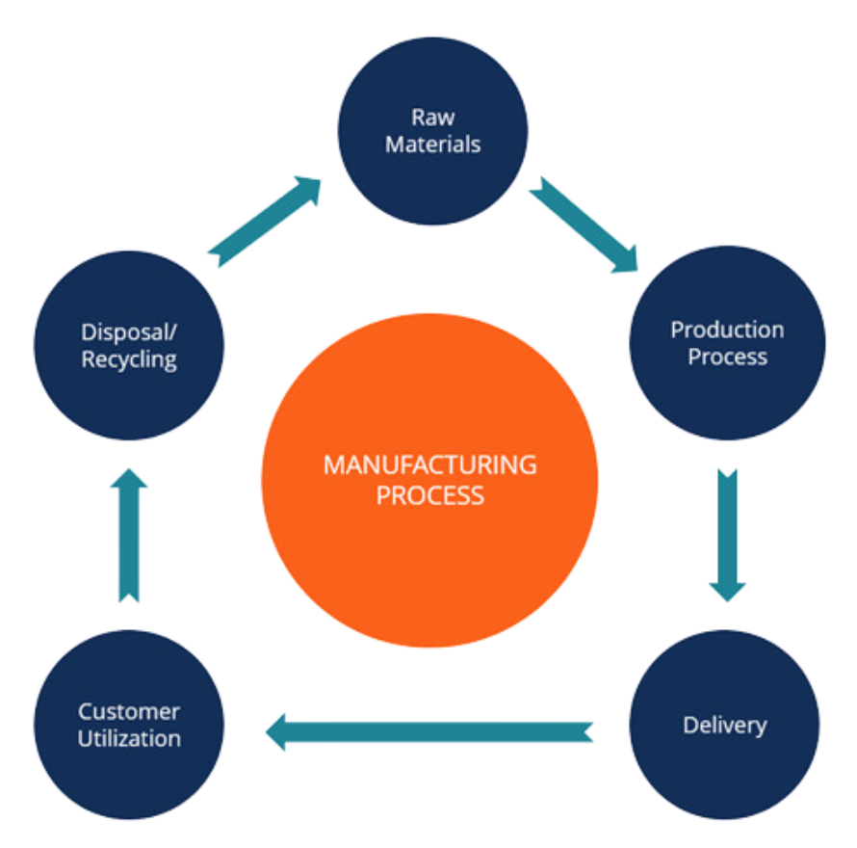
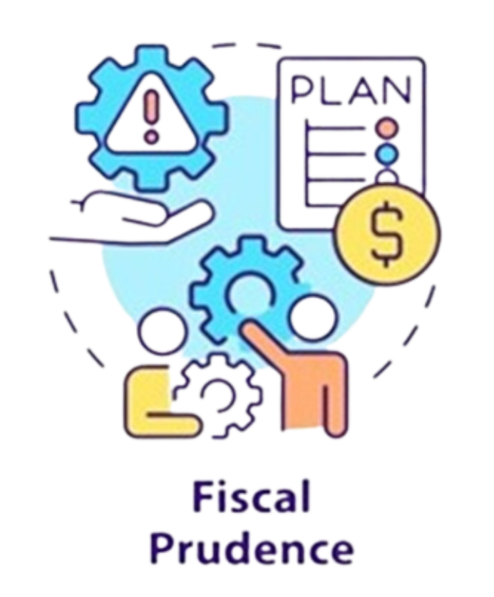
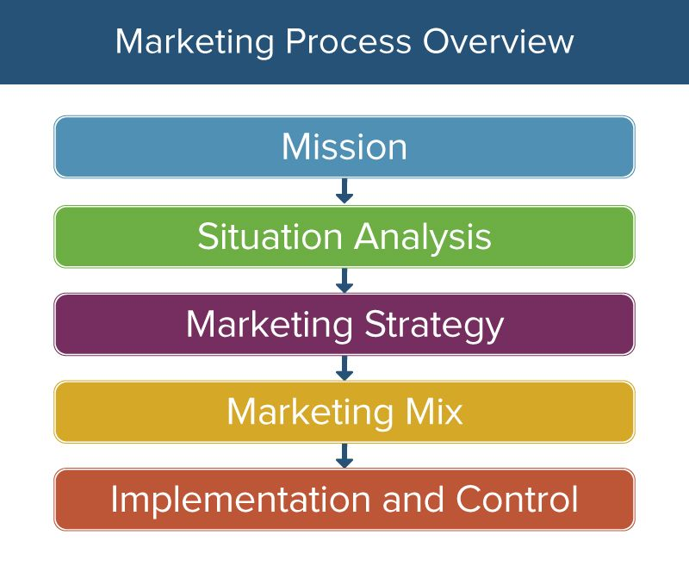
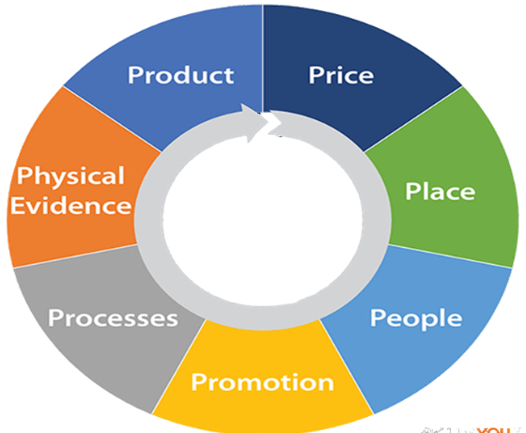
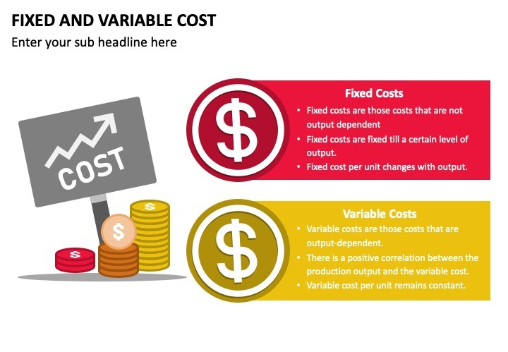
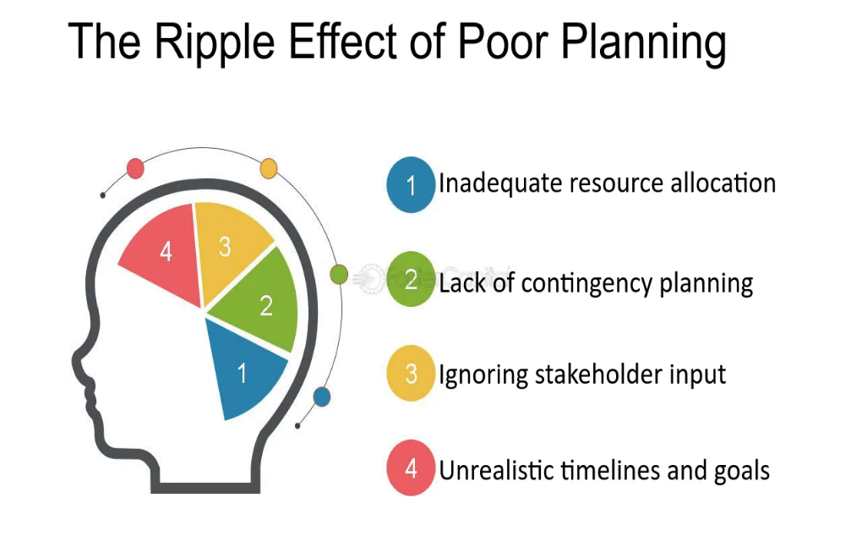
eight strategies for managing direct costs, which are expenses directly tied to producing goods or services
Human Resources including leadership, training, performance, potential, and research.
careful financial planning (gear) is key to fiscal responsibility
eight strategies for managing direct costs, which are expenses directly tied to producing goods or services
marketing mix model divided into seven sections labeled product, price, place, physical evidence, processes, people, and promotion

