Slide 1
Fundamentals
Data Analysis Workshop
Ben Collins
Queen’s University Belfast | School of Biological Sciences
BIO8206 – Introduction to Biological Mass Spectrometry
Notes:
**********************************************************
******************** PRESS RECORD *********************
**********************************************************

Slide 2
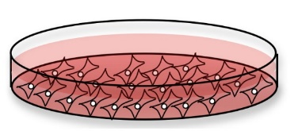

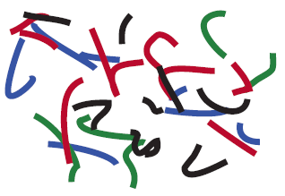
Experimental workflow for today’s data
HeLa cells
Protein
extraction
Protein
digestion
Peptide
separation
Ionization
organic
solvent, %
time
Proteins
Peptides
HPLC
ESI
MS1 – mass (m/z) of peptides
Mass
spectrometry
Isolation +
fragmentation
Q1 filter
Collision
cell
TOF analyzer
MS2 – mass (m/z) of fragments
mass spectrometer
Notes:
This is a very generalized workflow that is applied by groups working on proteomics using mass spectrometers
Broadly represents the most common method

Slide 3
2 topics for workshop – also related to assignment!
Calculating mass from m/z
We measure m/z but we want to know mass!
Review charge states and isotope distributions
Interpreting fragmentation (or MS2) spectra
Using peptide as example – but generalizable to other analytes
Manual annotation of amino acid sequence of peptide from MS2 spectrum

Slide 4
Recap on isotopic distributions and charge stages
2 separate issues to review:
Elemental isotopic abundances and MS
Using isotope distributions to determine charge state
In nature for given elements we find different isotopic abundances of various elements because or different numbers of neutrons
We are primarily concerned with carbon
98.9 % of the carbon in nature is ¹²C (6 protons + 6 neutrons in nucleus)
1.1 % is ¹³C (6 protons + 7 neutrons in nucleus)
1 part per trillion is ¹⁴C (6 protons + 8 neutrons in nucleus)
Unstable with half life of 5,730 years → radio carbon dating
Some elemental isotope abundances

Slide 5
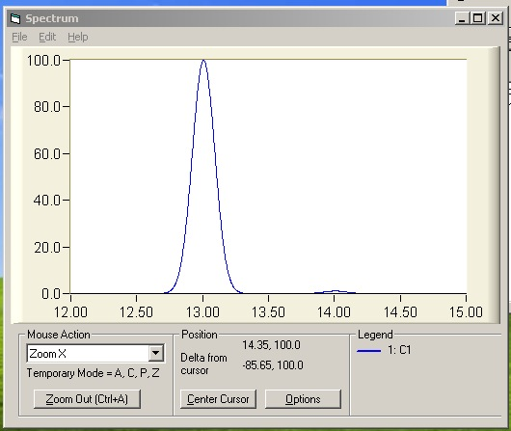
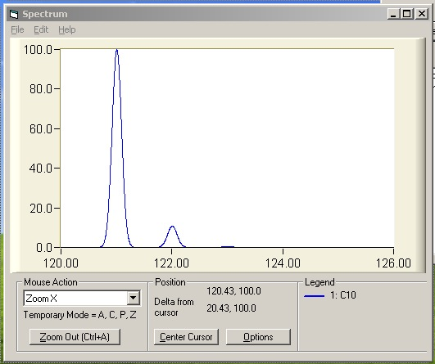
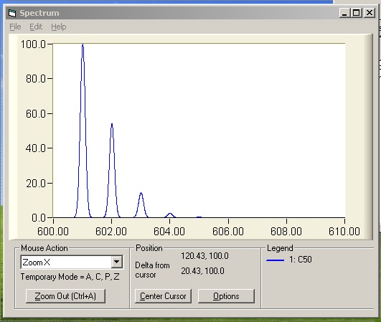
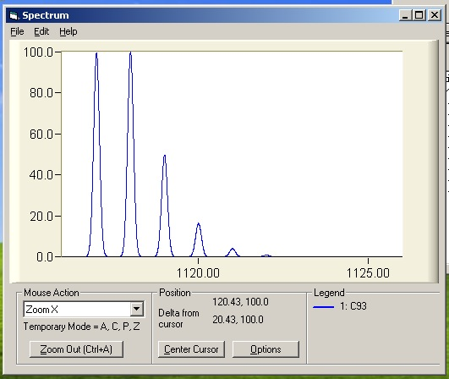
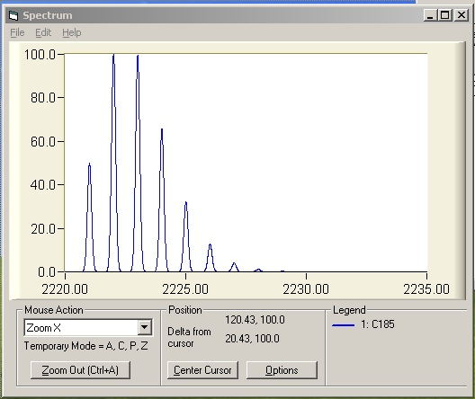
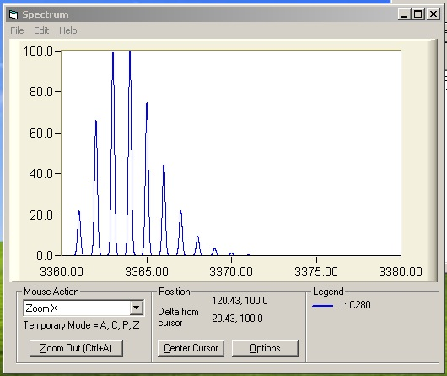
Isotope Distributions
10 x ¹²C
9 x ¹²C
1 x ¹³C
Mw of carbon is 12 Daltons
Question:
What is the natural abundance of the carbon 13 isotope?
Answer: ~1.1 %
C₁
8 x ¹²C
2 x ¹³C
C₁₀
C₅₀
C₉₃
C₁₈₅
C₂₈₀
~18 aa
(based on average
nb of C per amino acid=5.3)
~35 aa
~52 aa

Slide 6
Do we actually measure mass? No, mass to charge ratio
mass/charge
mass (inc. protons)
neutral mass
MH⁺
M2H⁺⁺
M3H⁺⁺⁺
501.008
501.008
500
M3H⁺⁺⁺
M2H⁺⁺
MH⁺
counts
251.008
502.016
500
167.674
503.024
500
167.67
251.008
501.008
m/z
To calculate the neutral mass from the measured m/z we need to know the charge state
We use the existence of the isotopic distribution as a trick to figure out the charge state!
~0.33 m/z
~0.5 m/z
~1 m/z
M3H⁺⁺⁺
MH⁺
M2H⁺⁺
counts
counts
counts
167
168
169
251
252
253
501
502
503
m/z
m/z
m/z

Slide 7
So, if we want to calculate neutral mass from m/z… Worked example:
686.26
686.59
counts
686.92
counts
m/z
687.26
Determine charge state
spacing between istopalogues = ~0.33
=> charge state = 1 / ~0.33 = 3+
Calculate mass (with protons)
Monoisotopic mass x charge state
686.26 x 3 = 2,058.78
Calculate neutral mass
Subtract mass of protons
2,058.78 – (3 x 1.008) = 2,055.756 Da
m/z
Note: assume positive mode electrospray so we expect ionizing protons

Slide 8
2 topics for workshop – also related to assignment!
Calculating mass from m/z
We measure m/z but we want to know mass!
Review charge states and isotope distribubtions
Interpreting fragmentation (or MS2) spectra
Using peptide as example – but generalizable to other analytes
Manual annotation of amino acid sequence of peptide from MS2 spectrum

Slide 9
Fragmenting a Peptide
A-P-N-D-F-N-L-K
(MH+ 919)
B-ions Y-ions
72.0 A P-N-D-F-N-L-K 847.4
169.1 A-P N-D-F-N-L-K 750.4
283.1 A-P-N D-F-N-L-K 636.3
398.2 A-P-N-D F-N-L-K 521.3
545.2 A-P-N-D-F N-L-K 374.2
659.3 A-P-N-D-F-N L-K 260.2
772.4 A-P-N-D-F-N-L K 147.1
b-ions = ΣAA + H⁺
y-ions = ΣAA + H₂O + H⁺
monoisotopic masses

Slide 10
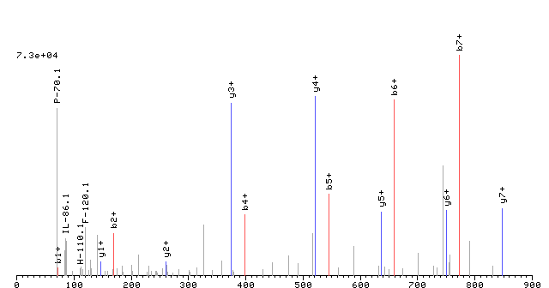
Sequence & MS2 Spectrum – b and y ions
A-P-N-D-F-N-L-K
(MH+ 919)
A
P
N
D
F
N
L
K
K
L
N
F
D
N
P
A

Slide 11
Amino Acid Masses

Slide 12
Procedure
Convert the precursor m/z to single charged (e.g. M2H⁺⁺ → MH⁺)
(If everything is singly charged it makes the math easier….)
2. Locate the peak with the biggest m/z value (i.e right most peak) and subtract that value from the precursor m/z
3. Check this value against the amino acid table (monoisotopic)
if match then this should be one of the terminal AA residues (go to step 4)
If no match then move onto the next biggest m/z value and try again
Note: error of ~0.01-0.02 m/z is still a match, but the error should not be larger than this
Hint: m/z gap should be ~57-186 to match an AA residue
Find the next biggest m/z peak and subtract it from the last peak you assigned, and then keep repeating this procedure until you get to lowest m/z peaks and can’t find more AA residues
This will be the y ion series series
Start again from the precursor MH⁺ calculated in step 1 and subtract 18.02 (H2O). Then look for another gap that fits an AA residue mass and work your way down again looking for gaps that correspond to AA residues as in step 4
This will be the b ion series
Hint: in peptides produced by trypsin cleavage the first AA residue you find should be K or R
Reverse the order of the b series AA residues and align the 2 sequences!
For a deeper tutorial see http://ionsource.com/tutorial/DeNovo/introduction.htm
Notes:
This is a very generalized workflow that is applied by groups working on proteomics using mass spectrometers
Broadly represents the most common method

Slide 13
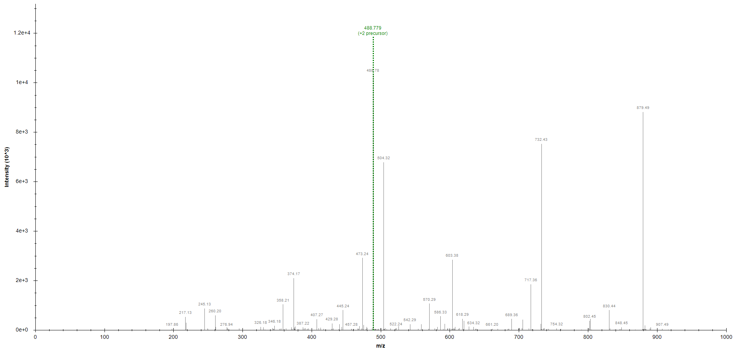
MS2 spectra -- Spectrum 1
M2H++ → MH+
488.78 x 2 = 977.56
- 1.008 = 976.55
MH+
976.55
MH+ - 18.02 = 958.53
Check results against theory here:
https://proteomicsresource.washington.edu/cgi-bin/fragment.cgi
PFEVPFLK
(or PFEVPFIK)
sequence from y ion series
PFEVPF..
F
P
V
E
F
P
147.07
97.05
99.06
129.05
147.06
97.06
sequence from b ion series
..EVPFLK
129.04
99.07
97.05
147.07
113.08
K
E
V
P
F
I/L
128.09
A210622_bcc_hela_200ng_dda_1538.60512.60512.2_PFEVPFLK

Slide 14
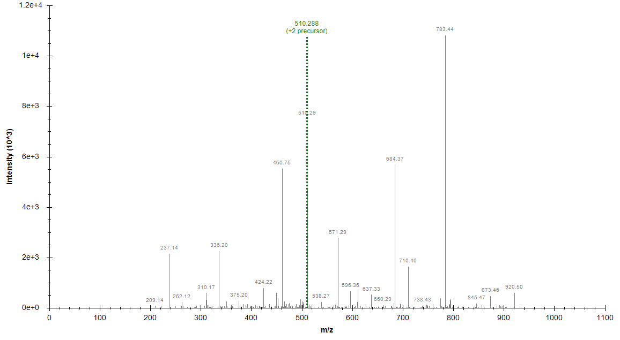
MS2 spectra -- Spectrum 2
510.28 x 2 = 1020.58
- 1.008 = 1019.57
M2H++ → MH+
MH+
1019.57
MH+ - 18.02 = 1001.55
VHVIFNYK
y ion series
VHVLFN..
F
V
N
I/L
V
H
114.05
147.07
113.08
99.07
137.06
99.07
b ion series
..VLFNYK
V
I/L
F
N
Y
K
99.06
113.09
147.07
114.04
163.06
128.09
449.29
A210622_bcc_hela_200ng_dda_1538.21410.21410.2_VHVIFNYK

Slide 15
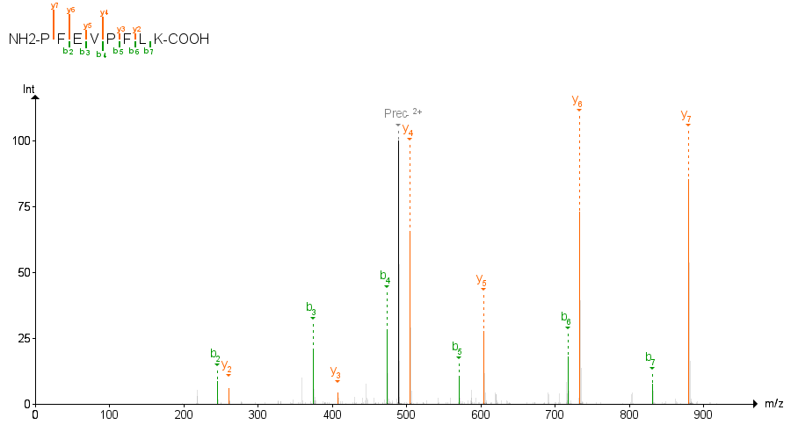
Computer annotation – spectrum 1
A210622_bcc_hela_200ng_dda_1538.60512.60512.2_PFEVPFLK

Slide 16
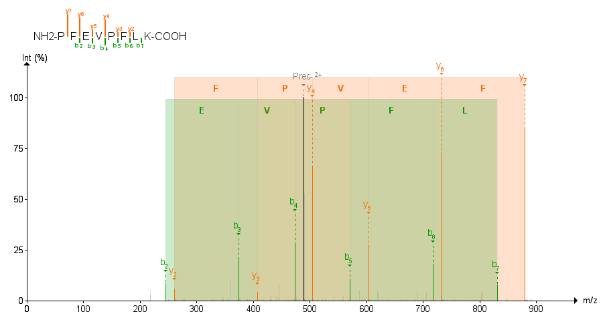
Computer annotation – spectrum 1
A210622_bcc_hela_200ng_dda_1538.60512.60512.2_PFEVPFLK

Slide 17
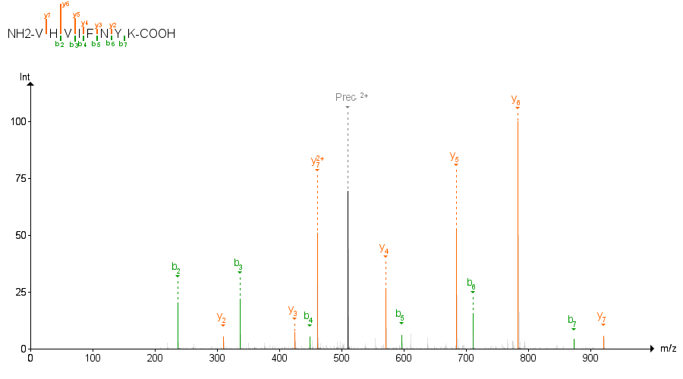
Computer annotation – spectrum 2
A210622_bcc_hela_200ng_dda_1538.21410.21410.2_VHVIFNYK

Slide 18
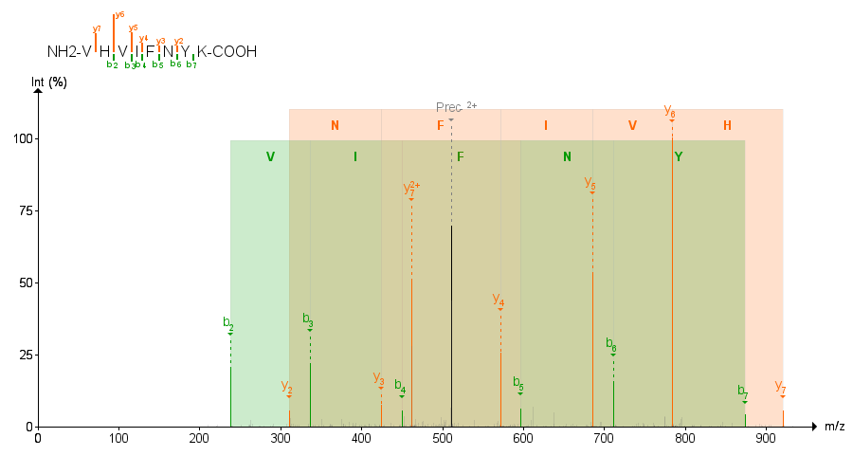
Computer annotation – spectrum 2
A210622_bcc_hela_200ng_dda_1538.21410.21410.2_VHVIFNYK

