Slide 1
Assessment type: Presentation video recording

Slide 2
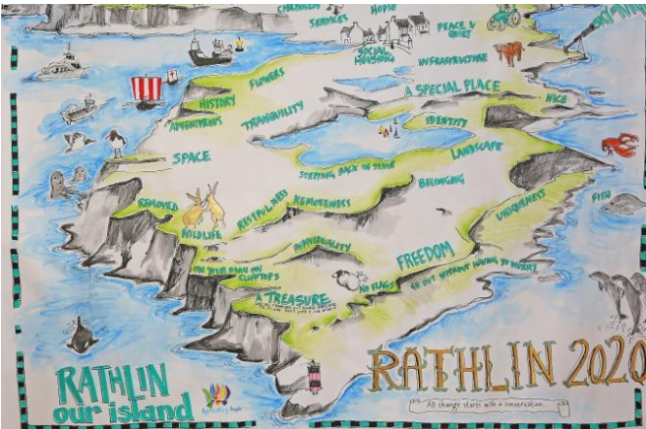
Introduce the topic
This presentation is based on the Rathin Island which is a small island and located at the north coast of Co. Antrim,
This island is situated at the Ireland and most of the visitors are visit this Island at frequently and also the number of tourists is increased day by day which is help to improve the popularity of this tourist area.
The government of the Ireland are also launching the Rathin Island Action Plan 2016-
2020 which is help to improve the uses of the natural resources and also the improvement of the energy efficiency and thus it is help to promote the development of the environment.
(Source:Clean -energy-islands.ec.europa.eu, 2023).
Notes:
In this slide, the introduction of this presentation has been discussed. The Rathin Development & Community Association (RDCA) are responsible to promote the development of the country and also promote the reduction of the burning of the natural resources which is help to improve the sustainability of the country and maintain the proper development of the service of the tourist. In this presentation, the proper uses of one technology from Distributed generation (DG) or Demand response (DR) and Energy Storage (ES) to help to promote the long-term carbon neutral and thus help to reduction of the pollution at the environment.

Slide 3
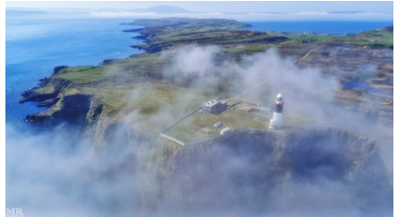
Overview
Rathin Island, there are 3000 people visited annually at this island, and a large number of people have visited this island, mainly in the summertime.
Due to the promote the service to the tourists, the governments need more fossil fuels, and thus, they need to invest more money, and therefore, it is required to reduce the government's costs(Clean -energy-islands.ec.europa.eu, 2023).
At Rathin Island, there are huge sources of natural resources, including wind and water, and thus, the Governments are getting the proper resources to promote the appropriate service to the tourists and maintain the appropriate development of the tourist development business at this location.
(Source:Clean -energy-islands.ec.europa.eu, 2023).
Notes:
In this slide, the overview of the Rathin island has been discussed. According to the survey, it is estimated that the annual emission of this areas is 2,057 tCO2e which is higher than the others locations. The household usage of the fossil fuels are high and the people are used more energy at the electricity purpose and thus it is required to reduces the consumption of the electricity at the household and thus the governments needs to implemented some proper technology and thus it is help to promote the development of the proper usage of the natural resources.

Slide 4
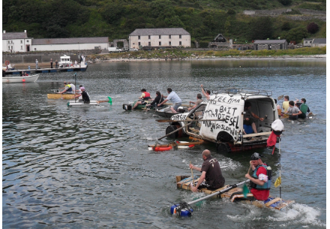
Aim of this presentation
This presentation aims to promote the proper issues of this island in case of the correct usage of natural resources and the appropriate technology to maintain the correct resources.
This presentation also helps to understand the main activity of the Rathin Island Policy and Action Plan. It thus will help to promote the understanding regarding the different policies and also encourage the proper development of the environment and maintain the reduction of pollution in the environment(Infrastructure -ni.gov.uk, 2023).
This presentation also helps to understand the way of improving the condition of the people at Rathin Island.
(Source:Clean -energy-islands.ec.europa.eu, 2023)
Notes:
In this slide, the aims of this presentation have been discussed. At the Rathin Island policy, there are three aspects are need to be completed and these are Rathin Island policy, Rathin island action plan (2016-2020) and also the Rathin island action plan of the (2013 -2015) and thus those action plan are help to reduction of the pollution at the environment. According to the action plan, the government are promoting the proper action which is help to development of the sustainable economic and tourism development and also reduction the usage of the natural resources and maintain the proper development of this country.

Slide 5
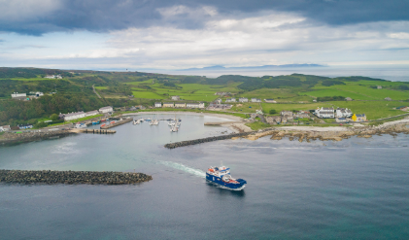
Key issues
At Rathin Island, there are many natural resources, and thus, the local people in this country use the natural resources effectively.
In this county, there is an increased number of tourists daily, and thus, it leads to more use of natural resources to promote the proper development of the service to those tourists(Mitali, Dhinakaran and Mohamad, 2022).
More burning of fossil fuels is also promoting increased pollution in the environment of this country.
Limited awareness about the conservation of natural resources among the local people of this country is also responsible for making the issues of this country and promoting the improper development of the country's environment(Olabi et al., 2021).
(Source:Clean -energy-islands.ec.europa.eu, 2023)
Notes:
In this slide the key issues of the Rathin Island has been discussed. The energy demands of this country are increased at the recent years as compared to the previous years and thus it makes threats for the governments as the government are faced the challenges regarding the reduction of the pollution and also promote the sustainability. At the domestic level, there are increased demands of the electricity and also others energy requirements and thus it is responsible to increased demands of the daily electric supply

Slide 6
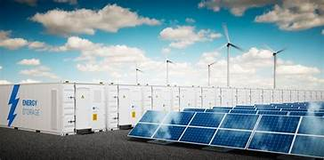
Rationale of technology
Distributed Generation (DG) Technology: Wind Power
Abundant Resource: Rathlin Island has an excellent wind resource, especially during the wintry weather months while energy demand may be higher.
Proven Technology: Wind turbines are a mature era with numerous a success installations international (Koohi-Fayegh and Rosen, 2020).
Scalability: Wind strength can be scaled to match the desires of the island, from small-scale mills for person families to large community-based totally projects.
Energy Storage (ES) Technology: Lithium-Ion Battery System
High Energy Density: Lithium-ion batteries have a high power density, making them efficient for storing huge amounts of energy in a distinctly small space.
Efficiency: These batteries have high round-experience efficiency (normally around ninety-ninety five%), that's essential for maximizing using generated renewable power.
Modularity: Lithium-ion battery systems may be scaled to healthy the storage needs, from small family systems to large network-scale installations.
(Source: Koohi-Fayegh and Rosen, 2020)
Notes:
In this slide, the discussion of the chosen energy and also the rational of the chosen technology for the reduction of the pollution and also promote the development of the proper resources has been discussed. This is help to promote the proper back up power at the time of the disruption. The flexibility of the technology are also help to maintain the reliability and resilience and thus it is help to promote the development of the reduction of the pollution.

Slide 7
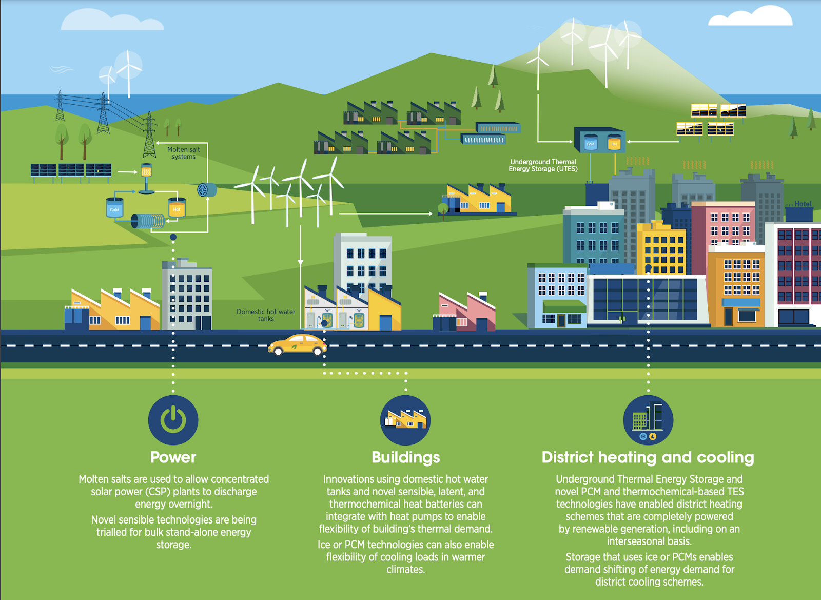
Technical Details
Wind Power as Distributed Generation (DG) Technology
Technical Information
Type: Onshore Wind Turbines
Size/Capacity: For Rathlin Island, small to medium-sized turbines are appropriate. Example sizes:
Small Turbines: 50 kW each
Medium Turbines: 500 kW to 1 MW each
Expected Output: Average capacity factor of 30-40%, depending on wind resource assessments.
(Source: Mitali, Dhinakaran and Mohamad, 2022).
Notes:
In this slide, total size of the batteries which is needed to meet the needs of the people at this island has been discussed.

Slide 8
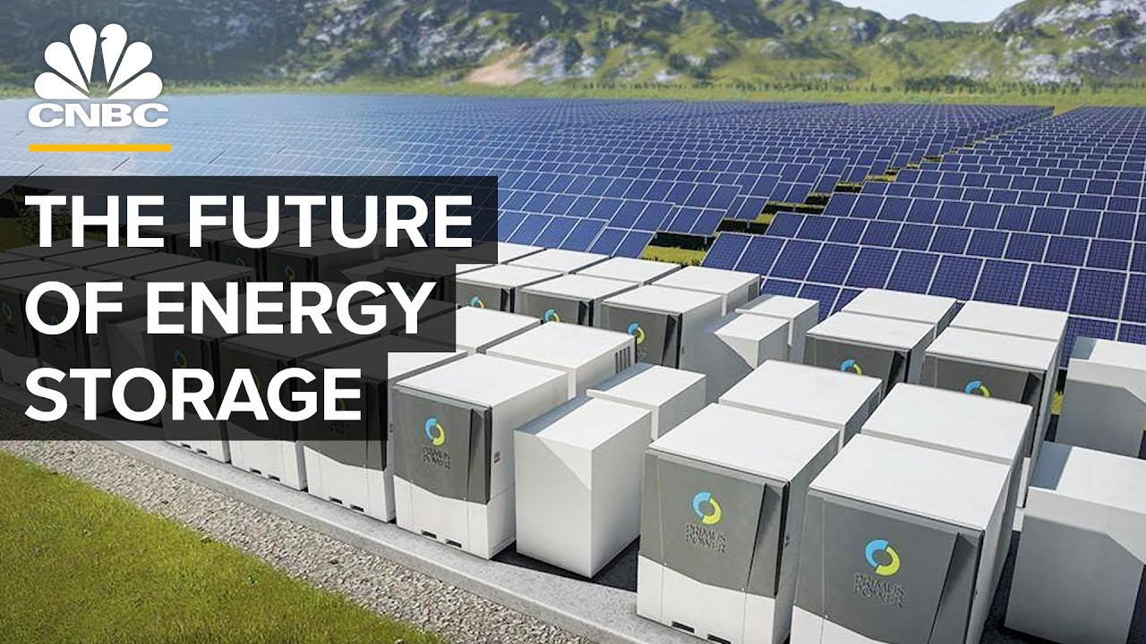
Technical details: Information on technology
Installation Costs:
Small Turbines (50 kW): Approximately $2,000 per kW, or $100,000 per turbine.
Medium Turbines (500 kW to 1 MW): Approximately $1,500 per kW, or $750,000 to $1.5 million per turbine.
Operation and Maintenance Costs:
Annual O&M costs are typically 2-3% of the installation cost.
Small Turbines: $2,000 to $3,000 per year.
Medium Turbines: $15,000 to $45,000 per year.
(Source: Koohi-Fayegh and Rosen, 2020)
Notes:
The technological details of the chosen technology for the reduction of pollution in the environment have been discussed in this slide,. Promotes electricity discharge at a shorter time than the other technology by the flywheel technology. It, helps to encourage the development of energy storage, promote the development of the proper storage of natural resources, and limit the burning of fossil fuels. Different machines and also the battery is help to promote the proper development of the storage of the different forms of energy.

Slide 9
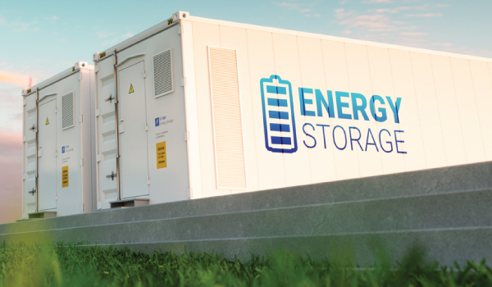
Technical details: Information on technology(Continue)
Technoeconomic Analysis
Lifespan: 20-25 years for wind turbines.
Payback Period: Typically 6-10 years, depending on wind resource quality and energy prices.
Savings:
Cost Savings: Reduced reliance on imported fossil fuels (average price $0.10-$0.15 per kWh). For a medium turbine generating 1.5 million kWh annually, savings can be $150,000 to $225,000 per year.
Energy Production: For example, a 500 kW turbine with a 35% capacity factor generates ~1.53 million kWh/year.
(Source: Koohi-Fayegh and Rosen, 2020)
Notes:
This is the continues slide of the previous slide. The Thermal energy storage at solar power plants is one of the technology which is help to promote the development of the energy storage and thus it is help to promote the development of the storage of the energy and limited the uses of the non renewable sources of energy. In this system, the energy can be developed through the help of the solar energy and thus it is help to promote the development of the usage of the solar power and also promote the storage of the energy which is help to make the proper service of the tourist and maintain the development of the proper environment.

Slide 10
Lithium-Ion Battery Storage System (ES Technology)
Type: Lithium-Ion Battery Storage
Size/Capacity: Scalable systems based on energy needs. Example sizes:
Small System: 100 kWh
Medium System: 500 kWh to 1 MWh
Installation Costs:
Small System (100 kWh): Approximately $500 per kWh, or $50,000.
Medium System (500 kWh to 1 MWh): Approximately $400 per kWh, or $200,000 to $400,000.
Operation and Maintenance Costs: Annual O&M costs are typically 1-2% of the installation cost.
Small System: $500 to $1,000 per year.
Medium System: $2,000 to $8,000 per year.

Slide 11
Lithium-Ion Battery Storage System (ES Technology)
Technoeconomic Analysis
Lifespan: 10-15 years for lithium-ion batteries.
Payback Period: Typically 5-8 years, depending on usage patterns and energy prices.
Savings:
Cost Savings: Batteries can store excess wind energy and provide it during high demand or low wind periods, reducing the need for expensive fossil fuel-generated electricity. For example, a 500 kWh system can save $50,000 to $75,000 annually if it offsets energy costs of $0.10-$0.15 per kWh.
Energy Storage: For example, a 500 kWh system can discharge at a rate of up to 50 kW for 10 hours or 100 kW for 5 hours.

Slide 12
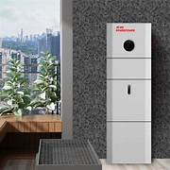
Key benefits, potential and barriers
Key benefits: Energy storage helps to promote the reduction of the operation cost and also the others cost, and thus, it helps to promote the reduction of the overall cost of the process and promote the proper operation with limited funds.
This process helps to increase the storage of the energy with the alternative method. Thus, it helps to promote the development of the process of conducting the electricity and maintain the proper development of the storage of the energy(Trahey et al., 2020).
Potential: In case of the change's requirements and also the flexibility, the potentiality of the energy storage is increased and also promotes the development of the environment.
(Source: Trahey et al., 2020).
Notes:
In this slide the key benefits and also the potential and also the barriers of the technology have been discussed. There is no proper regulatory framework to promote the proper storage of the energy at the different methods and thus it makes challenges for the technicist to promote the proper development of the storage of electricity and also the others sources of energy.

Slide 13
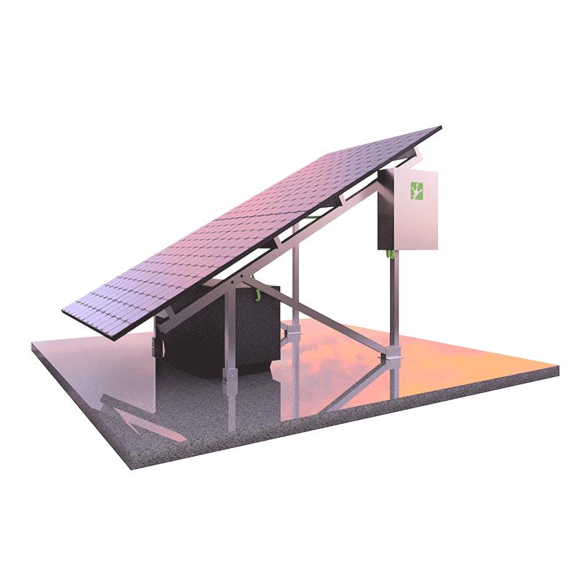
Solutions and changes to adopt
The government of Rathin Island are responsible for promoting the different frameworks and also some strategies which help to maintain the proper implementation of the other technology(Kebede et al., 2022).
The project manager of the action plan should be responsible for making the proper strategy of promoting the appropriate implementation of the different technologies.
The project manager is responsible for identifying the proper technology. Also, one technology is preferable for the particular scenario and thus helps to maintain the appropriate development of the work.
(Source:Kebede et al., 2022).
Notes:
In this slide, the proper solution and also the needed changes for the adoption have been discussed. The project manager are responsible to promote some awareness programme which is help to promote the awareness to the people regarding the importance of the reduction of the renewable source of energy and thus it is help to promote the reduction of the source of energy at the household level. Thus the government of the Rathin island are promotes the proper service to the tourist at the summer time and maintain the proper development of the project.

Slide 14
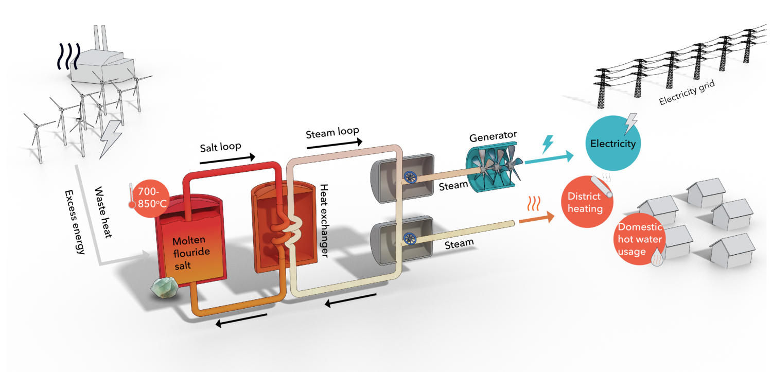
Conclusion
From the above discussion, it is concluded that Rathin Island is a location that attracts different people, and thus, the number of tourists is increasing daily. This leads to government issues regarding the maintenance of sustainability.
The government of Rathin Island are also responsible for promoting an action plan and a project plan which will help to reduce the use of natural resources.
The people of Rathin Island have limited knowledge regarding the conservation of natural resources. Thus, they are responsible for huge uses of natural resources and promote the limitation of the resources.
(Source:Kebede et al., 2022).
Notes:
In this slide, the conclusion of this presentation has been discussed. In this presentation, the energy storage technology are need to be used and thus it is help to promote the proper storage and thus maintain the proper development of the environment and reduces the pollution at the environment.

Slide 15
Reference list
Clean -energy-islands.ec.europa.eu, (2023). Rithan. clean-energy-islands.ec.europa.eu. Accessed from: https://clean-energy-islands.ec.europa.eu/countries/ireland/rathlin
Infrastructuree -ni.gov.uk, (2023). Rithan island policy and action plan. Infrastructuree -ni.gov.uk. Accessed from: https://www.infrastructure-ni.gov.uk/publications/rathlin-island-policy-and-action-plan
Kebede, A.A., Kalogiannis, T., Van Mierlo, J. and Berecibar, M.,( 2022). A comprehensive review of stationary energy storage devices for large scale renewable energy sources grid integration. Renewable and Sustainable Energy Reviews, 159, p.112213. https://www.sciencedirect.com/science/article/pii/S1364032122001368
Koohi-Fayegh, S. and Rosen, M.A., (2020). A review of energy storage types, applications and recent developments. Journal of Energy Storage, 27, p.101047. https://www.sciencedirect.com/science/article/pii/S2352152X19306012
Mitali, J., Dhinakaran, S. and Mohamad, A.A.,( 2022). Energy storage systems: A review. Energy Storage and Saving, 1(3), pp.166-216. https://www.sciencedirect.com/science/article/pii/S277268352200022X
Shaqsi, A.Z.A., Sopian, K. and Al-Hinai, A.,( 2020). Review of energy storage services, applications, limitations, and benefits. Energy reports, 6, pp.288-306. https://www.sciencedirect.com/science/article/pii/S2352484720312464
Tan, H., Li, J., He, M., Li, J., Zhi, D., Qin, F. and Zhang, C., (2021). Global evolution of research on green energy and environmental technologies: A bibliometric study. Journal of Environmental Management, 297, p.113382. https://www.sciencedirect.com/science/article/pii/S0301479721014444
Trahey, L., Brushett, F.R., Balsara, N.P., Ceder, G., Cheng, L., Chiang, Y.M., Hahn, N.T., Ingram, B.J., Minteer, S.D., Moore, J.S. and Mueller, K.T., (2020.) Energy storage emerging: A perspective from the Joint Center for Energy Storage Research. Proceedings of the National Academy of Sciences, 117(23), pp.12550-12557. https://www.pnas.org/syndication/doi/10.1073/pnas.1821672117

Slide 16
THANK YOU

