Slide 1


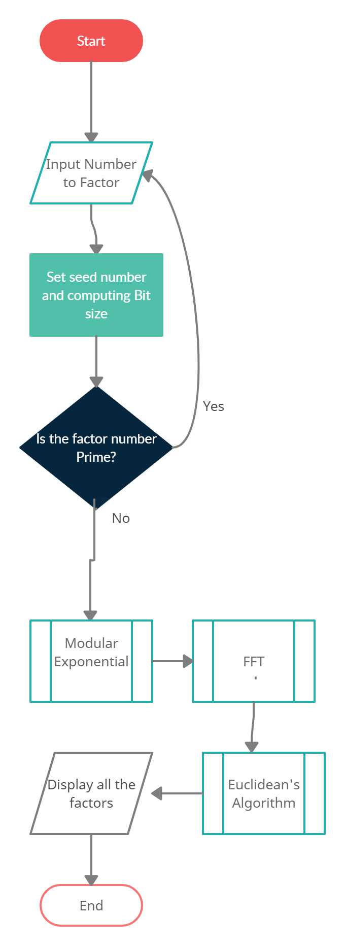
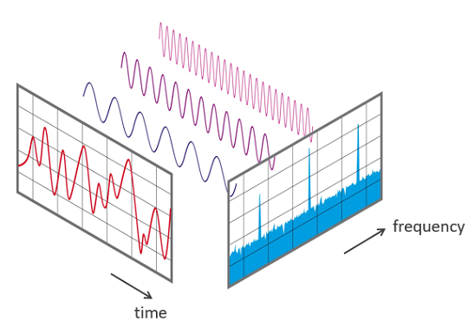
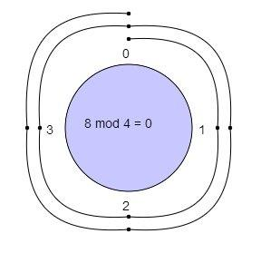
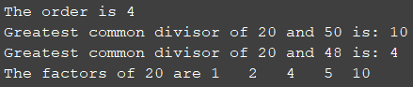
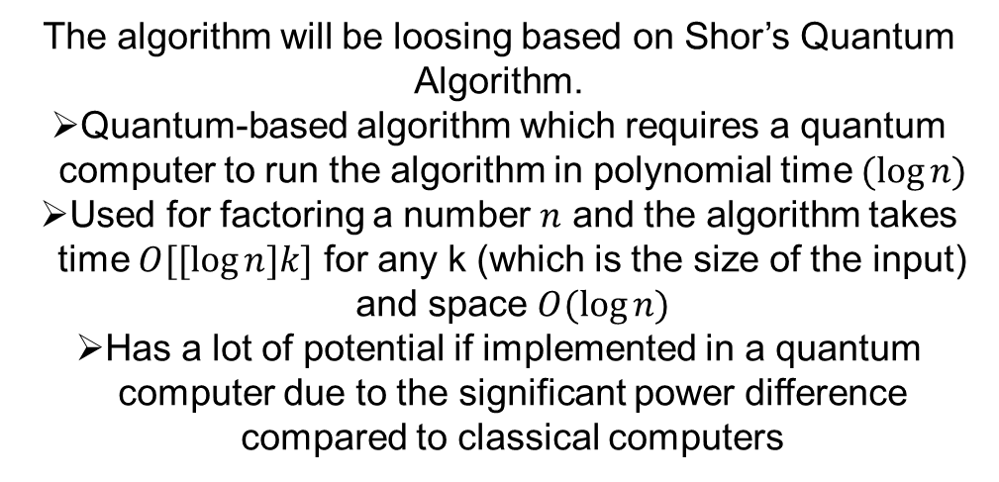
RY5: Integer Factorization Using Modular Exponential Function
Prayash Thapa
Research Advisor: Rupert Young
Introduction
Fast Fourier Transforms
Solution
Experimental Results
The aim and objectives:
Create an algorithm based on Modular Exponential Function
Implement FFT to make it more efficient and remove unnecessary steps to reduce processing time
Avoid the use of inbuilt MATLAB functions
Successfully be able to factorise relative small integers 20-40 bits in length
An Algorithm that computes the discrete DFT/IDFT of a sequence and converts the signal into a representation of frequency domain
The use of this function ‘fft()’ in MATLAB to measure and convert the signal into individual spectral components which provides the frequency information about the signal
The output information will be used to compute mathematical calculations to obtain factors
Using the combination of Fast Fourier Transforms, Modular Exponential Function, Euclidean Algorithm and MATLAB to design the algorithm
Flow chart:
These are the experimental results to date
Fast Fourier Transforms to convert the signal and get the output:
Factoring Numbers
Every Number has factors, numbers that divide another number or expression evenly with no remainders. E.g.
1000:1000 = 1 x 1000
2 x 500
4 x 250
5 x 200
8 x 125
10 x 100
20 x 50
25 x 40
Thus, 1000 has factors 1, 2, 4, 5, 8, 10, 20, 25, 40, 50, 100, 125, 200, 250, 500, 1000. Therefore, the aim of the project is to output every factor of the chosen input.
Modelling using Modular Exponential Function
Factor Number 20, Seed 7 and 128 bits:
Conclusion
Presented multiple methods of developing the algorithm in the report
Presented combination of various methods that can be implemented for the final algorithm
Presented the steps in the methods of developing the factoring algorithm based on modular exponential functions
Presented the sequence of operations required to implement the algorithm
Presented definitions, theorems and techniques
Results show progress in the factorization of the algorithm
Future work: Try different programming languages and compare with the current algorithm in terms of time complexity and efficiency
Shor’s Quantum Algorithm
The algorithm it self will be mainly modelled with Modular Exp0nential Function
A system for arithmetic integers which emphasises the importance on remainders
Similar to a clock, it uses a wrap around method to reach a fixed quantity (modulus) and leaves a remainder upon reaching
Exponentiation Property: A^B mod C = ((A mod C)^B) mod C
From this property, we can assume C is the number to be factored, A is the seed and B is the bit size e.g. 128, 256 bits
The algorithm will be loosing based on Shor’s Quantum Algorithm.
Quantum-based algorithm which requires a quantum computer to run the algorithm in polynomial time $(\log{n)}$
Used for factoring a number $n$ and the algorithm takes time $O[[\log{n]k]}$ for any k (which is the size of the input) and space $O(\log{n)}$
Has a lot of potential if implemented in a quantum computer due to the significant power difference compared to classical computers
Order online at https://www.postersession.com/order/

