Slide 1
Anonymous Social Networks versus Peer Networks in Restaurant Choice
Ashutosh Tiwari and Timothy Richards
Arizona State University

Slide 2
Overview
FAFH constitutes a major share of the household food budget- 50%
26 % of the restaurants fail within the 1st year
Restaurants complex offering
Uncertainty/Risk – Rely on WOM
Banerjee (1992), Cai, Chen, and Fang (2009), and Anderson and Magruder (2012) – social effects
But which one?

Slide 3
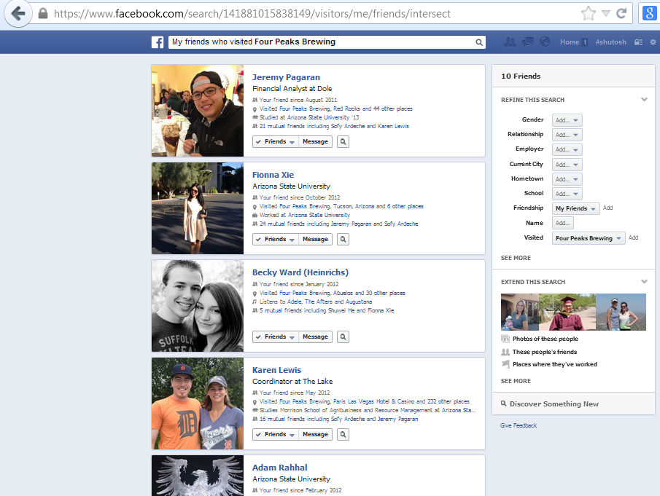
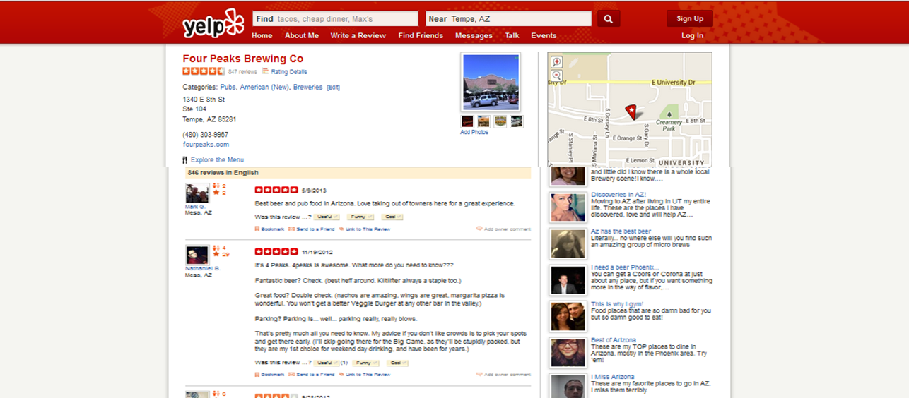
Peer or Anonymous Social Networks ?
Peer networks
Anonymous networks

Slide 4
Social networks
Peer Networks (Friends/Family/Coworkers)
Trust
Connection strength
Anonymous Networks (Unknown Experts)
Deep information pool
Wide variety of reviews
-

Slide 5
Methodology & Contribution
Two stage experiment
Control function modelling approach
Problems – Endogeneity & Reflection problem
Understand how Social Networks influence restaurant demand
Managerial:
How to avoid the Boom or Burst?
Intelligent marketing
Academic:
Gives a 2 stage influential framework for SN studies
First study which differentiates and compares anonymous and peer effects

Slide 6
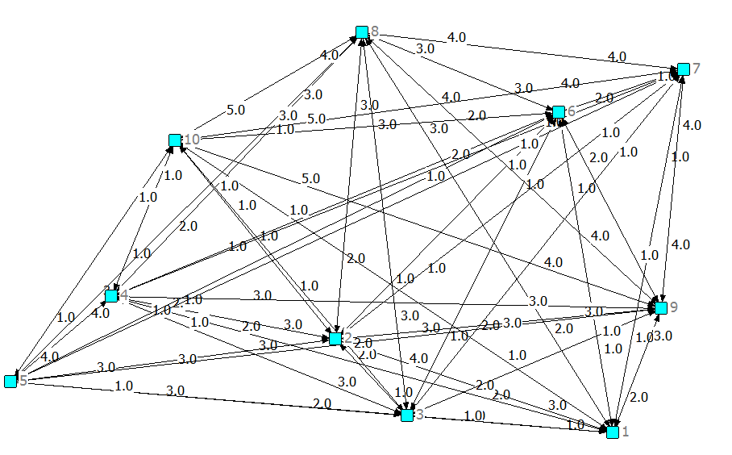
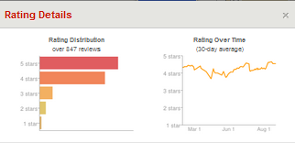
Utility & Networks
Utility dependence on peers
Utility dependence on reviews

Slide 7
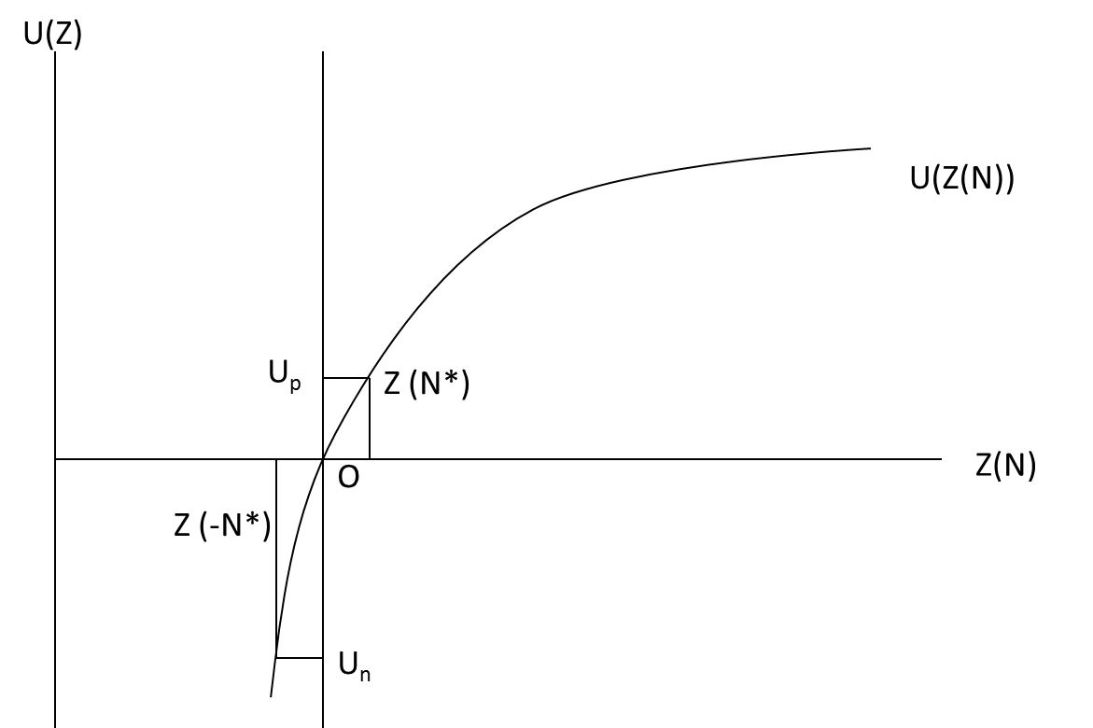
Positive Versus Negative Reviews

Slide 8
Experiment
Two stage experiment
Two similar restaurants
Anonymous reviews in stage 1
Peer reviews in stage 2
100 respondents in 10 peer groups
37 control respondents
Avoid endogeneity and reflection (Manski 1993)

Slide 9
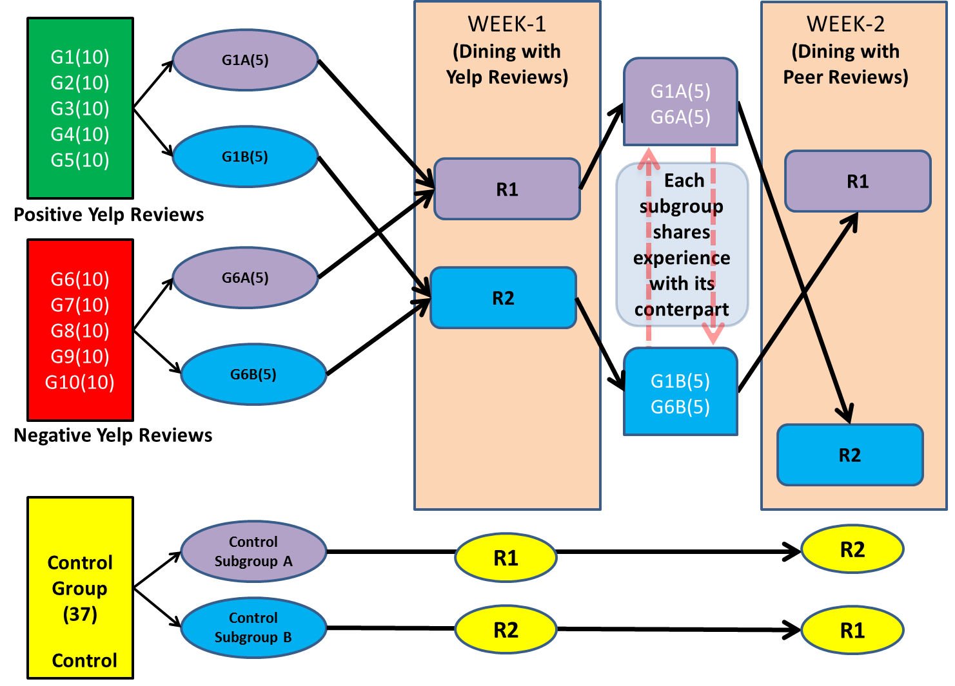
Experiment Layout

Slide 10
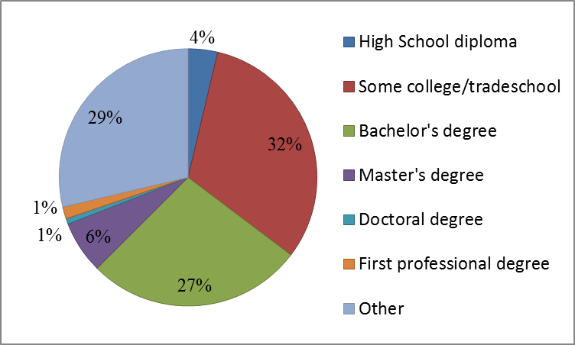
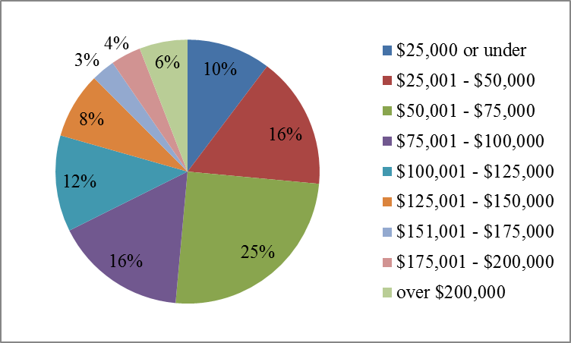
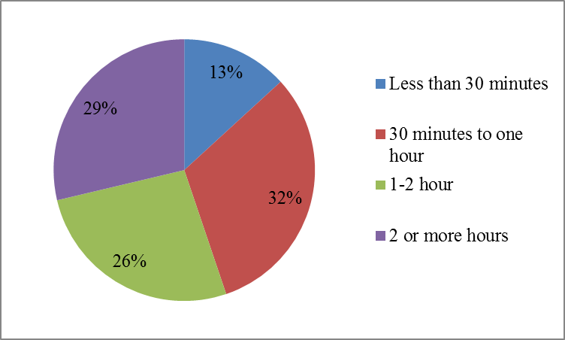
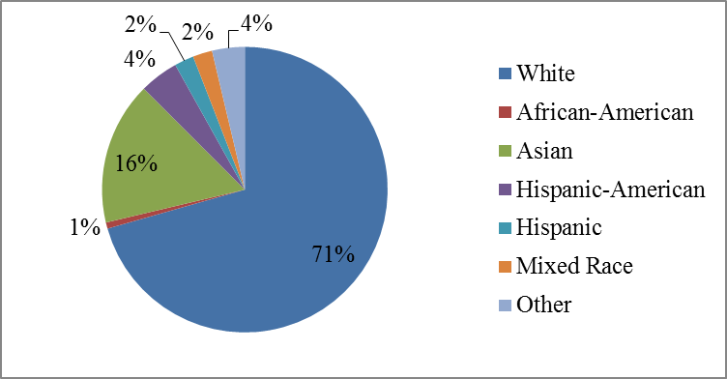
Representation

Slide 11
Model
Model 1: Peer versus Anonymous
Model 2: Negative versus Positive Reviews

Slide 12
Instruments for network
Dependent Variable: Likeliness to Revisit | Coefficient | t-value | p-value
Age | 0.0230** | 2.08 | 0.039
Consider Peer Review | -1.245** | -4.42 | 0.000
Written Online Review | 0.312** | 2.64 | 0.009
(Age × Gender)² | -0.051** | -10.09 | 0.000
Nutrient Consciousness | -1.183** | -3.77 | 0.000
Taste as an Attribute | 0.267** | 3.24 | 0.001
Age × Nutrient | 0.027** | 3.16 | 0.002
F value |  | 30.5
Hausman Test |  | 47.87**
Wu Test t-value |  | 13.60**

Slide 13
Model 1 Results (Network Effects)
Dependent variable: Likelihood to Revisit | Fixed Parameter Ordered Probit |  | Random Parameter Ordered Probit |  | Random Parameter O.P (Cholesky)
 | Coefficient | t-stat | Coefficient | t-stat | Coefficient | t-stat
Treated Peer Effect | -0.001** | -2.06 | 8.371** | 2.94 | 0.568** | 7.12
Anonymous Effect | -0.153* | -1.78 | -3.815 | -0.80 | 0.272** | 3.02
Preference for Service | 0.235** | 2.92 | 1.300** | 4.84 | 1.300** | 4.84
Preference for Taste | -0.013 | -0.16 | 3.414** | -4.18 | 3.414** | -4.18
Pref. Healthy Choices | 0.049 | 0.84 | 0.796** | 4.65 | 0.796** | 4.65
Threshold 1 | 0.641** | 9.67 | 0.421** | 6.37 | 0.421** | 6.37
Threshold 2 | 1.309** | 18.03 | 1.000** | 17.55 | 1.000** | 17.55
Threshold 3 | 2.177** | 22.73 | 1.872** | 17.42 | 1.872** | 17.42
Log-likelihood | -422.87 |  | -444.80

Slide 14
Model 1 Partial Network Effects
Outcome (Revisit) | Anonymous Networks Effects | Peer Networks Effects
Y = 0 | 0.025 | -0.183
Y = 1 | -0.002 | 0.015
Y = 2 | -0.007 | 0.056
Y = 3 | -0.011 | 0.080
Y = 4 | -0.004 | 0.031

Slide 15
Model 2 Results Positive vs. Negative
Dependent variable: Likelihood to Recommend | Fixed Parameter Ordered Probit |  | Random Parameter Ordered Probit
 | Coefficient | t-stat | Coefficient | t-stat
Positive Reviews | 0.624** | 4.74 | 0.624** | 3.18
Negative reviews | -0.790** | -6.76 | -0.790** | -5.46
Threshold 1 | 0.641** | 9.67 | 0.430** | 5.78
Threshold 2 | 1.309** | 18.03 | 0.886** | 9.48
Threshold 3 | 2.177** | 22.73 | 1.865** | 14.19
Log-likelihood | -234.934 |  | -238.049

Slide 16
Conclusion
Both peer and anonymous reviews are have a significant impact (peers are more influential than anonymous) on demand
Both negative and positive reviews affect preferences (negative more impact than positive)
First to compare the most prevalent form of social networks
Framework to setup multistage social network experiments to perform economic research.
Restaurants can target expenditures and avoid loss
Extend to hotels, local contractors, bars and amusement parks.-where uncertainty in consuming a multi-attribute good and are likely to turn to social media
The results of this research can help local small businesses: limited marketing budget and WOM is important
Small size of peer groups can be a limiting factor for any controlled social-networking experiment.
Future research in high involvement categories such as durable home appliances, automobile, medical care, holiday packages, house purchases and education investments
Anonymous network effect studies which include attributes of reviewers, review characteristics and dynamic changes in reviews

