Slide 1
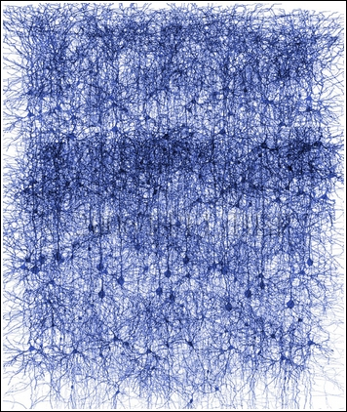
Perceptron Classifier

Slide 2
Applications
Optical character recognition (OCR)
Tablet Laptop Input
Speech Recognition

Slide 3
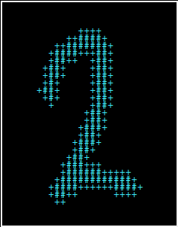

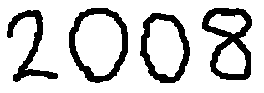
Datum Object of Input Image
Input Image
Filter/Crop
Datum Object

Slide 4
Perceptron Image Recognition
x₁ª
w₁ª
x₂ª
w₂ª
. . .
Σ
. . .
sª
w_{i}ª
x_{i}ª
x₁^{b}
Max
y
w₁^{b}
x₂^{b}
s^{b}
w₂^{b}
. . .
. . .
Σ
w_{i}^{b}
x_{i}^{b}

Slide 5
Perceptron Training
y’ = max(score(w,x))
If y’ != y
w_{i} += x_{i}
w_{i}’ -= x_{i}

Slide 6
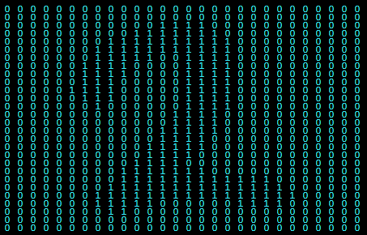
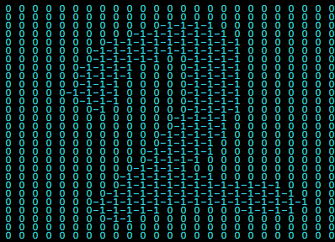
Prototype Weights

