Slide 1
AD5933 Impedance Analyzer Investigation
Ashton Johnson
CPE621 Advanced Embedded Systems
Electrical and Computer Engineering
The University of Alabama in Huntsville
e-mail: acj0008@uah.edu

Slide 2
The Need
Describe the need or opportunity
  Lack of the proposed device/software, or
  New enabling technology that can make existing devices smaller, lighter, faster, more power efficient, less obtrusive, better user interface, …
Who is affected and who will benefit?
Slide title should be descriptive rather than use “the need”

Slide 3
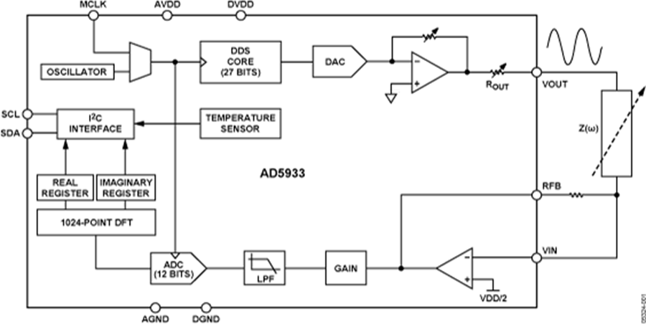
AD5933 Block Diagram

Slide 4
AD5933 Block Diagram

Slide 5
Applications
Impedance pneumography- Respiratory monitoring via varying imdance.

Slide 6
Survey (at least one slide)
Existing products on the market
Existing project in the literature
  Conference papers
  Journal papers
  WWW if necessary

Slide 7
Proposed approach
Describe briefly the solution and the proposed approach
Timeline
Milestones
What Hardware/Software do you need?

