Slide 1
Portable Impedance Tomography System
Mid-Term Status
Ashton Johnson
CPE621 Advanced Embedded Systems
Electrical and Computer Engineering
The University of Alabama in Huntsville

Slide 2
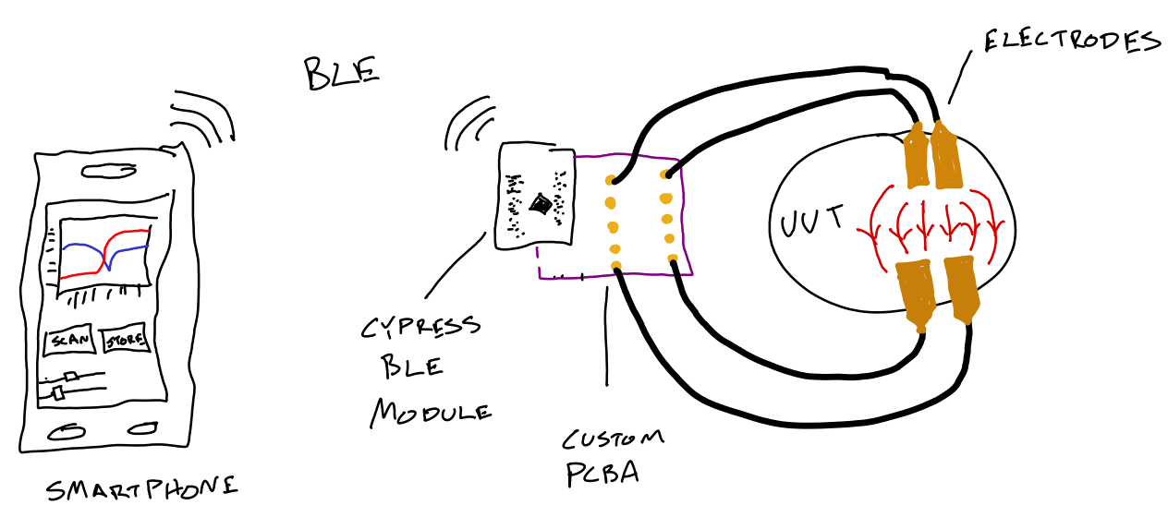
Scenario

Slide 3
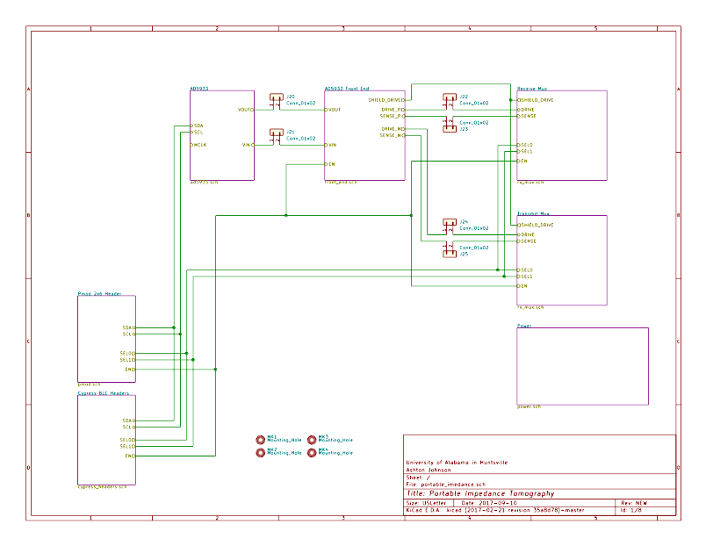

Slide 4
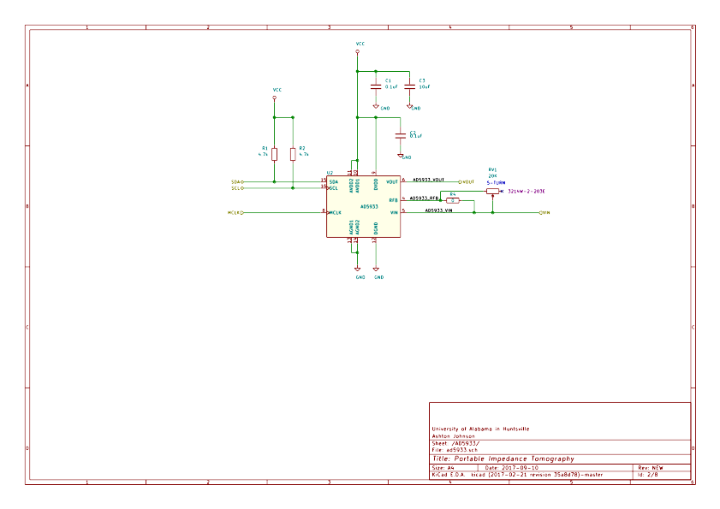

Slide 5
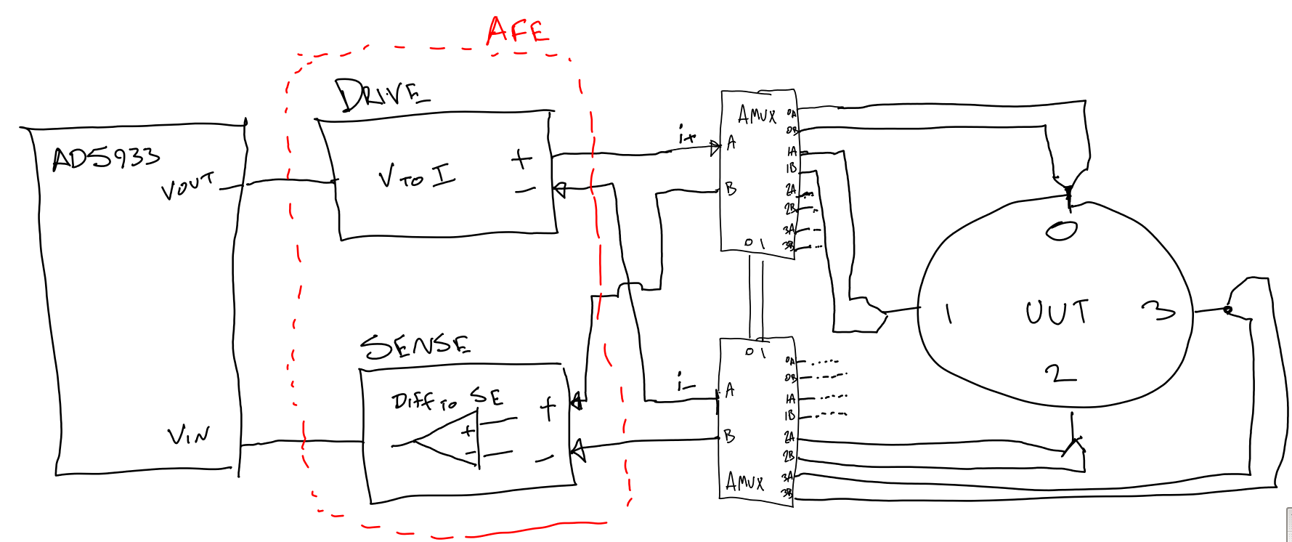
Analog Section

Slide 6
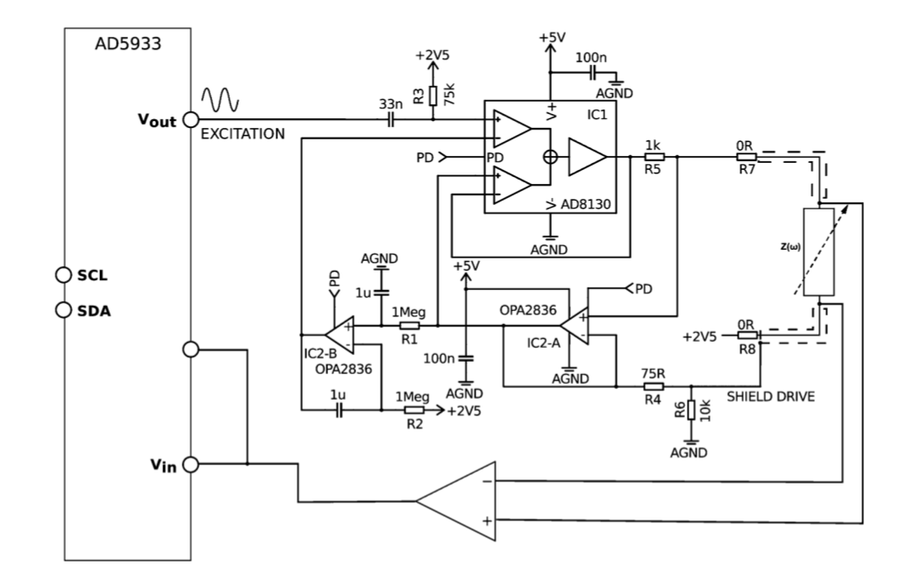
Analog Front End
R. Harder, A. Diedrich, J. S. Whitfield, M. S. Buchowski, J. B. Pietsch, and F. J. Baudenbacher, “Smart Multi-Frequency Bioelectrical Impedance Spectrometer for BIA and BIVA Applications,” IEEE Transactions on Biomedical Circuits and Systems, vol. 10, no. 4, pp. 912–919, Aug. 2016.

Slide 7
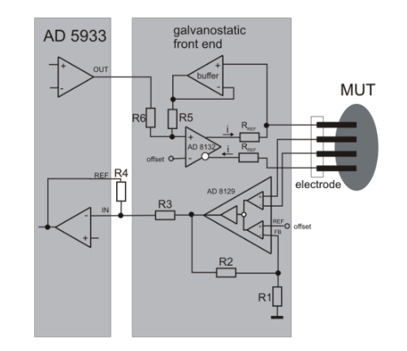
Analog Front End
U. Pliquett and A. Barthel, “Interfacing the AD5933 for bio-impedance measurements with front ends providing galvanostatic or potentiostatic excitation,” J. Phys.: Conf. Ser., vol. 407, no. 1, p. 012019, 2012.

Slide 8
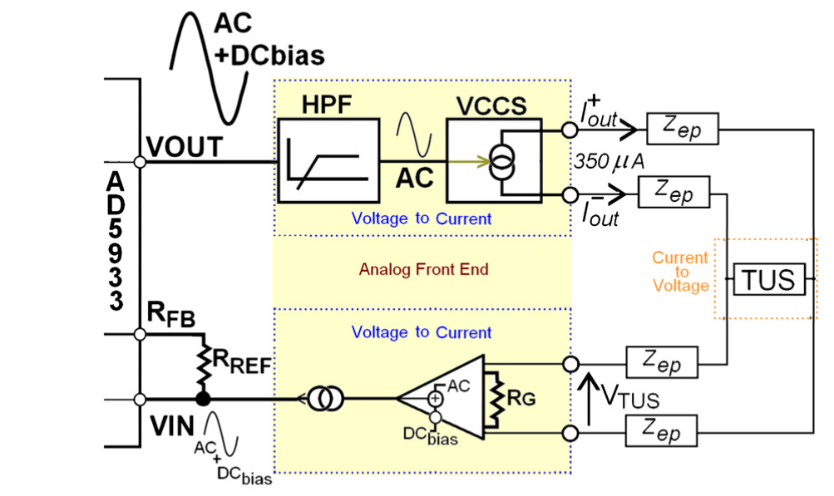
Analog Front End
F. Seoane, J. Ferreira, J. J. Sanchéz, and R. Bragós, “An analog front-end enables electrical impedance spectroscopy system on-chip for biomedical applications,” Physiol. Meas., vol. 29, no. 6, p. S267, 2008.

Slide 9
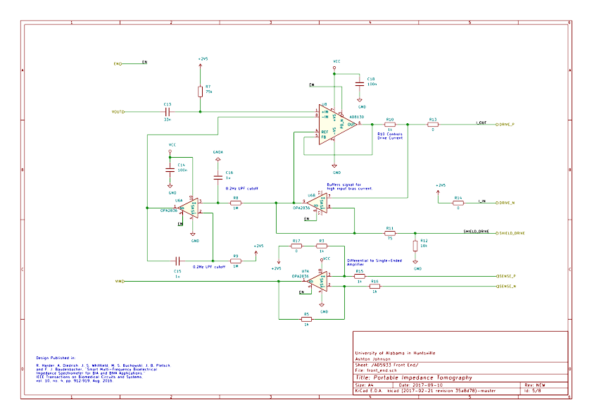

Slide 10
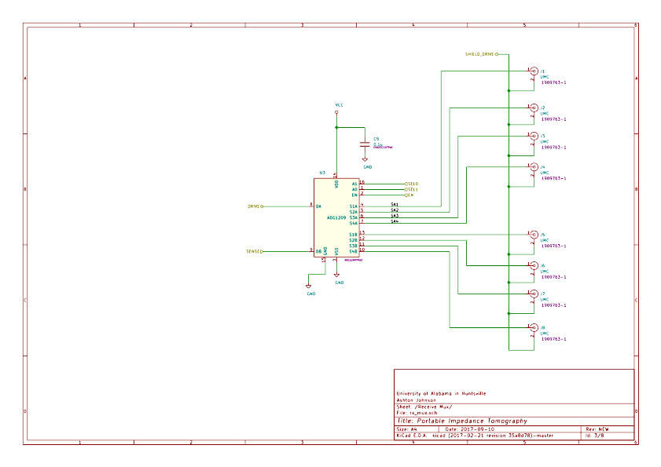

Slide 11
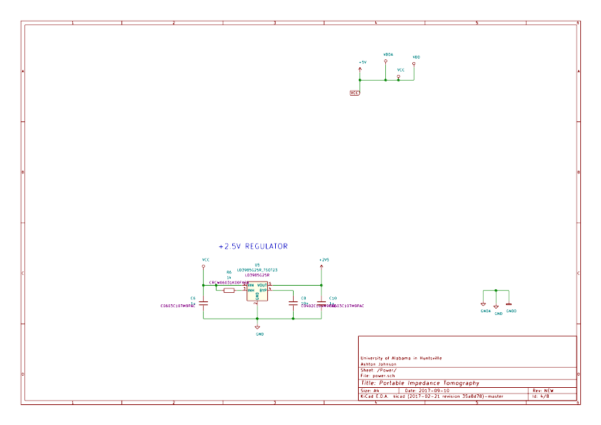

Slide 12
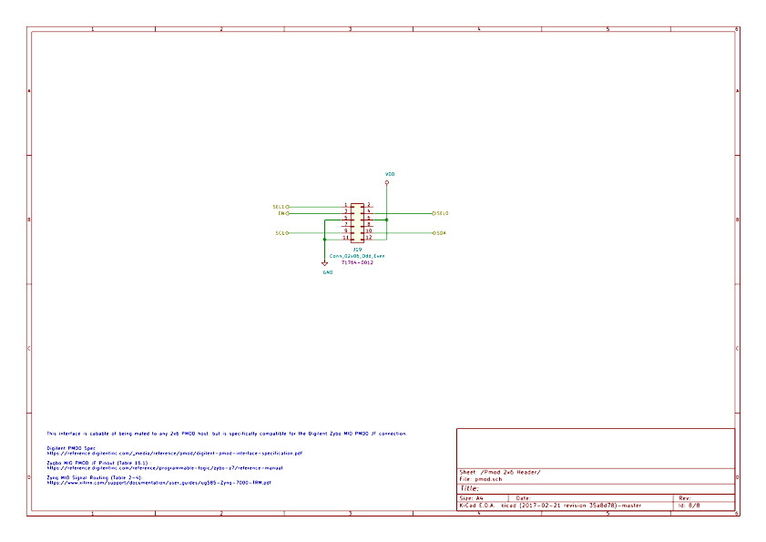

Slide 13
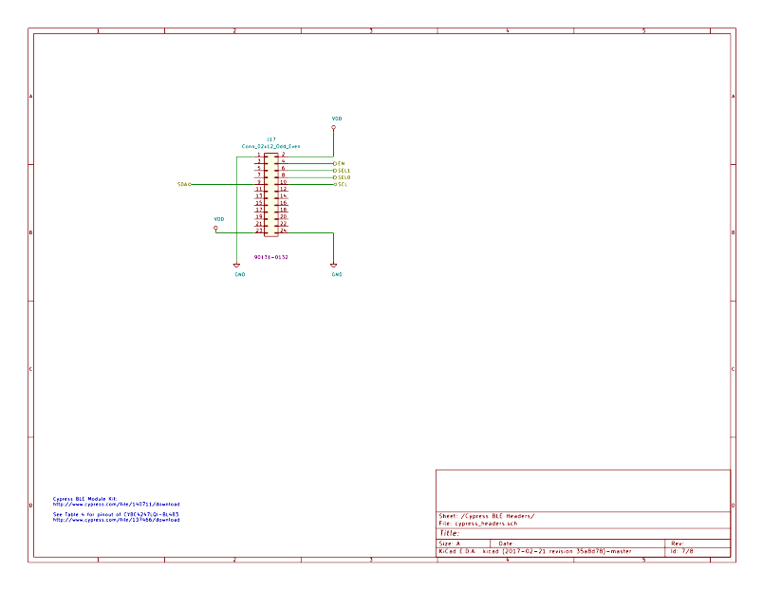

Slide 14
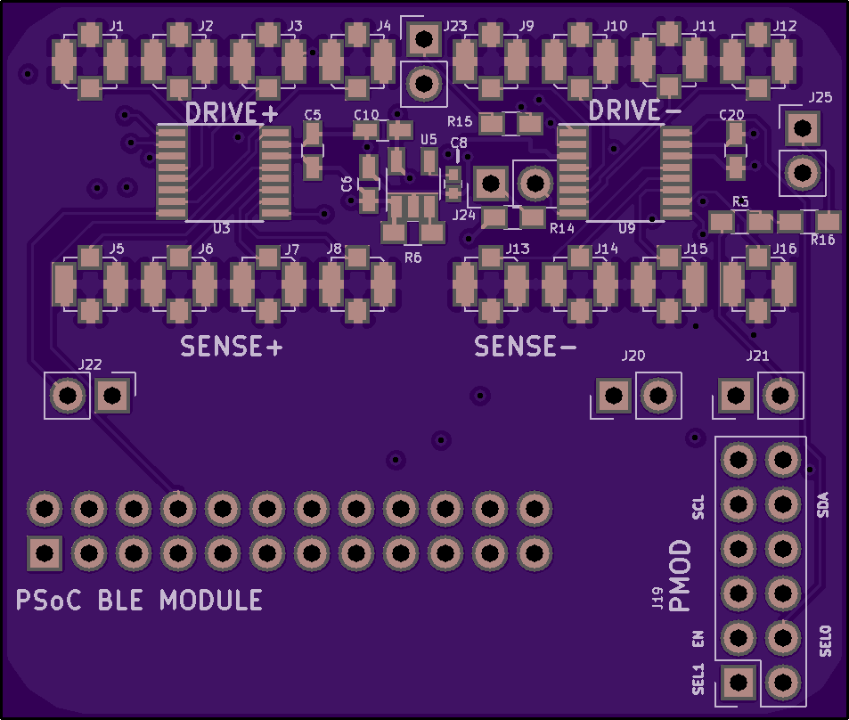
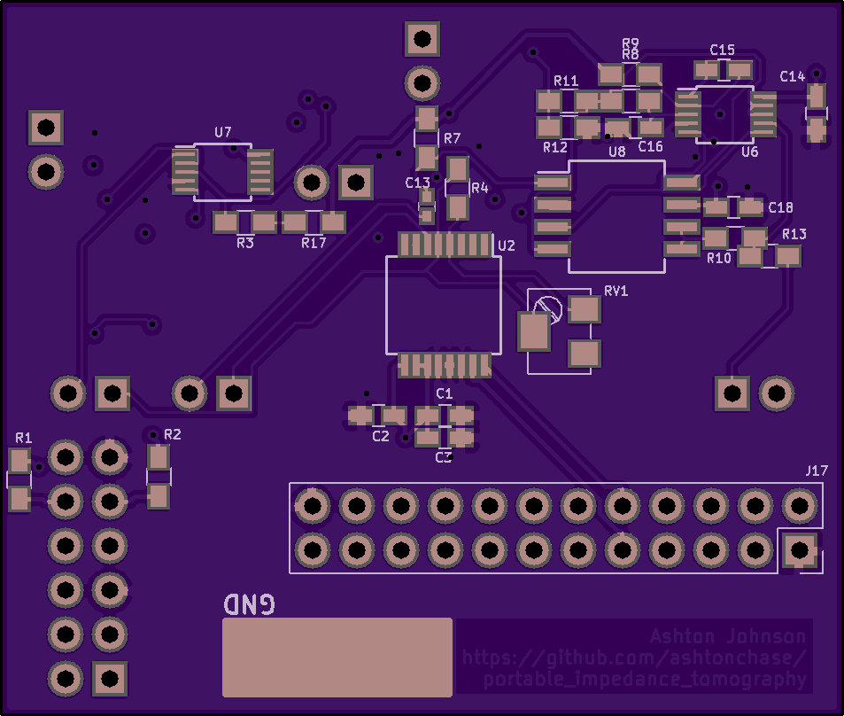
PCBA OSH Park Order
$30.80 for 3
Top View
Bottom View

Slide 15
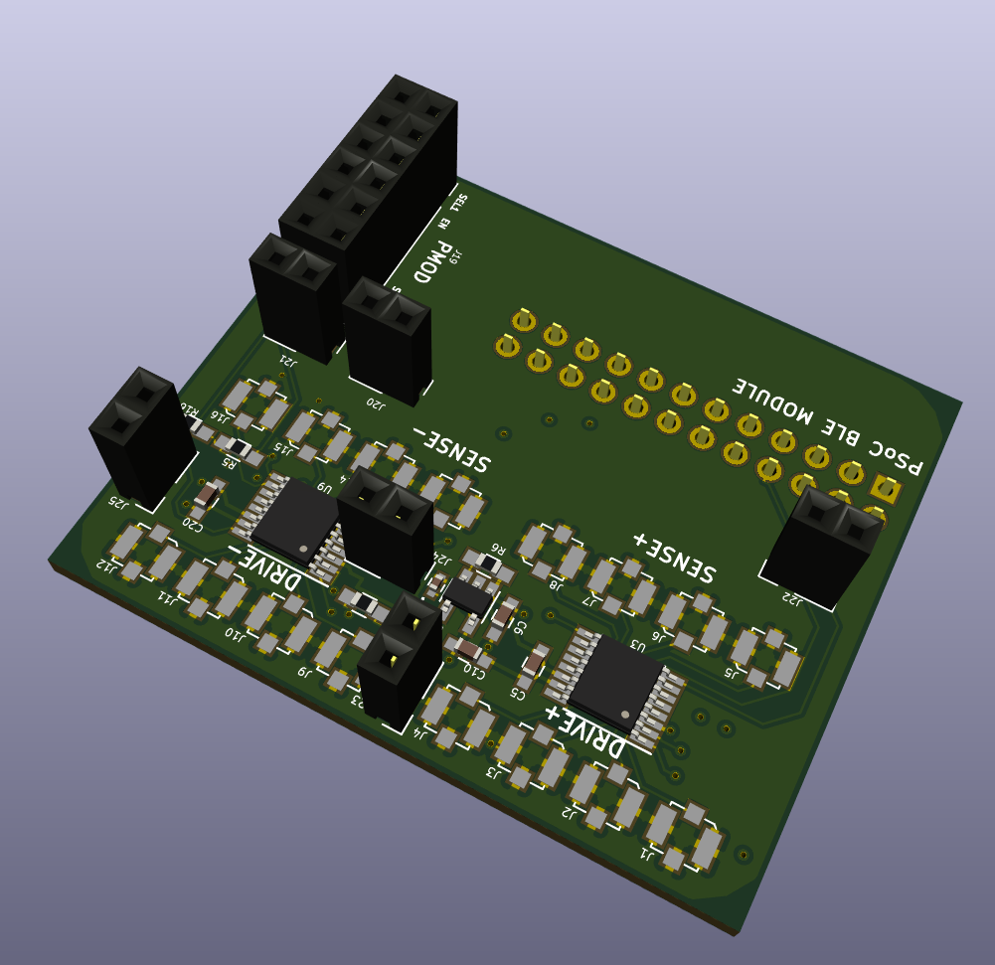
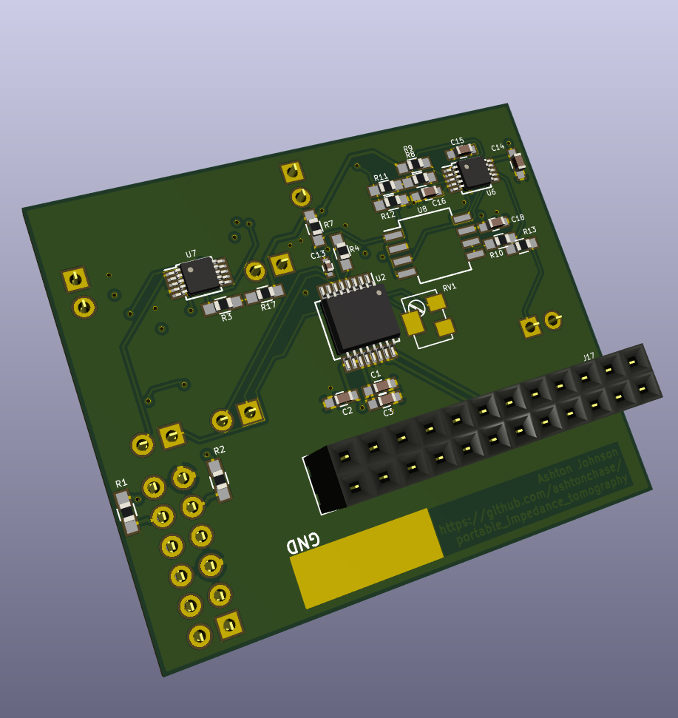
PCBA 3D View
Top View
Bottom View

Slide 16
Milestones
Hardware
    ☑Platform Selection (19 SEP)
      Cypress PsoC BLE Module
      Digilent Zybo (Xilinx Zynq-7000 SoC)
    ☑Schematic Design & Layout Complete (26 SEP)
      DRC Checks Competed
      DFM Checks Completed
    ☐PCB Ordered (None Specified)(18 OCT)
    ☐PCB Assembly Complete (10 OCT) (13 NOV)
    ☐PCB Checkout Complete (24 OCT)(20 NOV)

Slide 17
Milestones
Software
    ☑ Driver Development
      ☑ AD5933
      ☑ Analog Mux
    ☐ Application State Machine (30 OCT)
    ☐ Device Targeted Code
      ☐ BLE I/F (6 NOV)
      ☐ UART Debug I/F (6 NOV)
    ☐ Android Application Code (20 NOV)

Slide 18
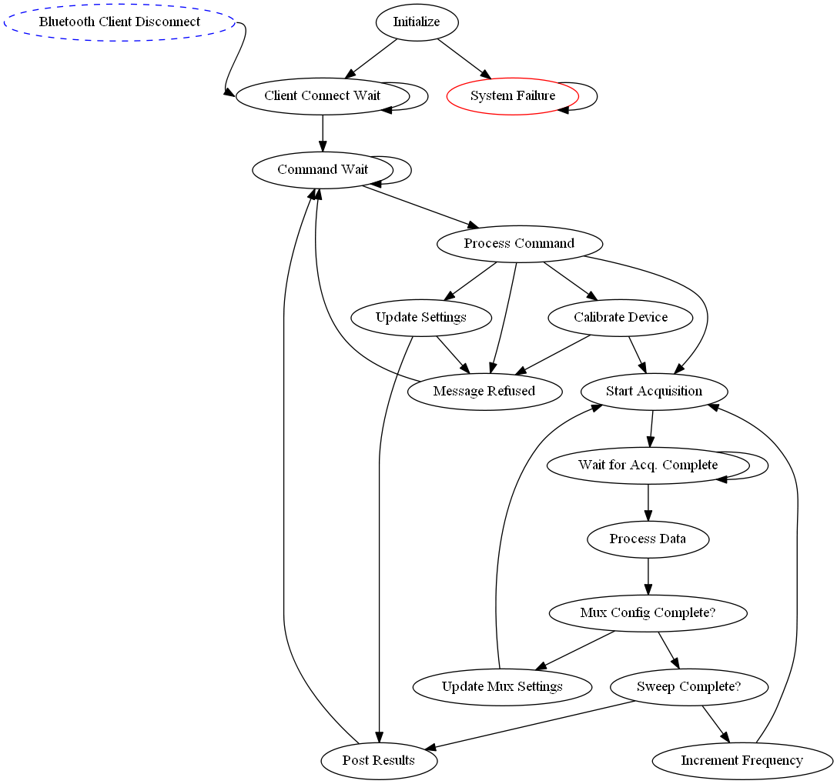
Device System States

Slide 19
Software Development
AD5933 Driver (ad5933/ad5933.h)
uint8_t ad5933_Init (ad5933_deviceConfig *config)
uint8_t ad5933_PerformFrequencySweep (ad5933_deviceConfig *config, uint32_t startFreq, uint32_t incrementFreq, uint16_t numOfIncrements, uint16_t *realArray, uint16_t *imagArray)
uint8_t ad5933_ConvertFreq (ad5933_deviceConfig *config, uint32_t desiredFreq, uint8_t *freqMsb, uint8_t *freqMid, uint8_t *freqLsb)
uint8_t ad5933_SetStartFreq (ad5933_deviceConfig *config, uint32_t desiredFreq)
uint8_t ad5933_SetIncrFreq (ad5933_deviceConfig *config, uint32_t desiredFreq)
uint8_t ad5933_SetIncrCount (ad5933_deviceConfig *config, uint16_t incrNum)
uint8_t ad5933_SetSettleTime (ad5933_deviceConfig *config, uint16_t cycles, uint8_t factor)
uint8_t ad5933_GetStatus (ad5933_deviceConfig *config, uint8_t *result)
uint8_t ad9533_WaitForValidTemp (ad5933_deviceConfig *config)
uint8_t ad9533_WaitForValidImpedance (ad5933_deviceConfig *config)
uint8_t ad9533_WaitForSweepComplete (ad5933_deviceConfig *config)
uint8_t ad5933_ReadRealResult (ad5933_deviceConfig *config, int16_t *real)
uint8_t ad5933_ReadImagResult (ad5933_deviceConfig *config, int16_t *imag)
uint8_t ad5933_InitWithStartFreq (ad5933_deviceConfig *config)
uint8_t ad5933_StartSweep (ad5933_deviceConfig *config)
uint8_t ad5933_IncrementFreq (ad5933_deviceConfig *config)
uint8_t ad5933_RepeatFreq (ad5933_deviceConfig *config)
uint8_t ad5933_MeasureTemp (ad5933_deviceConfig *config)
uint8_t ad5933_PowerDown (ad5933_deviceConfig *config)
uint8_t ad5933_Standby (ad5933_deviceConfig *config)
uint8_t ad5933_Stop (ad5933_deviceConfig *config)
uint8_t ad5933_SetPGAx1 (ad5933_deviceConfig *config)
uint8_t ad5933_SetPGAx5 (ad5933_deviceConfig *config)
uint8_t ad5933_SetVoutRange (ad5933_deviceConfig *config, uint8_t range)

Slide 20
Software Development
Analog Mux Driver (amux/hal/gpio_hal.h)
uint32_t Amux_Init(const Gpio_deviceConfig *config, uint8_t selection)
uint32_t Amux_SetTx(const Gpio_deviceConfig *config, uint8_t selection)
uint32_t Amux_SetRx(const Gpio_deviceConfig *config, uint8_t selection)
HAL Required Functions
(amux/hal/gpio_hal.h)
uint32_t Gpio_Init(const Gpio_deviceConfig *config);
uint32_t Gpio_Write(const Gpio_ConfigType *config, uint8_t value, uint8_t mask)
(ad5933/hal/iic_hal.h)
void Iic_Init (const Iic_ConfigType *config)
uint8_t Iic_RxByte (const Iic_ConfigType *config, const uint8_t addr, const uint8_t reg, uint8_t *rxValue)
uint8_t Iic_TxByte (const Iic_ConfigType *config, const uint8_t addr, const uint8_t reg, const uint8_t txValue)
uint32_t Gpio_Write(const Gpio_ConfigType *config, uint8_t value, uint8_t mask)
Hal functions must implemented for each target

