Slide 1
Portable Impedance Tomography Platform
Ashton Johnson
CPE 621, Fall 2017

Slide 2
Introduction
The impedance of an object can provide meaningful insight into the composition of a particular object.
Tomography is a technique for displaying a representation of a cross section though a human body or other solid object.

Slide 3
Project Goals
Demonstrate a portable solution for bioelectrical impedance measurements.
Features:
Single Frequency Impedance Measurement
Frequency Swept Impedance Measurement
Two-Dimensional Impedance Measurement
Wireless Connectivity

Slide 4
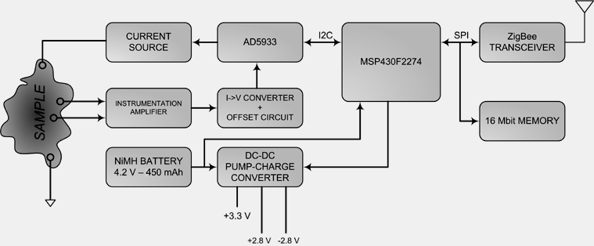
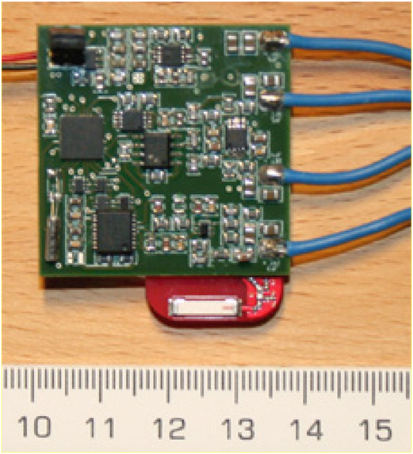
AD5933 in the wild (Bogonez et. al)
Zigbee Communication
  -10dBm
  Interface to PC with Application
Multi-frequency 0.1-200kHz
  Effective out to 60kHz
35 day runtime, 5 min sample rate
Assess temperature impacts on measurements. Negligible
Studies RF Implantable Solution
Tested/Installed into farm animals. RF levels required were lower than ICNIRP regulations
P. Bogónez-Franco, R. Bragós, A. Bayes-Genis, and J. Rosell-Ferrer, “Implantable bioimpedance monitor using ZigBee,” in Engineering in Medicine and Biology Society, 2009. EMBC 2009. Annual International Conference of the IEEE, 2009, pp. 4868–4871.
P. Bogónez-Franco, L. Nescolarde, C. Gálvez-Montón, R. Bragós, and J. Rosell-Ferrer, “An implantable bioimpedance monitor using 2.45 GHz band for telemetry,” Physiological measurement, vol. 34, no. 1, p. 1, 2012.

Slide 5
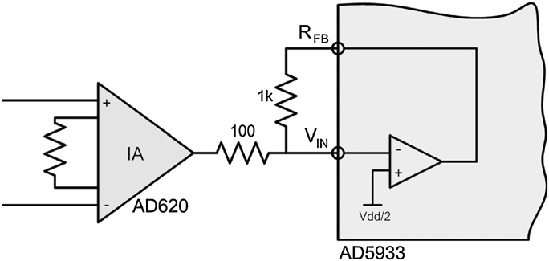
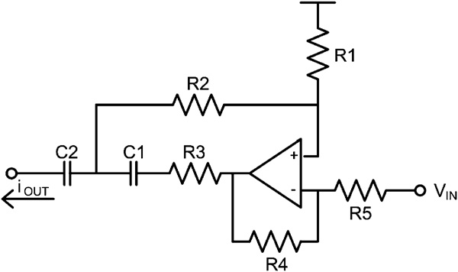
AD5933 in the wild (Bogonez et. al)
Voltage Sense
  AD820 differential amplifier
Uses modified Howland current source
  10uA 100Hz to 200kHz
Errors at low frequency due to high electrode contact resistance.
P. Bogónez-Franco, R. Bragós, A. Bayes-Genis, and J. Rosell-Ferrer, “Implantable bioimpedance monitor using ZigBee,” in Engineering in Medicine and Biology Society, 2009. EMBC 2009. Annual International Conference of the IEEE, 2009, pp. 4868–4871.
P. Bogónez-Franco, L. Nescolarde, C. Gálvez-Montón, R. Bragós, and J. Rosell-Ferrer, “An implantable bioimpedance monitor using 2.45 GHz band for telemetry,” Physiological measurement, vol. 34, no. 1, p. 1, 2012.

Slide 6
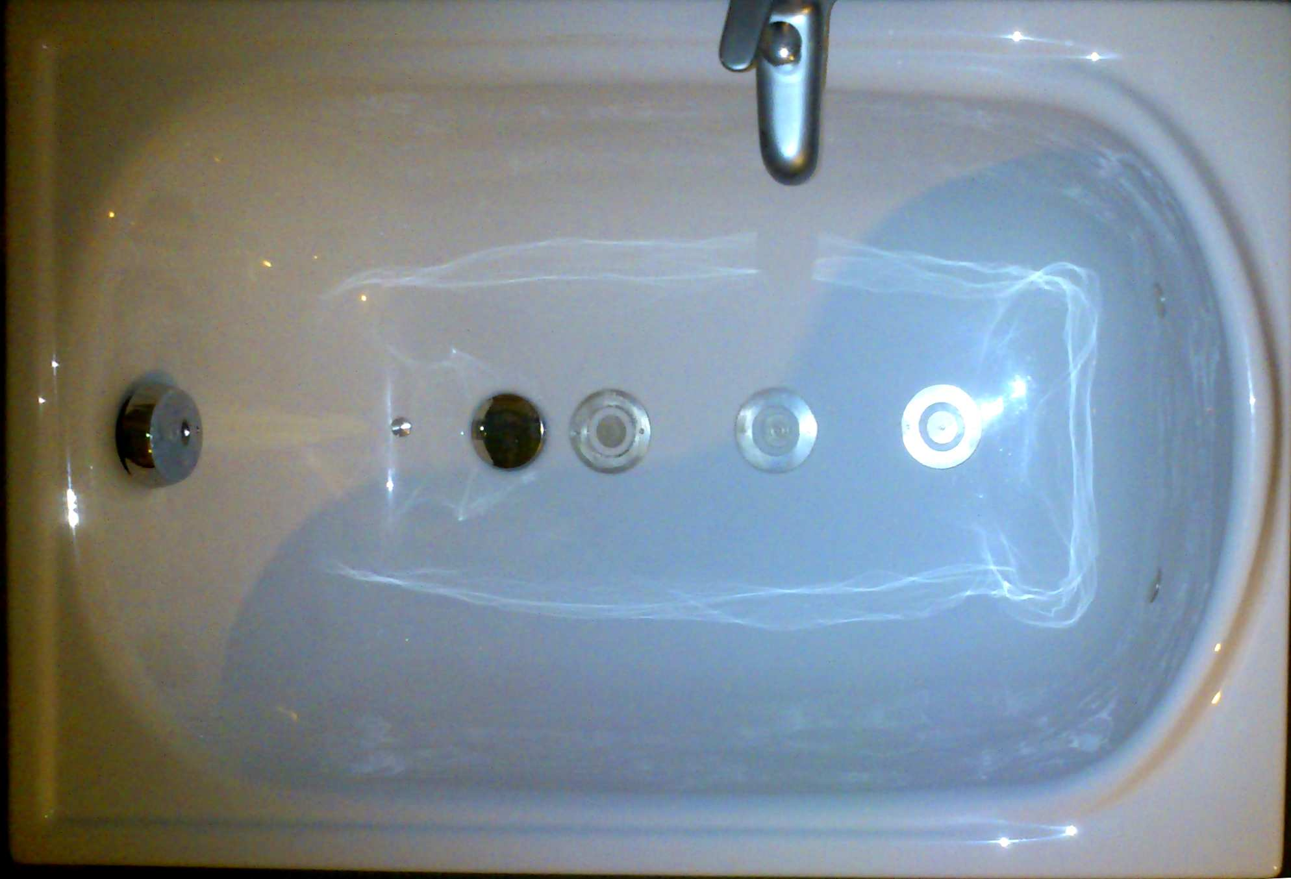
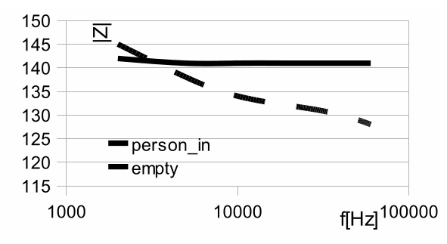
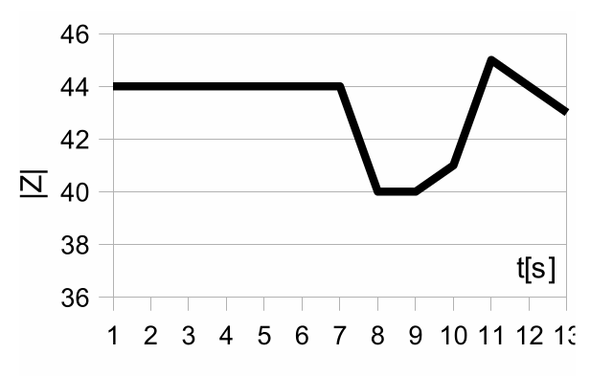
AD5933 in the wild (Bujnowski et. al)
Detecting bathtub presence
  Characterized tap water, soap, salts.
  Active vs inactive
  Single vs multi frequency
Howland Current Source Drive
A. Bujnowski, A. Palinski, P. Koscinski, L. Skalski, A. Skurczynska, and J. Wtorek, “Detection of person presence and its activity in the bathtub,” in Journal of Physics: Conference Series, 2013, vol. 434, p. 012035.

Slide 7
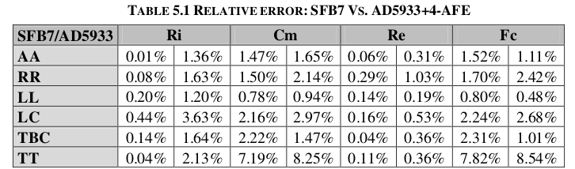
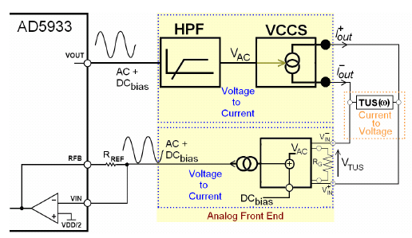
AD5933 in the wild (Pena)
Masters Thesis
  Compares AD5933 to ImpediMed SFB7
  Evaluated against
    Arm-Arm
    Respiration Rate
    Leg-Leg
    Lung Composition
    Total Body Composition
    Trunk-Trunk
A. Ansede Pena, “A Feasibility Study of the Suitability of an AD5933-based Spectrometer for EBI Applications,” 2009.

Slide 8
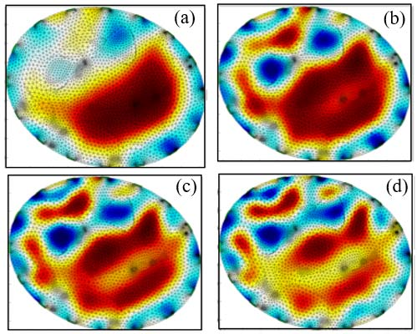
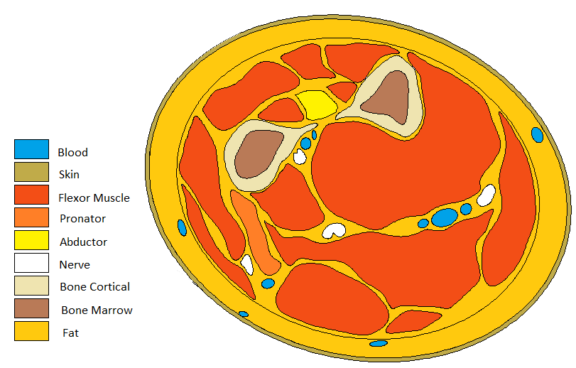
Image reconstruction (Vilchez-Monge et al.)
Tomography of forearm
Inverse Problem - Voltage is used to predict base model
Forward Problem – Uses conductivity base and current applied to predict voltage fields.
Image Reconstruction – open source EIDORS
Reconstructed image as a function of the current injection
level. (a) 0.1 mA, (b) 0.5 mA, (c) 1 mA, (d) 2 mA
M. Vilchez-Monge, D. Canales-Vasquez, and R. Rimolo-Donadio, “Image Reconstruction of the Human Foearm by Electrical Impedance Tomography,” in 2017 International Conference and Workshop on Bioinspired Intelligence (IWOBI), 2017, pp. 1–6.

Slide 9
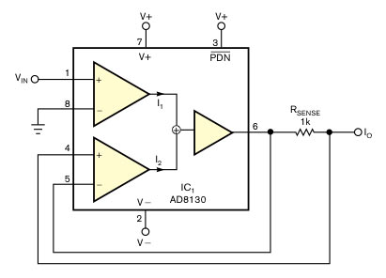
Constant Current Source (Birkett)
2005 Birkett Article Explains Constant Current Source
A. Birkett, “Bipolar current source maintains high output impedance at high frequencies,” Design Idea, 5-2005. [Online]. Available: https://www.edn.com/design/analog/4324499/Bipolar-current-source-maintains-high-output-impedance-at-high-frequencies.

Slide 10
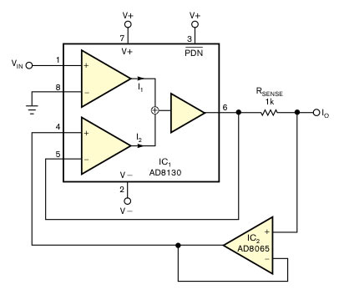
Constant Current Source (Birkett)
Adds Voltage Follower due to high input bias current
A. Birkett, “Bipolar current source maintains high output impedance at high frequencies,” Design Idea, 5-2005. [Online]. Available: https://www.edn.com/design/analog/4324499/Bipolar-current-source-maintains-high-output-impedance-at-high-frequencies.

Slide 11
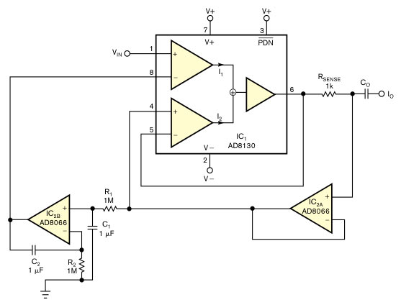
Constant Current Source (Birkett)
Add a DC servo loop to stabilize operating point and decouples output.
A. Birkett, “Bipolar current source maintains high output impedance at high frequencies,” Design Idea, 5-2005. [Online]. Available: https://www.edn.com/design/analog/4324499/Bipolar-current-source-maintains-high-output-impedance-at-high-frequencies.

Slide 12
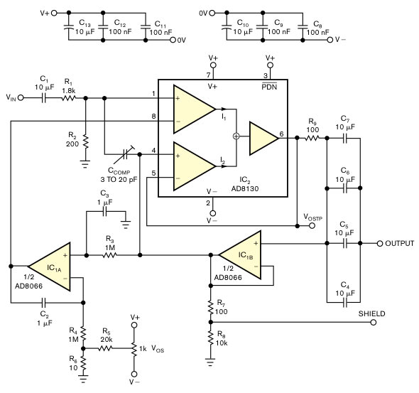
Constant Current Source (Birkett)
Adds Ccomp to provide additional stabilization.
Add shield drive
20Hz to 10MHz Bandwidth
A. Birkett, “Bipolar current source maintains high output impedance at high frequencies,” Design Idea, 5-2005. [Online]. Available: https://www.edn.com/design/analog/4324499/Bipolar-current-source-maintains-high-output-impedance-at-high-frequencies.

Slide 13
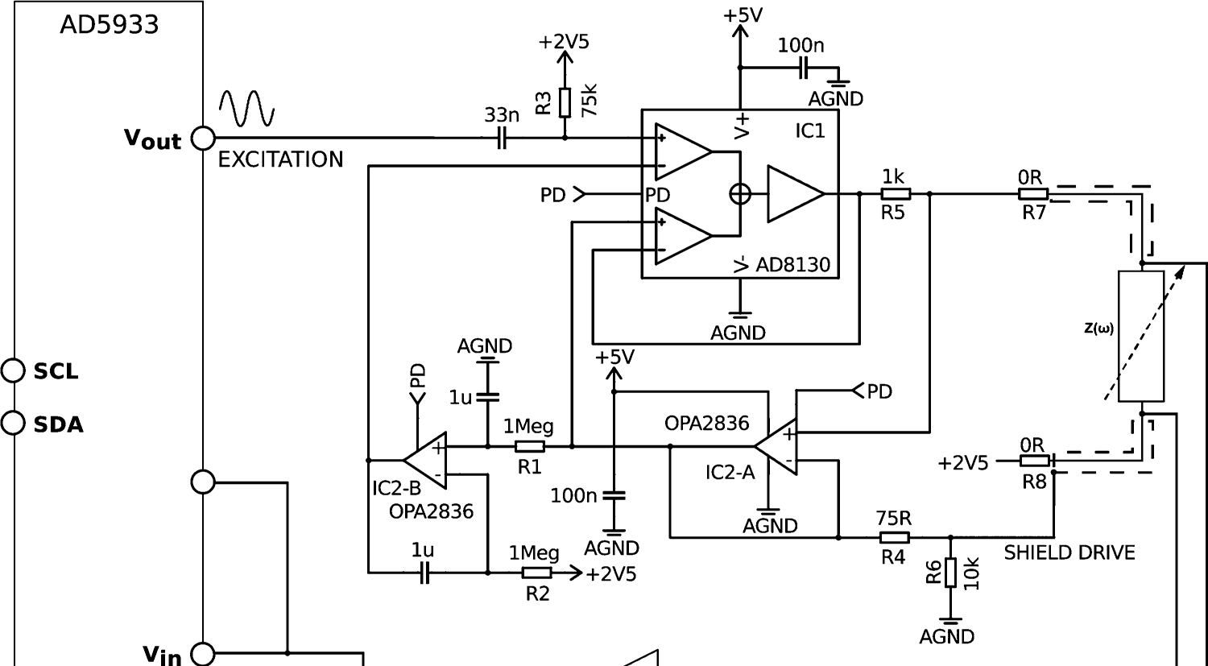
Constant Current Source
(Birkett) vs (Harder)
A. Birkett, “Bipolar current source maintains high output impedance at high frequencies,” Design Idea, 5-2005. [Online]. Available: https://www.edn.com/design/analog/4324499/Bipolar-current-source-maintains-high-output-impedance-at-high-frequencies.
R. Harder, A. Diedrich, J. S. Whitfield, M. S. Buchowski, J. B. Pietsch, and F. J. Baudenbacher, “Smart Multi-Frequency Bioelectrical Impedance Spectrometer for BIA and BIVA Applications,” IEEE Transactions on Biomedical Circuits and Systems, vol. 10, no. 4, pp. 912–919, Aug. 2016.

Slide 14
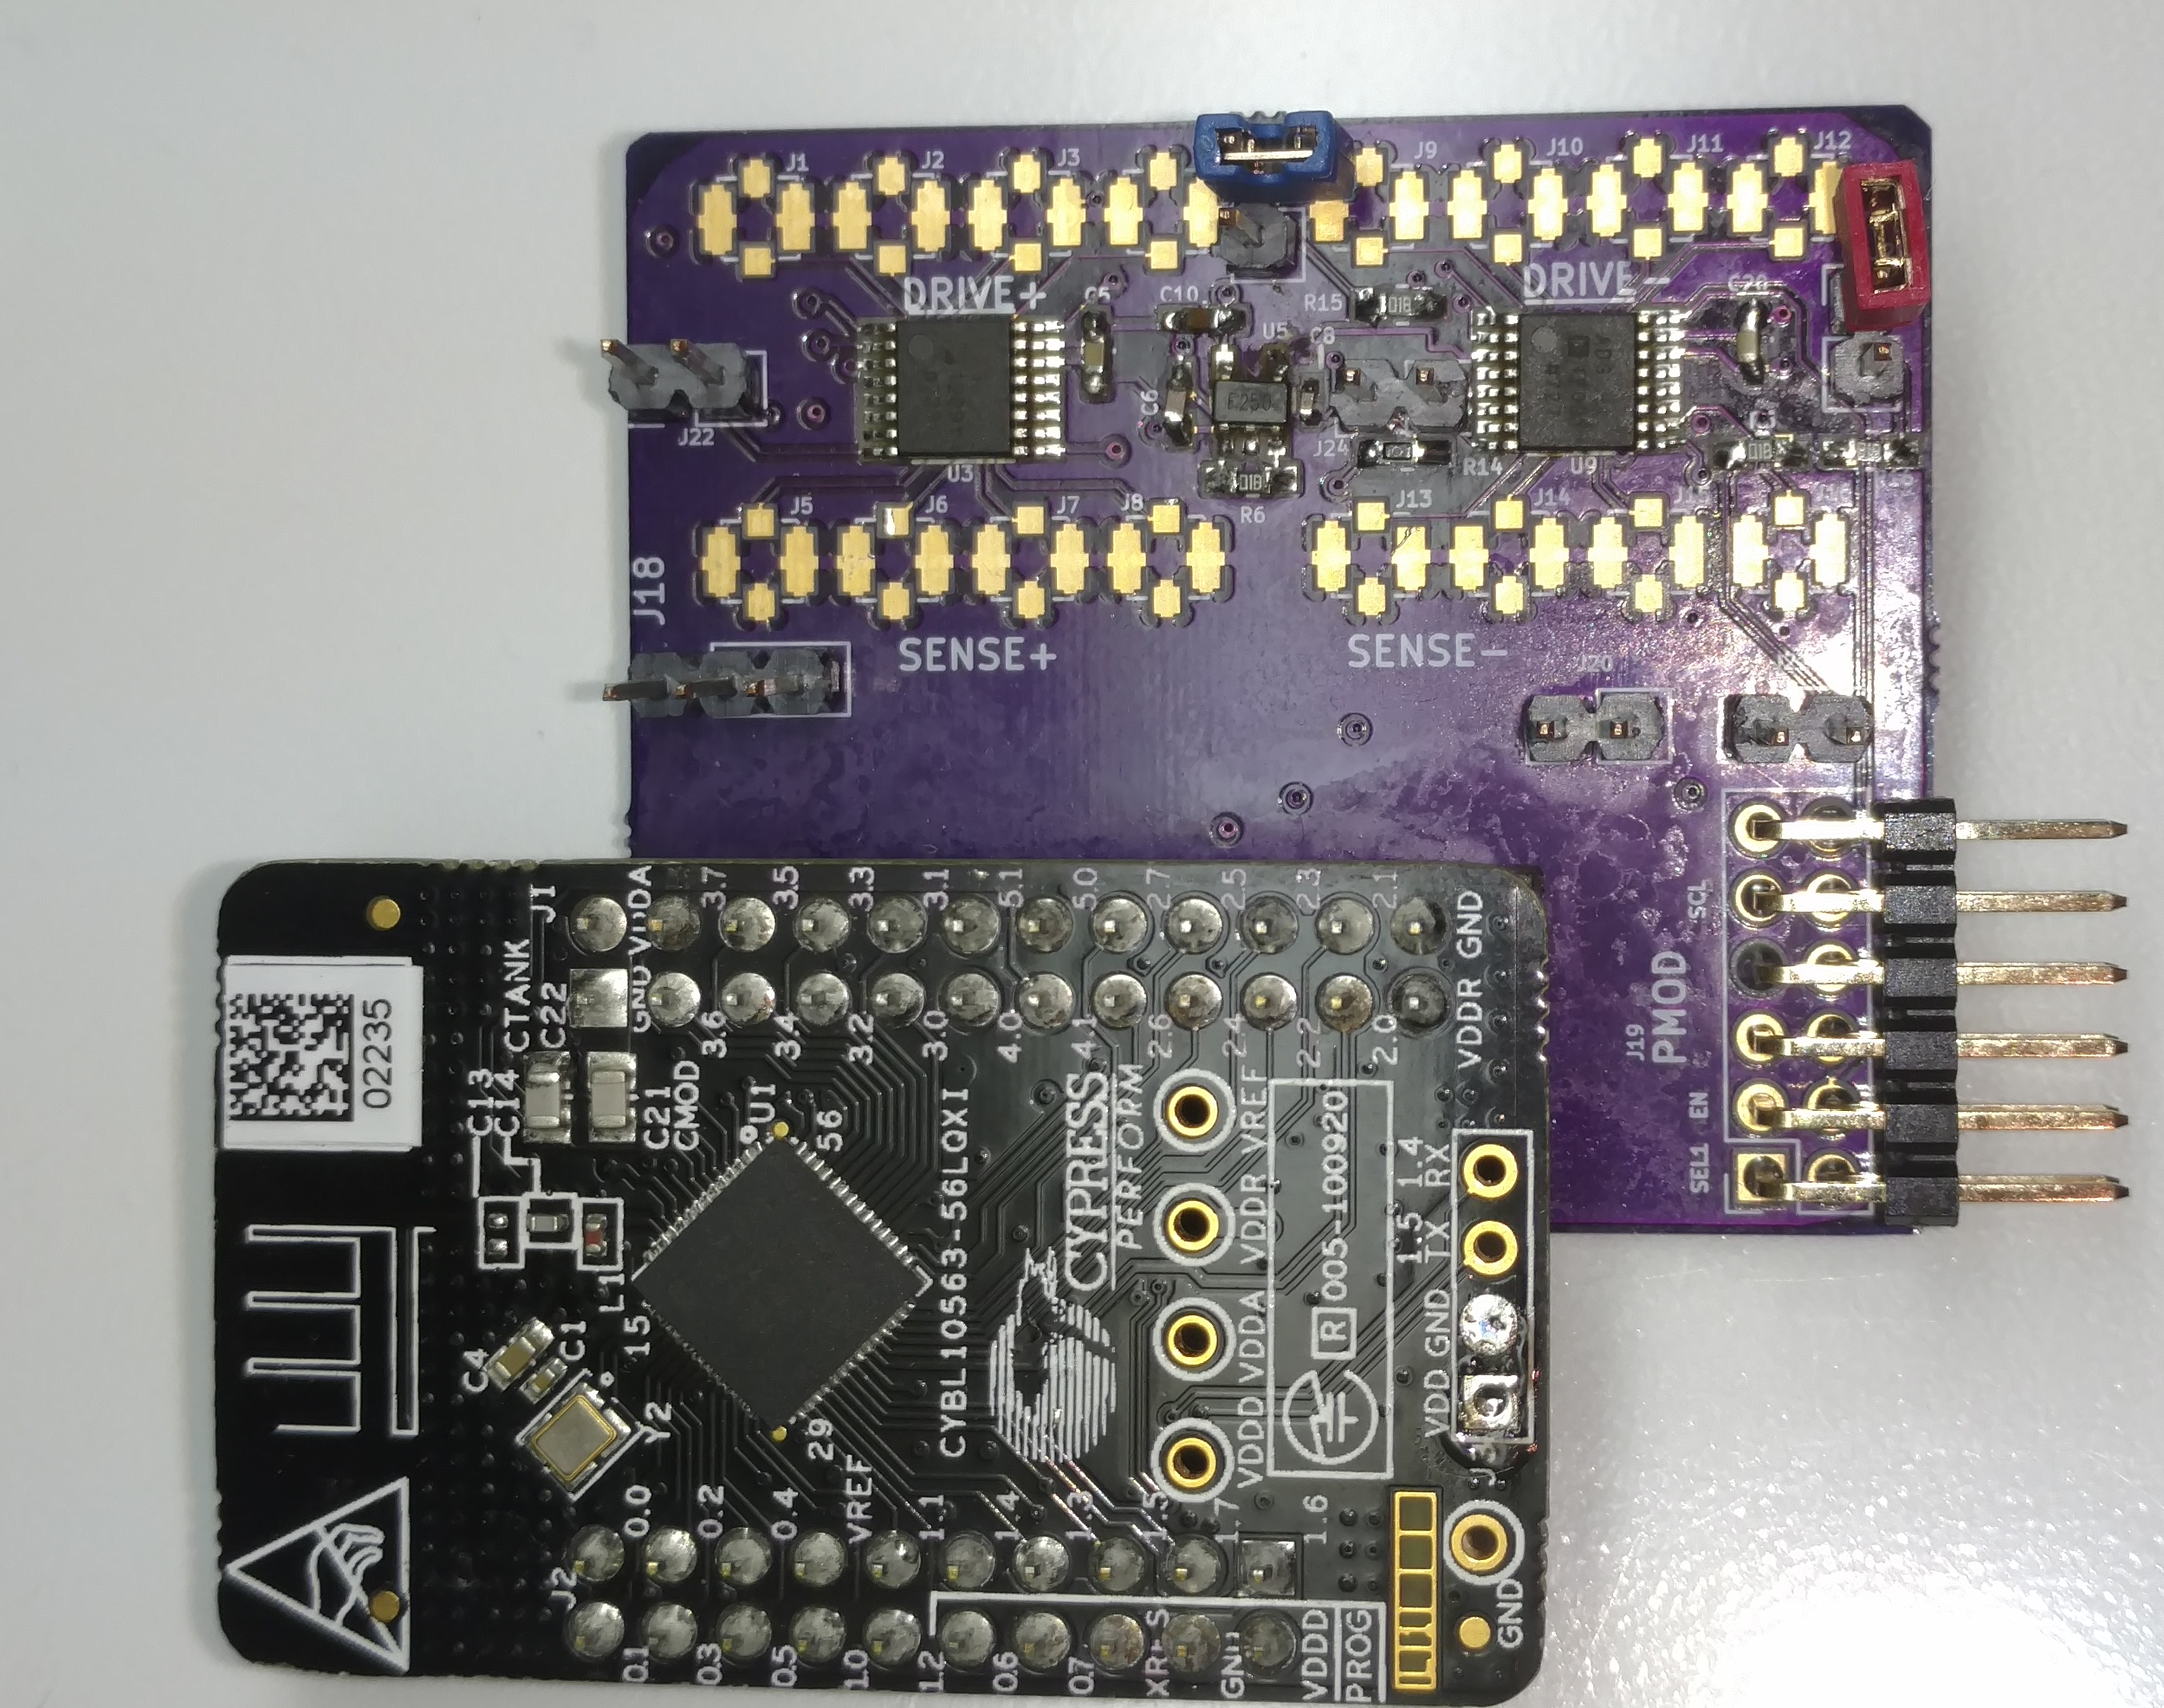
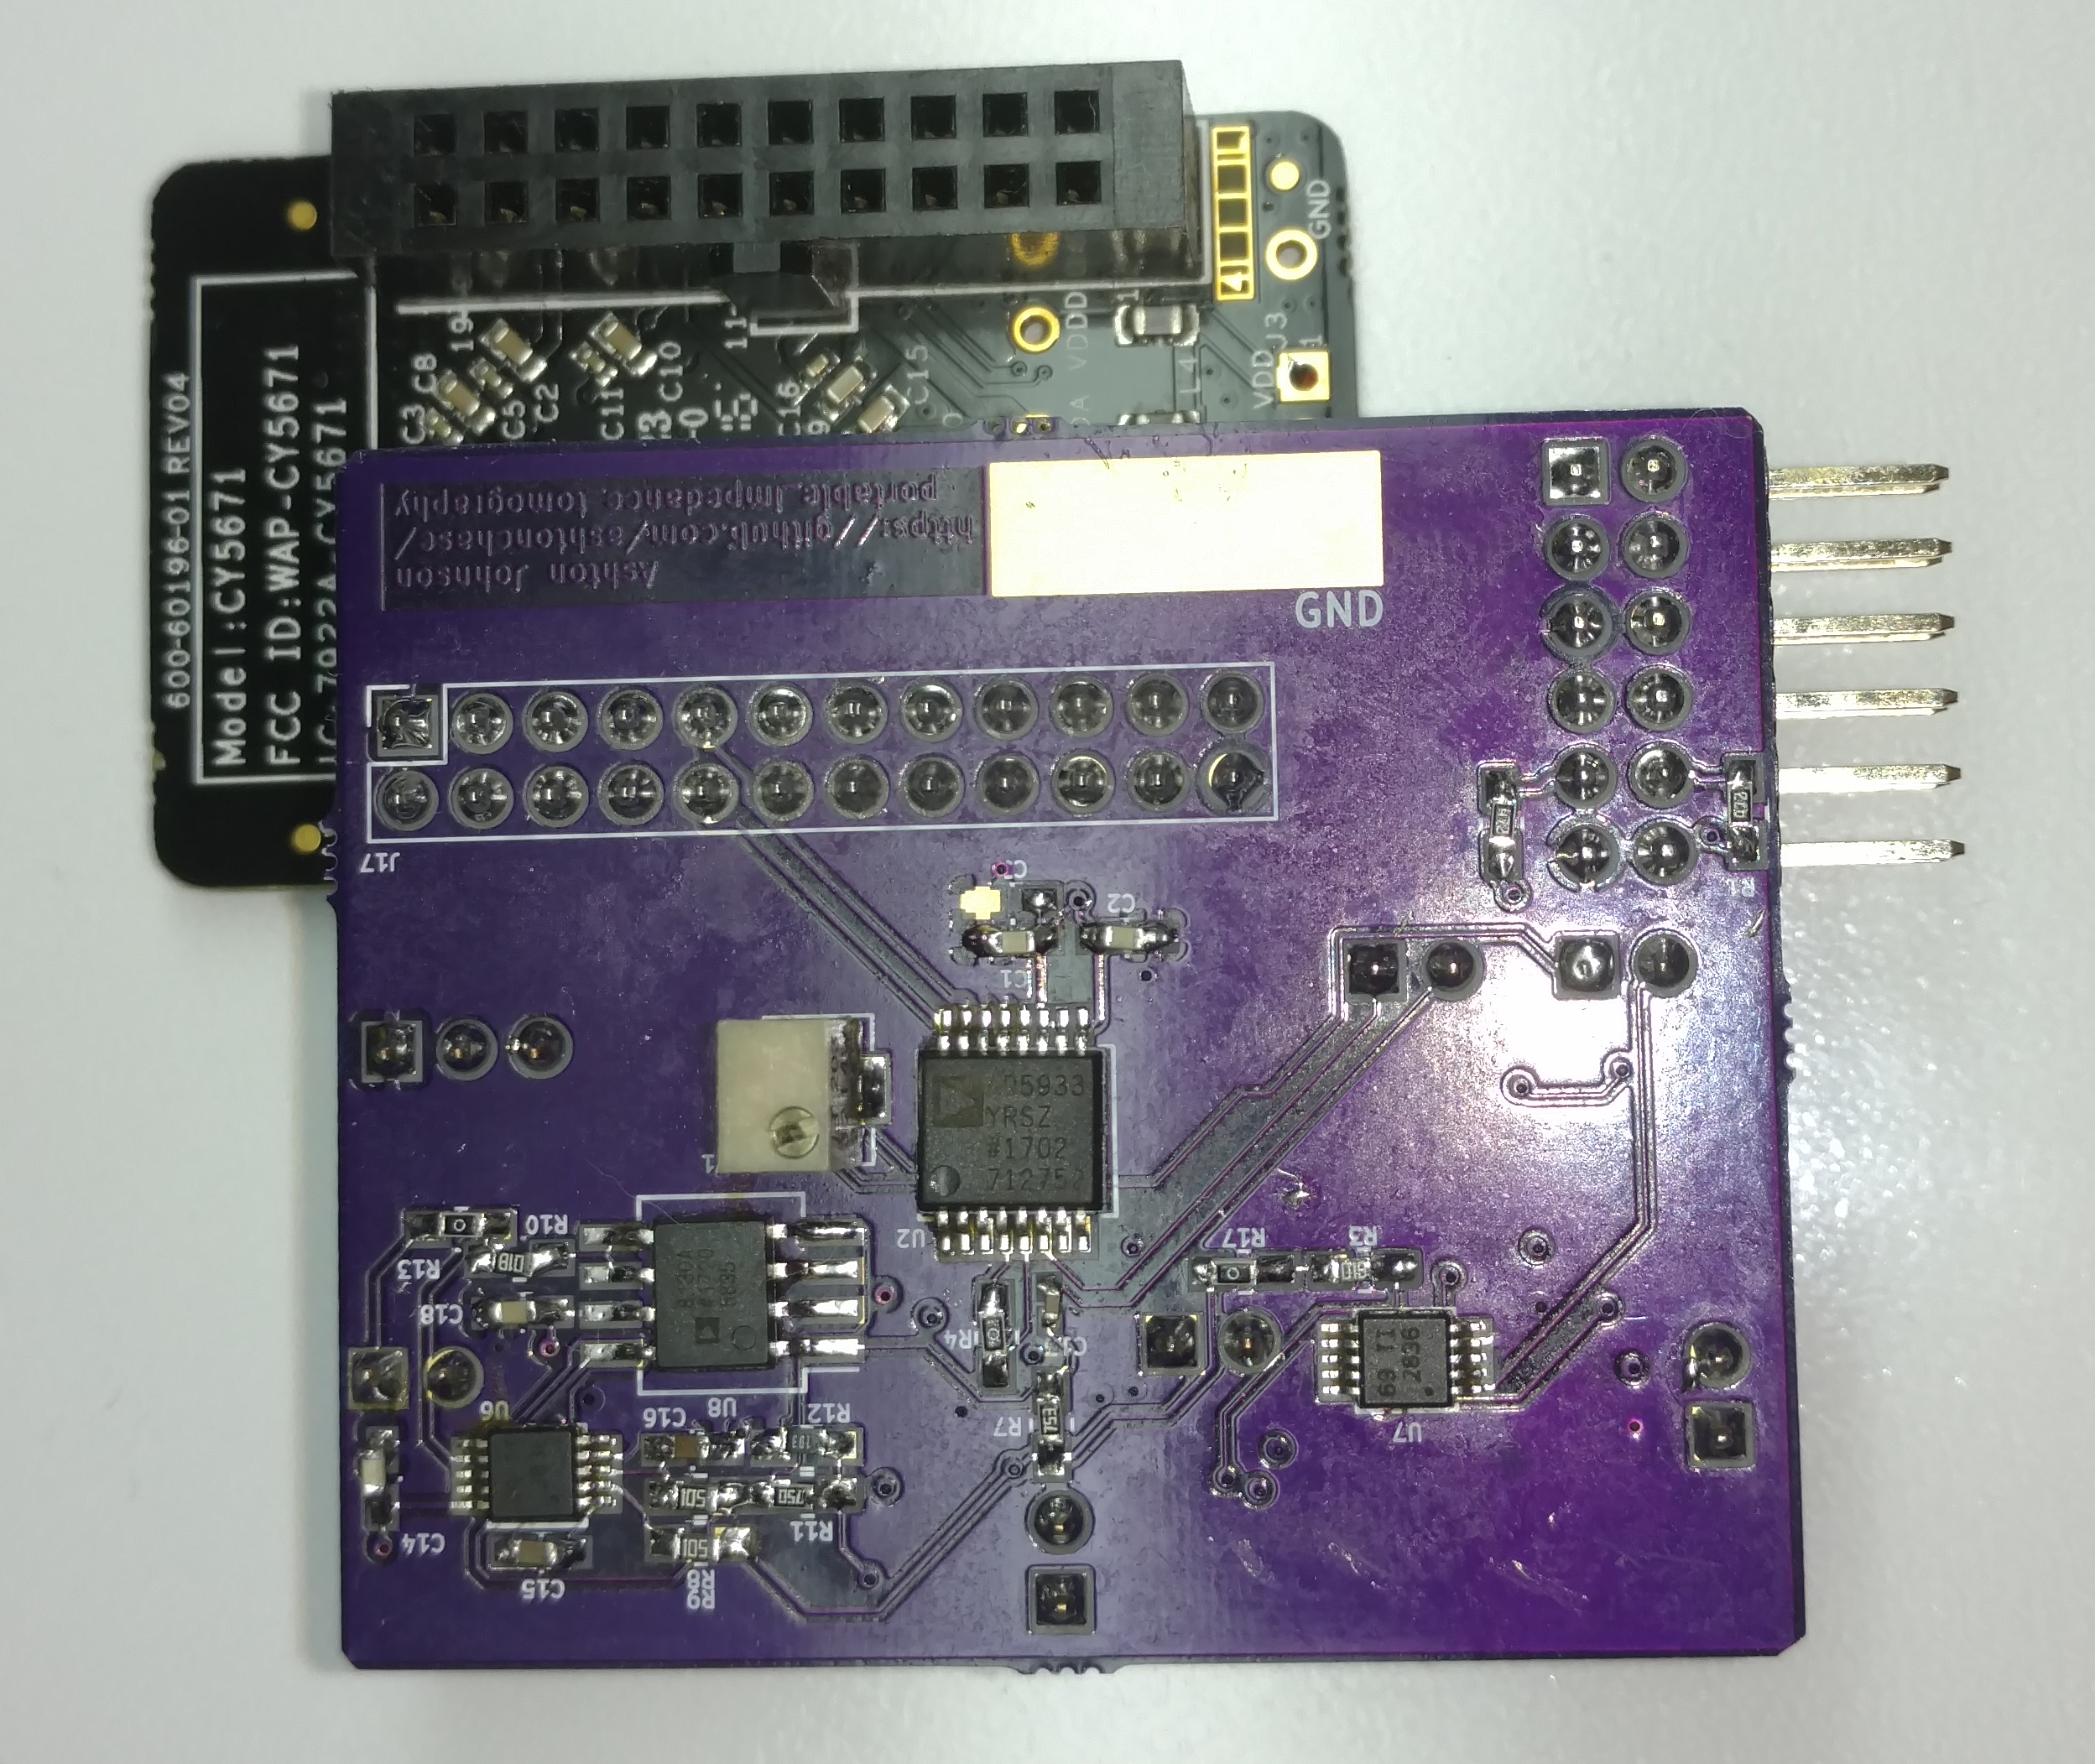
Project Status
Board Assembled
Platform Software Completed & Tested
Testing In Process
  Testing AD5933 I/O
  AFE looks ‘stuck’, requires further investigation.

Slide 15
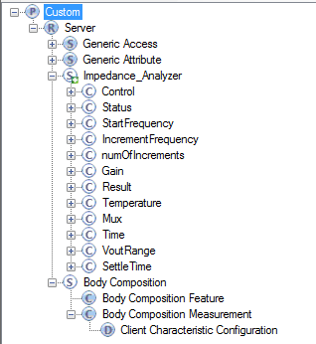
Project Status
BLE Custom Service

Slide 16
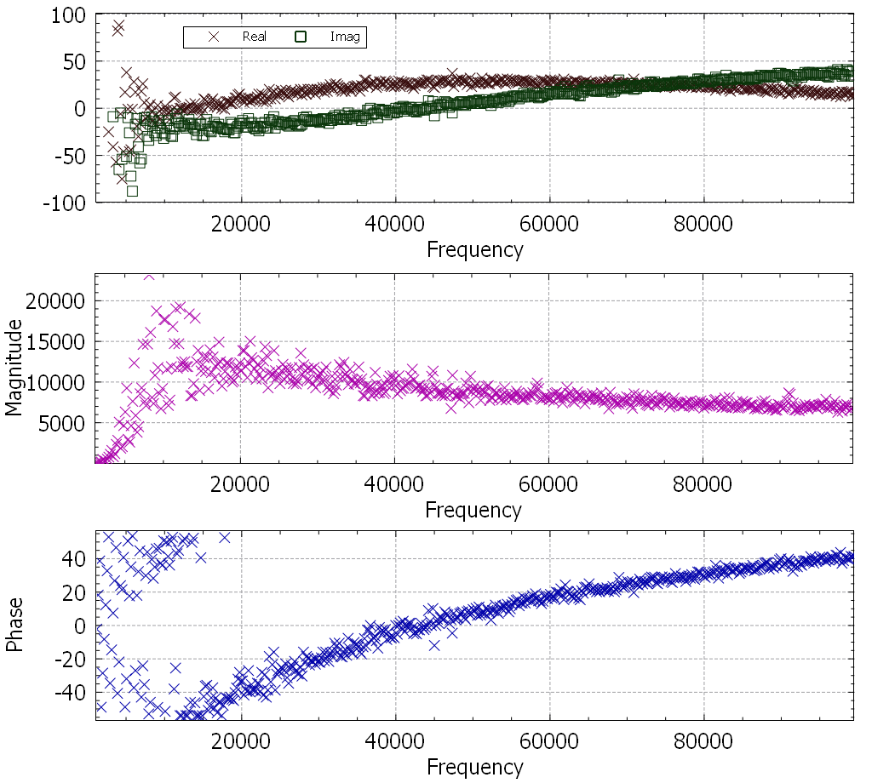
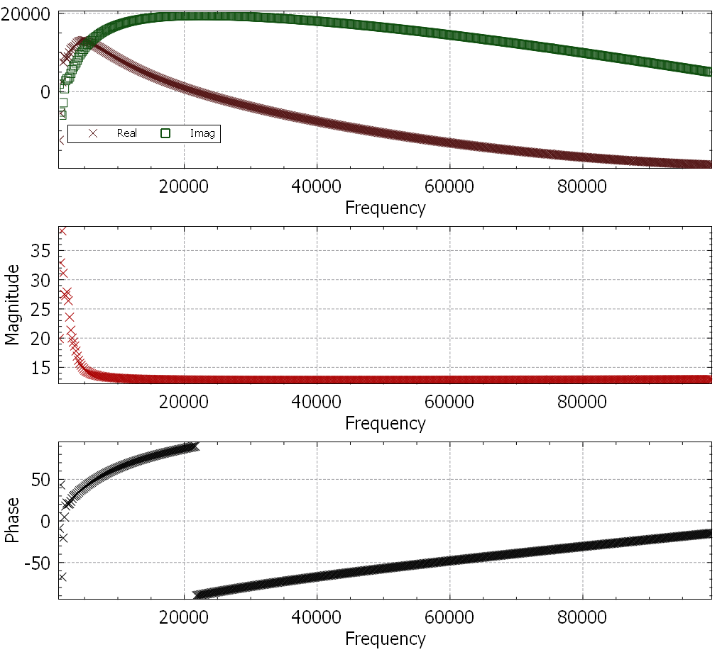
Preliminary Results
10k Resistor
100nF Capacitor

Slide 17
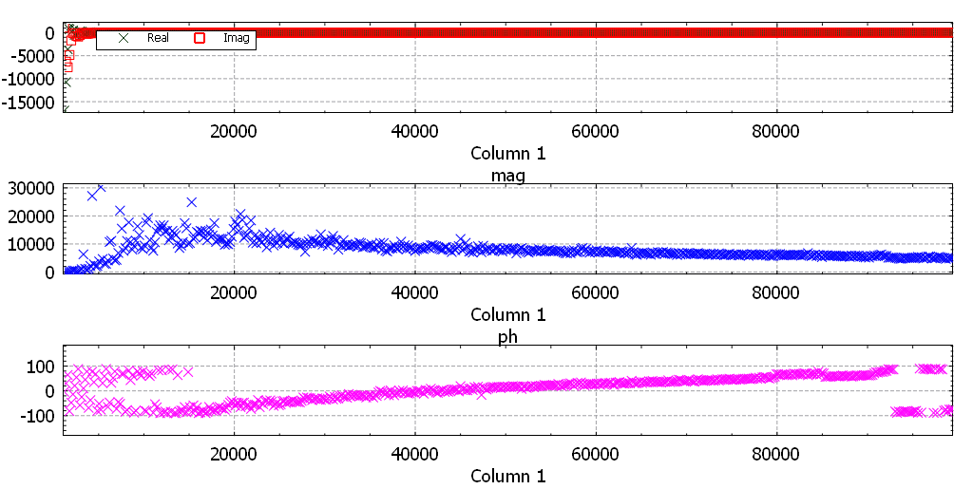
Preliminary Results
10k Resistor + 100nF Capacitor

Slide 18
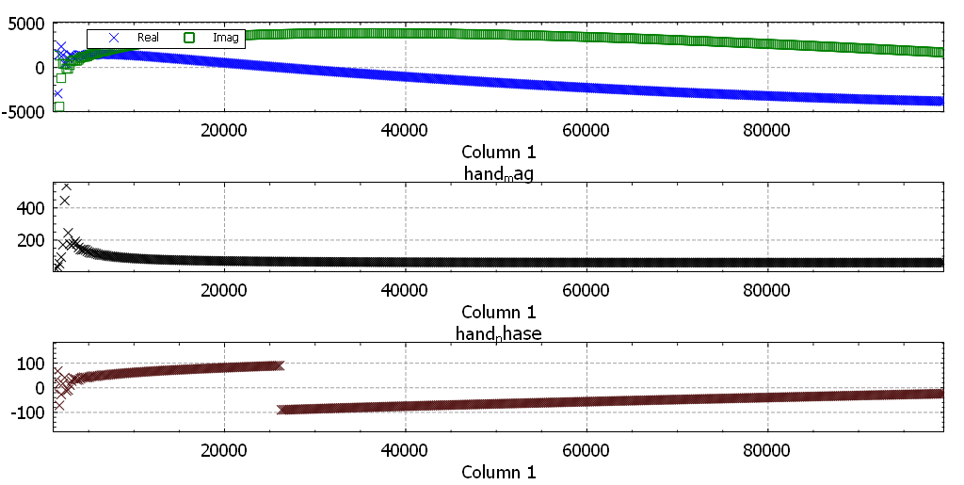
Preliminary Results
Hand-Hand Measurement

Slide 19
Lessons Learned
Human Body Interfacing can be difficult to understand.
In-line breaks between circuits is a good idea.
Don’t take 2 classes, work full time, and have a newborn baby.

Slide 20
What’s Left
AFE Checkout
  Independent test
  Drive appears operational, but difficulty overcoming contact resistance.
AMUX Checkout
  Tested operational (~500ohms)
Device Calibration
Android App Implementation

Slide 21
Calibration
Measurement results are not directly usable
  Much like raw bits from an ADC are not in volts.
  Have to apply scale factor & unit conversions.
  Results are in admittance.
Calibration is required for design specific AFE, or lack thereof.
  Measurements are performed a known ohmic resistance.
  Matseiv demonstrates that DC offset at input cause considerable measurement error and should open circuit DC bias measurement results should be factored out of all measurements.
L. Matsiev, “Improving performance and versatility of systems based on single-frequency dft detectors such as ad5933,” Electronics, vol. 4, no. 1, pp. 1–34, 2014.

Slide 22
Beyond Semester
Revise PCB mux control.
  All use the same address.
Investigate the Body Composition BLE Service.
  Impedance Characteristic.
  Do health apps use it??
Use EIDOR to construct tomography image.
Enhance Android Application.

Slide 23
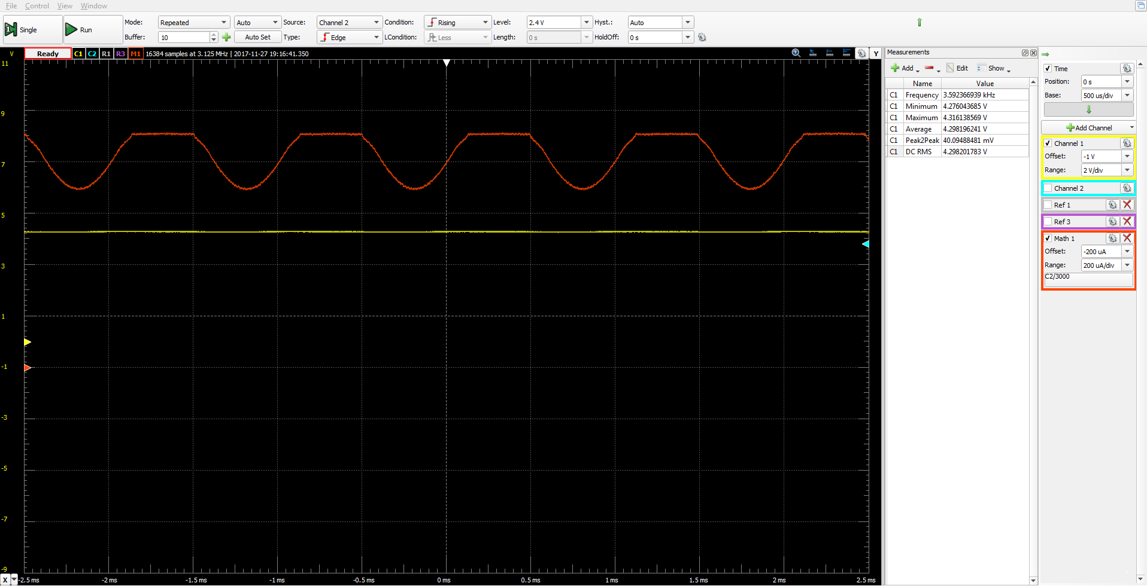
Powered from BLE Pioneer Board

Slide 24
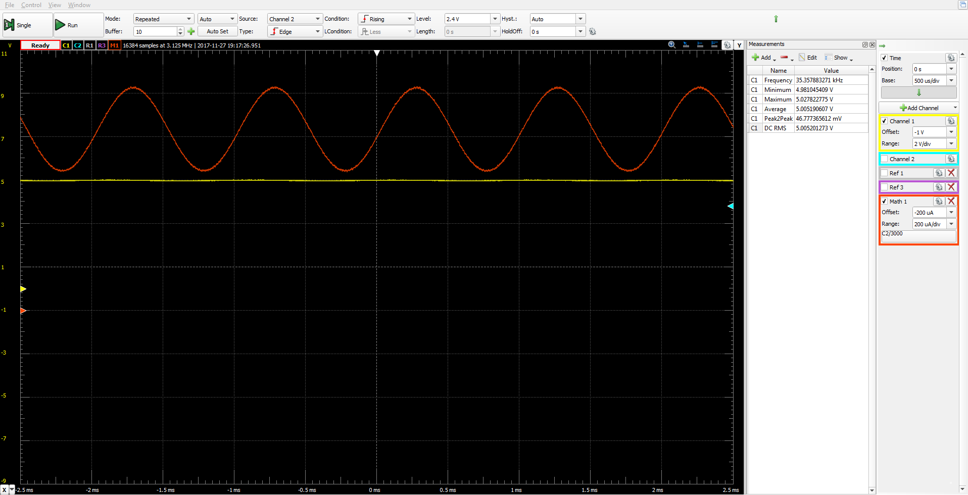
Powered from 5V Supply

Slide 25
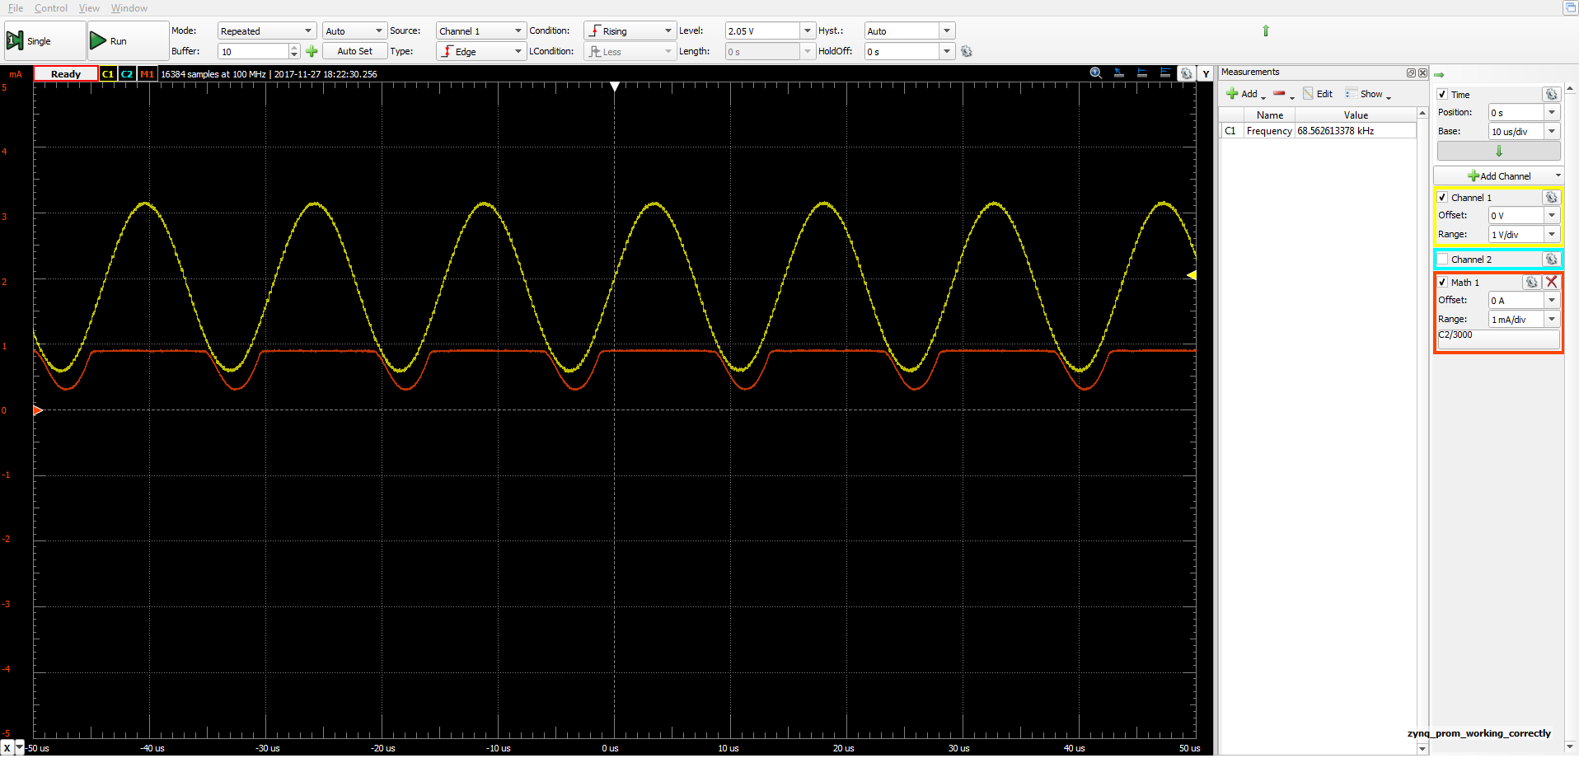
AFE Input to Output

Slide 26
Impedance
Resistance to the flow of current.
Combine from the ohmic resistance and frequency dependent reactance.
Expressed in complex form: Z=R+jX

Slide 27
Applications

Slide 28
Applications cont.

Slide 29
Measuring Impedance
Pass

Slide 30
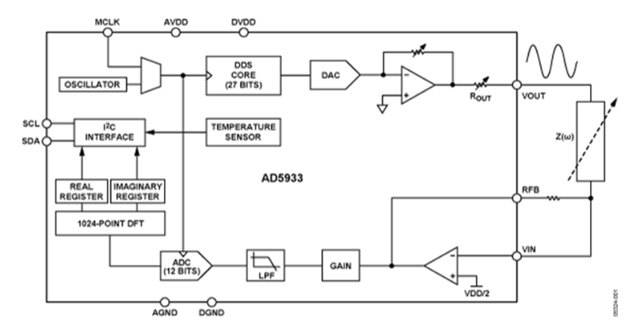
Analog AD5933
Low cost, impedance analyzer system on chip.
Programmable output peak-to-peak excitation voltage to a maximum frequency of 100 kHz
Programmable frequency sweep capability with serial I2C interface
Frequency resolution of 27 bits (<0.1 Hz)
Impedance measurement range from 1 kΩ to 10 MΩ
Capable of measuring of 100 Ω to 1 kΩ with additional circuitry
Phase measurement capability
2.7 V to 5.5 V power supply operation

Slide 31
Analog AD5933
Low cost, impedance analyzer system on chip.
Programmable output peak-to-peak excitation voltage to a maximum frequency of 100 kHz
Programmable frequency sweep capability with serial I2C interface
Frequency resolution of 27 bits (<0.1 Hz)
Impedance measurement range from 1 kΩ to 10 MΩ
Capable of measuring of 100 Ω to 1 kΩ with additional circuitry
Phase measurement capability
2.7 V to 5.5 V power supply operation

Slide 32
Body Interfacing
The AD9533 front-end is not ideal for BIA use.

Slide 33
Body Interfacing
Key Design Point!
The AD9533 front-end is not ideal for BIA use.
  Voltage driven interface without regard to current.
    IEC-60601 defined current limits for human body.
  Receive side has VCC/2 bias, therefor placing DC voltage on user. Long term electrolysis.
  Four-electrode method has been preferred method for measurement.
    Hua et al. Demonstrated p
    Never disclosed the actual V-to-I and I-to-V conversion.
P. Hua, E. J. Woo, J. G. Webster, and W. J. Tompkins, “Using compound electrodes in electrical impedance tomography,” IEEE Transactions on Biomedical Engineering, vol. 40, no. 1, pp. 29–34, Jan. 1993.

Slide 34
Multiplexing
Impedance Tomography requires multiple receive electrodes.

Slide 35
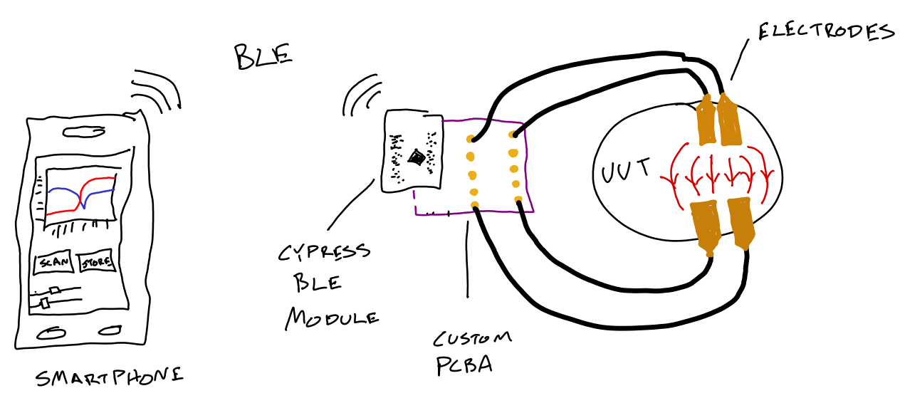
User Connectivity
Provide the user ability to control and receive platform wirelessly with graphical user interface (GUI).

Slide 36
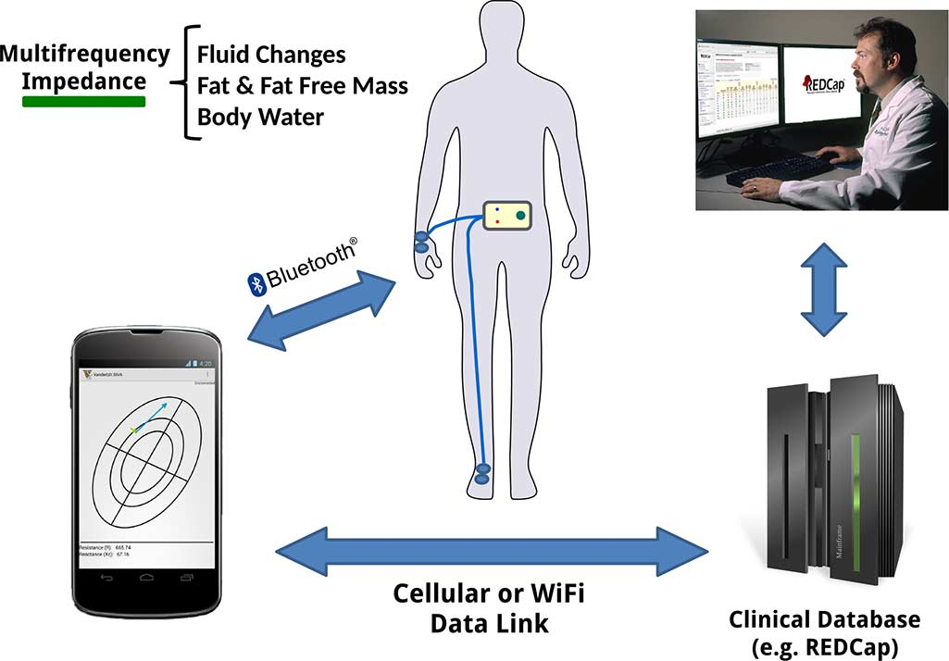
User Connectivity (existing)
Harder et al. Developed android to app to
upload download from module
and upload to health servers.

