Slide 1
Portable Impedance Tomography System
Ashton Johnson
CPE621 Advanced Embedded Systems
Electrical and Computer Engineering
The University of Alabama in Huntsville
e-mail: acj0008@uah.edu
Notes:
1

Slide 2
Impedance as a Tool
Complex Impedance Measurements provide insight on material composition.
More information can be observed using real and imaginary components.
1

Slide 3
Potential Applications
Electromechanical Impedance Spectroscopy (EIP)
Characterization of coatings and metal corrosions.
Electrical Bioimpedance Spectroscopy (EBIS) is a growing area of research.
Impedance pneumography- Respiration Rates
Continuous ECG measurements are subject to interference from motion artifacts.
Body composition measurements
Electrical Impedance Tomography – Using impedance to build a 2D/3D image of the material.
1

Slide 4
Analog Devices AD5933
Low cost, impedance analyzer system on chip.
Programmable output peak-to-peak excitation voltage to a maximum frequency of 100 kHz
Programmable frequency sweep capability with serial I2C interface
Frequency resolution of 27 bits (<0.1 Hz)
Impedance measurement range from 1 kΩ to 10 MΩ
Capable of measuring of 100 Ω to 1 kΩ with additional circuitry
Phase measurement capability
2.7 V to 5.5 V power supply operation
1

Slide 5
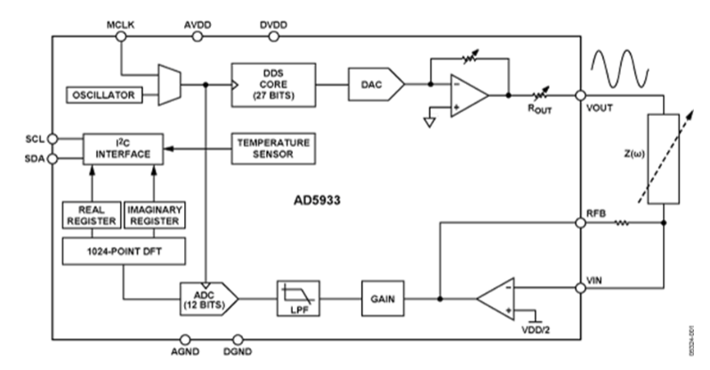
AD5933 Block Diagram
1

Slide 6
AD5933 Shortcomings
The AD9533 front-end is not design for bioimpedance use.
Voltage driven interface without regard to current.
IEC-60601 defined current limits for human body.
Receive side has VCC/2 bias, therefor placing DC voltage on user.
4 electrode measurement setup was introduced by Seoane et al.
Never disclosed the actual V-to-I and I-to-V conversion.
1

Slide 7
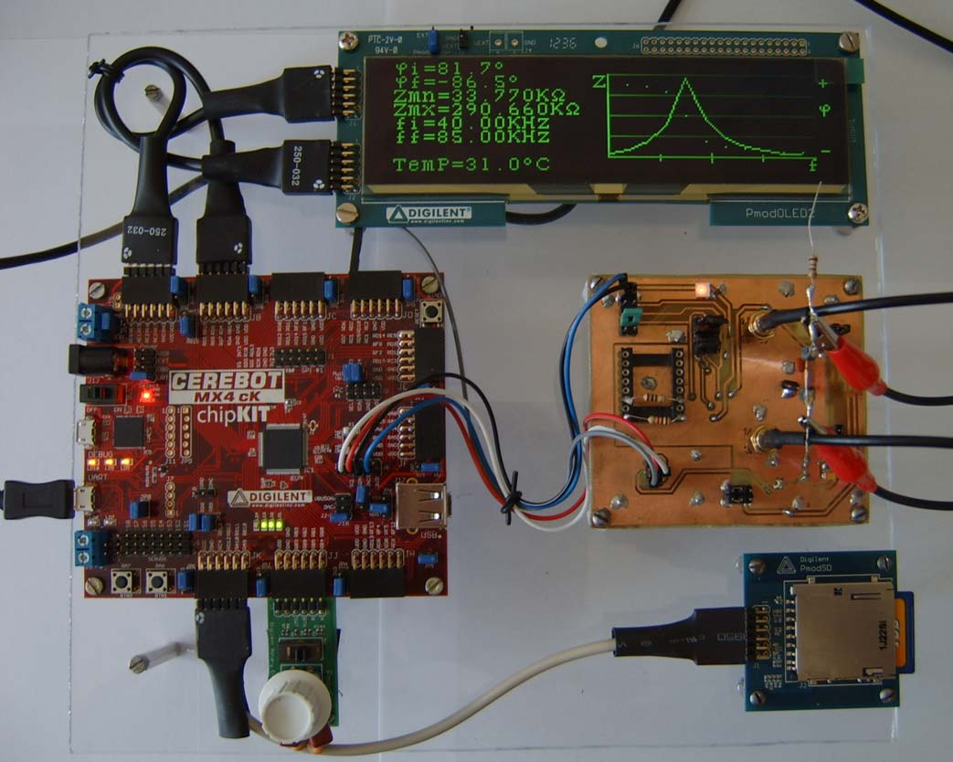
Breniuc et al.
Wearable Impedance Analyzer
“Wearable”
Self contained UI
No front end additions
1

Slide 8
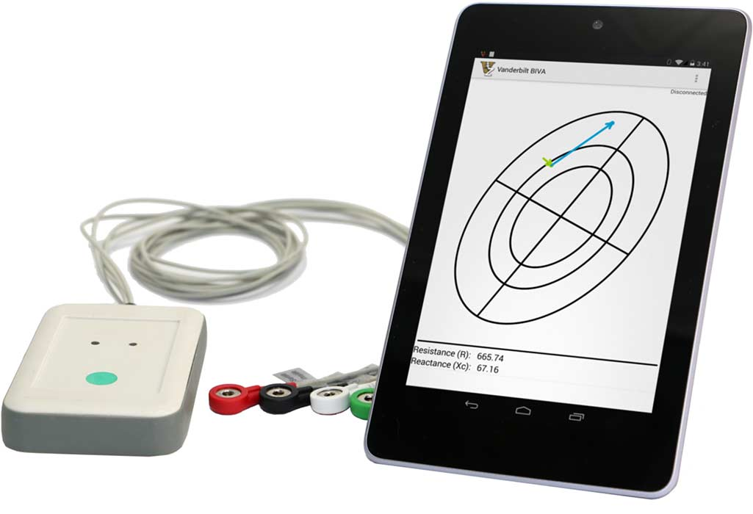
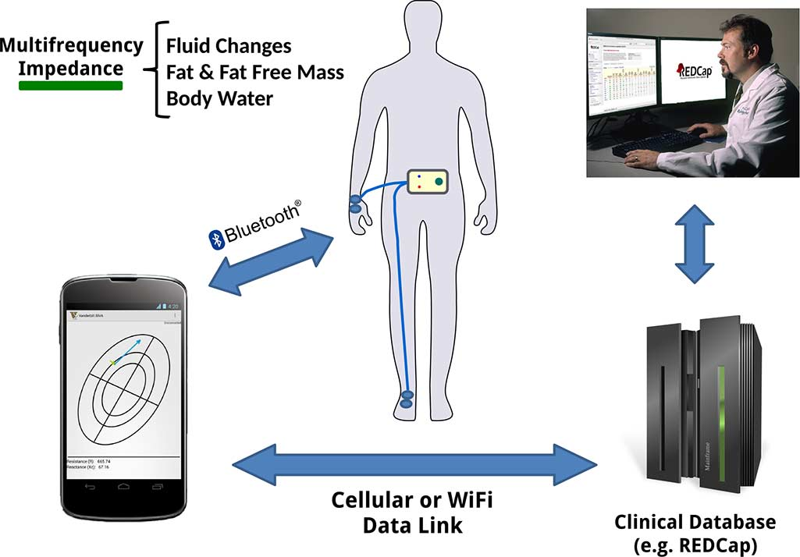
Harder et al.
Presented a solution to measure fluid changes, and fat mass.
Developed a reliable body interface to the AD5933
Bluetooth connectivity
1

Slide 9
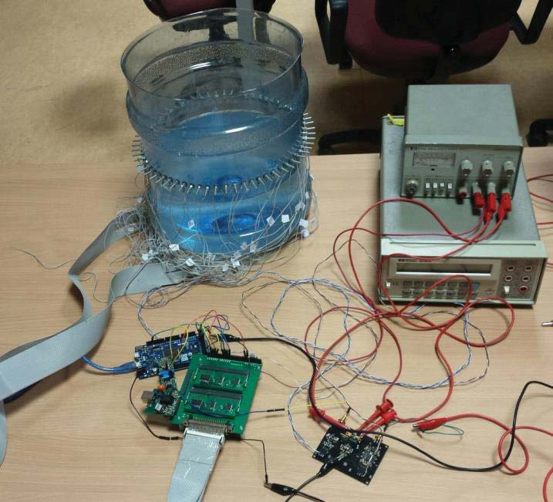
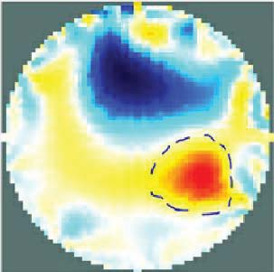
Dimas et al.
64-electrode Electrical Impedance Tomography system
Analog multiplexing 64 electrode system
Does not utilize AD5933
1

Slide 10
Proposed approach
Portable Impedance Tomography
Combine features of existing solutions
Multiple electrodes – 4 point
AD5933
Bluetooth connectivity
1

Slide 11
Logistics
Milestones
Hardware
Platform Selection (19 SEP)
Schematic Design & Layout Complete (26 SEP)
AD5933
Analog Multiplexers
Power Domain
PCB Assembly Complete (10 OCT)
PCB Checkout Complete (24 OCT)
1

Slide 12
Logistics
Milestones (cont)
Software Development
Iterative deliveries based on SCRUM development cycles.
Sensor Module firmware development
GNU/Linux application development
(opt) Android application development
1

Slide 13
Philosophies
Use and contribute free, libre, open source whenever possible.
PCB design will utilize KiCad
Design components will be submitted to official repositories.
GCC software compilation
Design and all document to be hosted at GitHub.
https://github.com/ashtonchase/portable_impedance_tomography
1

Slide 14
References
L. Breniuc, V. David, and C. G. Haba, “Wearable impedance analyzer based on AD5933,” in 2014 International Conference and Exposition on Electrical and Power Engineering (EPE), 2014, pp. 585–590.
R. Harder, A. Diedrich, J. S. Whitfield, M. S. Buchowski, J. B. Pietsch, and F. J. Baudenbacher, “Smart Multi-Frequency Bioelectrical Impedance Spectrometer for BIA and BIVA Applications,” IEEE Transactions on Biomedical Circuits and Systems, vol. 10, no. 4, pp. 912–919, Aug. 2016.
C. Dimas, P. Tsampas, N. Ouzounoglou, and P. P. Sotiriadis, “Development of a modular 64-electrodes Electrical Impedance Tomography system,” in 2017 6th International Conference on Modern Circuits and Systems Technologies (MOCAST), 2017, pp. 1–4.
1

