Slide 1
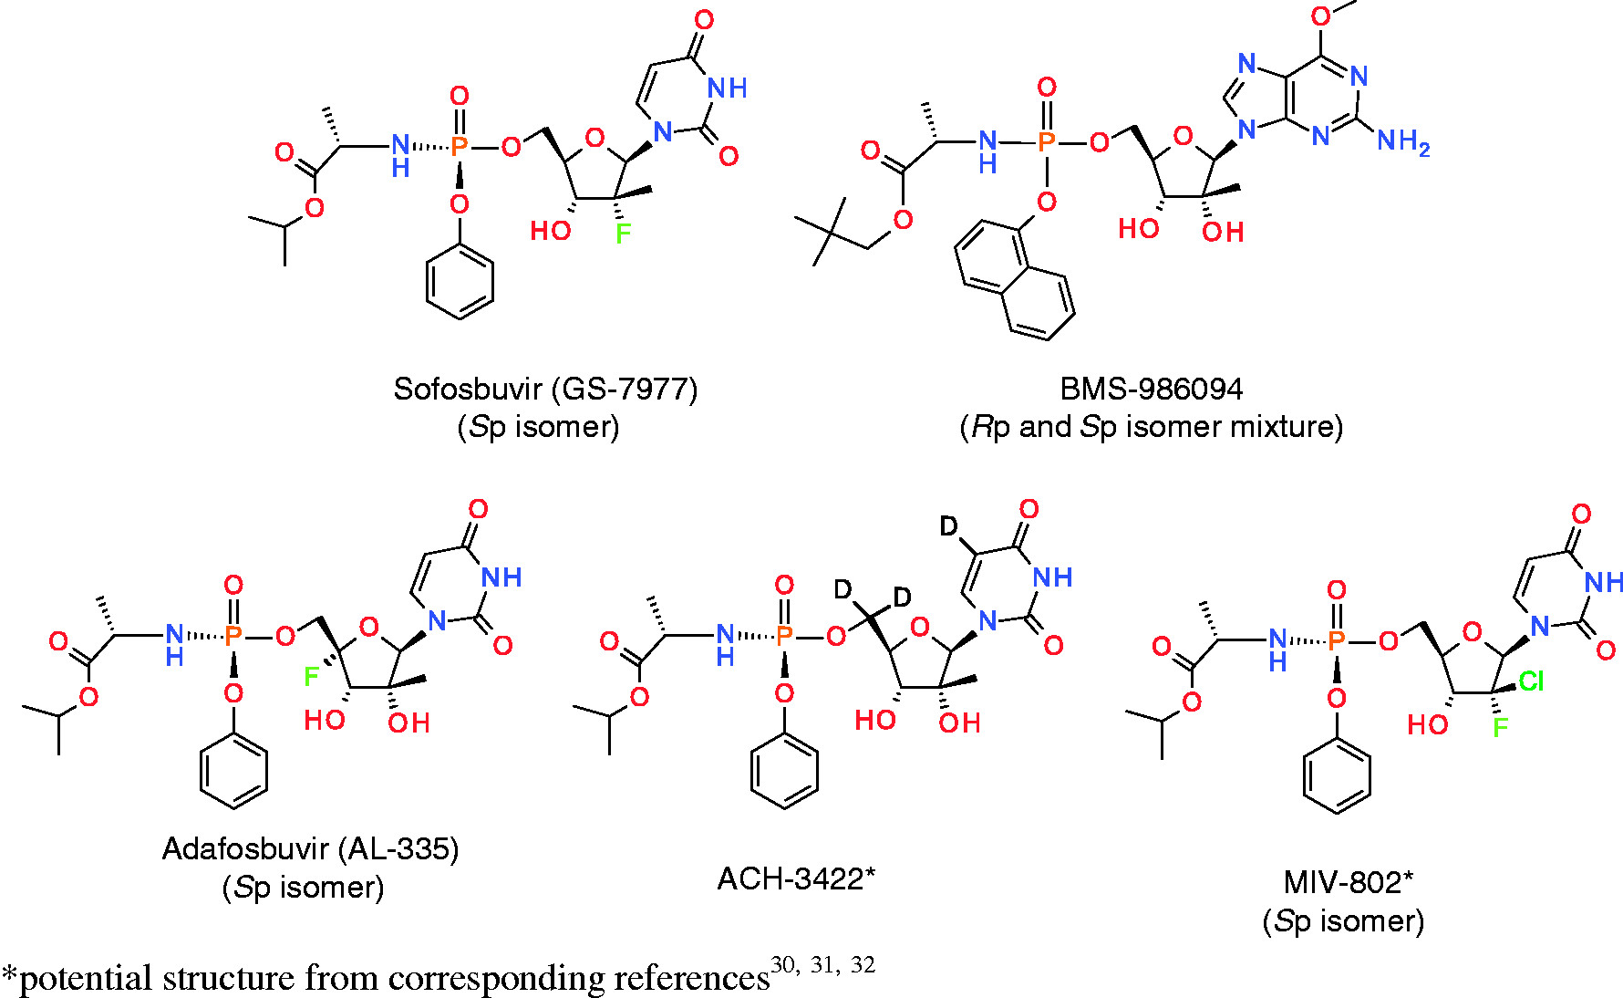
Figure 2. McGuigan phosphoramidate nucleotide prodrugs. (a) Sofosbuvir (GS-7977) (Sp isomer), (b) BMS-986094 (Rp and Sp isomer mixture), (c) Adafosbuvir (AL-335) (Sp isomer), (d) ACH-3422*, and (e) MIV-802* (Sp isomer). *Potential structure from Deshpande,31 Kalayanov et al.,45 and Andersson.46
Article Copyright © 2018 Authors, Source DOI: 10.1177/2040206618756430. See content reuse guidelines at: sagepub.com/journals-permissions

