Slide 1
JUNIPER SALON CANCELLATION RECOVERY
Cancellation gaps create a race against the clock
SAME-DAY RESPONSE WINDOW
15 minutes
Staff currently check a spreadsheet, match suitable clients, and manage replies by text while an open appointment may remain unfilled.
ACTIVE OFFERS PER OPENING
One
The first useful solution must
FAIRNESS RULE
Offer one slot to one eligible client at a time
Oldest eligible client first
Keep the oldest eligible client first
Show failures and resume without losing progress
Customer summary supplied by the user. Direct written confirmation from Lena remains unrecorded.
Evidence current as of October 6, 2026
01
Notes:
Sources: BUSINESS_NEEDS.md, sections Business Problem, Current Process, Business Rules, Desired Outcomes, Measurable Success Criteria, and Confirmation Record. REQUIREMENTS_HANDOFF.md, RQ-02 through RQ-10. No numeric business impact is claimed because baselines and targets remain unknown.

Slide 2
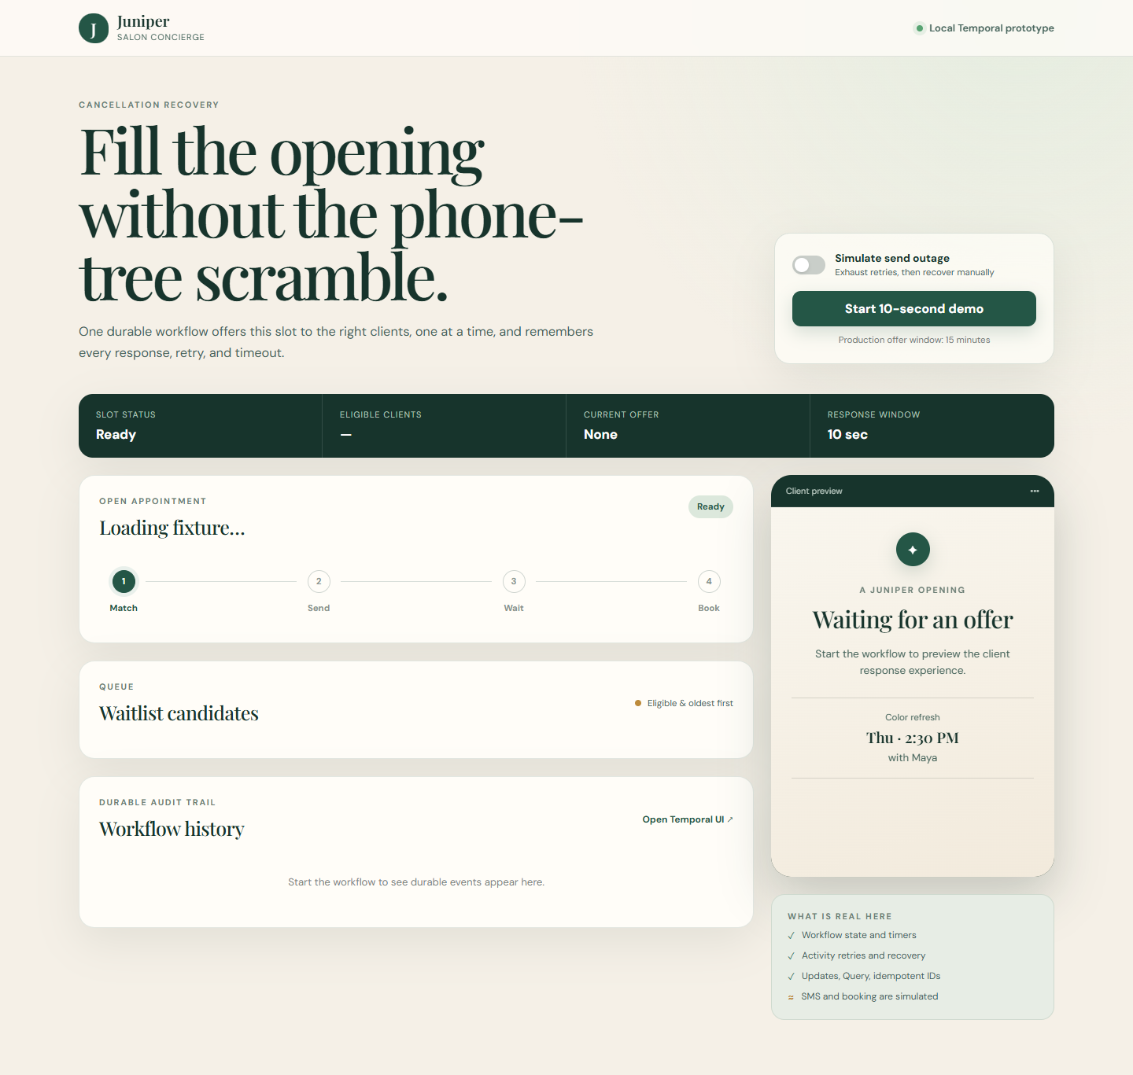
PROTOTYPE BEHAVIOR
One durable process coordinates each cancellation opening
01
Match
Filter by service, stylist, and availability. Order by waitlist join time.
02
Offer
Contact the oldest eligible client and keep only one offer active.
03
Wait
Record accept or decline. A durable timer advances after the response window.
04
Book or continue
Book once on acceptance. Otherwise move to the next eligible client.
Interface preview. The image shows the ready state, not a completed Temporal execution.
Evidence current as of October 6, 2026
02
Notes:
Sources: docs/approved-mvp-spec.md, Scope and outcome and Temporal contract. src/domain.ts for eligibility and ordering. src/workflows.ts for sequential offer control, timer, Updates, Query, and booking flow. evidence/juniper-dashboard.png is a static interface preview and does not prove runtime execution.

Slide 3
TEMPORAL BUSINESS VALUE
Durable orchestration addresses the failure points in the current process
TEMPORAL CAPABILITY
BUSINESS EFFECT
Workflow state and history
Preserves the current client, prior responses, and recovery point.
Durable response timer
Moves outreach forward when a client does not answer in time.
Activity retries and operator recovery
Retries transient send failures and gives staff a visible recovery path.
Stable IDs and idempotency controls
Limits duplicate starts and repeated commands. Production booking still needs durable external storage.
Evidence boundary
All nine tests passed: four offline checks plus five Temporal Workflow scenarios using the official time-skipping test server.
Verified locally: TypeScript, browser syntax, 4 offline tests, and 5 Temporal Workflow tests
03
Notes:
Sources: PROTOTYPE_SETUP_LOG.md, resumed Temporal validation. README.md, Capability truth table. src/workflows.ts, src/activities.ts, and tests/workflow.test.ts. Five Workflow scenarios passed with Temporal's official time-skipping test server after using a precompiled JavaScript bundle to avoid the managed host's SWC native-cache restriction. This is not a Docker-backed browser end-to-end run.

Slide 4
SCOPE AND NEXT STEP
The prototype tests the orchestration concept, not production readiness
IMPLEMENTED IN SOURCE
SIMULATED OR EXCLUDED
01
Eligibility and oldest-first ordering
01
SMS delivery, calendar booking, and waitlist data
02
One active offer and response deadline
02
Authentication, authorization, and persistent app storage
03
Accept, decline, skip, and recovery paths
03
Production scale, privacy, high availability, and deployment
04
Staff status Query and durable history design
04
Measured improvement in fill time or staff effort
Proposed next step
Choose the first live boundary and run a measured pilot
Confirm SMS or booking first, record a baseline for time to fill and staff touches, then exercise success, timeout, recovery, and late-reply scenarios.
Evidence current as of October 6, 2026
04
Notes:
Sources: README.md, Capability truth table and explicit exclusions. BUSINESS_NEEDS.md, quantitative measures requiring baselines and targets. REQUIREMENTS_HANDOFF.md, constraints and downstream validation focus. The proposed pilot is a recommendation, not a confirmed customer commitment.

