Slide 1

Arm Mbed – AWS IoT System Integration
Industrial Supervisor:
Dr. Ashkan Tousi
Academic Supervisors:
Dr. Hadi Heidari
Prof. Sandy Cochran
Sergio Martin
2092914M
Notes:
Hi my names is Sergio and this is the presentation for my Industrial Placement with Arm.

Slide 2
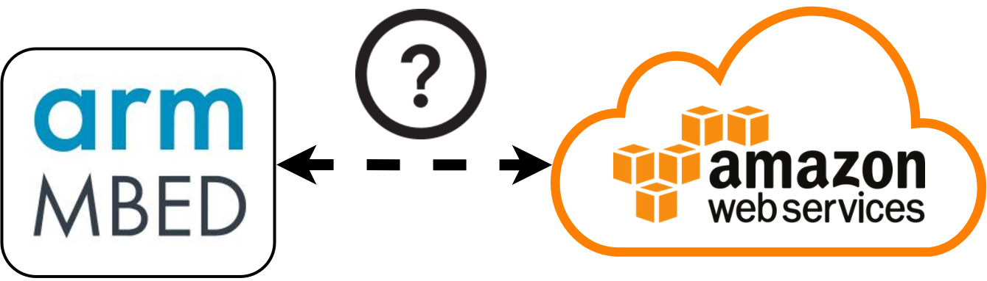
Aim of the Project
Define a system architecture that connects these two platforms:
Mbed IoT Platform & Amazon Web Services.
Notes:
Title + FOR INTERNET OF THINGS APPLICATIONS.
Arm is a processor IP company that is recently expanding into the IoT market
and Amazon that started as a retail company and has become one of the biggest if not the biggest Cloud provider.

Slide 3
Presentation Structure
Background Information
System Overview
System Evaluation
Smart Home Application
Conclusion & Future Work
Notes:
I will first give you some background information on IoT and the two Platforms just mentioned.
Then I will give an overview of the System and its main components.
Followed by an evaluation of this system.`
I will then briefly describe the example smart home application based on this system
And finally wrap everything up in the conclusion and future work.

Slide 4

Internet of Things
Notes:
The current Internet connects people together and the information they want to share.
The internet of things, is the network of things, literraly everything and anything.
Connecting this smart devices together,
Enables things like…
Process automation
Big DATA Analytics
And Device collaboration.

Slide 5
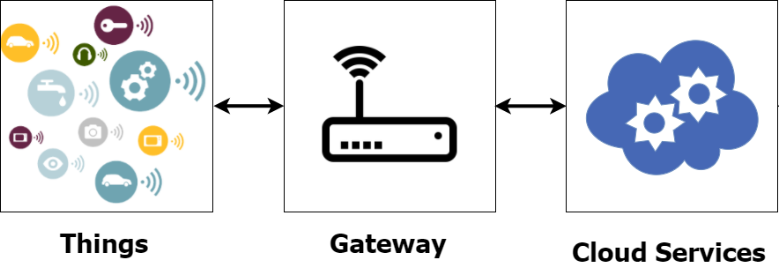
General IoT System
Notes:
So this things have resources that they want to share, such as temperature or motor speed.
For a device to connect to the Internet, it must connect to a Gateway Device that routes the data to the Cloud Services.
The Cloud then provides services such as storage and computation where the data from the device resources can be gathered and analysed.

Slide 6
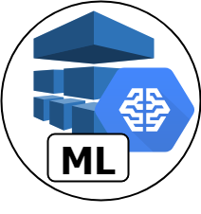
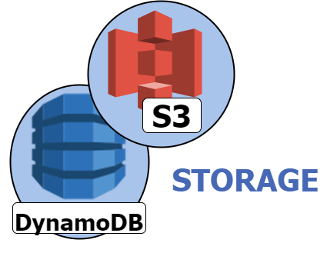
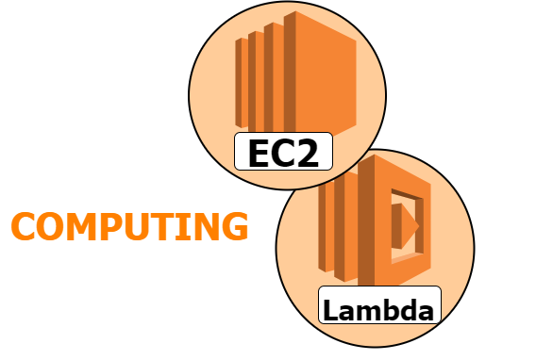
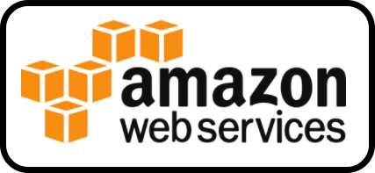
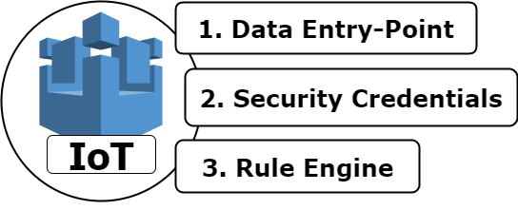
Amazon Web Services
Notes:
Amazon has 90+ Services, so I will outline the ones most relevant to this project.
The most important one is AWS IoT.
This is a Device Management Service:
-> the point to which IoT devices connect to and communicates with the Cloud.
-> The data can then be accessed by other Services using the Rule Engine, which I will talk a bit more about later.
So what kind of services are there available?
We have storage Services to create databases or store files and computing Services to Manage Servers and Serverless Applications.
There are also some more application specific services such as AWS Machine Learning: where you can create an ML model and request predictions in real-time.

Slide 7
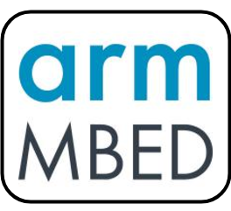
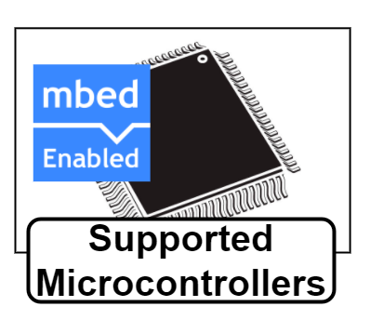
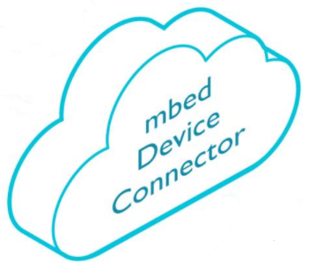
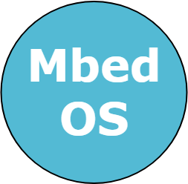
Mbed IoT Platform
Notes:
The Mbed IoT Platform is more orientated towards the Device level and offers a wide range of supported devices from its partner companies.
This Mbed Enabled devices can run the Mbed OS, a Real-time operating system for Cortex-M microcontrollers with a huge number of software libraries for embedded applications and connectivity.
On top of that it has the Mbed Device Connector (to which I will refer sometimes as MDC), a Device Management Service in the Cloud to which Mbed Enabled Devices can connect to.

Slide 8
System Overview
Notes:
Since the system has multiple components, I will build the system in a set of steps to make it more comprehensible. We will start from the device and build to get to the AWS Services.

Slide 9
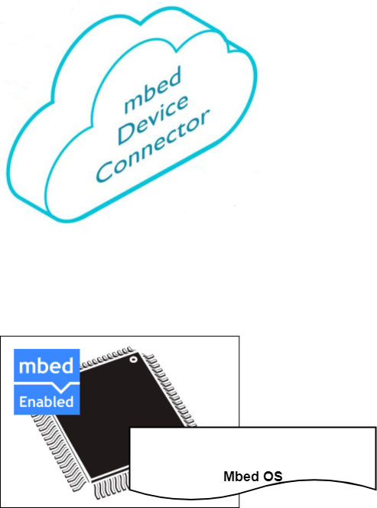
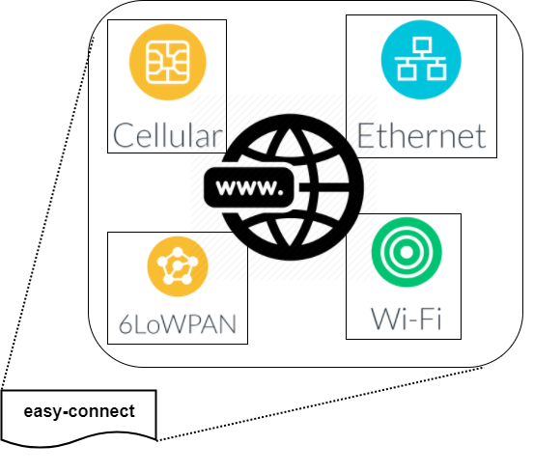
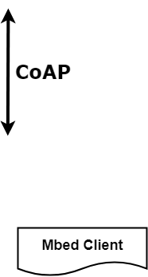
System Overview
Step 1:
Connecting an Mbed Device with Internet Access to Mbed Device Connector.
Notes:
The first step is to connect to Mbed Device Connector.
The Device must be able to connect to the internet, and for that we can use the easy-connect Library to use one of this communication protocols. The Mbed Client Library must be used to connect to MDC using Constrained application protocol.

Slide 10
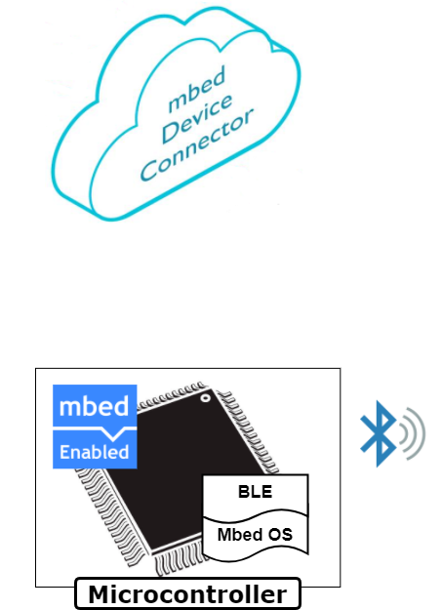
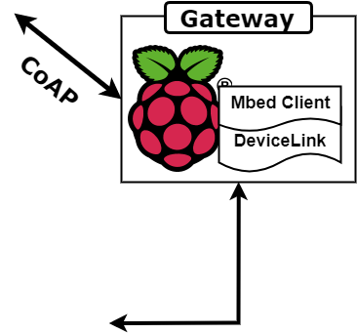
System Overview
Step 2:
Connecting a BLE Device to Mbed Device Connector.
Notes:
Other Devices use low-power and low-range communication protocols, such as BLE. This protocols cant connect directly to the internet, so what we have to do is implement a Specific Gateway Device. To do so we can use a Raspberry Pi with the DeviceLink Library, which carries out the translation from BLE to CoAP.

Slide 11
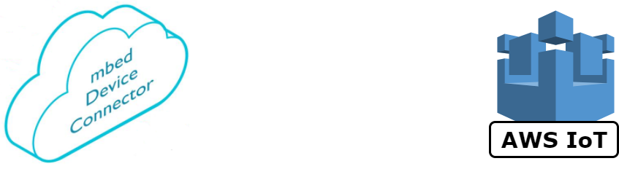
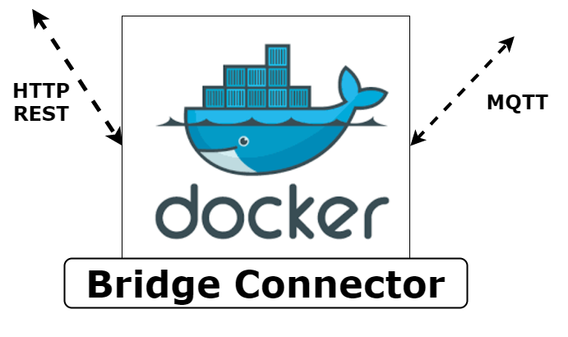
System Overview
Step 3:
Route the traffic between MDC and AWS IoT using the Bridge Connector.
Notes:
So we have this two Device Management Services from each of the platforms.
We can use the Bridge Connector to route the data traffic between them.
The Bridge Connector is a container application that what it basically does is:
For each device registered in MDC it registers a device in AWS IoT.
The application is listening both platforms, and when there is a new incoming messages it automatically sends them to the other platform.

Slide 12
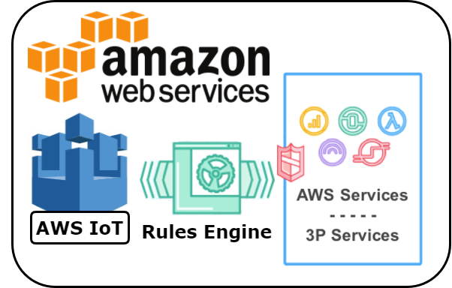
System Overview
Step 4:
Using the AWS Rule Engine to trigger Actions and AWS Services.
Notes:
The Final step is to connect the data traffic in AWS IoT with the rest of AWS Services using the Rule Engine we mentioned previously. In the MQTT protocol, Devices can subscribe and publish to Topics. So we can filter messages incoming to AWS IoT by Topic and add certain conditions. To this filter we can then add an action, which triggers an AWS Service and passes the message to it. We will see an example of this in later on.

Slide 13
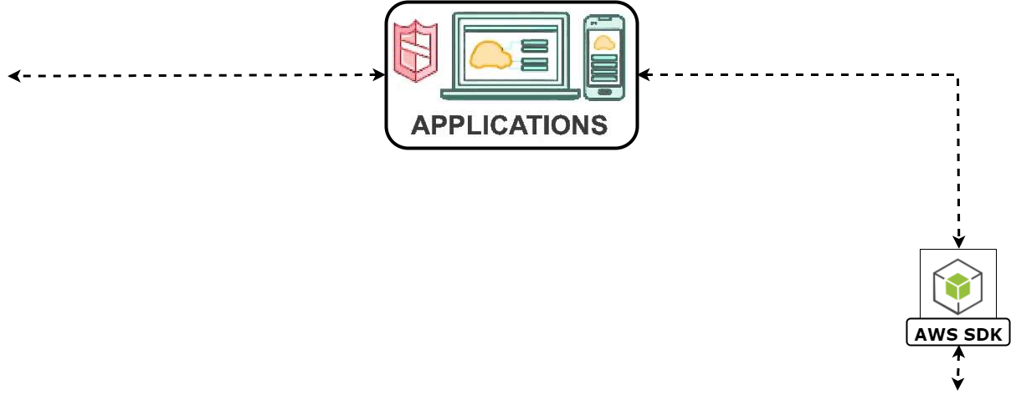
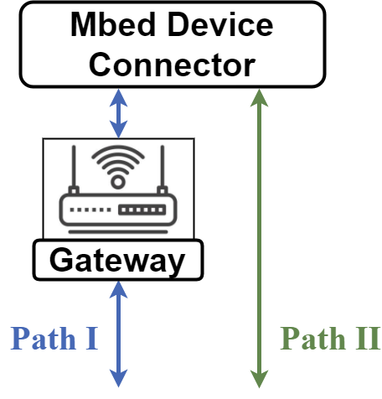
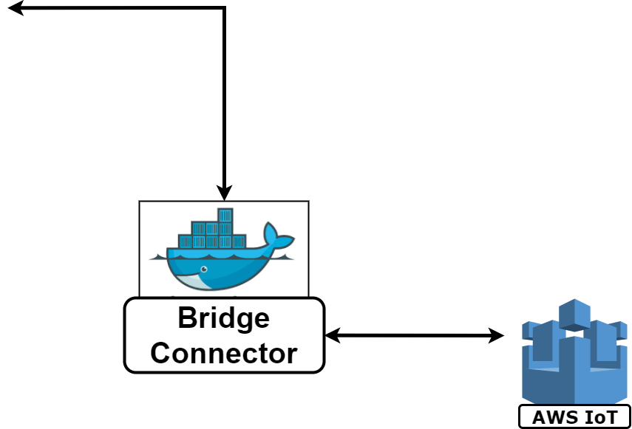
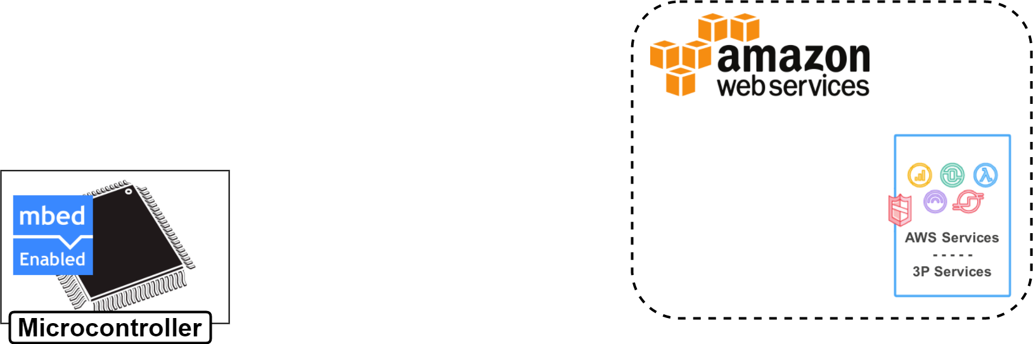


System Overview
Notes:
So lets put this last four steps together:
We first connect to Mbed Device Connector either directly or via a Gateway.
We Bridge the data traffic between the two Device Management Platforms
And Finally use the Rule Engine to trigger other AWS Services.
For the Sake of completion, we can define the points at which Mobile and Web Applications can interact with the system.
Extracting Device Information from Mbed Device Connector is as simple as an HTTP request, like in a web browser. For example you could just put the MDC web address slash the name of your device slash get slash temperature, and it would return the value.
But for more advanced applications, the AWS SDK can be used to access numerous Services that can offer greater functionalities.
Before moving on into the evaluation I would like to define one last thing in this system. The direct connection from an Mbed Enabled Device to AWS IoT is not currently supported by neither of the Platforms, but it has been currently done in an open-source example code. Nevertheless, this project is specific to one device, it was found to be SHIT when testing and it is using a legacy version of the Mbed OS so it can’t really be defined as part of the system.

Slide 14
System Evaluation

Slide 15
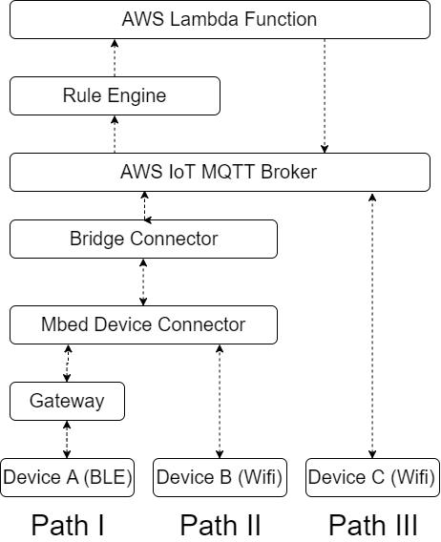
Experiment 1: Ping Time
Notes:
The first experiment was to calculate the ping time for each path of the system.
The Diagram shows the same system we saw previously, and what we would like to do is measure the time it takes for a message to travel from the device, to an AWS Service and Back. The AWS Service used is a Lamda function which bounces messages back.
It is essentially a function that gets triggered by the rule engine when the message comes into the MQTT Broker and automatically sends a message back.
So here are the results.
When testing, it was found that when we configured the device to send a message as soon as the response arrived, the system would take much longer than if we wait for around 10 seconds before sending the next message.
This are the two System States defined there as system under stress and delayed state. I will talk more about this later.
Each Path was tested in stress and delayed by sending 50 consecutive messages and averaging the result.
It is no surprise that the direct connection to AWS IoT would perform better since the other two routes have more components but we didn’t expect the difference to be 30 times worse. The difference between path 1 and path 2 was less significant showing that the Gateway was not adding that much time in the system.

Slide 16
Experiment 2: Maximum Data Packet Size
System Path | Protocol | Maximum Packet Size (bytes)
Path I | BLE | 26
Path II | CoAP | 1000
Path III | MQTT | 300
Results
System Path | Ping Time per Byte (ms/byte)
Path I (BLE) | 64.28
Path II (Wifi) | 4.06
Device III (Direct) | 1.26
Notes:
For each of the paths, there is a maximum data packet that can be sent. So in this second experiment we calculate the ping time when we send the maximum data packet for each device. The results show that for larger messages, the third path was 4 times greater. As expected Path I performed quite badly in this test, since it can only send 26 bytes at a time.

Slide 17
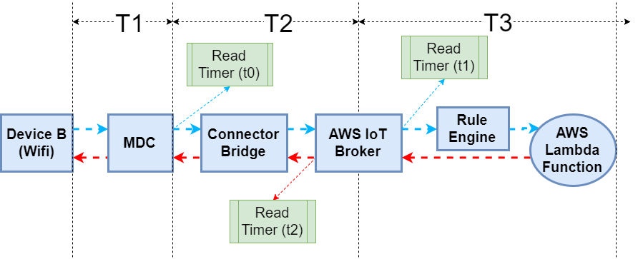
Experiment 3: Path II Component Time
Notes:
In this final experiment I wanted to investigate a bit further the behaviour we say in experiment 1 of stress and delayed system states.
I setup this third experiment to try to see the time the message was spending at each component of the system.
Using a python script to listen to the MDC and AWS IoT, I measured a timer at the points shown, and from this measurements and the ping time determined the following results.
As we can see in both states, most of the time is spent between being sent and coming out of the MDC, and the Bridge connector performs takes much longer when in stress.
I couldn’t really investigate this matter any further to find what was happening, but it could well be that there are rules in place in the MDC Server that limit the data traffic to avoid the overload of the server.

Slide 18
Smart Home Application

Slide 19
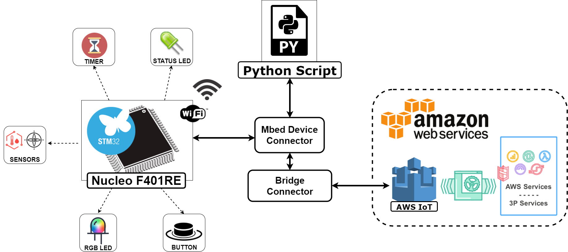
Smart Home Application
Notes:
This example application shows an example implementation of the system, because even though the experiments themselves where an implementation of the system, it didn’t show all of its capabilities. So five different resources where created as shown there: The sensor shield measured environmental measurements (temperature humidity, pressure) and IMU measurements (acceleration, gyroscope and magnetometer). The way resources are created in the Mbed Client is using the M2M Protocol. The five resources grown in complexity as well as cover all of the possible configurations. A python script was created to show how to extract data from MDC and the Rule Engine and other AWS Services where also configured to show some Cloud action capabilities as I will show in the next slide.

Slide 20
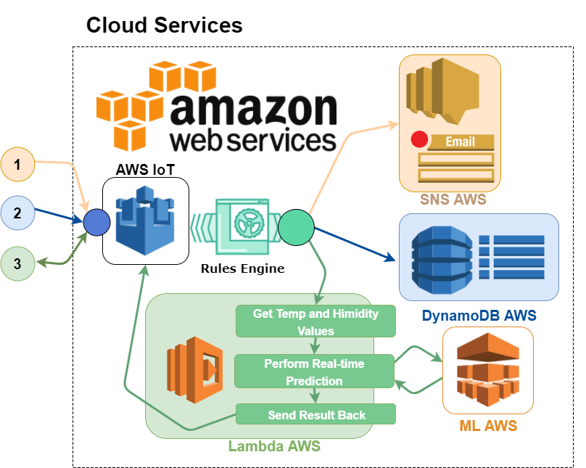
Smart Home Cloud Actions
Motion detected
Store Room Temperature
Request Prediction
Notes:
This are the three example Cloud actions that where implemented.
1. Motion Detected.
The device uses the accelerometer to detect when it has been shaken, and the rule engine is configured to send an email alert.
2. Store Room Temperature.
The temperature is sent periodically to the cloud and stored in a database using DynamoDB Service.
3. Requesting a Prediction:
An ML model was trained using ML AWS to predict the comfort level in the room based on the current temperature and humidity in the room. The way the prediction is retrieved is by using an Lambda function that gets the current condition, triggers the ML Service and returns back the result to the device.

Slide 21
Conclusion
Achievements
General system architecture
Implementation and evaluation
Smart home application.
System Advantages
Resource standardisation
Cloud agnostic
Number of supported devices
Notes:
Identified Weaknesses

Slide 22
Future Work
Explore other connectivity methods:
Cellular
Ethernet
Mesh Networks
Improve Connector Bridge performance
Serverless Connector Bridge.

Slide 23
Thank you
Any Questions?
Acknowledgements:
Dr. Hadi Heidari
Dr. Ashkan Tousi
Prof. Sandy Cochran

