Slide 1
SOFT COMPUTING CONCEPTS (ITPC-302)
FUZZY MATRICES
by
Harsh Gupta

Slide 2

CONTENTS
Introduction to Fuzzy logics, Fuzzy relations and compositions and Fuzzy matrices
Types of Fuzzy Matrices
Equality of Fuzzy Matrices
Operations on Fuzzy Matrices
Sum
Max Product
Scalar Product
Union
Intersection
Complement

Slide 3

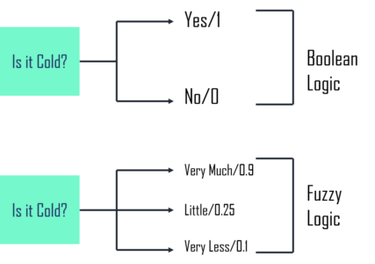
WHAT IS A FUZZY LOGIC?
The term fuzzy logic was introduced by Lotfi Zadeh in 1965.
The term fuzzy refers to things that are not clear that is vague.
Fuzzy logics provide a very valuable flexibility of reasoning.
In Boolean system there are absolute true values or absolute false values. Whereas in fuzzy logics there are intermediate values which are partially true and partially false.

Slide 4
WHAT IS A FUZZY RELATION?
To understand a Fuzzy relation we first need to understand what a Product set and Crisp set.
Product Set:- Let A and B be two non-empty sets, the product set or Cartesian Product A*B is defined as:-
A*B={(a,b)|a belongs to A, b belongs to B}
Crisp Relation:- A relation among crisp sets A1,A2,….. ,An is a subset of the Cartesian product. It is denoted by R.
Using the membership function defines the crisp relation R :

Slide 5
FUZZY RELATION
A fuzzy relation is a fuzzy set defined on the Cartesian product of crisp sets A₁, A₂, ..., A_{n} where tuples (x₁, x₂, ..., x_{n}) may have varying degrees of membership within the relation.
The membership grade indicates the strength of the relation present between the elements of the tuple.
Representation Methods of a Fuzzy Relation:-
Bipartigraph
Fuzzy Matrices
Digraph

Slide 6
FUZZY MATRICES
Fuzzy matrices are one of the representation methods of Fuzzy Relations.
A fuzzy matrix is a matrix that has its parts from [0,1].
Consider a matrix A=[aij]mxn where aij Є[0,1],1≤i≤m and 1≤j≤n. Then A is a fuzzy matrix.
Fuzzy matrices were introduced for the first time by Thomason.

Slide 7
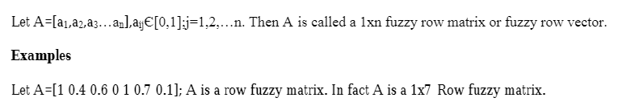
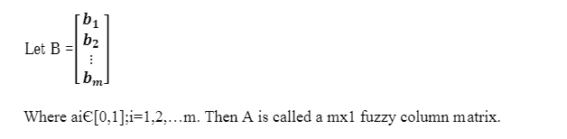
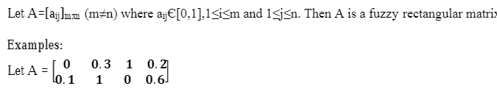
TYPES OF FUZZY MATRICES
Fuzzy Row Matrix:-
2. Fuzzy Column Matrix:-
3. Fuzzy Rectangle matrix:-

Slide 8
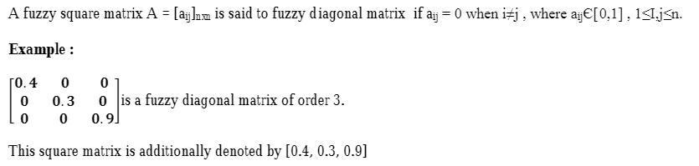
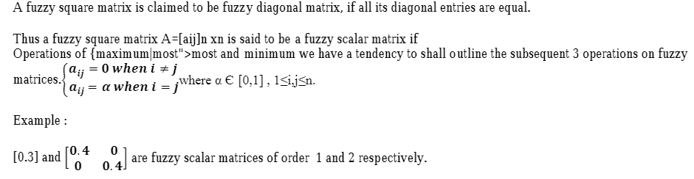
TYPES OF FUZZY MATRIX (continued)
4. Fuzzy Diagonal Matrix:-
5. Fuzzy Scalar Matrix:-

Slide 9
EQUIVALENCE OF TWO FUZZY MATRICES
Two fuzzy matrices of the same type are said to be equal iff there elements in the corresponding positions are equal.
A= [0.1, 0.2], B=[0.2, 0.1], C=[0.1, 0.2]
Here fuzzy matrices A and C are equal whereas A and B are not equal.

Slide 10
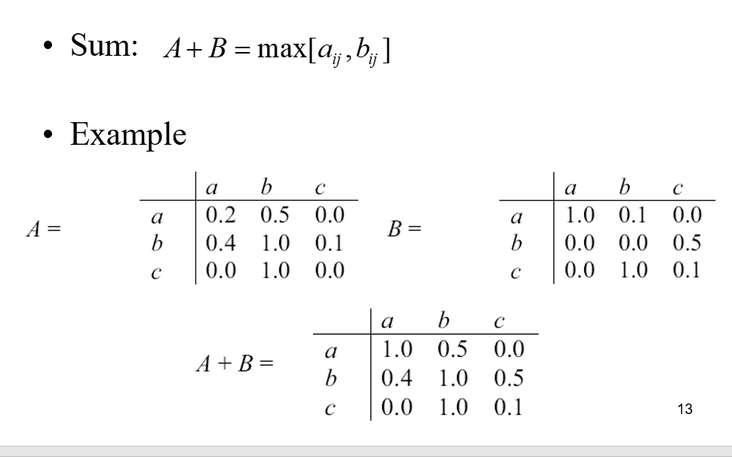
OPERATIONS ON FUZZY MATRICES
Sum:-

Slide 11
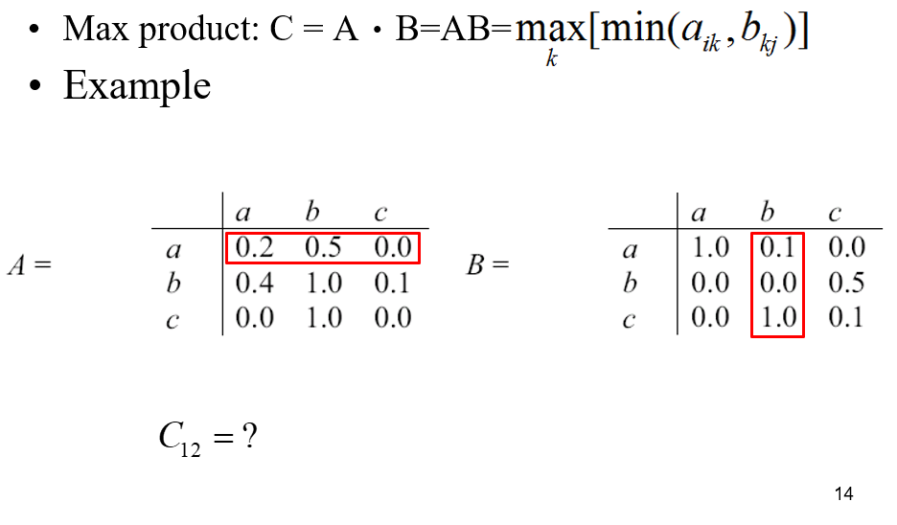
OPERATIONS ON FUZZY MATRICES
Max-Product:-

Slide 12
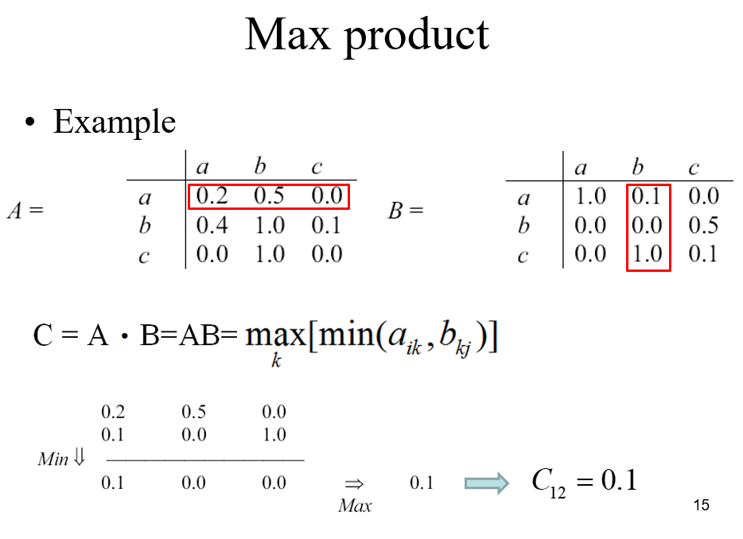
OPERATIONS ON FUZZY MATRICES
Max-product (continued) :-

Slide 13
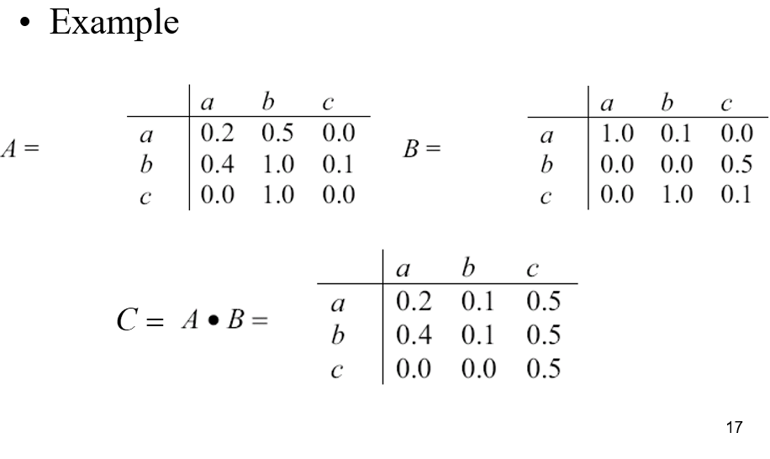
OPERATIONS ON FUZZY MATRICES
Max-product (continued):-

Slide 14
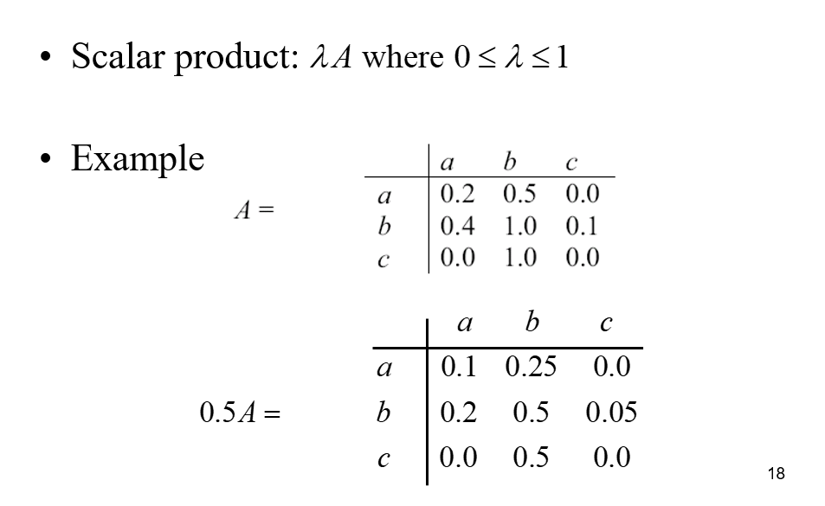
OPERATIONS ON FUZZY MATRICES
Scalar-Product:-

Slide 15
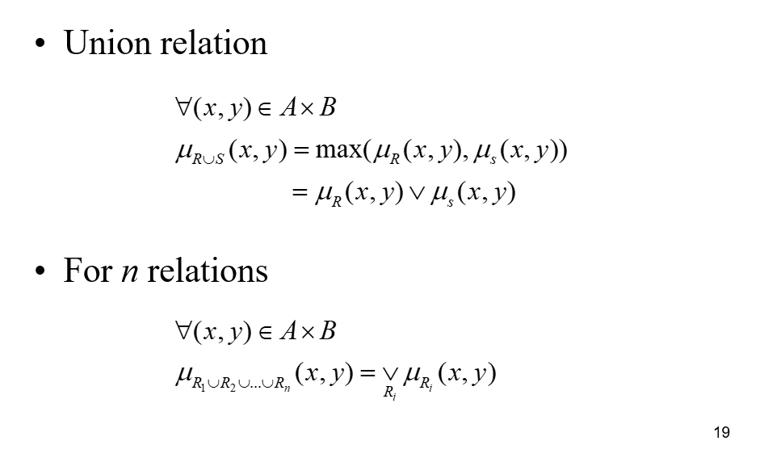
OPERATIONS ON FUZZY MATRICES
Union:-

Slide 16
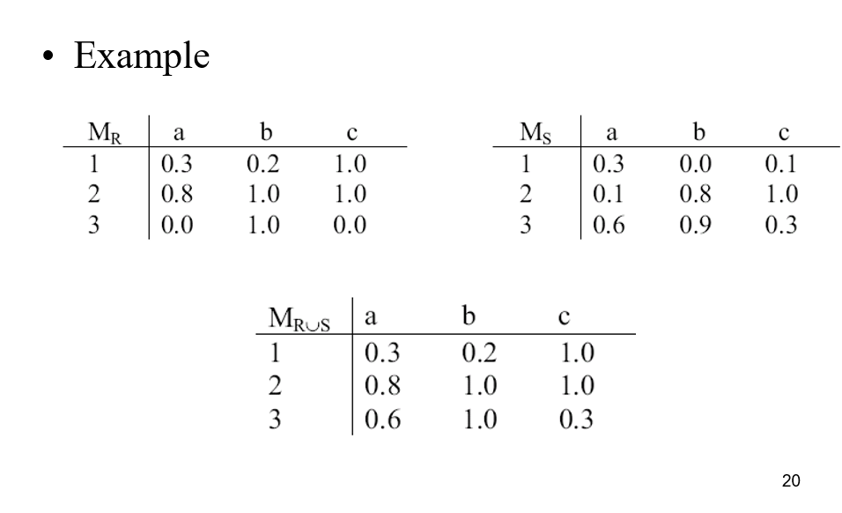
OPERATIONS ON FUZZY MATRICES
Union (continued):-

Slide 17
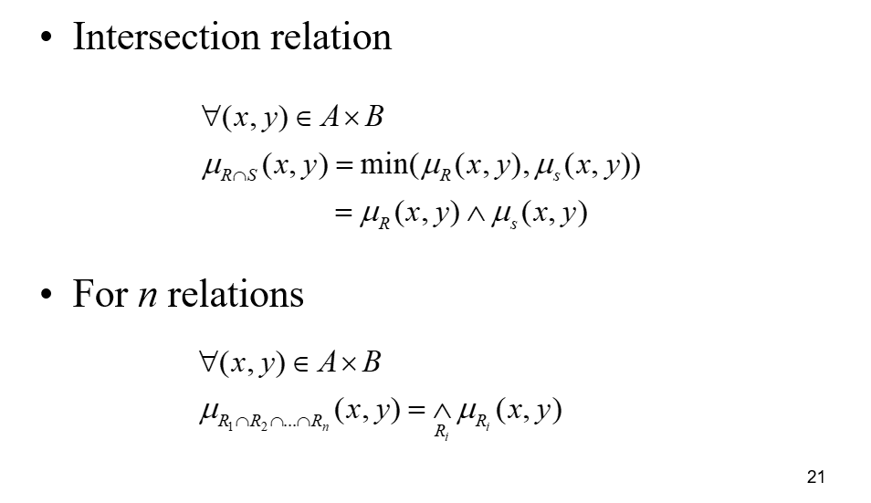
OPERATIONS ON FUZZY MATRICES
Intersection:-

Slide 18
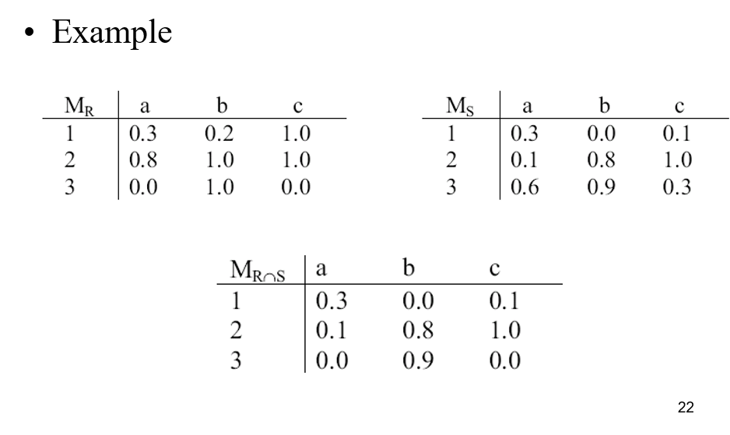
OPERATIONS ON FUZZY MATRICES
Intersection (continued):-

Slide 19
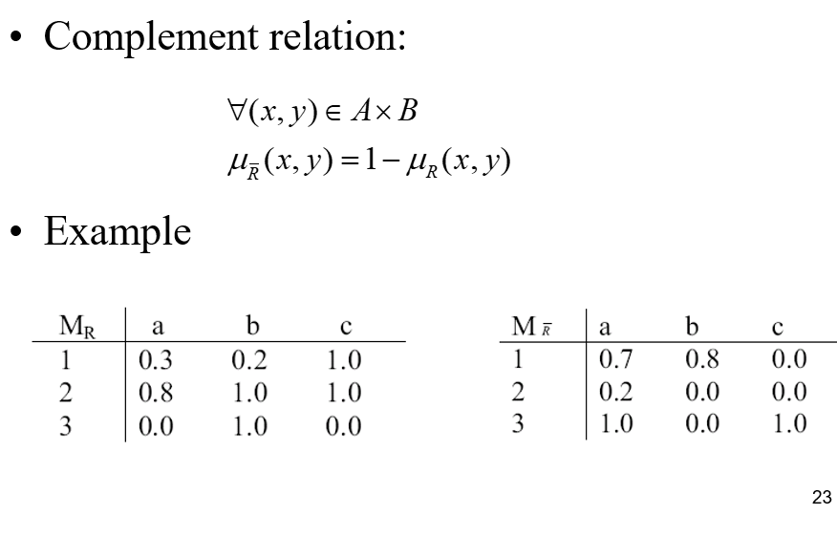
OPERATIONS ON FUZZY MATRICES
Complement:-

Slide 20
THANKS FOR YOUR ATTENTION!

