Slide 1
An Improved Data Stream Summary:
The Count-Min Sketch and its Applications
Graham Cormode, S. Muthukrishnan
2003

Slide 2
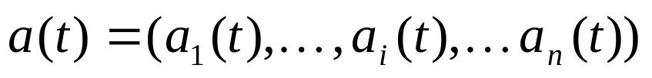
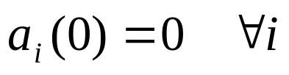


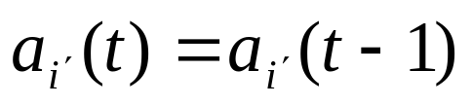
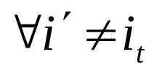
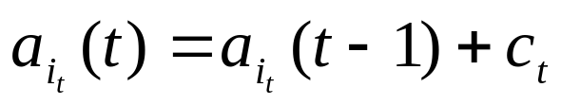
Data Stream Model
⬇ We consider the vector
initially
⬇ The
th
update

Slide 3



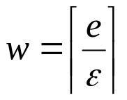
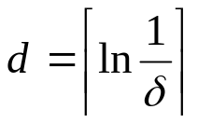


Count-Min Sketch
⬇ A Count-Min (CM) Sketch with parameters is represented by
a two-dimensional array counts with width and depth .
Given parameters , set and .
Each entry of the array is initially zero.
hash functions are chosen uniformly at random from a pairwise
independent family

Slide 4



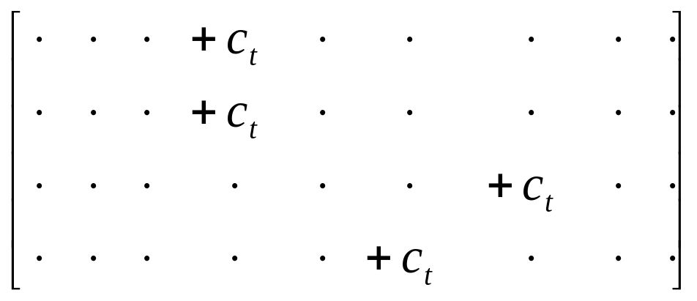



⬇ Update procedure :
When arrives, set

Slide 5
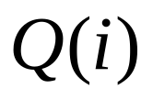

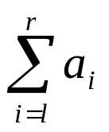

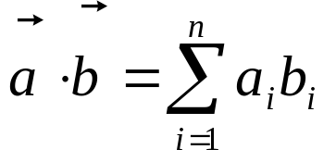
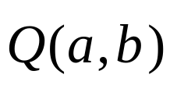
Approximate Query Answering Using CM Sketches
approx.
• point query
approx.
• range queries
approx.
• inner product queries

Slide 6

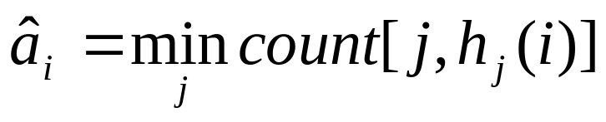
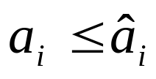
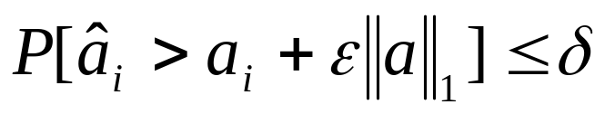
Point Query
• Non-negative case ( )
Theorem 1

Slide 7

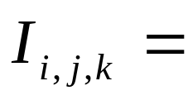
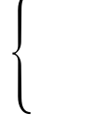
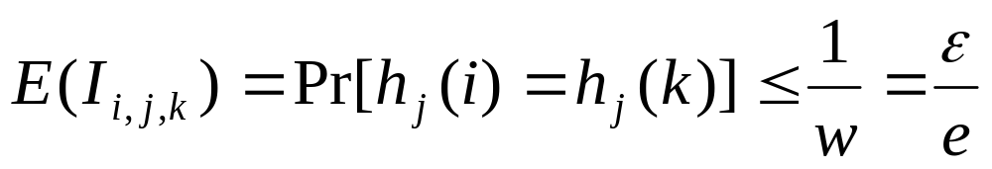
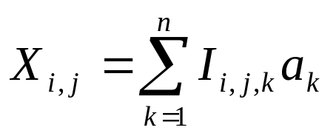

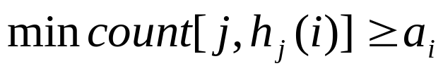
PROOF : We introduce indicator variables
1 if
0 otherwise
Define the variable
By construction,

Slide 8
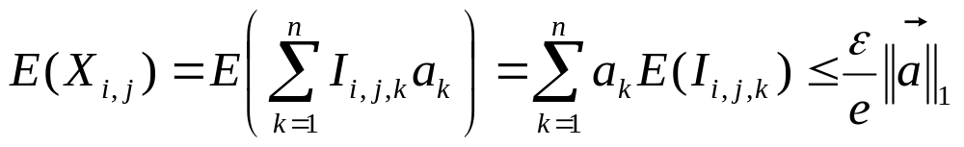
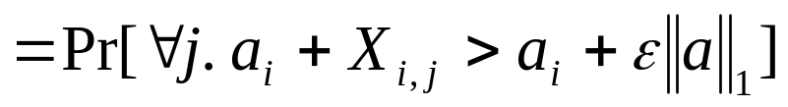
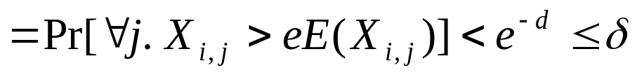
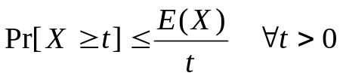
For the other direction, observe that
Markov inequality
■

Slide 9
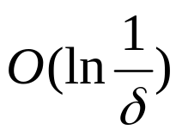
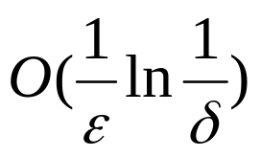

Time to produce the estimate
Space used
Time for updates
Remark : The constant is used here to minimize the space used.

Slide 10
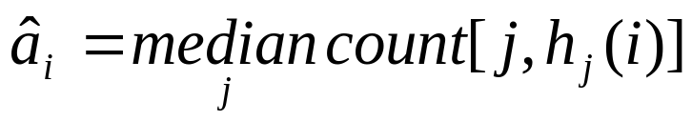
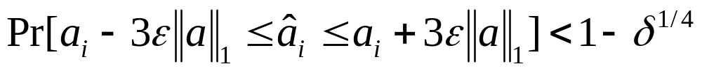
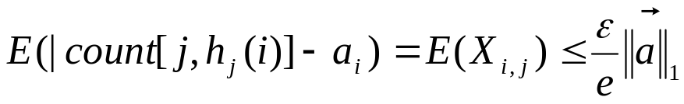
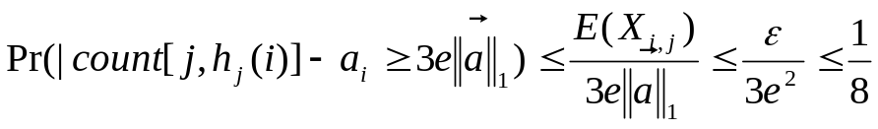

• General case
Theorem 2
PROOF :
Chernoff bounds
■

Slide 11
Time to produce the estimate
Space used
Time for updates

Slide 12
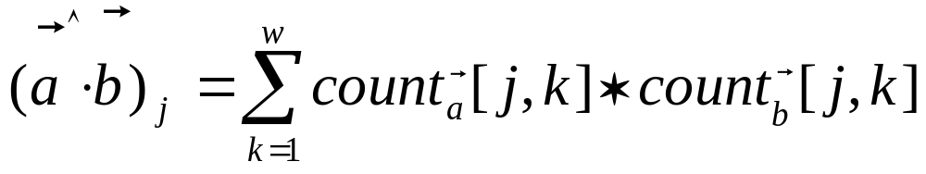
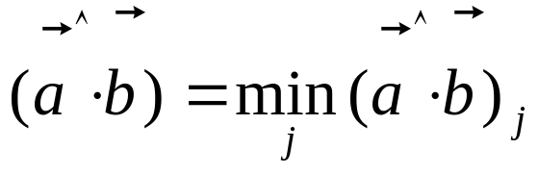
Inner Product Query
Set

Slide 13
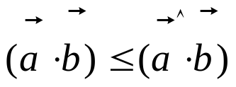
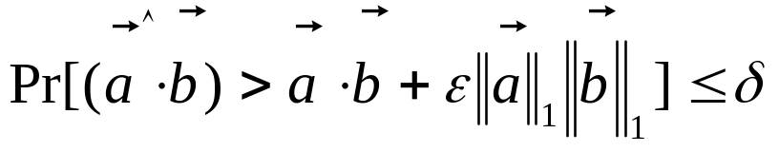
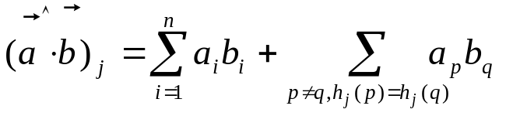
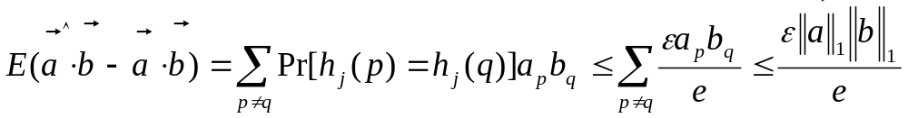
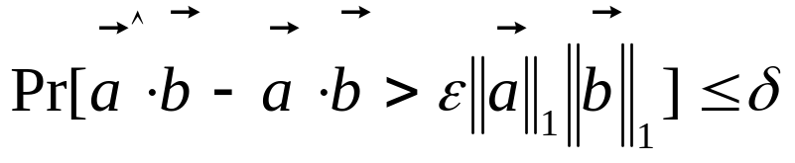
Theorem 3
PROOF:
Markov inequality
■

Slide 14
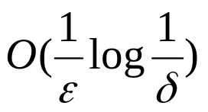
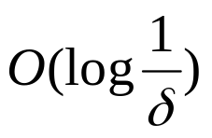
Time to produce the estimate
Space used
Time for updates

Slide 15






The application of inner-product computation to Join size estimation
(where the vectors generated have non-negative entries)
Join size of 2 database relations on a particular attribute :
= the number of items in the cartesian product of the 2 relations which
agree the value of that attribute
: the nr of tuples which have value

Slide 16
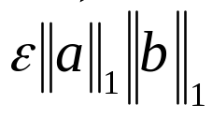

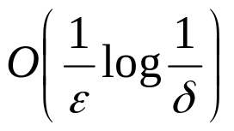
Collorary 1 The Join size of two relations on a particular attribute can
be approximated up to with probability by
keeping space .

Slide 17





Range Query
• Dyadic range:
for parameters
(at most)
• range query
dyadic range queries
single point query
For each set of dyadic ranges of length
a sketch is kept
CM Sketches

Slide 18


Compute the dyadic ranges
(at most ) which
canonically cover the range
Pose that many point queries
to the sketches
Sum of queries

Slide 19

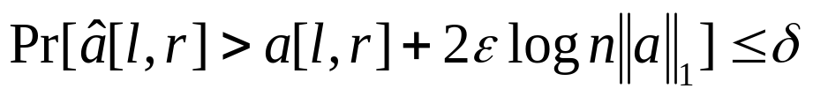

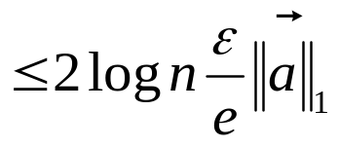
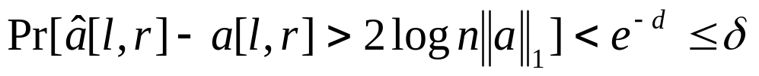
Theorem 4
Proof :
Theorem 1
E(Σ error for each estimator)
E(error for each estimator)
■

Slide 20
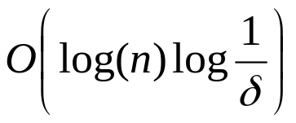
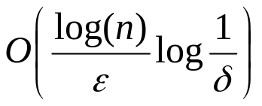

Time to produce the estimate
Space used
Time for updates
Remark : the guarantee will be more useful when stated without terms of
In the approximation bound.

Slide 21

Applications of Count-Min Sketches
Quantiles
Heavy Hitters
•
•

Slide 22

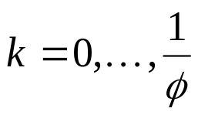



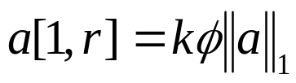
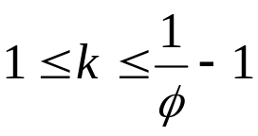
Quantiles in the Turnstile Model
•
Quantiles
Items with rank
(approx. rank and rank )
• Do binary searches for ranges whose range sum

Slide 23

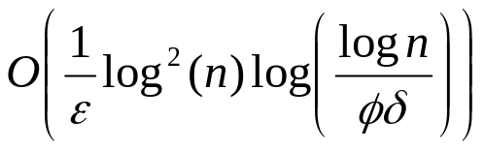


Theorem 5 approximate quantiles can be found with probability
at least by keeping a data structure with space
The time for insert or delete operation is , and the time
to find each quantile on demand is .

Slide 24





Heavy Hitters (cash register case)
•
Heavy Hitters
Items whose multiplicity exceeds the fraction
(approx. )
•
added
to a heap

Slide 25





Theorem 6 The heavy hitters can be found from an inserts only sequence of
length by using CM sketches with space , and time
per item. Every item which occurs with count more than
time is output, and with probability , no item whose count is less than
is output.

Slide 26
Sketching techniques
tug-of-war Alon, Matias and Szegedy (1996)
Count sketch Alon, Matias and Szegedy (2002)
⬇ Random subset sums Gilbert, Kotidis, Muthukrishnan and Strauss (2002)
⬇ Count-min sketch Cormode and Muthukrishnan (2003)

Slide 27





- Linear projections of the vector with appropriately chosen random vectors
Computation :
⬇
Sketch
Array
⬇
pairwise independent hash functions
⬇
hash function whose range and randomness varies
⬇
The th entry of the sketch :

Slide 28






tug-of-war
is with 4-wise independence
Count sketch
is with 2-wise independence
⬇ Random subset sums
is
⬇ Count-min sketch

Slide 29






Method | Query | Space | Update Time | Query Time | Randomness Needed
Tug-of-war | Inner-product |  |  |  | 4-wise
Tug-of-war | Point Range |  |  |  | 4-wise 4-wise
Rundom subset-sums | Range |  |  |  | Pairwise
Count sketches | Point |  | 1 | 1 | Pairwise
Count-Min sketches | Point Inner-product Range |  |  |  | Pairwise Pairwise Pairwise

