Slide 1

CODE-ALPHA
IILM UNIVERSITY
FRONT-END DEVELOPMENT
INTERNSHIP
Greater Noida, Uttar Pradesh
Internship Report Presentation
HTML
CSS
JS
ASHUTOSH SAHOO
B.Tech CSE • Batch 2025–29
School of Computer Science and Engineering
IILM University, Greater Noida, U.P.
Roll No.: [25SCS1003004011]
2026–27

Slide 2
Candidate & Internship Overview
Candidate Details
Internship Profile
Student Name: ASHUTOSH SAHOO
Roll Number: [25SCS1003004011]
Degree: B.Tech (Computer Science & Engineering)
Academic Batch: 2026–2027
University: IILM University, Greater Noida, U.P.
Organization: CodeAlpha
Program: Frontend Development Internship
Core Technologies: HTML, CSS, JavaScript
Completed Projects: 2
Internship Period: 10 August 2026 – 10 September 2026
Task-based practical learning
2 completed projects
GitHub + GitHub Pages
02

Slide 3
About CodeAlpha
Internship context and practical learning environment
Internship Context
Work Focus
Delivery Approach
CodeAlpha provided a mini, task-based frontend development internship.
The work focused on applying core web technologies through practical projects.
The internship emphasized building complete browser-based interfaces rather than isolated exercises.
Frontend interface development
Responsive layouts
JavaScript-based interaction
Basic project organization
Repository and static deployment workflow
Build the interface
Style and refine the layout
Add interaction with JavaScript
Test the result
Publish through GitHub Pages
03

Slide 4
Internship Context & Practical Challenge
The central learning challenge was to combine HTML, CSS and JavaScript into usable, responsive web interfaces.
HTML / CSS / JS
Practical
implementation
Responsive &
interactive UI
GitHub
repository
Live
GitHub Pages
Project 1
Project 2
First-Calculator established core structure, styling and JavaScript interaction.
Lumina-Image-gallery extended the work into filtering, navigation and richer visual interaction.
04

Slide 5
Internship Objectives
01
HTML Structure
02
CSS & Responsiveness
03
JavaScript Interaction
Build clear browser-based page structures.
Create clean layouts that adapt across screen sizes.
Implement functional user interactions.
04
Interactive UI
05
GitHub Workflow
06
Static Deployment
Build calculator and gallery interfaces.
Organize and publish project repositories.
Deploy completed projects using GitHub Pages.
05

Slide 6
Technologies & Tools
A deliberately simple stack focused on core frontend fundamentals.
HTML
CSS
JavaScript
Page structure and content
Styling, layout and responsiveness
Interaction and DOM-driven behaviour
Development & Hosting
GitHub
GitHub Pages
Public repository management and README documentation.
Static deployment for publicly accessible project websites.
06

Slide 7
Frontend System Architecture
Both projects follow a lightweight browser-based architecture with no backend or database layer.
User Input
HTML Structure
CSS Styling
& Responsive Layout
JavaScript
Interaction
Browser UI
GitHub Repository
+ GitHub Pages
Project-specific behaviour
Calculator logic
Gallery filtering
Image navigation
Responsive UI
07

Slide 8
Project 1 — First-Calculator
A responsive and minimalist calculator built with HTML, CSS and JavaScript.
FIRST-CALCULATOR
What was implemented
Responsive calculator interface
HTML structure and CSS styling
JavaScript interaction and calculation behaviour
Basic responsive frontend layout
12 × 8 = 96
7
8
9
+
4
5
6
−
Project Delivery
Public GitHub repository • README.md • GitHub Pages deployment
The main HTML file was renamed to index.html for GitHub Pages.
1
2
3
=
GitHub: ashu2sh-hub/First-Calculator
Live: ashu2sh-hub.github.io/First-Calculator/
08

Slide 9
Project 2 — Lumina-Image-gallery
A responsive minimalist image gallery showcasing curated photography.
Key Features
Cars, Flowers and Landscapes categories
Category filtering and navigation
Enlarged / lightbox-style image viewing
Previous / next image navigation
Hover effects, smooth transitions and responsive behaviour
CARS
FLOWERS
LANDSCAPES
Project Delivery
Public GitHub repository • index.html • style.css • script.js • README.md
Published as a live static website using GitHub Pages.
Unsplash photography • category-based gallery
GitHub: ashu2sh-hub/Lumina-Image-gallery
Live: ashu2sh-hub.github.io/Lumina-Image-gallery/
09

Slide 10
Development Methodology & Progression
A practical workflow was repeated across both projects, with the second project introducing richer UI behaviour.
01
02
03
04
05
06
Understand task
Build HTML
Style with CSS
Add JavaScript
Test & refine
GitHub + Pages
DEVELOPMENT PROGRESSION
Project 1 • First-Calculator
Project 2 • Lumina-Image-gallery
Core functionality → HTML/CSS structure → JavaScript interaction
Responsive visual presentation → filtering → navigation → image viewing
10

Slide 11
Skills Demonstrated & Learning Outcomes
HTML5
CSS3
Responsive Design
JavaScript
Page structure
Layout & styling
Screen-size adaptation
UI interaction
DOM Behaviour
Filtering & Navigation
GitHub
GitHub Pages
Dynamic interface actions
Gallery interaction
Repository management
Static deployment
Outcome
The internship strengthened the ability to turn basic frontend concepts into small, complete and publicly accessible web projects.
11

Slide 12
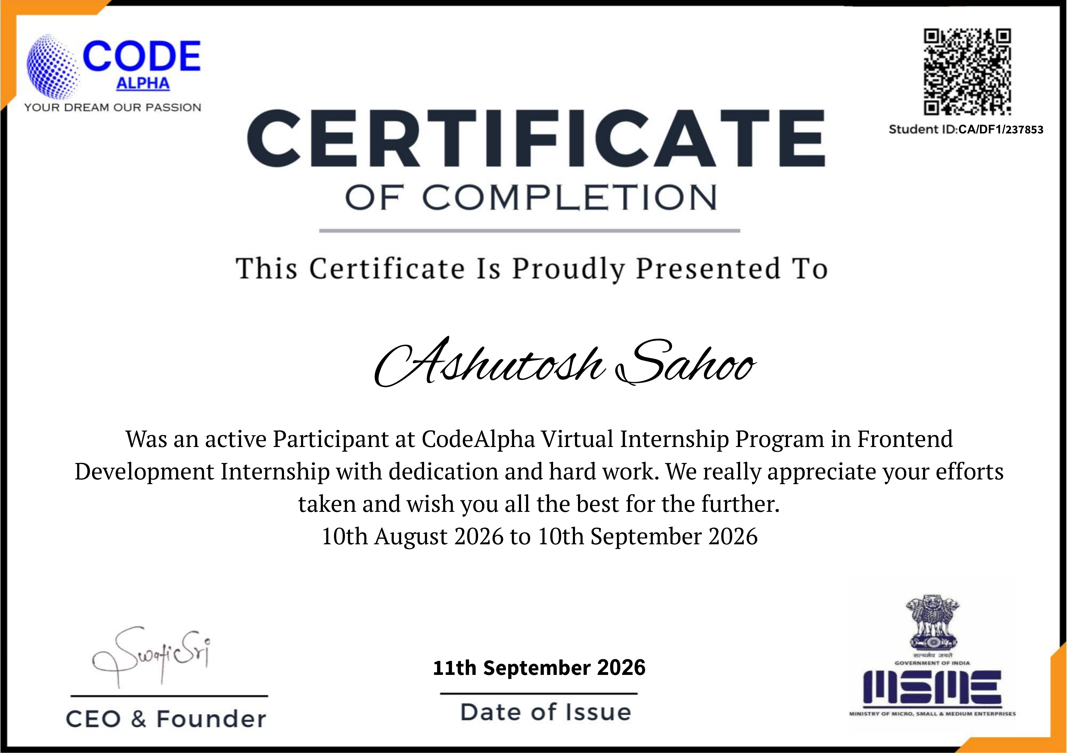
Certification & Internship Verification
Official CodeAlpha Certificate of Completion
Certificate Details
Student: Ashutosh Sahoo
Student ID: CA/DF1/237853
Program: CodeAlpha Virtual Internship Program
Specialization: Frontend Development Internship
Period: 10 August 2026 – 10 September 2026
Issue Date: 11 September 2026
Project Verification
2 public GitHub repositories + live GitHub Pages websites
12

Slide 13
THANK YOU
CodeAlpha Frontend Development Internship
ASHUTOSH SAHOO
B.Tech CSE • IILM University, Greater Noida, U.P.
First-Calculator
Lumina-Image-gallery
[25SCS1003004011]
13

