Slide 1
Computer Networks
Data Link Layer
Mayank Pandey

Slide 2

Link Layer: Introduction
Terminology:
hosts and routers are nodes
communication channels that connect adjacent nodes along communication path are links
wired links
wireless links
LANs
layer-2 packet is a frame, encapsulates datagram
data-link layer has responsibility of
transferring datagram from one node
to physically adjacent node over a link

Slide 3
Link layer: context
datagram transferred by different link protocols over different links:
e.g., Ethernet on first link, frame relay on intermediate links, 802.11 on last link
each link protocol provides different services
e.g., may or may not provide rdt over link
transportation analogy
trip from Princeton to Lausanne
limo: Princeton to JFK
plane: JFK to Geneva
train: Geneva to Lausanne
tourist = datagram
transport segment = communication link
transportation mode = link layer protocol
travel agent = routing algorithm

Slide 4
Link Layer Services
framing, link access:
encapsulate datagram into frame, adding header, trailer
channel access if shared medium
“MAC” addresses used in frame headers to identify source, dest
different from IP address!
reliable delivery between adjacent nodes
we learned how to do this already !
seldom used on low bit-error link (fiber, some twisted pair)
wireless links: high error rates
Q: why both link-level and end-end reliability?

Slide 5
Link Layer Services (more)
flow control:
pacing between adjacent sending and receiving nodes
error detection:
errors caused by signal attenuation, noise.
receiver detects presence of errors:
signals sender for retransmission or drops frame
error correction:
receiver identifies and corrects bit error(s) without resorting to retransmission
half-duplex and full-duplex
with half duplex, nodes at both ends of link can transmit, but not at same time

Slide 6
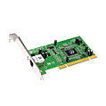
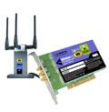
Where is the link layer implemented?
in each and every host
link layer implemented in “adaptor” (aka network interface card NIC)
Ethernet card, PCMCI card, 802.11 card
implements link, physical layer
attaches into host’s system buses
combination of hardware, software, firmware
host schematic
application
transport
network
link
cpu
memory
link
physical
host
bus
(e.g., PCI)
controller
physical
transmission
network adapter
card

Slide 7
Adaptors Communicating
datagram
datagram
controller
controller
sending host
receiving host
datagram
frame
sending side:
encapsulates datagram in frame
adds error checking bits, rdt, flow control, etc.
receiving side
looks for errors, rdt, flow control, etc
extracts datagram, passes to upper layer at receiving side

Slide 8
Link Layer
5.1 Introduction and services
5.2 Error detection and correction
5.3Multiple access protocols
5.4 Link-layer Addressing
5.5 Ethernet
5.6 Link-layer switches
5.7 PPP
5.8 Link virtualization: MPLS
5.9 A day in the life of a web request

Slide 9
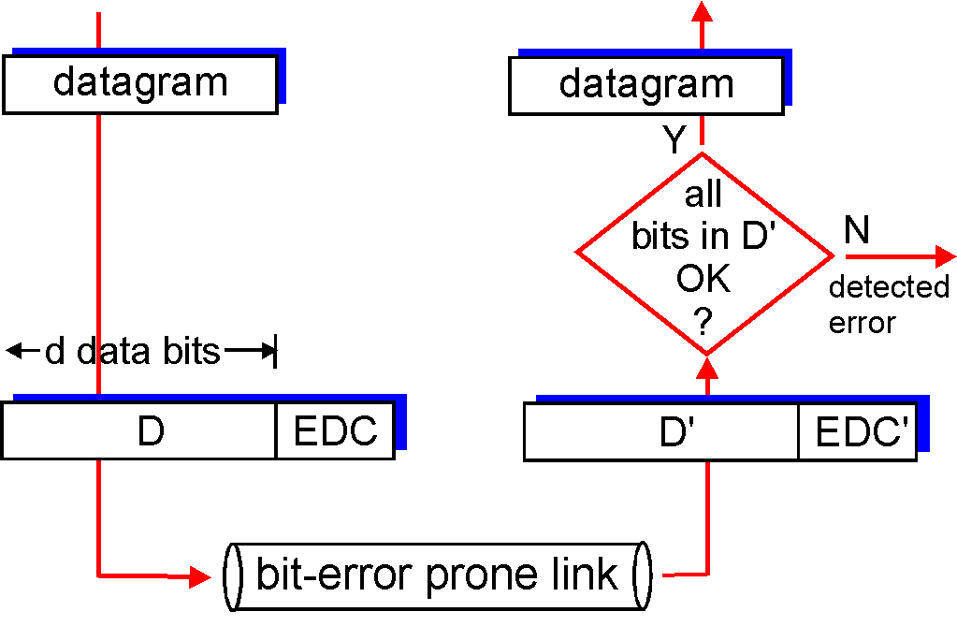
Error Detection
EDC= Error Detection and Correction bits (redundancy)
D = Data protected by error checking, may include header fields
Error detection not 100% reliable!
protocol may miss some errors, but rarely
larger EDC field yields better detection and correction
otherwise

Slide 10
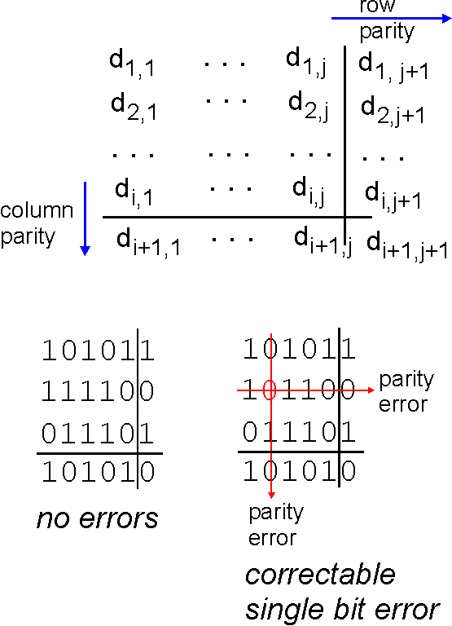
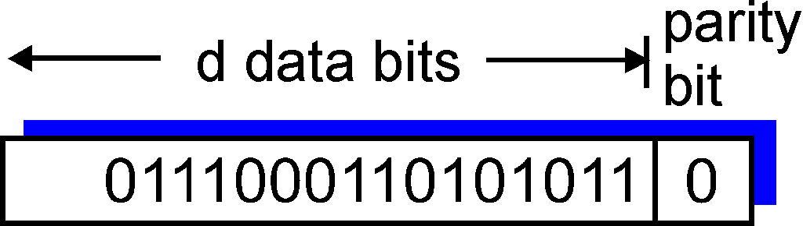
Parity Checking
Single Bit Parity:
Detect single bit errors
Two Dimensional Bit Parity:
Detect and correct single bit errors
0
0

Slide 11
Internet checksum (review)
Goal: detect “errors” (e.g., flipped bits) in transmitted packet (note: used at transport layer only)
Sender:
treat segment contents as sequence of 16-bit integers
checksum: addition (1’s complement sum) of segment contents
sender puts checksum value into UDP checksum field
Receiver:
compute checksum of received segment
check if computed checksum equals checksum field value:
NO - error detected
YES - no error detected. But maybe errors nonetheless?

Slide 12
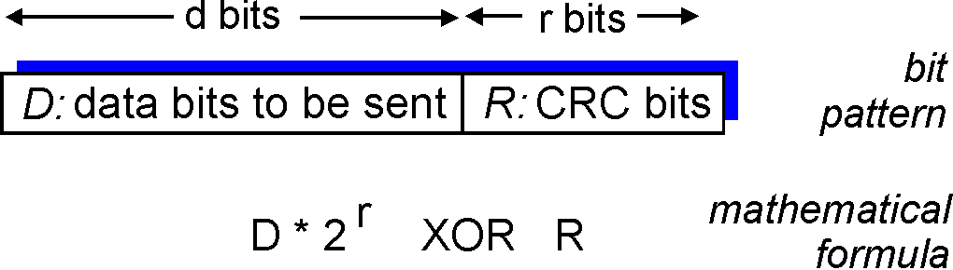
Checksumming: Cyclic Redundancy Check
view data bits, D, as a binary number
choose r+1 bit pattern (generator), G
goal: choose r CRC bits, R, such that
<D,R> exactly divisible by G (modulo 2)
receiver knows G, divides <D,R> by G. If non-zero remainder: error detected!
can detect all burst errors less than r+1 bits
widely used in practice (Ethernet, 802.11 WiFi, ATM)

Slide 13
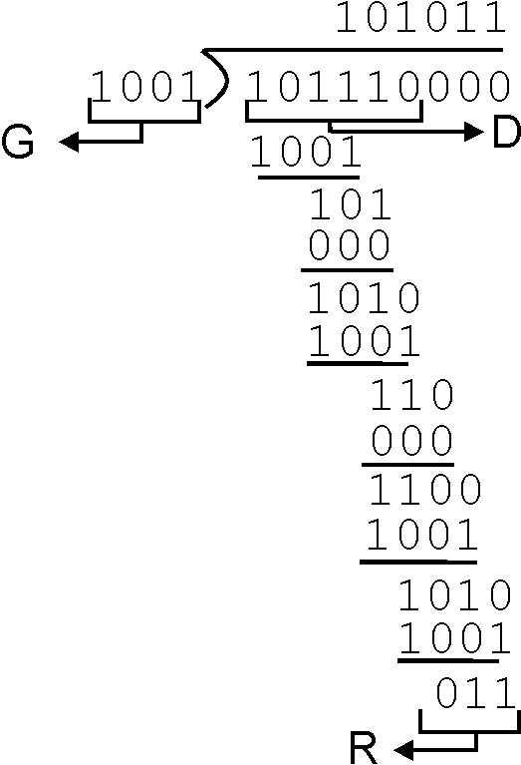
CRC Example
Want:
D.2^{r} XOR R = nG
equivalently:
D.2^{r} = nG XOR R
equivalently:
if we divide D.2^{r} by G, want remainder R
D.2^{r}
G
R = remainder[ ]

Slide 14
Link Layer
5.1 Introduction and services
5.2 Error detection and correction
5.3Multiple access protocols
5.4 Link-layer Addressing
5.5 Ethernet
5.6 Link-layer switches
5.7 PPP
5.8 Link virtualization: MPLS
5.9 A day in the life of a web request

Slide 15
Link Layer
5.1 Introduction and services
5.2 Error detection and correction
5.3Multiple access protocols
5.4 Link-Layer Addressing
5.5 Ethernet
5.6 Link-layer switches
5.7 PPP
5.8 Link virtualization: MPLS
5.9 A day in the life of a web request

Slide 16
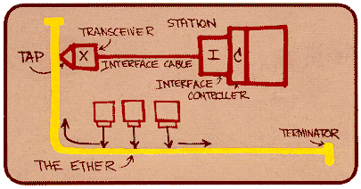
Ethernet
“dominant” wired LAN technology:
cheap $20 for NIC
first widely used LAN technology
simpler, cheaper than token LANs and ATM
kept up with speed race: 10 Mbps – 10 Gbps
Metcalfe’s Ethernet
sketch

Slide 17
Star topology
bus topology popular through mid 90s
all nodes in same collision domain (can collide with each other)
today: star topology prevails
active switch in center
each “spoke” runs a (separate) Ethernet protocol (nodes do not collide with each other)
switch
bus: coaxial cable
star

Slide 18

Ethernet Frame Structure
Sending adapter encapsulates IP datagram (or other network layer protocol packet) in Ethernet frame
Preamble:
7 bytes with pattern 10101010 followed by one byte with pattern 10101011
used to synchronize receiver, sender clock rates

Slide 19
Ethernet Frame Structure (more)
Addresses: 6 bytes
if adapter receives frame with matching destination address, or with broadcast address (e.g. ARP packet), it passes data in frame to network layer protocol
otherwise, adapter discards frame
Type: indicates higher layer protocol (mostly IP but others possible, e.g., Novell IPX, AppleTalk)
CRC: checked at receiver, if error is detected, frame is dropped

Slide 20
Ethernet: Unreliable, connectionless
connectionless: No handshaking between sending and receiving NICs
unreliable: receiving NIC doesn’t send acks or nacks to sending NIC
stream of datagrams passed to network layer can have gaps (missing datagrams)
gaps will be filled if app is using TCP
otherwise, app will see gaps
Ethernet’s MAC protocol: unslotted CSMA/CD

Slide 21
Ethernet CSMA/CD algorithm
1. NIC receives datagram from network layer, creates frame
2. If NIC senses channel idle, starts frame transmission If NIC senses channel busy, waits until channel idle, then transmits
3. If NIC transmits entire frame without detecting another transmission, NIC is done with frame !
4. If NIC detects another transmission while transmitting, aborts and sends jam signal
5. After aborting, NIC enters exponential backoff: after mth collision, NIC chooses K at random from {0,1,2,…,2^{m}-1}. NIC waits K·512 bit times, returns to Step 2

Slide 22
Ethernet’s CSMA/CD (more)
Jam Signal: make sure all other transmitters are aware of collision; 48 bits
Bit time: .1 microsec for 10 Mbps Ethernet ; for K=1023, wait time is about 50 msec
Exponential Backoff:
Goal: adapt retransmission attempts to estimated current load
heavy load: random wait will be longer
first collision: choose K from {0,1}; delay is K· 512 bit transmission times
after second collision: choose K from {0,1,2,3}…
after ten collisions, choose K from {0,1,2,3,4,…,1023}
See/interact with Java
applet on AWL Web site:
highly recommended !

Slide 23
Link Layer
5.1 Introduction and services
5.2 Error detection and correction
5.3 Multiple access protocols
5.4 Link-layer Addressing
5.5 Ethernet
5.6 Link-layer switches, LANs, VLANs
5.7 PPP
5.8 Link virtualization: MPLS
5.9 A day in the life of a web request

Slide 24
VLANs: motivation
What’s wrong with this picture?
What happens if:
CS user moves office to EE, but wants connect to CS switch?
single broadcast domain:
all layer-2 broadcast traffic (ARP, DHCP) crosses entire LAN (security/privacy, efficiency issues)
each lowest level switch has only few ports in use
Computer
Science
Computer
Engineering
Electrical
Engineering

Slide 25

VLANs
Port-based VLAN: switch ports grouped (by switch management software) so that single physical switch ……
Virtual Local
Area Network
1
7
9
15
2
8
10
16
…
…
Switch(es) supporting VLAN capabilities can be configured to define multiple virtual LANS over single physical LAN infrastructure.
Electrical Engineering
(VLAN ports 1-8)
Computer Science
(VLAN ports 9-15)
… operates as multiple virtual switches
1
7
9
15
2
8
10
16
…
…
Electrical Engineering
(VLAN ports 1-8)
Computer Science
(VLAN ports 9-16)

Slide 26
Port-based VLAN
router
traffic isolation: frames to/from ports 1-8 can only reach ports 1-8
can also define VLAN based on MAC addresses of endpoints, rather than switch port
1
7
9
15
2
8
10
16
dynamic membership: ports can be dynamically assigned among VLANs
…
…
Electrical Engineering
(VLAN ports 1-8)
Computer Science
(VLAN ports 9-15)
forwarding between VLANS: done via routing (just as with separate switches)
in practice vendors sell combined switches plus routers

Slide 27
VLANS spanning multiple switches
1
7
9
15
1
3
5
7
2
8
10
16
2
4
6
8
…
…
Electrical Engineering
(VLAN ports 1-8)
Computer Science
(VLAN ports 9-15)
Ports 2,3,5 belong to EE VLAN
Ports 4,6,7,8 belong to CS VLAN
trunk port: carries frames between VLANS defined over multiple physical switches
frames forwarded within VLAN between switches can’t be vanilla 802.1 frames (must carry VLAN ID info)
802.1q protocol adds/removed additional header fields for frames forwarded between trunk ports

Slide 28


802.1Q VLAN frame format
Type
802.1 frame
802.1Q frame
2-byte Tag Protocol Identifier
(value: 81-00)
Recomputed
CRC
Tag Control Information (12 bit VLAN ID field,
3 bit priority field like IP TOS)

Slide 29
Link Layer
5.1 Introduction and services
5.2 Error detection and correction
5.3Multiple access protocols
5.4 Link-Layer Addressing
5.5 Ethernet
5.6 Link-layer switches
5.7 PPP
5.8 Link virtualization: MPLS
5.9 A day in the life of a web request

Slide 30
Point to Point Data Link Control
one sender, one receiver, one link: easier than broadcast link:
no Media Access Control
no need for explicit MAC addressing
e.g., dialup link, ISDN line
popular point-to-point DLC protocols:
PPP (point-to-point protocol)
HDLC: High level data link control (Data link used to be considered “high layer” in protocol stack!

Slide 31
PPP Design Requirements [RFC 1557]
packet framing: encapsulation of network-layer datagram in data link frame
carry network layer data of any network layer protocol (not just IP) at same time
ability to demultiplex upwards
bit transparency: must carry any bit pattern in the data field
error detection (no correction)
connection liveness: detect, signal link failure to network layer
network layer address negotiation: endpoint can learn/configure each other’s network address

Slide 32
PPP non-requirements
no error correction/recovery
no flow control
out of order delivery OK
no need to support multipoint links (e.g., polling)
Error recovery, flow control, data re-ordering
all relegated to higher layers!

Slide 33
Synthesis: a day in the life of a web request
journey down protocol stack complete!
application, transport, network, link
putting-it-all-together: synthesis!
goal: identify, review, understand protocols (at all layers) involved in seemingly simple scenario: requesting www page
scenario: student attaches laptop to campus network, requests/receives www.google.com

Slide 34

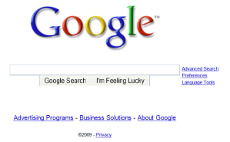
A day in the life: scenario
browser
DNS server
Comcast network
68.80.0.0/13
school network
68.80.2.0/24
web page
web server
Google’s network
64.233.160.0/19
64.233.169.105

Slide 35
A day in the life… connecting to the Internet
DHCP
DHCP
UDP
IP
Eth
Phy
connecting laptop needs to get its own IP address, addr of first-hop router, addr of DNS server: use DHCP
DHCP
DHCP
DHCP
DHCP
DHCP request encapsulated in UDP, encapsulated in IP, encapsulated in 802.1 Ethernet
DHCP
DHCP
UDP
IP
Eth
Phy
DHCP
DHCP
DHCP
DHCP
router
(runs DHCP)
Ethernet frame broadcast (dest: FFFFFFFFFFFF) on LAN, received at router running DHCP server
Ethernet demuxed to IP demuxed, UDP demuxed to DHCP

Slide 36
A day in the life… connecting to the Internet
DHCP
DHCP
UDP
IP
Eth
Phy
DHCP server formulates DHCP ACK containing client’s IP address, IP address of first-hop router for client, name & IP address of DNS server
DHCP
DHCP
DHCP
encapsulation at DHCP server, frame forwarded (switch learning) through LAN, demultiplexing at client
DHCP
DHCP
UDP
IP
Eth
Phy
DHCP
DHCP
DHCP
router
(runs DHCP)
DHCP client receives DHCP ACK reply
DHCP
Client now has IP address, knows name & addr of DNS
server, IP address of its first-hop router

Slide 37
A day in the life… ARP (before DNS, before HTTP)
DNS
UDP
IP
Eth
Phy
before sending HTTP request, need IP address of www.google.com: DNS
DNS
DNS
DNS
ARP
ARP query
DNS query created, encapsulated in UDP, encapsulated in IP, encapsulated in Eth. In order to send frame to router, need MAC address of router interface: ARP
ARP
ARP reply
Eth
Phy
ARP query broadcast, received by router, which replies with ARP reply giving MAC address of router interface
client now knows MAC address of first hop router, so can now send frame containing DNS query

Slide 38
A day in the life… using DNS
DNS
UDP
IP
Eth
Phy
DNS
DNS server
DNS
UDP
IP
Eth
Phy
DNS
DNS
DNS
DNS
DNS
DNS
DNS
DNS
Comcast network
68.80.0.0/13
IP datagram forwarded from campus network into comcast network, routed (tables created by RIP, OSPF, IS-IS and/or BGP routing protocols) to DNS server
IP datagram containing DNS query forwarded via LAN switch from client to 1st hop router
demuxed to DNS server
DNS server replies to client with IP address of www.google.com

Slide 39
A day in the life… TCP connection carrying HTTP
HTTP
HTTP
TCP
IP
Eth
Phy
SYNACK
SYN
SYNACK
SYN
SYNACK
SYN
SYN
to send HTTP request, client first opens TCP socket to web server
TCP SYN segment (step 1 in 3-way handshake) inter-domain routed to web server
TCP
IP
Eth
Phy
SYNACK
SYN
SYNACK
SYN
SYNACK
SYNACK
SYN
web server responds with TCP SYNACK (step 2 in 3-way handshake)
web server
64.233.169.105
TCP connection established!

Slide 40
A day in the life… HTTP request/reply
web page finally (!!!) displayed
HTTP
HTTP
TCP
IP
Eth
Phy
HTTP
HTTP
HTTP
HTTP
HTTP
HTTP
HTTP
HTTP
HTTP request sent into TCP socket
IP datagram containing HTTP request routed to www.google.com
HTTP
HTTP
TCP
IP
Eth
Phy
HTTP
HTTP
HTTP
web server responds with HTTP reply (containing web page)
HTTP
web server
64.233.169.105
IP datagram containing HTTP reply routed back to client

