Slide 1
Computer Networks
P2P Overlay Networks
Mayank Pandey

Slide 2
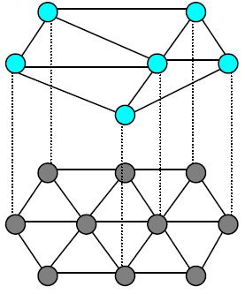
Overlay Networks
An overlay network is a computer network
that is built on top of another network
Nodes in the overlay network can
connected by virtual or logical links
Through many physical links, in the underlying network
Computer Networks: A Systems Approach, Peterson and Davie

Slide 3
Overlay Networks
Logical network implemented on top of some underlying network:
the Internet was built as an overlay over telephone network
The links that connect the overlay nodes
implemented as tunnels through the underlying network
For example, Tunneling in:
VPN (Virtual Private Networks)
IPv6 deployment (IP in IP tunnel)
Multicast Back Bone (MBONE, IP in IP tunnel)

Slide 4
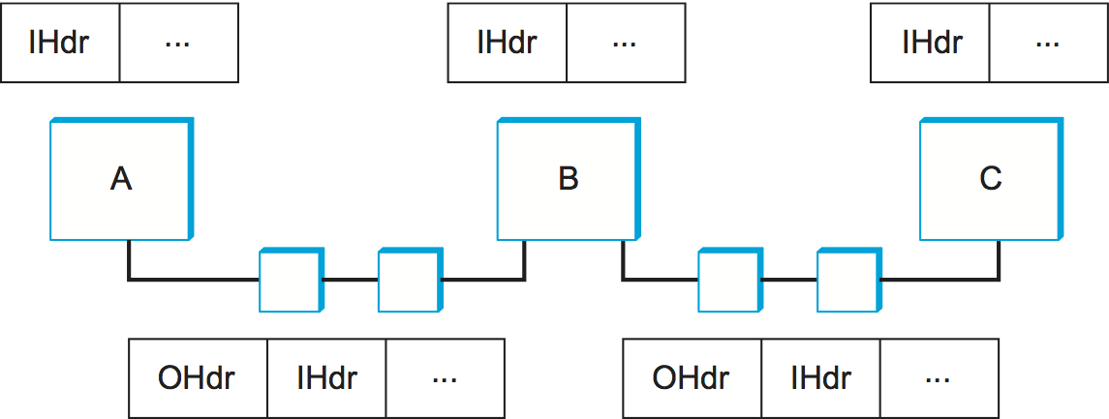
Overlay Networks
Computer Networks: A Systems Approach, Peterson and Davie
Three overlay nodes (A, B, and C) connected by a pair of tunnels.
Overlay node B makes a forwarding decision for packets from A to C based on the inner header (IHdr)
and then attaches an outer header (OHdr) that identifies C as the destination in the underlying network.

Slide 5
Overlay Networks
Computer Networks: A Systems Approach, Peterson and Davie
Nodes A, B, and C are able to interpret both the inner and outer header
intermediate routers understand only the outer header.
A, B, and C have addresses in both the overlay network and the underlying network
not necessarily the same

Slide 6
Overlay Networks
Computer Networks: A Systems Approach, Peterson and Davie
Underlying address (of A, B,C) might be a 32-bit IP address
Their overlay address might be an experimental 128-bit address.
In fact, the overlay need not use conventional addresses at all
may route based on URLs, domain names, an XML query, or even the content of the packet.

Slide 7
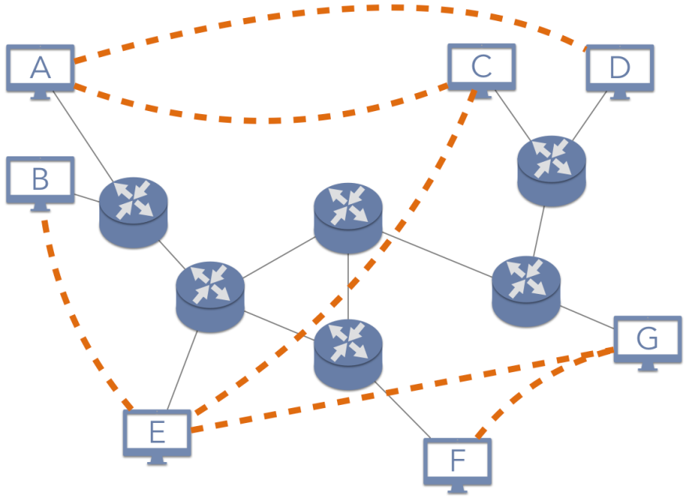
Application Layer Overlay Network
Also known as P2P overlays
Nodes-> End hosts (Processes running there)
May act as routers of network
Edges-> Transport Layer Virtual links

Slide 8
Applications:
Application | Service Description | Examples
Content Distribution | Scalable approaches to sharing data with users across the Internet | File storage and sharing: Gnutella, Bittorrent, InterPlanetary File System (IPFS) Content delivery networks (CDNs): Akamai, Limelight Streaming media: Spotify, Sonos Software update distribution: Linux, World of Warcraft
Distributed Computing | Delegating the work for an application across many computers | Privacy and censorship resistance: Tor, Freenet Cryptocurrency: Bitcoin Botnets and malware: Storm
Collaboration | Providing real-time human communication | Voice Over IP (VOIP): Skype Instant Messaging: Tox
Platforms | Building applications | Java: JXTA

Slide 9
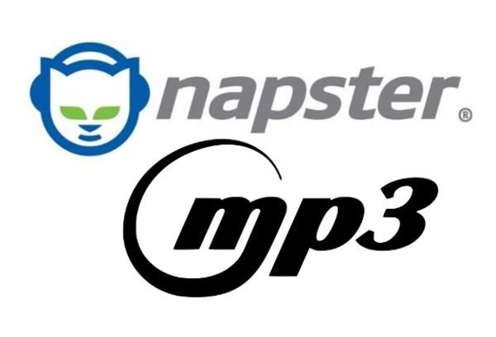

P2P Networks: Overview
Music-sharing apps:
Napster and later on KaZaA
introduced term “peer-to-peer”
In context of sharing MP3 files
Don’t download music from a central site:
access music files directly from whoever on Internet have a copy on their computer

Slide 10
P2P Networks: Overview
Generally peer-to-peer network allows:
community of users to pool and their resources
content, storage, network bandwidth, CPU etc.
in a distributed and decentralized manner
P2P networks provide access to larger
archival store, computation capability , Audio/video streaming and conferencing
than any one user could afford individually.

Slide 11
P2P Networks: Overview
Decentralized and Self-Organized:
nodes organize themselves into a network
without any centralized coordination
Locating an object of interest and downloading that
happen without centralized authority
System is able to scale to millions of nodes
Nodes are hosts willing to share objects
Transport layer links connecting these nodes
Utilized to traverse sequence of machines to locate object

Slide 12
P2P Networks: Types
Two main P2P Network types
Unstructured (based on searching)
“Network has structure, but peers are free to join any where and objects can be stored anywhere”
Structured (based on addressing)
“Network structure determines where peers belong in the network and where objects are stored “

Slide 13
P2P Networks: Another Classification
1st generation
Typically: Napster
Only file download P2P, Publish and Search Centralized
2nd generation
Typically: Gnutella
Pure P2P
3rd generation
Typically: Super-peer networks
Hybrid of P2P and Centralized
4th generation
Typically: Distributed hash tables
Structured P2P overlays

Slide 14
P2P Networks: Beginning
A killer application: Napster
Free music over the Internet
Key idea:
share the content, storage and bandwidth of individual (home) users
Each user stores a subset of files
Each user has access (can download) files from all users in the system

Slide 15
Napster: Challenges
Find where a particular file is stored
Scalability: up to hundred of thousands or millions of systems
Dynamicity: systems can come and go any time

Slide 16
Napster: History
The rise
January 1999: Napster version 1.0
May 1999: company founded
December 1999: first lawsuits
2000: 80 million users
The fall
Mid 2001: out of business due to lawsuits

Slide 17
Napster Technology
User installs the software
Download the client program
Register name, password, local directory, etc.
Client contacts Napster (via TCP)
Provides a list of music files it will share
Napster’s central server updates the directory
Client searches on a title or performer
Napster identifies online clients with the file
and provides IP addresses
Client requests the file from the chosen supplier
Supplier transmits the file to the client
Both client and supplier report status to Napster
Bob
centralized
directory server
1
peers
1
1
3
2
1
Alice

Slide 18
Napster: Properties
Publishing and Searching Centralized
Only download in P2P manner
No load on single provider
Server’s directory continually updated
Always know what music is currently available
Point of vulnerability for legal action
Proprietary protocol
Bandwidth issues
Suppliers ranked by apparent bandwidth & response time
Single point of failure, Performance bottleneck, Copyright infringement

Slide 19
Pure P2P system: Gnutella
Gnutella history
2000: J. Frankel & T. Pepper released Gnutella
Soon after: many other clients (e.g., Morpheus, Limewire, Bearshare)
2001: protocol enhancements, e.g., “ultrapeers”
Query flooding
Join: contact a few nodes to become neighbours
Publish: no need!
Search:
ask neighbours, who ask their neighbours
Fetch: get file directly from another node

Slide 20
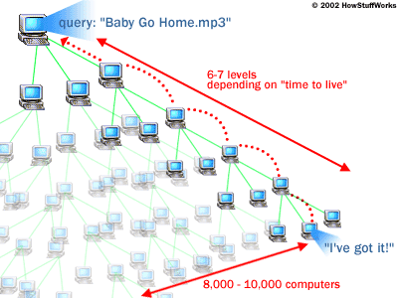
Gnutella: Query Flooding
Fully distributed
No central server
Public domain protocol
Many Gnutella clients implementing protocol
Overlay network: graph
Edge between peer X and Y if there’s a TCP connection
All active peers and edges form the overlay network
Given peer will typically be connected with < 10 overlay neighbors

Slide 21
Gnutella: Protocol
Query message sent over existing TCP connections
Peers forward Query message
QueryHit sent over reverse path
File transfer:
HTTP
Query
QueryHit
Query
QueryHit
Query
Query
QueryHit
Scalability:
limited scope flooding
Query

Slide 22
Gnutella: Peer Joining
Joining peer X must find some other peers
Start with a list of candidate peers
A bootstrap server is needed
X sequentially attempts TCP connections with peers on list until connection setup with Y
X sends Ping message to Y
Y forwards Ping message.
All peers receiving Ping message respond with Pong message
X receives many Pong messages
X can then set up additional TCP connections

Slide 23
Gnutella: Pros and Cons
Advantages
Fully decentralized
Search cost distributed
Processing per node permits powerful search semantics
Disadvantages
Search scope may be quite large
Search time may be quite long
High overhead, and nodes come and go often

Slide 24
Hybrid P2P system: KaAzA
KaZaA history
2001: created by Dutch company (Kazaa BV)
Smart query flooding
Join: on start, the client contacts a super-node (and may later become one)
Publish: client sends list of files to its super-node
Search: send query to super-node, and the super-nodes flood queries among themselves
Fetch: get file directly from peer(s)

Slide 25
KaZaA: Exploiting Heterogeneity
Each peer is either a group leader or assigned to a group leader
TCP connection between peer and its group leader
TCP connections between some pairs of group leaders
Group leader tracks the content in all its children

Slide 26
KaZaA: Motivation for Super-Nodes
Query consolidation
Many connected nodes may have only a few files
Propagating query to a sub-node may take more time than for the super-node to answer itself
Stability
Super-node selection favors nodes with high up-time
How long you’ve been on is a good predictor of how long you’ll be around in the future

Slide 27
BitTorrent
BitTorrent history and motivation
2002: B. Cohen debuted BitTorrent
Key motivation: popular content
Popularity exhibits temporal locality
Focused on efficient fetching, not searching
To handle very large files
If few publisher and many downloaders
Publishers may bog down

Slide 28
BitTorrent: Simultaneous Downloading
Divide large file into many pieces
Replicate different pieces on different peers
Peer can (hopefully) assemble the entire file
Allows simultaneous downloading
Retrieving different parts of the file from different peers at the same time
And uploading parts of the file to peers
Important for very large files

Slide 29
BitTorrent: Simultaneous Downloading
Replication: natural side effect of downloading
As soon as a peer downloads a particular piece
it becomes another source for that piece.
The more peers downloading pieces of the file, the more piece replication occurs
distributes the load proportionately
more total bandwidth is available to share the file with others.
Pieces are downloaded in random order
to avoid a situation where peers find themselves lacking the same set of pieces.

Slide 30
BitTorrent: Swarms
File is shared via independent BitTorrent network swarm
The lifecycle of a swarm
starts as a singleton peer with a complete copy of the file
node that wants to download joins the swarm
becomes its second member and begins downloading pieces
becomes another source for the pieces it has downloaded
Other nodes join the swarm and begin downloading pieces from multiple peers, not just the original peer
If the file remains in high demand
New peers keep on replacing those who leave the swarm,
The swarm could remain active or it could shrink back original peer based on the demand and popularity

Slide 31
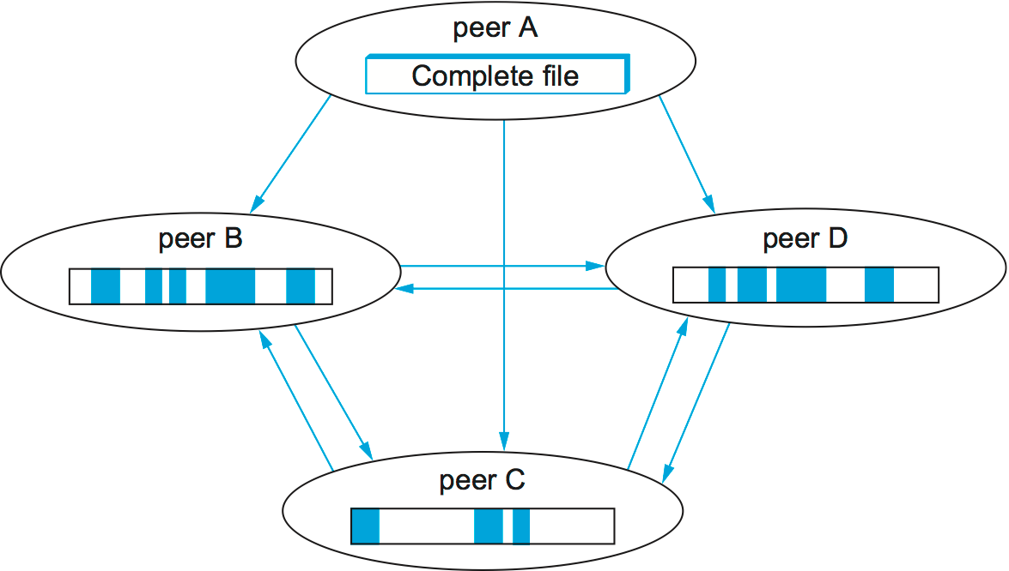
Swarm:
Computer Networks: A Systems Approach, Peterson and Davie

Slide 32
BitTorrent Components
32
Seed: Peer with entire file
Fragmented in pieces
Leacher: Peer with an incomplete copy of the file
Torrent file: Passive component
Contains meta information about file and swarm
The target file’s size
The piece size
SHA-1 hash values pre-computed from each piece
The URL of the swarm’s tracker
Tracker: server that tracks a swarm’s current membership
Allows peers to find each other
Returns a list of random peers
Notes:
32

Slide 33
Structured P2P: The DHTs
Why we need DHTs?
Searching in P2P networks is not efficient
Either centralized system with all its problems
Or distributed system with all its problems
Actual file transfer process in P2P network is scalable
File transfers directly between peers
Searching does not scale in same way
Original motivation for DHTs
More efficient searching and object location
Put another way:
Use addressing instead of searching

Slide 34
Recall: Hash Tables
Hash tables are a well-known data structure
Hash tables allow insertions, deletions, and finds in constant (average) time
Hash table is a fixed-size array
Elements of array also called hash buckets
Hash function maps keys to elements in the array
Properties of good hash functions:
Fast to compute
Good distribution of keys into hash table
Example: SHA-1 algorithm

Slide 35
Hash Tables: Example
Hash function: hash(x) = x mod 10
Insert numbers 0, 1, 4, 9,16, and 25
Easy to find if a given key
is present in the table

Slide 36
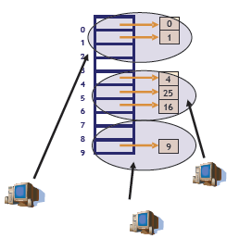
DHT: Idea
Hash tables are for fast lookups
Idea: Distribute hash buckets to peers
Result is Distributed Hash Table (DHT)
Need efficient mechanism for
finding which peer is responsible for which bucket and
routing between them

Slide 37
DHT: Principle
In a DHT, each node is responsible for
one or more hash buckets
As nodes join and leave
responsibilities change
Nodes communicate to
find the responsible node

Slide 38
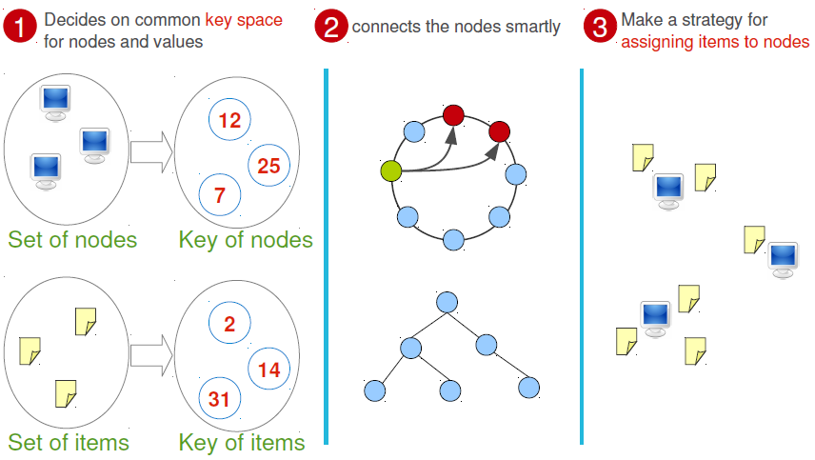
DHT: Principle

Slide 39
DHT: Examples
Chord
CAN
Tapestry
Several others exist too
Pastry, Plaxton, Kademlia, Koorde, Symphony, P-Grid, CARP, …

Slide 40
Chord
Chord was developed at MIT
Originally published in 2001 at SIGCOMM conference
Paper has mathematical proofs of correctness and performance
Many projects at MIT around Chord
CFS storage system
Ivy storage system
Plus many others…

Slide 41
Chord: Basics
Chord uses SHA-1 hash function
Results in a 160-bit object/node identifier
Same hash function for objects and nodes
Node ID hashed from IP address
Object ID hashed from object name
Object names: Based on the context
SHA-1 gives a 160-bit identifier space
Organized in a ring which wraps around
Nodes keep track of predecessor and successor
Node responsible for objects between
its predecessor and itself
Overlay is often called “Chord ring”

Slide 42
Chord: Different procedures
Joining the network
Storing in to the network
Retrieving from the network
Periodic stabilization
To keep the overlay structure intact

Slide 43
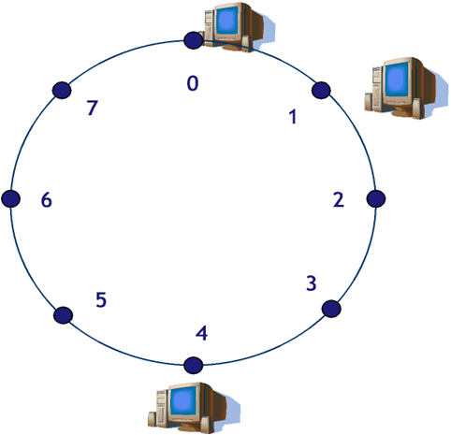
Joining: Step by Step Example
Existing network with nodes on 0, 1 and 4
Hash id of nodes are 0,1 and 4
Many different ways to implement Chord
Here only conceptual example
Covers all important aspects

Slide 44


Joining: Step by Step Example
New node wants to join
Hash of the new node: 6
Known node in network:
Node1
Contact Node1
With own hash id

Slide 45
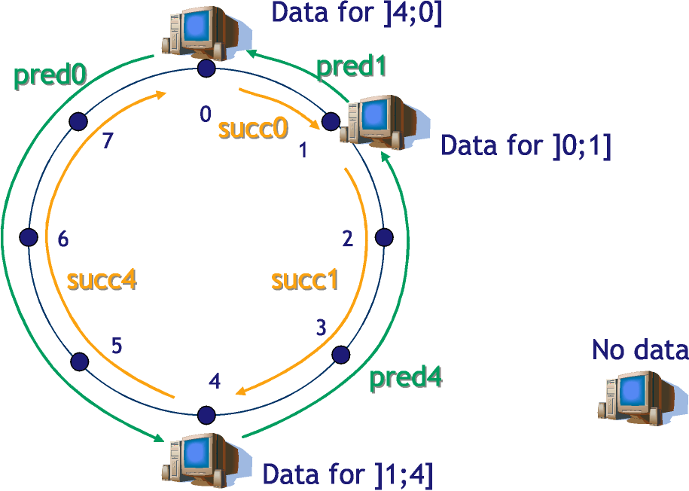
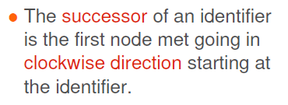
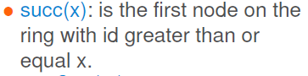

Joining: Situation Before Join

Slide 46
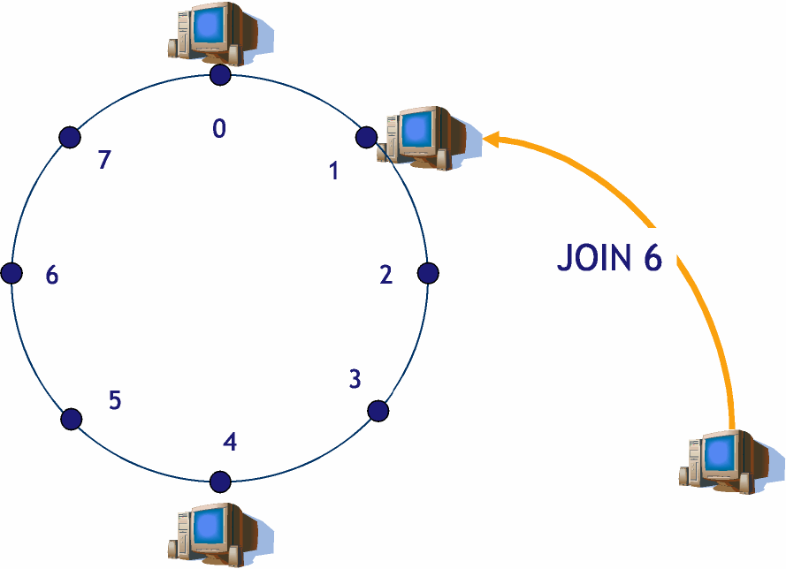
Joining: Contact known node

Slide 47
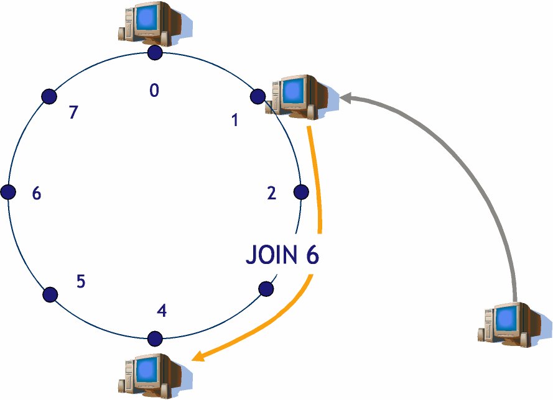
Joining: Join gets routed along the network

Slide 48
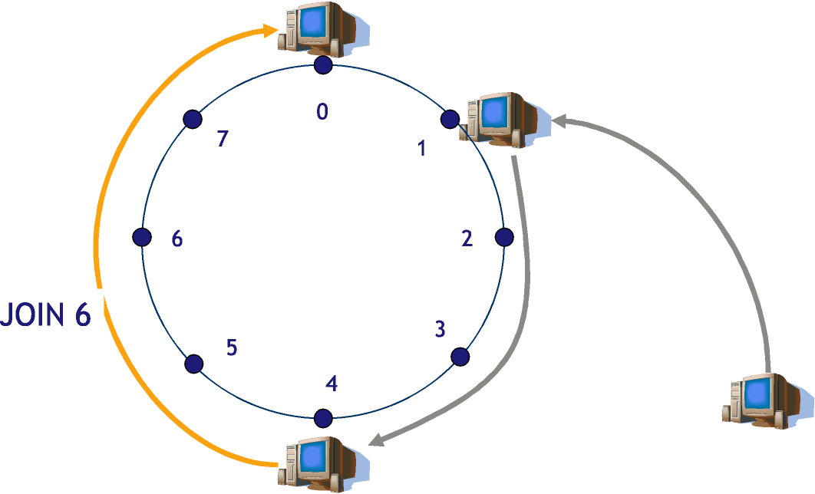
Joining: Successor of New Node Found

Slide 49
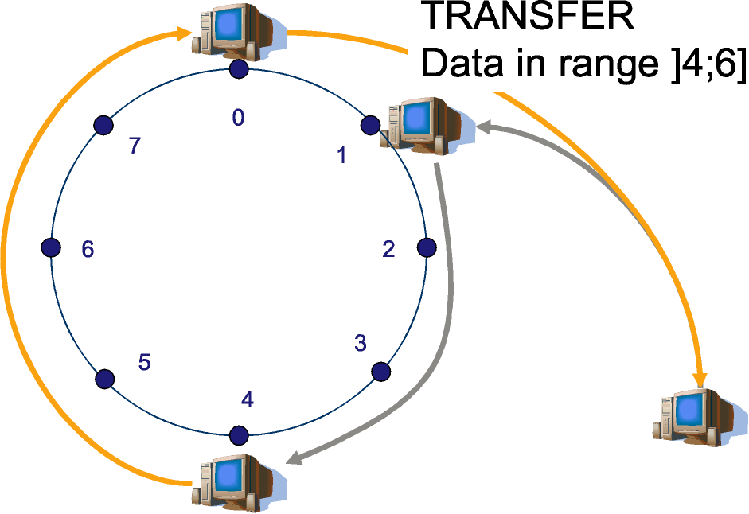
Joining Successful + Data Transfer
Joining is successful
Old responsible node transfers data that should be in new node
New node informs Node4 about new successor (not shown)

Slide 50
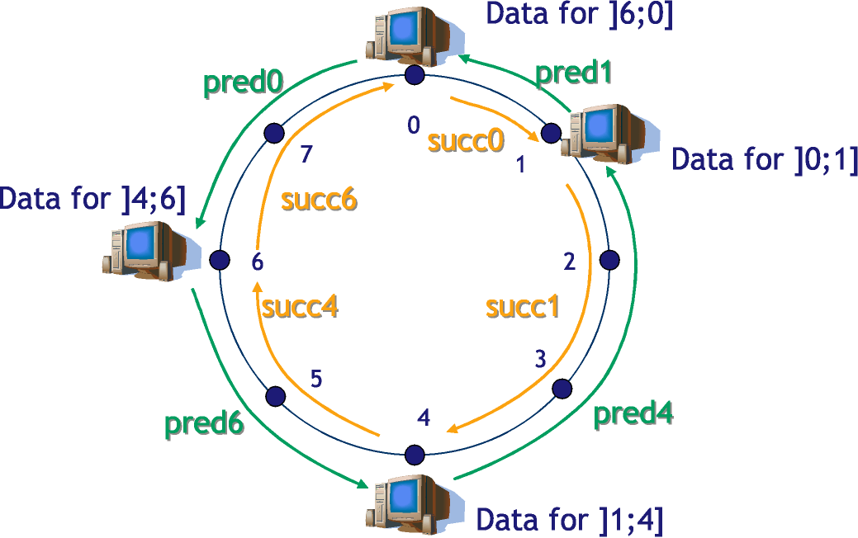
Joining: All Is Done

Slide 51
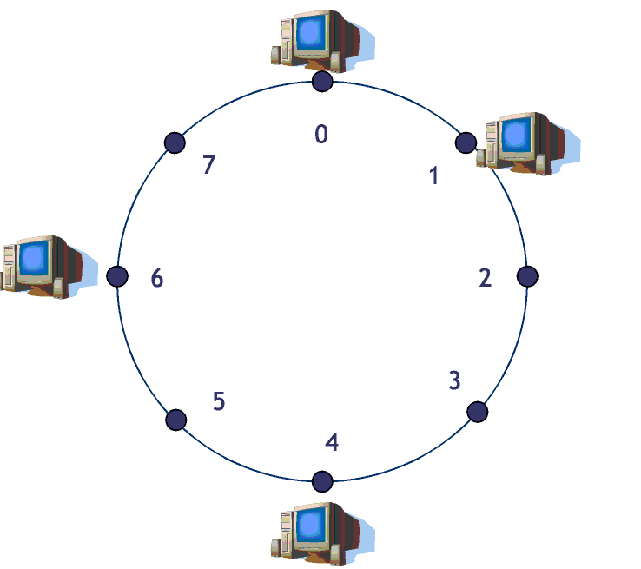
Storing a Value
Node 6 wants to store object with name “Foo” and value 5
hash(Foo) = 2

Slide 52
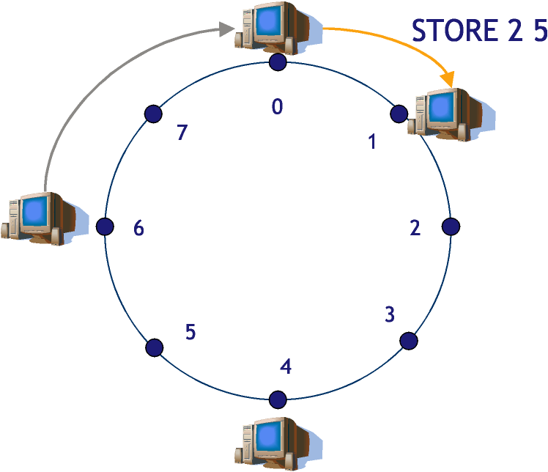
Storing a value: (Contd.)

Slide 53
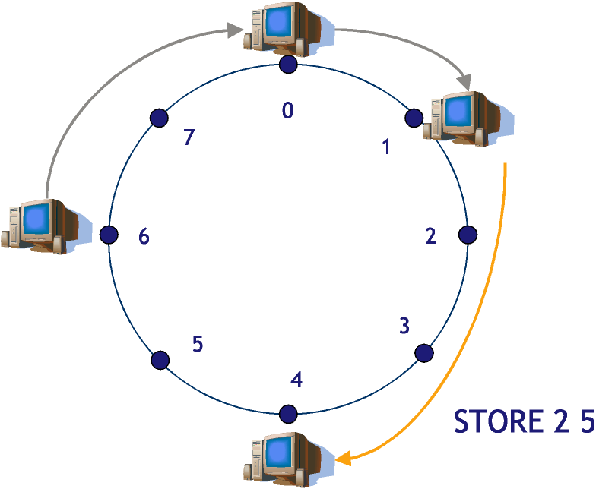
Storing a value: (Contd.)

Slide 54
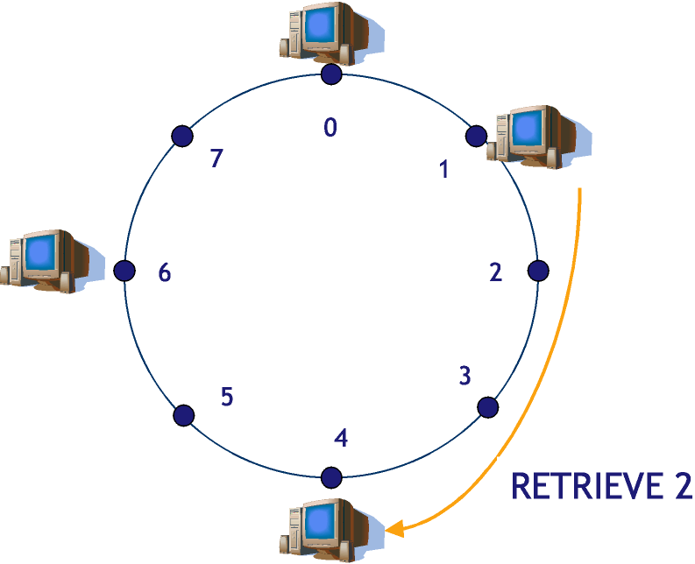
Retrieving a Value
Node 1 wants to get object with name “Foo”
hash(Foo) = 2
Foo is stored on node 4

Slide 55
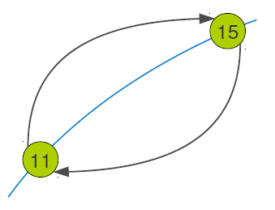
Handling Dynamism: Joining
Stabilization Algorithm:
Ask successor to tell about predecessor

Slide 56
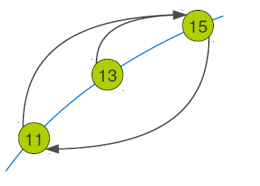
Handling Dynamism: Joining
Stabilization Algorithm:
Ask successor to tell about predecessor
Suppose 13 joins and sets its successor as 15 and predecessor as nil

Slide 57
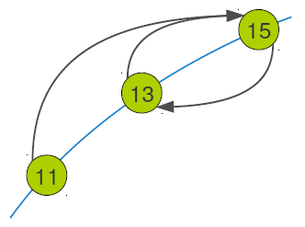
Handling Dynamism: Joining
Stabilization Algorithm:
Ask successor to tell about predecessor
Suppose 13 joins and sets its successor as 15 and predecessor as nil
When 13 runs stabilization
15 Sets its pred as 13

Slide 58
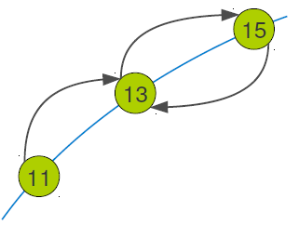
Handling Dynamism: Joining
Stabilization Algorithm:
Ask successor to tell about predecessor
Suppose 13 joins and sets its successor as 15 and predecessor as nil
13 runs stabilization
15 Sets its pred as 13
11 runs stabilization
Sets its succ as 13

Slide 59
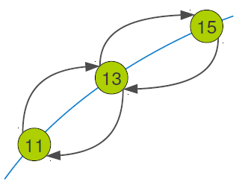
Handling Dynamism: Joining
Stabilization Algorithm:
Ask successor to tell about predecessor
Suppose 13 joins and sets its successor as 15 and predecessor as nil
13 runs stabilization
15 Sets its pred as 13
11 runs stabilization
Sets its succ as 13
13 sets its pred as 11

Slide 60
Handling Dynamism: Leaving
Some more state needed
Successor list
Containing some immediate K successors
Some algorithm needed
Check predecessor (heartbeat messages)
If fails---- set as nil (stabilization can handle)
During stabilization if successor does not respond:
Replace with closest alive successor

Slide 61
Chord: Scalable Routing
Routing happens by passing message to successor
What happens when there are 1 million nodes?
On average, need to route 1/2-way across the ring
In other words, 0.5 million hops! Complexity O(n)
How to make routing scalable?
Answer: Finger tables
Basic Chord keeps track of predecessor and successor
Finger tables keep track of more nodes
Allow for faster routing by jumping long way across the ring
Routing scales well, but need more state information
Finger tables not needed for correctness, only for performance improvement

Slide 62
Chord: Finger Tables
In m-bit identifier space, node has up to m fingers
Fingers are stored in the finger table
Row i in finger table at node n contains first node s
that succeeds n by at least 2^{i-1} on the ring
In other words:
finger[i] = successor(n + 2^{i-1})
First finger is the successor
Distance to finger[i] is at least 2^{i-1}

Slide 63
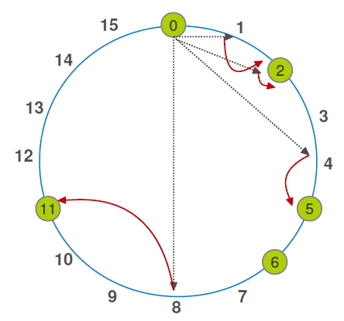
Chord: Scalable Routing
Finger intervals increase with distance from node n
If close, short hops and if far, long hops
Two key properties:
Each node only stores information about a small number of nodes
Example has five nodes at 0, 2, 5, 6 and 11
4-bit ID space --> 4 rows of fingers

Slide 64
Chord: Final Words
Search performance of “pure” Chord is O(n)
Number of nodes is n
With finger tables
need O(log n) hops to find the correct node

