Slide 1
TCP Advanced
Mayank Pandey
MNNIT Allahabad, Prayagraj, India

Slide 2
Recap:
1st Module
Connectionless and Connection oriented MUX/DEMUX (Concept of Ports)
UDP (User Datagram Protocol)
Pseudo-header and Checksum
Developing a Reliable Data Transport (RDT) Protocol from scratch: The FSM way.
Pipelined Protocols:
GBN (Go Back N)
SR (Selective Repeat)

Slide 3
Recap
2nd Module
TCP Header
TCP usage model
Connection Establishment
Data transport
Connection Termination
TCP Flow Control (Sliding window concepts, Acknowledgement Dynamics)
TCP Congestion Control
Slow start, Congestion avoidance
Fast Retransmit, Fast Recovery
TCP Variants
Tahoe, Reno, New-Reno
TCP SACK

Slide 4
This module: (Two lectures)
When Sender can trigger?
Silly Window Syndrome
Nagle’s Algorithm
Protection against Wraparound
Window Scaling
Adaptive Retransmissions
Original Algorithm
Karn/Patridge Algorithm
Jacobson/Karels Algorithm
Network Assisted Congestion Avoidance
DecBit, TCP RED, ECN (Explicit Congestion Notification)
Source Based Congestion Avoidance
TCP Vegas

Slide 5
Triggering Transmission
How does TCP decides to transmit segment:
Byte stream abstraction
Application writes bytes into stream
When to send??
Suppose widow is closed
TCP Sender is accumulating bytes
Now ACK is received
Opens the window for MSS/2
Should sender send now?
Or wait for the window to open more?
Original specification was silent on this point

Slide 6
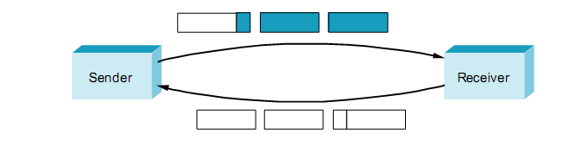
Triggering Transmissions
Early Implementations aggressively
take advantage of any available window
Leads to Silly window Syndrome
Network get filled with tiny segments

Slide 7
Silly window Problem
When either:
The sender transmits a small segment
Or receiver opens a small window
If neither of this happens:
Then small container will never be introduced in the system
But is this possible?
Receiver side can:
After advertizing zero window, wait for space equal to MSS
Delay the acknowledgements
Ultimately onus is on sender

Slide 8
Nagle’s Algorithm
If there is data to send
but the window is open less than MSS
wait some time before sending the available data
but how long?
If we wait too long
we hurt interactive applications like Telnet.
If we don’t wait long enough
we risk sending a bunch of tiny packets and
falling into the silly window syndrome.
The answer is to introduce a timer and
transmit when the timer expires.

Slide 9
Nagle’s Algorithm
Nagle introduced an elegant self-clocking solution.
The idea is that as long as TCP has any data in flight
sender will eventually receive an ACK.
This ACK can be treated like a timer firing
triggering the transmission of more data.
Nagle’s algorithm provides a simple, unified rule for deciding when to transmit

Slide 10
Nagle’s Algorithm
When the application produces data to send
if both the available data and the window ≥ MSS
send a full segment
else
if there is unACKed data in flight
buffer the new data until an ACK arrives
else
send all the new data now
The socket interface allows the application to turn off Nagel’s algorithm by setting the TCP_NODELAY option

Slide 11
Protecting against Wraparound
32-bit sequence number space
sequence number used on a given connection might wrap around
byte with sequence number x could be sent at one time
then at a later time a second byte with the same sequence number x might be sent.
If we assume that packets cannot survive
in the Internet for longer than the recommended MSL.
we currently need to make sure that the sequence number
does not wrap around within a 120-second period

Slide 12
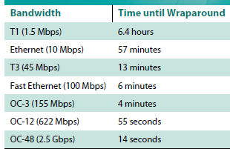
Protecting against Wraparound

Slide 13
TCP Extension for PAWS
Implemented as Header Options
define a new 64-bit sequence number field
TCP uses the 32-bit timestamp to extend the seq. num space.
64-bit identifier that has the SequenceNum field in the low-order 32 bits and
the timestamp in the high-order 32 bits.
timestamp is always increasing,
it serves to distinguish between two different incarnations of the same sequence number.
timestamp is being used in this setting only to protect against wraparound
it is not treated as part of the sequence number for the purpose of ordering or acknowledging data.

Slide 14
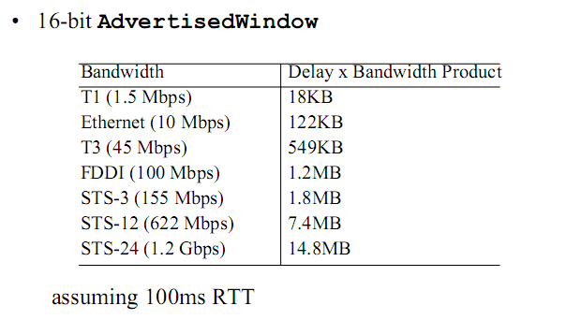
Keeping the Pipe Full

Slide 15
Window Scaling
TCP’s Advertised Window field
is worse shaped than its SequenceNum field
it is not big enough to handle even a T3 connection
16-bit field allows to advertise
a window of only 64 KB.

Slide 16
Window Scaling
TCP extension to advertise a larger window,
to fill larger delay × bandwidth pipes
This TCP option defines a scaling factor
Interpret differently the number that appears in the Advertised Window field
Instead of how many bytes the sender is allowed to have unacknowledged,
allows the two sides of TCP to agree that the Advertised Window field counts larger chunks
e.g., how many 16-byte units of data the sender can have unacknowledged.

Slide 17
Adaptive Retransmission
TCP guarantees the reliable delivery of data
retransmits each segment if ACK is not received in a certain period of time
This timeout is set as a function of the expected RTT
between the two ends of the connection.
Choosing an appropriate timeout value is not easy
Much variation in RTT between the same two hosts over time
TCP uses an adaptive retransmission mechanism
it has evolved over time

Slide 18
Original Algorithm (RFC 0793)
Keep a running average of the RTT
compute the timeout as a function of this RTT
Every time TCP sends a data segment
it records the time, When ACK for that segment arrives
TCP reads the time again, and then takes the difference between these two times as a SampleRTT
EstimatedRTT is a weighted average between
the previous estimate and this new sample

Slide 19
Original Algorithm (RFC 0793)
The parameter α is selected to smooth the EstimatedRTT.
A small α tracks changes in the RTT but is perhaps too heavily influenced by temporary fluctuations.
a large α is more stable but perhaps not quick enough to adapt to real changes.
EstimatedRTT is also termed as Smoothed RTT (SRTT)
The original TCP specification recommended α between 0.8 and 0.9.
TCP uses EstimatedRTT to compute the timeout in a rather conservative way:
RTO = min(ubound, max(lbound,(SRTT)β))
β is a delay variance factor with a recommended value of 1.3 to 2.0, ubound is an upper bound (suggested to be 1 minute), and lbound is a lower bound (suggested to be 1s) on the RTO
It generally results in the RTO being set either to
1s, or to about twice SRTT

Slide 20
Standard Method (Jacobson Algo)
RFC 2988 obsoleted by RFC 6298
TCP sender maintains two state variables
SRTT (smoothed round-trip time) and
RTTVAR (round-trip time variation)
Assume clock granularity of G
Until a round-trip time (RTT) measurement has been made for a segment sent between the sender and receiver, the sender SHOULD
set RTO = 1 second

Slide 21
Standard Method (RFC 6298)
When the first RTT measurement R is made:
the host MUST set
SRTT = R
RTTVAR = R/2
RTO = SRTT + max (G, K × RTTVAR) where K = 4
When a subsequent RTT measurement R' is made
a host MUST set
RTTVAR = (1 - β) × RTTVAR + β × |SRTT - R'|
SRTT = (1 - α) × SRTT + α × R‘
The above SHOULD be computed using α =1/8 and β =1/4 . After the computation, a host MUST update
RTO = SRTT + max (G, K × RTTVAR) where K=4

Slide 22
Standard Method (RFC 6298)
Value of SRTT used in the update to RTTVAR
is its value before updating SRTT itself
updating RTTVAR and SRTT MUST be computed in the above order
After the computation, a host MUST update
RTO = SRTT + max (G, K × RTTVAR) where K = 4
Whenever RTO is computed, if it is less than 1 second, then the RTO SHOULD be rounded up to 1 second??

Slide 23
Standard Method (RFC 6298)
Traditionally, TCP implementations use coarse grain clocks
to measure the RTT and trigger the RTO, which imposes a large minimum value on the RTO
Linux Granularity 500 ms that time

Slide 24
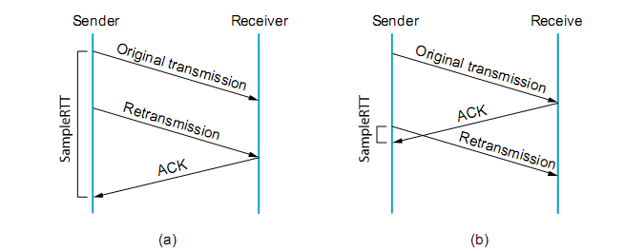
RFC 6298: Uses Karn’s Algo
Retransmission Dilemma: Karn’s Algorithm
Do not sample while retransmitting
Double timeout after each retransmission

Slide 25
RFC 6298: Timer Management
Every time packet is sent (including a retransmission),
if the timer is not running, start it running
so that it will expire after RTO seconds (for the current value of RTO).
When all outstanding data acknowledged, turn off the timer.
When an ACK is received that acknowledges new data,
restart the retransmission timer so that it will expire after RTO seconds (for the current value of RTO).
When the retransmission timer expires, do the following:
Retransmit the earliest segment that has not been acknowledged by the TCP receiver.
The host MUST set RTO = RTO × 2 ("back off the timer").
Start the retransmission timer, such that it expires after RTO seconds (for the value of RTO after the doubling operation).
Conservative approach

Slide 26
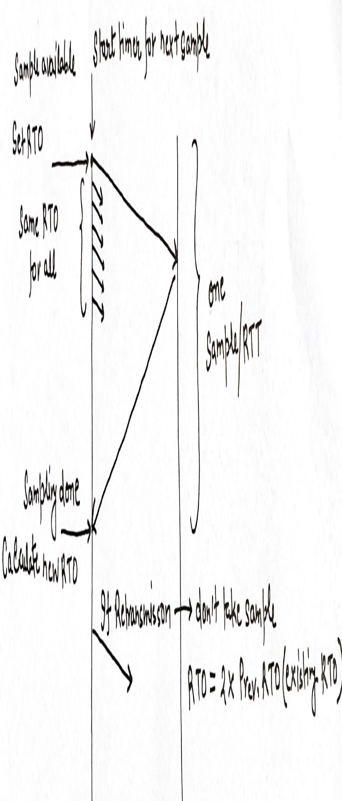
RFC 6298: Taking RTT samples
Traditionally, TCP implementations have taken one RTT measurement at a time
typically, once per RTT
If retransmission (no sample)

Slide 27
How Linux does it?
Basic premise is RFC 6298 only
Lets look at the clock first:
TCP has a continuously running “clock” that is used when taking RTT measurements.
Clock does not have infinite precision.
TCP clock is usually the value of a variable that is updated as the system clock advances.
The length of the TCP’s clock “tick” is called its granularity
Traditionally, this value was relatively large (about 500ms)
More recent implementations use finer-granularity clocks (1ms ).

Slide 28
How Linux does it?
Uses TCP timestamp Option
For more accurate estimate of RTT
The sending TCP includes a 32-bit timestamp value in the TSV (Time Stamp Value) portion TCP option in each segment it sends
A receiving TCP keeps track of the received TSV value to send as TSER (Time Stamp Echo Reply) the next ACK.
A sender receiving an ACK subtracts the TSER from its current TCP clock
uses the difference as a sample value to update its RTT estimators

Slide 29
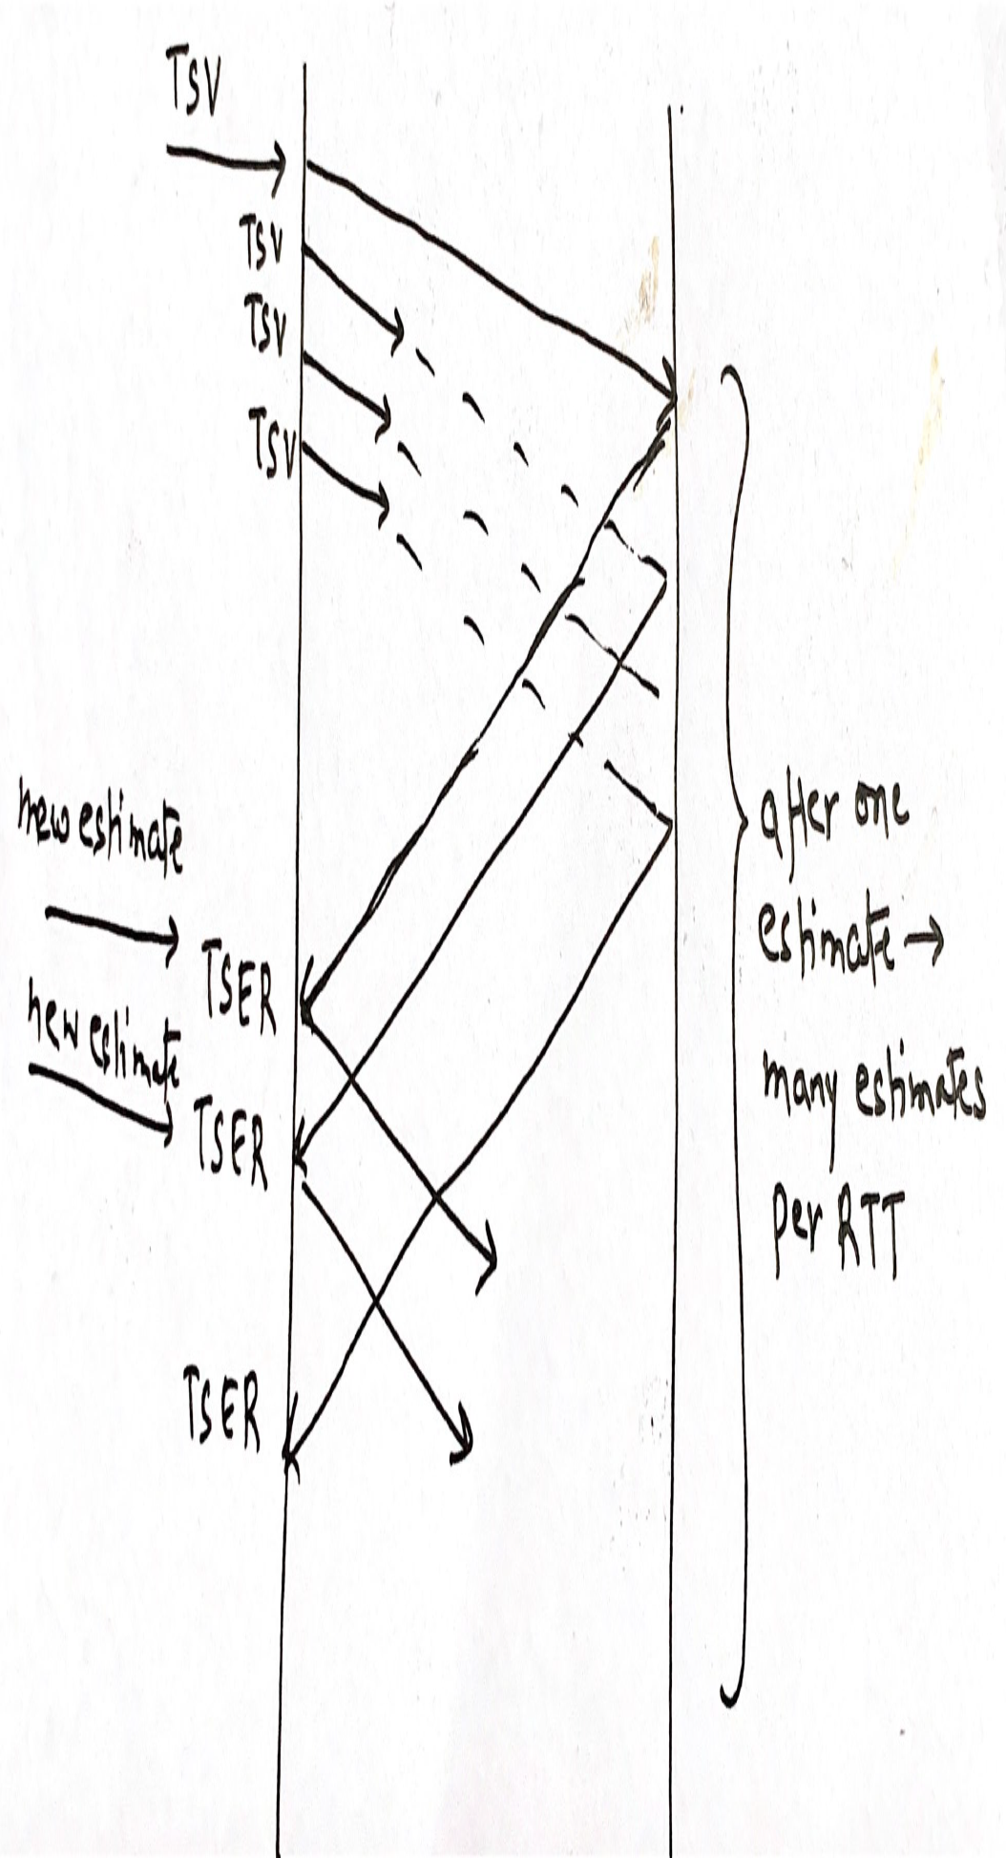
How Linux does it?

Slide 30
How Linux does it?
The combination of frequent measurements of the RTT and the fine-grain clock contributes to a more accurate estimate of the RTT
Minimum recommended RTO is 200ms
The minimum RTO can be changed
TCP_RTO_MIN, which is a kernel configuration constant
Useful when using TCP in data center environment with very less RTT

Slide 31
How Linux does it? Final words
The TCP specifications delay the acknowledgements for a maximum time of 500 ms
to avoid the Silly Window Syndrome.
The specifications do not mandate any specific delay time, but many implementations use a static delay of 200 ms
fixed delay time may not be adequate in all networking environments.
Linux TCP receiver adjusts timer for delaying acknowledgements dynamically
while sending acknowledgements for at least every second incoming segment.

Slide 32
How Linux does it? Final words
Using delayed ACKs slows down the TCP sender
congestion window size increases based on the rate of incoming acknowledgements.
In order to speed up the transmission in the beginning of the slow start
the Linux TCP receiver refrains from delaying the acknowledgements for the first incoming segments at the beginning of the connection.
This is called quick acknowledgements

Slide 33
How Linux does it? Final words
Explicit Congestion Notification
Linux implements Explicit Congestion Notification (ECN) to allow
ECN-capable congested routers to report congestion before dropping packets.
A congested router can mark a bit in the IP header
echoed to the TCP sender by an ECN-capable receiver.
When TCP sender gets the congestion signal, it enters the CWR state
gradually decreases the congestion window to half of its current size
at the rate of one segment for two incoming acknowledgements.
ECN is expected to improve the network performance
when it is more widely deployed to the Internet routers.

Slide 34
Recap: TCP Flags
Currently eight bit fields are defined for the TCP header, older implementations understand only the last six of them:
CWR. Congestion Window Reduced ( sender reduced its sending rate)
ECE. ECN Echo (the sender received an earlier congestion notification)
URG. Urgent (the Urgent Pointer field is valid; rarely used)
ACK. Acknowledgment (the Acknowledgment Number field is valid, always on after a connection is established)
PSH. Push (the receiver should pass this data to the application as soon as possible; not reliably implemented or used)
RST. Reset the connection (connection abort, usually because of an error)
SYN. Synchronize sequence numbers to initiate a connection
FIN. The sender of the segment is finished sending data to its peer.

Slide 35
Network Assisted Congestion Avoidance
TCP follows the strategy to control congestion once it happens
as opposed to avoid congestion in the first place.
An alternative can be
to predict when congestion is about to happen
then to reduce the rate at which hosts send data just before packets start being discarded.
There are three interesting approaches:
DecBit
TCP RED
ECN (Explicit Congestion Notification)

Slide 36
DecBit
The first mechanism was developed for use on the Digital Network Architecture (DNA)
a connectionless network with a connection-oriented transport protocol
The idea here to evenly split the responsibility for congestion control
between the routers and the end nodes.
Each router monitors the load it is experiencing
explicitly notifies the end nodes when congestion is about to occur
implemented by setting a binary congestion bit in the packets that flow through the router
That's why named as DECbit.

Slide 37
DecBit
A single congestion bit is added to the packet header.
A router sets this bit in a packet if its average queue length is greater than or equal to 1 at the time the packet arrives.
This average queue length is measured over a time interval that spans
the last busy+idle cycle, plus the current busy cycle.
The router is busy when it is transmitting and idle when it is not

Slide 38
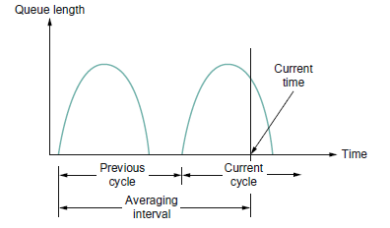
DecBit
router calculates the area under the curve
divides this value by the time interval to compute the average queue length

Slide 39
DecBit
If less than 50% of the packets had the bit set
source increases its congestion window by one packet.
If 50% or more of the last window’s worth of packets had the congestion bit set
source decreases its congestion window to 0.875 times the previous value.

Slide 40
TCP RED (Random Early Detection)
Invented by Sally Floyd and Van Jacobson in the early 1990s
differs from the DECbit scheme in two major ways:
rather than explicitly sending a congestion notification message to the source
RED implicitly notifies the source of congestion by dropping one of its packets
How RED decides when to drop a packet and what packet it decides to drop

Slide 41
TCP RED
Average Queue length:
AvgLen = (1−Weight) × AvgLen + Weight × SampleLen
where 0 < Weight < 1 and
SampleLen is the length of the queue when a sample measurement is made
if AvgLen ≤ MinThreshold
queue the packet
if MinThreshold < AvgLen < MaxThreshold
calculate probability P
drop the arriving packet with probability P
if AvgLen ≥ MaxThreshold
drop the arriving packet

Slide 42
Explicit Congestion Notification
ECN requires two bits:
uses bits 6 and 7 in the IP type of service (TOS) field (more later)
One is set by the source to indicate that it is ECN capable
The other is set by routers along the end-to-end path when congestion is encountered.
The latter bit is also echoed back to the source by the destination host.
TCP running on the source responds to the ECN bit set in exactly he same way it responds to a dropped packet.

Slide 43
Source Based Congestion Avoidance
TCP Vegas
You have to read by yourself and submit the assignment.

