Slide 1
TCP Basics
Mayank Pandey
MNNIT Allahabad, Prayagraj, India

Slide 2
Recap:
Connectionless and Connection oriented MUX/DEMUX (Concept of Ports)
UDP (User Datagram Protocol)
Pseudo-header and Checksum
Developing a Reliable Data Transport (RDT) Protocol from scratch: The FSM way.
Pipelined Protocols:
GBN (Go Back N)
SR (Selective Repeat)

Slide 3
Transmission Control Protocol (TCP)
Service Model:
Connection Orientation Connection Abstraction
Illusion of connection over connection less Internet
Byte stream Abstraction
no record markers or message boundaries
Packetization and Re-packetization
Reliable and Ordered Delivery
Sequence numbers, ACKs, Retransmission
Point to Point with Full duplex
Protocol Implemented Entirely at Ends

Slide 4
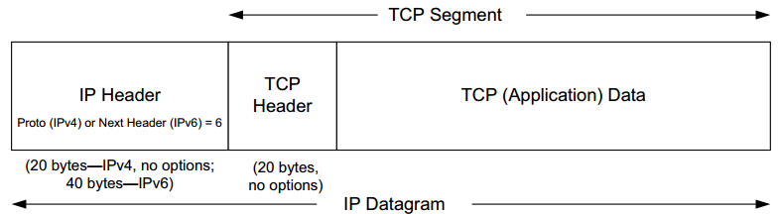
TCP Encapsulation

Slide 5
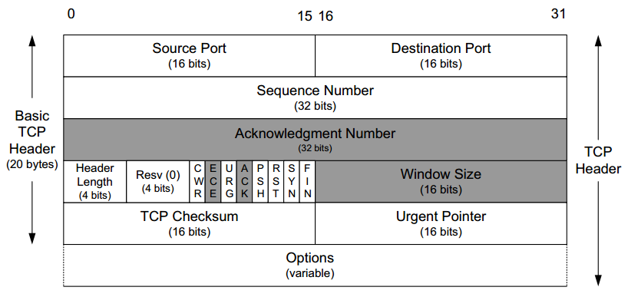
TCP Header

Slide 6
TCP Header
Source Port, Destination Port
The source and destination port number, along with the source and destination IP addresses in the IP header, uniquely identify each connection
The combination of an IP address and a port number is called
an endpoint or socket in the TCP literature
The term "socket" appeared in [RFC0793]
ultimately adopted as the name of the Berkeley-derived programming interface for network communications (called "Berkeley sockets").
It is a pair of sockets or endpoints (the 4-tuple consisting of the client IP address, client port number, server IP address, and server port number) that uniquely identifies each TCP connection.
Important when multiple clients are connecting to a server.

Slide 7
TCP Header
The Sequence Number field
identifies the byte in the stream of data
from the sending TCP to the receiving TCP
TCP numbers each byte with a sequence number.
Sequence number of first byte in any segment represents the sequence number of that segment
This sequence number is a 32-bit unsigned number that wraps back around to 0 after reaching (2³²) − 1.
More on it later ( This space can be extended using TCP options)

Slide 8
TCP Header
The Acknowledgment Number field
contains the next sequence number
that the sender of the acknowledgment expects to receive.
This is therefore the sequence number of the last successfully received byte of data plus 1 (Different from GBN)
This field is valid only if the ACK bit field is on
Sending an ACK costs nothing more than sending any other TCP segment
the 32-bit ACK Number field is always part of the header,
as is the ACK bit field.

Slide 9
TCP Header: Flags
Currently eight bit fields are defined for the TCP header, older implementations understand only the last six of them:
CWR. Congestion Window Reduced ( sender reduced its sending rate)
ECE. ECN Echo (the sender received an earlier congestion notification)
URG. Urgent (the Urgent Pointer field is valid; rarely used)
ACK. Acknowledgment (the Acknowledgment Number field is valid, always on after a connection is established)
PSH. Push (the receiver should pass this data to the application as soon as possible; not reliably implemented or used)
RST. Reset the connection (connection abort, usually because of an error)
SYN. Synchronize sequence numbers to initiate a connection
FIN. The sender of the segment is finished sending data to its peer.

Slide 10
TCP Header
The Header Length field
length of the header in 32-bit words.
required because the length of the Options field is variable.
With a 4-bit field, TCP is limited to a 60-byte header.
?????
Without options, the size is 20 bytes.

Slide 11
TCP Header
Window Size field
Used for TCP’s flow control
number of bytes, starting with the one specified by the ACK number that the receiver is willing to accept.
16-bit field, limiting the window to 65,535 bytes
and thereby limiting TCP’s throughput performance.
Window Scale option (More Later)

Slide 12
TCP Header (Other Fields)
The TCP Checksum field
TCP header and data and some fields
in the IP header using a pseudo-header computation.
The Urgent Pointer field
valid only if the URG flag bit field is set
This "pointer" is a positive offset
must be added to the Sequence Number field of the segment
to yield the sequence number of the last byte of urgent data.

Slide 13
TCP Options
Will be covered in a separate lecture.
Maximum Segment Size (MSS) Option
Selective Acknowledgment (SACK) Options
Window Scale (WSCALE or WSOPT) Option
Timestamps Option and Protection against Wrapped Sequence Numbers (PAWS)
User Timeout (UTO) Option
Authentication Option (TCP-AO)

Slide 14
Evolution of TCP
1975
Three-way handshake
Raymond Tomlinson
In SIGCOMM 75
1984
Nagel’s algorithm
to reduce overhead
of small packets;
predicts congestion collapse
1987
Karn’s algorithm
to better estimate round-trip time
1990
4.3BSD Reno
fast retransmit
delayed ACK’s
1983
BSD Unix 4.2
supports TCP/IP
1986
Congestion collapse
observed
1988
Van Jacobson’s algorithms
congestion avoidance and congestion control
(most implemented in 4.3BSD Tahoe)
1974
TCP described by
Vint Cerf and Bob Kahn
In IEEE Trans Comm
1982
TCP & IP
RFC 793 & 791
1975
1980
1985
1990

Slide 15
TCP Through the 1990s
1994
T/TCP
(Braden)
Transaction
TCP
1996
SACK TCP
(Floyd et al)
Selective Acknowledgement
1993
TCP Vegas
(Brakmo et al)
real congestion avoidance
1994
ECN
(Floyd)
Explicit
Congestion
Notification
1996
Hoe
Improving TCP startup
1996
FACK TCP
(Mathis et al)
extension to SACK
1993
1994
1996

Slide 16
TCP Usage Model
Connection setup
3-way handshake
Data transport
Sender writes data and TCP
Breaks data into segments
Sends each segment over IP
Retransmits, reorders and removes duplicates
Receiver reads data
Teardown
4 step exchange

Slide 17
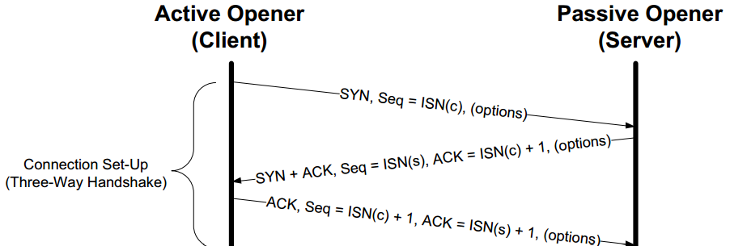
TCP Connection Setup

Slide 18
TCP Connection Setup
The active opener (client)
sends a SYN segment (SYN bit field turned on)
specifying the port number of the peer to which it wants to connect and the client’s initial sequence number or ISN(c)
It typically sends one or more options at this point. This is segment 1.
The passive opener (server) responds with its
own SYN segment containing its initial sequence number (ISN(s)).
also acknowledges the client’s SYN by ACKing ISN(c) plus 1. This is segment 2.
The client must acknowledge this SYN
from the server by ACKing ISN(s) plus 1. This is segment 3.

Slide 19
TCP Connection Setup
Initial Sequence Number:
The Sequence Number field in SYN segment
contains the first sequence number to be used on that direction of the connection
for subsequent sequence numbers and in returning ACK numbers.
This number is not 0 or 1 but instead is another number
often randomly chosen, called the initial sequence number (ISN).
The reason for the ISN not being 0 or 1: ????

Slide 20
TCP Connection Setup
MSS option (most commonly used)
Each end of a connection specifies this option with the SYN segment.
The MSS option specifies
maximum-size segment, end host is willing to receive in the reverse direction.
Typically set to
(MTU of directly connected network – size of TCP and IP headers)
TCP_MAXSEG socket option

Slide 21
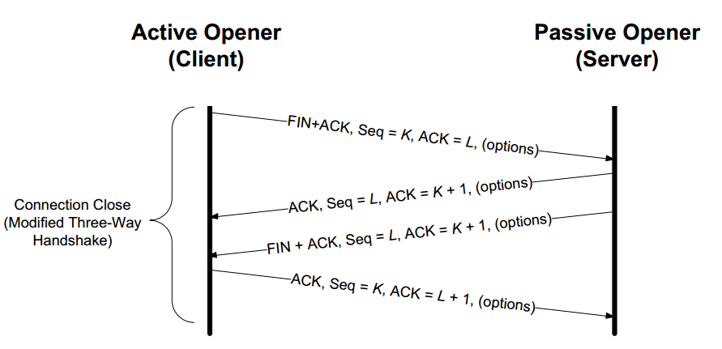
TCP Connection Termination

Slide 22
TCP Connection Termination
The active closer sends a FIN segment
specifying the current sequence number the receiver expects to see (K)
FIN also includes an ACK for the last data sent in the other direction (L)
The passive closer responds by
ACKing value K + 1: successful receipt of the active closer’s FIN.
The passive closer then effectively becomes another active closer and sends its own FIN. The sequence number is equal to L.
To complete the close, the final segment contains an ACK for the last FIN.
if a FIN is lost, it is retransmitted until an ACK for it is received.
Berkley Sockets: close() and shutdown() system calls, TCP Half close:
"I am done sending data, so send a FIN to the other end, but I still want to receive data from the other end, until it sends me a FIN."

Slide 23
Flow/Congestion/Error Control
Flow Control
Algorithms to prevent that the sender overruns the receiver with information
Error Control
Algorithms to recover from or conceal the effects from packet losses
Congestion Control
Algorithms to prevent that the sender overloads the network
The goals of each control mechanisms are different
In TCP, the implementation of these algorithms is combined

Slide 24
Acknowledgements in TCP
TCP receivers use acknowledgments (ACKs)
to confirm the receipt of data to the sender
Acknowledgment can be added (“piggybacked”) to
a data segment that carries data in the opposite direction
ACK information is included in TCP header
Acknowledgements are used for
flow control, error control, and congestion control

Slide 25
Cumulative Acknowledgements
TCP has cumulative acknowledgements:
An acknowledgment confirms the receipt of all unacknowledged data with a smaller sequence number
SeqNo=20 10 bytes
SeqNo=10 10 bytes
SeqNo=90 10 bytes
SeqNo=0 10 bytes
SeqNo=30 10 bytes
SeqNo=40 10 bytes
SeqNo=50 10 bytes
SeqNo=60 10 bytes
SeqNo=70 10 bytes
SeqNo=80 10 bytes
A
B
ACK 10
ACK 20
ACK 40
ACK 70
ACK 100

Slide 26
Cumulative Acknowledgements
With cumulative ACKs
the receiver can only acknowledge a segment if all previous segments have been received
receiver cannot selectively acknowledge blocks of segments:
e.g., ACK for S₀-S₃ and S₅-S₇ (but not for S₄)
The use of cumulative ACKs imposes constraints on the retransmission schemes:
In case of an error, the sender may need to
retransmit all data that has not been acknowledged

Slide 27
TCP Flow Control

Slide 28
TCP Flow Control
TCP uses a version of the sliding window flow control, where
Sending acknowledgements is separated from setting the window size at sender
Acknowledgements do not automatically increase the window size
During connection establishment, both ends of a TCP connection set the initial size of the sliding window

Slide 29
Window Management in TCP
The receiver is returning two parameters to the sender
The interpretation is:
I am ready to receive new data with
SeqNo= AckNo, AckNo+1, …., AckNo+Win-1

Slide 30
Sliding Window Flow Control
Sliding Window Protocol is performed at the byte level:
Here: Sender can transmit sequence numbers 6,7,8.

Slide 31
Sliding Window: “Window Closes”
Transmission of a single byte (with SeqNo = 6) and acknowledgement is received (AckNo = 5, Win=4):

Slide 32
Sliding Window: “Window Opens”
Acknowledgement is received that enlarges the window to the right (AckNo = 5, Win=6):
A receiver opens a window when TCP buffer empties (meaning that data is delivered to the application).

Slide 33
Sliding Window: “Window Shrinks”
Acknowledgement is received that reduces the window from the right (AckNo = 5, Win=3):
Shrinking a window should not be used

Slide 34
Sliding Window: Example
Zero window Advertisement
Persistence Timer……Then Zero Window Probe (More on this Later)

Slide 35
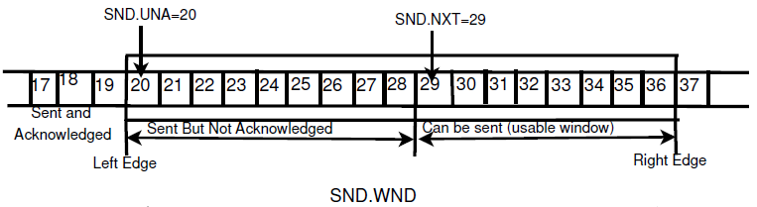
Sliding Window: Bit more details
SND.WND
gives the number of unacknowledged packets
SND.UNA
represents first unacknowledged packet
SND.NXT represents the sequence number of next packet
which can be sent without waiting for any acknowledgement.

Slide 36
Sliding Window: Important Issue
usable_window = SND.UNA + SND.WND − SND.NXT
= 20+17-29 = 8
Suppose in the snapshot of previous slide:
There is a ZWA (Zero Window Advertisement)
Which also acknowledges 25
It makes usable window negative (26+0-29 = -3)
According to RFC 793 and RFC 1122, shrinking of window is discouraged.
It is stated that TCP receiver should not shrink the window.
However, TCP sender should be robust against any such window shrinking (which causes negative usable window).
This unclear statement of RFC lead to variations in TCP implementations

Slide 37
Error Control in TCP
TCP maintains a Retransmission Timer for each connection:
The timer is started during a transmission. A timeout causes a retransmission
TCP couples error control and congestion control (i.e., it assumes that errors are caused by congestion)
Retransmission is part of congestion control algorithm
Here: How to set the timeout value of the retransmission timer?

Slide 38
TCP Retransmission Timer
Retransmission Timer:
The setting of the retransmission timer is crucial
Timeout value too small → unnecessary retransmissions
Timeout value too large → long waiting time before a retransmission can be issued
A problem is that the delays in the network are not fixed
Therefore, the retransmission timers must be adaptive
(More on it Later)

Slide 39
TCP ACK generation [RFC 1122, RFC 2581]
Event at Receiver
Arrival of in-order segment with
expected seq #. All data up to
expected seq # already ACKed
Arrival of in-order segment with
expected seq #. One other
segment has ACK pending
Arrival of out-of-order segment
higher-than-expect seq. # .
Gap detected
Arrival of segment that
partially or completely fills gap
TCP Receiver action
Delayed ACK. Wait up to 500ms
for next segment. If no next segment,
send ACK
Immediately send single cumulative
ACK, ACKing both in-order segments
Immediately send duplicate ACK,
indicating seq. # of next expected byte
Immediate send ACK, provided that
segment starts at lower end of gap

Slide 40
TCP Congestion Control

Slide 41
TCP Congestion Control
TCP has a mechanism for congestion control.
The mechanism is implemented at the sender
The window size at the sender is set as follows:
Send Window = MIN (flow control window, congestion window)
where
flow control window
is advertised by the receiver
congestion window
is adjusted based on feedback from the network

Slide 42
TCP Congestion Control Algorithms
The standard TCP implementations today follow RFC 2581.
This reference document specifies four standard congestion control algorithms that are now in common use.
The four algorithms are:
Slow Start
Congestion Avoidance
Fast Retransmit
Fast Recovery

Slide 43
TCP Congestion Control
TCP congestion control is governed by
Congestion Window (cwnd)
Slow-start threshhold Value (ssthresh)
Initial value is 2¹⁶-1
Congestion control works in two modes:
slow start (cwnd < ssthresh)
congestion avoidance (cwnd ≥ ssthresh)

Slide 44
Slow Start
Initial value: Set cwnd = 1
Each time an ACK is received by the sender
the congestion window is increased by 1 segment:
cwnd = cwnd + 1
Does Slow Start increment slowly?
Not really.
In fact, the increase of cwnd is exponential

Slide 45
Slow Start Example
The congestion window size grows very rapidly
TCP slows down the increase of cwnd when cwnd > ssthresh

Slide 46
Congestion Avoidance
Congestion avoidance phase is started if
cwnd has reached the slow-start threshold value
If cwnd ≥ ssthresh then each time an ACK is received
increment cwnd as follows:
cwnd = cwnd + 1/ cwnd
So cwnd is increased by one only if all cwnd segments have been acknowledged.

Slide 47
Example
Assume that ssthresh = 8
ssthresh
Cwnd (in segments)
Roundtrip times

Slide 48
Responses to Congestion
TCP assumes there is congestion if it detects a packet loss
A TCP sender can detect lost packets via:
Timeout of a retransmission timer
Receipt of a duplicate ACK

Slide 49
Responses to Congestion
TCP interprets a Timeout as a binary congestion signal
When a timeout occurs, the sender performs:
cwnd is reset to one:
cwnd = 1
ssthresh is set to half the current size of the congestion window:
ssthressh = cwnd / 2
and slow-start is entered

Slide 50
Summary : Congestion Control
Initially:
cwnd = 1;
ssthresh = advertised window size;
New Ack received:
if (cwnd < ssthresh)
/* Slow Start*/
cwnd = cwnd + 1;
else
/* Congestion Avoidance */
cwnd = cwnd + 1/cwnd;
Timeout:
/* Multiplicative decrease */
ssthresh = cwnd/2;
cwnd = 1;

Slide 51
Fast Retransmit
If three or more duplicate ACKs are received in a row
TCP sender believes that a segment has been lost.
TCP performs a retransmission of what seems to be the missing segment
without waiting for a timeout to happen.
Enter slow start:
ssthresh = cwnd/2
cwnd = 1

Slide 52
Fast Recovery
Fast recovery avoids slow start after a fast retransmit
Intuition: Duplicate ACKs indicate that data is getting through
After three duplicate ACKs set:
Retransmit packet that is presumed lost
ssthresh = cwnd/2
cwnd = cwnd/2 +3
Increment cwnd by one for each additional duplicate ACK
When ACK arrives that acknowledges “new data”
cwnd=ssthresh and enter congestion avoidance

Slide 53
Comparison (TCP Variants)
Tahoe:
Slow start, congestion avoidance and fast retransmit
Reno:
Tahoe + fast recovery
New-Reno:
Reno with modified fast recovery
SACK:
Reno + selective ACKs

Slide 54
Tahoe:
On new ack:
if (cwnd < sstresh)
-- cwnd += 1
else
-- cwnd += 1/cwnd
On timeout/3rd dup ack:
-- retransmit all unacked
-- ssthresh = cwnd/2
-- cwnd = 1

Slide 55
Reno: Improving TCP Tahoe
Packets still getting through in dup ack
no need to reset the clock!
On new ack:
if (cwnd < sstresh)
-- cwnd += 1
else
-- cwnd += 1/cwnd

Slide 56
Reno:
timeout:
retransmit 1st unacked
ssthresh = cwnd/2
cwnd = 1
3rd dup ack:
retransmit 1st unacked
ssthresh = cwnd/2
cwnd = cwnd/2 + 3

Slide 57
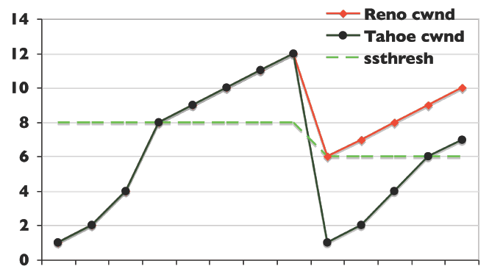
Reno:
subsequent dup ack:
cwnd++
new ack:
cwnd = ssthresh

Slide 58
TCP With SACK
Based on RFC 2018
(TCP Selective Acknowledgement Options) –standards track
Good for when multiple packets are lost
from one window of data
Gives sender view of
which segments queued at receiver and which in flight
Uses two TCP options
“SACK permitted”
may be sent in a SYN segment
SACK option itself
may be sent over an established connection
Notes:
SACK option itself, which may be sent over an established connection one permission has been given
By SACK-permitted

Slide 59
SACK Options : Format
Sack-permitted option
Two bytes option
Sack option itself (Kind = 5, Length=variable)
Kind = 2
Length = 4
Kind = 5
Length
Left edge of 1st block
Right edge of 1st block
Left edge of n^{th} block
Right edge of n^{th} block

Slide 60
SACK Options : Examples
Assume the left edge is 5000 and transmitter sends a burst of 8 segments, each containing 500 data bytes
Example (1) The first four segments are received but the last 4 are dropped
The data receiver will return a normal TCP ACK segment acknowledging sequence number 7000, with no SACK option

Slide 61
SACK Options : Examples
Example (2) The first segment is lost but the remaining 7 segments are received.
Receiver will return a TCP ACK segment that acknowledges sequence number 5000 and contains SACK option specifying one block of queued data
LE = Left Edge
RE = Right Edge

Slide 62
SACK Options : Examples
Example (3)The 2nd, 4th, 6th and 8th (last) segments are dropped.
First block
Second block
Third block
Left
Edge
Right
Edge
Left
Edge
Right
Edge
Left
Edge
Right
Edge
(a)
SACK not used
(b)
6000
6500
(c)
7000
7500
6000
6500
(d)
8000
8500
7000
7500
6000
6500

Slide 63
SACK Options : Examples
Suppose at this point (continue from pervious example) the 4th packet is received out of order.
Receiver replies with the following SACK:
ACK
First block
Second block
Third block
Left
edge
Right
edge
Left
edge
Right
edge
Left
edge
Right
edge
5500
6000
7500
8000
8500

Slide 64
SACK Options : Examples
Suppose that the 2nd segment is received.
Receiver replies with the following SACK:
First block
7500
8000
8500

Slide 65
SACK Blocks
1st block - report most recently received segments
subsequent blocks – repeat most recent previous blocks

