Slide 1
Variable Length Subnet Masking (VLSM)
Supports more efficient use of the assigned IP addresses and reduces the amount of routing information at the top level

Slide 2
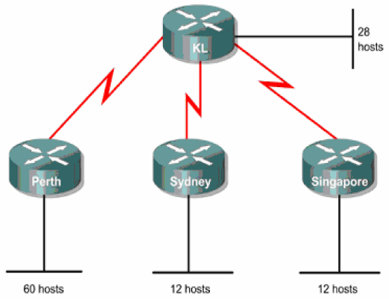
VLSM (By Example)
Class C address 192.168.10.0/24 has been allocated
Perth, Sydney and Singapore have a WAN connection to Kuala Lumpur
Hosts Required:
Perth – 60, Kuala Lumpur – 28, Sydney – 12, Singapore – 12 hosts

Slide 3
VLSM (By Example)
To calculate VLSM subnets and the respective hosts allocate the largest requirements first from the address range
Requirements levels should be listed from the largest to the smallest
In this example, Perth requires 60 hosts (largest)
  Use 6 bits, since 2⁶ – 2 = 62 usable addresses
  2 bits will be used from the 4th octet to represent the extended-network-prefix of /26
  Remaining 6 bits will be used for host addresses

Slide 4
VLSM (By Example)
Step I : Divide the allocated address of 192.168.10.0/24 into four equal-size address blocks
  Since 4 = 2², 2 bits are required to identify each of the 4 subnets
  Next take subnet #0 (192.168.10.0/26) and identify its hosts
Allocated Address | Sub-networks | 62 usable addresses/sub-network (subnet #0)
192.168.10.0/24 | 192.168.10.0/26 | 192.168.10.0/26 (Network Address)
 | 192.168.10.64/26 | 192.168.10.1/26 (for Router interface)
 | 192.168.10.128/26 | 192.168.10.2/26 (Host 1)
 | 192.168.10.192/26 | 192.168.10.3/26 (Host 2)
 |  | thru
 |  | 192.168.10.61/26 (Host 60)
 |  | 192.168.10.62/26 (unused)
 |  | 192.168.10.63/26 (Broadcast Address)

Slide 5
VLSM (By Example)
Here is the range for /26 mask
Perth | Range of addresses in the last octet
192.168.10.0/26 | From 0 to 63, 60 hosts are required Hosts 0 and 63 cannot be used because they are the network and broadcast addresses for their subnet First usable address given to router interface Next 60 addresses given to hosts Last address is unused

Slide 6
VLSM (By Example)
Step II: Allocate next level after all requirements for higher level
  Kuala Lumpur requires 28 hosts; Next available address is 192.168.10.64/26
  5 bits needed for hosts, since 2⁵ – 2 = 30 usable addresses
  3 bits will be used to represent the extended-network-prefix of /27
  Applying VLSM on 192.168.10.64/26
Sub-network #1 | Sub-sub-networks | 30 usable addresses
192.168.10.64/26 | 192.168.10.64/27 | 192.168.10.64/27 (Network Address)
 | 192.168.10.96/27 | 192.168.10.65/27 (for Router interface)
 |  | 192.168.10.66/27 (Host 1)
 |  | 192.168.10.67/27 (Host 2)
 |  | thru
 |  | 192.168.10.93/27 (Host 28)
 |  | 192.168.10.94/27 (unused)
 |  | 192.168.10.95/27 (Broadcast Address)

Slide 7
VLSM (By Example)
Here is the range for /27 mask
Kuala Lumpur | Range of addresses in the last octet
192.168.10.64/27 | From 64 to 95, 28 hosts are required Hosts 64 and 95 cannot be used because they are the network and broadcast addresses for their subnet First usable address given to router interface Next 28 addresses given to hosts Last address is unused

Slide 8
VLSM (By Example)
Step III : Allocate next level after all requirements for higher level
  Sydney requires 12 hosts; Next available address is 192.168.10.96/27
  4 bits needed for hosts, since 2⁴ – 2 = 14 usable addresses
  4 bits will be used to represent the extended-network-prefix of /28
  Applying VLSM on 192.168.10.96/27
Sub-network #1 | Sub-sub-networks | 14 usable addresses
192.168.10.96/27 | 192.168.10.96/28 | 192.168.10.96/28 (Network Address)
 | 192.168.10.112/28 | 192.168.10.97/28 (for Router interface)
 |  | 192.168.10.98/28 (Host 1)
 |  | 192.168.10.99/28 (Host 2)
 |  | thru
 |  | 192.168.10.109/28 (Host 12)
 |  | 192.168.10.110/28 (unused)
 |  | 192.168.10.111/28 (Broadcast Address)

Slide 9
VLSM (By Example)
Here is the range for /28 mask
Sydney | Range of addresses in the last octet
192.168.10.96/28 | From 96 to 111, 12 hosts are required Hosts 96 and 111 cannot be used because they are the network and broadcast addresses for their subnet First usable address given to router interface Next 12 addresses given to hosts Last address is unused

Slide 10
VLSM (By Example)
Step IV : Allocate next level after all requirements for higher level
  Singapore requires 12 hosts; Next available address is 192.168.10.112/28
  4 bits needed for hosts, since 2⁴ – 2 = 14 usable addresses
  4 bits will be used to represent the extended-network-prefix of /28
  Using 192.168.10.112/28
Sub-network #1 | Sub-sub-networks | 14 usable addresses
192.168.10.96/27 | 192.168.10.112/28 | 192.168.10.112/28 (Network Address)
 |  | 192.168.10.113/28 (for Router interface)
 |  | 192.168.10.114/28 (Host 1)
 |  | 192.168.10.115/28 (Host 2)
 |  | Thru
 |  | 192.168.10.125/28 (Host 12)
 |  | 192.168.10.126/28 (unused)
 |  | 192.168.10.127/28 (Broadcast Address)

Slide 11
VLSM (By Example)
Here is the range for /28 mask
Singapore | Range of addresses in the last octet
192.168.10.112/28 | From 112 to 127, 12 hosts are required Hosts 112 and 127 cannot be used because they are the network and broadcast addresses for their subnet First usable address given to router interface Next 12 addresses given to hosts Last address is unused

Slide 12
VLSM (By Example)
Step V : Now allocate addresses for WAN links
  Each WAN link requires 2 IP addresses
  Next available address is 192.168.10.128/28
  2 bits needed, since 2² – 2 = 2 usable addresses
  2 bits required to represent the links
  6 bits for the extended-network-prefix of /30
  Applying VLSM on 192.168.10.112/28

Slide 13
VLSM (By Example)
Sub-sub-networks | 14 usable addresses
192.168.10.128/30 | 192.168.10.128/30 (Network Address)
(WAN Link A b/w Kuala Lumpur and Singapore) | 192.168.10.129/30 (interface 1 at Singapore)
 | 192.168.10.130/30 (interface 2 at Kuala Lumpur)
 | 192.168.10.131/30 (Broadcast Address)
192.168.10.132/30 | 192.168.10.132/30 (Network Address)
(WAN Link B b/w Kuala Lumpur and Sydney) | 192.168.10.133/30 (interface 1 at Sydney)
 | 192.168.10.134/30 (interface 2 at Kuala Lumpur)
 | 192.168.10.135/30 (Broadcast Address)
192.168.10.136/30 | 192.168.10.136/30 (Network Address)
(WAN Link C b/w Kuala Lumpur and Perth) | 192.168.10.137/30 (interface 1 at Perth)
 | 192.168.10.138/30 (interface 2 at Kuala Lumpur)
 | 192.168.10.139/30 (Broadcast Address)

Slide 14
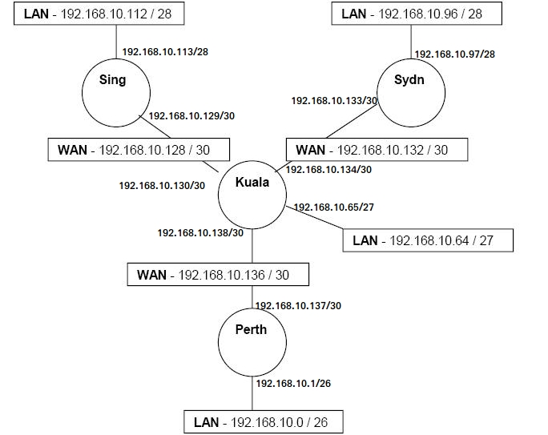
VLSM (By Example) – Solution Diagram

Slide 15
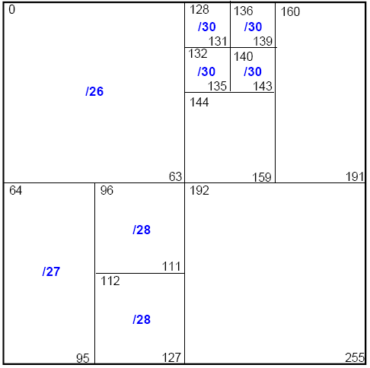
VLSM (By Example)
This is how the Class C address was subnetted using VLSM
The network address and broadcast address for each subnet are shown in the corners of each box

Slide 16
Routing Table for Router at Perth
Network Destination | Network Mask | Next-hop | Interface
192.168.10.0 | /26 | Direct | 192.168.10.1/26
192.168.10.136 | /30 | Direct | 192.168.10.137/30
192.168.10.64 | /27 | 192.168.10.138 | 192.168.10.137/30
192.168.10.132 | /30 | 192.168.10.138 | 192.168.10.137/30
192.168.10.96 | /28 | 192.168.10.138 | 192.168.10.137/30
192.168.10.128 | /30 | 192.168.10.138 | 192.168.10.137/30
192.168.10.112 | /28 | 192.168.10.138 | 192.168.10.137/30

Slide 17
Routing Table for Router at Sydney
Network Destination | Network Mask | Next-hop | Interface
192.168.10.96 | /28 | Direct | 192.168.10.97/26
192.168.10.132 | /30 | Direct | 192.168.10.133/30
192.168.10.64 | /27 | 192.168.10.134 | 192.168.10.133/30
192.168.10.136 | /30 | 192.168.10.134 | 192.168.10.133/30
192.168.10.0 | /26 | 192.168.10.134 | 192.168.10.133/30
192.168.10.128 | /30 | 192.168.10.134 | 192.168.10.133/30
192.168.10.112 | /28 | 192.168.10.134 | 192.168.10.133/30

Slide 18
Routing Table for Router at Singapore
Network Destination | Network Mask | Next-hop | Interface
192.168.10.112 | /28 | Direct | 192.168.10.113/28
192.168.10.128 | /30 | Direct | 192.168.10.129/30
192.168.10.64 | /27 | 192.168.10.130 | 192.168.10.129/30
192.168.10.132 | /30 | 192.168.10.130 | 192.168.10.129/30
192.168.10.96 | /28 | 192.168.10.130 | 192.168.10.129/30
192.168.10.136 | /30 | 192.168.10.130 | 192.168.10.129/30
192.168.10.0 | /26 | 192.168.10.130 | 192.168.10.129/30

Slide 19
Routing Table for Router at Kuala Lumpur
Network Destination | Network Mask | Next-hop | Interface
192.168.10.64 | /27 | Direct | 192.168.10.65/27
192.168.10.136 | /30 | Direct | 192.168.10.138/30
192.168.10.132 | /30 | Direct | 192.168.10.134/30
192.168.10.128 | /30 | Direct | 192.168.10.130/30
192.168.10.0 | /26 | 192.168.10.137 | 192.168.10.138/30
192.168.10.96 | /28 | 192.168.10.133 | 192.168.10.134/30
192.168.10.112 | /28 | 192.168.10.129 | 192.168.10.130/30

Slide 20
Complete Scenario
Routing Table at Singapore
Network Destination | Net-Mask | Next-hop | Interface
192.168.10.112 | /28 | Direct | 192.168.10.113/28
192.168.10.128 | /30 | Direct | 192.168.10.129/30
192.168.10.64 | /27 | 192.168.10.130 | 192.168.10.129/30
192.168.10.132 | /30 | 192.168.10.130 | 192.168.10.129/30
192.168.10.96 | /28 | 192.168.10.130 | 192.168.10.129/30
192.168.10.136 | /30 | 192.168.10.130 | 192.168.10.129/30
192.168.10.0 | /26 | 192.168.10.130 | 192.168.10.129/30
Routing Table at Sydney
Network Destination /Mask | Next-hop | Interface
192.168.10.96/28 | Direct | 192.168.10.97/26
192.168.10.132/30 | Direct | 192.168.10.133/30
192.168.10.64/27 | 192.168.10.134 | 192.168.10.133/30
192.168.10.136/30 | 192.168.10.134 | 192.168.10.133/30
192.168.10.0/26 | 192.168.10.134 | 192.168.10.133/30
192.168.10.128/30 | 192.168.10.134 | 192.168.10.133/30
192.168.10.112/28 | 192.168.10.134 | 192.168.10.133/30
Routing Table at Kuala Lumpur
Network Destination | Net-Mask | Next-hop | Interface
192.168.10.64 | /27 | Direct | 192.168.10.65/27
192.168.10.136 | /30 | Direct | 192.168.10.138/30
192.168.10.132 | /30 | Direct | 192.168.10.134/30
192.168.10.128 | /30 | Direct | 192.168.10.130/30
192.168.10.0 | /26 | 192.168.10.137 | 192.168.10.138/30
192.168.10.96 | /28 | 192.168.10.133 | 192.168.10.134/30
192.168.10.112 | /28 | 192.168.10.129 | 192.168.10.130/30
Routing Table at Perth
Network Destination | Net-Mask | Next-hop | Interface
192.168.10.0 | /26 | Direct | 192.168.10.1/26
192.168.10.136 | /30 | Direct | 192.168.10.137/30
192.168.10.64 | /27 | 192.168.10.138 | 192.168.10.137/30
192.168.10.132 | /30 | 192.168.10.138 | 192.168.10.137/30
192.168.10.96 | /28 | 192.168.10.138 | 192.168.10.137/30
192.168.10.128 | /30 | 192.168.10.138 | 192.168.10.137/30
192.168.10.112 | /28 | 192.168.10.138 | 192.168.10.137/30

Slide 21
Packet Transfer
Source IP : 192.168.10.70 Dest IP: 192.168.10.120

Slide 22
Packet Transfer
Dest IP : 192.168.10.120 AND Net-mask: 255.255.255.240 (/28)
ANDing: (showing the last octet) 01111000 AND 11110000 = 01110000 i.e. 192.168.10.112
Source IP : 192.168.10.70 Dest IP: 192.168.10.120
Routing Table at Kuala Lumpur
Network Destination | Net-Mask | Next-hop | Interface
192.168.10.64 | /27 | Direct | 192.168.10.65/27
192.168.10.136 | /30 | Direct | 192.168.10.138/30
192.168.10.132 | /30 | Direct | 192.168.10.134/30
192.168.10.128 | /30 | Direct | 192.168.10.130/30
192.168.10.0 | /26 | 192.168.10.137 | 192.168.10.138/30
192.168.10.96 | /28 | 192.168.10.133 | 192.168.10.134/30
192.168.10.112 | /28 | 192.168.10.129 | 192.168.10.130/30

Slide 23
Packet Transfer
Dest IP : 192.168.10.120 AND Net-mask: 255.255.255.240 (/28)
ANDing: (showing the last octet) 01111000 AND 11110000 = 01110000 i.e. 192.168.10.112
Source IP : 192.168.10.70 Dest IP: 192.168.10.120
Routing Table at Kuala Lumpur
Network Destination | Net-Mask | Next-hop | Interface
192.168.10.64 | /27 | Direct | 192.168.10.65/27
192.168.10.136 | /30 | Direct | 192.168.10.138/30
192.168.10.132 | /30 | Direct | 192.168.10.134/30
192.168.10.128 | /30 | Direct | 192.168.10.130/30
192.168.10.0 | /26 | 192.168.10.137 | 192.168.10.138/30
192.168.10.96 | /28 | 192.168.10.133 | 192.168.10.134/30
192.168.10.112 | /28 | 192.168.10.129 | 192.168.10.130/30

Slide 24
Packet Transfer
Source IP : 192.168.10.70 Dest IP: 192.168.10.120
Routing Table at Kuala Lumpur
Network Destination | Net-Mask | Next-hop | Interface
192.168.10.64 | /27 | Direct | 192.168.10.65/27
192.168.10.136 | /30 | Direct | 192.168.10.138/30
192.168.10.132 | /30 | Direct | 192.168.10.134/30
192.168.10.128 | /30 | Direct | 192.168.10.130/30
192.168.10.0 | /26 | 192.168.10.137 | 192.168.10.138/30
192.168.10.96 | /28 | 192.168.10.133 | 192.168.10.134/30
192.168.10.112 | /28 | 192.168.10.129 | 192.168.10.130/30

Slide 25
Packet Transfer
Routing Table at Singapore
Network Destination | Net-Mask | Next-hop | Interface
192.168.10.112 | /28 | Direct | 192.168.10.113/28
192.168.10.128 | /30 | Direct | 192.168.10.129/30
192.168.10.64 | /27 | 192.168.10.130 | 192.168.10.129/30
192.168.10.132 | /30 | 192.168.10.130 | 192.168.10.129/30
192.168.10.96 | /28 | 192.168.10.130 | 192.168.10.129/30
192.168.10.136 | /30 | 192.168.10.130 | 192.168.10.129/30
192.168.10.0 | /26 | 192.168.10.130 | 192.168.10.129/30
Source IP : 192.168.10.70 Dest IP: 192.168.10.120
Dest IP : 192.168.10.120 AND Net-mask: 255.255.255.240 (/28)
ANDing: (showing the last octet) 01111000 AND 11110000 = 01110000 i.e. 192.168.10.112

Slide 26
Packet Transfer
Routing Table at Singapore
Network Destination | Net-Mask | Next-hop | Interface
192.168.10.112 | /28 | Direct | 192.168.10.113/28
192.168.10.128 | /30 | Direct | 192.168.10.129/30
192.168.10.64 | /27 | 192.168.10.130 | 192.168.10.129/30
192.168.10.132 | /30 | 192.168.10.130 | 192.168.10.129/30
192.168.10.96 | /28 | 192.168.10.130 | 192.168.10.129/30
192.168.10.136 | /30 | 192.168.10.130 | 192.168.10.129/30
192.168.10.0 | /26 | 192.168.10.130 | 192.168.10.129/30
Source IP : 192.168.10.70 Dest IP: 192.168.10.120
Dest IP : 192.168.10.120 AND Net-mask: 255.255.255.240 (/28)
ANDing: (showing the last octet) 01111000 AND 11110000 = 01110000 i.e. 192.168.10.112

Slide 27
Packet Transfer
Routing Table at Singapore
Network Destination | Net-Mask | Next-hop | Interface
192.168.10.112 | /28 | Direct | 192.168.10.113/28
192.168.10.128 | /30 | Direct | 192.168.10.129/30
192.168.10.64 | /27 | 192.168.10.130 | 192.168.10.129/30
192.168.10.132 | /30 | 192.168.10.130 | 192.168.10.129/30
192.168.10.96 | /28 | 192.168.10.130 | 192.168.10.129/30
192.168.10.136 | /30 | 192.168.10.130 | 192.168.10.129/30
192.168.10.0 | /26 | 192.168.10.130 | 192.168.10.129/30
Source IP : 192.168.10.70 Dest IP: 192.168.10.120

Slide 28
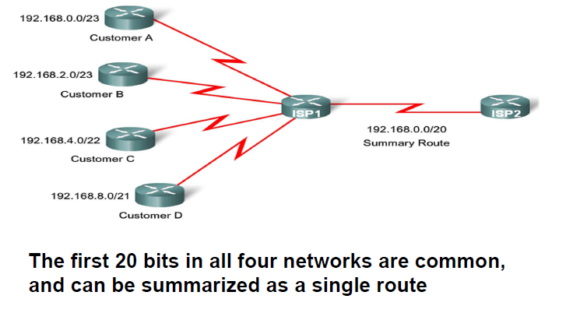
Route Summarization

Slide 29
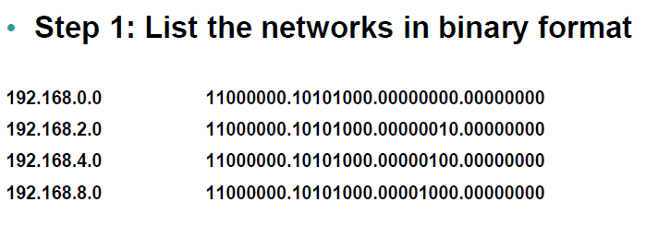
Performing Route Summarization

Slide 30
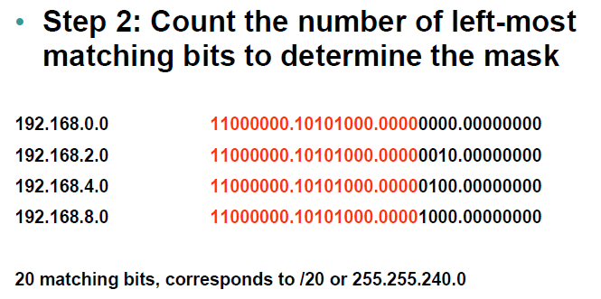
Performing Route Summarization

Slide 31
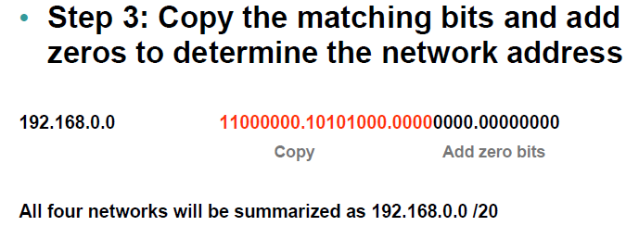
Performing Route Summarization

