Slide 1
Daily market Report of different participants
12-05-2023

Slide 2
Content
FII Daily market Report
Participants wise daily market report in Futures
Participants wise daily market report in Options
Over all market report

Slide 3
Fii Stats Report in Futures and Options
FII F&O stats in the index
FII | BUY_No. of contracts | SELL_No. of contracts | OPEN INTEREST AT THE END OF THE DAY | Total_Contracts
INDEX FUTURES | 24858 | 28298 | 186061 | 53156
FINNIFTY FUTURES | 28 | 28 | 53 | 56
BANKNIFTY FUTURES | 11735 | 7902 | 41691 | 19637
MIDCPNIFTY FUTURES | 0 | 0 | 0 | 0
NIFTY FUTURES | 13095 | 20368 | 144317 | 33463
0 | 0 | 0 | 0 | 0
INDEX OPTIONS | 9091551 | 9104440 | 2785689 | 18195991
NIFTY OPTIONS | 2922162 | 2964196 | 1445403 | 5886358
FINNIFTY OPTIONS | 753295 | 774961 | 380072 | 1528256
MIDCPNIFTY OPTIONS | 0 | 0 | 0 | 0
BANKNIFTY OPTIONS | 5416094 | 5365283 | 960214 | 10781377

Slide 4
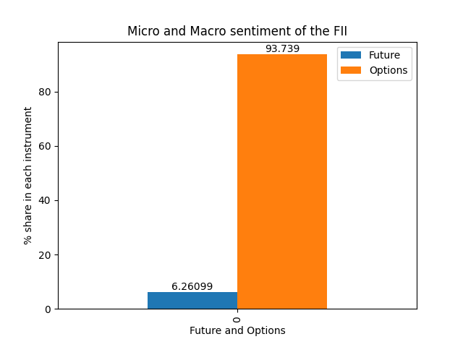
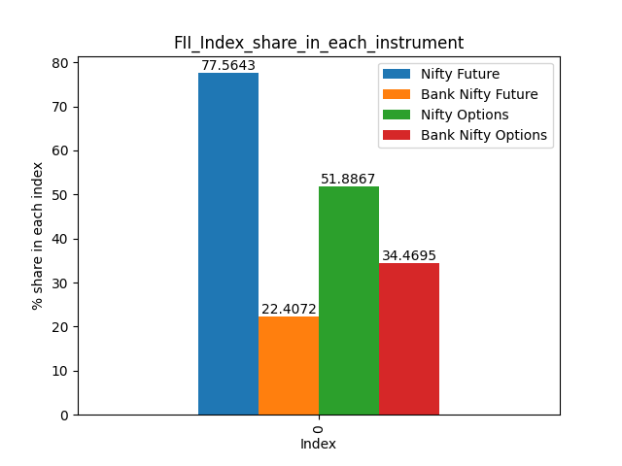
Fii Index share in F&O and Macro and Micro view

Slide 5
Participants report in Futures
Participant wise Open Interest in Equity Derivatives as on 12-05-2023
Client Type | Future Index Long | Future Index Short | Total_Future_OI | percentage_long | percentage_short | total_long_absolute | Long_vs_Short
Client | 201375 | 193452 | 394827 | 51.0 | 49.0 | 7923.0 | 1.04
DII | 47664 | 41142 | 88806 | 53.67 | 46.33 | 6522.0 | 1.16
FII | 85811 | 100250 | 186061 | 46.12 | 53.88 | -14439.0 | 0.86
Pro | 38363 | 38369 | 76732 | 50.0 | 50.0 | -6.0 | 1.0

Slide 6
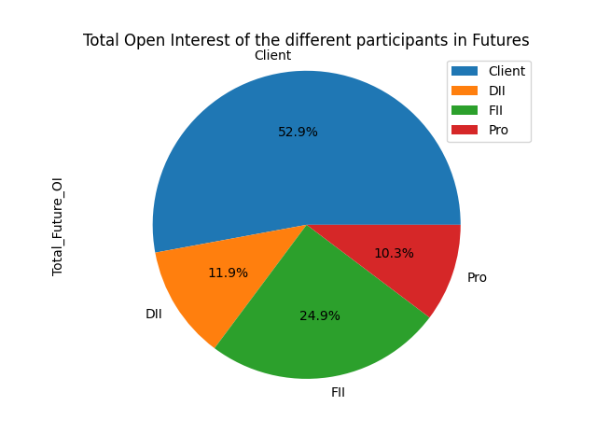
% OI of the different participants in Futures

Slide 7
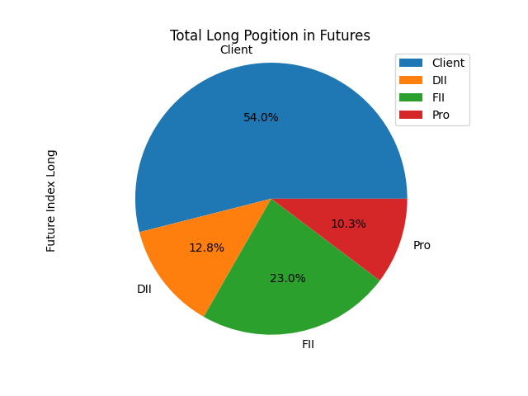
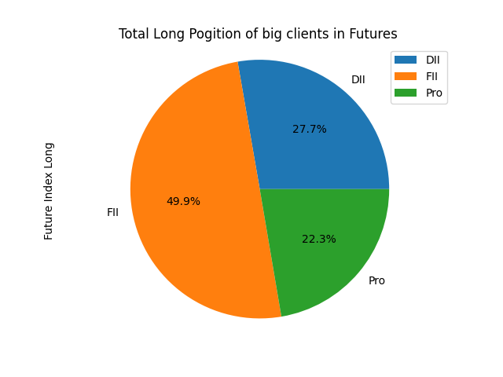
Total Long pogitions of different clients in Futures

Slide 8
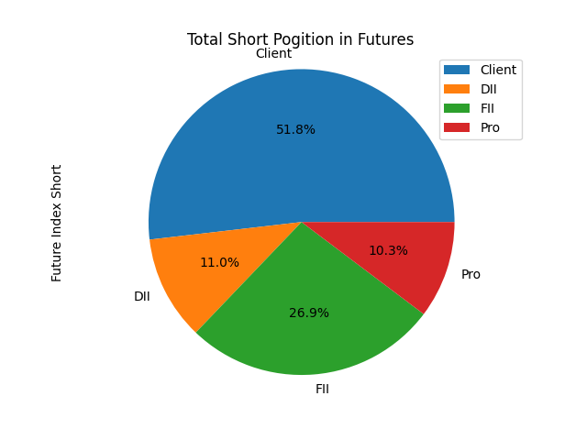
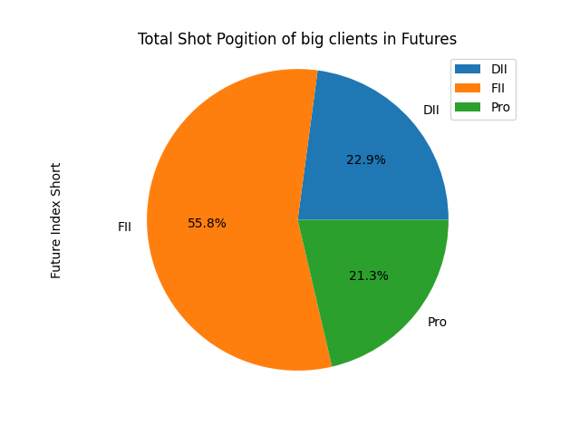
Total Shot pogitions of different clients in Futures

Slide 9
Participants report in Options
Participant wise Open Interest in Equity Derivatives as on 12-05-2023
Client Type | Option Index Call Long | Option Index Call Short | Option Index Put Long | Option Index Put Short | Total_Option_OI | total_long_Option | total_short_Option | percentage_long_option | percentage_short_option | net_long | Long_vs_Short
Client | 2818941 | 3119035 | 3616417 | 3754875 | 13309268 | 6573816 | 6735452 | 49.39 | 50.61 | -161636.0 | 0.98
DII | 401 | 0 | 73084 | 0 | 73485 | 401 | 73084 | 0.55 | 99.45 | -72683.0 | 0.01
FII | 766830 | 480564 | 897414 | 640882 | 2785690 | 1407712 | 1377978 | 50.53 | 49.47 | 29734.0 | 1.02
Pro | 1005397 | 991970 | 1209691 | 1400850 | 4607908 | 2406247 | 2201661 | 52.22 | 47.78 | 204586.0 | 1.09

Slide 10
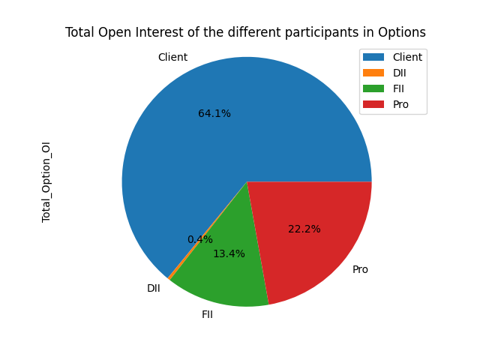
% OI of the different participants in Options

Slide 11
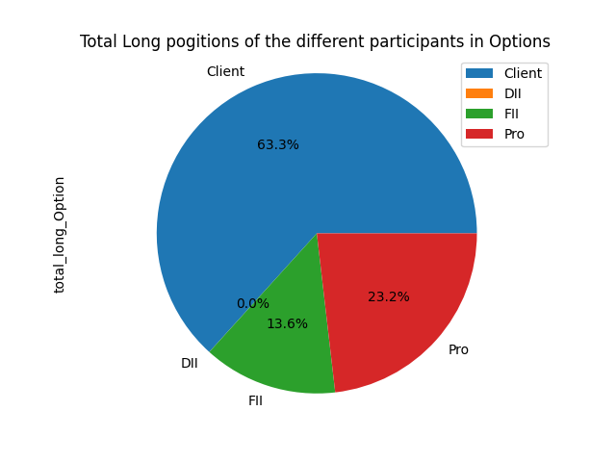
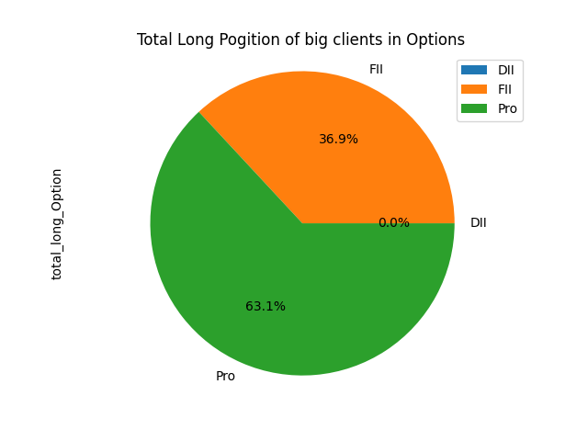
Total Long pogitions of different clients in Options

Slide 12
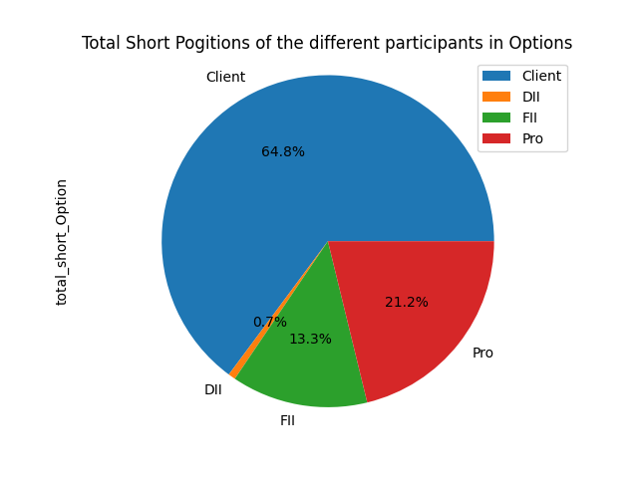
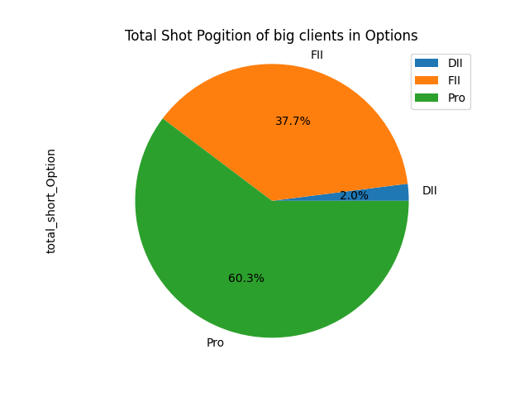
Total Shot pogitions of different clients in Options

Slide 13
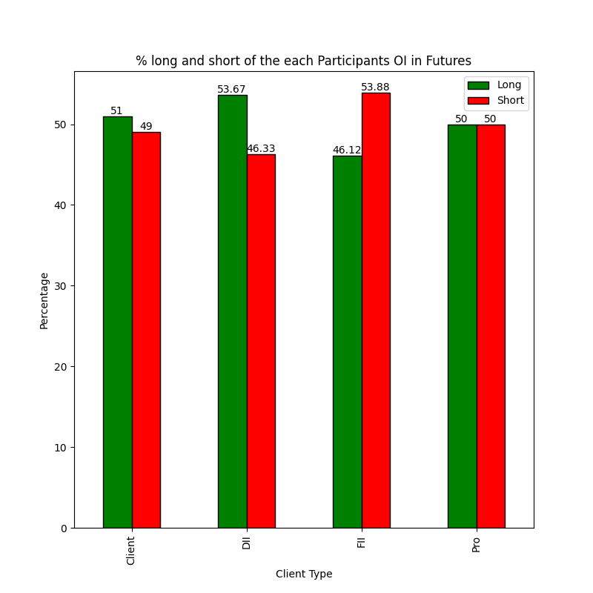
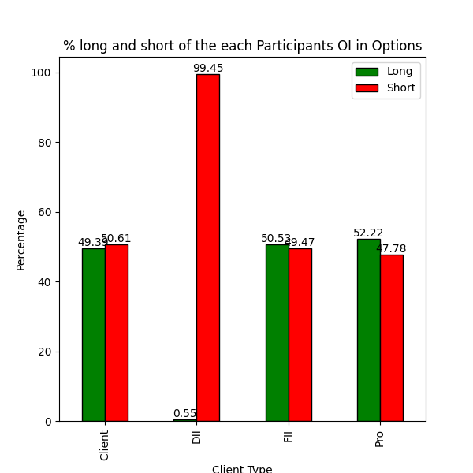
Over all % Long and the Short pogition of the different client in F&O

Slide 14
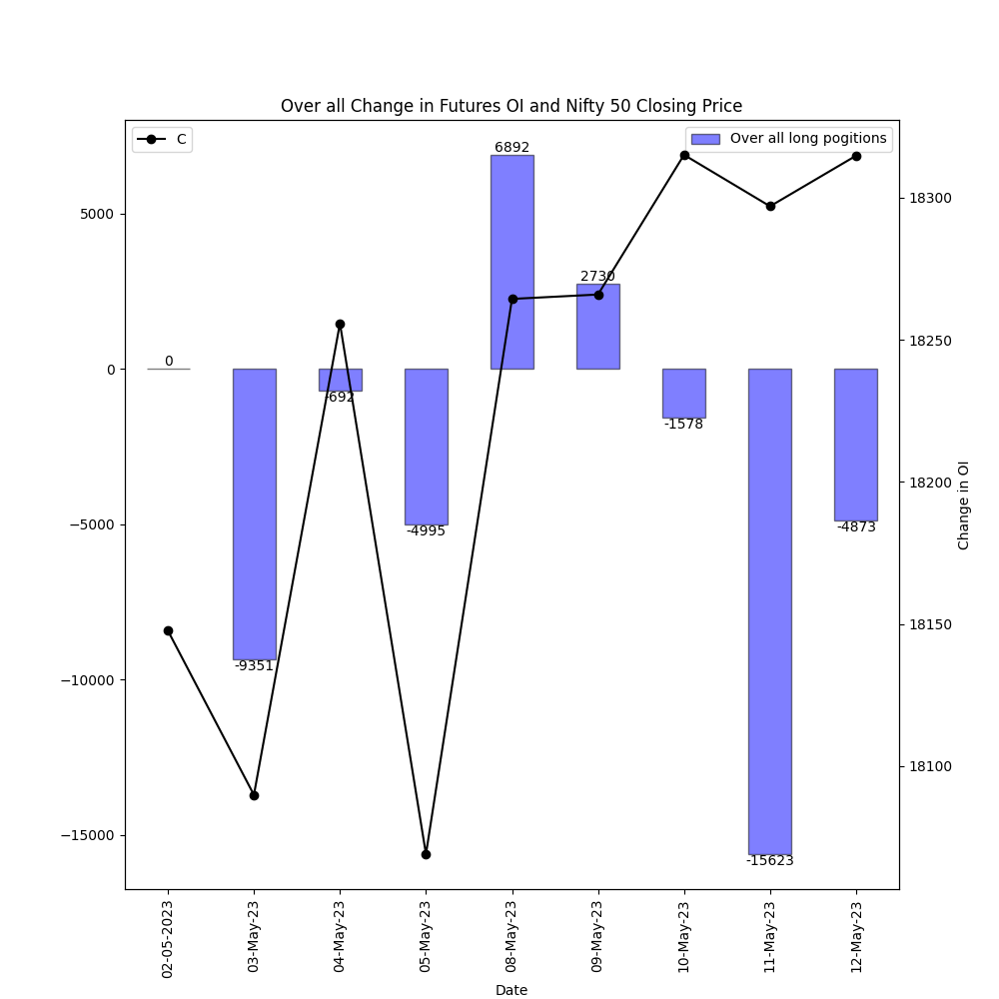
Historical OI change in the futures for Nifty 50

Slide 15
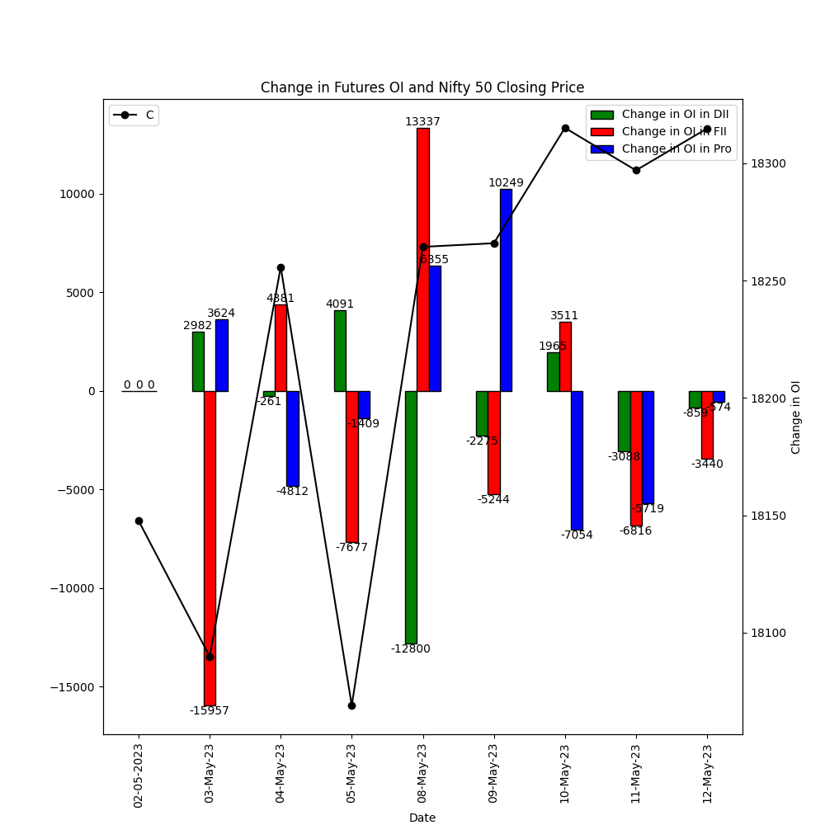
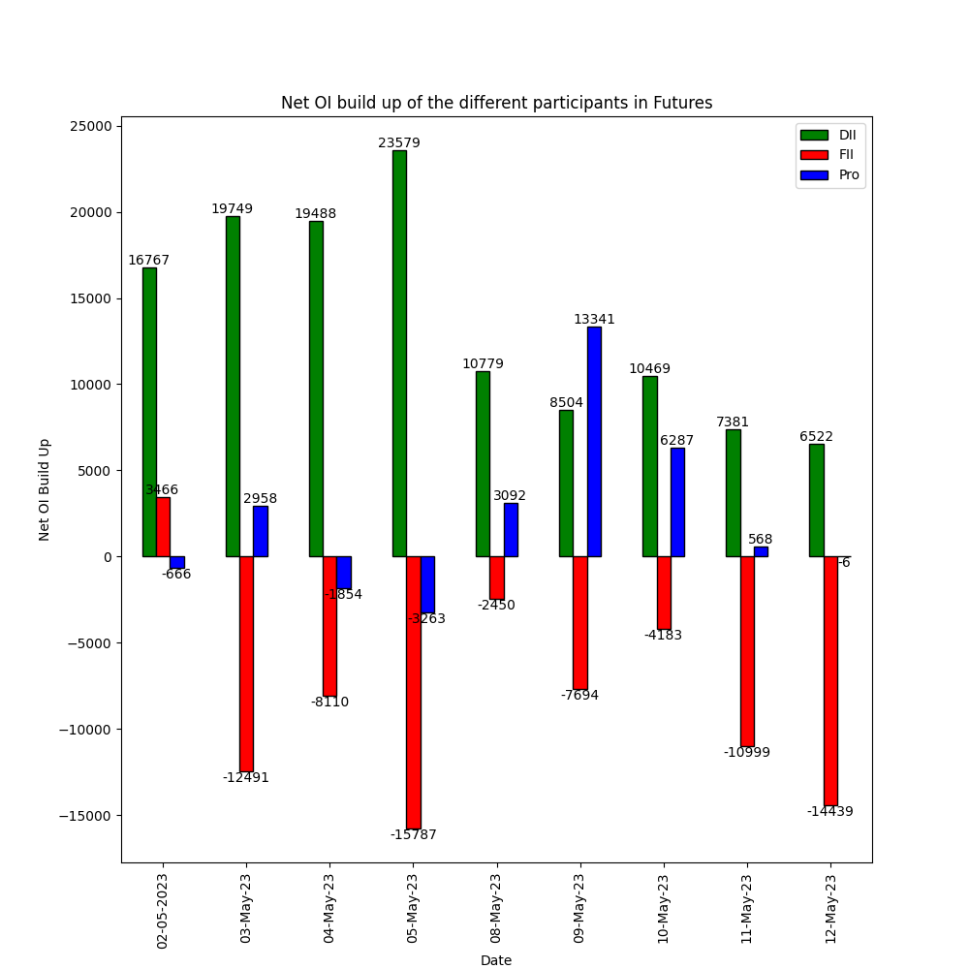
Change in OI for the different participants and Net OI Build up in Futures

Slide 16
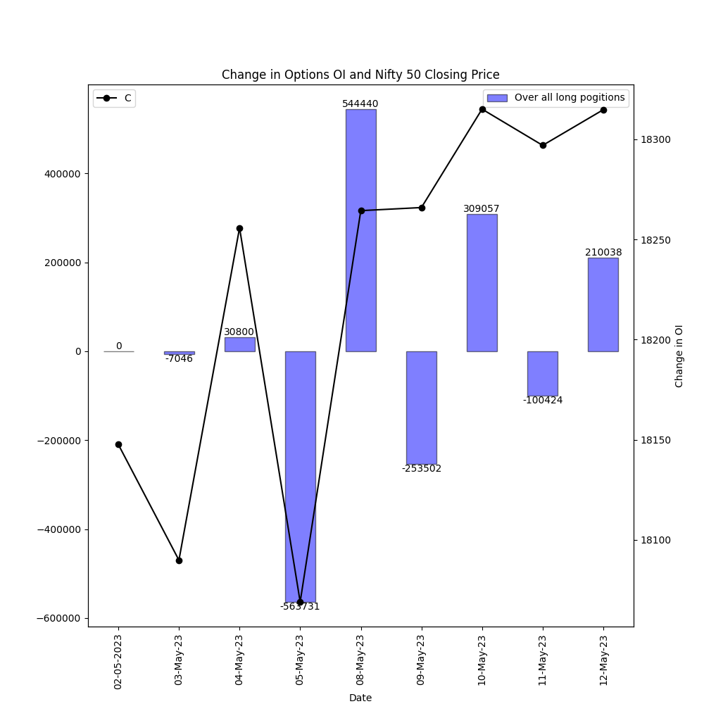
Historical OI change in the Options for Nifty 50

Slide 17
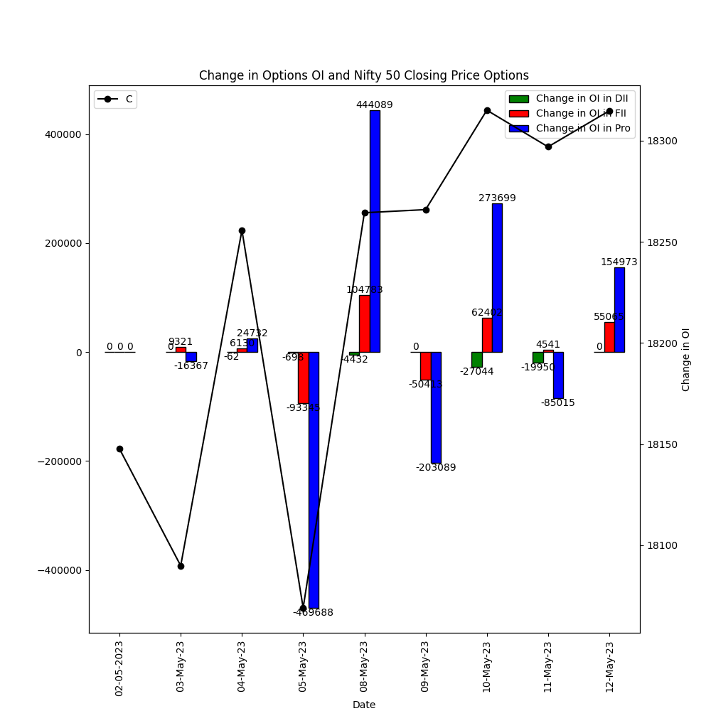
Change in OI for the different participants and Net OI Build up in Options

