Slide 2
23-05-2023
 | 03:16:05 PM | 03:16:05 PM | 09:37:25 AM | 09:37:25 AM
strikePrice | CE_OI | CE_LTP | CE_OI | CE_LTP | Change in OI | Change in LTP
18150 | 17909 | 225.35 | 21181 | 262.2 | -3272 | -36.85 | Long Covering
18200 | 70275 | 179.95 | 102250 | 215.45 | -31975 | -35.5 | Long Covering
18250 | 27438 | 137.05 | 39782 | 172.95 | -12344 | -35.9 | Long Covering
18300 | 141947 | 97.6 | 144895 | 131.85 | -2948 | -34.25 | Long Covering
18350 | 75706 | 65.25 | 73193 | 95.7 | 2513 | -30.45 | Shot Build UP
18400 | 232641 | 40.05 | 179357 | 64.55 | 53284 | -24.5 | Shot Build UP
18450 | 121941 | 22.1 | 103644 | 41.05 | 18297 | -18.95 | Shot Build UP
18500 | 211805 | 11.1 | 197881 | 23.9 | 13924 | -12.8 | Shot Build UP
18550 | 128200 | 5.15 | 97534 | 12.45 | 30666 | -7.3 | Shot Build UP
 |  |  |  |  |  |  |  | Bearish View
 | 03:16:05 PM | 03:16:05 PM | 09:37:25 AM | 09:37:25 AM
strikePrice | PE_OI | PE_LTP | PE_OI | PE_LTP | Change in OI | Change in LTP
18150 | 111010 | 8.9 | 76977 | 11.6 | 34033 | -2.7 | Shot Build UP
18200 | 231749 | 13.3 | 250558 | 15.55 | -18809 | -2.25 | Long Covering
18250 | 88316 | 20.2 | 95102 | 21.5 | -6786 | -1.3 | Long Covering
18300 | 234142 | 31.3 | 208722 | 30.3 | 25420 | 1 | Long Build Up
18350 | 96266 | 48.9 | 73553 | 44.2 | 22713 | 4.7 | Long Build Up
18400 | 139566 | 73.65 | 94342 | 63.6 | 45224 | 10.05 | Long Build Up
18450 | 24471 | 105.8 | 20078 | 89.7 | 4393 | 16.1 | Long Build Up
18500 | 45743 | 144.85 | 42010 | 122.85 | 3733 | 22 | Long Build Up
18550 | 6296 | 188.85 | 3402 | 161.6 | 2894 | 27.25 | Long Build Up

Slide 3
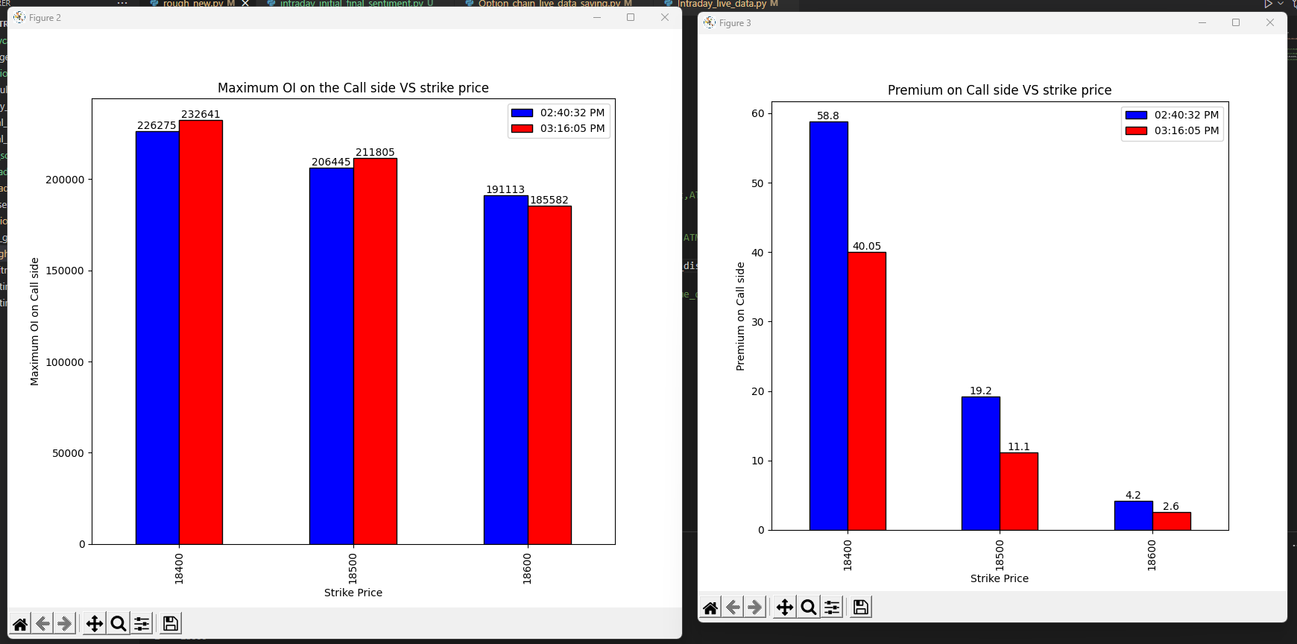
23-05-2023

Slide 4
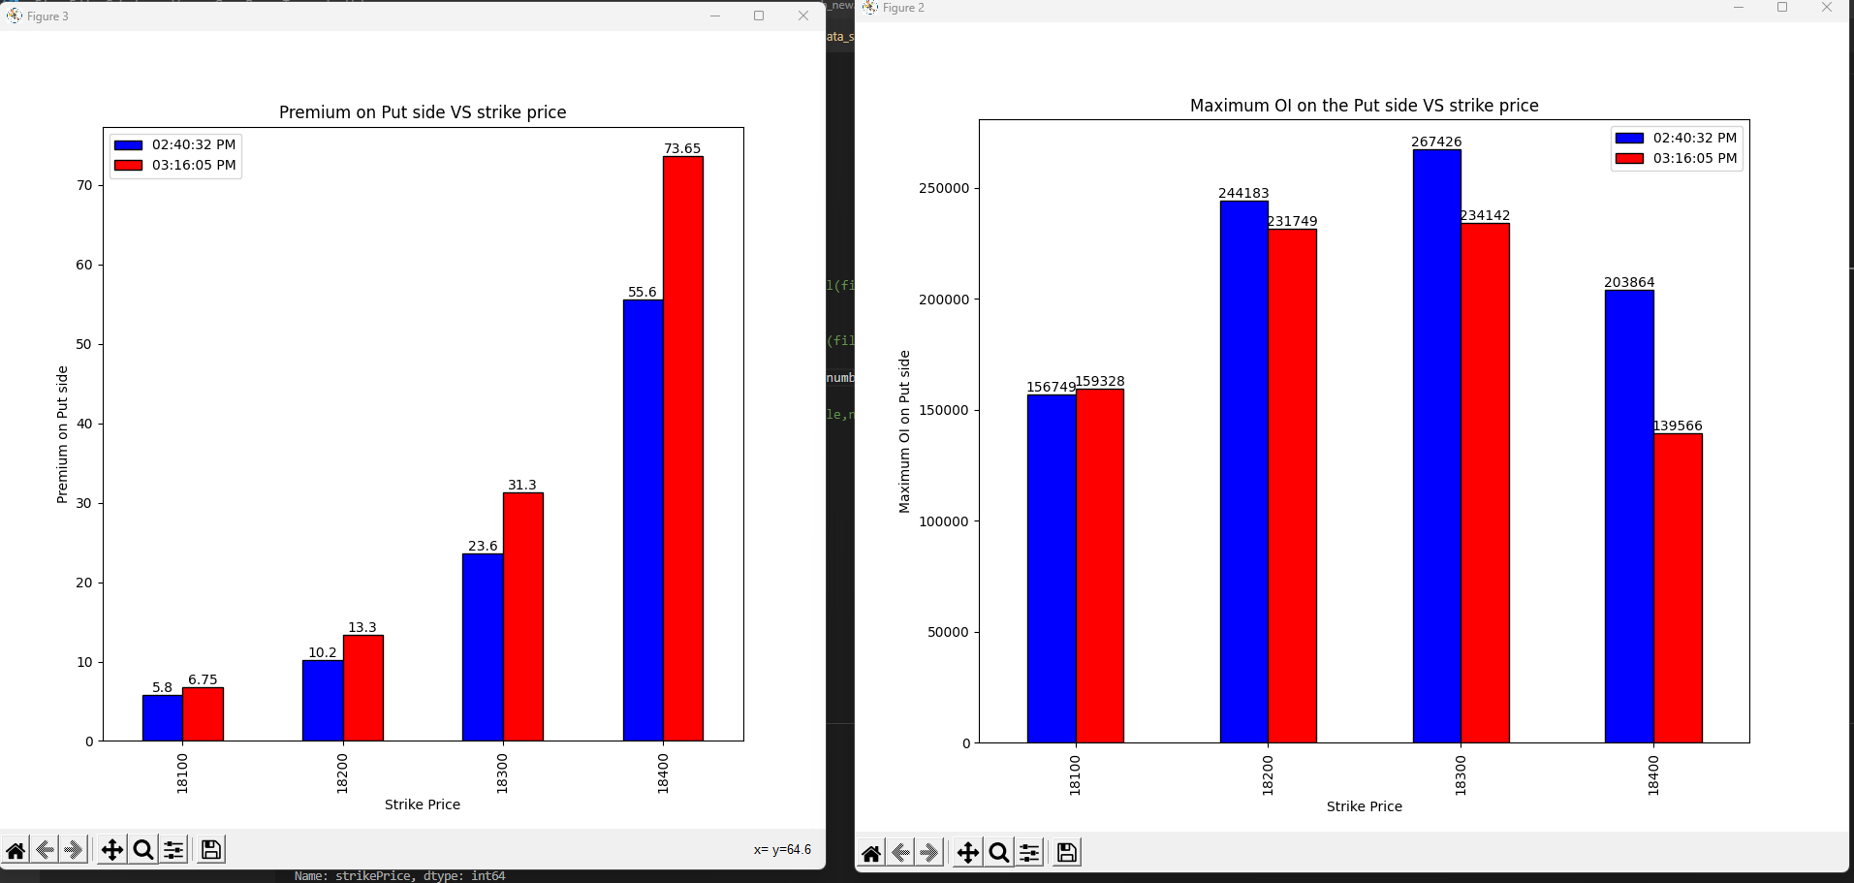
23-05-2023

Slide 5
Conclusion

Slide 6
24-05-2023
strikePrice | CE_OI_03:32:33 PM | CE_LTP_03:32:33 PM | CE_OI_09:23:43 AM | CE_LTP_09:23:43 AM | Change_in_OI | Change_in_Premium | Conclusion
18000 | 25720 | 303.1 | 30605 | 290.75 | -4885 | 12.35 | Shot covering
18050 | 3519 | 254 | 4841 | 244.2 | -1322 | 9.8 | Shot covering
18100 | 22176 | 206 | 24992 | 197.3 | -2816 | 8.7 | Shot covering
18150 | 16676 | 157.55 | 17358 | 151.95 | -682 | 5.6 | Shot covering
18200 | 76420 | 113.55 | 77797 | 111 | -1377 | 2.55 | Shot covering
18250 | 57234 | 74.05 | 40664 | 75.8 | 16570 | -1.75 | Shot Buildup
18300 | 246353 | 42.45 | 207594 | 47.1 | 38759 | -4.65 | Shot Buildup
18350 | 174086 | 20.8 | 106043 | 27.15 | 68043 | -6.35 | Shot Buildup
18400 | 298867 | 8.85 | 239762 | 14.75 | 59105 | -5.9 | Shot Buildup
18450 | 204132 | 3.35 | 143899 | 7.6 | 60233 | -4.25 | Shot Buildup
18500 | 261873 | 1.85 | 225737 | 4.3 | 36136 | -2.45 | Shot Buildup
18550 | 150542 | 1.35 | 123632 | 2.65 | 26910 | -1.3 | Shot Buildup
18600 | 181278 | 0.95 | 197597 | 1.95 | -16319 | -1 | Long covering
strikePrice | PE_OI_03:32:33 PM | PE_LTP_03:32:33 PM | PE_OI_09:23:43 AM | PE_LTP_09:23:43 AM | Change_in_OI | Change_in_Premium | Conclusion
18000 | 182829 | 2 | 207545 | 5 | -24716 | -3 | Long Covering
18050 | 66489 | 2.6 | 78986 | 6.5 | -12497 | -3.9 | Long Covering
18100 | 178713 | 3.8 | 170153 | 9.95 | 8560 | -6.15 | Shot Buildup
18150 | 115735 | 6.6 | 112547 | 14.75 | 3188 | -8.15 | Shot Buildup
18200 | 251057 | 12.3 | 245681 | 24.8 | 5376 | -12.5 | Shot Buildup
18250 | 126187 | 22.9 | 114173 | 39.4 | 12014 | -16.5 | Shot Buildup
18300 | 233783 | 40.45 | 265001 | 60.2 | -31218 | -19.75 | Long Covering
18350 | 46775 | 69.55 | 76278 | 90.25 | -29503 | -20.7 | Long Covering
18400 | 69297 | 107 | 94152 | 127.5 | -24855 | -20.5 | Long Covering
18450 | 10340 | 150.75 | 14273 | 170.05 | -3933 | -19.3 | Long Covering
18500 | 28732 | 200 | 36818 | 217.65 | -8086 | -17.65 | Long Covering
18550 | 2164 | 249.7 | 3523 | 266.9 | -1359 | -17.2 | Long Covering
18600 | 8138 | 299.15 | 10696 | 314.55 | -2558 | -15.4 | Long Covering

Slide 7
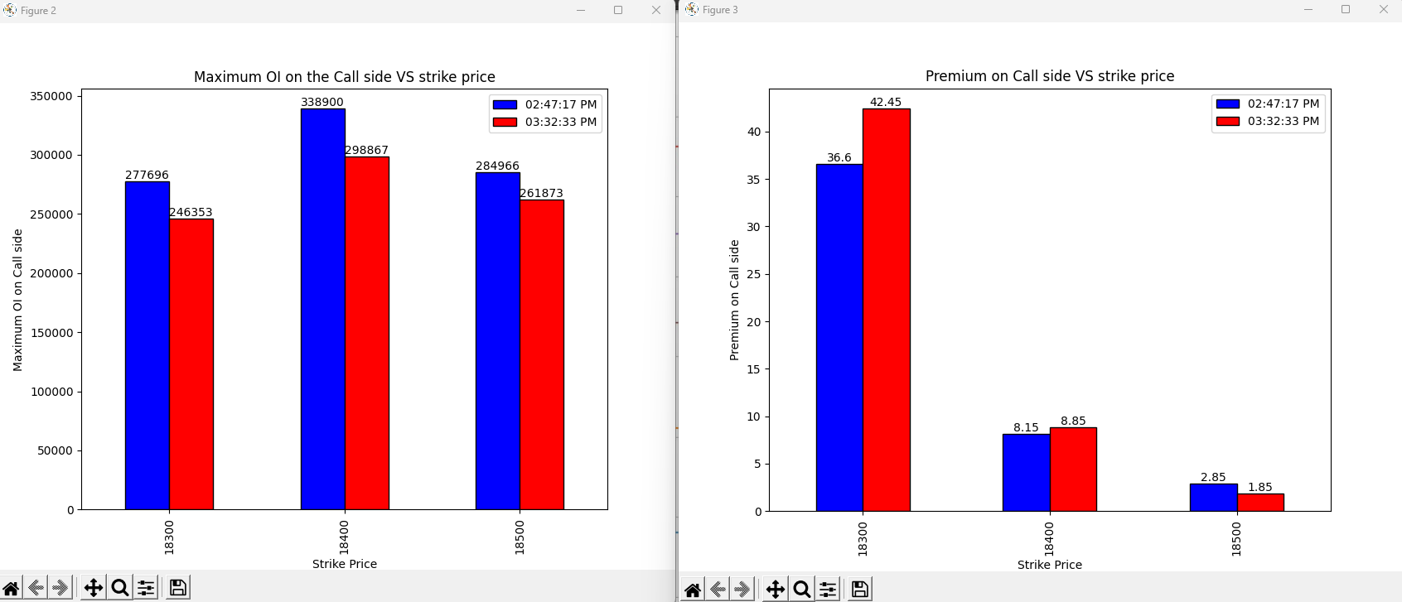
24-05-2023
Notes:
Final 45 mins:
18300: Shot covering
18400: Shot Covering
18500:Long Covering

Slide 8
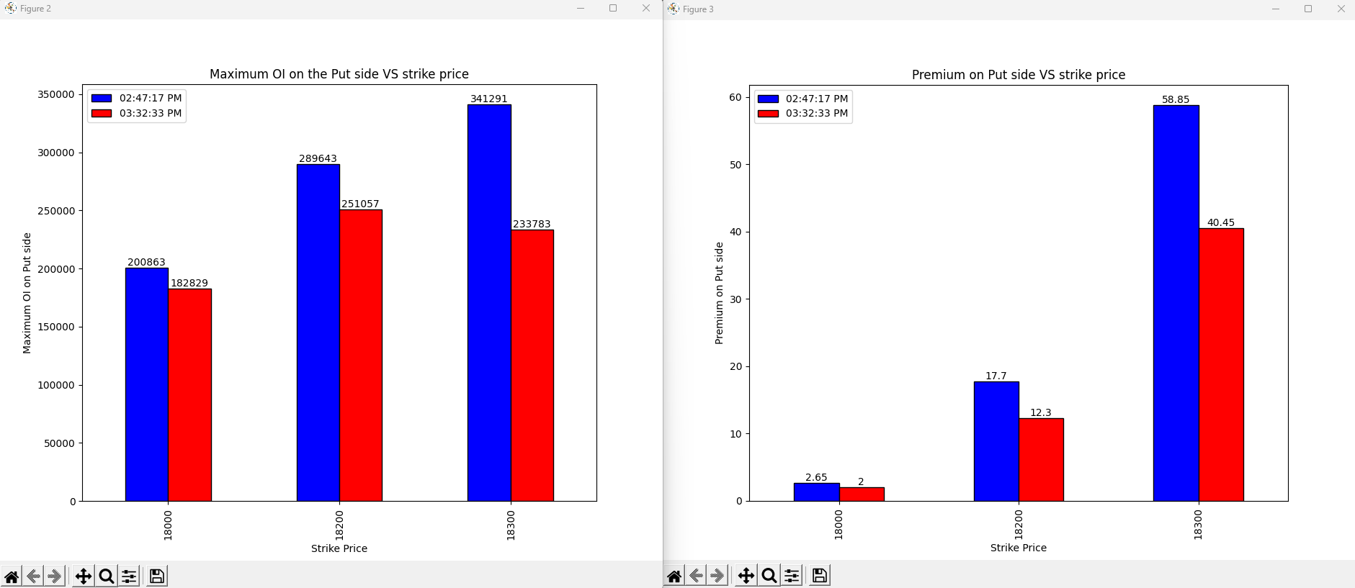
24-05-2023
Notes:
Final 45 mins:
18000:Long Covering
18200:Long Covering
18300: Long Covering

Slide 9
Conclusion
Bullish as at final 45 mins 18300 and 18400 saw shot covering even though the over all there is shot build up at these strike prices from the start of the day signifying change in view of the some sellers.
Long covering on the put side at all the higher strike price above 18300 both on final 45 mins and over all market signifying the bullish view next day
Vote is bullish View

Slide 10
29-05-2023

Slide 11
29-05-2023

Slide 12
29-05-2023

Slide 13
30-05-2023

Slide 14
30-05-2023

Slide 15
30-05-2023

Slide 16
31-05-2023

Slide 17
31-05-2023

Slide 18
31-05-2023

Slide 19
02-06-2023
 | 09:27:24 AM | 09:27:24 AM | 03:30:23 PM | 03:30:23 PM
strikePrice | CE_OI | CE_LTP | CE_OI | CE_LTP | Change in OI | Change in Premium | Conclusion
18300 | 12149 | 304.7 | 13564 | 281.85 | 1415 | -22.85 | Shot build up
18350 | 2333 | 260.75 | 2329 | 237.7 | -4 | -23.05 | Long covering
18400 | 19951 | 219.3 | 22220 | 196.4 | 2269 | -22.9 | Shot build up
18450 | 11822 | 180.1 | 11410 | 158.2 | -412 | -21.9 | Long covering
18500 | 148475 | 144.8 | 159911 | 122.9 | 11436 | -21.9 | Shot build up
18550 | 66507 | 112.6 | 62788 | 92.75 | -3719 | -19.85 | Long covering
18600 | 171614 | 85.5 | 215349 | 66.95 | 43735 | -18.55 | Shot build up
18650 | 72254 | 62.75 | 66497 | 46.5 | -5757 | -16.25 | Long covering
18700 | 101245 | 44.3 | 132076 | 30.8 | 30831 | -13.5 | Shot build up
18750 | 36214 | 30.35 | 55531 | 19.7 | 19317 | -10.65 | Shot build up
18800 | 87010 | 20.1 | 126849 | 11.9 | 39839 | -8.2 | Shot build up
 | 09:27:24 AM | 09:27:24 AM | 03:30:23 PM | 03:30:23 PM
strikePrice | PE_OI | PE_LTP | PE_OI | PE_LTP | Change in OI | Change in Premium
18300 | 60027 | 16.7 | 80667 | 15.8 | 20640 | -0.9 | Shot build up
18350 | 22399 | 22.45 | 39037 | 21.8 | 16638 | -0.65 | Shot build up
18400 | 77966 | 30.8 | 84463 | 30.4 | 6497 | -0.4 | Shot build up
18450 | 41855 | 41.6 | 45000 | 42.1 | 3145 | 0.5 | Long build up
18500 | 179463 | 56.2 | 215000 | 58.25 | 35537 | 2.05 | Long build up
18550 | 61163 | 74.1 | 47202 | 77.05 | -13961 | 2.95 | Shot covering
18600 | 90565 | 96.7 | 121418 | 101 | 30853 | 4.3 | Long build up
18650 | 12764 | 124.45 | 12034 | 130.45 | -730 | 6 | Shot covering
18700 | 18905 | 155.65 | 19735 | 164.6 | 830 | 8.95 | Long build up
18750 | 2338 | 190.95 | 2924 | 203.6 | 586 | 12.65 | Long build up
18800 | 6827 | 231.6 | 8508 | 245.05 | 1681 | 13.45 | Long build up

Slide 20
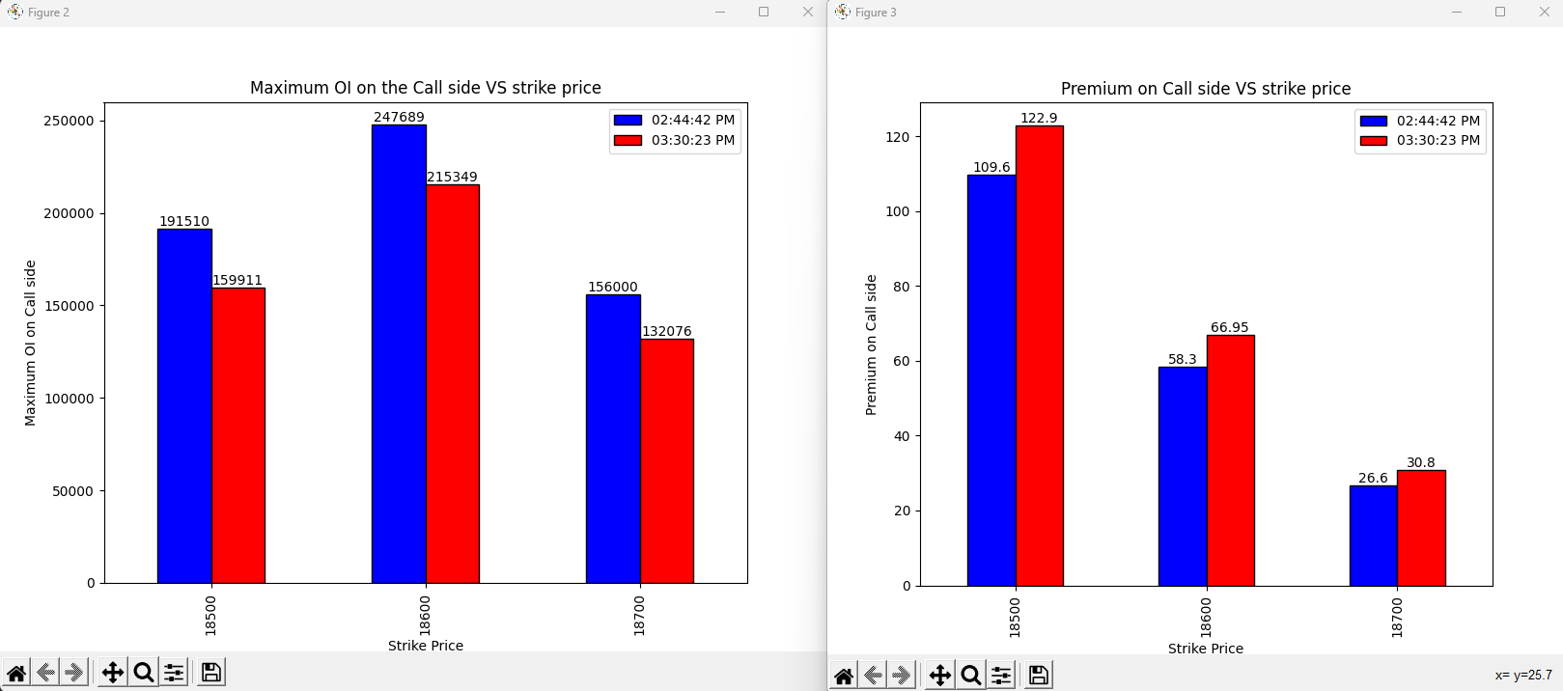
02-06-2023
Notes:
Shot covering on all the strike prices

Slide 21
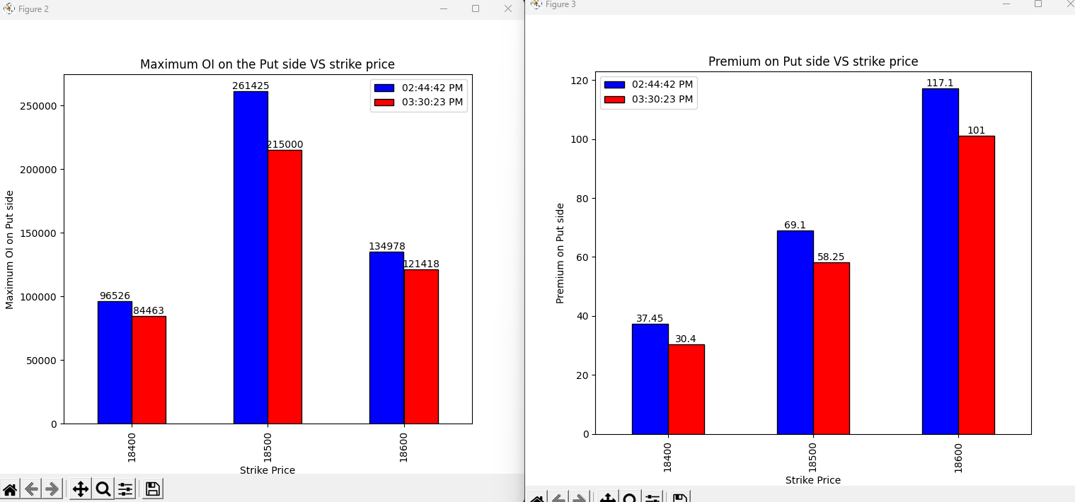
02-06-2023
Notes:
Long covering on all the strike prices

Slide 22
Conclusion

Slide 23
05-06-2023

Slide 24
05-06-2023

Slide 25
05-06-2023

Slide 26
06-06-2023

Slide 27
06-06-2023

Slide 28
06-06-2023

Slide 29
07-06-2023

Slide 30
07-06-2023

Slide 31
07-06-2023

Slide 32
09-06-2023

Slide 33
09-06-2023

Slide 34
09-06-2023

Slide 35
12-06-2023

Slide 36
12-06-2023

Slide 37
12-06-2023

Slide 38
13-06-2023
 | 09:25:45 AM | 09:25:45 AM | 03:33:49 PM | 03:33:49 PM
strikePrice | CE_OI | CE_LTP | CE_OI | CE_LTP | change in OI | change in LTP | Conclusion
18400 | 10118 | 304.6 | 7568 | 330.35 | -2550 | 25.75 | Shot covering
18450 | 7725 | 256 | 4525 | 280.95 | -3200 | 24.95 | Shot covering
18500 | 32412 | 209.4 | 22607 | 233 | -9805 | 23.6 | Shot covering
18550 | 20378 | 166.75 | 12415 | 186.9 | -7963 | 20.15 | Shot covering
18600 | 164264 | 126.45 | 89311 | 143.3 | -74953 | 16.85 | Shot covering
18650 | 107986 | 89.75 | 53203 | 104.05 | -54783 | 14.3 | Shot covering
18700 | 292512 | 60.45 | 199258 | 70 | -93254 | 9.55 | Shot covering
18750 | 103474 | 37.15 | 117741 | 43.5 | 14267 | 6.35 | Long Build up
18800 | 176675 | 21.1 | 177337 | 24.3 | 662 | 3.2 | Long Build up
18850 | 107167 | 11 | 110518 | 11.7 | 3351 | 0.7 | Long Build up
18900 | 153271 | 5.55 | 204975 | 5.05 | 51704 | -0.5 | Shot build up
18950 | 73017 | 3.55 | 87285 | 2.6 | 14268 | -0.95 | Shot build up
19000 | 123581 | 2.5 | 157784 | 1.8 | 34203 | -0.7 | Shot build up
 |  |  |  |  |  |  |  | Bullish
 | 09:25:45 AM | 09:25:45 AM | 03:33:49 PM | 03:33:49 PM
strikePrice | PE_OI | PE_LTP | PE_OI | PE_LTP | change in OI | change in LTP | Conclusion
18400 | 102208 | 6.1 | 85061 | 3.75 | -17147 | -2.35 | Long covering
18450 | 52736 | 8.55 | 82876 | 4.85 | 30140 | -3.7 | Shot covering
18500 | 133458 | 12.7 | 173246 | 7.1 | 39788 | -5.6 | Shot covering
18550 | 81949 | 18.8 | 96084 | 10.85 | 14135 | -7.95 | Shot covering
18600 | 229981 | 28.3 | 217536 | 18 | -12445 | -10.3 | Long covering
18650 | 81670 | 42.4 | 127891 | 28.7 | 46221 | -13.7 | Shot build up
18700 | 164293 | 62.9 | 220252 | 44.6 | 55959 | -18.3 | Shot build up
18750 | 22729 | 89.15 | 40812 | 67.6 | 18083 | -21.55 | Shot build up
18800 | 32479 | 123.6 | 49564 | 98.5 | 17085 | -25.1 | Shot build up
18850 | 3068 | 164.2 | 6565 | 136 | 3497 | -28.2 | Shot build up
18900 | 7047 | 208.55 | 13102 | 179.85 | 6055 | -28.7 | Shot build up
18950 | 969 | 255.4 | 1765 | 226.5 | 796 | -28.9 | Shot build up
19000 | 3133 | 305 | 3997 | 275.9 | 864 | -29.1 | Shot build up

Slide 39
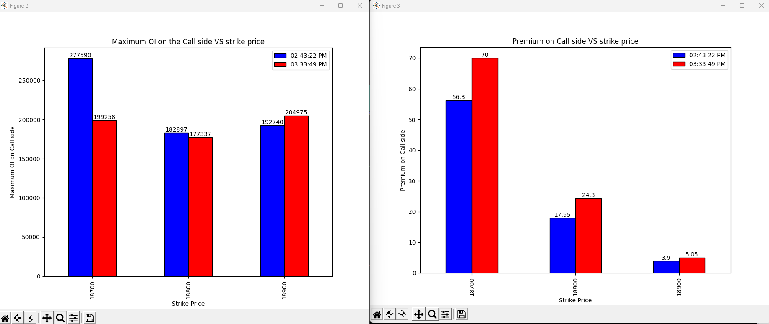
13-06-2023
Notes:
Shot covering on the 18700 and the 18800 strike price indicating bullish view
Long build up on the 18900 strike price

Slide 40
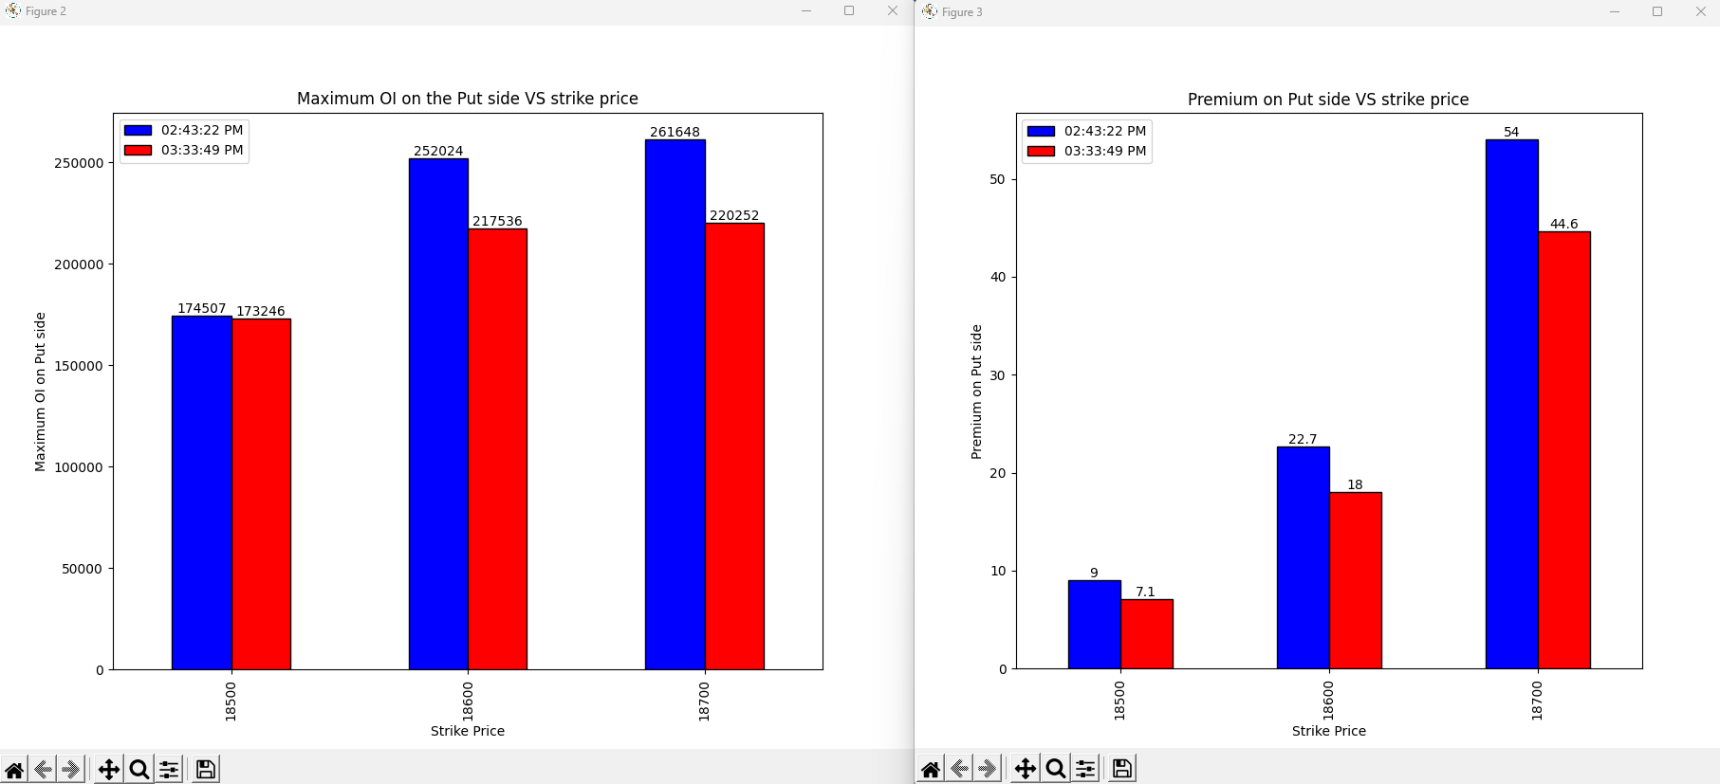
13-06-2023
Notes:
Long covering on all the strike price indicating bullish view

Slide 41
Conclusion
Market will open gap up next day

Slide 42
30-06-2023
strikePrice | CE_OI_03:33:42 PM | CE_LTP_03:33:42 PM | CE_OI_09:25:58 AM | CE_LTP_09:25:58 AM | Change_in_OI | Change_in_Premium | Conclusion
18900 | 38454 | 311.85 | 52036 | 225.15 | -13582 | 86.7 | Shot Covering
18950 | 11287 | 263.1 | 14651 | 185.25 | -3364 | 77.85 | Shot Covering
19000 | 59145 | 220 | 104135 | 148.05 | -44990 | 71.95 | Shot Covering
19050 | 16358 | 179.5 | 44160 | 115.9 | -27802 | 63.6 | Shot Covering
19100 | 79393 | 139.65 | 88489 | 87.8 | -9096 | 51.85 | Shot Covering
19150 | 39607 | 106 | 36538 | 63.2 | 3069 | 42.8 | Long Buildup
19200 | 138736 | 77 | 85473 | 43.95 | 53263 | 33.05 | Long Buildup
19250 | 53025 | 53.6 | 29213 | 29.7 | 23812 | 23.9 | Long Buildup
19300 | 117686 | 35.15 | 79727 | 18.85 | 37959 | 16.3 | Long Buildup
19350 | 61739 | 21.9 | 29391 | 12.05 | 32348 | 9.85 | Long Buildup
19400 | 124699 | 12.45 | 60841 | 7.65 | 63858 | 4.8 | Long Buildup
19450 | 72818 | 7.65 | 35348 | 5 | 37470 | 2.65 | Long Buildup
19500 | 147104 | 5 | 101370 | 3.75 | 45734 | 1.25 | Long Buildup
strikePrice | PE_OI_03:33:42 PM | PE_LTP_03:33:42 PM | PE_OI_09:25:58 AM | PE_LTP_09:25:58 AM | Change_in_OI | Change_in_Premium | Conclusion
18900 | 160632 | 18.65 | 154768 | 33 | 5864 | -14.35 | Shot Buildup
18950 | 61272 | 23 | 44949 | 43.1 | 16323 | -20.1 | Shot Buildup
19000 | 243540 | 29 | 153462 | 56.55 | 90078 | -27.55 | Shot Buildup
19050 | 79410 | 37.9 | 37520 | 73.85 | 41890 | -35.95 | Shot Buildup
19100 | 181121 | 48 | 50649 | 96.2 | 130472 | -48.2 | Shot Buildup
19150 | 70171 | 65.15 | 8681 | 121 | 61490 | -55.85 | Shot Buildup
19200 | 103814 | 85.6 | 18139 | 153.15 | 85675 | -67.55 | Shot Buildup
19250 | 15758 | 112.2 | 2095 | 188.55 | 13663 | -76.35 | Shot Buildup
19300 | 24030 | 144.15 | 2906 | 228.2 | 21124 | -84.05 | Shot Buildup
19350 | 3300 | 180.2 | 374 | 272 | 2926 | -91.8 | Shot Buildup
19400 | 5194 | 220.75 | 1089 | 316 | 4105 | -95.25 | Shot Buildup
19450 | 350 | 267.6 | 48 | 362 | 302 | -94.4 | Shot Buildup
19500 | 2564 | 314.95 | 1113 | 411.95 | 1451 | -97 | Shot Buildup
Notes:
Heavy Bullish Sign on all strike prices

Slide 43
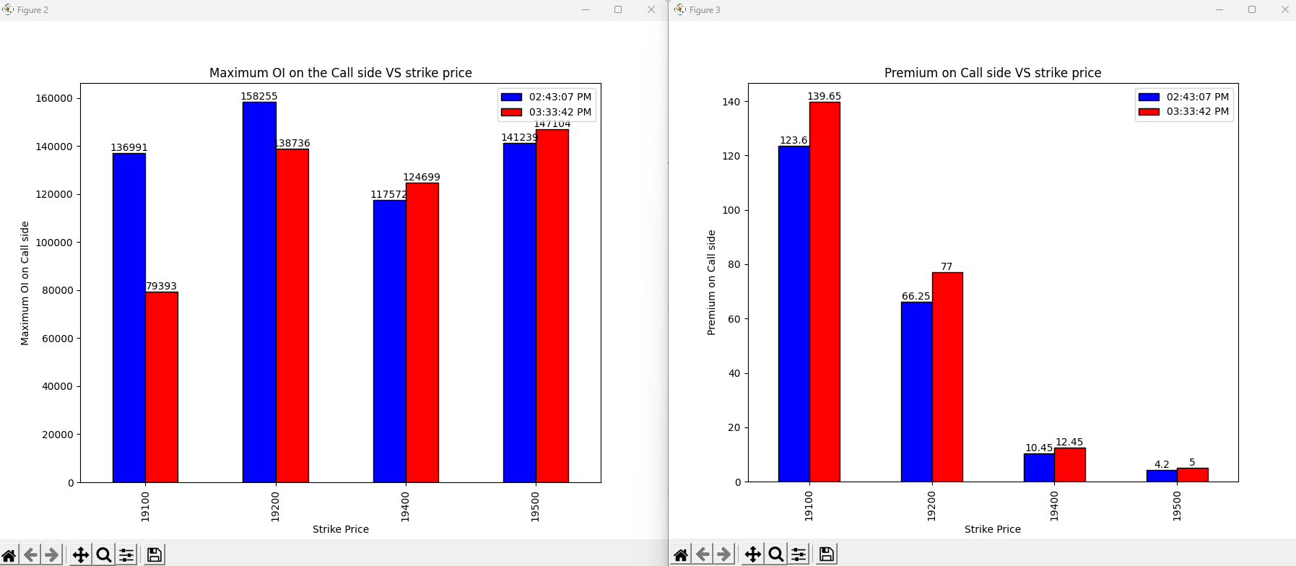
30-06-2023
Notes:
19100, 19200 Shot covering
19400, 19500 Long Build up
Bullish Sign on all strike price

Slide 44
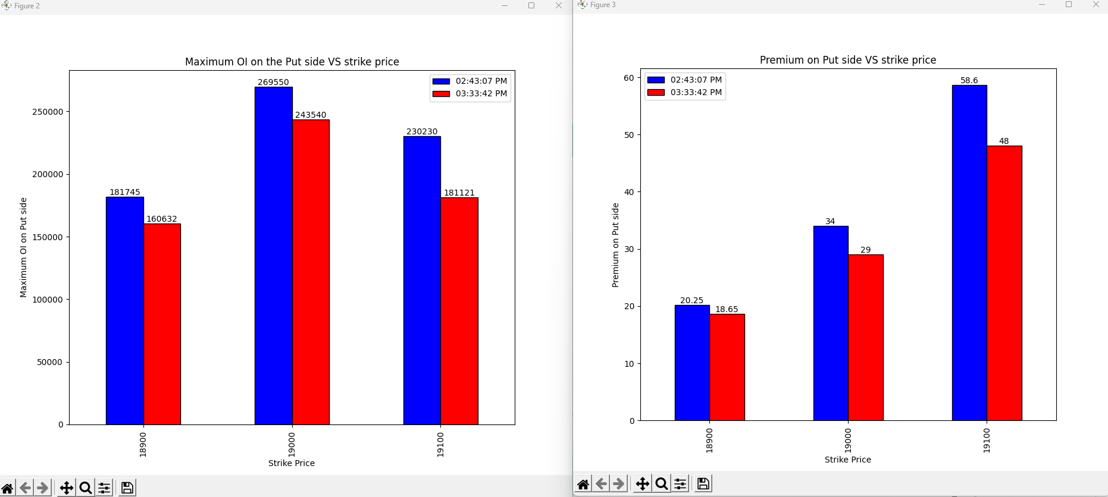
30-06-2023
Notes:
Long covering on all the strike prices

Slide 45
Conclusion
Market will be bullish tomorrow as the last 45 mins and the over all data is showing bullish view on all the strike prices.
Market may open gap up.
Notes:
Result: Market Opened gap UP next day and rallied up as expected.

Slide 46
03-07-2023
strikePrice | CE_OI_03:32:39 PM | CE_LTP_03:32:39 PM | CE_OI_09:25:55 AM | CE_LTP_09:25:55 AM | Change_in_OI | Change_in_Premium | Conclusion
19000 | 37582 | 347.8 | 46784 | 298.55 | -9202 | 49.25 | Shot covering
19050 | 9157 | 298.1 | 15705 | 252.15 | -6548 | 45.95 | Shot covering
19100 | 33649 | 251.7 | 68574 | 208.75 | -34925 | 42.95 | Shot covering
19150 | 17559 | 208 | 38073 | 168 | -20514 | 40 | Shot covering
19200 | 65431 | 165.25 | 137376 | 130.55 | -71945 | 34.7 | Shot covering
19250 | 40888 | 125.95 | 77910 | 97.3 | -37022 | 28.65 | Shot covering
19300 | 201718 | 92 | 152228 | 70.05 | 49490 | 21.95 | Long Buildup
19350 | 84735 | 64.95 | 73550 | 47.5 | 11185 | 17.45 | Long Buildup
19400 | 151359 | 42.85 | 143463 | 30.75 | 7896 | 12.1 | Long Buildup
19450 | 85127 | 27.5 | 84723 | 18.9 | 404 | 8.6 | Long Buildup
19500 | 210566 | 17 | 153271 | 11.95 | 57295 | 5.05 | Long Buildup
19550 | 85840 | 9.95 | 36692 | 7.45 | 49148 | 2.5 | Long Buildup
19600 | 113340 | 6.5 | 71519 | 4.95 | 41821 | 1.55 | Long Buildup
strikePrice | PE_OI_03:32:39 PM | PE_LTP_03:32:39 PM | PE_OI_09:25:55 AM | PE_LTP_09:25:55 AM | Change_in_OI | Change_in_Premium | Conclusion
19000 | 193689 | 15 | 222780 | 16.65 | -29091 | -1.65 | Long covering
19050 | 62868 | 17.3 | 74722 | 20.95 | -11854 | -3.65 | Long covering
19100 | 152214 | 20.55 | 184283 | 27 | -32069 | -6.45 | Long covering
19150 | 72831 | 25.55 | 69646 | 35.85 | 3185 | -10.3 | Shot Build up
19200 | 158887 | 33.2 | 144219 | 48.35 | 14668 | -15.15 | Shot Build up
19250 | 65251 | 43.75 | 55600 | 65.45 | 9651 | -21.7 | Shot Build up
19300 | 198160 | 60 | 51656 | 88.1 | 146504 | -28.1 | Shot Build up
19350 | 30245 | 82.4 | 8739 | 116.1 | 21506 | -33.7 | Shot Build up
19400 | 39619 | 110.65 | 16618 | 149.4 | 23001 | -38.75 | Shot Build up
19450 | 3575 | 145 | 1369 | 187.55 | 2206 | -42.55 | Shot Build up
19500 | 15045 | 185 | 4855 | 229.9 | 10190 | -44.9 | Shot Build up
19550 | 1009 | 228.5 | 325 | 275.35 | 684 | -46.85 | Shot Build up
19600 | 2358 | 273.05 | 914 | 321.8 | 1444 | -48.75 | Shot Build up
Notes:
Heavy Bullish Sign on all strike prices

Slide 47
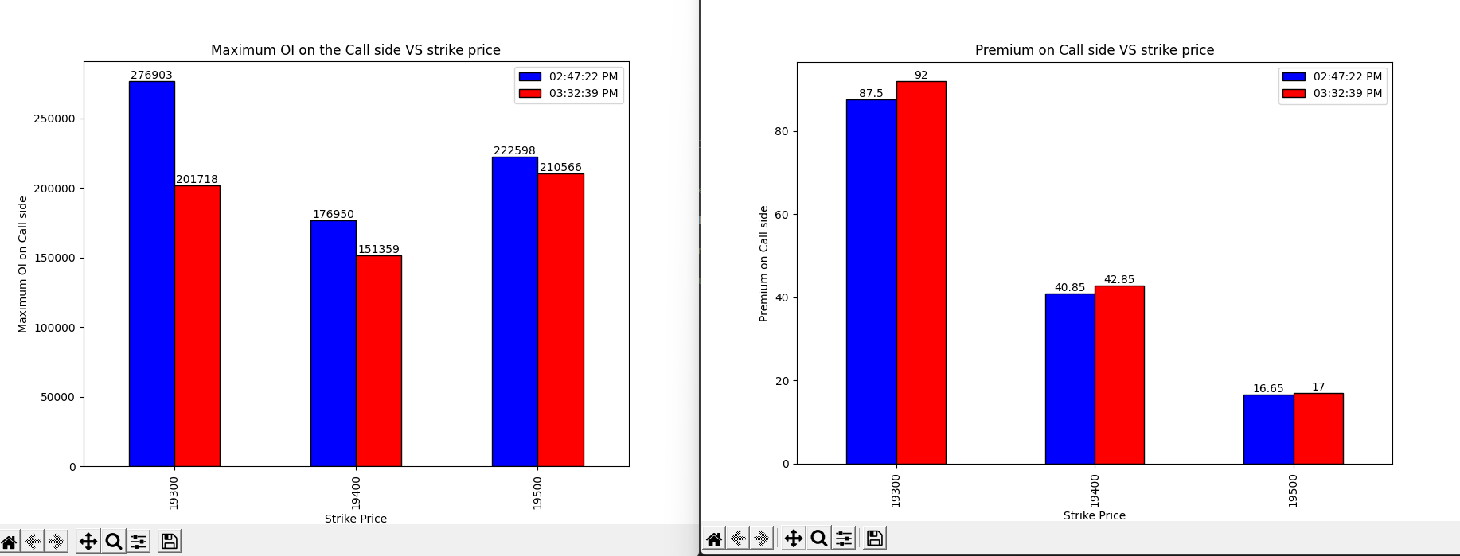
03-07-2023
Notes:
Shot Covering on all the strike prices

Slide 48
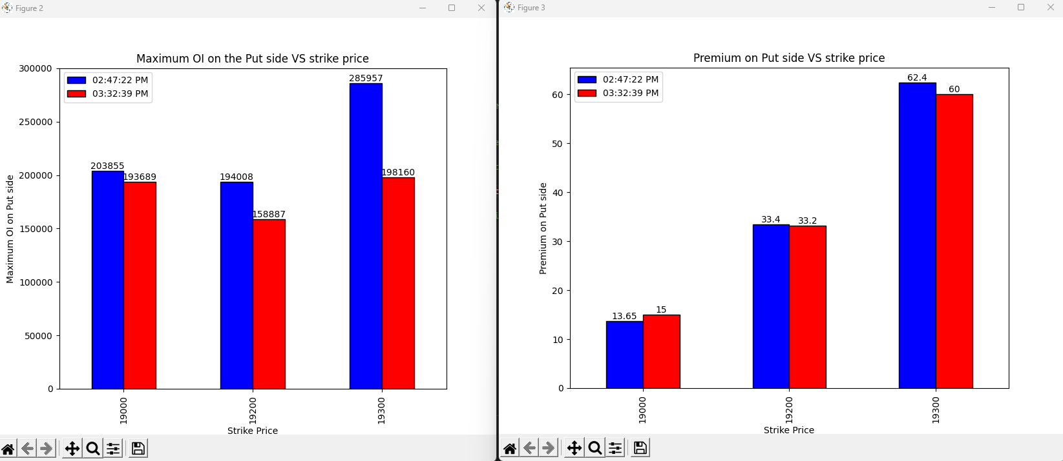
03-07-2023
Notes:
Shot covering on 19000 and 19200
Long covering on 19300

Slide 49
Conclusion
Bullish sign as both the Over all data and the end 45 mins data is consistent.
Market may open gap up.
Notes:
Result: Market Opened gap UP next day but rallied down.

Slide 50
04-07-2023
strikePrice | CE_OI_03:30:29 PM | CE_LTP_03:30:29 PM | CE_OI_09:28:47 AM | CE_LTP_09:28:47 AM | Change_in_OI | Change_in_Premium | Conclusion
19100 | 21312 | 291.7 | 28253 | 295.2 | -6941 | -3.5 | Long Covering
19150 | 11712 | 244.75 | 14153 | 247 | -2441 | -2.25 | Long Covering
19200 | 33686 | 198.1 | 56192 | 203.05 | -22506 | -4.95 | Long Covering
19250 | 24457 | 152.7 | 33357 | 160.05 | -8900 | -7.35 | Long Covering
19300 | 75815 | 113 | 144427 | 121.15 | -68612 | -8.15 | Long Covering
19350 | 57120 | 78.35 | 69303 | 87.5 | -12183 | -9.15 | Long Covering
19400 | 209615 | 50.55 | 195656 | 59.7 | 13959 | -9.15 | Shot Build up
19450 | 104000 | 31.15 | 98941 | 38.85 | 5059 | -7.7 | Shot Build up
19500 | 202453 | 18.3 | 200585 | 24 | 1868 | -5.7 | Shot Build up
19550 | 145126 | 9.9 | 89226 | 14.2 | 55900 | -4.3 | Shot Build up
19600 | 136938 | 5.8 | 121989 | 8.9 | 14949 | -3.1 | Shot Build up
19650 | 50284 | 3.8 | 39718 | 5.85 | 10566 | -2.05 | Shot Build up
19700 | 113326 | 2.5 | 89463 | 4.05 | 23863 | -1.55 | Shot Build up
strikePrice | PE_OI_03:30:29 PM | PE_LTP_03:30:29 PM | PE_OI_09:28:47 AM | PE_LTP_09:28:47 AM | Change_in_OI | Change_in_Premium | Conclusion
19100 | 150053 | 8 | 146468 | 15.15 | 3585 | -7.15 | Shot Buildup
19150 | 67772 | 10.1 | 73074 | 17.9 | -5302 | -7.8 | Long Covering
19200 | 146821 | 13.7 | 157493 | 22.85 | -10672 | -9.15 | Long Covering
19250 | 89709 | 19.35 | 70510 | 29.5 | 19199 | -10.15 | Shot Buildup
19300 | 213575 | 29.4 | 220773 | 40.6 | -7198 | -11.2 | Long Covering
19350 | 76904 | 44.6 | 63027 | 57.25 | 13877 | -12.65 | Shot Buildup
19400 | 121752 | 66.6 | 115936 | 80.15 | 5816 | -13.55 | Shot Buildup
19450 | 19209 | 96.9 | 17764 | 109.2 | 1445 | -12.3 | Shot Buildup
19500 | 28044 | 134.4 | 28590 | 144.75 | -546 | -10.35 | Long Covering
19550 | 2673 | 176 | 2476 | 184.5 | 197 | -8.5 | Shot Buildup
19600 | 5672 | 221.55 | 5387 | 229.7 | 285 | -8.15 | Shot Buildup
19650 | 517 | 270.35 | 746 | 275.05 | -229 | -4.7 | Long Covering
19700 | 1788 | 318.05 | 937 | 322.9 | 851 | -4.85 | Shot Buildup
Notes:
On call side the sentiment is bearish and the relevant OI on the call side is high.
On Put side the sentiment is bullish but the relevant OI is small compared to the OI on call side

Slide 51
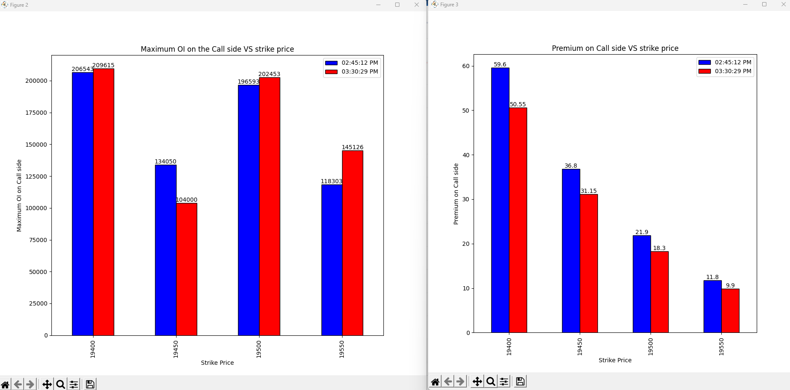
04-07-2023
Notes:
Shot build up on 19400, 19500, 19550
Long Covering on 19450

Slide 52
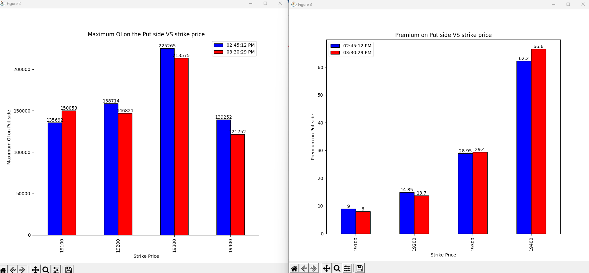
04-07-2023
Notes:
19100-> Shot Build up
19200->Long Covering
19300, 19400 -> Shot covering

Slide 53
Conclusion
Sentiment on the Overall OI is the bearish on the call side also the OI is high giving the sign of the heavy involvement compared to the Put side also on put side the sentiment is bullish but the OI is less-> Vote Bearish.
In final 45 minutes there is shot build up on the 19400, 19500, 19550 on call side which shows the confidence on the call side where as on the put side the there is shot covering on 19300, 19400 -> Vote Bearish.
Over all vote is bearish
Market may not open gap up or gap down but over all movement is bearish in nature.
Notes:
Result: As expected market have not opened gap up and gap down.
Advance to decline and the previous day analysis tells the market will open gap up or gap down.

Slide 54
05-07-2023
strikePrice | CE_OI_03:33:08 PM | CE_LTP_03:33:08 PM | CE_OI_09:28:25 AM | CE_LTP_09:28:25 AM | Change_in_OI | Change_in_Premium | Conclusion
19100 | 15155 | 311.25 | 21611 | 313.8 | -6456 | -2.55 | Long Unwinding
19150 | 10069 | 262.2 | 11954 | 267.1 | -1885 | -4.9 | Long Unwinding
19200 | 30624 | 213.2 | 34790 | 221.2 | -4166 | -8 | Long Unwinding
19250 | 19765 | 166.05 | 25122 | 175.35 | -5357 | -9.3 | Long Unwinding
19300 | 64975 | 122.55 | 79786 | 135.35 | -14811 | -12.8 | Long Unwinding
19350 | 54349 | 82.45 | 76327 | 98.65 | -21978 | -16.2 | Long Unwinding
19400 | 246020 | 50.65 | 258040 | 67.55 | -12020 | -16.9 | Long Unwinding
19450 | 149578 | 28.45 | 118454 | 44.05 | 31124 | -15.6 | Shot Buildup
19500 | 267720 | 14.5 | 231490 | 25.55 | 36230 | -11.05 | Shot Buildup
19550 | 206681 | 6.6 | 158888 | 14.65 | 47793 | -8.05 | Shot Buildup
19600 | 170988 | 3.55 | 151746 | 8.55 | 19242 | -5 | Shot Buildup
19650 | 74288 | 2.15 | 61652 | 5.1 | 12636 | -2.95 | Shot Buildup
19700 | 130625 | 1.65 | 143179 | 3.25 | -12554 | -1.6 | Long Unwinding
strikePrice | PE_OI_03:33:08 PM | PE_LTP_03:33:08 PM | PE_OI_09:28:25 AM | PE_LTP_09:28:25 AM | Change_in_OI | Change_in_Premium | Conclusion
19100 | 147039 | 3.85 | 161059 | 7.4 | -14020 | -3.55 | Long Unwinding
19150 | 93301 | 4 | 80173 | 9.55 | 13128 | -5.55 | Shot Buildup
19200 | 187261 | 5.8 | 172805 | 13.05 | 14456 | -7.25 | Shot Buildup
19250 | 117102 | 8.55 | 111614 | 18.65 | 5488 | -10.1 | Shot Buildup
19300 | 256296 | 14.25 | 259286 | 27.95 | -2990 | -13.7 | Long Unwinding
19350 | 167329 | 24.7 | 130662 | 41.15 | 36667 | -16.45 | Shot Buildup
19400 | 183795 | 41.8 | 163581 | 61.4 | 20214 | -19.6 | Shot Buildup
19450 | 33116 | 69 | 29384 | 86.35 | 3732 | -17.35 | Shot Buildup
19500 | 35911 | 106.1 | 41225 | 119.6 | -5314 | -13.5 | Long Unwinding
19550 | 6040 | 149 | 6642 | 157.4 | -602 | -8.4 | Long Unwinding
19600 | 6301 | 195.05 | 6759 | 200.6 | -458 | -5.55 | Long Unwinding
19650 | 740 | 244.55 | 688 | 248.65 | 52 | -4.1 | Shot Buildup
19700 | 1455 | 292.6 | 2013 | 296 | -558 | -3.4 | Long Unwinding
Notes:
Closing price is 19398.5
Both upside and downside is limited due to the shot build on both side market might not go below 19350 due to the heavy shot build up on the put side.

Slide 55
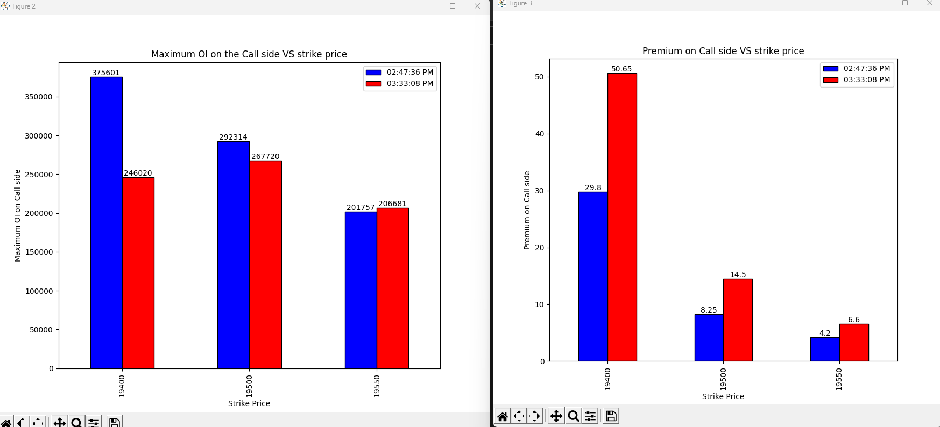
05-07-2023
Notes:
19400 and 19500 -> shot covering is going on
19550-> Long Build up

Slide 56
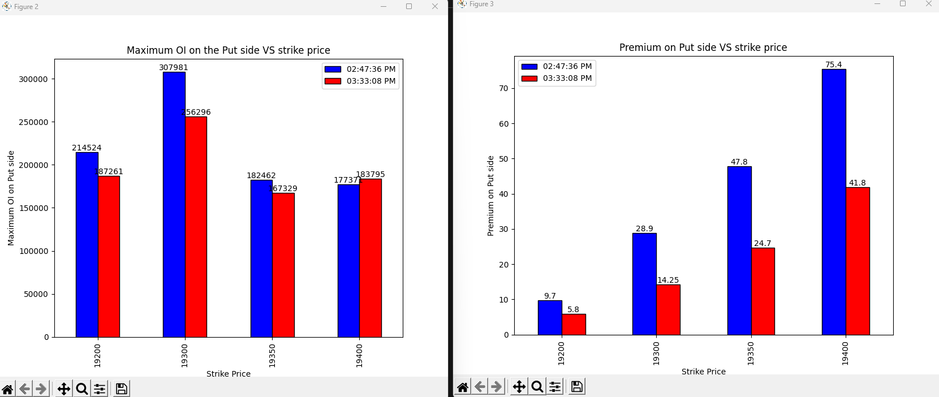
05-07-2023
Notes:
19200, 19300, 19350 -> Long covering
19400-> Shot build up

Slide 57
Conclusion
Overall market->Both upside and downside is limited due to the shot build on both side market might not go below 19350 due to the heavy shot build up on the put side and also might not go much above.
Last 45 mins->Last 45 mins shows the change in the opinion of the call and put side traders as the shot pogition of the near atm strike prices is closed and long pogition is made on 19550 on call side and more shot pogition is made on the put side
My vote is bullish as I’ll give more weightage to the final 45 mins change in the opinion of call side short sellers during the expiry.
Notes:
Result: Market opened gap down but not below 19350 as expected.
Advance is 19 and decline is 20-> Market will open gap down.

Slide 58
05-07-2023
Notes:
Closing price is 19398.5
Both upside and downside is limited due to the shot build on both side market might not go below 19350 due to the heavy shot build up on the put side.

Slide 59
05-07-2023
Notes:
19400 and 19500 -> shot covering is going on
19550-> Long Build up

Slide 60
05-07-2023
Notes:
19200, 19300, 19350 -> Long covering
19400-> Shot build up

Slide 61
Conclusion
Overall market->Both upside and downside is limited due to the shot build on both side market might not go below 19350 due to the heavy shot build up on the put side and also might not go much above.
Last 45 mins->Last 45 mins shows the change in the opinion of the call and put side traders as the shot pogition of the near atm strike prices is closed and long pogition is made on 19550 on call side and more shot pogition is made on the put side
My vote is bullish as I’ll give more weightage to the final 45 mins change in the opinion of call side short sellers during the expiry.
Notes:
Result: Market opened gap down but not below 19350 as expected.
Advance is 19 and decline is 20-> Market will open gap down.

