Slide 1
Market Sentiment Report OI Build up

Slide 2
23-05-2023
 | 03:16:05 PM | 03:16:05 PM | 09:37:25 AM | 09:37:25 AM
strikePrice | CE_OI | CE_LTP | CE_OI | CE_LTP | Change in OI | Change in LTP
18150 | 17909 | 225.35 | 21181 | 262.2 | -3272 | -36.85 | Long Covering
18200 | 70275 | 179.95 | 102250 | 215.45 | -31975 | -35.5 | Long Covering
18250 | 27438 | 137.05 | 39782 | 172.95 | -12344 | -35.9 | Long Covering
18300 | 141947 | 97.6 | 144895 | 131.85 | -2948 | -34.25 | Long Covering
18350 | 75706 | 65.25 | 73193 | 95.7 | 2513 | -30.45 | Shot Build UP
18400 | 232641 | 40.05 | 179357 | 64.55 | 53284 | -24.5 | Shot Build UP
18450 | 121941 | 22.1 | 103644 | 41.05 | 18297 | -18.95 | Shot Build UP
18500 | 211805 | 11.1 | 197881 | 23.9 | 13924 | -12.8 | Shot Build UP
18550 | 128200 | 5.15 | 97534 | 12.45 | 30666 | -7.3 | Shot Build UP
 |  |  |  |  |  |  |  | Bearish View
 | 03:16:05 PM | 03:16:05 PM | 09:37:25 AM | 09:37:25 AM
strikePrice | PE_OI | PE_LTP | PE_OI | PE_LTP | Change in OI | Change in LTP
18150 | 111010 | 8.9 | 76977 | 11.6 | 34033 | -2.7 | Shot Build UP
18200 | 231749 | 13.3 | 250558 | 15.55 | -18809 | -2.25 | Long Covering
18250 | 88316 | 20.2 | 95102 | 21.5 | -6786 | -1.3 | Long Covering
18300 | 234142 | 31.3 | 208722 | 30.3 | 25420 | 1 | Long Build Up
18350 | 96266 | 48.9 | 73553 | 44.2 | 22713 | 4.7 | Long Build Up
18400 | 139566 | 73.65 | 94342 | 63.6 | 45224 | 10.05 | Long Build Up
18450 | 24471 | 105.8 | 20078 | 89.7 | 4393 | 16.1 | Long Build Up
18500 | 45743 | 144.85 | 42010 | 122.85 | 3733 | 22 | Long Build Up
18550 | 6296 | 188.85 | 3402 | 161.6 | 2894 | 27.25 | Long Build Up

Slide 3
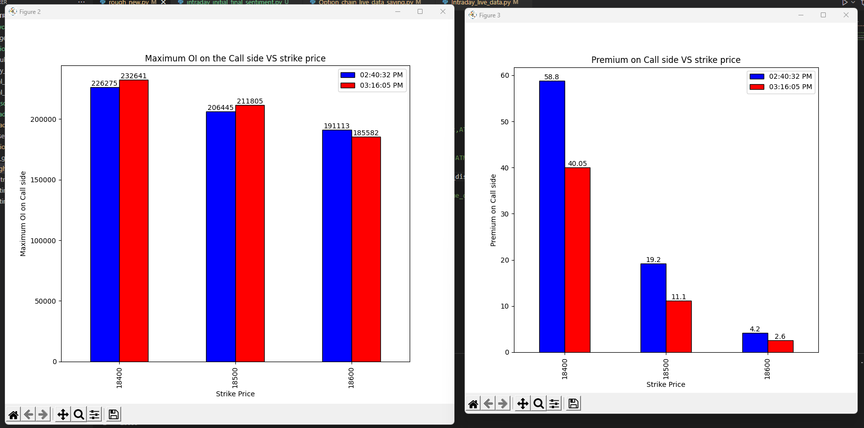
23-05-2023

Slide 4
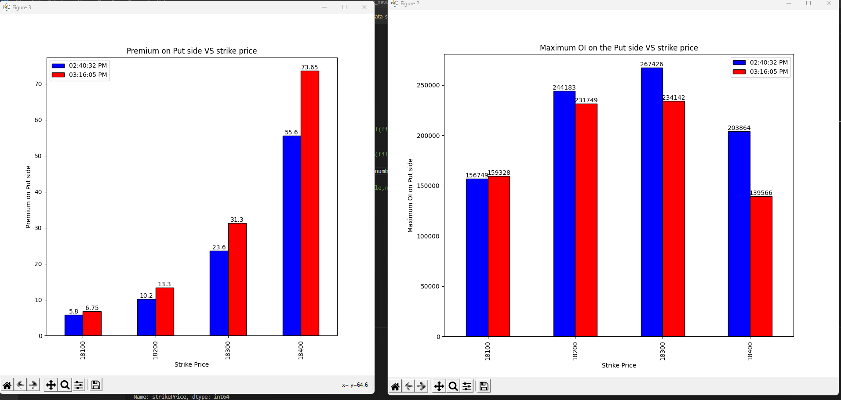
23-05-2023

Slide 5
Conclusion

Slide 6
24-05-2023
strikePrice | CE_OI_03:32:33 PM | CE_LTP_03:32:33 PM | CE_OI_09:23:43 AM | CE_LTP_09:23:43 AM | Change_in_OI | Change_in_Premium | Conclusion
18000 | 25720 | 303.1 | 30605 | 290.75 | -4885 | 12.35 | Shot covering
18050 | 3519 | 254 | 4841 | 244.2 | -1322 | 9.8 | Shot covering
18100 | 22176 | 206 | 24992 | 197.3 | -2816 | 8.7 | Shot covering
18150 | 16676 | 157.55 | 17358 | 151.95 | -682 | 5.6 | Shot covering
18200 | 76420 | 113.55 | 77797 | 111 | -1377 | 2.55 | Shot covering
18250 | 57234 | 74.05 | 40664 | 75.8 | 16570 | -1.75 | Shot Buildup
18300 | 246353 | 42.45 | 207594 | 47.1 | 38759 | -4.65 | Shot Buildup
18350 | 174086 | 20.8 | 106043 | 27.15 | 68043 | -6.35 | Shot Buildup
18400 | 298867 | 8.85 | 239762 | 14.75 | 59105 | -5.9 | Shot Buildup
18450 | 204132 | 3.35 | 143899 | 7.6 | 60233 | -4.25 | Shot Buildup
18500 | 261873 | 1.85 | 225737 | 4.3 | 36136 | -2.45 | Shot Buildup
18550 | 150542 | 1.35 | 123632 | 2.65 | 26910 | -1.3 | Shot Buildup
18600 | 181278 | 0.95 | 197597 | 1.95 | -16319 | -1 | Long covering
strikePrice | PE_OI_03:32:33 PM | PE_LTP_03:32:33 PM | PE_OI_09:23:43 AM | PE_LTP_09:23:43 AM | Change_in_OI | Change_in_Premium | Conclusion
18000 | 182829 | 2 | 207545 | 5 | -24716 | -3 | Long Covering
18050 | 66489 | 2.6 | 78986 | 6.5 | -12497 | -3.9 | Long Covering
18100 | 178713 | 3.8 | 170153 | 9.95 | 8560 | -6.15 | Shot Buildup
18150 | 115735 | 6.6 | 112547 | 14.75 | 3188 | -8.15 | Shot Buildup
18200 | 251057 | 12.3 | 245681 | 24.8 | 5376 | -12.5 | Shot Buildup
18250 | 126187 | 22.9 | 114173 | 39.4 | 12014 | -16.5 | Shot Buildup
18300 | 233783 | 40.45 | 265001 | 60.2 | -31218 | -19.75 | Long Covering
18350 | 46775 | 69.55 | 76278 | 90.25 | -29503 | -20.7 | Long Covering
18400 | 69297 | 107 | 94152 | 127.5 | -24855 | -20.5 | Long Covering
18450 | 10340 | 150.75 | 14273 | 170.05 | -3933 | -19.3 | Long Covering
18500 | 28732 | 200 | 36818 | 217.65 | -8086 | -17.65 | Long Covering
18550 | 2164 | 249.7 | 3523 | 266.9 | -1359 | -17.2 | Long Covering
18600 | 8138 | 299.15 | 10696 | 314.55 | -2558 | -15.4 | Long Covering

Slide 7
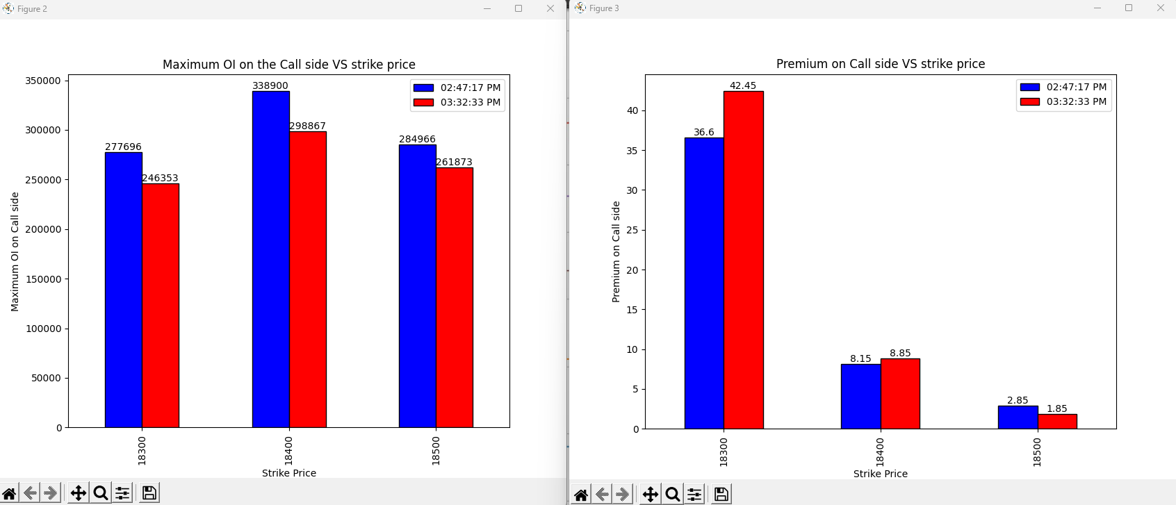
24-05-2023
Notes:
Final 45 mins:
18300: Shot covering
18400: Shot Covering
18500:Long Covering

Slide 8
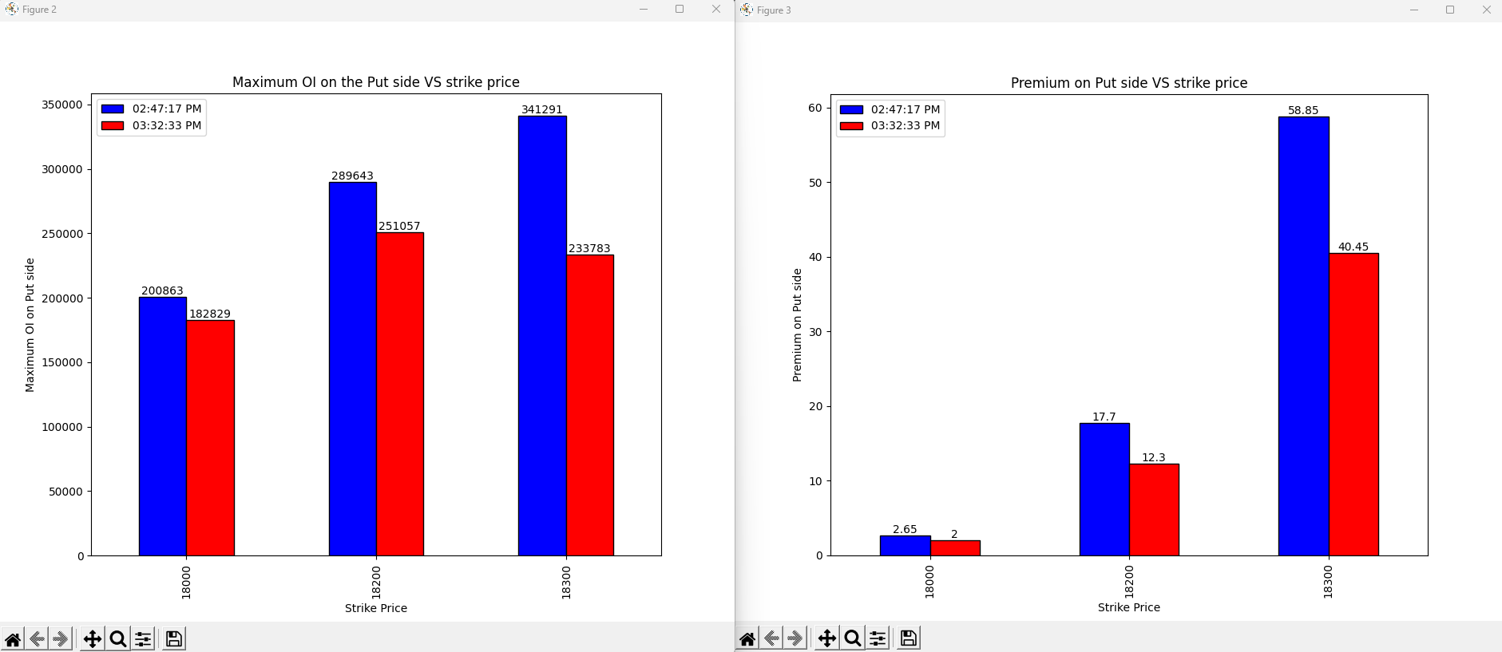
24-05-2023
Notes:
Final 45 mins:
18000:Long Covering
18200:Long Covering
18300: Long Covering

Slide 9
Conclusion
Bullish as at final 45 mins 18300 and 18400 saw shot covering even though the over all there is shot build up at these strike prices from the start of the day signifying change in view of the some sellers.
Long covering on the put side at all the higher strike price above 18300 both on final 45 mins and over all market signifying the bullish view next day
Vote is bullish View

Slide 10
02-06-2023
 | 09:27:24 AM | 09:27:24 AM | 03:30:23 PM | 03:30:23 PM
strikePrice | CE_OI | CE_LTP | CE_OI | CE_LTP | Change in OI | Change in Premium | Conclusion
18300 | 12149 | 304.7 | 13564 | 281.85 | 1415 | -22.85 | Shot build up
18350 | 2333 | 260.75 | 2329 | 237.7 | -4 | -23.05 | Long covering
18400 | 19951 | 219.3 | 22220 | 196.4 | 2269 | -22.9 | Shot build up
18450 | 11822 | 180.1 | 11410 | 158.2 | -412 | -21.9 | Long covering
18500 | 148475 | 144.8 | 159911 | 122.9 | 11436 | -21.9 | Shot build up
18550 | 66507 | 112.6 | 62788 | 92.75 | -3719 | -19.85 | Long covering
18600 | 171614 | 85.5 | 215349 | 66.95 | 43735 | -18.55 | Shot build up
18650 | 72254 | 62.75 | 66497 | 46.5 | -5757 | -16.25 | Long covering
18700 | 101245 | 44.3 | 132076 | 30.8 | 30831 | -13.5 | Shot build up
18750 | 36214 | 30.35 | 55531 | 19.7 | 19317 | -10.65 | Shot build up
18800 | 87010 | 20.1 | 126849 | 11.9 | 39839 | -8.2 | Shot build up
 | 09:27:24 AM | 09:27:24 AM | 03:30:23 PM | 03:30:23 PM
strikePrice | PE_OI | PE_LTP | PE_OI | PE_LTP | Change in OI | Change in Premium
18300 | 60027 | 16.7 | 80667 | 15.8 | 20640 | -0.9 | Shot build up
18350 | 22399 | 22.45 | 39037 | 21.8 | 16638 | -0.65 | Shot build up
18400 | 77966 | 30.8 | 84463 | 30.4 | 6497 | -0.4 | Shot build up
18450 | 41855 | 41.6 | 45000 | 42.1 | 3145 | 0.5 | Long build up
18500 | 179463 | 56.2 | 215000 | 58.25 | 35537 | 2.05 | Long build up
18550 | 61163 | 74.1 | 47202 | 77.05 | -13961 | 2.95 | Shot covering
18600 | 90565 | 96.7 | 121418 | 101 | 30853 | 4.3 | Long build up
18650 | 12764 | 124.45 | 12034 | 130.45 | -730 | 6 | Shot covering
18700 | 18905 | 155.65 | 19735 | 164.6 | 830 | 8.95 | Long build up
18750 | 2338 | 190.95 | 2924 | 203.6 | 586 | 12.65 | Long build up
18800 | 6827 | 231.6 | 8508 | 245.05 | 1681 | 13.45 | Long build up

Slide 11
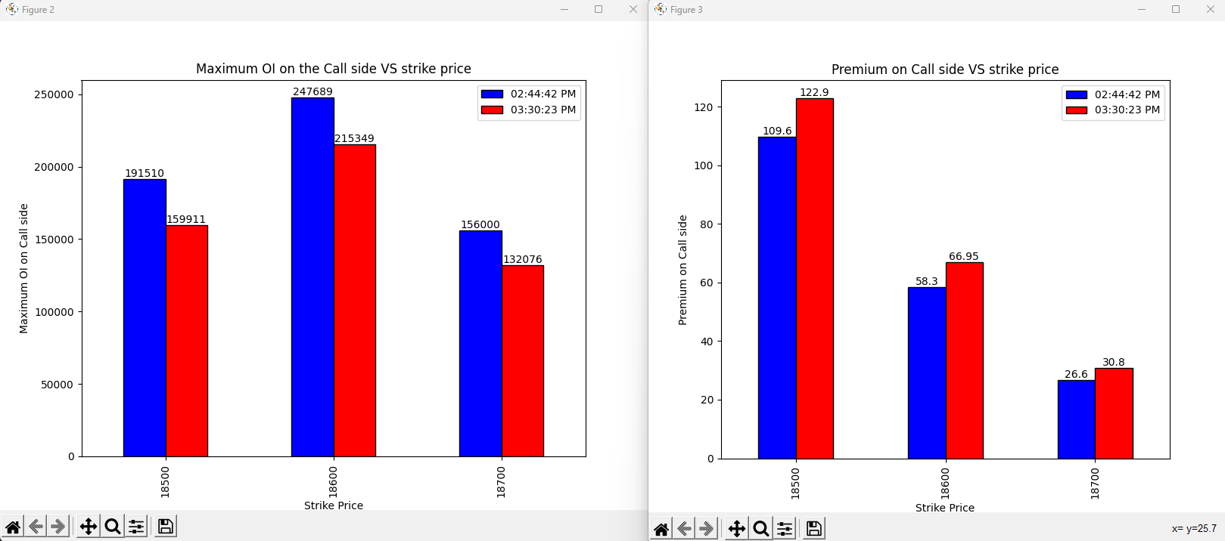
02-06-2023
Notes:
Shot covering on all the strike prices

Slide 12
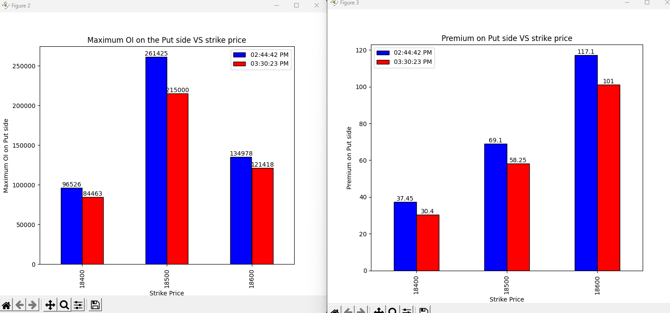
02-06-2023
Notes:
Long covering on all the strike prices

Slide 13
Conclusion

Slide 14
13-06-2023
 | 09:25:45 AM | 09:25:45 AM | 03:33:49 PM | 03:33:49 PM
strikePrice | CE_OI | CE_LTP | CE_OI | CE_LTP | change in OI | change in LTP | Conclusion
18400 | 10118 | 304.6 | 7568 | 330.35 | -2550 | 25.75 | Shot covering
18450 | 7725 | 256 | 4525 | 280.95 | -3200 | 24.95 | Shot covering
18500 | 32412 | 209.4 | 22607 | 233 | -9805 | 23.6 | Shot covering
18550 | 20378 | 166.75 | 12415 | 186.9 | -7963 | 20.15 | Shot covering
18600 | 164264 | 126.45 | 89311 | 143.3 | -74953 | 16.85 | Shot covering
18650 | 107986 | 89.75 | 53203 | 104.05 | -54783 | 14.3 | Shot covering
18700 | 292512 | 60.45 | 199258 | 70 | -93254 | 9.55 | Shot covering
18750 | 103474 | 37.15 | 117741 | 43.5 | 14267 | 6.35 | Long Build up
18800 | 176675 | 21.1 | 177337 | 24.3 | 662 | 3.2 | Long Build up
18850 | 107167 | 11 | 110518 | 11.7 | 3351 | 0.7 | Long Build up
18900 | 153271 | 5.55 | 204975 | 5.05 | 51704 | -0.5 | Shot build up
18950 | 73017 | 3.55 | 87285 | 2.6 | 14268 | -0.95 | Shot build up
19000 | 123581 | 2.5 | 157784 | 1.8 | 34203 | -0.7 | Shot build up
 |  |  |  |  |  |  |  | Bullish
 | 09:25:45 AM | 09:25:45 AM | 03:33:49 PM | 03:33:49 PM
strikePrice | PE_OI | PE_LTP | PE_OI | PE_LTP | change in OI | change in LTP | Conclusion
18400 | 102208 | 6.1 | 85061 | 3.75 | -17147 | -2.35 | Long covering
18450 | 52736 | 8.55 | 82876 | 4.85 | 30140 | -3.7 | Shot covering
18500 | 133458 | 12.7 | 173246 | 7.1 | 39788 | -5.6 | Shot covering
18550 | 81949 | 18.8 | 96084 | 10.85 | 14135 | -7.95 | Shot covering
18600 | 229981 | 28.3 | 217536 | 18 | -12445 | -10.3 | Long covering
18650 | 81670 | 42.4 | 127891 | 28.7 | 46221 | -13.7 | Shot build up
18700 | 164293 | 62.9 | 220252 | 44.6 | 55959 | -18.3 | Shot build up
18750 | 22729 | 89.15 | 40812 | 67.6 | 18083 | -21.55 | Shot build up
18800 | 32479 | 123.6 | 49564 | 98.5 | 17085 | -25.1 | Shot build up
18850 | 3068 | 164.2 | 6565 | 136 | 3497 | -28.2 | Shot build up
18900 | 7047 | 208.55 | 13102 | 179.85 | 6055 | -28.7 | Shot build up
18950 | 969 | 255.4 | 1765 | 226.5 | 796 | -28.9 | Shot build up
19000 | 3133 | 305 | 3997 | 275.9 | 864 | -29.1 | Shot build up

Slide 15
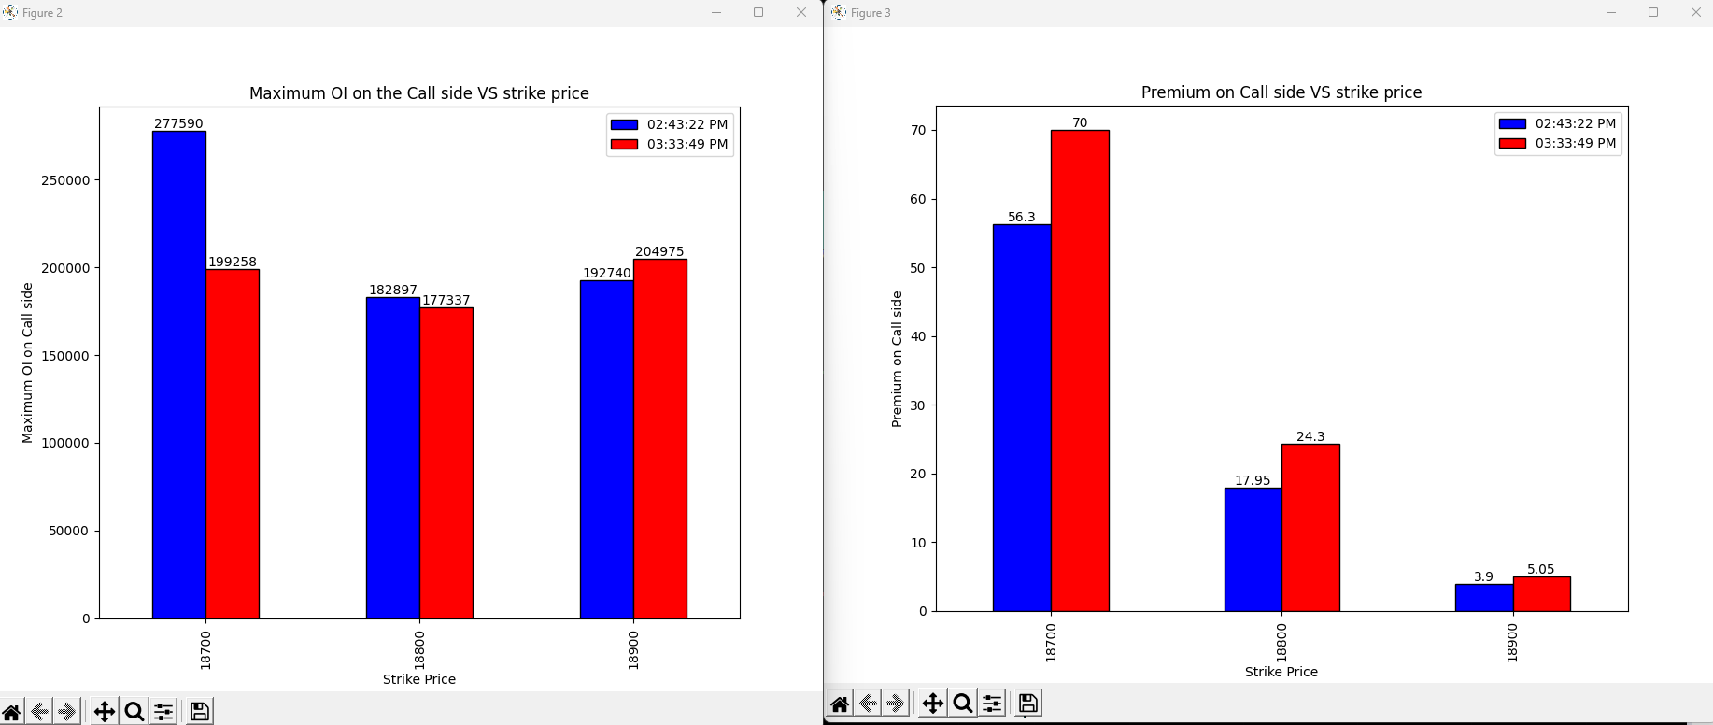
13-06-2023
Notes:
Shot covering on the 18700 and the 18800 strike price indicating bullish view
Long build up on the 18900 strike price

Slide 16
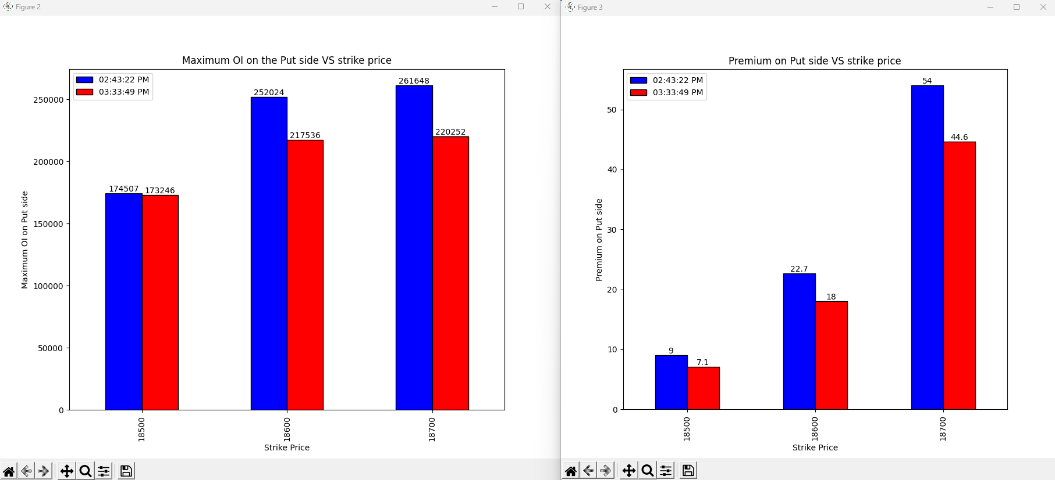
13-06-2023
Notes:
Long covering on all the strike price indicating bullish view

Slide 17
Conclusion
Market will open gap up next day

Slide 18
30-06-2023
strikePrice | CE_OI_03:33:42 PM | CE_LTP_03:33:42 PM | CE_OI_09:25:58 AM | CE_LTP_09:25:58 AM | Change_in_OI | Change_in_Premium | Conclusion
18900 | 38454 | 311.85 | 52036 | 225.15 | -13582 | 86.7 | Shot Covering
18950 | 11287 | 263.1 | 14651 | 185.25 | -3364 | 77.85 | Shot Covering
19000 | 59145 | 220 | 104135 | 148.05 | -44990 | 71.95 | Shot Covering
19050 | 16358 | 179.5 | 44160 | 115.9 | -27802 | 63.6 | Shot Covering
19100 | 79393 | 139.65 | 88489 | 87.8 | -9096 | 51.85 | Shot Covering
19150 | 39607 | 106 | 36538 | 63.2 | 3069 | 42.8 | Long Buildup
19200 | 138736 | 77 | 85473 | 43.95 | 53263 | 33.05 | Long Buildup
19250 | 53025 | 53.6 | 29213 | 29.7 | 23812 | 23.9 | Long Buildup
19300 | 117686 | 35.15 | 79727 | 18.85 | 37959 | 16.3 | Long Buildup
19350 | 61739 | 21.9 | 29391 | 12.05 | 32348 | 9.85 | Long Buildup
19400 | 124699 | 12.45 | 60841 | 7.65 | 63858 | 4.8 | Long Buildup
19450 | 72818 | 7.65 | 35348 | 5 | 37470 | 2.65 | Long Buildup
19500 | 147104 | 5 | 101370 | 3.75 | 45734 | 1.25 | Long Buildup
strikePrice | PE_OI_03:33:42 PM | PE_LTP_03:33:42 PM | PE_OI_09:25:58 AM | PE_LTP_09:25:58 AM | Change_in_OI | Change_in_Premium | Conclusion
18900 | 160632 | 18.65 | 154768 | 33 | 5864 | -14.35 | Shot Buildup
18950 | 61272 | 23 | 44949 | 43.1 | 16323 | -20.1 | Shot Buildup
19000 | 243540 | 29 | 153462 | 56.55 | 90078 | -27.55 | Shot Buildup
19050 | 79410 | 37.9 | 37520 | 73.85 | 41890 | -35.95 | Shot Buildup
19100 | 181121 | 48 | 50649 | 96.2 | 130472 | -48.2 | Shot Buildup
19150 | 70171 | 65.15 | 8681 | 121 | 61490 | -55.85 | Shot Buildup
19200 | 103814 | 85.6 | 18139 | 153.15 | 85675 | -67.55 | Shot Buildup
19250 | 15758 | 112.2 | 2095 | 188.55 | 13663 | -76.35 | Shot Buildup
19300 | 24030 | 144.15 | 2906 | 228.2 | 21124 | -84.05 | Shot Buildup
19350 | 3300 | 180.2 | 374 | 272 | 2926 | -91.8 | Shot Buildup
19400 | 5194 | 220.75 | 1089 | 316 | 4105 | -95.25 | Shot Buildup
19450 | 350 | 267.6 | 48 | 362 | 302 | -94.4 | Shot Buildup
19500 | 2564 | 314.95 | 1113 | 411.95 | 1451 | -97 | Shot Buildup
Notes:
Heavy Bullish Sign on all strike prices

Slide 19
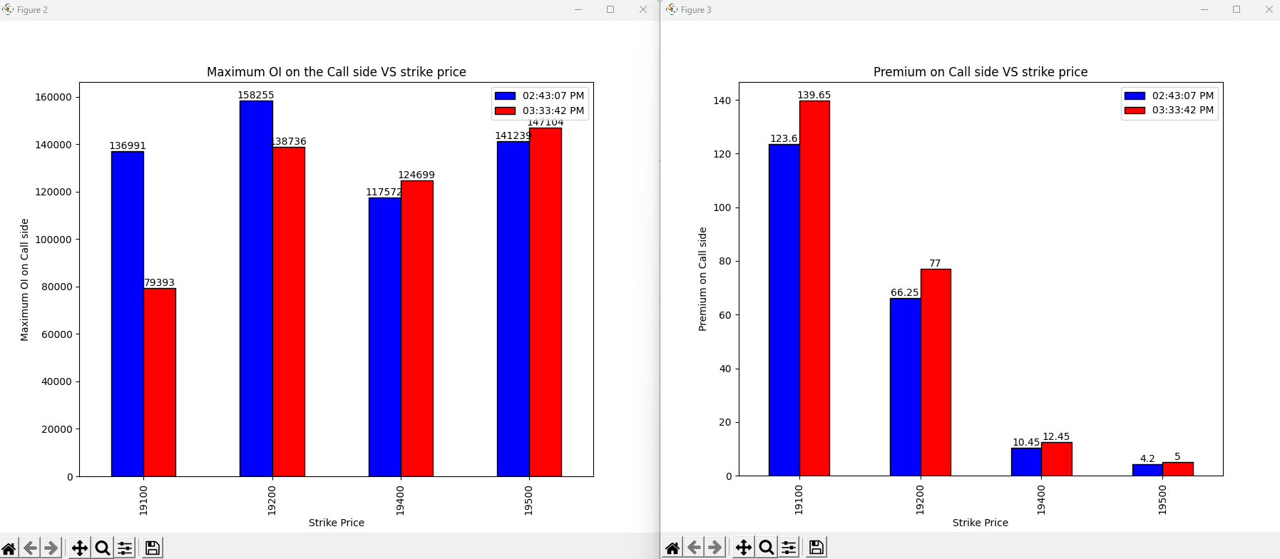
30-06-2023
Notes:
19100, 19200 Shot covering
19400, 19500 Long Build up
Bullish Sign on all strike price

Slide 20
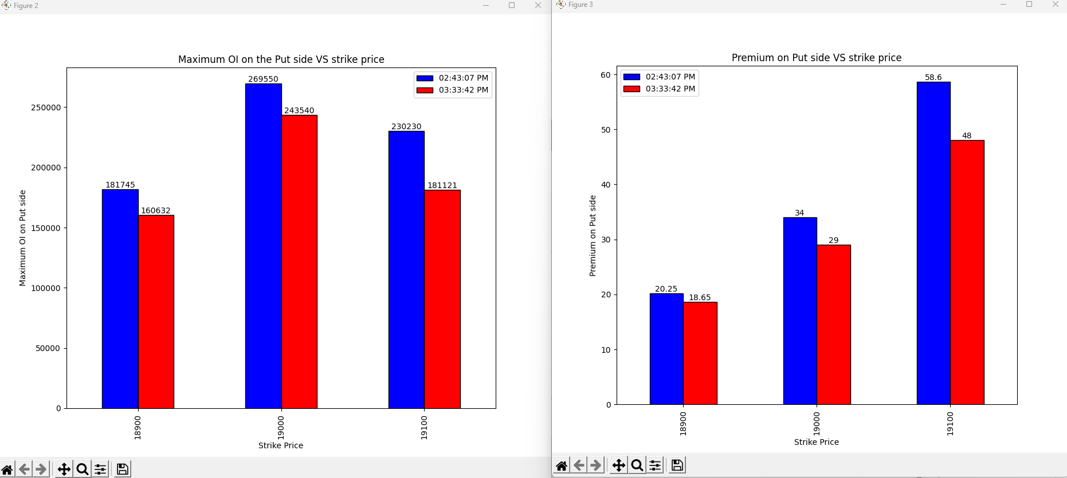
30-06-2023
Notes:
Long covering on all the strike prices

Slide 21
Conclusion
Market will be bullish tomorrow as the last 45 mins and the over all data is showing bullish view on all the strike prices.
Market may open gap up.
Notes:
Result: Market Opened gap UP next day and rallied up as expected.

Slide 22
03-07-2023
strikePrice | CE_OI_03:32:39 PM | CE_LTP_03:32:39 PM | CE_OI_09:25:55 AM | CE_LTP_09:25:55 AM | Change_in_OI | Change_in_Premium | Conclusion
19000 | 37582 | 347.8 | 46784 | 298.55 | -9202 | 49.25 | Shot covering
19050 | 9157 | 298.1 | 15705 | 252.15 | -6548 | 45.95 | Shot covering
19100 | 33649 | 251.7 | 68574 | 208.75 | -34925 | 42.95 | Shot covering
19150 | 17559 | 208 | 38073 | 168 | -20514 | 40 | Shot covering
19200 | 65431 | 165.25 | 137376 | 130.55 | -71945 | 34.7 | Shot covering
19250 | 40888 | 125.95 | 77910 | 97.3 | -37022 | 28.65 | Shot covering
19300 | 201718 | 92 | 152228 | 70.05 | 49490 | 21.95 | Long Buildup
19350 | 84735 | 64.95 | 73550 | 47.5 | 11185 | 17.45 | Long Buildup
19400 | 151359 | 42.85 | 143463 | 30.75 | 7896 | 12.1 | Long Buildup
19450 | 85127 | 27.5 | 84723 | 18.9 | 404 | 8.6 | Long Buildup
19500 | 210566 | 17 | 153271 | 11.95 | 57295 | 5.05 | Long Buildup
19550 | 85840 | 9.95 | 36692 | 7.45 | 49148 | 2.5 | Long Buildup
19600 | 113340 | 6.5 | 71519 | 4.95 | 41821 | 1.55 | Long Buildup
strikePrice | PE_OI_03:32:39 PM | PE_LTP_03:32:39 PM | PE_OI_09:25:55 AM | PE_LTP_09:25:55 AM | Change_in_OI | Change_in_Premium | Conclusion
19000 | 193689 | 15 | 222780 | 16.65 | -29091 | -1.65 | Long covering
19050 | 62868 | 17.3 | 74722 | 20.95 | -11854 | -3.65 | Long covering
19100 | 152214 | 20.55 | 184283 | 27 | -32069 | -6.45 | Long covering
19150 | 72831 | 25.55 | 69646 | 35.85 | 3185 | -10.3 | Shot Build up
19200 | 158887 | 33.2 | 144219 | 48.35 | 14668 | -15.15 | Shot Build up
19250 | 65251 | 43.75 | 55600 | 65.45 | 9651 | -21.7 | Shot Build up
19300 | 198160 | 60 | 51656 | 88.1 | 146504 | -28.1 | Shot Build up
19350 | 30245 | 82.4 | 8739 | 116.1 | 21506 | -33.7 | Shot Build up
19400 | 39619 | 110.65 | 16618 | 149.4 | 23001 | -38.75 | Shot Build up
19450 | 3575 | 145 | 1369 | 187.55 | 2206 | -42.55 | Shot Build up
19500 | 15045 | 185 | 4855 | 229.9 | 10190 | -44.9 | Shot Build up
19550 | 1009 | 228.5 | 325 | 275.35 | 684 | -46.85 | Shot Build up
19600 | 2358 | 273.05 | 914 | 321.8 | 1444 | -48.75 | Shot Build up
Notes:
Heavy Bullish Sign on all strike prices

Slide 23
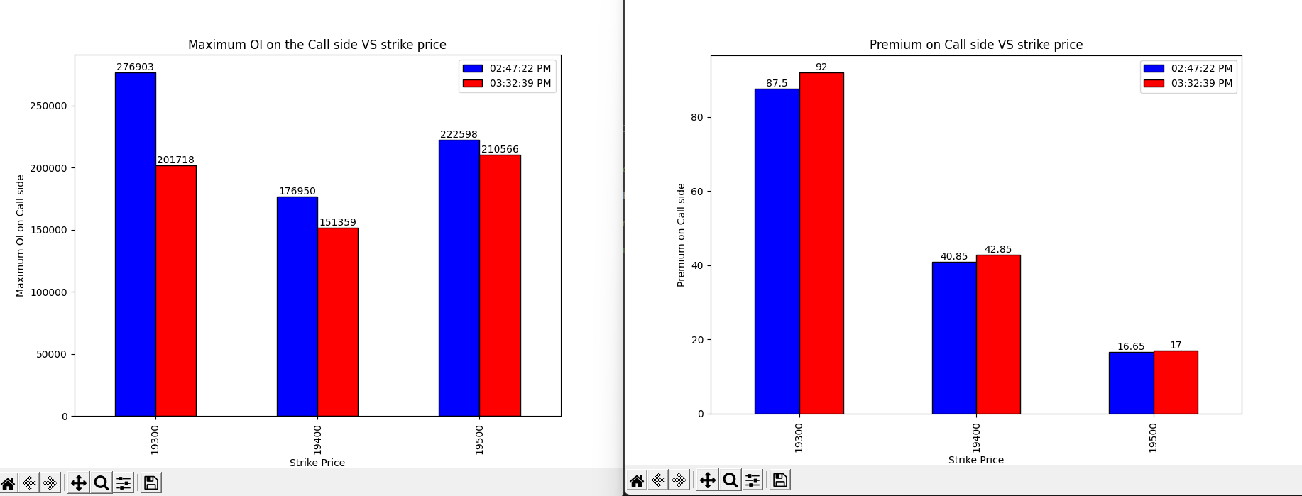
03-07-2023
Notes:
Shot Covering on all the strike prices

Slide 24
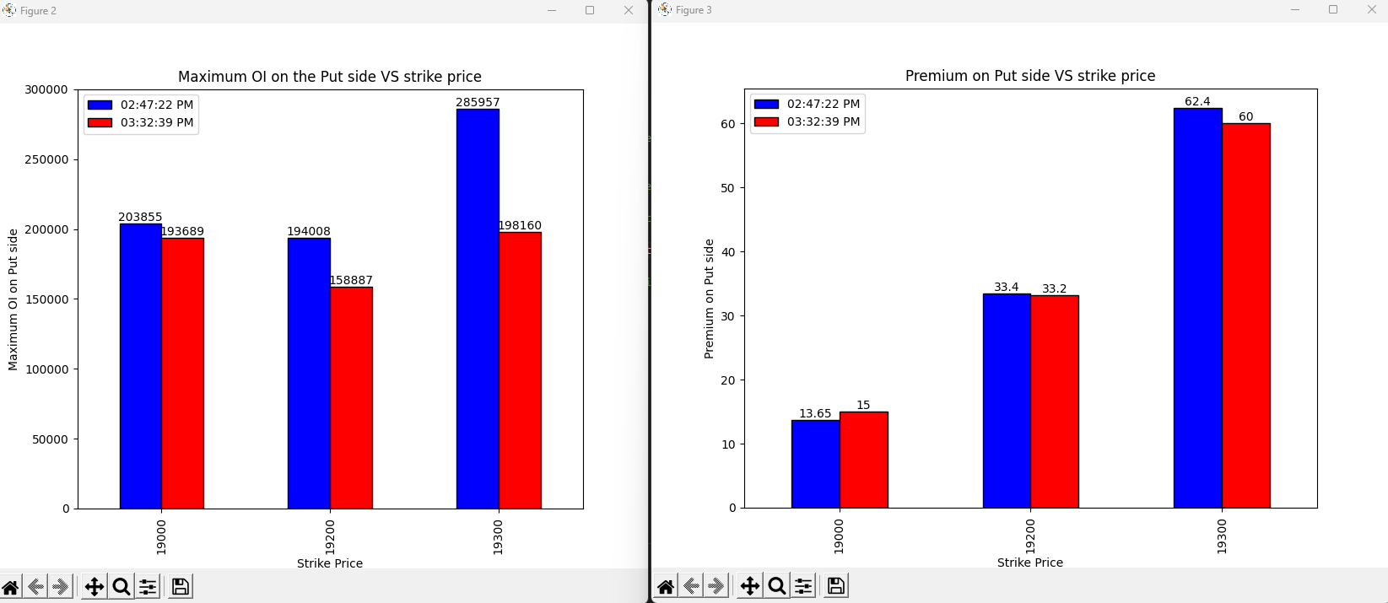
03-07-2023
Notes:
Shot covering on 19000 and 19200
Long covering on 19300

Slide 25
Conclusion
Bullish sign as both the Over all data and the end 45 mins data is consistent.
Market may open gap up.
Notes:
Result: Market Opened gap UP next day but rallied down.

Slide 26
04-07-2023
strikePrice | CE_OI_03:30:29 PM | CE_LTP_03:30:29 PM | CE_OI_09:28:47 AM | CE_LTP_09:28:47 AM | Change_in_OI | Change_in_Premium | Conclusion
19100 | 21312 | 291.7 | 28253 | 295.2 | -6941 | -3.5 | Long Covering
19150 | 11712 | 244.75 | 14153 | 247 | -2441 | -2.25 | Long Covering
19200 | 33686 | 198.1 | 56192 | 203.05 | -22506 | -4.95 | Long Covering
19250 | 24457 | 152.7 | 33357 | 160.05 | -8900 | -7.35 | Long Covering
19300 | 75815 | 113 | 144427 | 121.15 | -68612 | -8.15 | Long Covering
19350 | 57120 | 78.35 | 69303 | 87.5 | -12183 | -9.15 | Long Covering
19400 | 209615 | 50.55 | 195656 | 59.7 | 13959 | -9.15 | Shot Build up
19450 | 104000 | 31.15 | 98941 | 38.85 | 5059 | -7.7 | Shot Build up
19500 | 202453 | 18.3 | 200585 | 24 | 1868 | -5.7 | Shot Build up
19550 | 145126 | 9.9 | 89226 | 14.2 | 55900 | -4.3 | Shot Build up
19600 | 136938 | 5.8 | 121989 | 8.9 | 14949 | -3.1 | Shot Build up
19650 | 50284 | 3.8 | 39718 | 5.85 | 10566 | -2.05 | Shot Build up
19700 | 113326 | 2.5 | 89463 | 4.05 | 23863 | -1.55 | Shot Build up
strikePrice | PE_OI_03:30:29 PM | PE_LTP_03:30:29 PM | PE_OI_09:28:47 AM | PE_LTP_09:28:47 AM | Change_in_OI | Change_in_Premium | Conclusion
19100 | 150053 | 8 | 146468 | 15.15 | 3585 | -7.15 | Shot Buildup
19150 | 67772 | 10.1 | 73074 | 17.9 | -5302 | -7.8 | Long Covering
19200 | 146821 | 13.7 | 157493 | 22.85 | -10672 | -9.15 | Long Covering
19250 | 89709 | 19.35 | 70510 | 29.5 | 19199 | -10.15 | Shot Buildup
19300 | 213575 | 29.4 | 220773 | 40.6 | -7198 | -11.2 | Long Covering
19350 | 76904 | 44.6 | 63027 | 57.25 | 13877 | -12.65 | Shot Buildup
19400 | 121752 | 66.6 | 115936 | 80.15 | 5816 | -13.55 | Shot Buildup
19450 | 19209 | 96.9 | 17764 | 109.2 | 1445 | -12.3 | Shot Buildup
19500 | 28044 | 134.4 | 28590 | 144.75 | -546 | -10.35 | Long Covering
19550 | 2673 | 176 | 2476 | 184.5 | 197 | -8.5 | Shot Buildup
19600 | 5672 | 221.55 | 5387 | 229.7 | 285 | -8.15 | Shot Buildup
19650 | 517 | 270.35 | 746 | 275.05 | -229 | -4.7 | Long Covering
19700 | 1788 | 318.05 | 937 | 322.9 | 851 | -4.85 | Shot Buildup
Notes:
On call side the sentiment is bearish and the relevant OI on the call side is high.
On Put side the sentiment is bullish but the relevant OI is small compared to the OI on call side

Slide 27
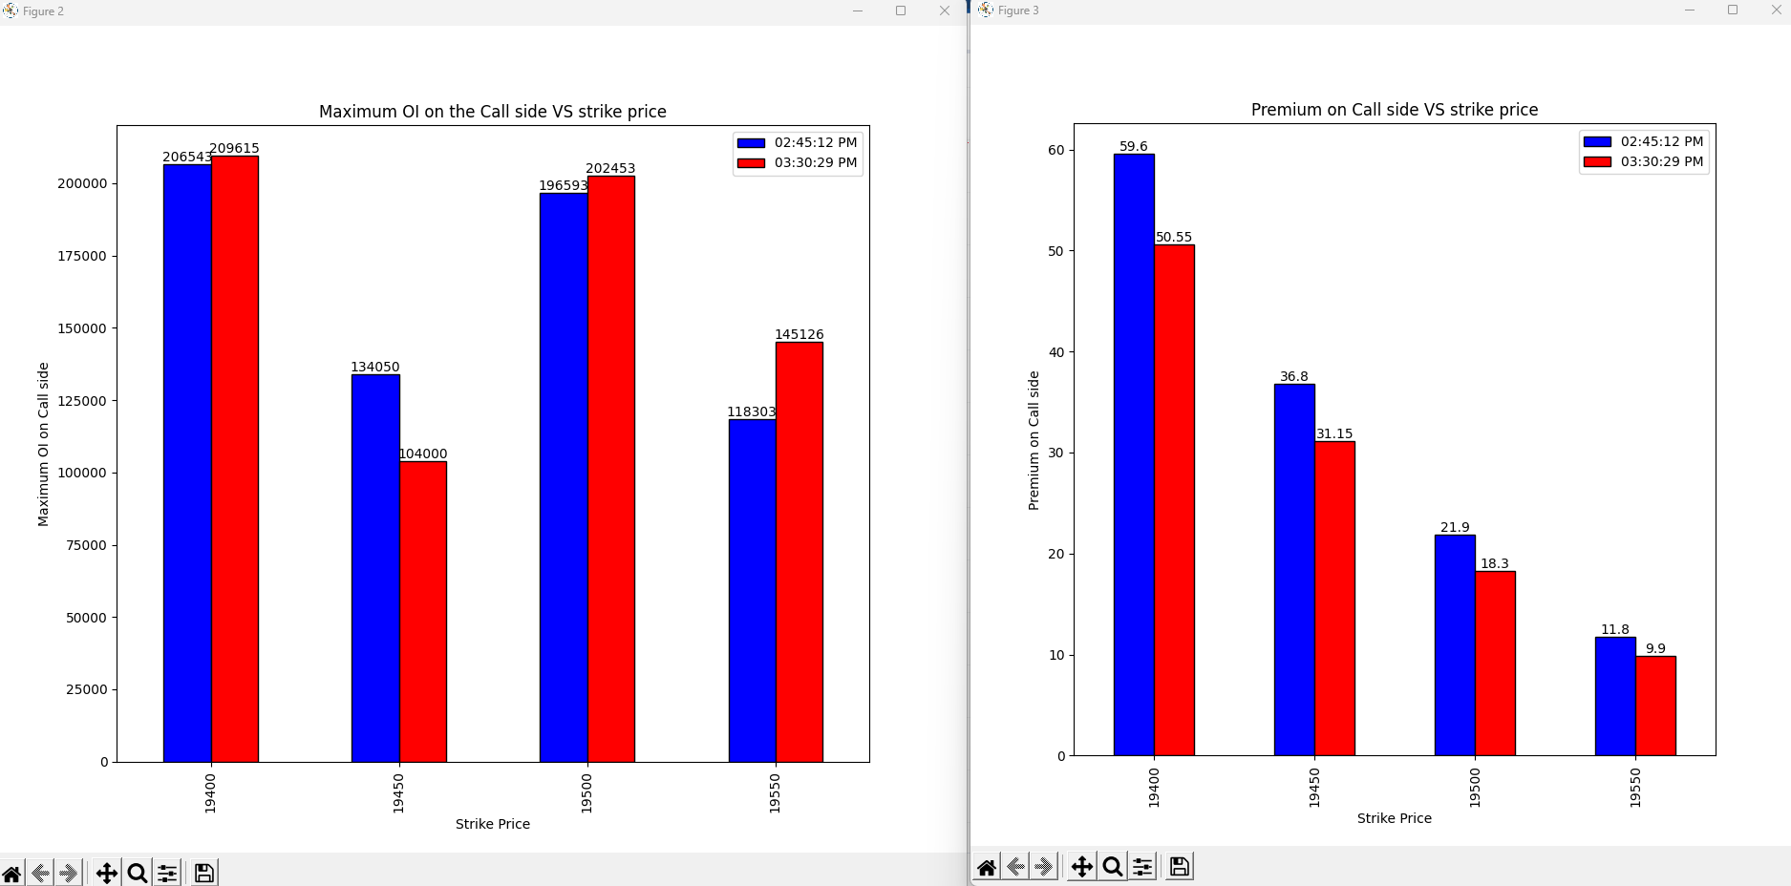
04-07-2023
Notes:
Shot build up on 19400, 19500, 19550
Long Covering on 19450

Slide 28
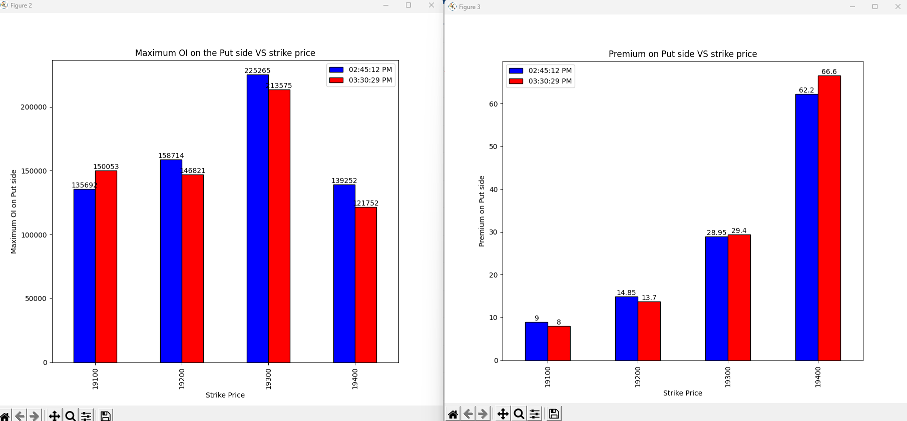
04-07-2023
Notes:
19100-> Shot Build up
19200->Long Covering
19300, 19400 -> Shot covering

Slide 29
Conclusion
Sentiment on the Overall OI is the bearish on the call side also the OI is high giving the sign of the heavy involvement compared to the Put side also on put side the sentiment is bullish but the OI is less-> Vote Bearish.
In final 45 minutes there is shot build up on the 19400, 19500, 19550 on call side which shows the confidence on the call side where as on the put side the there is shot covering on 19300, 19400 -> Vote Bearish.
Over all vote is bearish
Market may not open gap up or gap down but over all movement is bearish in nature.
Notes:
Result: As expected market have not opened gap up and gap down.
Advance to decline and the previous day analysis tells the market will open gap up or gap down.

Slide 30
05-07-2023
strikePrice | CE_OI_03:33:08 PM | CE_LTP_03:33:08 PM | CE_OI_09:28:25 AM | CE_LTP_09:28:25 AM | Change_in_OI | Change_in_Premium | Conclusion
19100 | 15155 | 311.25 | 21611 | 313.8 | -6456 | -2.55 | Long Unwinding
19150 | 10069 | 262.2 | 11954 | 267.1 | -1885 | -4.9 | Long Unwinding
19200 | 30624 | 213.2 | 34790 | 221.2 | -4166 | -8 | Long Unwinding
19250 | 19765 | 166.05 | 25122 | 175.35 | -5357 | -9.3 | Long Unwinding
19300 | 64975 | 122.55 | 79786 | 135.35 | -14811 | -12.8 | Long Unwinding
19350 | 54349 | 82.45 | 76327 | 98.65 | -21978 | -16.2 | Long Unwinding
19400 | 246020 | 50.65 | 258040 | 67.55 | -12020 | -16.9 | Long Unwinding
19450 | 149578 | 28.45 | 118454 | 44.05 | 31124 | -15.6 | Shot Buildup
19500 | 267720 | 14.5 | 231490 | 25.55 | 36230 | -11.05 | Shot Buildup
19550 | 206681 | 6.6 | 158888 | 14.65 | 47793 | -8.05 | Shot Buildup
19600 | 170988 | 3.55 | 151746 | 8.55 | 19242 | -5 | Shot Buildup
19650 | 74288 | 2.15 | 61652 | 5.1 | 12636 | -2.95 | Shot Buildup
19700 | 130625 | 1.65 | 143179 | 3.25 | -12554 | -1.6 | Long Unwinding
strikePrice | PE_OI_03:33:08 PM | PE_LTP_03:33:08 PM | PE_OI_09:28:25 AM | PE_LTP_09:28:25 AM | Change_in_OI | Change_in_Premium | Conclusion
19100 | 147039 | 3.85 | 161059 | 7.4 | -14020 | -3.55 | Long Unwinding
19150 | 93301 | 4 | 80173 | 9.55 | 13128 | -5.55 | Shot Buildup
19200 | 187261 | 5.8 | 172805 | 13.05 | 14456 | -7.25 | Shot Buildup
19250 | 117102 | 8.55 | 111614 | 18.65 | 5488 | -10.1 | Shot Buildup
19300 | 256296 | 14.25 | 259286 | 27.95 | -2990 | -13.7 | Long Unwinding
19350 | 167329 | 24.7 | 130662 | 41.15 | 36667 | -16.45 | Shot Buildup
19400 | 183795 | 41.8 | 163581 | 61.4 | 20214 | -19.6 | Shot Buildup
19450 | 33116 | 69 | 29384 | 86.35 | 3732 | -17.35 | Shot Buildup
19500 | 35911 | 106.1 | 41225 | 119.6 | -5314 | -13.5 | Long Unwinding
19550 | 6040 | 149 | 6642 | 157.4 | -602 | -8.4 | Long Unwinding
19600 | 6301 | 195.05 | 6759 | 200.6 | -458 | -5.55 | Long Unwinding
19650 | 740 | 244.55 | 688 | 248.65 | 52 | -4.1 | Shot Buildup
19700 | 1455 | 292.6 | 2013 | 296 | -558 | -3.4 | Long Unwinding
Notes:
Closing price is 19398.5
Both upside and downside is limited due to the shot build on both side market might not go below 19350 due to the heavy shot build up on the put side.

Slide 31
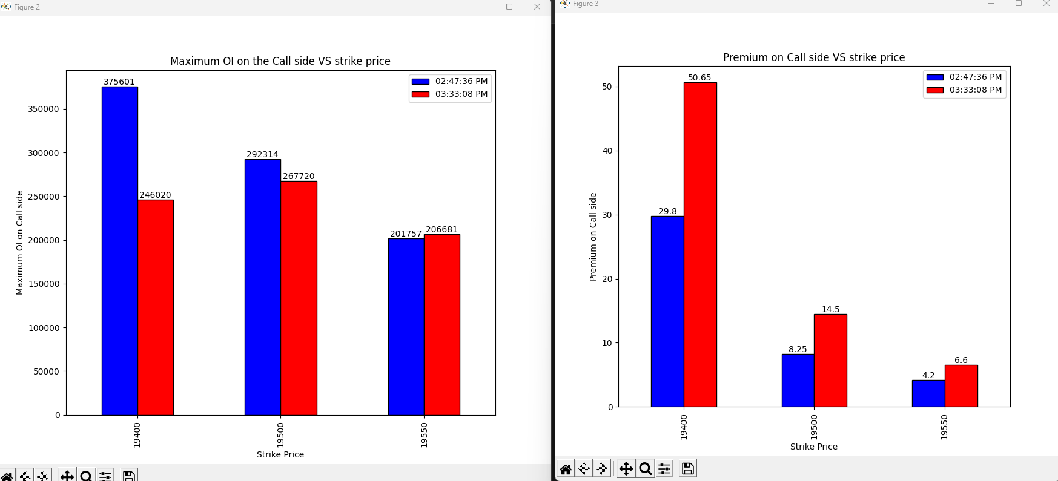
05-07-2023
Notes:
19400 and 19500 -> shot covering is going on
19550-> Long Build up

Slide 32
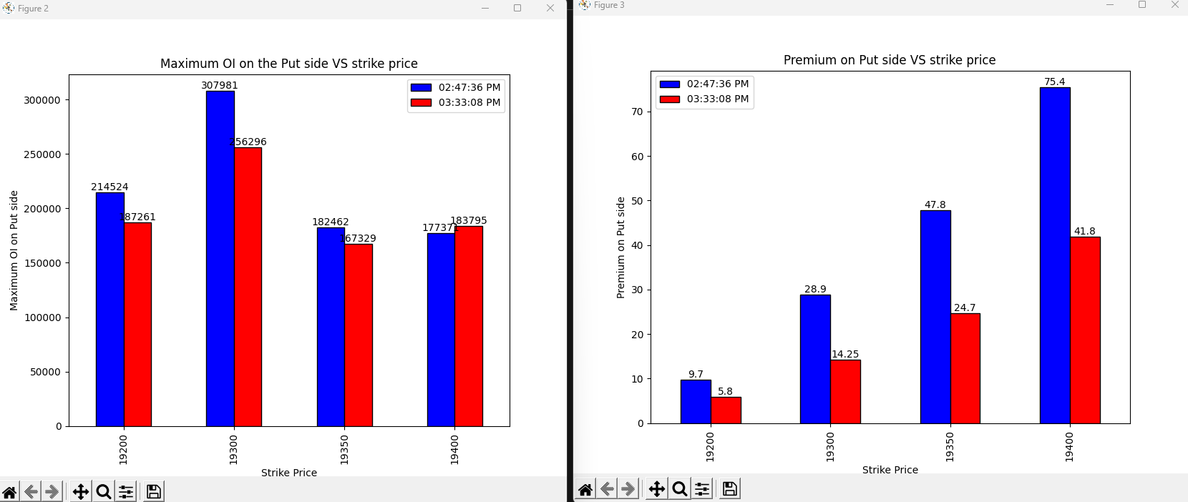
05-07-2023
Notes:
19200, 19300, 19350 -> Long covering
19400-> Shot build up

Slide 33
Conclusion
Overall market->Both upside and downside is limited due to the shot build on both side market might not go below 19350 due to the heavy shot build up on the put side and also might not go much above.
Last 45 mins->Last 45 mins shows the change in the opinion of the call and put side traders as the shot pogition of the near atm strike prices is closed and long pogition is made on 19550 on call side and more shot pogition is made on the put side
My vote is bullish as I’ll give more weightage to the final 45 mins change in the opinion of call side short sellers during the expiry.
Notes:
Result: Market opened gap down but not below 19350 as expected.
Advance is 19 and decline is 20-> Market will open gap down.

Slide 34
07-07-2023
strikePrice | CE_OI_03:30:30 PM | CE_LTP_03:30:30 PM | CE_OI_09:28:12 AM | CE_LTP_09:28:12 AM | Change_in_OI | Change_in_Premium | Conclusion
19050 | 674 | 300.45 | 785 | 435.4 | -111 | -134.95 | Long covering
19100 | 6054 | 260.5 | 6217 | 388.9 | -163 | -128.4 | Long covering
19150 | 2206 | 212.75 | 1320 | 343.5 | 886 | -130.75 | Shot Buildup
19200 | 15823 | 176.9 | 10460 | 300.65 | 5363 | -123.75 | Shot Buildup
19250 | 13195 | 142 | 11078 | 258.5 | 2117 | -116.5 | Shot Buildup
19300 | 51546 | 109.45 | 23305 | 218.35 | 28241 | -108.9 | Shot Buildup
19350 | 41094 | 85 | 12337 | 181.65 | 28757 | -96.65 | Shot Buildup
19400 | 234404 | 62.35 | 76063 | 147.3 | 158341 | -84.95 | Shot Buildup
19450 | 98298 | 44.95 | 68984 | 117.3 | 29314 | -72.35 | Shot Buildup
19500 | 216994 | 32.05 | 137681 | 90.8 | 79313 | -58.75 | Shot Buildup
19550 | 80576 | 22.6 | 42959 | 67.8 | 37617 | -45.2 | Shot Buildup
19600 | 112178 | 16.3 | 79845 | 49.3 | 32333 | -33 | Shot Buildup
19650 | 51792 | 12.1 | 73509 | 35.05 | -21717 | -22.95 | Long covering
strikePrice | PE_OI_03:30:30 PM | PE_LTP_03:30:30 PM | PE_OI_09:28:12 AM | PE_LTP_09:28:12 AM | Change_in_OI | Change_in_Premium | Conclusion
19050 | 32157 | 14.6 | 24994 | 12.1 | 7163 | 2.5 | Long Buildup
19100 | 72474 | 20.45 | 55755 | 15.2 | 16719 | 5.25 | Long Buildup
19150 | 53690 | 28.1 | 29712 | 19.2 | 23978 | 8.9 | Long Buildup
19200 | 93213 | 39.75 | 82605 | 24.9 | 10608 | 14.85 | Long Buildup
19250 | 38758 | 53.8 | 63396 | 32.75 | -24638 | 21.05 | Shot Covering
19300 | 117723 | 73 | 94056 | 42.85 | 23667 | 30.15 | Long Buildup
19350 | 35925 | 95 | 50174 | 55.8 | -14249 | 39.2 | Shot Covering
19400 | 136368 | 122.7 | 142767 | 72.2 | -6399 | 50.5 | Shot Covering
19450 | 17782 | 157.1 | 65046 | 91.3 | -47264 | 65.8 | Shot Covering
19500 | 52733 | 193.8 | 102035 | 114.55 | -49302 | 79.25 | Shot Covering
19550 | 7375 | 233.85 | 9946 | 142.15 | -2571 | 91.7 | Shot Covering
19600 | 12173 | 275.05 | 14907 | 175.1 | -2734 | 99.95 | Shot Covering
19650 | 3150 | 320.7 | 4843 | 210.85 | -1693 | 109.85 | Shot Covering
Notes:
Closing Price->19331.8
All strike prices indicating the bearish trend on next trading day
19400 is the important level as it have the maximum OI build up on shot side on call end

Slide 35
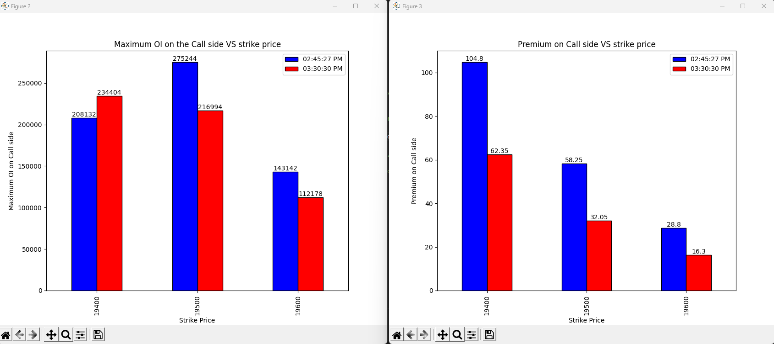
07-07-2023
Notes:
19400-> Shot build up
19500 and 19600 ->Long Covering

Slide 36
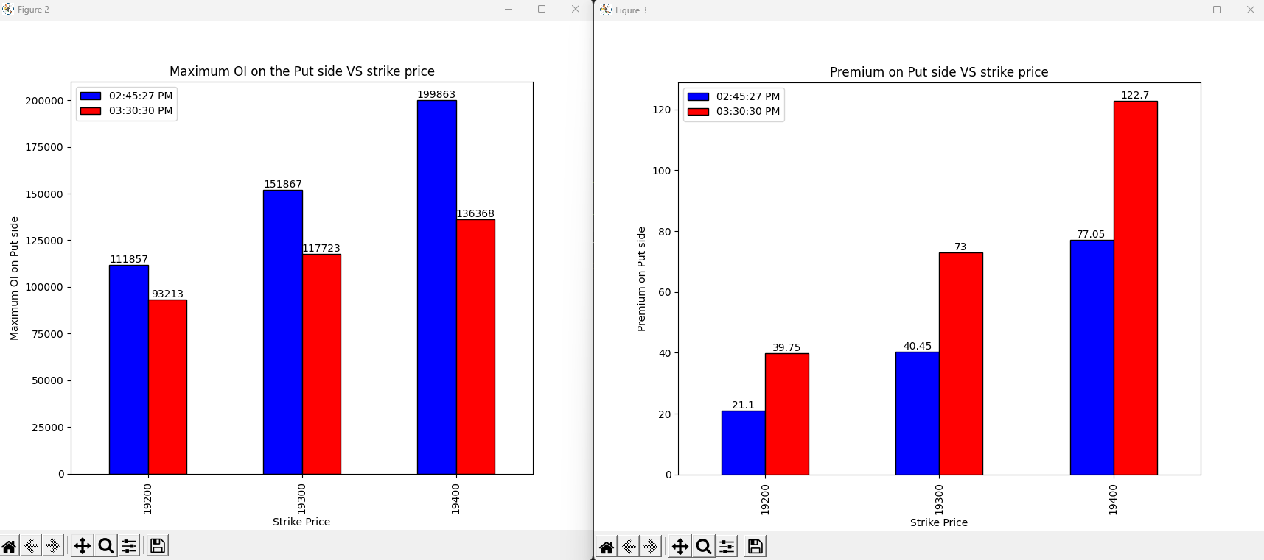
07-07-2023
Notes:
Shot covering on all the strike prices

Slide 37
Conclusion
Overall market -> Bearish as there is shot buildup on all the strike prices. 19400 is the important level as there is maximum buildup on the shot side on call end.
Last 45 mins-> Bearish as there shot build up on 19400 and the long covering on all the other strike prices on call side also there is shot covering on put side showing the inability of the bulls to push the market to upside.
My Vote will be bearish for the next day and 19400 as the key resistance level.
Notes:
As expected market is bearish overall.

Slide 38
10-07-2023
strikePrice | CE_OI_03:34:40 PM | CE_LTP_03:34:40 PM | CE_OI_09:25:21 AM | CE_LTP_09:25:21 AM | Change_in_OI | Change_in_Premium | Conclusion
19050 | 713 | 337.2 | 702 | 340.15 | 11 | -2.95 | Shot Buildup
19100 | 5637 | 288.3 | 5898 | 291.95 | -261 | -3.65 | Long Covering
19150 | 2315 | 243.3 | 2214 | 248.8 | 101 | -5.5 | Shot Buildup
19200 | 16723 | 200 | 16396 | 204.15 | 327 | -4.15 | Shot Buildup
19250 | 13332 | 158 | 13656 | 165.1 | -324 | -7.1 | Long Covering
19300 | 43728 | 121 | 51579 | 130.1 | -7851 | -9.1 | Long Covering
19350 | 52906 | 89 | 41831 | 99.35 | 11075 | -10.35 | Shot Buildup
19400 | 222558 | 61.25 | 212292 | 73.7 | 10266 | -12.45 | Shot Buildup
19450 | 111515 | 42.2 | 100490 | 53.6 | 11025 | -11.4 | Shot Buildup
19500 | 221991 | 28.05 | 215086 | 37.85 | 6905 | -9.8 | Shot Buildup
19550 | 81511 | 17.85 | 83372 | 26.35 | -1861 | -8.5 | Long Covering
19600 | 136162 | 11.3 | 118289 | 17.95 | 17873 | -6.65 | Shot Buildup
19650 | 74579 | 7.25 | 57925 | 12.3 | 16654 | -5.05 | Shot Buildup
strikePrice | PE_OI_03:34:40 PM | PE_LTP_03:34:40 PM | PE_OI_09:25:21 AM | PE_LTP_09:25:21 AM | Change_in_OI | Change_in_Premium | Conclusion
19050 | 38240 | 5.3 | 31151 | 9.55 | 7089 | -4.25 | Shot Buildup
19100 | 85057 | 7.2 | 73385 | 13.05 | 11672 | -5.85 | Shot Buildup
19150 | 71944 | 10.1 | 53212 | 18.1 | 18732 | -8 | Shot Buildup
19200 | 110643 | 15.75 | 99291 | 26 | 11352 | -10.25 | Shot Buildup
19250 | 73533 | 24.8 | 51930 | 36.95 | 21603 | -12.15 | Shot Buildup
19300 | 116154 | 37.6 | 149337 | 51.5 | -33183 | -13.9 | Long Covering
19350 | 81178 | 55 | 56203 | 71.2 | 24975 | -16.2 | Shot Buildup
19400 | 139687 | 79.25 | 143688 | 95.4 | -4001 | -16.15 | Long Covering
19450 | 15093 | 109.05 | 21987 | 125.35 | -6894 | -16.3 | Long Covering
19500 | 48505 | 143.7 | 57648 | 159.4 | -9143 | -15.7 | Long Covering
19550 | 6335 | 185.85 | 8924 | 197.75 | -2589 | -11.9 | Long Covering
19600 | 9430 | 226.45 | 13422 | 238.8 | -3992 | -12.35 | Long Covering
19650 | 2261 | 273.6 | 2876 | 282.65 | -615 | -9.05 | Long Covering
Notes:
Closing Price->19355.9.
Market will not go below 19350 .
Upside looks limited due to shot build up on the call side.

Slide 39
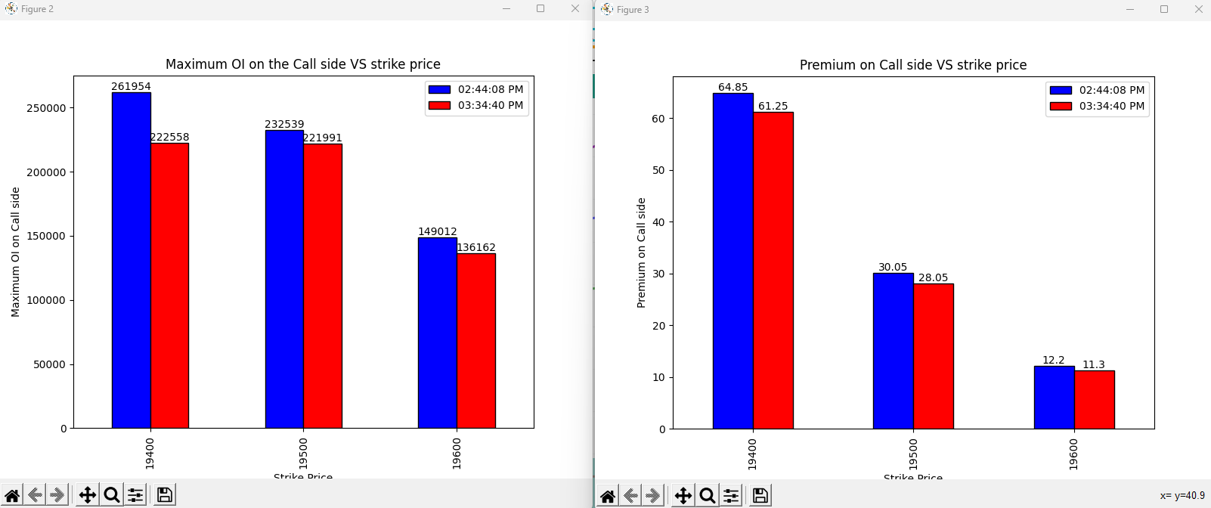
10-07-2023
Notes:
Long covering on all the strike price-> Bearish View

Slide 40
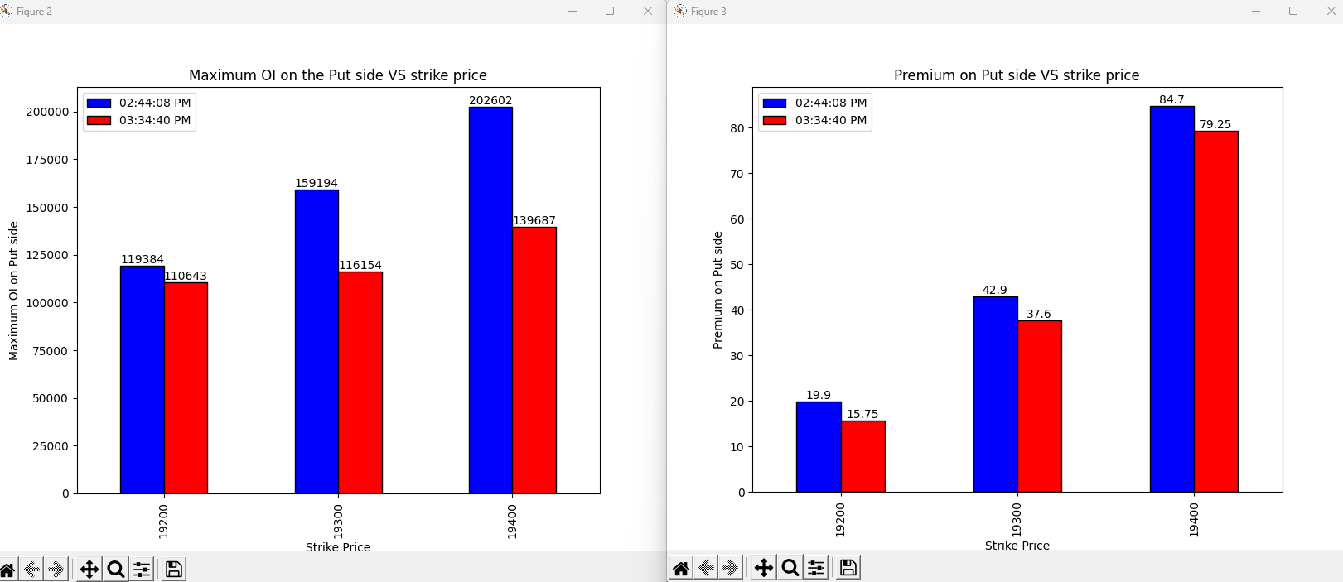
10-07-2023
Notes:
Long covering on all the strike price-> Bullish View

Slide 41
Conclusion
Overall market -> Market will not go below 19350 .Upside looks limited due to shot build up on the call side. If the Open interest created is not closed
Last 45 mins-> On call side and on put side the view is opposite in last 45 mins
My Vote will be sideways market.
Notes:
As opposed to the expectation market was not side ways but the closing is very close to the opening.

Slide 42
14-07-2023
strikePrice | CE_OI_03:32:34 PM | CE_LTP_03:32:34 PM | CE_OI_09:27:17 AM | CE_LTP_09:27:17 AM | Change_in_OI | Change_in_Premium | Conclusion
19250 | 2376 | 359.15 | 2599 | 254.8 | -223 | 104.35 | Shot covering
19300 | 13153 | 310.75 | 15320 | 213.05 | -2167 | 97.7 | Shot covering
19350 | 5299 | 266.95 | 8520 | 171.75 | -3221 | 95.2 | Shot covering
19400 | 56421 | 223.5 | 60281 | 136.5 | -3860 | 87 | Shot covering
19450 | 23068 | 184.45 | 39758 | 108.35 | -16690 | 76.1 | Shot covering
19500 | 122671 | 145 | 227587 | 81.5 | -104916 | 63.5 | Shot covering
19550 | 55554 | 109.85 | 78775 | 58.25 | -23221 | 51.6 | Shot covering
19600 | 124259 | 82 | 123906 | 42.55 | 353 | 39.45 | Long Buildup
19650 | 91368 | 56 | 48152 | 28.7 | 43216 | 27.3 | Long Buildup
19700 | 113582 | 40 | 98283 | 19.35 | 15299 | 20.65 | Long Buildup
19750 | 87110 | 26 | 32710 | 13.7 | 54400 | 12.3 | Long Buildup
19800 | 98767 | 15 | 62848 | 9.7 | 35919 | 5.3 | Long Buildup
19850 | 66556 | 9.45 | 36832 | 6.85 | 29724 | 2.6 | Long Buildup
strikePrice | PE_OI_03:32:34 PM | PE_LTP_03:32:34 PM | PE_OI_09:27:17 AM | PE_LTP_09:27:17 AM | Change_in_OI | Change_in_Premium | Conclusion
19250 | 40722 | 11.2 | 28028 | 23.1 | 12694 | -11.9 | Shot Buildup
19300 | 122233 | 15 | 85584 | 31.45 | 36649 | -16.45 | Shot Buildup
19350 | 66392 | 20 | 62990 | 43.1 | 3402 | -23.1 | Shot Buildup
19400 | 184118 | 25 | 113591 | 58.35 | 70527 | -33.35 | Shot Buildup
19450 | 107724 | 35.5 | 50443 | 76.7 | 57281 | -41.2 | Shot Buildup
19500 | 216626 | 47 | 190898 | 100 | 25728 | -53 | Shot Buildup
19550 | 68446 | 63 | 27934 | 130.05 | 40512 | -67.05 | Shot Buildup
19600 | 54324 | 83.8 | 41794 | 163.35 | 12530 | -79.55 | Shot Buildup
19650 | 13741 | 109.1 | 4594 | 198.15 | 9147 | -89.05 | Shot Buildup
19700 | 18170 | 141.35 | 8083 | 240.3 | 10087 | -98.95 | Shot Buildup
19750 | 4716 | 176.7 | 1395 | 281.05 | 3321 | -104.35 | Shot Buildup
19800 | 4240 | 218.9 | 2081 | 328.6 | 2159 | -109.7 | Shot Buildup
19850 | 292 | 263.65 | 195 | 372.5 | 97 | -108.85 | Shot Buildup
Notes:
Market closed at 19564.5
Long build up above the ATM strike price on call side and shot covering at strike price below the ATM-> Bullish sentiment tomorrow
Shot buildup on the put side on all the strike price signify the bullish movement
19500 and 19550 will act as the good support as the high shot build up on the put side and large shot covering on the call side.

Slide 43
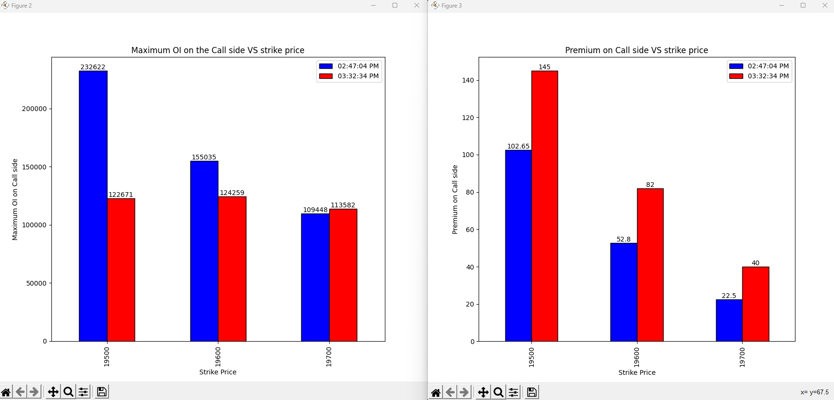
14-07-2023
Notes:
Shot covering on the strike price 19500, 19600
Long buildup on 19700
Bullish sentiment

Slide 44
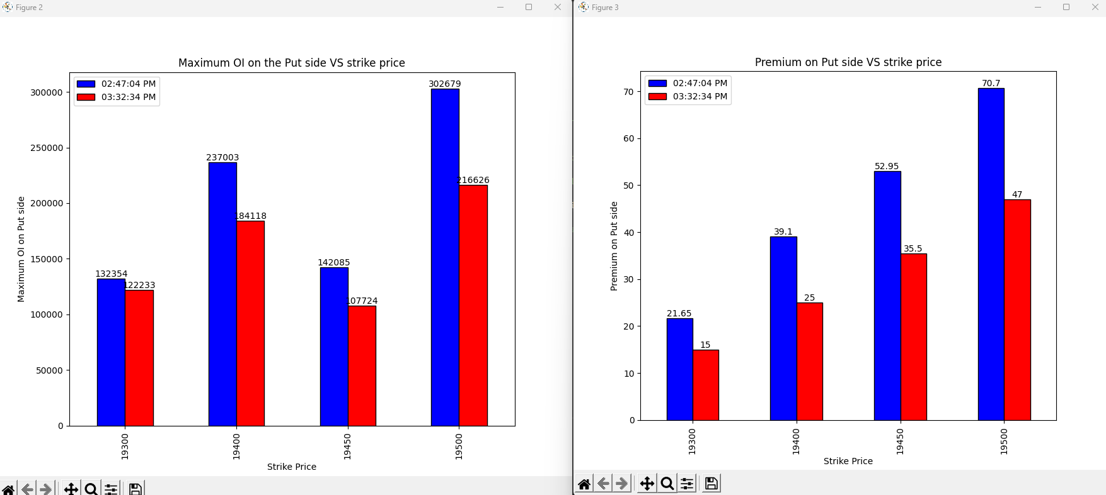
14-07-2023
Notes:
Long covering on the put side on all the strike prices indicating bullish sentiment.

Slide 45
Conclusion
Overall market -> Long build up above the ATM strike price on call side and shot covering at strike price below the ATM-> Bullish sentiment tomorrow. Shot buildup on the put side on all the strike price signify the bullish movement. 19500 and 19550 will act as the good support as the high shot build up on the put side and large shot covering on the call side.
Last 45 mins-> No shot build up in the last 45 mins market went up due to the shot covering on call side and long covering on the put side. -> Mild bullish
My Vote will be bullish market as there is no resistance near any strike price.
Notes:
As expected market was bullish next day

Slide 46
17-07-2023
strikePrice | CE_OI_03:35:01 PM | CE_LTP_03:35:01 PM | CE_OI_09:24:52 AM | CE_LTP_09:24:52 AM | Change_in_OI | Change_in_Premium | Conclusion
19400 | 34714 | 329.35 | 54622 | 215 | -19908 | 114.35 | Shot Covering
19450 | 12363 | 282 | 20656 | 174.85 | -8293 | 107.15 | Shot Covering
19500 | 62312 | 237.7 | 105257 | 137 | -42945 | 100.7 | Shot Covering
19550 | 36770 | 194.8 | 58621 | 104.45 | -21851 | 90.35 | Shot Covering
19600 | 125465 | 153.5 | 151753 | 76.2 | -26288 | 77.3 | Shot Covering
19650 | 66288 | 116.45 | 103316 | 53.55 | -37028 | 62.9 | Shot Covering
19700 | 136965 | 84.8 | 124869 | 36 | 12096 | 48.8 | Long Buildup
19750 | 87108 | 58.6 | 89398 | 22.8 | -2290 | 35.8 | Shot Covering
19800 | 123359 | 38.25 | 101099 | 14.1 | 22260 | 24.15 | Long Buildup
19850 | 88611 | 23.15 | 69792 | 8.6 | 18819 | 14.55 | Long Buildup
19900 | 124045 | 13.4 | 86622 | 5.5 | 37423 | 7.9 | Long Buildup
19950 | 52871 | 7.95 | 33000 | 3.7 | 19871 | 4.25 | Long Buildup
20000 | 159889 | 5.2 | 130970 | 2.85 | 28919 | 2.35 | Long Buildup
strikePrice | PE_OI_03:35:01 PM | PE_LTP_03:35:01 PM | PE_OI_09:24:52 AM | PE_LTP_09:24:52 AM | Change_in_OI | Change_in_Premium | Conclusion
19400 | 171421 | 19 | 182037 | 27.7 | -10616 | -8.7 | Long covering
19450 | 97344 | 22.9 | 108119 | 36.45 | -10775 | -13.55 | Long covering
19500 | 227310 | 28 | 236095 | 49.8 | -8785 | -21.8 | Long covering
19550 | 106994 | 34.65 | 80688 | 67.05 | 26306 | -32.4 | Shot buildup
19600 | 283188 | 43.65 | 98630 | 88.85 | 184558 | -45.2 | Shot buildup
19650 | 79943 | 56.85 | 21713 | 116.4 | 58230 | -59.55 | Shot buildup
19700 | 96897 | 75.15 | 22623 | 149.75 | 74274 | -74.6 | Shot buildup
19750 | 28444 | 98.7 | 7553 | 186.9 | 20891 | -88.2 | Shot buildup
19800 | 25682 | 128.45 | 6140 | 224.3 | 19542 | -95.85 | Shot buildup
19850 | 3314 | 163.15 | 651 | 271.1 | 2663 | -107.95 | Shot buildup
19900 | 4844 | 204.05 | 964 | 318.9 | 3880 | -114.85 | Shot buildup
19950 | 372 | 221.45 | 165 | 366.25 | 207 | -144.8 | Shot buildup
20000 | 2510 | 295.65 | 1647 | 413.55 | 863 | -117.9 | Shot buildup
Notes:
Closing price is 19711.45
19700 and 19600 is the good support due to the very high Open interest buildup on put side

Slide 47
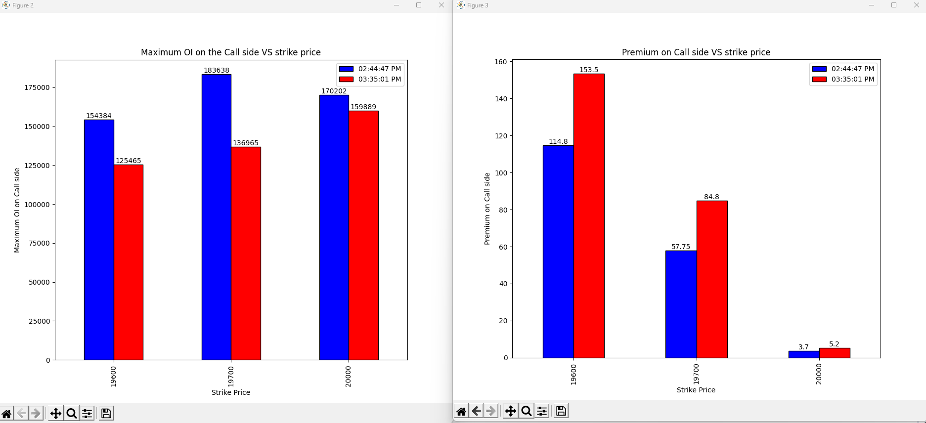
17-07-2023
Notes:
Shot covering on all the strike prices->Bullish View

Slide 48
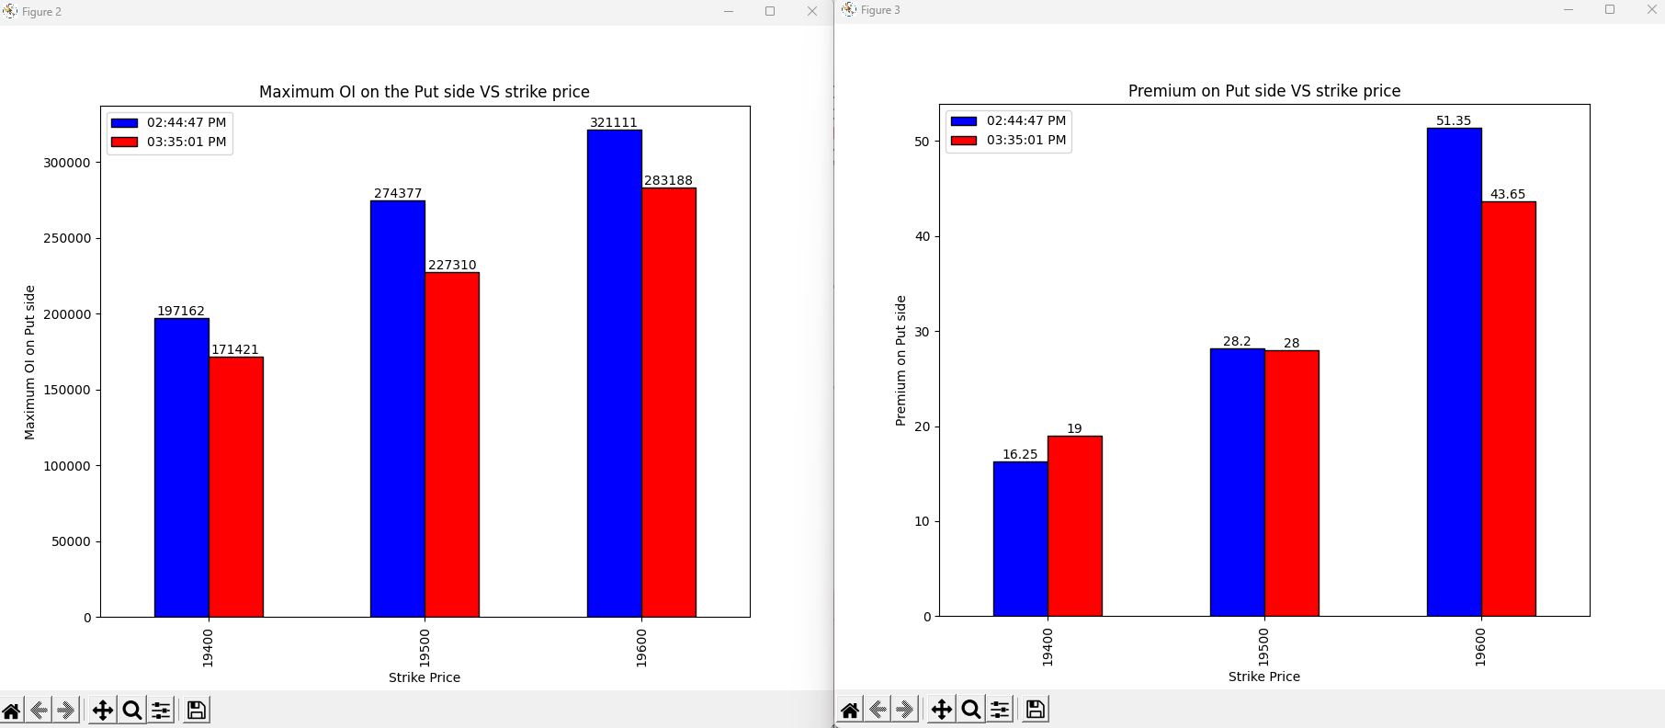
17-07-2023
Notes:
19400->shot covering
19500, 19600 -> Long covering
Bullish View

Slide 49
Conclusion
Overall market ->Bullish view with 19700 and 19600 as the important support level due to very high shot buildup on put side
Last 45 mins-> Shot covering on the call side-> Bullish view and long covering on put side -> Bullish view
My Vote will be bullish
Notes:
As expected market held the support of 19700 and haven’t broken that but the market was bearish

Slide 50
18-07-2023
strikePrice | CE_OI_03:28:39 PM | CE_LTP_03:28:39 PM | CE_OI_09:24:05 AM | CE_LTP_09:24:05 AM | Change_in_OI | Change_in_Premium | Conclusion
19450 | 7587 | 313.1 | 10971 | 337.65 | -3384 | -24.55 | Long Covering
19500 | 41486 | 265.6 | 56406 | 290.85 | -14920 | -25.25 | Long Covering
19550 | 26249 | 221 | 31381 | 245.65 | -5132 | -24.65 | Long Covering
19600 | 47684 | 176 | 113198 | 203.6 | -65514 | -27.6 | Long Covering
19650 | 21864 | 136.6 | 50600 | 163.25 | -28736 | -26.65 | Long Covering
19700 | 114038 | 99.9 | 134364 | 127.15 | -20326 | -27.25 | Long Covering
19750 | 104611 | 70.3 | 93351 | 94.45 | 11260 | -24.15 | Shot Buildup
19800 | 167560 | 46.45 | 153043 | 67.4 | 14517 | -20.95 | Shot Buildup
19850 | 95970 | 29.85 | 84910 | 46 | 11060 | -16.15 | Shot Buildup
19900 | 150182 | 17.6 | 127122 | 29.6 | 23060 | -12 | Shot Buildup
19950 | 93863 | 9.9 | 58171 | 19.05 | 35692 | -9.15 | Shot Buildup
20000 | 198571 | 6.15 | 148487 | 12.55 | 50084 | -6.4 | Shot Buildup
20050 | 51307 | 3.7 | 30837 | 8 | 20470 | -4.3 | Shot Buildup
strikePrice | PE_OI_03:28:39 PM | PE_LTP_03:28:39 PM | PE_OI_09:24:05 AM | PE_LTP_09:24:05 AM | Change_in_OI | Change_in_Premium | Conclusion
19450 | 90610 | 7.4 | 91709 | 17.1 | -1099 | -9.7 | Long Covering
19500 | 171463 | 10.45 | 206119 | 21.15 | -34656 | -10.7 | Long Covering
19550 | 78034 | 14.75 | 98888 | 26.1 | -20854 | -11.35 | Long Covering
19600 | 179754 | 20.85 | 274946 | 32.45 | -95192 | -11.6 | Long Covering
19650 | 93882 | 29.8 | 87330 | 42.45 | 6552 | -12.65 | Shot Buildup
19700 | 139185 | 44 | 127235 | 55.35 | 11950 | -11.35 | Shot Buildup
19750 | 63611 | 63.25 | 52195 | 74.5 | 11416 | -11.25 | Shot Buildup
19800 | 46729 | 90.75 | 59295 | 98.1 | -12566 | -7.35 | Long Covering
19850 | 8325 | 123.2 | 12191 | 125.3 | -3866 | -2.1 | Long Covering
19900 | 11738 | 162 | 10774 | 158.45 | 964 | 3.55 | Long Buildup
19950 | 1585 | 204.2 | 1691 | 198.35 | -106 | 5.85 | Shot Covering
20000 | 4647 | 249 | 4837 | 241.25 | -190 | 7.75 | Shot Covering
20050 | 489 | 297.25 | 321 | 287.5 | 168 | 9.75 | Long Buildup
Notes:
Closing price is 19749.25
There is the heavy shot buildup on the call side so market is expected to face the fight at opening

Slide 51
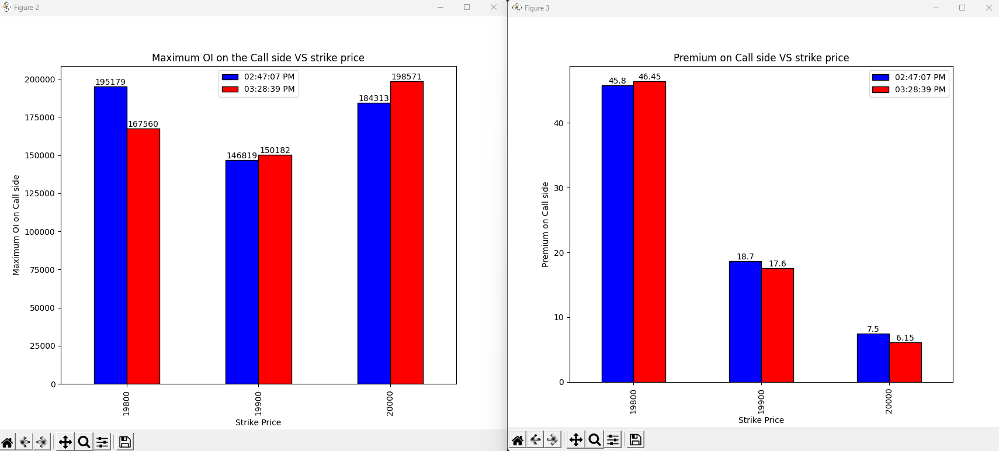
18-07-2023
Notes:
19800->shot covering
19900->shot buildup
20000->Shot buildup
So from the call side opinion is that might 19800 level be broken but other strike price will behave as the good resistance.

Slide 52
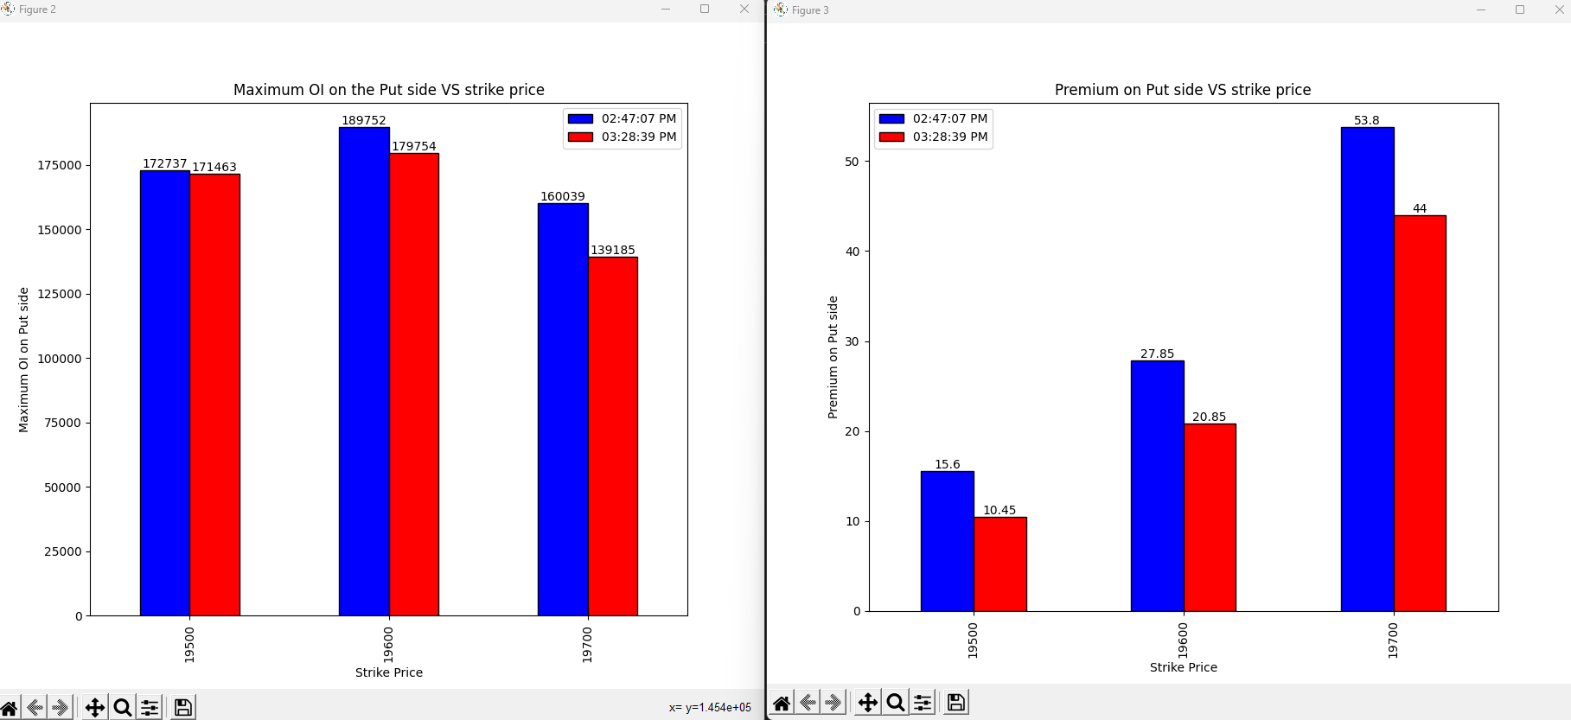
18-07-2023
Notes:
Long covering on all the strike price

Slide 53
Conclusion
Overall market ->Since there is high shot buildup on the call side indicate the market face resistance on rising above but the put side opinion is opposite at 19750 strike price. So the overall market data indicate the sideways market next day.
Last 45 mins-> in last 45 mins there is shot build up at 19900 and 20000 strike price and covering at 19800 so indicating not big up move but down move is also limited due to the long covering at the lower strike price indicating that market may not go down that much
My Vote->sideways market may not make any big move tomorrow
Notes:
As expected market was mostly sideways with big movement in bearish direction but the market was not able to break the 19900 level and the 19750 are was the effective support so as expected market haven’t gone down too much.

Slide 54
19-07-2023
strikePrice | CE_OI_03:30:42 PM | CE_LTP_03:30:42 PM | CE_OI_09:24:11 AM | CE_LTP_09:24:11 AM | Change_in_OI | Change_in_Premium | Conclusion
19550 | 25216 | 305.55 | 26555 | 257.45 | -1339 | 48.1 | Shot covering
19600 | 27916 | 258.8 | 49223 | 211.2 | -21307 | 47.6 | Shot covering
19650 | 15707 | 209.95 | 21572 | 167.1 | -5865 | 42.85 | Shot covering
19700 | 47301 | 164.45 | 113092 | 127.35 | -65791 | 37.1 | Shot covering
19750 | 40206 | 118.8 | 104746 | 92 | -64540 | 26.8 | Shot covering
19800 | 169388 | 78.95 | 222507 | 63.4 | -53119 | 15.55 | Shot covering
19850 | 159619 | 49 | 121732 | 41.05 | 37887 | 7.95 | Long Buildup
19900 | 208238 | 26 | 164427 | 25.1 | 43811 | 0.9 | Long Buildup
19950 | 160064 | 12.6 | 103088 | 14.5 | 56976 | -1.9 | Shot buildup
20000 | 259200 | 6 | 220940 | 8.4 | 38260 | -2.4 | Shot buildup
20050 | 71760 | 3.3 | 61349 | 5.3 | 10411 | -2 | Shot buildup
20100 | 154633 | 1.9 | 110874 | 3.55 | 43759 | -1.65 | Shot buildup
20150 | 38742 | 1.25 | 32129 | 2.55 | 6613 | -1.3 | Shot buildup
strikePrice | PE_OI_03:30:42 PM | PE_LTP_03:30:42 PM | PE_OI_09:24:11 AM | PE_LTP_09:24:11 AM | Change_in_OI | Change_in_Premium | Conclusion
19550 | 104268 | 4.55 | 92131 | 10.45 | 12137 | -5.9 | shot buildup
19600 | 170381 | 5.5 | 193340 | 14.55 | -22959 | -9.05 | Long covering
19650 | 118794 | 7 | 97714 | 21.1 | 21080 | -14.1 | shot buildup
19700 | 195664 | 10 | 182726 | 30.7 | 12938 | -20.7 | shot buildup
19750 | 135552 | 16 | 88910 | 45.75 | 46642 | -29.75 | shot buildup
19800 | 214644 | 26.5 | 133327 | 66.55 | 81317 | -40.05 | shot buildup
19850 | 51617 | 45.1 | 22787 | 94.75 | 28830 | -49.65 | shot buildup
19900 | 29368 | 75 | 22115 | 128.55 | 7253 | -53.55 | shot buildup
19950 | 4052 | 113.8 | 4016 | 168.65 | 36 | -54.85 | shot buildup
20000 | 7694 | 152.4 | 8227 | 212.7 | -533 | -60.3 | Long covering
20050 | 520 | 202 | 565 | 259.45 | -45 | -57.45 | Long covering
20100 | 935 | 250 | 436 | 305 | 499 | -55 | shot buildup
20150 | 170 | 303 | 110 | 355.6 | 60 | -52.6 | shot buildup
Notes:
Closing price is 19833.15
19800 will be the best support as the huge shot covering is done on the call side and large shot buildup on the put side.
19950 is the best resistance and the market may move flawlessly from 19800 to 19950 a 150 points move.

Slide 55
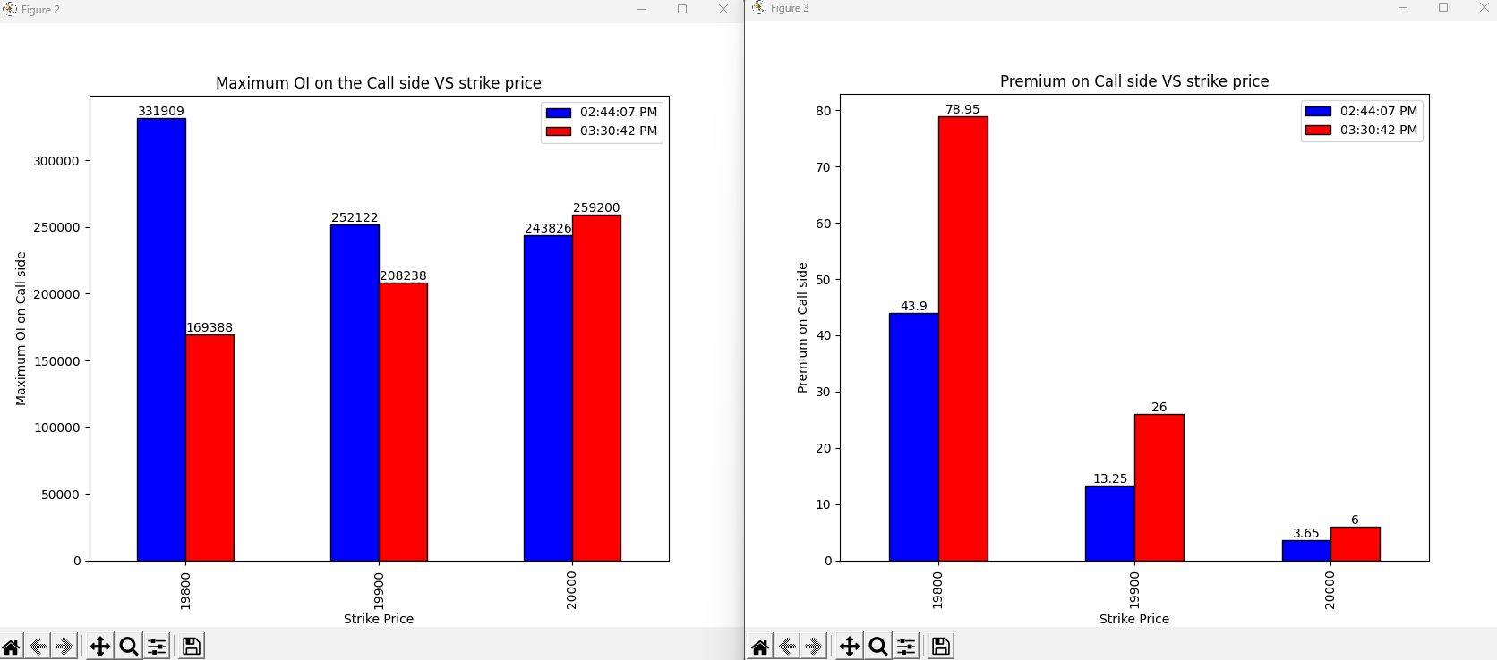
19-07-2023
Notes:
19800 and 19900 -> Shot covering (Bullish view)
20000 -> Shot buildup

Slide 56
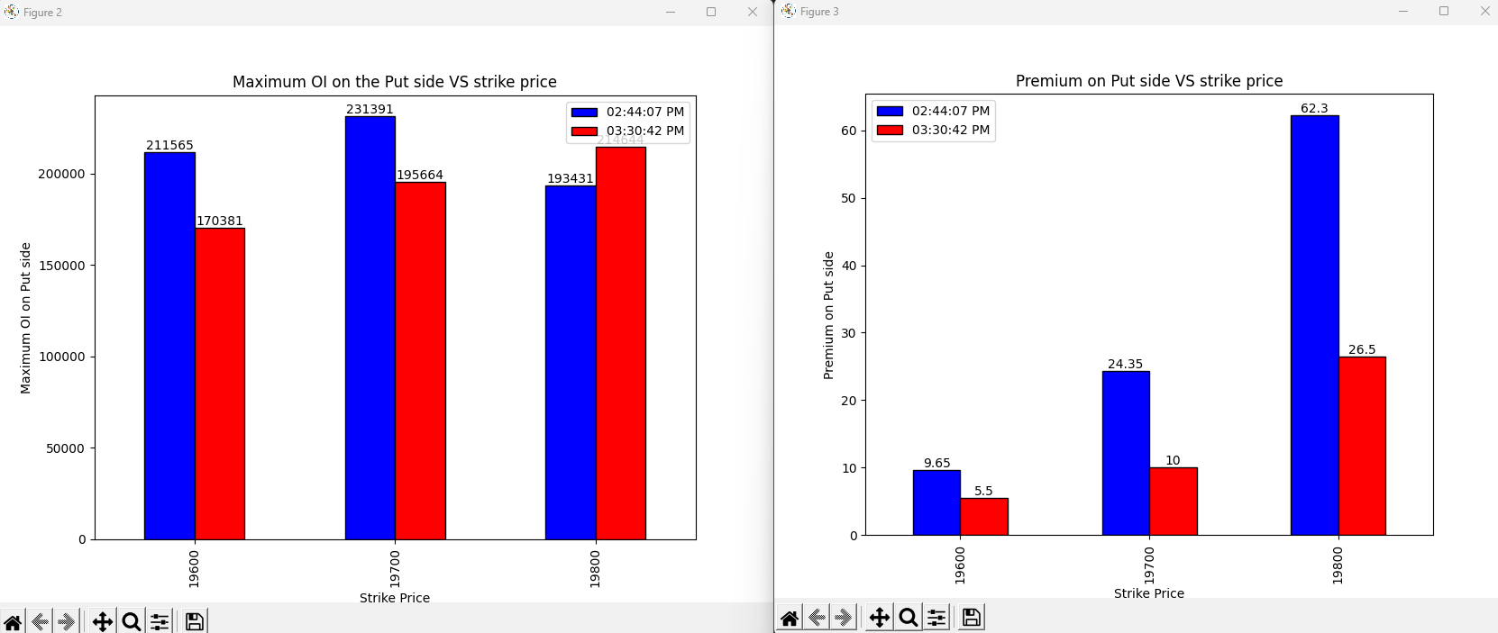
19-07-2023
Notes:
19600 and 19700 -> Long covering
19800 -> Shot buildup

Slide 57
Conclusion
Overall market ->19800 will be the best support as the huge shot covering is done on the call side and large shot buildup on the put side.19950 is the best resistance and the market may move flawlessly from 19800 to 19950 a 150 points move.
Last 45 mins->shot covering on 19800 and 19900 on the call side and shot build up on the 19800 on put side increases the chances that 19800 will be the best support and long covering on the lower strike price on put side indicate bullish view.
My Vote->Bullish with 19800 as the good Support.
Notes:
As expected market closed bullish but it went down but not much below the 19800 and not much above the 19900 these zones act as the good resistance and support level.

Slide 58
21-07-2023
strikePrice | CE_OI_03:39:00 PM | CE_LTP_03:39:00 PM | CE_OI_09:24:04 AM | CE_LTP_09:24:04 AM | Change_in_OI | Change_in_Premium | Conclusion
19450 | 4257 | 370.85 | 3865 | 461.5 | 392 | -90.65 | Shot Buildup
19500 | 38983 | 325.15 | 42753 | 413.95 | -3770 | -88.8 | Long Covering
19550 | 4186 | 281.45 | 3921 | 370.05 | 265 | -88.6 | Shot Buildup
19600 | 23124 | 238.55 | 23529 | 325.45 | -405 | -86.9 | Long Covering
19650 | 9054 | 203.1 | 4094 | 283.45 | 4960 | -80.35 | Shot Buildup
19700 | 58128 | 168.1 | 39465 | 241.7 | 18663 | -73.6 | Shot Buildup
19750 | 44277 | 137.8 | 19601 | 206.55 | 24676 | -68.75 | Shot Buildup
19800 | 221285 | 110 | 130398 | 172 | 90887 | -62 | Shot Buildup
19850 | 94252 | 86 | 31738 | 139.7 | 62514 | -53.7 | Shot Buildup
19900 | 229835 | 65.3 | 94035 | 112.1 | 135800 | -46.8 | Shot Buildup
19950 | 81842 | 50.35 | 44214 | 87.65 | 37628 | -37.3 | Shot Buildup
20000 | 199944 | 37.85 | 134403 | 67.6 | 65541 | -29.75 | Shot Buildup
20050 | 41775 | 27.95 | 34334 | 49.65 | 7441 | -21.7 | Shot Buildup
strikePrice | PE_OI_03:39:00 PM | PE_LTP_03:39:00 PM | PE_OI_09:24:04 AM | PE_LTP_09:24:04 AM | Change_in_OI | Change_in_Premium | Conclusion
19450 | 36735 | 16.65 | 23327 | 19.2 | 13408 | -2.55 | Shot buildup
19500 | 117676 | 21.8 | 105532 | 23.45 | 12144 | -1.65 | Shot buildup
19550 | 30315 | 28.25 | 20906 | 27.8 | 9409 | 0.45 | Long Buildup
19600 | 101352 | 37.25 | 74996 | 33.8 | 26356 | 3.45 | Long Buildup
19650 | 84544 | 48.4 | 26441 | 42.3 | 58103 | 6.1 | Long Buildup
19700 | 111638 | 63.55 | 108069 | 52.15 | 3569 | 11.4 | Long Buildup
19750 | 58922 | 82.7 | 48467 | 64.7 | 10455 | 18 | Long Buildup
19800 | 169384 | 104.7 | 183257 | 80 | -13873 | 24.7 | Shot covering
19850 | 33953 | 130.7 | 41957 | 98.6 | -8004 | 32.1 | Shot covering
19900 | 89853 | 162.5 | 92078 | 120.2 | -2225 | 42.3 | Shot covering
19950 | 15358 | 195.15 | 20909 | 146.3 | -5551 | 48.85 | Shot covering
20000 | 38912 | 232.7 | 59062 | 175.55 | -20150 | 57.15 | Shot covering
20050 | 2580 | 271.95 | 3361 | 209.6 | -781 | 62.35 | Shot covering
Notes:
Closing price is 19745
Bearish sentiment on all the strike price with 19800 as the good resistance due to high shot buildup on the call side and large shot covering on the put side.
There is no important support visible till 19500 due to heavy shot buildup on the put side.

Slide 59
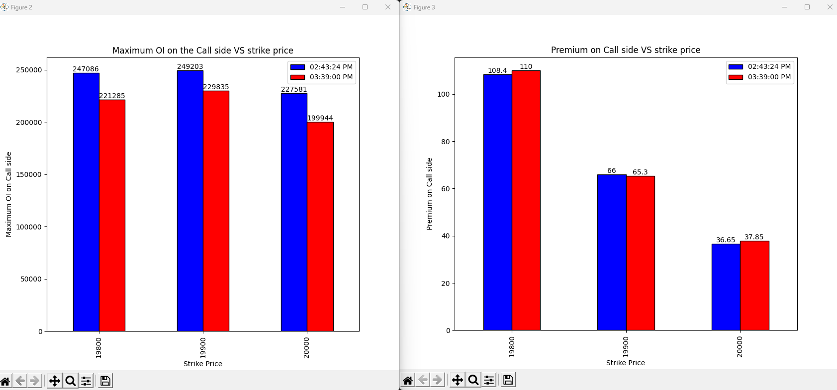
21-07-2023
Notes:
19800->Shot covering
19900 -> Long covering
20000 -> Shot buildup

Slide 60
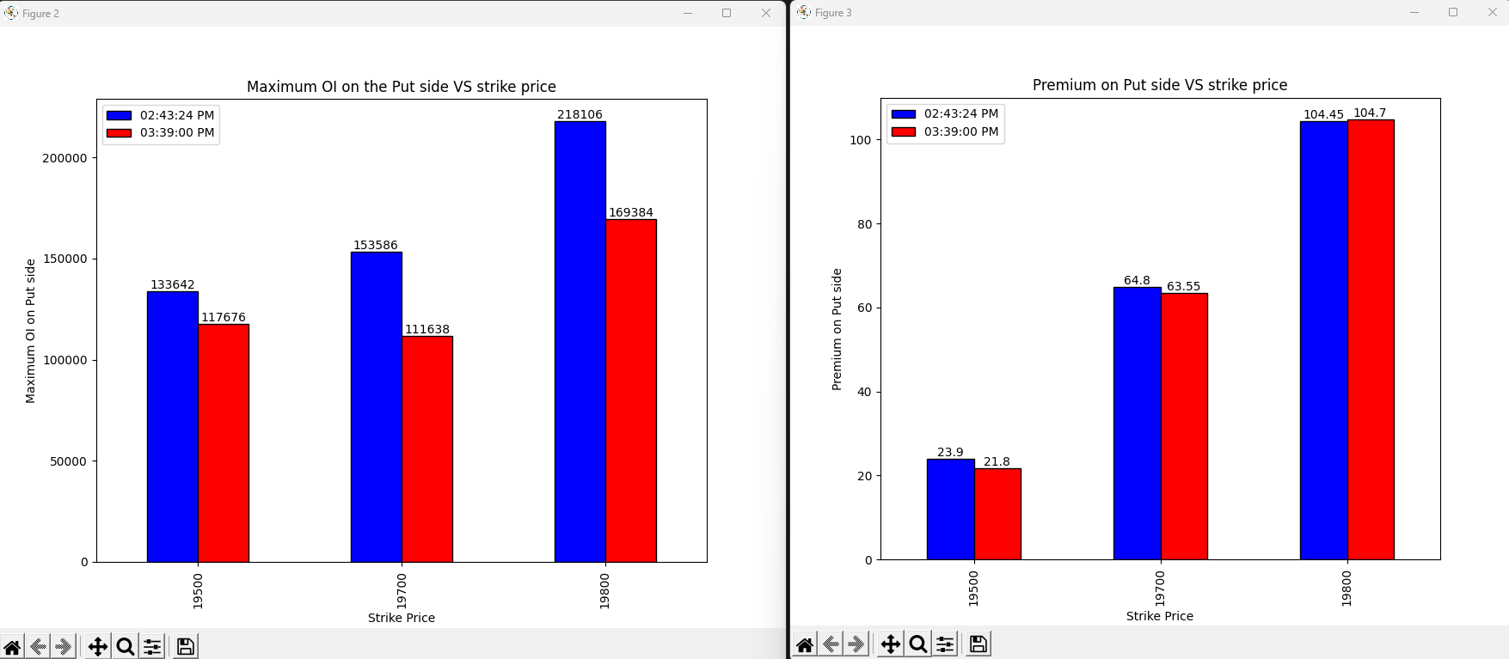
21-07-2023
Notes:
19500 and 19700 -> Long covering
19800 -> Shot covering

Slide 61
Conclusion
Overall market ->Bearish sentiment on all the strike price with 19800 as the good resistance due to high shot buildup on the call side and large shot covering on the put side. There is no important support visible till 19500 due to heavy shot buildup on the put side.
Last 45 mins->The last 45 min conclusion is different as on call side 19800 shot covering is going on indicating the bullish sign and long covering on the 19500 and 19700 on put side indicating that market may not go down very much.
My Vote-> Limited bullishness and the but limited bearishness -> Side way market with higher weakness bias.
Notes:
As expected market was bearish and the 19800 act as the good resistance but market was not able to reach to 19500 reversal point.

Slide 62
24-07-2023
strikePrice | CE_OI_03:35:15 PM | CE_LTP_03:35:15 PM | CE_OI_09:19:07 AM | CE_LTP_09:19:07 AM | Change_in_OI | Change_in_Premium | Conclusion_Call_side
19350 | 1557 | 340.1 | 1576 | 407.6 | -19 | -67.5 | Long Covering
19400 | 13216 | 292.95 | 15225 | 358.6 | -2009 | -65.65 | Long Covering
19450 | 4265 | 247.9 | 4251 | 314.55 | 14 | -66.65 | Shot Buildup
19500 | 38984 | 208 | 38465 | 271.65 | 519 | -63.65 | Shot Buildup
19550 | 6636 | 170 | 4152 | 231.1 | 2484 | -61.1 | Shot Buildup
19600 | 28796 | 133.5 | 0 | 193.65 | 28796 | -60.15 | Shot Buildup
19650 | 27134 | 103.65 | 9621 | 158.6 | 17513 | -54.95 | Shot Buildup
19700 | 178693 | 78 | 54448 | 127.65 | 124245 | -49.65 | Shot Buildup
19750 | 94357 | 58.15 | 39675 | 99.8 | 54682 | -41.65 | Shot Buildup
19800 | 255709 | 42 | 205593 | 78.7 | 50116 | -36.7 | Shot Buildup
19850 | 125380 | 30 | 87634 | 57.9 | 37746 | -27.9 | Shot Buildup
19900 | 214584 | 21.15 | 220747 | 43.8 | -6163 | -22.65 | Long Covering
19950 | 95407 | 15.2 | 79823 | 30.95 | 15584 | -15.75 | Shot Buildup
strikePrice | PE_OI_03:35:15 PM | PE_LTP_03:35:15 PM | PE_OI_09:19:07 AM | PE_LTP_09:19:07 AM | Change_in_OI | Change_in_Premium | Conclusion_Put_side
19350 | 40242 | 8.45 | 21331 | 11.9 | 18911 | -3.45 | Shot Buildup
19400 | 110137 | 11.65 | 81769 | 15.4 | 28368 | -3.75 | Shot Buildup
19450 | 51611 | 17.5 | 36636 | 20.35 | 14975 | -2.85 | Shot Buildup
19500 | 127833 | 25.2 | 114497 | 27.65 | 13336 | -2.45 | Shot Buildup
19550 | 45159 | 36.55 | 29146 | 36.7 | 16013 | -0.15 | Shot Buildup
19600 | 94983 | 52.2 | 100419 | 48.65 | -5436 | 3.55 | Shot Covering
19650 | 60876 | 71.35 | 86416 | 63.25 | -25540 | 8.1 | Shot Covering
19700 | 152782 | 95.6 | 106858 | 82.55 | 45924 | 13.05 | Long BuildUP
19750 | 50251 | 125.45 | 53687 | 105.05 | -3436 | 20.4 | Shot Covering
19800 | 133513 | 159.6 | 161850 | 132.5 | -28337 | 27.1 | Shot Covering
19850 | 27684 | 196 | 32105 | 163.05 | -4421 | 32.95 | Shot Covering
19900 | 54841 | 237.2 | 80721 | 197.3 | -25880 | 39.9 | Shot Covering
19950 | 11798 | 282.65 | 15150 | 236.4 | -3352 | 46.25 | Shot Covering
Notes:
Closing Price=19672.35
Market will be bearish next day with 19700 acting as the best resistance
On call side all strike prices is bearish
On put side above ATM strike prices are bearish in nature and best support is the 19550

Slide 63
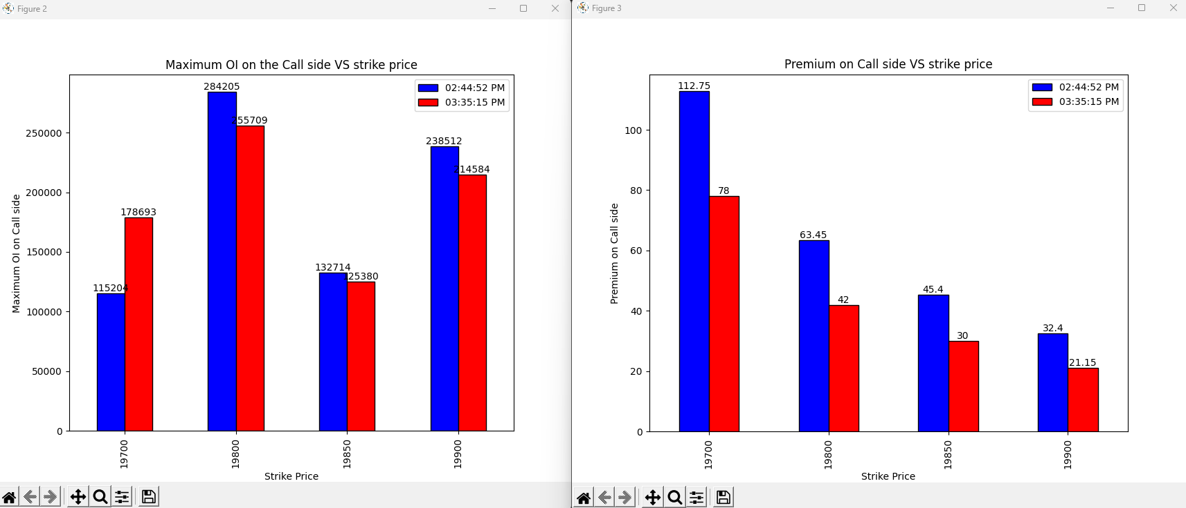
24-07-2023
Notes:
19700->Shot buildup
19800, 19850, 19900 -> Long covering
Bearish with 19700 acting as the best resistance

Slide 64
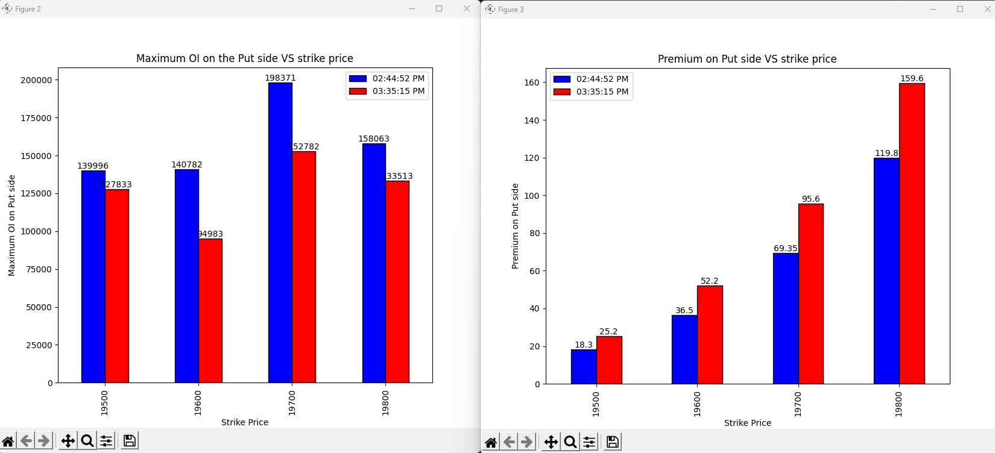
24-07-2023
Notes:
Shot covering on all the strike prices.

Slide 65
Conclusion
Overall market ->Market will be bearish next day with 19700 acting as the best resistance and 19550 acting as the best support .
Last 45 mins->bearish and 19700 acting as the best resistance.
My Vote->Bearish with 19700 acting as the best resistance.
Notes:
As expected 19700 was very good resistance and market closed bearish.
Market was mostly sideways.

Slide 66
25-07-2023
strikePrice | CE_OI_03:32:43 PM | CE_LTP_03:32:43 PM | CE_OI_09:19:11 AM | CE_LTP_09:19:11 AM | Change_in_OI | Change_in_Premium | Conclusion_Call_side
19400 | 12019 | 298.45 | 13168 | 316.3 | -1149 | -17.85 | Long Covering
19450 | 4259 | 250.7 | 4251 | 273.35 | 8 | -22.65 | Shot Buildup
19500 | 38735 | 206 | 38172 | 228.2 | 563 | -22.2 | Shot Buildup
19550 | 8101 | 161.75 | 6556 | 184.7 | 1545 | -22.95 | Shot Buildup
19600 | 45384 | 124.25 | 27881 | 149.05 | 17503 | -24.8 | Shot Buildup
19650 | 48055 | 91.1 | 26967 | 116.25 | 21088 | -25.15 | Shot Buildup
19700 | 228515 | 64 | 178669 | 86.4 | 49846 | -22.4 | Shot Buildup
19750 | 116791 | 43.3 | 89378 | 64.95 | 27413 | -21.65 | Shot Buildup
19800 | 261701 | 28.4 | 247876 | 46.85 | 13825 | -18.45 | Shot Buildup
19850 | 129206 | 17.6 | 123643 | 31.85 | 5563 | -14.25 | Shot Buildup
19900 | 204184 | 10.8 | 209911 | 22.85 | -5727 | -12.05 | Long Covering
19950 | 115733 | 5.8 | 91438 | 15.65 | 24295 | -9.85 | Shot Buildup
20000 | 225695 | 4.2 | 214990 | 11.15 | 10705 | -6.95 | Shot Buildup
strikePrice | PE_OI_03:32:43 PM | PE_LTP_03:32:43 PM | PE_OI_09:19:11 AM | PE_LTP_09:19:11 AM | Change_in_OI | Change_in_Premium | Conclusion_Put_side
19400 | 130465 | 3.85 | 110656 | 9.25 | 19809 | -5.4 | Shot Buildup
19450 | 88976 | 6.65 | 51513 | 13.6 | 37463 | -6.95 | Shot Buildup
19500 | 162595 | 11.5 | 125977 | 19.7 | 36618 | -8.2 | Shot Buildup
19550 | 66164 | 18.9 | 42801 | 28.45 | 23363 | -9.55 | Shot Buildup
19600 | 121939 | 31 | 89008 | 41.4 | 32931 | -10.4 | Shot Buildup
19650 | 79174 | 47.35 | 54135 | 57.7 | 25039 | -10.35 | Shot Buildup
19700 | 154553 | 70.05 | 145686 | 78.35 | 8867 | -8.3 | Shot Buildup
19750 | 42652 | 99.85 | 45727 | 106.55 | -3075 | -6.7 | Long Covering
19800 | 76307 | 135 | 121193 | 139.1 | -44886 | -4.1 | Long Covering
19850 | 24262 | 174.3 | 27107 | 175 | -2845 | -0.7 | Long Covering
19900 | 42629 | 216.4 | 52921 | 214.65 | -10292 | 1.75 | Shot Covering
19950 | 10589 | 263.65 | 11687 | 257.45 | -1098 | 6.2 | Shot Covering
20000 | 26451 | 309.1 | 32278 | 301.95 | -5827 | 7.15 | Shot Covering
Notes:
Closing price=19680.6
19700 is the good resistance and the 19650 is the good support
Market may remain may remain mild bearish

Slide 67
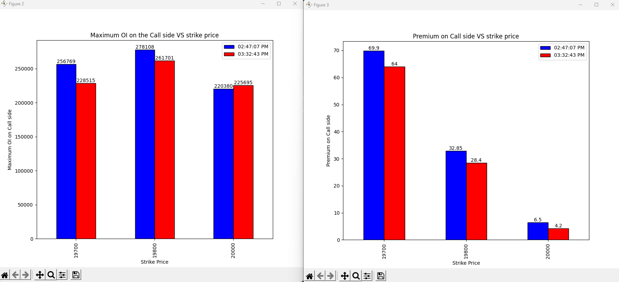
25-07-2023
Notes:
19700, 19800-> Long covering
20000->Shot build up

Slide 68
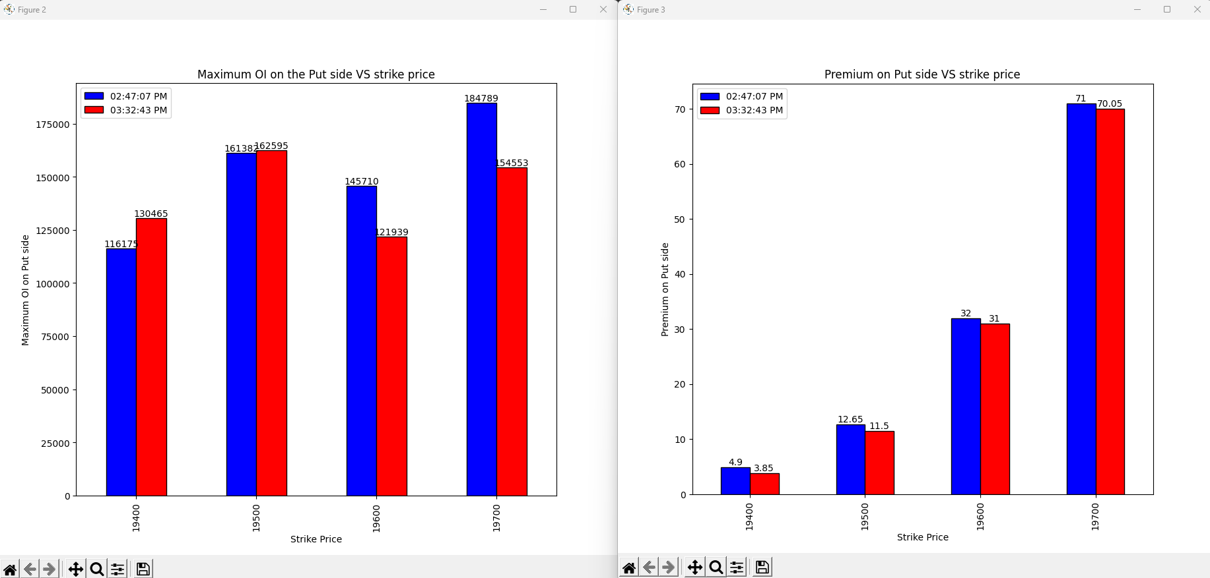
25-07-2023
Notes:
19400, 19500 -> Shot build up
19600, 19700 -> Long covering

Slide 69
Conclusion
Overall market ->19700 is the good resistance and the 19650 is the good support. Market may remain may remain mild bearish
Last 45 mins->Long covering at 19700 and 19800 strike price on call side implies bearish sign and long covering at 19700 strike price on put side implies mild bullish sign and shot build up on the lower strike price.
My Vote->bearish market as there is shot build up on the call side and 19700 as the good resistance and 19650 as the good support.
Notes:
As opposed to the expectation market as bullish and 19700 was not the good resistance as the market opened much above it.

Slide 70
26-07-2023
strikePrice | CE_OI_03:32:51 PM | CE_LTP_03:32:51 PM | CE_OI_09:19:22 AM | CE_LTP_09:19:22 AM | Change_in_OI | Change_in_Premium | Conclusion_Call_side
19500 | 32213 | 276.5 | 38986 | 228.8 | -6773 | 47.7 | Shot Covering
19550 | 5086 | 229 | 7474 | 184.7 | -2388 | 44.3 | Shot Covering
19600 | 29717 | 181.6 | 43582 | 141.1 | -13865 | 40.5 | Shot Covering
19650 | 20119 | 139.1 | 43777 | 106.95 | -23658 | 32.15 | Shot Covering
19700 | 80591 | 100 | 217451 | 75.1 | -136860 | 24.9 | Shot Covering
19750 | 102444 | 67.8 | 112960 | 50.75 | -10516 | 17.05 | Shot Covering
19800 | 281583 | 43.4 | 257458 | 31.85 | 24125 | 11.55 | Long BuildUP
19850 | 183197 | 27 | 131465 | 19.25 | 51732 | 7.75 | Long BuildUP
19900 | 268946 | 15.85 | 204133 | 11.2 | 64813 | 4.65 | Long BuildUP
19950 | 148425 | 9 | 116819 | 6.65 | 31606 | 2.35 | Long BuildUP
20000 | 284987 | 4.8 | 229384 | 4.4 | 55603 | 0.4 | Long BuildUP
20050 | 136211 | 2.5 | 76816 | 2.9 | 59395 | -0.4 | Shot Buildup
20100 | 168321 | 1.9 | 132778 | 2.25 | 35543 | -0.35 | Shot Buildup
strikePrice | PE_OI_03:32:51 PM | PE_LTP_03:32:51 PM | PE_OI_09:19:22 AM | PE_LTP_09:19:22 AM | Change_in_OI | Change_in_Premium | Conclusion_Put_side
19500 | 143485 | 3.5 | 159289 | 7.9 | -15804 | -4.4 | Long Covering
19550 | 103249 | 5.2 | 64671 | 13.1 | 38578 | -7.9 | Shot Buildup
19600 | 178026 | 8.35 | 116375 | 21.8 | 61651 | -13.45 | Shot Buildup
19650 | 128126 | 15 | 73534 | 34.45 | 54592 | -19.45 | Shot Buildup
19700 | 216214 | 26.5 | 143267 | 53.5 | 72947 | -27 | Shot Buildup
19750 | 142084 | 44.35 | 37033 | 78.25 | 105051 | -33.9 | Shot Buildup
19800 | 134561 | 70 | 72334 | 113.1 | 62227 | -43.1 | Shot Buildup
19850 | 33542 | 103.2 | 23948 | 148.75 | 9594 | -45.55 | Shot Buildup
19900 | 44410 | 141.85 | 41701 | 190.1 | 2709 | -48.25 | Shot Buildup
19950 | 10032 | 186.75 | 10508 | 235.7 | -476 | -48.95 | Long Covering
20000 | 24832 | 231.95 | 26351 | 284.85 | -1519 | -52.9 | Long Covering
20050 | 1141 | 278.75 | 1377 | 0 | -236 | 278.75 | Shot Covering
20100 | 2556 | 328.1 | 2817 | 380 | -261 | -51.9 | Long Covering
Notes:
Closing price: 19778.3
19750 will be the best support due to the high shot build up on put side and next good support is 19800
Market will be bullish as massive shot covering on the call side at 19700 and long build up at higher strike price

Slide 71
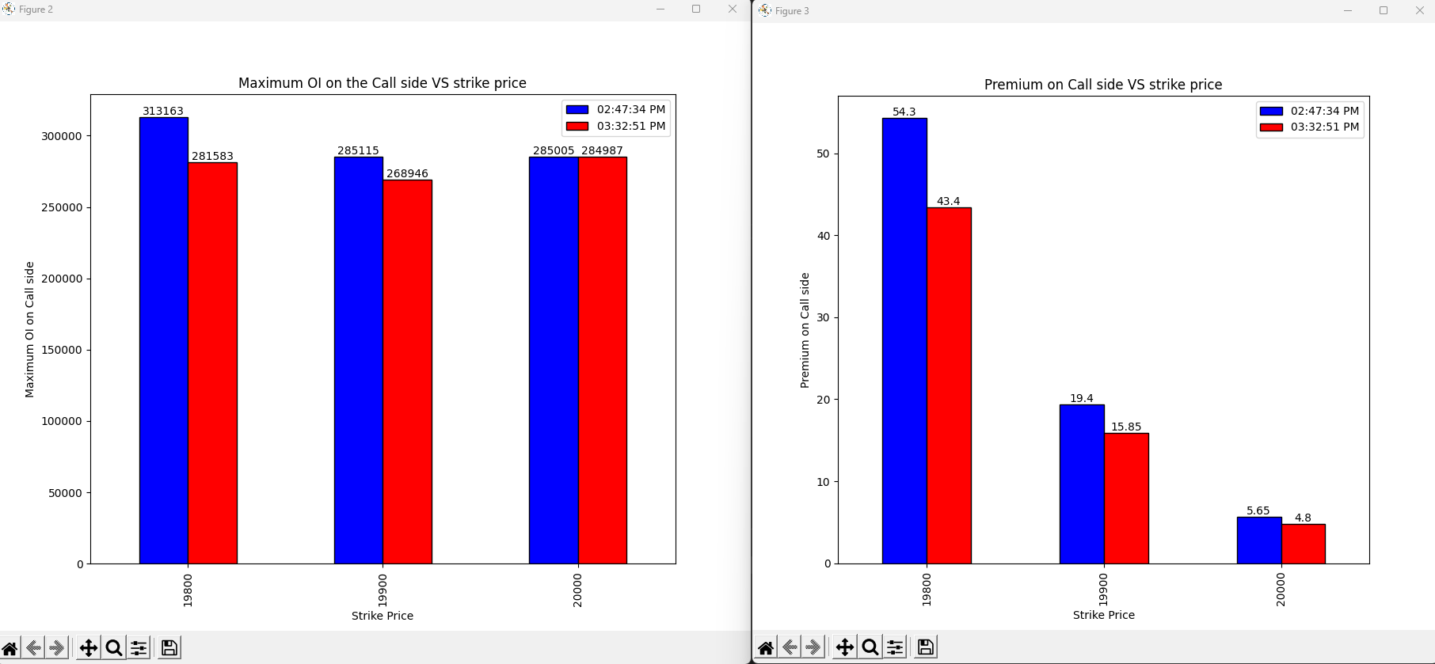
27-07-2023
Notes:
Long covering on all the strike price -> Bearish

Slide 72
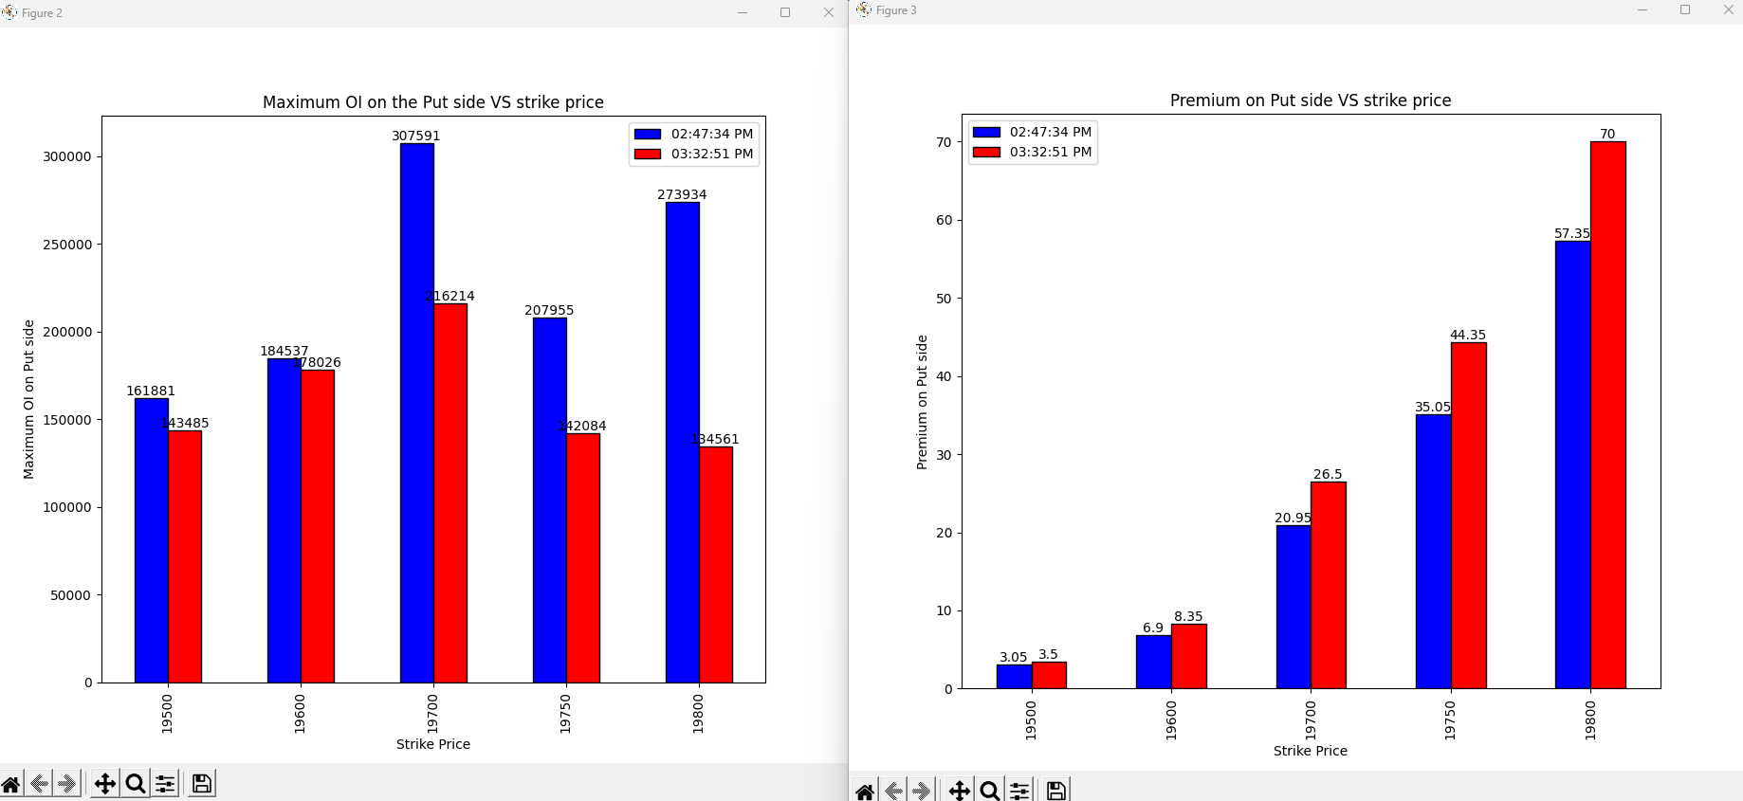
27-07-2023
Notes:
Shot covering on all the strike price -> Bearish move

Slide 73
Conclusion
Overall market ->19750 will be the best support due to the high shot build up on put side and next good support is 19800. Market will be bullish as massive shot covering on the call side at 19700 and long build up at higher strike price
Last 45 mins->call side long covering on all the strike price -> Bearish sentiment and on put side shot covering -> Bearish move
My Vote->Bearish as the tomorrow is expiry so last 45 mins sentiment is given high importance.
Notes:
As expected market was bearish but the support 19750 and 19800 was broken after the consolidation.

Slide 74
EOD Call Side Conclusion 28-07-2023
strikePrice | CE_OI_03:30:15 PM | CE_LTP_03:30:15 PM | CE_OI_09:25:55 AM | CE_LTP_09:25:55 AM | Change_in_OI | Change_in_Premium | Conclusion_Call_side
19350 | 849 | 314.3 | 550 | 321.3 | 299 | -7.0 | Shot Buildup
19400 | 9368 | 274.35 | 2695 | 279.25 | 6673 | -4.9 | Shot Buildup
19450 | 2753 | 225.35 | 1089 | 239.0 | 1664 | -13.65 | Shot Buildup
19500 | 25206 | 191.7 | 15107 | 201.4 | 10099 | -9.7 | Shot Buildup
19550 | 9798 | 156.85 | 6137 | 167.0 | 3661 | -10.15 | Shot Buildup
19600 | 92458 | 123.95 | 53245 | 136.45 | 39213 | -12.5 | Shot Buildup
19650 | 58420 | 95.0 | 45121 | 108.75 | 13299 | -13.75 | Shot Buildup
19700 | 150894 | 71.5 | 123637 | 84.9 | 27257 | -13.4 | Shot Buildup
19750 | 111978 | 52.35 | 51966 | 64.95 | 60012 | -12.6 | Shot Buildup
19800 | 192183 | 39.0 | 233398 | 48.85 | -41215 | -9.85 | Long Covering
19850 | 69874 | 27.5 | 60229 | 36.55 | 9645 | -9.05 | Shot Buildup
19900 | 105175 | 19.0 | 107126 | 27.0 | -1951 | -8.0 | Long Covering
19950 | 44354 | 13.0 | 28908 | 19.85 | 15446 | -6.85 | Shot Buildup
Notes:
Closing price: 19646.05
All near ATM strike price is shot build up->Bearish sign
19750 have the highest OI -> Good resistance

Slide 75
EOD Put Side Conclusion 28-07-2023
strikePrice | PE_OI_03:30:15 PM | PE_LTP_03:30:15 PM | PE_OI_09:25:55 AM | PE_LTP_09:25:55 AM | Change_in_OI | Change_in_Premium | Conclusion_Put_side
19350 | 34961 | 13.65 | 19170 | 22.6 | 15791 | -8.95 | Shot Buildup
19400 | 74767 | 19.85 | 65393 | 29.85 | 9374 | -10.0 | Shot Buildup
19450 | 54006 | 26.95 | 19635 | 39.6 | 34371 | -12.65 | Shot Buildup
19500 | 116747 | 37.0 | 72133 | 52.05 | 44614 | -15.05 | Shot Buildup
19550 | 42565 | 51.1 | 25452 | 67.6 | 17113 | -16.5 | Shot Buildup
19600 | 138822 | 70.0 | 106697 | 86.45 | 32125 | -16.45 | Shot Buildup
19650 | 35258 | 91.0 | 47211 | 108.95 | -11953 | -17.95 | Long Covering
19700 | 59004 | 116.75 | 77121 | 135.05 | -18117 | -18.3 | Long Covering
19750 | 10891 | 149.9 | 18520 | 165.55 | -7629 | -15.65 | Long Covering
19800 | 49712 | 183.2 | 108009 | 199.7 | -58297 | -16.5 | Long Covering
19850 | 6924 | 223.65 | 9910 | 237.25 | -2986 | -13.6 | Long Covering
19900 | 9396 | 266.45 | 16997 | 278.0 | -7601 | -11.55 | Long Covering
19950 | 2263 | 309.4 | 3014 | 321.65 | -751 | -12.25 | Long Covering
Notes:
Since on call side Shot Build up is on 19600 and also on the put side so market may remain sideways when it touches 19600
19600 and 19500 act as the best support

Slide 76
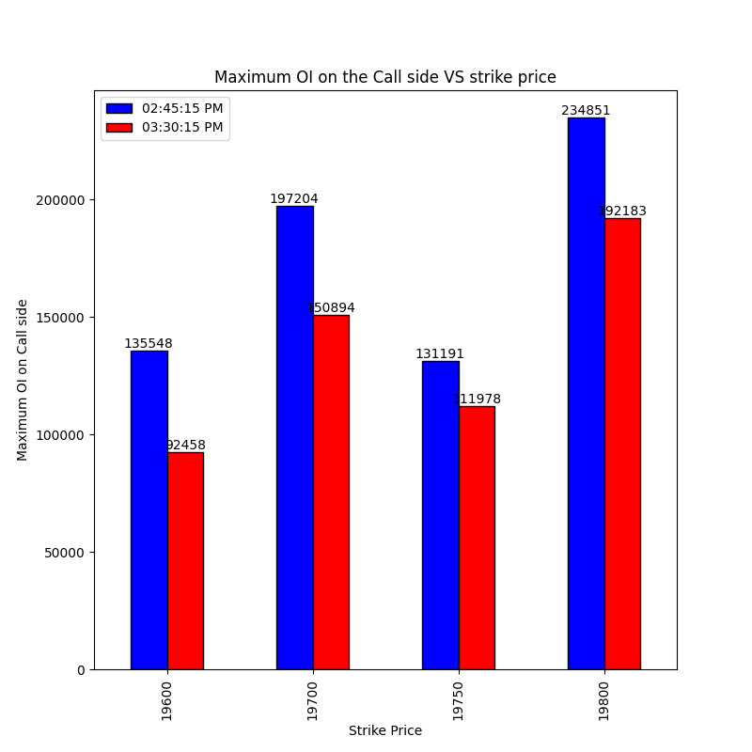
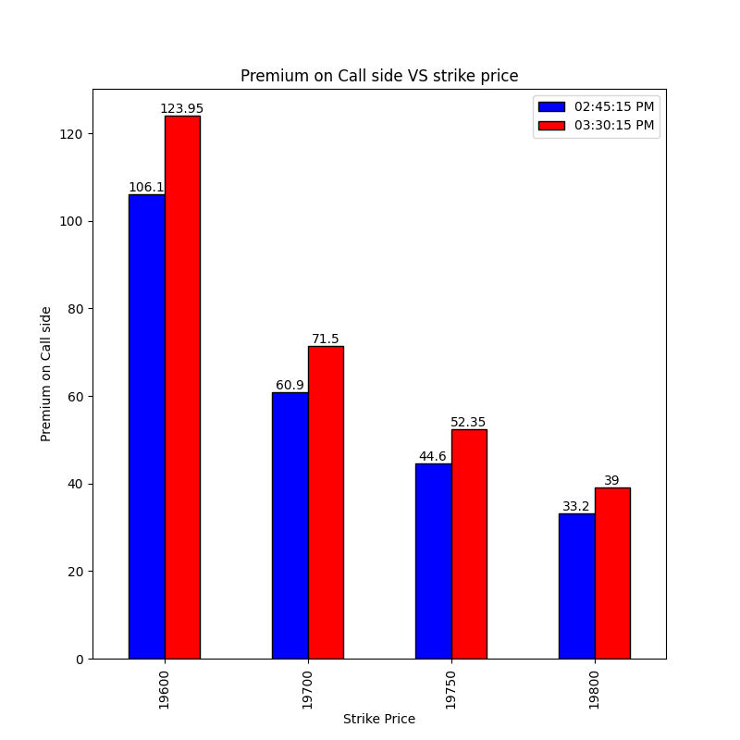
Final 45 mins Call side 28-07-2023
Notes:
Shot covering on all the strike price->Bullish view

Slide 77
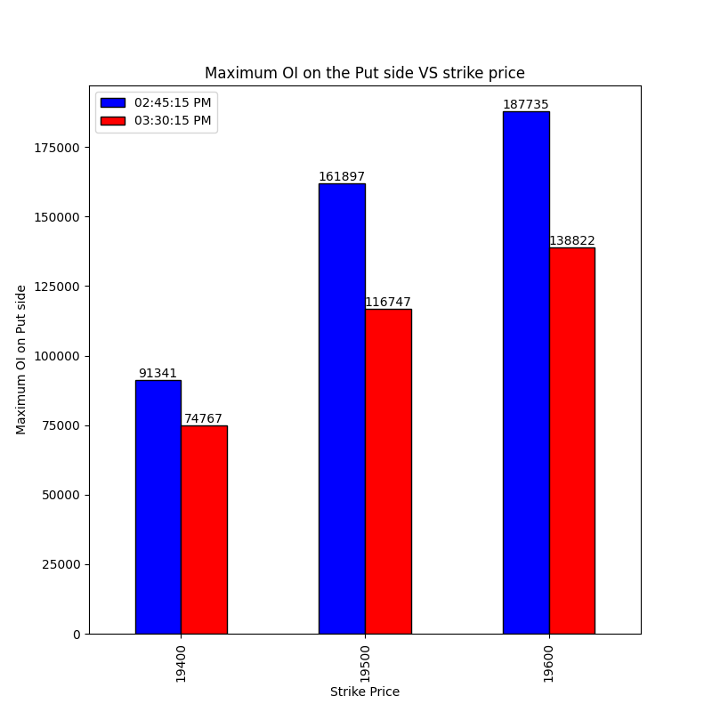
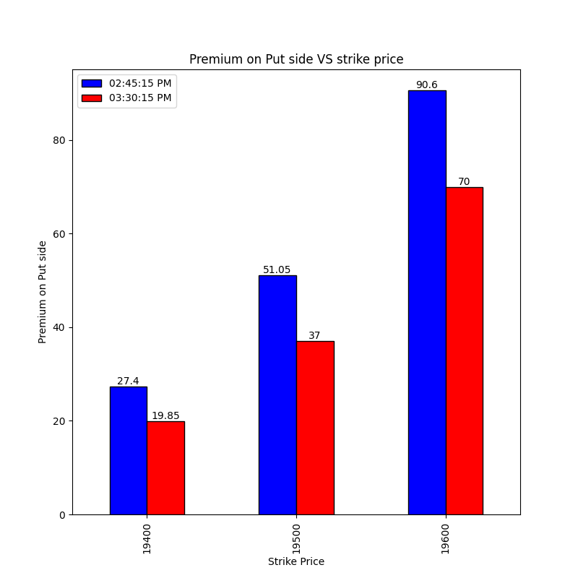
Final 45 mins Put side 28-07-2023
Notes:
Long covering on all the strike price->Bullish view

Slide 78
Over All conclusion
Overall Sentiment: Bearish sentiment with 19750 act as the good resistance and 19600 as the good support.
Final 45 mins Sentiment: Bullish view as there is shot covering on the call side and long covering put side.
My Vote: Side way or bearish due to large shot buildup on the call side.
Result: Market went bullish but it have respected support and resistance.

Slide 79
EOD Call Side Conclusion 31-07-2023
strikePrice | CE_OI_03:35:31 PM | CE_LTP_03:35:31 PM | CE_OI_10:41:15 AM | CE_LTP_10:41:15 AM | Change_in_OI | Change_in_Premium | Conclusion_Call_side
19450 | 1874 | 316.8 | 4290 | 260.15 | -2416 | 56.65 | Shot Covering
19500 | 17717 | 268.1 | 27152 | 219.45 | -9435 | 48.65 | Shot Covering
19550 | 5975 | 225.1 | 13858 | 183.05 | -7883 | 42.05 | Shot Covering
19600 | 54831 | 182.0 | 133979 | 146.55 | -79148 | 35.45 | Shot Covering
19650 | 37368 | 142.2 | 93851 | 111.05 | -56483 | 31.15 | Shot Covering
19700 | 128429 | 109.4 | 211439 | 83.7 | -83010 | 25.7 | Shot Covering
19750 | 75478 | 79.0 | 133996 | 60.6 | -58518 | 18.4 | Shot Covering
19800 | 170271 | 54.85 | 229487 | 44.2 | -59216 | 10.65 | Shot Covering
19850 | 78772 | 36.6 | 81325 | 29.1 | -2553 | 7.5 | Shot Covering
19900 | 112586 | 23.4 | 129347 | 19.75 | -16761 | 3.65 | Shot Covering
19950 | 77055 | 14.0 | 67436 | 12.4 | 9619 | 1.6 | Long BuildUP
20000 | 140618 | 8.35 | 151736 | 8.35 | -11118 | 0.0 | nan
20050 | 65672 | 5.15 | 68898 | 5.4 | -3226 | -0.25 | Long Covering
Notes:
Closing Price- 19753.8
Bullish View due to all near ATM strike prices

Slide 80
EOD Put Side Conclusion 31-07-2023
strikePrice | PE_OI_03:35:31 PM | PE_LTP_03:35:31 PM | PE_OI_10:41:15 AM | PE_LTP_10:41:15 AM | Change_in_OI | Change_in_Premium | Conclusion_Put_side
19450 | 64290 | 8.2 | 71133 | 16.55 | -6843 | -8.35 | Long Covering
19500 | 122485 | 12.2 | 149129 | 24.1 | -26644 | -11.9 | Long Covering
19550 | 64408 | 17.2 | 81224 | 32.65 | -16816 | -15.45 | Long Covering
19600 | 195740 | 24.15 | 270644 | 45.85 | -74904 | -21.7 | Long Covering
19650 | 94717 | 35.8 | 111955 | 65.75 | -17238 | -29.95 | Long Covering
19700 | 166897 | 50.45 | 120259 | 88.4 | 46638 | -37.95 | Shot Buildup
19750 | 45736 | 70.2 | 24031 | 115.45 | 21705 | -45.25 | Shot Buildup
19800 | 58402 | 97.75 | 65428 | 143.3 | -7026 | -45.55 | Long Covering
19850 | 8164 | 127.1 | 10259 | 184.15 | -2095 | -57.05 | Long Covering
19900 | 12419 | 165.0 | 11118 | 219.2 | 1301 | -54.2 | Shot Buildup
19950 | 2195 | 204.35 | 2336 | 266.55 | -141 | -62.2 | Long Covering
20000 | 9413 | 248.05 | 8538 | 308.0 | 875 | -59.95 | Shot Buildup
20050 | 786 | 297.65 | 921 | 354.9 | -135 | -57.25 | Long Covering
Notes:
19750 and 19700 will act as the good support due to high shot buildup on the put side.

Slide 81
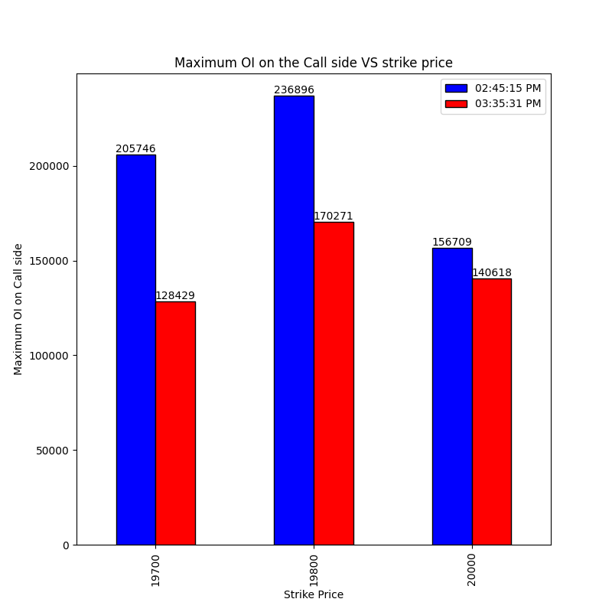
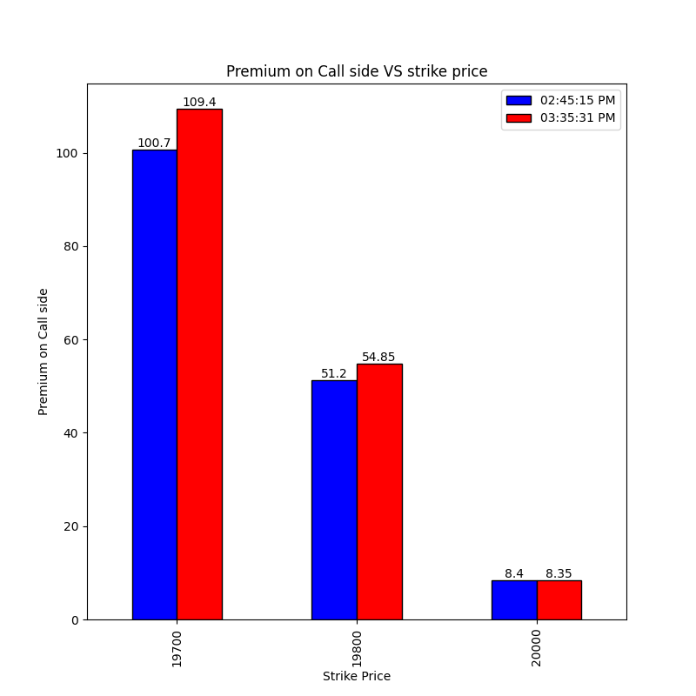
Final 45 mins Call side 31-07-2023
Notes:
Shot covering on all the strike price-> Bullish View

Slide 82
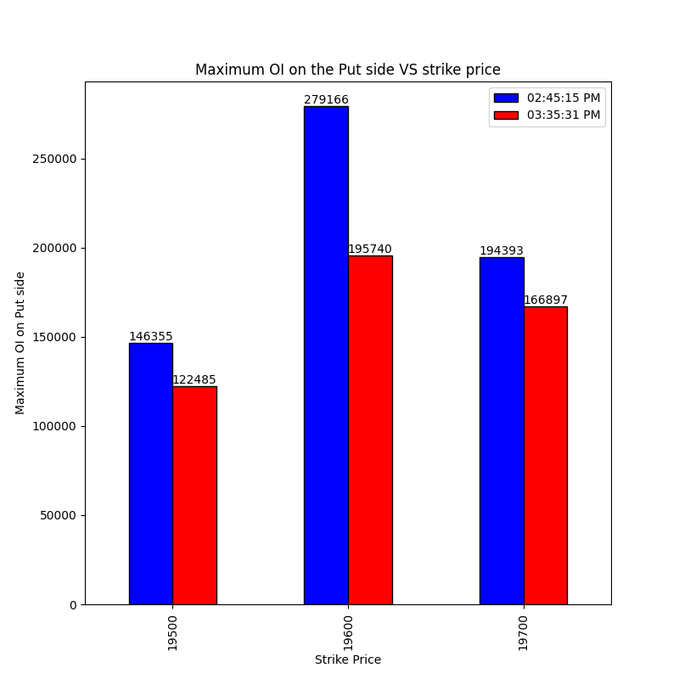
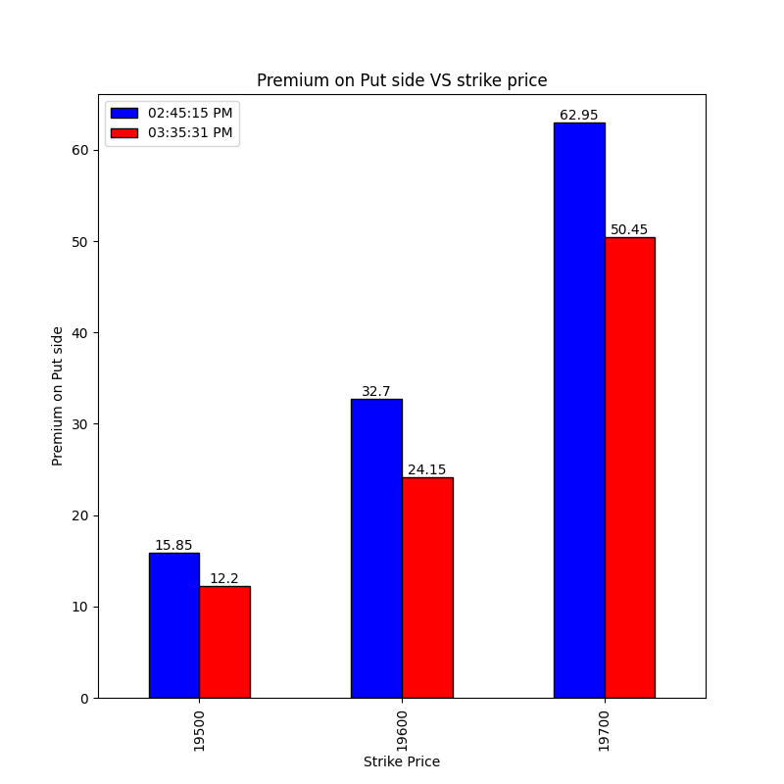
Final 45 mins Put side 31-07-2023
Notes:
Long covering on all the strike price-> Bullish View

Slide 83
Over All conclusion 31-07-2023
Overall Sentiment: Bullish with 19750 as the good support
Final 45 mins Sentiment: Bullish View due to the covering on all the strike prices
My Vote: Bullish with 19750 as the good support
Result: Market Opened gap up but ended up in the bearish move and 19750 support was not respected but 19700 support was respected.

Slide 84
EOD Call Side Conclusion 01-08-2023
strikePrice | CE_OI_03:31:02 PM | CE_LTP_03:31:02 PM | CE_OI_09:19:04 AM | CE_LTP_09:19:04 AM | Change_in_OI | Change_in_Premium | Conclusion_Call_side
19450 | 1397 | 291.0 | 1820 | 327.25 | -423 | -36.25 | Long Covering
19500 | 12243 | 244.3 | 17227 | 279.25 | -4984 | -34.95 | Long Covering
19550 | 4559 | 198.35 | 5567 | 234.6 | -1008 | -36.25 | Long Covering
19600 | 40190 | 155.7 | 50217 | 190.65 | -10027 | -34.95 | Long Covering
19650 | 35531 | 116.5 | 35875 | 149.0 | -344 | -32.5 | Long Covering
19700 | 157081 | 82.4 | 122220 | 113.1 | 34861 | -30.7 | Shot Buildup
19750 | 150274 | 55.65 | 74812 | 82.2 | 75462 | -26.55 | Shot Buildup
19800 | 280593 | 35.6 | 173262 | 57.2 | 107331 | -21.6 | Shot Buildup
19850 | 135215 | 21.1 | 78680 | 38.05 | 56535 | -16.95 | Shot Buildup
19900 | 161848 | 11.8 | 113477 | 24.55 | 48371 | -12.75 | Shot Buildup
19950 | 112243 | 6.25 | 75678 | 14.15 | 36565 | -7.9 | Shot Buildup
20000 | 159541 | 3.5 | 140049 | 8.75 | 19492 | -5.25 | Shot Buildup
20050 | 77902 | 2.45 | 65550 | 5.4 | 12352 | -2.95 | Shot Buildup
Notes:
Closing Price: 19733.55
Bearish sentiment due to heavy shot build up at call side with 19700, 19750 and 19800 as effective resistance.

Slide 85
EOD Put Side Conclusion 01-08-2023
strikePrice | PE_OI_03:31:02 PM | PE_LTP_03:31:02 PM | PE_OI_09:19:04 AM | PE_LTP_09:19:04 AM | Change_in_OI | Change_in_Premium | Conclusion_Put_side
19450 | 72126 | 5.15 | 62508 | 6.4 | 9618 | -1.25 | Shot Buildup
19500 | 146257 | 8.05 | 119567 | 9.25 | 26690 | -1.2 | Shot Buildup
19550 | 64372 | 12.3 | 61153 | 13.0 | 3219 | -0.7 | Shot Buildup
19600 | 199546 | 19.85 | 190862 | 19.6 | 8684 | 0.25 | Long BuildUP
19650 | 96021 | 30.5 | 89659 | 29.7 | 6362 | 0.8 | Long BuildUP
19700 | 194820 | 46.4 | 159632 | 43.4 | 35188 | 3.0 | Long BuildUP
19750 | 72552 | 68.95 | 41013 | 62.65 | 31539 | 6.3 | Long BuildUP
19800 | 82538 | 99.0 | 59713 | 87.65 | 22825 | 11.35 | Long BuildUP
19850 | 16532 | 134.85 | 7883 | 118.15 | 8649 | 16.7 | Long BuildUP
19900 | 12709 | 176.25 | 11790 | 152.6 | 919 | 23.65 | Long BuildUP
19950 | 3335 | 219.5 | 2168 | 194.8 | 1167 | 24.7 | Long BuildUP
20000 | 8801 | 267.2 | 9352 | 237.15 | -551 | 30.05 | Shot Covering
20050 | 1093 | 315.5 | 741 | 284.4 | 352 | 31.1 | Long BuildUP
Notes:
Bearish sentiment
19700 might act as the good resistance

Slide 86
Final 45 mins Call side 01-08-2023
Notes:
19850, 19950, 2000 -> Shot buildup
Other Strike prices-> Shot covering
Bearish due to the small covering at 19800 stk price and her stk prices.

Slide 87
Final 45 mins Put side 01-08-2023
Notes:
Shot covering on all the strike prices
Bearish sentiment

Slide 88
Over All conclusion 01-08-2023
Overall Sentiment: Bearish due to heavy shot build up at call side with 19700, 19750 and 19800 as effective resistance.
Final 45 mins Sentiment: Mild bullish on the call side due to small short covering and bearish on the put side.
My Vote: Bearish as majority data points are bearish in nature
Result: bearish

Slide 89
EOD Call Side Conclusion 02-08-2023
strikePrice | CE_OI_03:33:55 PM | CE_LTP_03:33:55 PM | CE_OI_09:37:35 AM | CE_LTP_09:37:35 AM | Change_in_OI | Change_in_Premium | Conclusion_Call_side
19250 | 706 | 266.4 | 221 | 384.8 | 485 | -118.4 | Shot Buildup
19300 | 5845 | 221.15 | 1764 | 336.65 | 4081 | -115.5 | Shot Buildup
19350 | 3962 | 173.4 | 852 | 286.65 | 3110 | -113.25 | Shot Buildup
19400 | 26290 | 130.0 | 7316 | 240.7 | 18974 | -110.7 | Shot Buildup
19450 | 29875 | 92.95 | 2631 | 194.05 | 27244 | -101.1 | Shot Buildup
19500 | 159953 | 62.3 | 28001 | 150.65 | 131952 | -88.35 | Shot Buildup
19550 | 101703 | 39.2 | 19342 | 108.1 | 82361 | -68.9 | Shot Buildup
19600 | 257055 | 22.9 | 116262 | 75.15 | 140793 | -52.25 | Shot Buildup
19650 | 196656 | 12.9 | 164471 | 50.65 | 32185 | -37.75 | Shot Buildup
19700 | 266445 | 7.15 | 315916 | 31.45 | -49471 | -24.3 | Long Covering
19750 | 207280 | 4.1 | 183472 | 18.95 | 23808 | -14.85 | Shot Buildup
19800 | 277444 | 3.0 | 311590 | 11.2 | -34146 | -8.2 | Long Covering
19850 | 131970 | 2.2 | 162842 | 6.45 | -30872 | -4.25 | Long Covering
Notes:
Closing price: 19526.55
Heavy Shot buildup on all the near ATM strike prices-> Heavy bearish
19500, 19550 and 19600 act as the good resistance

Slide 90
EOD Put Side Conclusion 02-08-2023
strikePrice | PE_OI_03:33:55 PM | PE_LTP_03:33:55 PM | PE_OI_09:37:35 AM | PE_LTP_09:37:35 AM | Change_in_OI | Change_in_Premium | Conclusion_Put_side
19250 | 58873 | 2.75 | 35919 | 1.8 | 22954 | 0.95 | Long BuildUP
19300 | 129998 | 5.6 | 118914 | 2.4 | 11084 | 3.2 | Long BuildUP
19350 | 96712 | 9.0 | 53805 | 3.25 | 42907 | 5.75 | Long BuildUP
19400 | 154791 | 16.2 | 107496 | 5.05 | 47295 | 11.15 | Long BuildUP
19450 | 141275 | 28.35 | 86486 | 8.4 | 54789 | 19.95 | Long BuildUP
19500 | 169919 | 47.0 | 177811 | 14.9 | -7892 | 32.1 | Shot Covering
19550 | 45486 | 74.1 | 140697 | 26.55 | -95211 | 47.55 | Shot Covering
19600 | 96986 | 108.9 | 244640 | 44.05 | -147654 | 64.85 | Shot Covering
19650 | 24960 | 148.8 | 132766 | 65.25 | -107806 | 83.55 | Shot Covering
19700 | 35736 | 192.0 | 147297 | 97.0 | -111561 | 95.0 | Shot Covering
19750 | 11421 | 240.2 | 49663 | 132.9 | -38242 | 107.3 | Shot Covering
19800 | 26445 | 288.35 | 65103 | 175.45 | -38658 | 112.9 | Shot Covering
19850 | 6457 | 336.2 | 14627 | 220.6 | -8170 | 115.6 | Shot Covering
Notes:
Huge shot covering on all the strike prices near ATM-> Bearish nature

Slide 91
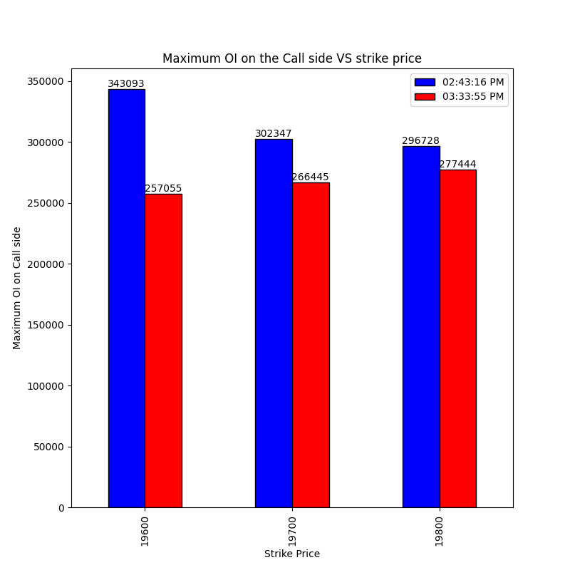
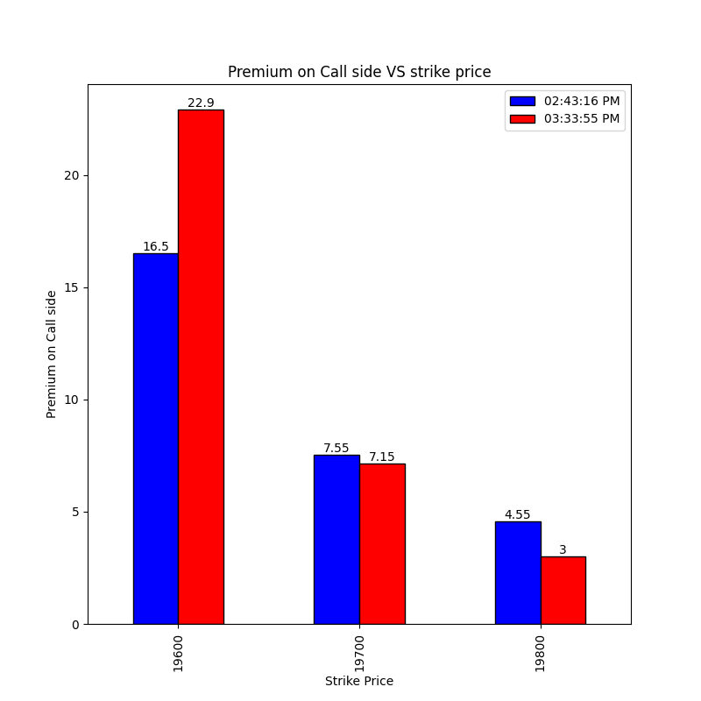
Final 45 mins Call side 02-08-2023
Notes:
19600-> Shot covering Bullish nature
19700, 19800-> Long covering Bearish

Slide 92
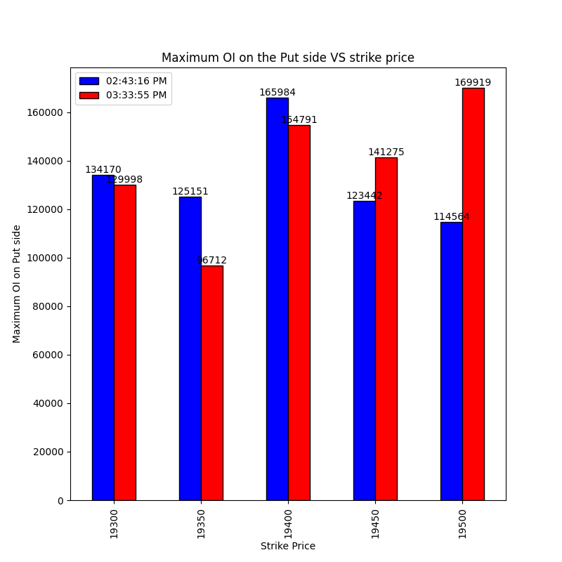
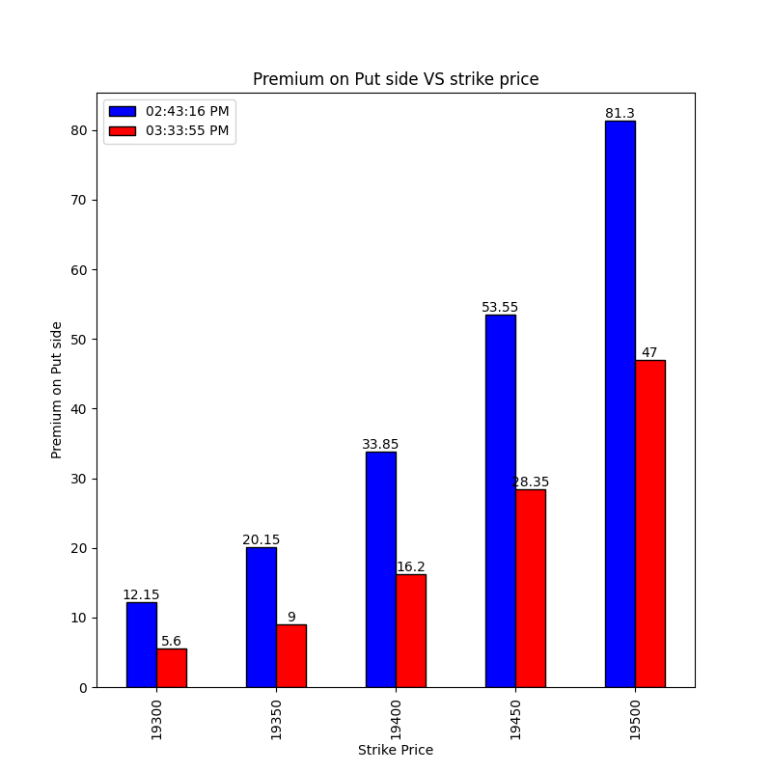
Final 45 mins Put side 02-08-2023
Notes:
Long covering on -> 19300, 19350, 19400 -> Bullish view
Shot build up at 19450 and 19500 -> Act as the good support

Slide 93
Over All conclusion 02-08-2023
Overall Sentiment: Heavy Shot buildup on all the near ATM strike Heavy bearish 19500, 19550 and 19600 act as the good resistance
Final 45 mins Sentiment: mild bearish on call side and on put side 19450 and 19500 act as the good support
My Vote: Need to see who wins at 19500 then take positions based on it
Result: Bearish market consolidated near 19500 for 2 hrs but unable to make the new high so 19500 act as good resistance but 19450 support was broken

Slide 94
EOD Call Side Conclusion 18-08-2023
strikePrice | CE_OI_03:32:49 PM | CE_LTP_03:32:49 PM | CE_OI_09:19:13 AM | CE_LTP_09:19:13 AM | Change_in_OI | Change_in_Premium | Conclusion_Call_side
19000 | 5391 | 303.0 | 4741 | 303.7 | 650 | -0.7 | Shot Buildup
19050 | 713 | 257.4 | 214 | 261.0 | 499 | -3.6 | Shot Buildup
19100 | 6436 | 219.7 | 1502 | 218.9 | 4934 | 0.8 | Long BuildUP
19150 | 3466 | 181.7 | 779 | 180.45 | 2687 | 1.25 | Long BuildUP
19200 | 19818 | 141.15 | 7772 | 147.0 | 12046 | -5.85 | Shot Buildup
19250 | 29643 | 109.8 | 3043 | 115.5 | 26600 | -5.7 | Shot Buildup
19300 | 128078 | 81.3 | 32238 | 89.15 | 95840 | -7.85 | Shot Buildup
19350 | 103124 | 57.4 | 27604 | 66.9 | 75520 | -9.5 | Shot Buildup
19400 | 238444 | 39.1 | 104454 | 49.1 | 133990 | -10.0 | Shot Buildup
19450 | 98596 | 26.0 | 44128 | 35.1 | 54468 | -9.1 | Shot Buildup
19500 | 154821 | 16.5 | 100113 | 24.55 | 54708 | -8.05 | Shot Buildup
19550 | 56941 | 10.1 | 26823 | 16.95 | 30118 | -6.85 | Shot Buildup
19600 | 124824 | 6.4 | 56849 | 11.65 | 67975 | -5.25 | Shot Buildup
Notes:
CP->19310.15
19350, 19300, 19400 -> Good resistance -> Heavy SB

Slide 95
EOD Put Side Conclusion 18-08-2023
strikePrice | PE_OI_03:32:49 PM | PE_LTP_03:32:49 PM | PE_OI_09:19:13 AM | PE_LTP_09:19:13 AM | Change_in_OI | Change_in_Premium | Conclusion_Put_side
19000 | 105661 | 14.95 | 50024 | 18.35 | 55637 | -3.4 | Shot Buildup
19050 | 43470 | 20.45 | 18928 | 24.8 | 24542 | -4.35 | Shot Buildup
19100 | 70600 | 28.15 | 46831 | 33.7 | 23769 | -5.55 | Shot Buildup
19150 | 41315 | 38.5 | 22048 | 45.85 | 19267 | -7.35 | Shot Buildup
19200 | 135566 | 52.7 | 47787 | 61.35 | 87779 | -8.65 | Shot Buildup
19250 | 119061 | 70.95 | 25811 | 80.55 | 93250 | -9.6 | Shot Buildup
19300 | 160351 | 92.7 | 68407 | 103.25 | 91944 | -10.55 | Shot Buildup
19350 | 40875 | 119.95 | 29983 | 131.0 | 10892 | -11.05 | Shot Buildup
19400 | 58245 | 149.55 | 67407 | 163.2 | -9162 | -13.65 | Long Covering
19450 | 10522 | 187.15 | 12266 | 199.25 | -1744 | -12.1 | Long Covering
19500 | 28596 | 228.6 | 24882 | 238.55 | 3714 | -9.95 | Shot Buildup
19550 | 3004 | 270.55 | 2626 | 280.85 | 378 | -10.3 | Shot Buildup
19600 | 9568 | 320.3 | 9552 | 325.0 | 16 | -4.7 | Shot Buildup
Notes:
19300, 19250, 19200-> SB -> Good support

Slide 96
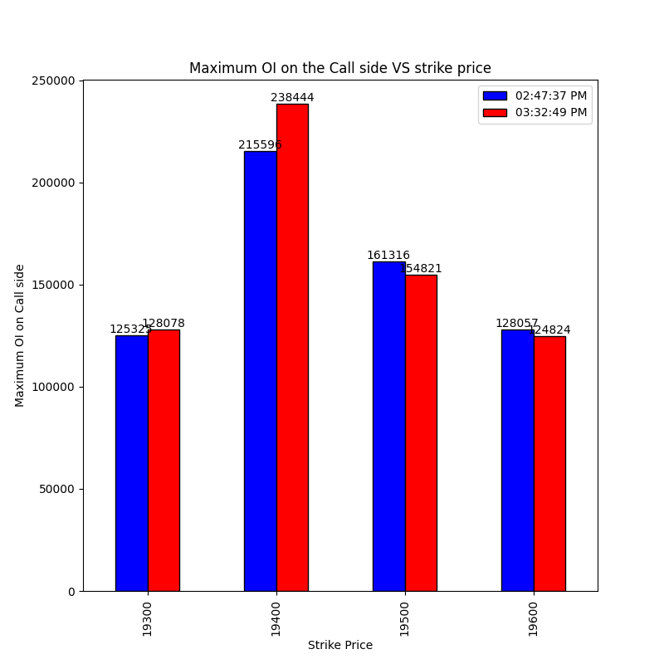
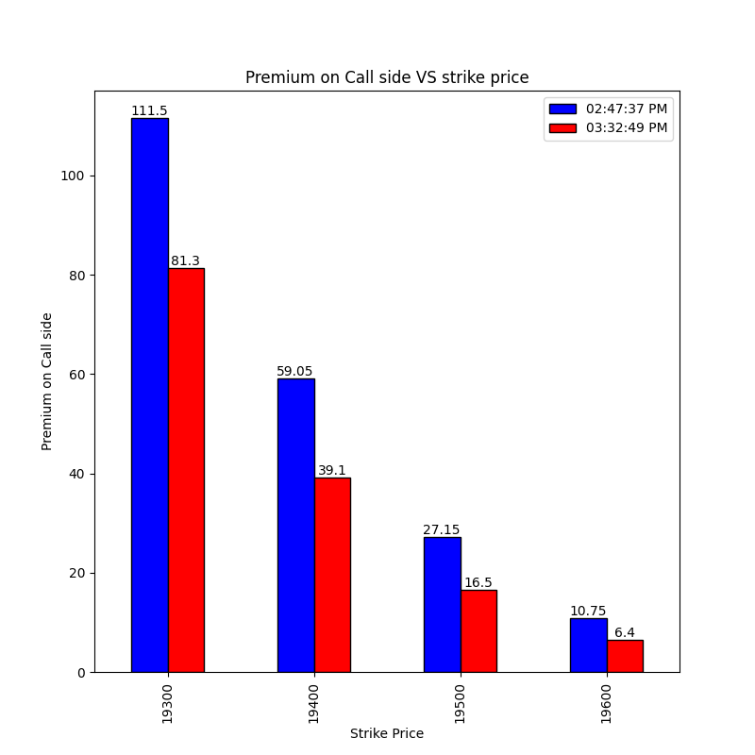
Final 45 mins Call side 18-08-2023
Notes:
19300, 19400-> Shot buildup
Other strike prices Long Covering

Slide 97


Final 45 mins Put side 18-08-2023
Notes:
19300-> Shot Covering
19250-> Long Build up
19200->Shot Covering

Slide 98
Over All conclusion 18-08-2023
Overall Sentiment: Neutral
Final 45 mins Sentiment: Bearish
My Vote: Bearish (19300 as good support, 19400 and 19350 Resistance)
Result: Bullish Market but Support and resistance were respected.

Slide 99
EOD Call Side Conclusion 23-08-2023
strikePrice | CE_OI_03:27:36 PM | CE_LTP_03:27:36 PM | CE_OI_09:19:03 AM | CE_LTP_09:19:03 AM | Change_in_OI | Change_in_Premium | Conclusion_Call_side
19150 | 2942 | 286.35 | 1882 | 236.5 | 1060 | 49.85 | Long BuildUP
19200 | 10451 | 236.7 | 13684 | 190.1 | -3233 | 46.6 | Shot Covering
19250 | 15166 | 188.4 | 14940 | 145.9 | 226 | 42.5 | Long BuildUP
19300 | 62627 | 141.45 | 90240 | 105.3 | -27613 | 36.15 | Shot Covering
19350 | 65488 | 98.4 | 110704 | 71.5 | -45216 | 26.9 | Shot Covering
19400 | 198110 | 62.3 | 302572 | 45.5 | -104462 | 16.8 | Shot Covering
19450 | 218107 | 36.2 | 182465 | 26.9 | 35642 | 9.3 | Long BuildUP
19500 | 294430 | 19.6 | 233818 | 15.55 | 60612 | 4.05 | Long BuildUP
19550 | 161790 | 9.4 | 121170 | 8.05 | 40620 | 1.35 | Long BuildUP
19600 | 243108 | 4.3 | 209710 | 4.6 | 33398 | -0.3 | Shot Buildup
19650 | 120969 | 2.0 | 112490 | 2.85 | 8479 | -0.85 | Shot Buildup
19700 | 186590 | 1.2 | 171458 | 1.9 | 15132 | -0.7 | Shot Buildup
19750 | 53859 | 0.95 | 55565 | 1.6 | -1706 | -0.65 | Long Covering
Notes:
Closing Price=19444
Bullish

Slide 100
EOD Put Side Conclusion 23-08-2023
strikePrice | PE_OI_03:27:36 PM | PE_LTP_03:27:36 PM | PE_OI_09:19:03 AM | PE_LTP_09:19:03 AM | Change_in_OI | Change_in_Premium | Conclusion_Put_side
19150 | 120923 | 2.45 | 126502 | 4.05 | -5579 | -1.6 | Long Covering
19200 | 184596 | 3.3 | 188726 | 7.3 | -4130 | -4.0 | Long Covering
19250 | 212835 | 4.6 | 137166 | 13.1 | 75669 | -8.5 | Shot Buildup
19300 | 273601 | 7.9 | 190795 | 22.7 | 82806 | -14.8 | Shot Buildup
19350 | 161916 | 14.6 | 125649 | 39.25 | 36267 | -24.65 | Shot Buildup
19400 | 292718 | 27.95 | 112127 | 63.15 | 180591 | -35.2 | Shot Buildup
19450 | 105377 | 50.95 | 22275 | 94.9 | 83102 | -43.95 | Shot Buildup
19500 | 68655 | 85.0 | 26924 | 133.5 | 41731 | -48.5 | Shot Buildup
19550 | 8932 | 125.35 | 5156 | 176.75 | 3776 | -51.4 | Shot Buildup
19600 | 12455 | 169.8 | 10205 | 222.75 | 2250 | -52.95 | Shot Buildup
19650 | 1426 | 218.2 | 1090 | 270.05 | 336 | -51.85 | Shot Buildup
19700 | 3225 | 267.25 | 3054 | 320.0 | 171 | -52.75 | Shot Buildup
19750 | 617 | 315.75 | 752 | 370.0 | -135 | -54.25 | Long Covering
Notes:
Bullish and 1945and 19400 act as the good support

Slide 101


Final 45 mins Call side 23-08-2023
Notes:
Long Covering on all the strike price

Slide 102


Final 45 mins Put side 23-08-2023
Notes:
19400-> Short covering
19250, 19300-> Neutral

Slide 103
Over All conclusion 23-08-2023
Overall Sentiment: Bullish with 19400 and 19450 as the good support
Final 45 mins Sentiment: Neutral
My Vote: Bullish
Result:

