Slide 1
UNIT - I
Data Management: Design Data Architecture and manage the data for analysis, understand various sources of Data like Sensors/Signals/GPS etc. Data Management, Data Quality(noise, outliers, missing values, duplicate data) and Data Processing & Processing

Slide 2
Data Is the Foundation on Which Business Success is built
Data can be defined as a representation of facts.
Information is organized or classified data, which has some meaningful values for the receiver
Data science is the study of data. It involves developing methods of recording, storing, and analyzing data to effectively extract useful information. The goal of data science is to gain insights and knowledge from any type of data — both structured and unstructured

Slide 3
Data analytics:
Data analytics refers to qualitative and quantitative techniques and processes used to enhance productivity and business gain. Data analytics is the science of analyzing raw data in order to make conclusions about that information. Data analytics is also known as data analysis.
As the process of analyzing raw data to find trends and answer questions.

Slide 4
Evolution of Database Technology
1960s: Data collection, database creation.
1970s: Relational data model, relational DBMS implementation.
1980s: RDBMS, advanced data models (extended-relational, OO, deductive, etc.) Application-oriented DBMS (spatial, scientific, engineering, etc.)
1990s: Data mining, data warehousing, multimedia databases, and Web databases.
2000s: Stream data management and mining, Data mining and its applications.
2007s: Bigdata, Hadoop Framework

Slide 5
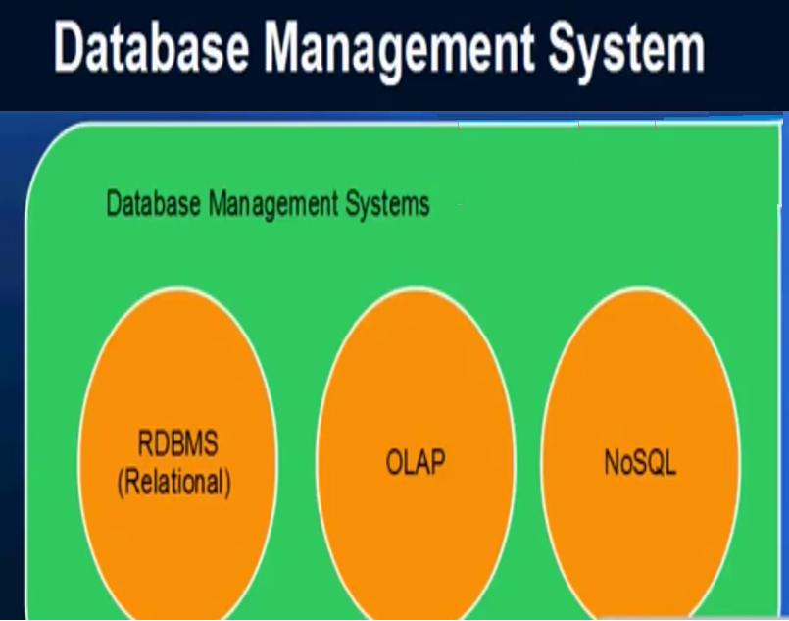
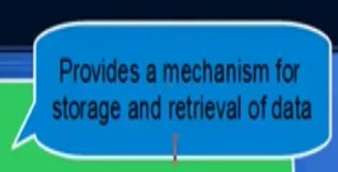

Slide 6
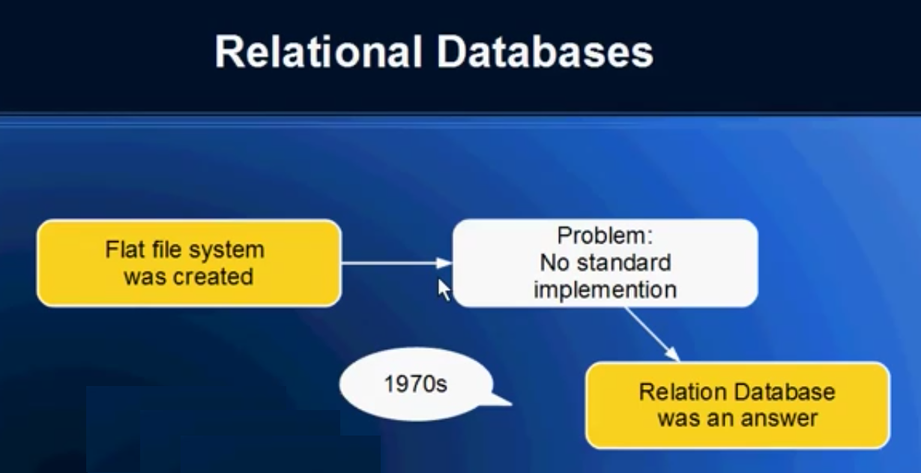

Slide 7
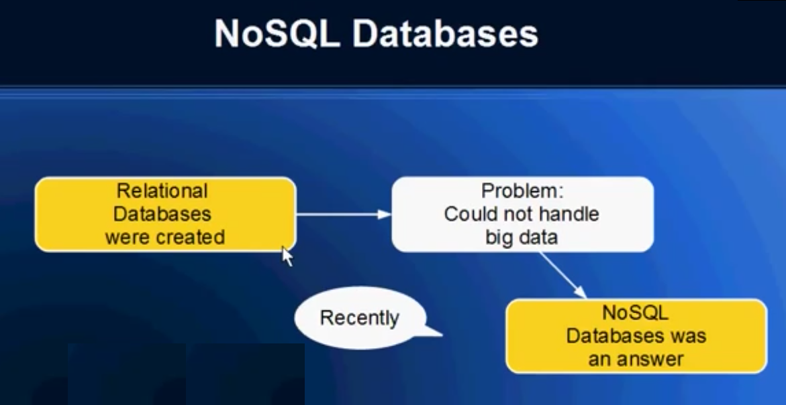

Slide 8
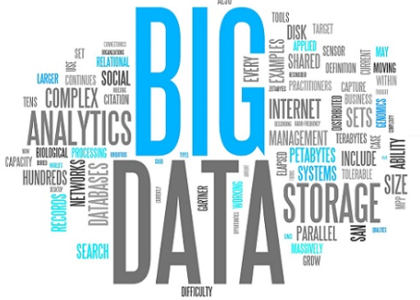

Slide 9
Big data:
The data which is beyond to the storage capacity and which is beyond to the processing power is considered as big data.
Data that is unstructured or time sensitive or simply very large cannot be processed by relational database engines.
It refers to a massive amount of data that keeps on growing exponentially with time.
It is high valume that it cannot be processed or analyzed using conventional data processing techniques.

Slide 10
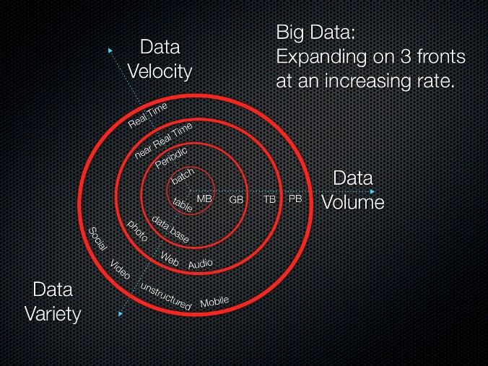
The V’s of Big Data:
Volume
Velocity
Variety

Slide 11
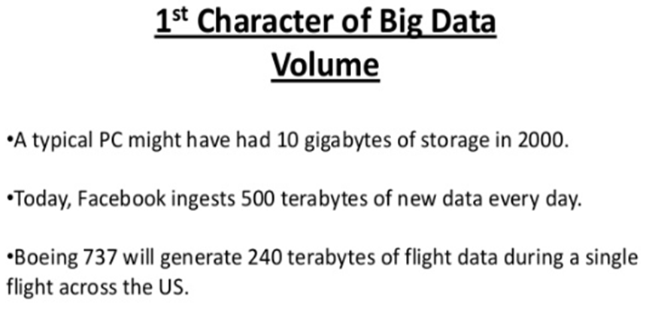

Slide 12
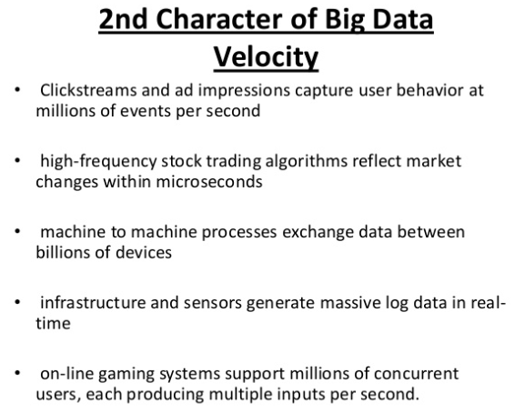

Slide 13
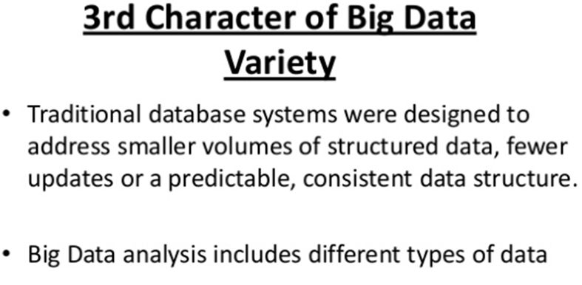

Slide 14
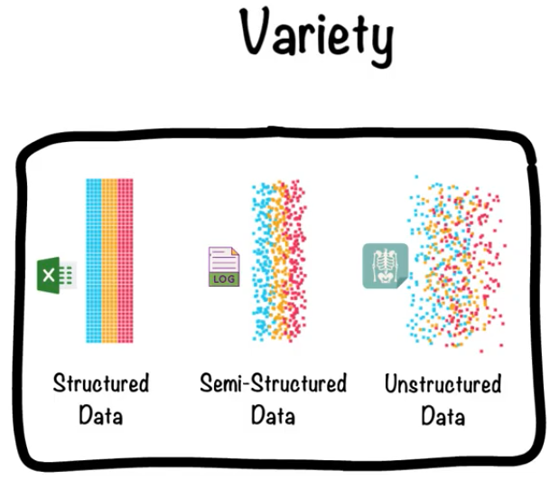

Slide 15
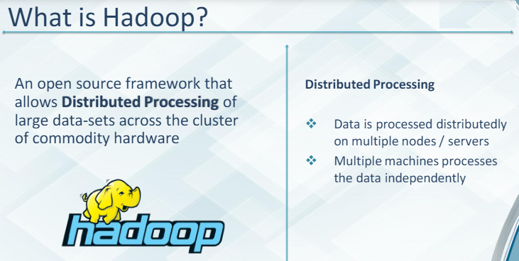
Solution for Bigdata is Hadoop:

Slide 16
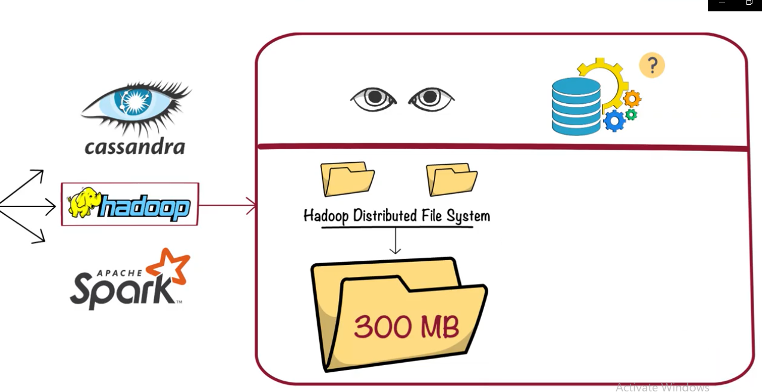
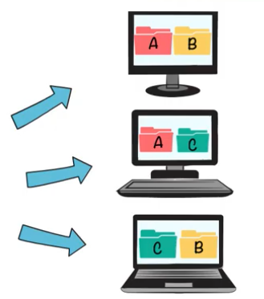
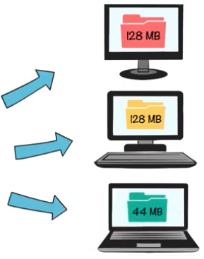

Slide 17
Structured:
Structured data refers to any data that resides in a fixed field within a record or file. This includes data contained in relational databases and spreadsheets.
Unstructured:
Unstructured data (or unstructured information) is information that either does not have a pre-defined data model or is not organized in a pre-defined manner.
Unstructured data files often include text and multimedia content. Examples include e-mail messages, word processing documents, videos, photos, audio files, etc..
Semi-structured: Semi structured is the third type of big data. Semi-structured data pertains to the data containing both the formats mentioned above, that is, structured and unstructured data.

Slide 18
Data management:
Data management is an administrative process that includes acquiring, validating, storing, protecting, and processing required data to ensure the accessibility, reliability, and timeliness of the data for its users. ...
Data management software is essential, as we are creating and consuming data at unprecedented rates.

Slide 19

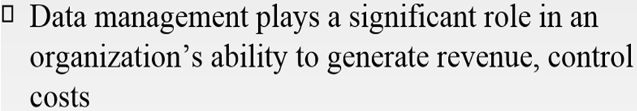
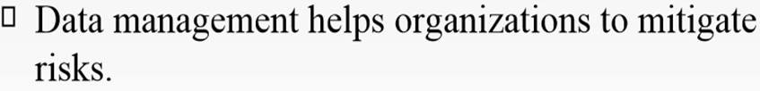

Slide 20



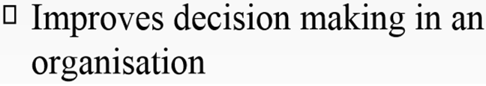

Slide 21

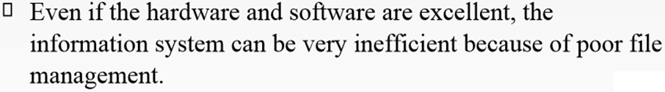

Slide 22

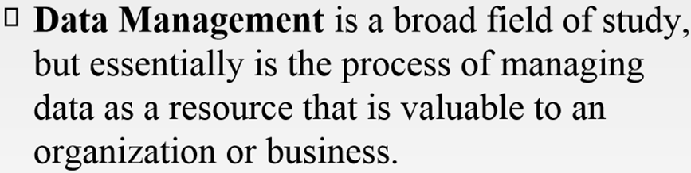
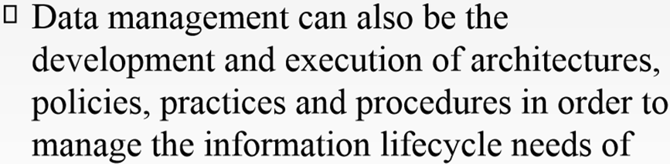

Slide 23

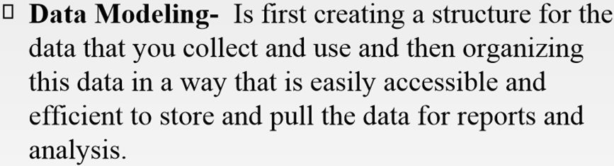

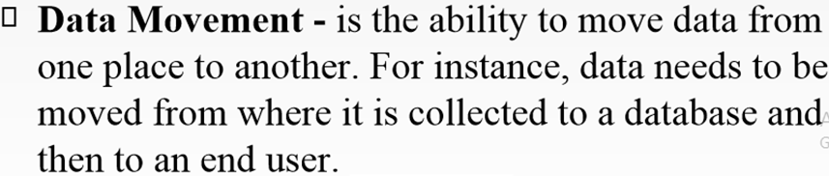

Slide 24
Data mining, also called knowledge discovery in databases, in computer science, the process of discovering interesting and useful patterns and relationships in large volumes of data. The field combines tools from statistics and artificial intelligence (such as neural networks and machine learning) with database management to analyze large digital collections, known as data sets.

