Slide 1

UNIT - II
Data Analytics: Introduction to Analytics, Introduction to Tools and Environment, Application of Modeling in Business, Databases & Types of Data and variables, Data Modeling Techniques, Missing Imputations etc. Need for Business Modeling.

Slide 2
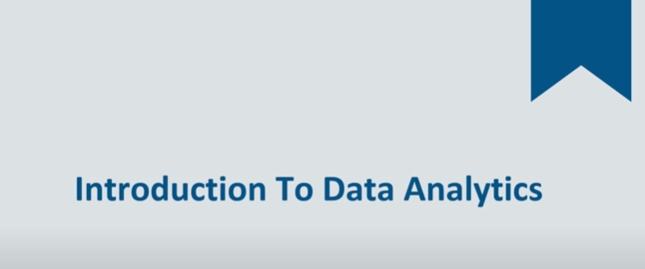

Slide 3

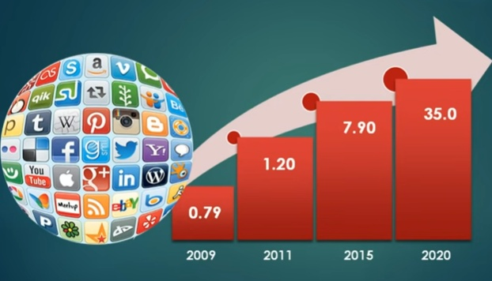

Slide 4

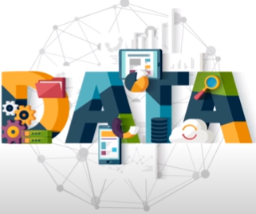




Slide 6
Data Analytics:
It is the Analysis of data, typically larger sets of data, by the use of mathematics, statistics, and computer software. - Niall sclater
Analytics is the science of using data to build a models that lead to better decision that in turn add value to individuals, companies and institutions.
- Dimitris Bertsimas

Slide 7
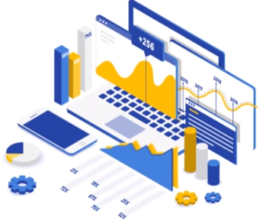






Data Analytics refers to the techniques to analyze data to enhance productivity and business gain

Slide 8

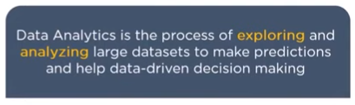
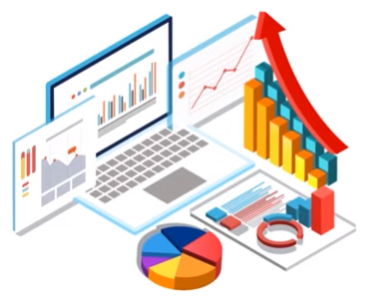
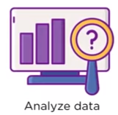


Slide 9
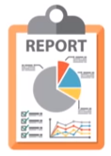
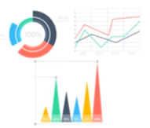






Slide 10



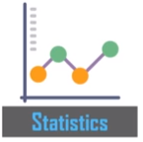

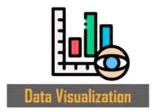


Slide 11

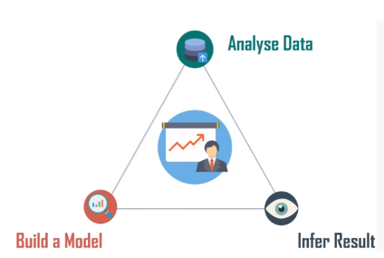

Slide 12

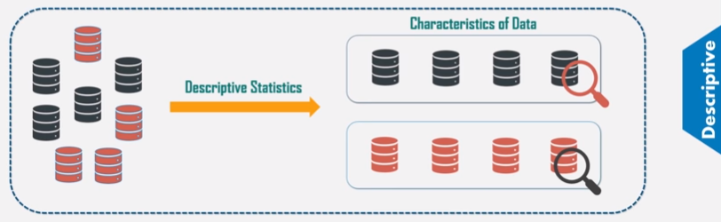

Slide 13

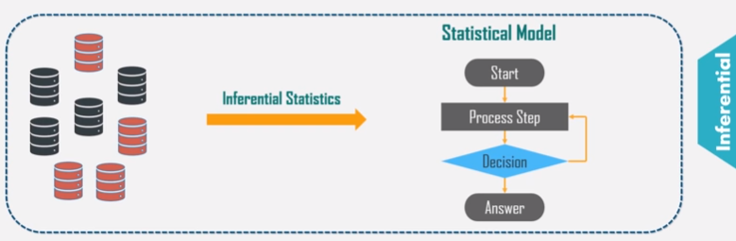

Slide 14
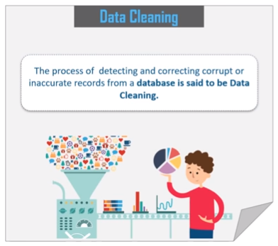
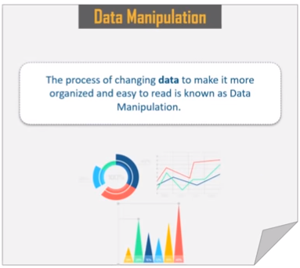

Slide 15





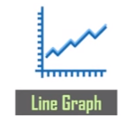

Slide 16
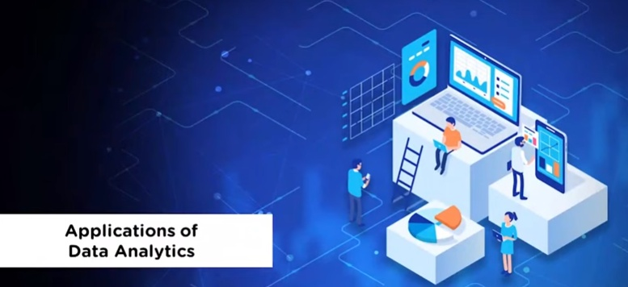

Slide 17


Slide 18



Slide 19


Slide 20
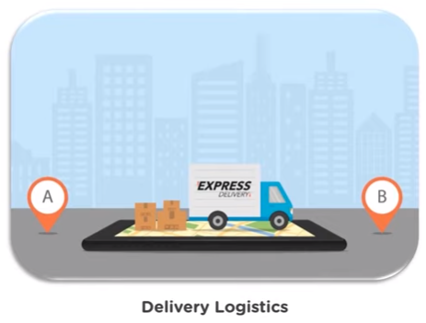

Slide 21
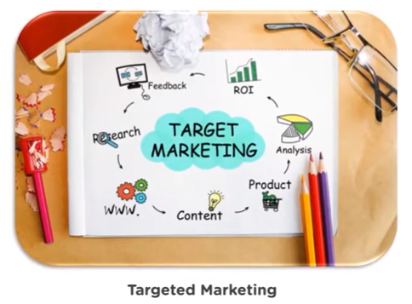

Slide 22
Types of data analytics:
There are 3 different types of analytics. Here, we start with the simplest one and go further to the more sophisticated types. As it happens, the more complex an analysis is, the more value it brings.
Descriptive analytics: It analytics answers the question of what happened.
Predictive analytics: It tells what is likely to happen
Prescriptive analytics: It is to literally prescribe what action to take to eliminate a future problem or take full advantage of a promising trend.

Slide 23
