Slide 1

Understand various sources of Data

Slide 2
Data can be generated from two types of sources namely
1. Primary sources of data
2. Secondary sources of data

Slide 3
Primary sources of data
Primary data means ‘First-hand information’.
It is collected from the source of the origin. Primary data sources include information collected and processed directly by the researcher, such as observations, surveys and interviews,.

Slide 4
Advantages:
Data is original and more reliable.
You know the accuracy of the data.
Ownership
Up to date information
Disadvantage:
Primary data sources will take more time to collect the data.
It is Expensive.

Slide 5
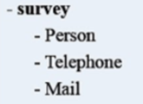
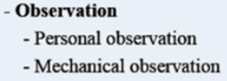
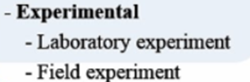
Primary sources of data
Surveys
Observations
Experimental

Slide 6
Survey Method:
Survey is defined as the act of examining a process or questioning a selected sample of individuals to obtain data about a service, product, or process.
Data collection surveys collect information from a targeted group of people about their opinions, behavior, or knowledge

Slide 7
Observation Method:
Observation is a technique that involves systematically selecting, watching, listening, reading and recording behavior and characteristics of living beings, objects, or phenomena.
There exist various observation practices, and role as an observer may vary according to the research approach.

Slide 8
CRD - Completely
Randomized Design
RBD - Randomized Block Design
Experimental
LSD - Latin Square Design
FD - Factorial Designs

Slide 9
Completely Randomized Design
Completely Randomized design(CRD) is a simple experimental design used in data analytics which is based on randomization and replication. It is mostly used for comparing the experiments.
Completely randomized design is one where the treatments are assigned completely at random so that each experimental unit has the same chance of receiving any one treatment.

Slide 10
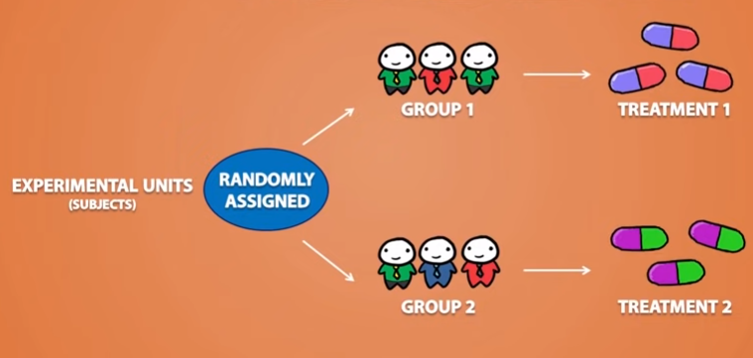

Slide 11
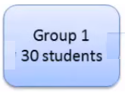



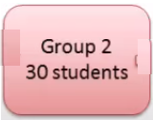

Completely Randomized Design

Slide 12





Slide 13
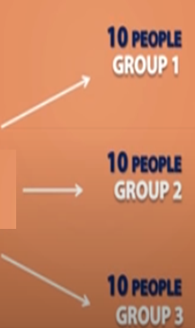
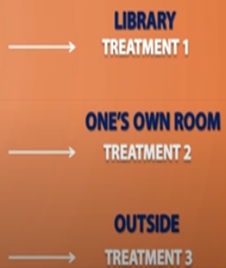


Completely Randomized Design

Slide 14
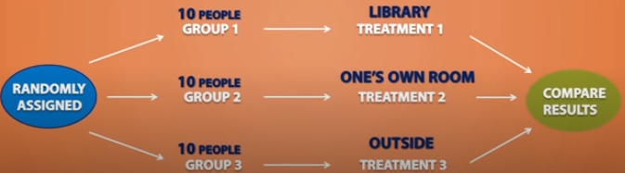
Completely Randomized Design

Slide 15

Randomized block Design
The researcher believes that Gender has an effect on the results

Slide 16
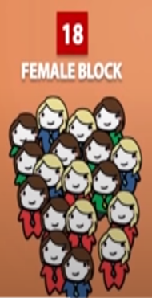








Slide 17
Randomized block Design
The randomized complete block design (RBD) is one of the most widely used experimental designs in forestry research. RBD was originated from the agriculture sector.
Randomized Block Design is an experimental design in which the experiment is divided into small units called blocks. Random experiments are performed on each of the blocks and results are drawn using a technique known as analysis of variance (ANOVA).

Slide 18

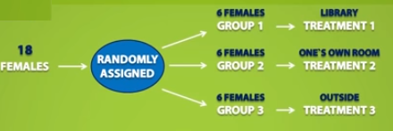



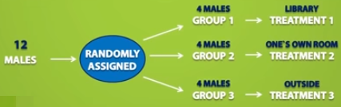


Slide 19
LSD - Latin Square Design
Latin Square Design is an experimental design that is similar to CRD and RBD blocks but contains rows and columns. It is an arrangement of NxN squares with an equal amount of rows and columns which contain letters that occurs only once in a row.
Hence the differences can be easily found with fewer errors in the experiment. Sudoku puzzle is an example of a Latin square design.

Slide 20
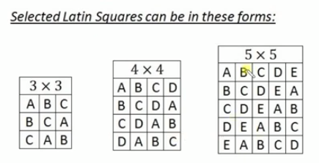
LSD - Latin Square Design

Slide 21
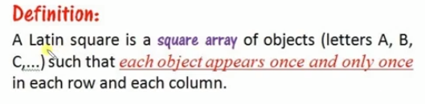
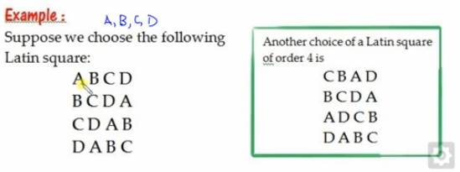
LSD - Latin Square Design

Slide 22
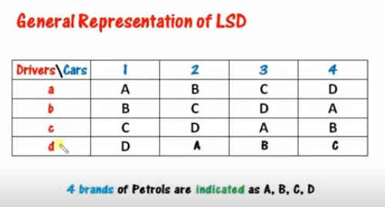

Slide 23
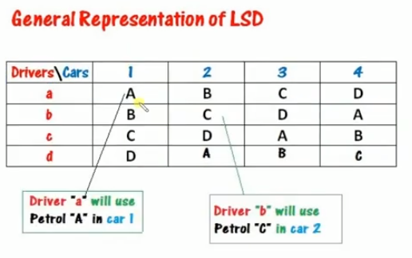

Slide 24
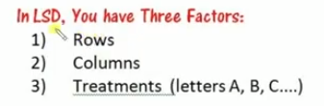



Slide 25
FD - Factorial Designs
This design allows the experimenter to test two or more variables simultaneously. It also measures interaction effects of the variables and analyzes the impacts of each of the variables.

Slide 26

Factorial Designs

