Slide 1
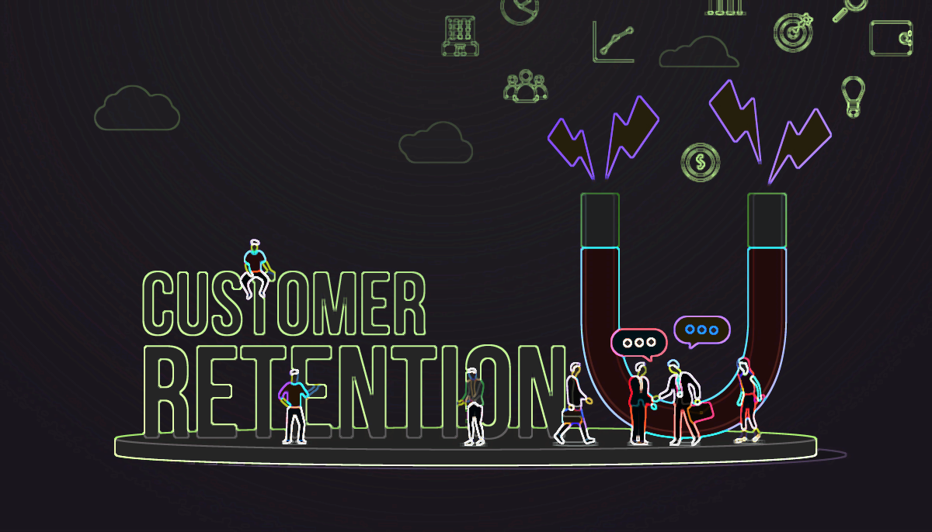
A PROJECT ON E-RETAIL FACTORS FOR CUSTOMER ACTIVATION AND RETENTION IN E-COMMERCE COMPANIES

Slide 2
PROBLEM STATEMENT
To find out the E-Factors which could play a vital role in increasing the Customer Engagement and Retention of an E-commerce company like Amazon, Flipkart, Myntra and etcetera.
My dataset is having 269 rows and 71 attributes and I’ll be doing some Exploratory Data Analysis and Data Visualizations on the same dataset and will try to find out the attributes that are really important for these e-commerce company in order to increase its sales, customer satisfaction and retention.
Our data frame has only 1 integer column and rest 70 features are in categorical object format having two or more than two categories.

Slide 3
EXPLORATORY DATA ANALYSIS
EDA is a critical first step in analyzing the data from an experiment. Here are the main reasons we use EDA.
Detection of mistakes or finding null values, repetition etcetera
Determining Relationships among the explanatory variables
Assessing the direction and rough size of relationships between explanatory and outcome variables.
Making Data Clean and Normalize for the further model-building purpose.

Slide 4
CHECKING NULL VALUE PRESENCE
The dataset is not having any null value presence. It means that the sum of all the null values in respective columns all together is zero.
There are almost more than two categories present for each attributes. Attribute four (column no. 4) of our data set contains almost 39 category of pin code which is highest among others.
Mobile Internet and Mobile internet both are same categories given under a attribute name hence I’ve merged them into a single category as Mobile Internet as any mistake of information can lead towards false decision-making by the companies and it will affect their customer retention and engagement decision

Slide 5
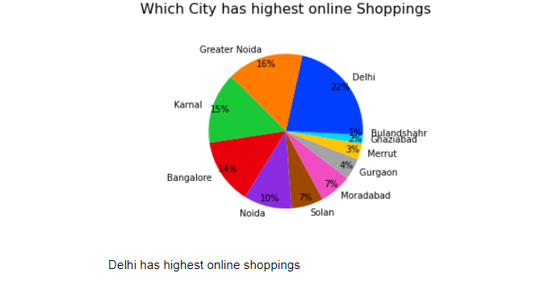
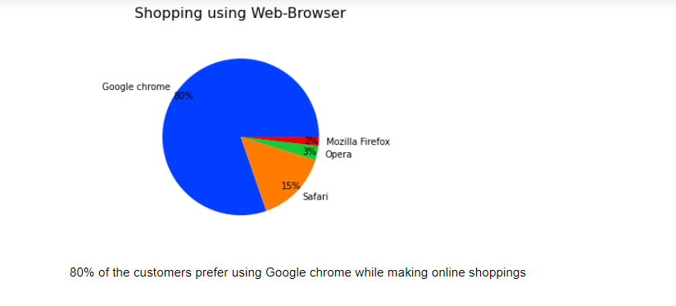
DATA VISUALIZATION (PIE-CHARTS)

Slide 6
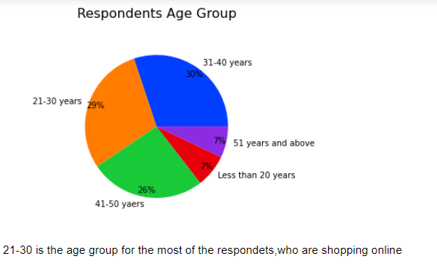
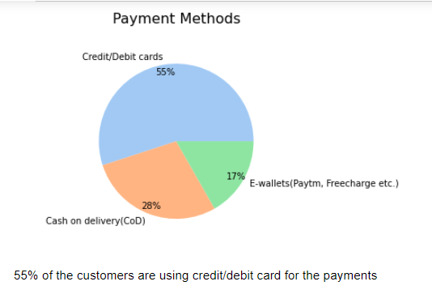
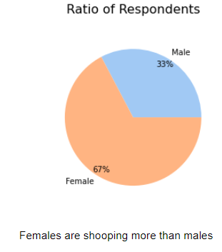
DATA VISUALIZATION (PIE-CHARTS)

Slide 7
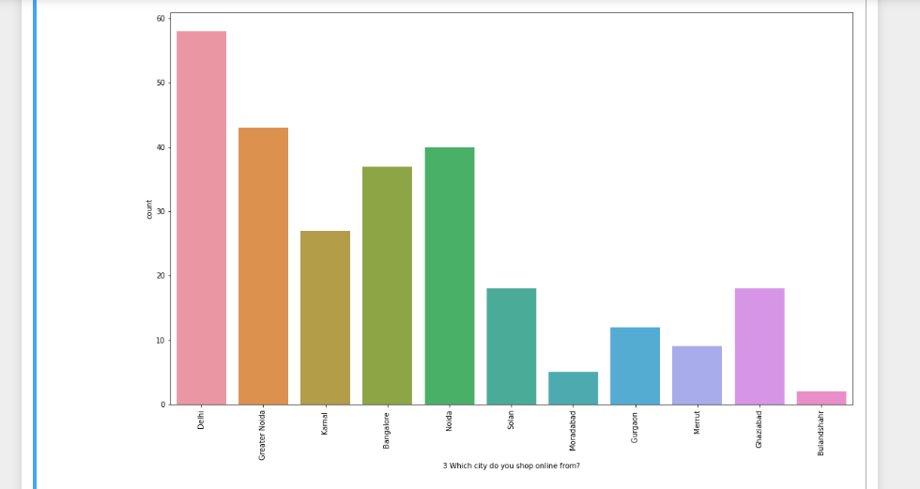
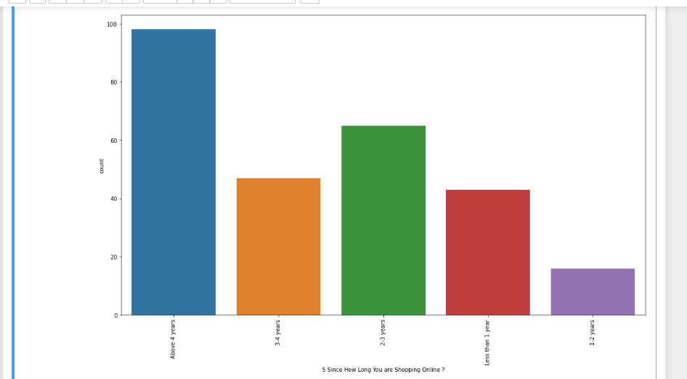
DATA VISUALIZATION (COUNTPLOT)

Slide 8
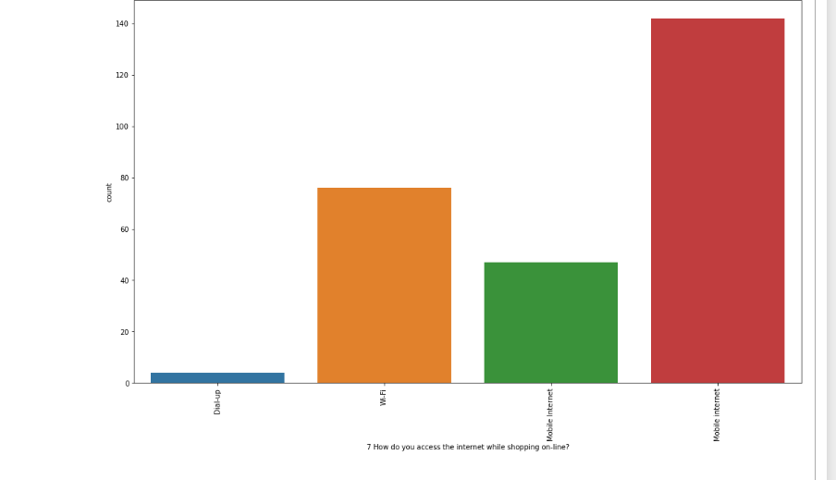
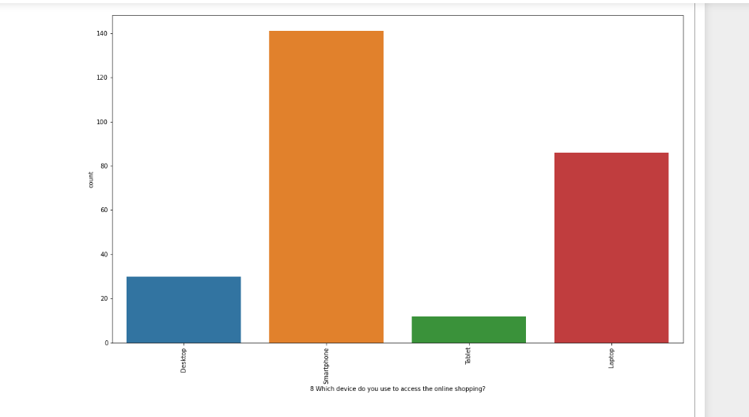
DATA VISUALIZATION (COUNTPLOT)

Slide 9
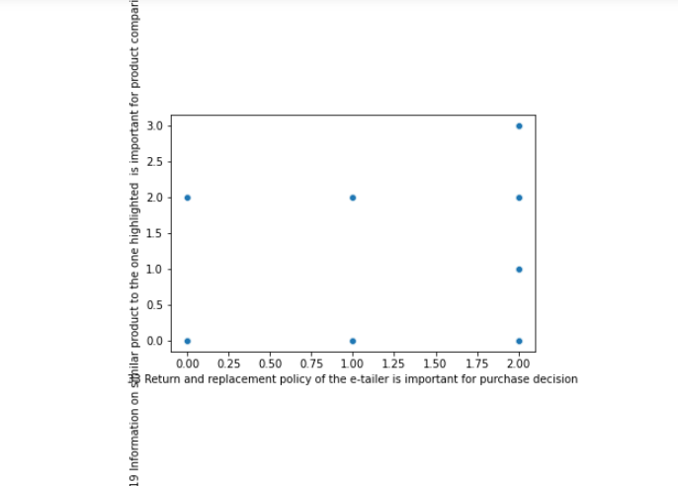
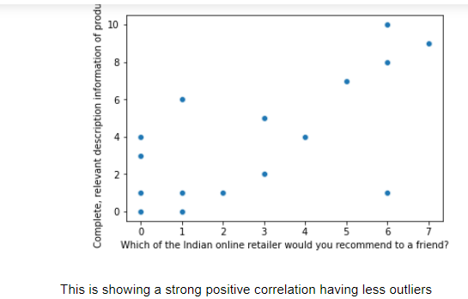
DATA VISUALIZATION (SCATTERPLOT)

Slide 10
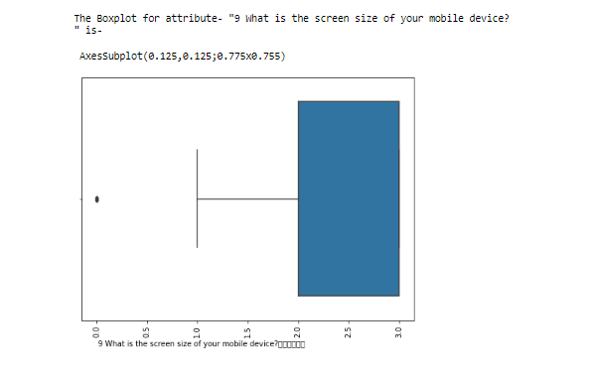
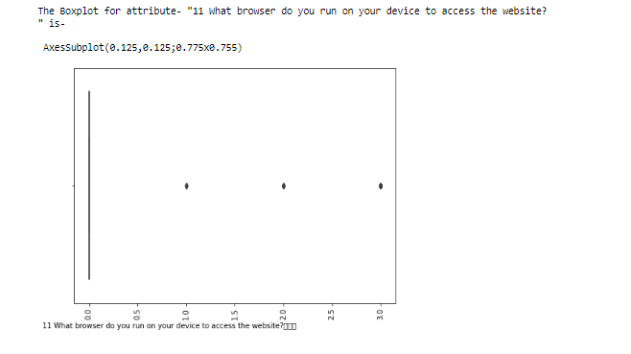
DATA VISUALIZATION (BOXPLOT)

Slide 11
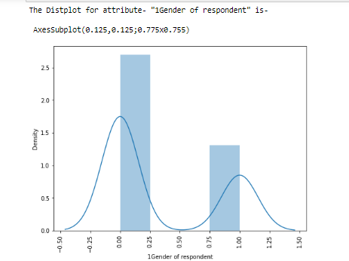
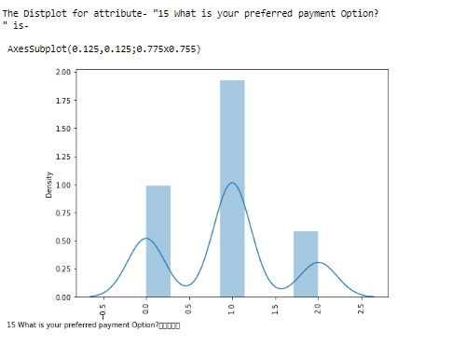
DATA VISUALIZATION (DISTRIBUTIONPLOT)

Slide 12
FINDINGS
As, by seeing all the above count-plots diagrams we can say that, most of the respondents are females of Delhi having age more than 4 Years and they are using mobile internet through smartphone and accessing Google Chrome Browser for shopping their favorite products and when it comes to referring the best e-commerce platform for shopping to any friends or family member then the name they are suggesting is Amazon.
From the above scatterplot diagram and my findings in jupyter notebook we can say that there are strong positive correlation b/w ('Which of the Indian online retailer would you recommend to a friend?' and 'Complete, relevant description information of products') & ('Speedy order delivery ‘ and 'Website is as efficient as before') & ('Displaying quality Information on the website improves satisfaction of customers' and 'Fast loading website speed of website and application') & ('Return and replacement policy of the e-tailer is important for purchase decision' and 'Information on similar product to the one highlighted is important for product comparison'). There are many more but we can’t plot that much correlation as the inputs are 75 that’s why I’ve plotted only the important relations.

Slide 13
FINDINGS
All the above distribution plots are showing that almost no attributes are normally distributed and since all the attributes were in categorical format earlier, hence if skewness is present, we can't remove the skewness as it doesn't support its property on categorical attributes. Hence will skip this part and also as the integer column (which is Pin-code) is not meaningful as City is already given hence will ignore the presence of pin-code attribute in the dataset.

Slide 14
OUTLIERS
All the below attributes have higher outliers presence possibility as compare to other attributes.
'What is the screen size of your mobile device',
'What browser do you run on your device to access the website',
'Which channel did you follow to arrive at your favorite online store for the first time?'
'User friendly Interface of the website','
Empathy (readiness to assist with queries) towards the customers',
'Being able to guarantee the privacy of the customer',
'Responsiveness, availability of several communication channels (email, online rep, twitter, phone etc.)',
'Net Benefit derived from shopping online can lead to users satisfaction'

Slide 15
CONCLUSION
Out of 269 respondents Female are 181 which is more than twice as that of Male respondents.
Most of the respondents are having age group b/w 21-50.
Delhi, Greater Noida and Noida are top three cities when it comes to shopping online while Bulandshahr, Moradabad and Meerut are in bottom three for the same.
98 respondents are shopping from last 4 years while the number is less and which 16, b/w the years 1-2 is.
114 respondents have made less than 10 times online purchase in the past 1 year.

Slide 16
CONCLUSION
189 Respondents are using mobile internet while shopping on-line unlike Wi-Fi and others.
141 Respondents are using Smartphones while accessing to online shopping.
230 Respondents inspired to do shopping because of Search-Engine advertisements.
123 respondents takes more than 15 minutes while making their first purchase.
148 Respondents uses Credit/Debit cards as the preferred payment Option while making payment.

Slide 17
CONCLUSION
133 Respondents thinks they are getting better alternative offer that's why they abandon the Bags and Shopping Carts option.
The content on the website must be easy to read and understand that are said by 164 respondents.
116 Respondents says Information on similar product to the one highlighted is must for product comparison.
101 Respondents thinks complete information on listed seller and product being offered is important for purchase decision.
132 Respondents thinks all relevant information on listed products should be stated clearly.

Slide 18
CONCLUSION
141 Respondents thinks Ease of navigation in website is really must.
189 Respondents thinks User friendly Interface of the website is must.
194 Respondents thinks Empathy (readiness to assist with queries) towards the customers is must.
185 Respondents thinks being able to guarantee the privacy of the customer is must.
149 Respondents think Responsiveness, availability of several communication channels (email, online rep, twitter, phone etc.) is must.

Slide 19
CONCLUSION
105 Respondents thinks online shopping monetary benefit and discounts is must.
146 Respondents think shopping online must be convenient and flexible.
198 Respondents think Return and replacement policy of the e-tailer is must for purchase decision
122 Respondents think User satisfaction cannot exist without trust
111 Respondents thinks Offering a wide variety of listed product in several category is must.
135 Respondents thinks Provision of complete and relevant product information is must.
149 Respondents think getting value for money spent is must.
According to me above 27 points are important to retain/add new set of customers, customer satisfaction.

Slide 20
CONCLUSION
82 Respondents have shopped from e-commerce websites like- Amazon.in, Flipkart.com, Paytm.com, Myntra.com, Snapdeal.com
64 Respondents thinks Amazon.in, Flipkart.com, Paytm.com, Myntra.com, Snapdeal.com is Easy to use website or application
87 Respondents thinks Amazon.in and Flipkart.com have Visual appealing web-page layout
130 Respondents thinks Amazon.in and Flipkart.com are providing Wild variety of product on offer unlike others.
100 Respondents thinks Amazon.in and Flipkart.com have Complete, relevant description information of products
66 Respondents thinks Amazon.in is quickest when it comes to purchase anything.
65 Respondents thinks Amazon.in and Flipkart.com have Availability of several payment options unlike others.

Slide 21
CONCLUSION
107 Respondents thinks Amazon.in have Speedy order delivery unlike others.
107 Respondents thinks Amazon.in is best when it comes to the privacy of the customers.
79 Respondents would like to refer Amazon.in to others
Above 10 points are just indicating that which e-commerce companies has great Positioning, Branding, Advertisement or Presence unlike others. Hence I would like conclude that- Amazon.in and Flipkart are among two companies that customers are loving it as they are doing lots of shopping because customers have great faith on their user friendly applications, Multiple Payments options, privacy & Security of customer financial information, speedy delivery, trust, offers, cashbacks and etcetera. Also, when it comes to referring the website, for shopping, to friends, family or others Amazon.in comes at first choice on their minds.

