Slide 1
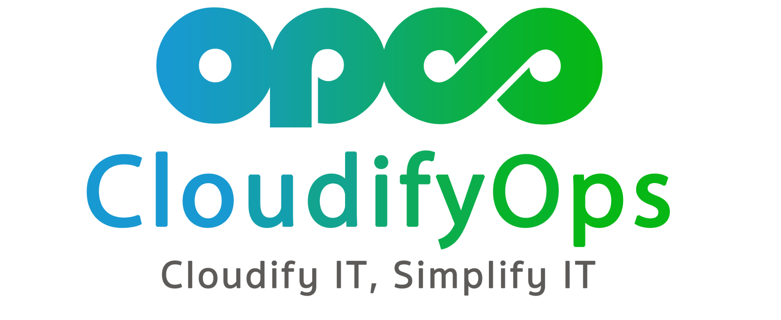

Post-Production Deployment Support
Post-Production Deployment Support
Prowler Open Source
]

Slide 2

Prowler Open Source
By:- Naresh Kumar C

Slide 3
AGENDA!
Introduction
Why Use Prowler?
Setup & Configuration
Sample Report
Architecture
Features
Demo

Slide 4
Introduction
Prowler is an Open Source security tool to perform security best practices assessments in AWS, Azure and Google Cloud.
In this presentation, we'll explore the features, benefits, and use cases of Prowler, as well as how it can help organizations achieve better security and compliance in the AWS environments.

Slide 5
Why Use Prowler?
Enhances security posture.
Identifies misconfigurations and vulnerabilities.
Helps achieve compliance.(e.g., CIS, PCI-DSS, ISO27001, GDPR, HIPAA, FFIEC, SOC2, AWS FTR, ENS)
Saves time and effort with automated checks.
Enables proactive security monitoring.

Slide 6
Setup & Configuration
Prowler is available as a project in PyPI, thus can be installed using pip with Python >= 3.9
It is also available as Docker Images.
Prowler uses AWS Credentials under the hood, so we can Configure the AWS CLI and use them.
We must add SecurityAudit and ViewOnlyAccess AWS managed policies to the user or role being used
To run Prowler for specific cloud like AWS, we will need to specify the provider(prowler aws).

Slide 7
Sample Report
By default, prowler will generate a CSV, a JSON and a HTML report within the Output directory.
Sample html report will be like the image in the following slide.

Slide 8
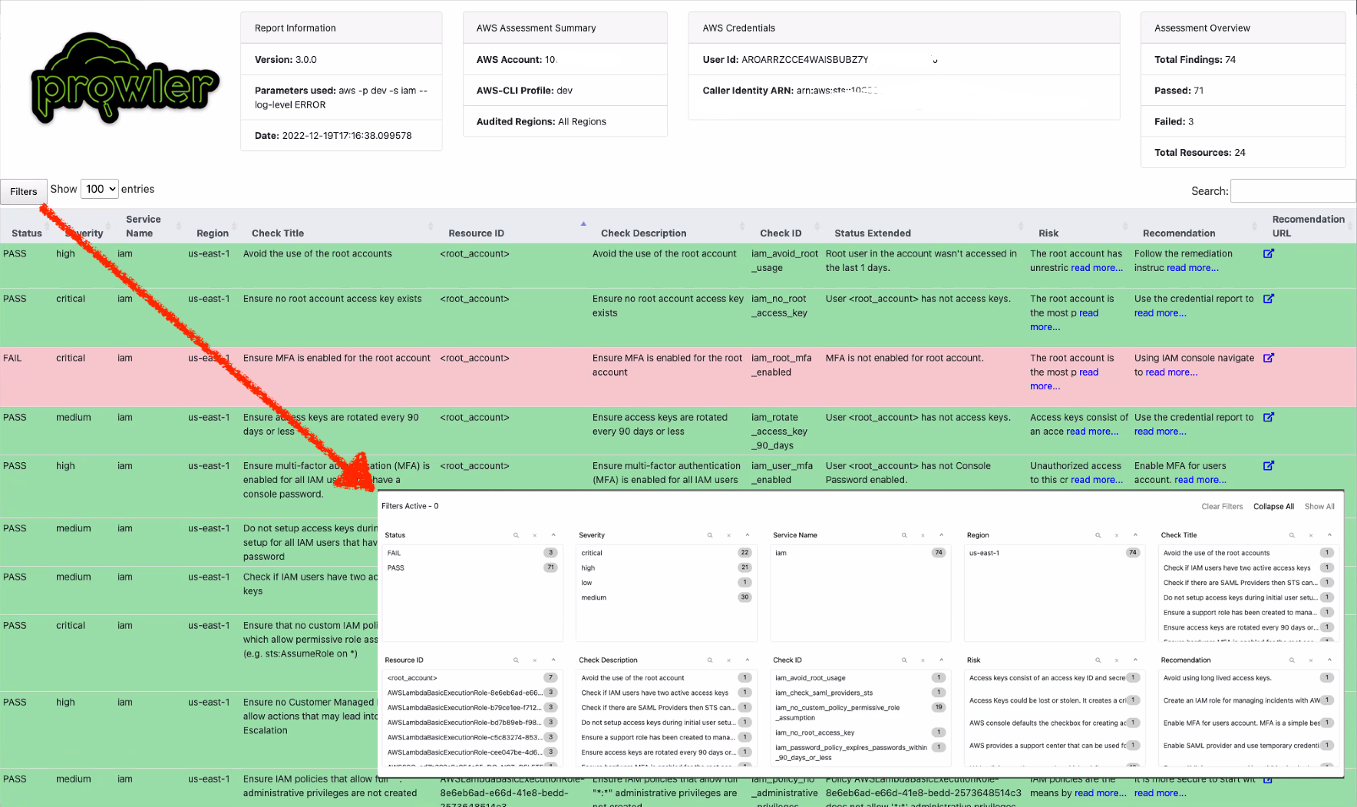
HTML Report

Slide 9
Architecture
Basically Prowler is a Command Line Interface(CLI) Tool.
We can run Prowler from your workstation, an EC2 instance, Fargate or any other container, Codebuild, CloudShell, Cloud9 and many more.
The following slide displays the Architecture Diagram.

Slide 10
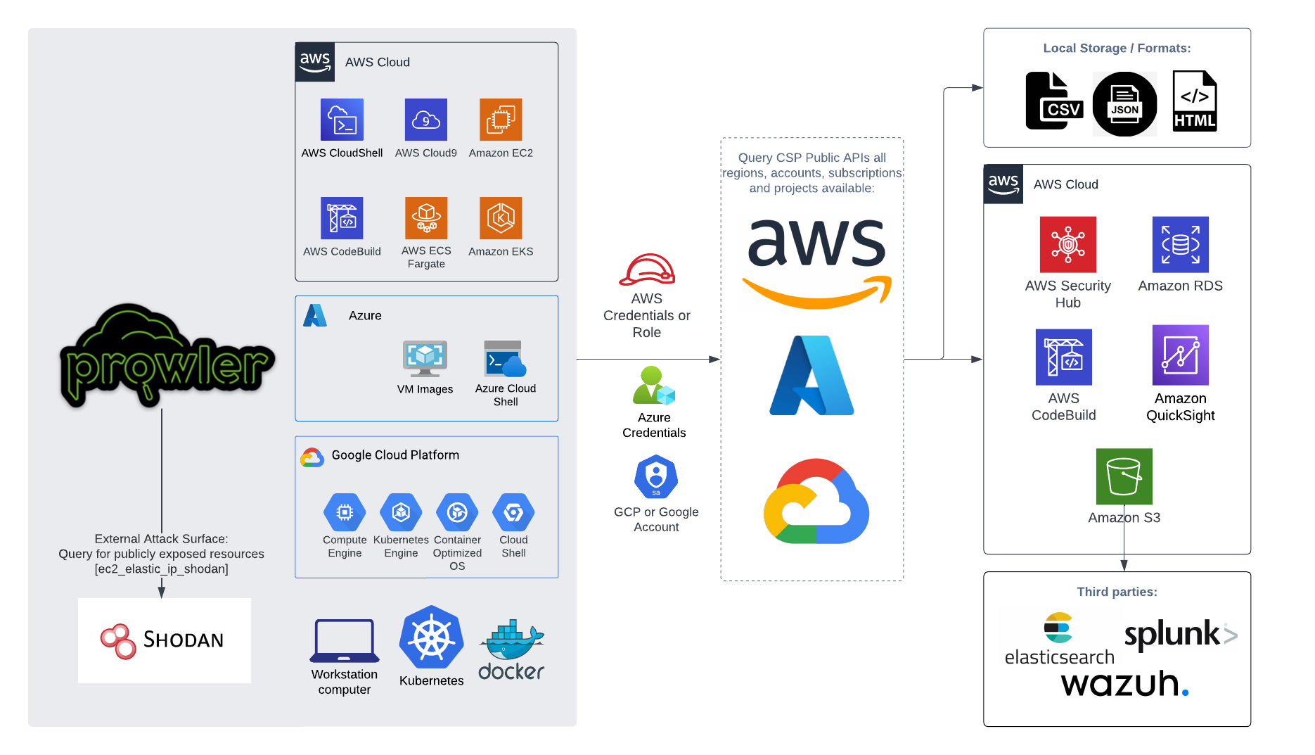
Architecture Diagram

Slide 11
Features
Automated checks for security best practices.
Regularly updated with new checks.
Easy-to-read reports and alerts.
It can Scan Multiple AWS Accounts simultaneously.
Send output report to AWS S3 Bucket.
Prowler can be integrated with Slack to send a summary of the execution.
Prowler supports natively and as official integration sending findings to AWS Security Hub.This integration allows Prowler to import its findings to AWS Security Hub.
For that we have to enable AWS Security Hub and the Prowler integration.

Slide 12
Reference Links
GitHub - prowler-cloud/prowler: Prowler is an Open Source Security tool for AWS, Azure, GCP and Kubernetes to do security assessments, audits, incident response, compliance, continuous monitoring, hardening and forensics readiness. Includes CIS, NIST 800, NIST CSF, CISA, FedRAMP, PCI-DSS, GDPR, HIPAA, FFIEC, SOC2, GXP, Well-Architected Security, ENS and more
Prowler Documentation Site

Slide 13

Demo

Slide 14

THANK YOU
naresh.kumar@cloudifyops.com

