Slide 1
CMS : Complaint Management System
By:
Ashutosh Bahinipati (557769)
Kaza Jeevan Kumar(559607)

Slide 2
ABSTRACT:
The traditional way to report a problem was by call. When the customer faced an issue with the product, they were supposed to call the executive and report a complaint or the executive used to come to the residency in order to note down the issue. The complaint resolving procedure was very cumbersome. The issue was raised to the team of experts and was resolved by various group discussions or meetings which were a time taking process.
In Complaint Management System (CMS), we provide the user to directly click on the link that is associated with the product if they have any issue. The complaint will be forwarded to the product administrator. The product administrator will further forward the requests to the specified team who will resolve the problem and the entire process will be tracked till the closure. The customers and the Complaint Handling Team can connect with each other for efficient rectification of the issue.

Slide 3
MODULES:
Login Module:
Customers or Administrator can login to the system by providing correct login credentials. Customers will have different privileges and operations than that of the administrator.
Administrator Module:
Administrator module is associated to monitor various users, sections and provide login credentials for the customers.
Complaint Register Module:
Customer can register a complaint clicking on the link that is provided beside the product. When the customer register a complaint the system will generate a unique application or complaint ID associated with it. The complaint that is lodged can be tracked until its closure.
Reports Module:
The customer and the product Administrator will have an inbox to check the list of complaints. When the customer registers a complaint associated with a product, the complaint will be stored in the customers inbox and as well as it will be stored in the product administrators inbox.

Slide 4
Working:
User will be prompted the Welcome page on the screen where in they can login as a administrator or a customer.
Once the credentials of the user or the administrator get validated and is correct, they will be redirected to the next page.
For customers, the following page will consists of the products and the links associated with it to register a complaint. The customer can link any of the link associated with the product with which they are facing an issue. For Administrator, the following page will consist of the users and their privileges.
Both the customer and the administrator can change the password by clicking the change password button available on the page.
If the customer files a complaint, an associated complaint ID will be generated by the system.
After the customer has filed a complaint for a product, the issue will be resolved by the product team.
The Product Admin can view all the complaints and its status. Product Admin can directly contact the Product Team through e-mail.
The handling team will resolve the complaint and the User can track the complaint until its closure.
Once the complaint is resolved, The complaint ticket or ID that is generated will be closed and the status of the complaint will change to resolved

Slide 5
Snapshots of the Application

Slide 6
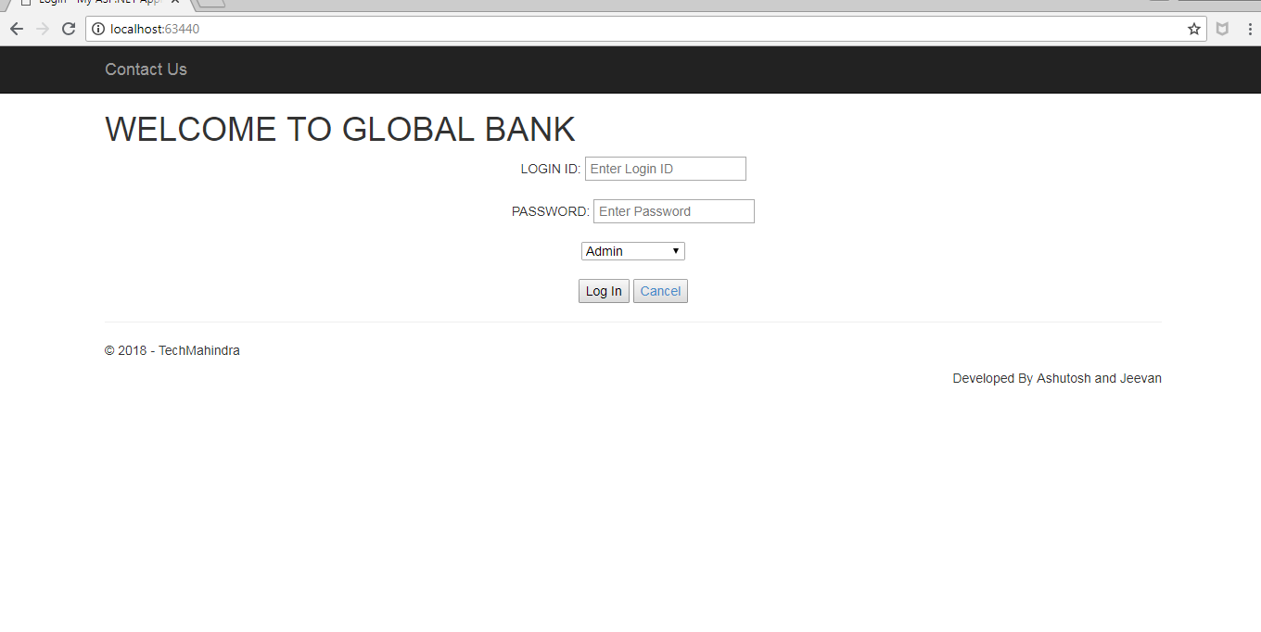
Login Page:

Slide 7
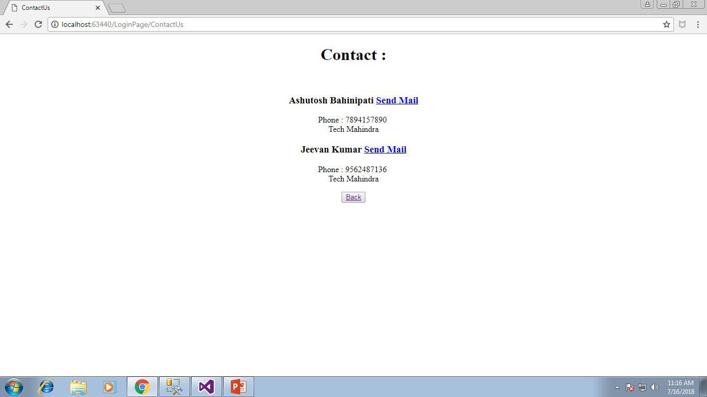
Contact Us:

Slide 8
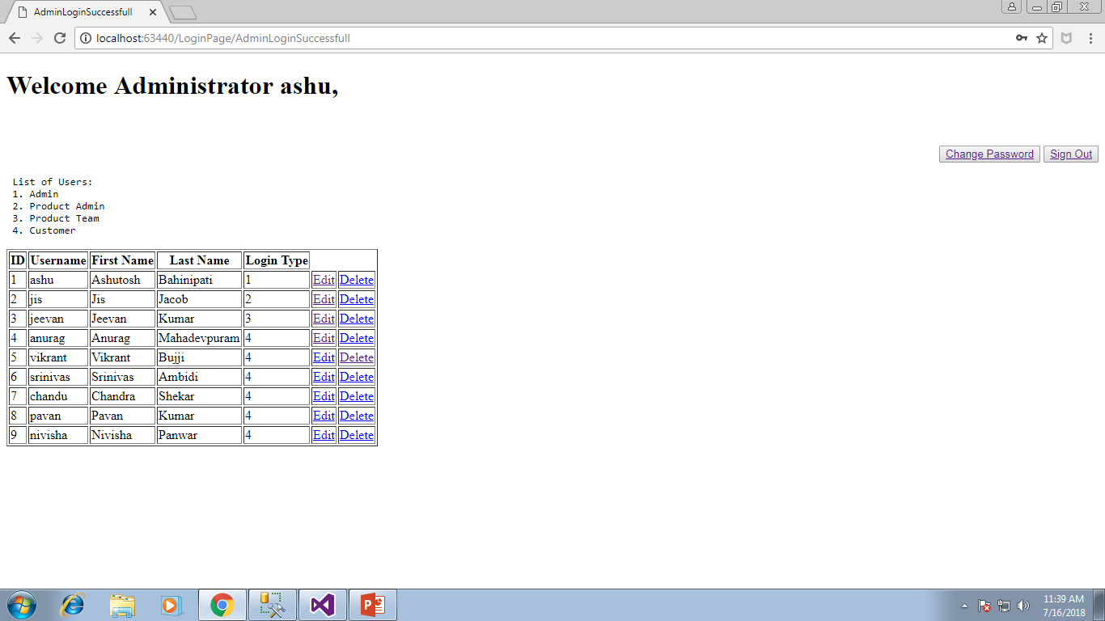
Admin Successful Login

Slide 9
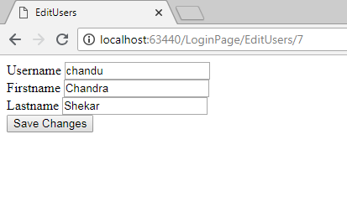
Admin : Editing Users

Slide 10
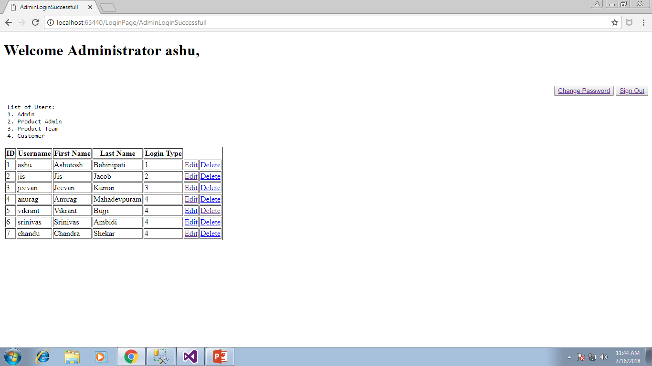
Admin : Deleting Users

Slide 11
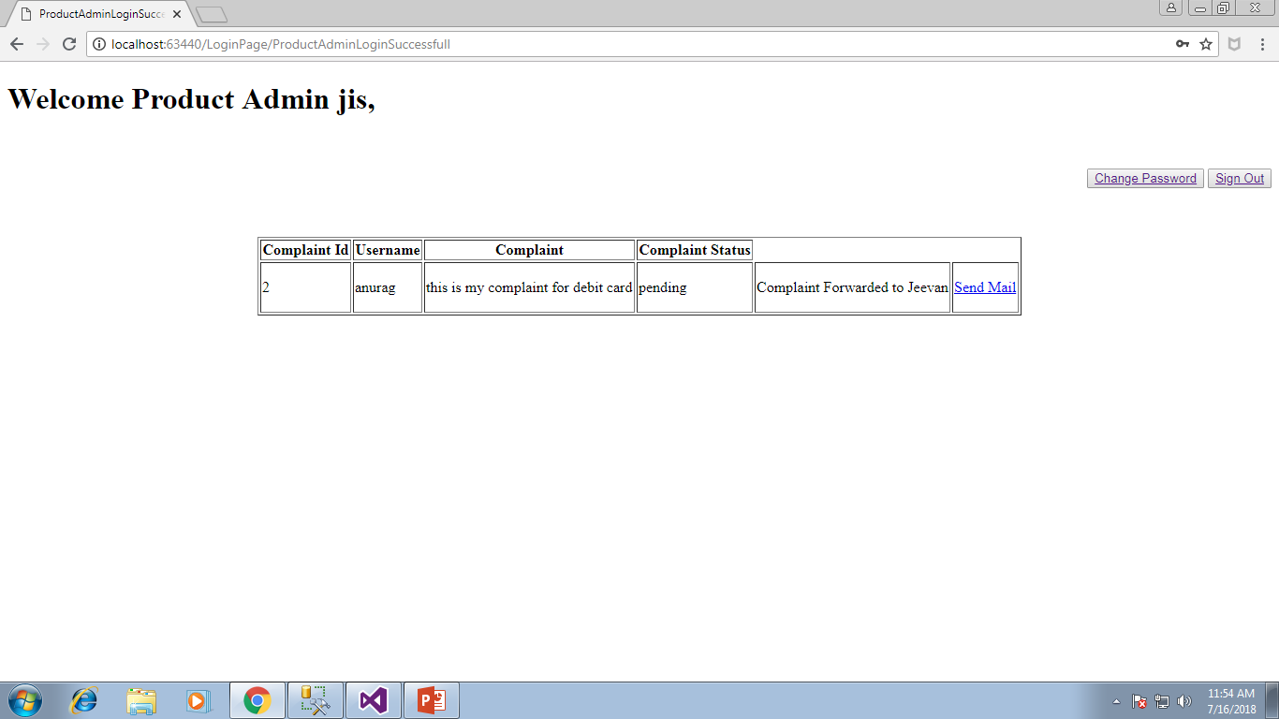
Product Admin Login:

Slide 12
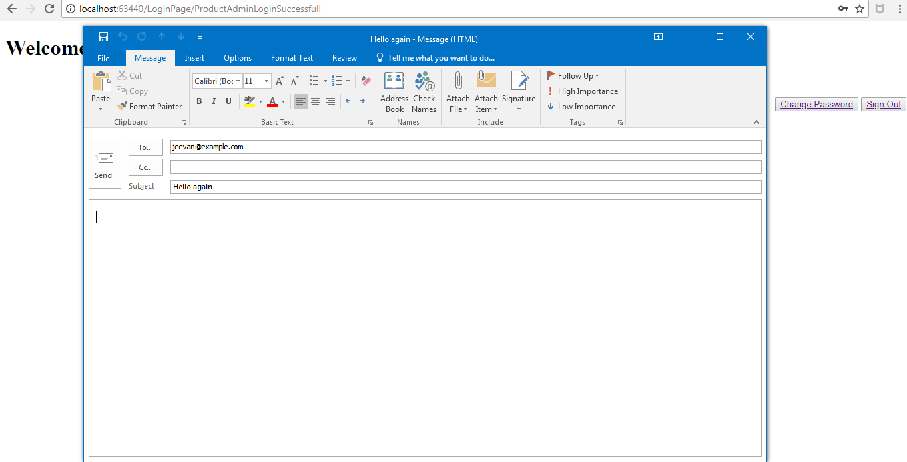
Contacting Product Team:

Slide 13
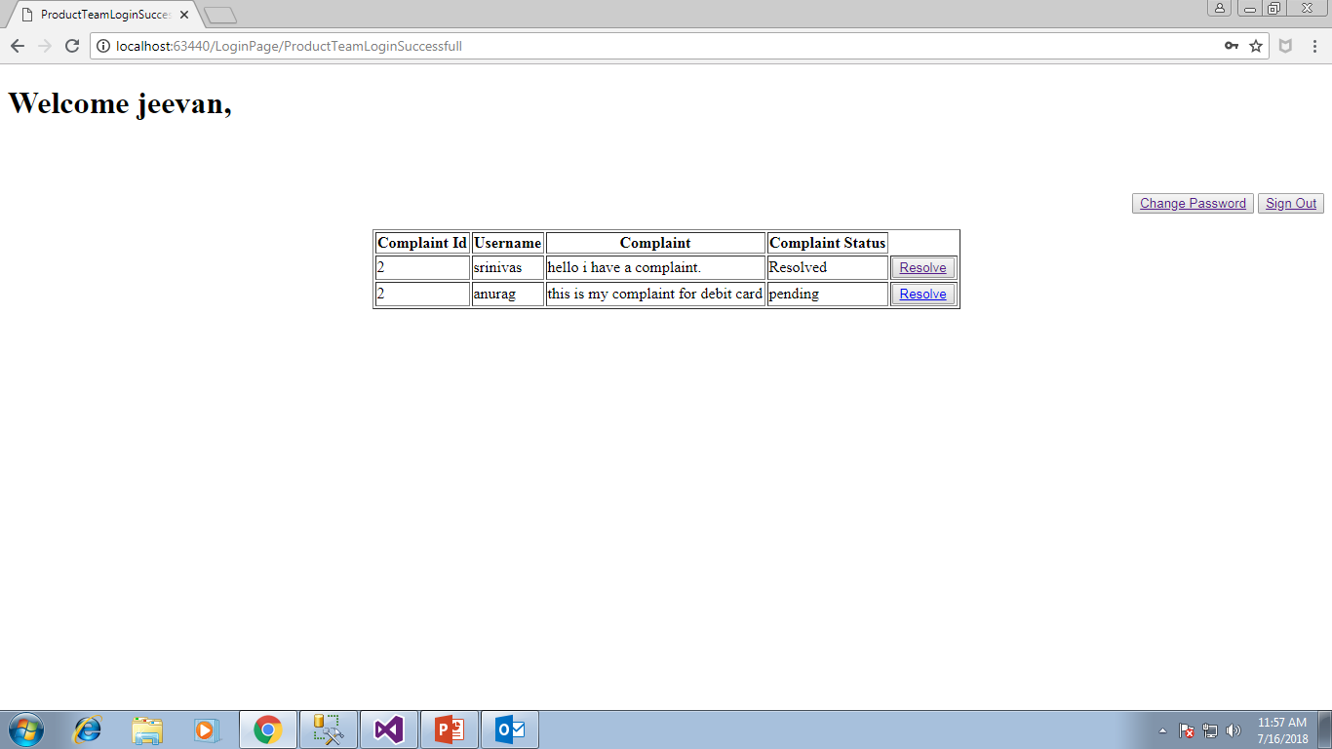
Product Team Login:

Slide 14
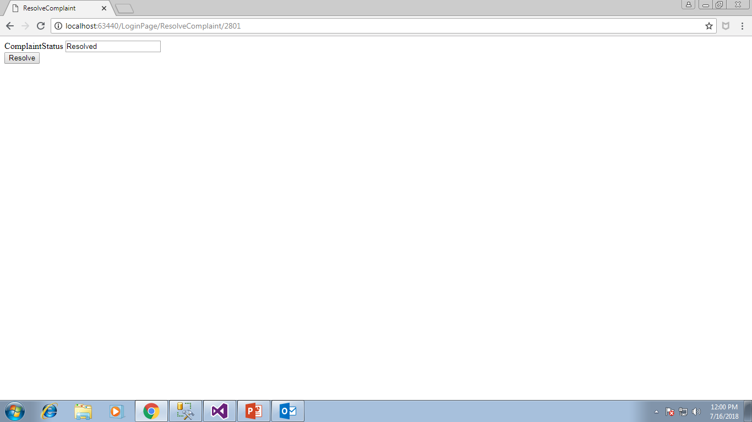
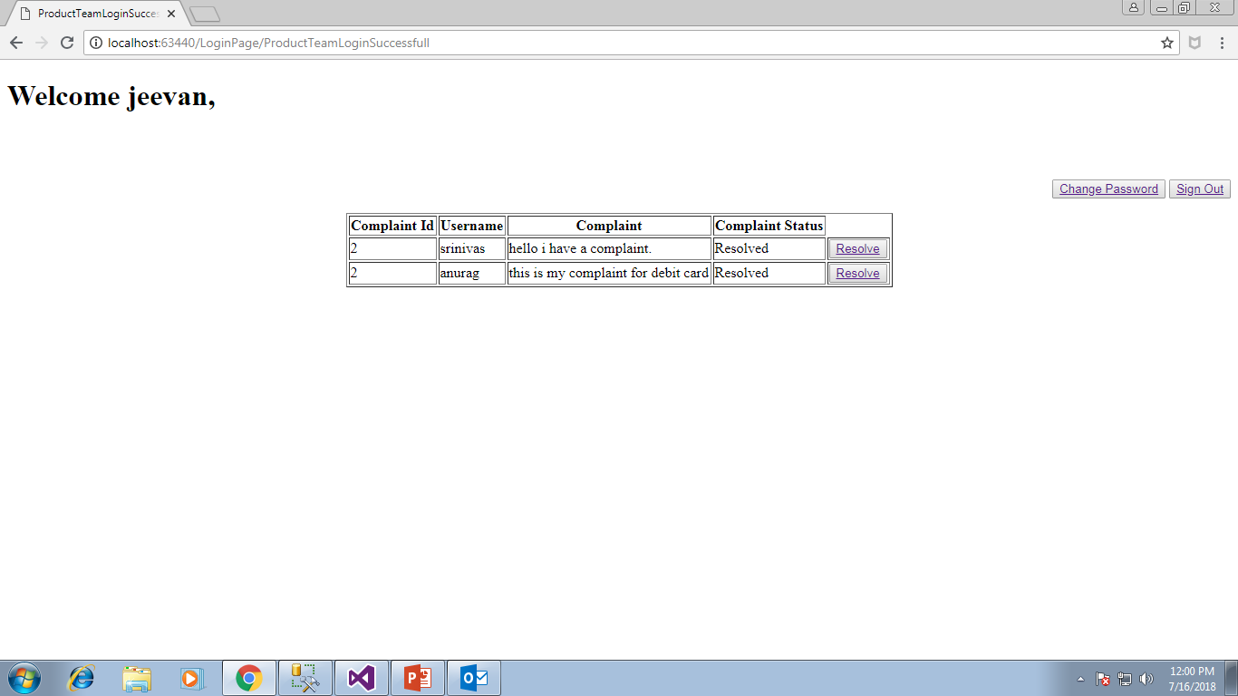
After resolving the complaint:

Slide 15
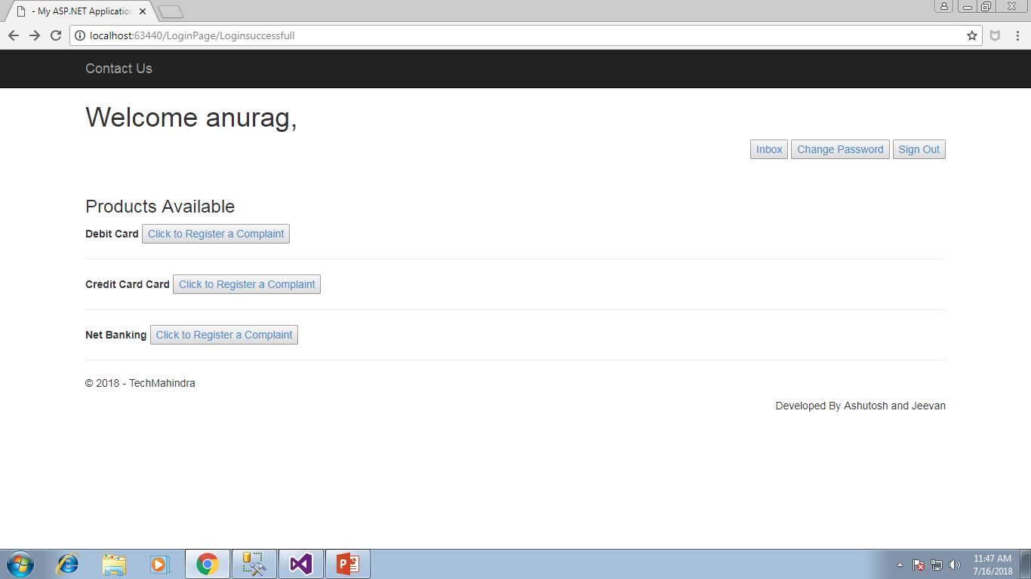
Customer Successful Login:

Slide 16
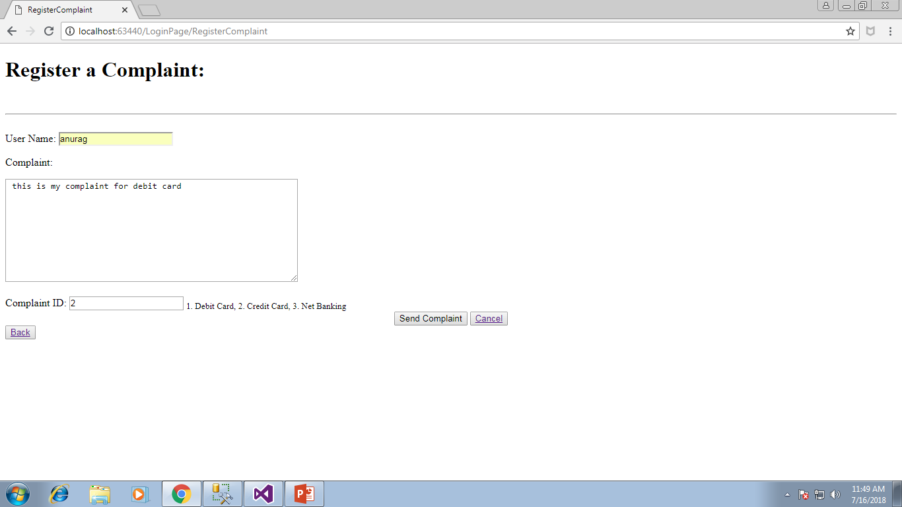
Registering a Complaint:

Slide 17
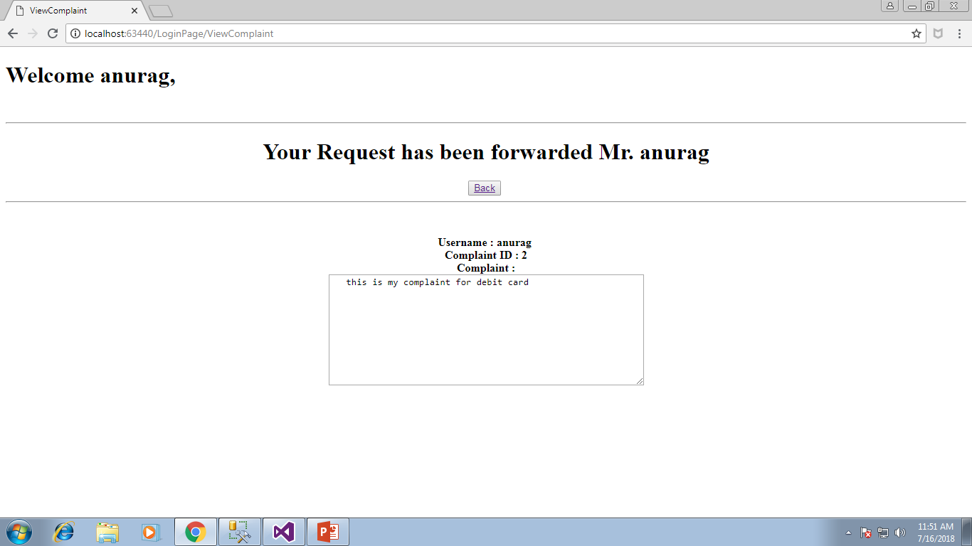
On Successful Complaint Registration:

Slide 18
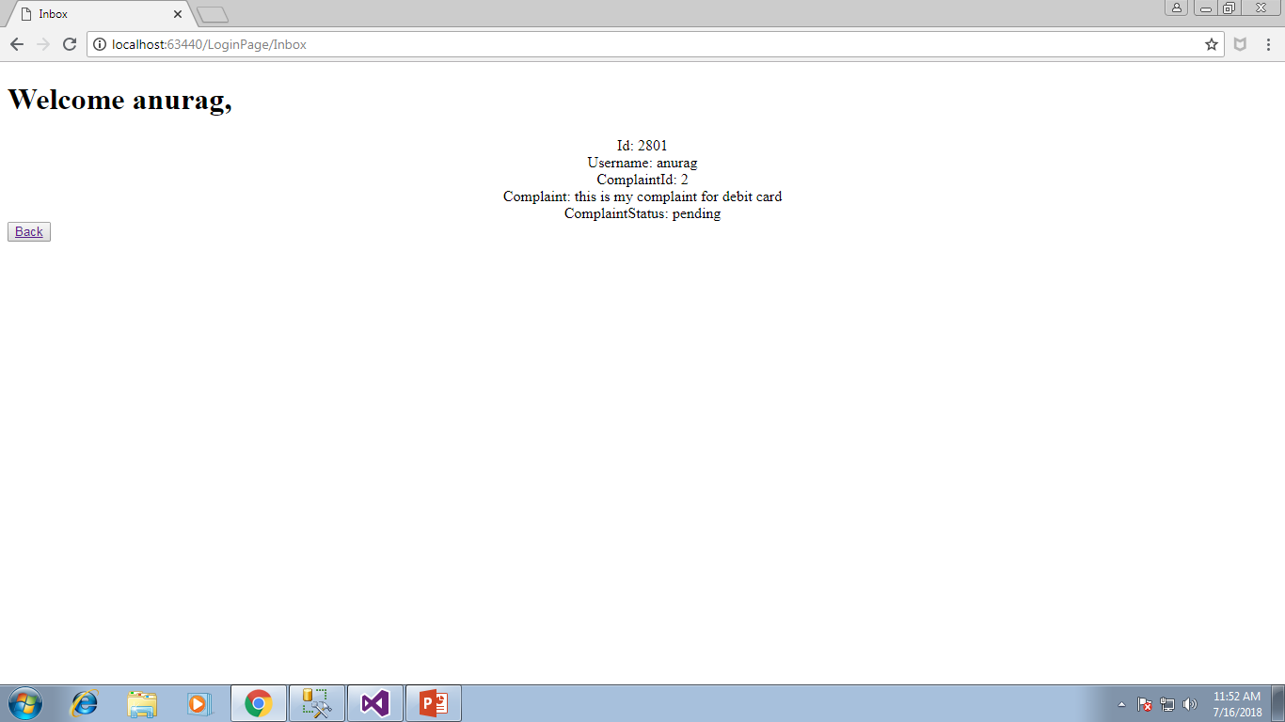
Customer Inbox

Slide 19
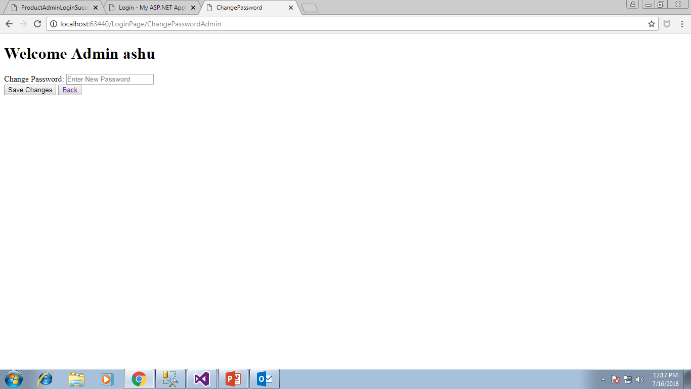
Change Password:

Slide 20
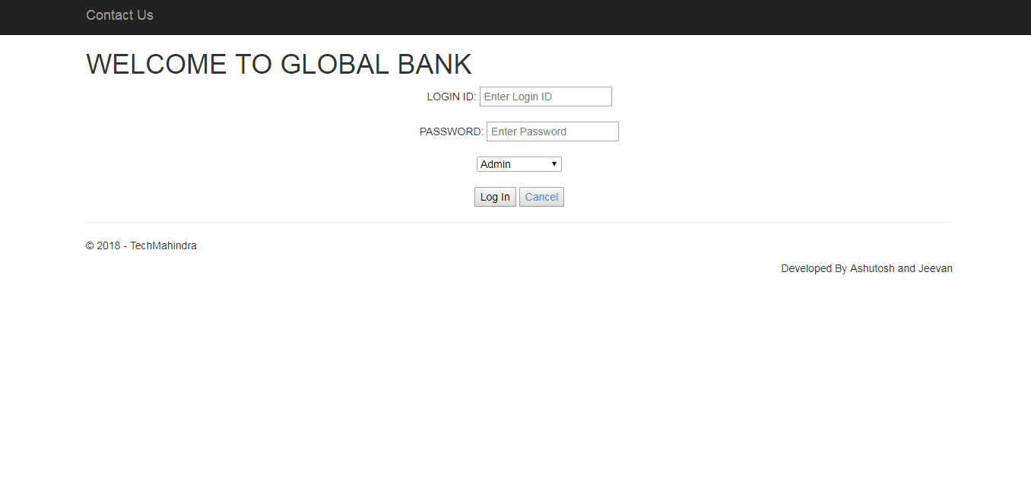
Sign Out:

Slide 21
THANK YOU

