Slide 1

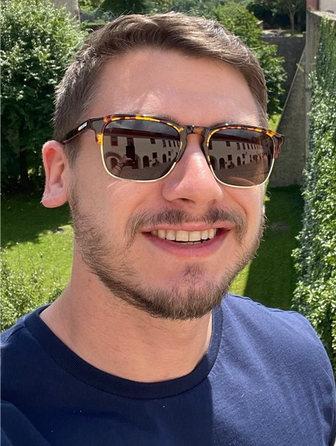
Malware involvement at Battlefields
Ashu Sharma
Ryan Estes

Slide 2
Agenda
Introduction
Why Virtual war?
Virtual War strategy with an example
Threats
Timeline of various attacks executed in War
Major Malware involved
Risk and Losses
Detective measures
Recommendations
Q&A

Slide 3
Introduction

Slide 4
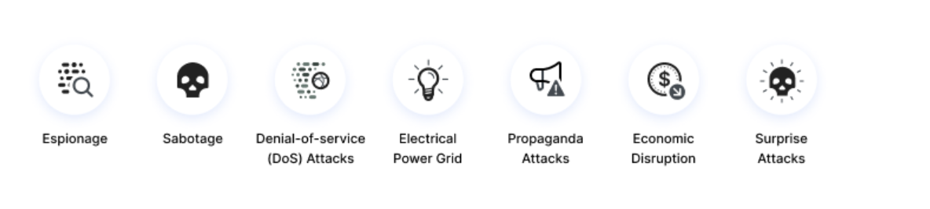
Why Virtual war?
#https//www.imperva.com/learn/application-security/cyber-warfare/#~text=Cyber%20warfare%20is%20usually%20defined,and%20even%20loss%20of%20life.

Slide 5
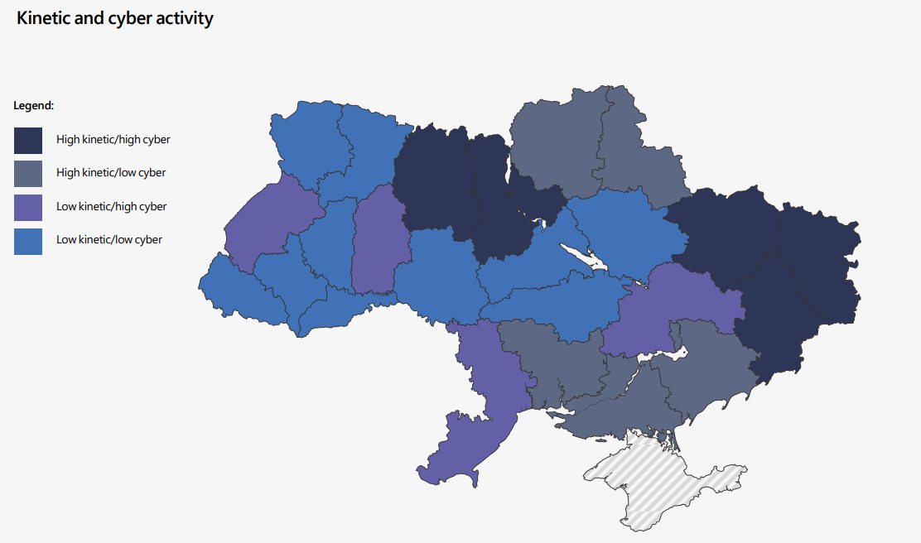
Why Virtual war?
https//query.prod.cms.rt.microsoft.com/cms/api/am/binary/RE4Vwwd

Slide 6
How it started
Stuxnet
We are safe
Unexpected Attack Vectors
Delay is detections

Slide 7
Timeline of various attacks executed in War

Slide 8
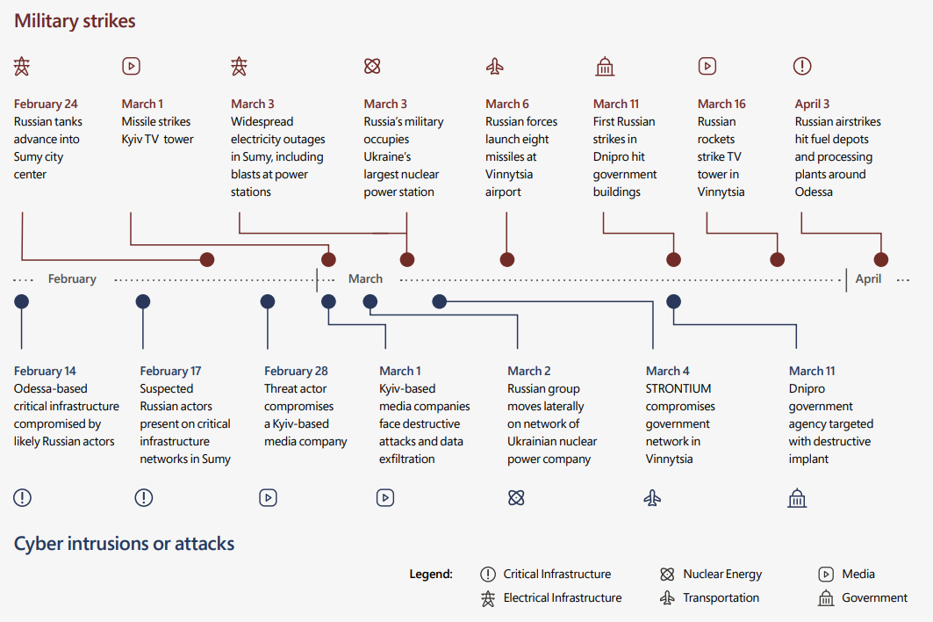
How it become now
https//query.prod.cms.rt.microsoft.com/cms/api/am/binary/RE4Vwwd

Slide 9
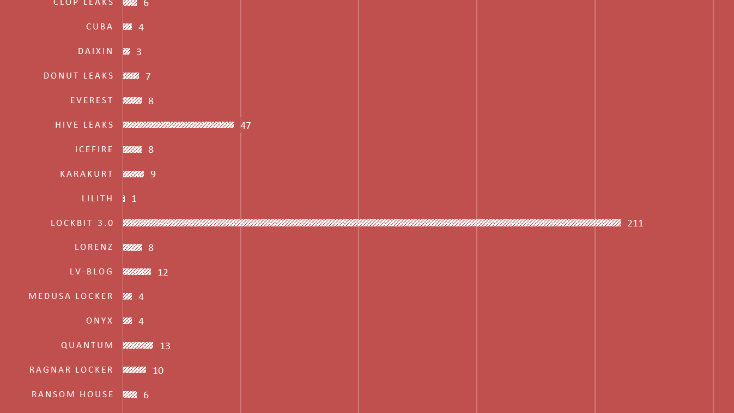

Slide 10
Detective measures

Slide 11
Defence techniques
_Wiper_WhisperGate_Jan22_1 {
meta:
description = "Detects unknown wiper malware"
author = "Florian Roth"
reference = "https://www.microsoft.com/security/blog/2022/01/15/destructive-malware-targeting-ukrainian-organizations/"
date = "2022-01-16"
score = 85
hash1 = "a196c6b8ffcb97ffb276d04f354696e2391311db3841ae16c8c9f56f36a38e92"
strings:
/* AAAAA\x00Your hard drive has been corrupted. */
$xc1 = { 41 41 41 41 41 00 59 6F 75 72 20 68 61 72 64 20
64 72 69 76 65 20 68 61 73 20 62 65 65 6E 20 63
6F 72 72 75 70 74 65 64 }
$op1 = { 89 34 24 e8 3f ff ff ff 50 8d 65 f4 31 c0 59 5e 5f }
$op2 = { 8d bd e8 df ff ff e8 04 de ff ff b9 00 08 00 00 f3 a5 c7 44 24 18 00 00 00 00 c7 44 24 14 00 00 00 00 c7 44 24 10 03 00 00 00 c7 44 24 0c 00 00 00 00 }
$op3 = { c7 44 24 0c 00 00 00 00 c7 44 24 08 00 02 00 00 89 44 24 04 e8 aa fe ff ff 83 ec 14 89 34 24 e8 3f ff ff ff 50 }
condition:
uint16(0) == 0x5a4d and
filesize < 100KB and ( 1 of ($x*) or 2 of them ) or all of them
} rule APT_HKTL

Slide 12
Recomendations

Slide 13
Recommendations
Minimize credential theft and account abuse
Secure internet-facing systems and remote access solutions
Leverage anti-malware, endpoint detection, and identity protection solutions
Enable investigations and recovery
Defend against destructive attacks
Review and implement “best practices” for defense in depth
https//query.prod.cms.rt.microsoft.com/cms/api/am/binary/RE4Vwwd

Slide 14
Thank you!

