Slide 1

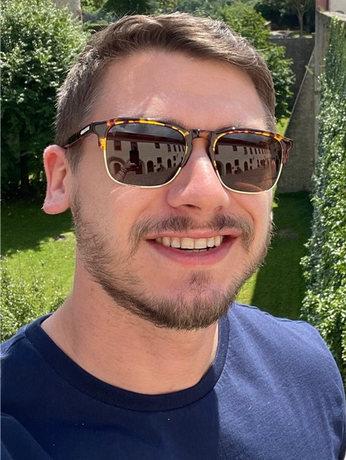
Malware involvement at Battlefields
Ashu Sharma
Ryan Estes

Slide 2
Agenda
Introduction
How It Started
Wat is Virtual war?
Threats
A New battlefield
Timeline of Russian and Ukraine War
Major Malware involved
Risk and Losses
Detective measures
Recommendations
Threat Hunting Directions
Q&A

Slide 3
Introduction

Slide 4
How new era of warfare started
A customer in Iran reported arbitrary BSODs and computer reboots and Responded with a Windows OS misconfiguration.
Observed persistence.
58% of devices in Iran were infected and Nobody knew what this code was intended to do.
Highly skilled hackers used Zero-day vulnerabilities.
Notes:
The Man Who Found Stuxnet – Sergey Ulasen
Blue screen of death
#https://www.youtube.com/watch?v=U_7CGl6VWaQ
#https://eugene.kaspersky.com/2011/11/02/the-man-who-found-stuxnet-sergey-ulasen-in-the-spotlight/
#https://www.wilderssecurity.com/threads/rootkit-tmphider.276994/#post-1712134

Slide 5
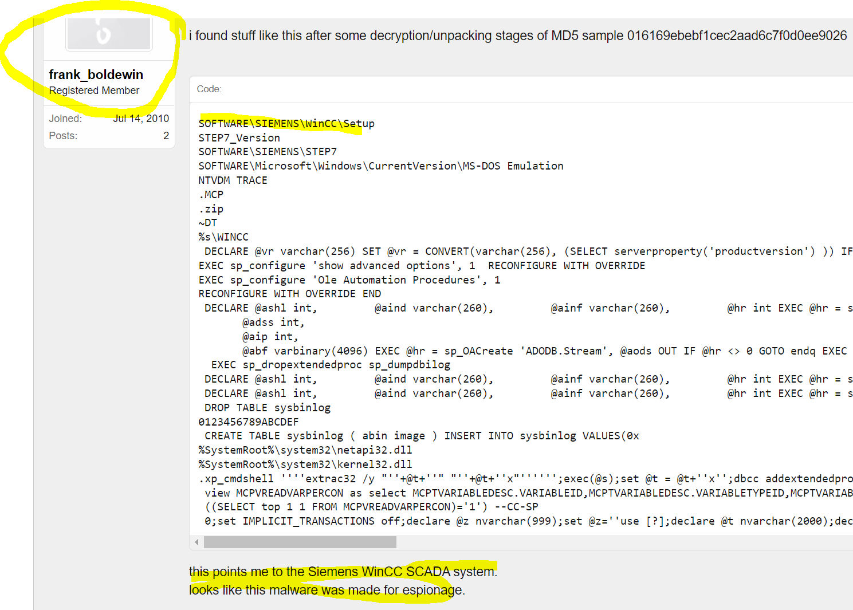
How new era of warfare started

Slide 6
How new era of warfare started
The Stuxnet drivers were signed with genuine digital certificates from respected companies.
Said; It was a third option.
And then Estates comes in business.
Detections were delayed.
Pay Exploit hackers; buy exploits and keep zero days.
Notes:
The Man Who Found Stuxnet – Sergey Ulasen

Slide 7
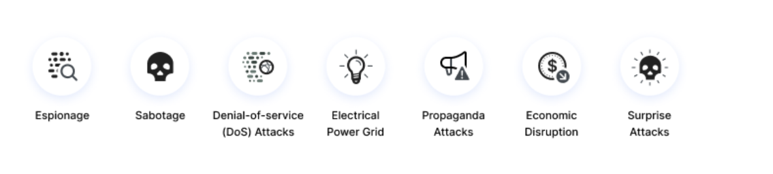
Why Virtual war?
#https//www.imperva.com/learn/application-security/cyber-warfare/#~text=Cyber%20warfare%20is%20usually%20defined,and%20even%20loss%20of%20life.

Slide 8
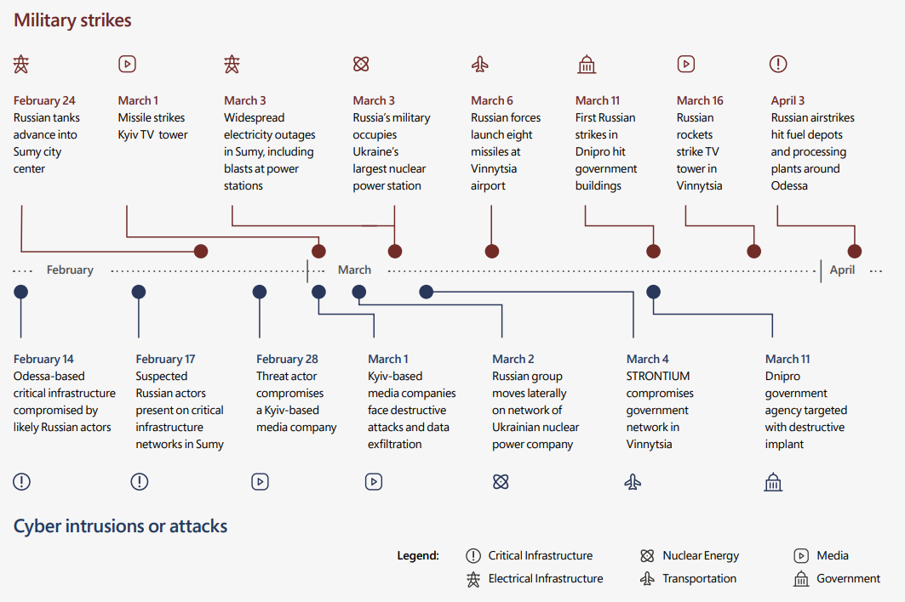
How it become now
https//query.prod.cms.rt.microsoft.com/cms/api/am/binary/RE4Vwwd

Slide 9
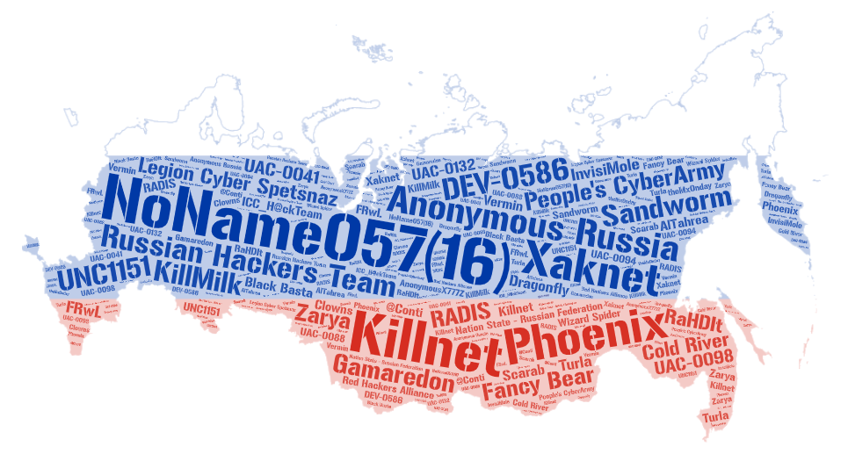
Threats
Allegiance to Russia
Name | Type | Country | Attacks
NoName057(16) | Collective | Russia | 171
Anonymous Russia | Nation State | Russia | 100
Killnet | Collective | Russia | 85
People's CyberArmy | Collective | Russia | 64
Russian Hackers Team | Collective | Unknown | 19
Phoenix | Collective | Russia | 18
Sandworm | Nation State | Russia | 16
Xaknet | Individual | Russia | 14
DEV-0586 | Collective | Russia | 10
Legion Cyber Spetsnaz | Collective | Russia | 8
Fancy Bear | Collective | Russia | 8
UNC1151 | Collective | Belarus | 7
Gamaredon | Collective | Russia | 6
Nation State - Russian Federation | Collective | Russia | 5
Cold River | Collective | Russia | 3
KillMilk | Collective | Russia | 3
RADIS | Cybercriminal | Unknown | 3
UAC-0098 | Unknown | Russia | 2
UAC-0041 | Collective | Russia | 2
Zarya | Collective | Russia | 2
ICC_H@ckTeam | Collective | Russia | 2
Many more … | Collective | … | …

Slide 10
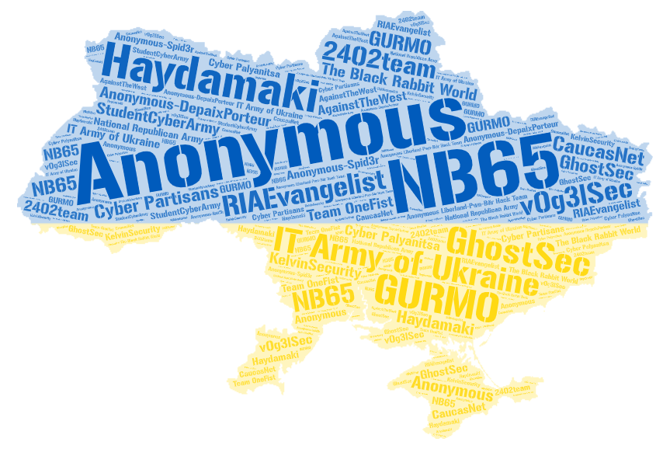
Threats
Allegiance to Ukraine
Name | Type | Country | Attacks
Anonymous | Collective | Unknown | 55
IT Army of Ukraine | Nation State | Ukraine | 39
NB65 | Collective | Unknown | 9
Haydamaki | Collective | Ukraine | 9
GhostSec | Collective | USA | 4
Anonymous-DepaixPorteur | Collective | Unknown | 3
GURMO | Nation State | Ukraine | 2
RIAEvangelist | Individual | USA | 2
The Black Rabbit World | Collective | Unknown | 2
StudentCyberArmy | Collective | Ukraine | 2
v0g3lSec | Collective | Unknown | 2
Cyber Partisans | Collective | Belarus | 2
2402team | Collective | Unknown | 1
Cyber Palyanitsa | Collective | Ukraine | 1
National Republican Army | Collective | Russia | 1
AgainstTheWest | Collective | Unknown | 1
KelvinSecurity | Cybercriminal | Unknown | 1
CaucasNet | Unknown | Unknown | 1
Team OneFist | Collective | Ukraine | 1
Anonymous-Spid3r | Collective | Unknown | 1
Anonymous Liberland-Pwn-Bär Hack Team | Collective | Unknown | 1

Slide 11
Timeline of various attacks executed in War

Slide 12
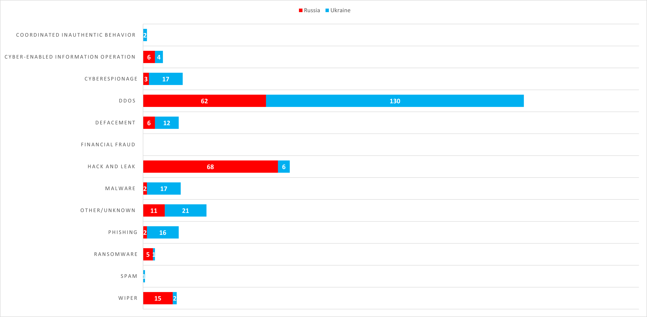
Types of attacks used in the War-time

Slide 13
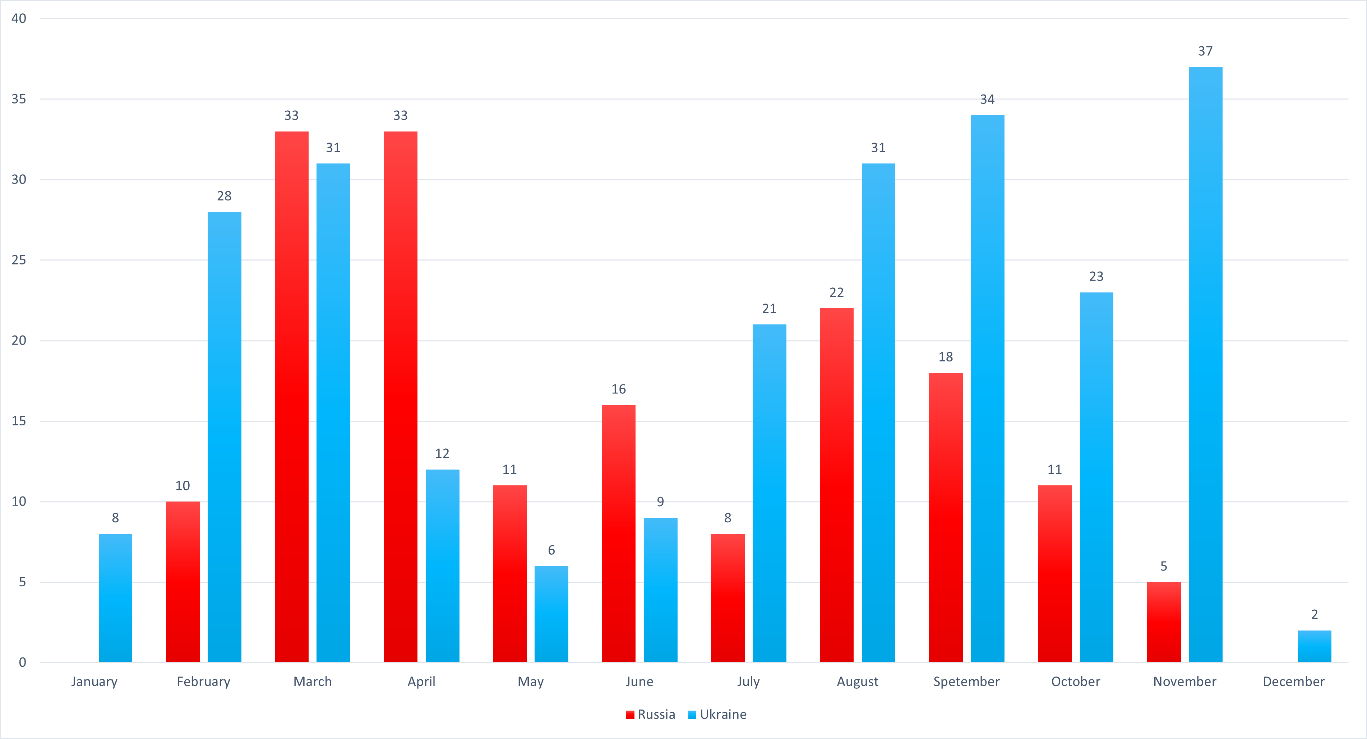
Reported Incidents

Slide 14
Major Malware involved
1-12-2022 – WhisperGate / Whisperkill By: Russia
Victim: Ukraine
Type: Wiper
Targets: Government, ICT, and non-profits
Purpose: Destruction
Impact: WhisperGate wiper was found on some of the IT company's systems and had overwritten the master boot records on those machines. The company took the systems down to rebuild from scratch.
Confidence: Probable
Threat Actor: Dev-0586
References: Recorded Future, Zero Day, Microsoft
1-13-2022 – WhisperGate / Whisperkill By: Russia
Victim: Ukraine
Type: Defacement
Targets: ICT
Purpose: Disruption
Impact: On January 14, 2022, Orthodox New Year, over 70 Ukrainian government websites were defaced with political imagery and a statement in Russian, Ukrainian, and Polish before going down temporarily. Most sites were restored within hours. The attack crippled much of the government’s public-facing digital infrastructure, including the most widely used site for handling government services online, Diia. Diia also has a role in Ukraine’s coronavirus response and in encouraging vaccination. It also crippled the sites of the Cabinet of Ministers and the ministries of energy, sports, agriculture, veterans’ affairs, and ecology. The Ukrainian company Kitsoft also confirmed that it found the WhisperGate malware on some of its systems. At least 50 of the 70 sites targeted for defacement were developed and maintained by Kitsoft. Kitsoft was compromised, which allowed the hackers to gain access to Kitsoft’s administrator panel and use the company’s credentials to deface customer websites. The purpose of such attacks is reportedly: to destabilize the internal situation in the country. - to spread chaos and despair in society.
Confidence: Confirmed
Threat Actor: UNC1151
References: Ukraine Center for Strategic Communications, New York Times, BBC, Zero Day

Slide 15
Major Malware involved
2-22-2022 – HermeticWiper / FoxBlade By: Russia
Victim: Ukraine
Type: Wiper
Targets: Government, ICT, Financial, and Energy
Purpose: Destruction
Impact: Hundreds of systems spanning multiple government, information technology, financial sector, and energy organizations were impacted.
Confidence: Confirmed
Threat Actor: Sandworm
References: Wall Street Journal, SC Media, Microsoft(2), Broadcom, Microsoft(1), ESET WeLiveSecurity
2-23-2022 – AcidRain By: Russia
Victim: Ukraine
Type: Wiper
Targets: ICT
Purpose: Destruction
Impact: Internet access offline for more than 2 weeks. - Nearly 9,000 subscribers of a satellite internet service provider were deprived of the internet in France. - Around a third of 40,000 subscribers of another satellite internet service provider in Europe (Germany, France, Hungary, Greece, Italy, Poland) were affected. - A major German energy company has lost remote monitoring access to over 5,800 wind turbines. - Impacted several thousand customers located in Ukraine and tens of thousands of other fixed broadband customers across Europe.
Confidence: Confirmed
Threat Actor: Nation State - Russian Federation
References: The Record, SecurityWeek, France24, The Stack, REVERSEMODE, Viasat, SentinelLabs, Council of the EU, Reuters, Washingtonpost

Slide 16
Major Malware involved
2-23-2022 – IsaacWiper By: Russia
Victim: Ukraine
Type: Wiper
Targets: Government
Purpose: Destruction
Impact: ESET identified a further wiper in Ukrainian government networks, affecting organizations that had not been attacked by HermeticWiper and does not share any code similarity with it. On February 25, the attackers dropped a new version of IsaacWiper with debug logs, indicating that the attackers were unable to wipe some of the compromised machines. The malware was developed/employed at least since October 19, 2021.
Confidence: Confirmed
Threat Actor: Sandworm
References: ESET WeLiveSecurity

Slide 17
Major Malware involved
2-24-2022 – Official Invasion of Ukraine
2-28-2022 – DesertBlade By: Russia
Victim: Ukraine
Type: Wiper
Targets: Media
Purpose: Disruption
Impact: Suspected Russian threat actor launched "DesertBlade" malware against a major broadcasting company on March 1, the same day that the Russian military announced its intention to destroy “disinformation” targets in Ukraine and directed a missile strike against a TV tower in Kyiv. The intent was the loss of access to a key source of information for the Ukrainian public.
Confidence: Probable
Threat Actor: Unknown
References: Microsoft
3-13-2022 – CaddyWiper By: Russia
Victim: Ukraine
Type: Wiper
Targets: Unknown
Purpose: Destruction
Impact: ESET researchers have uncovered yet another destructive data wiper that was used in attacks against a limited number of organizations in Ukraine. No code similarities to either HermeticWiper or IsaacWiper were identified. There’s evidence to suggest that the threat actors behind CaddyWiper infiltrated the target’s network before executing the wiper.
Confidence: Confirmed
Threat Actor: Sandworm
References: ESET, Bleeping Computer

Slide 18
Major Malware involved
3-14-2022 – CaddyWiper Deployment of CaddyWiper against a Ukrainian bank
3-16-2022 – DoubleZero By: Russia
Victim: Ukraine
Type: Wiper
Targets: Unknown
Purpose: Destruction
Impact: On March 17, CERT-UA discovered several ZIP archives of a destructive malware dubbed “DoubleZero.” The activity is tracked by the UAC-0088 identifier and is directly related to attempts to violate the regular mode of operation of information systems of Ukrainian enterprises.
Confidence: Confirmed
Threat Actor: UAC-0088
References: CERT-UA, SOC Prime
4-1-2022 – CaddyWiper Deployment of CaddyWiper against a Ukrainian governmental entity
4-8-2022 – CaddyWiper Deployment of CaddyWiper on some Windows machines and of Linux and Solaris destructive malware at the energy provider
All malware below was part of a single attack by Sandworm (Russian APT) on a Ukrainian energy system.
https://www.welivesecurity.com/2022/04/12/industroyer2-industroyer-reloaded/
-------------------------------------------------------------------------------------------------------------------------------

Slide 19
Major Malware involved
4-8-2022 – Industroyer2 The second iteration of Industroyer malware used to destroy and disrupt energy ICS systems
4-8-2022 – ORCSHRED Linux and Solaris wiper used with Industroyer2
4-8-2022 – AWFULSHRED Linux and Solaris wiper used with Industroyer2
4-8-2022 – SOLOSHRED Linux and Solaris wiper used with Industroyer2
4-8-2022 – CaddyWiper Deployment of CaddyWiper on some Windows machines and of Linux and Solaris destructive malware at the energy provider

Slide 20
Major Malware involved
10-11-2022 – Prestige Ransomware By: Russia
Victim: Ukraine
Type: Ransomware
Targets: Polish and Ukrainian logistics companies.
Purpose: Destruction
Impact: Unknown
Confidence: Very Likely
Threat Actor: IRIDIUM (Sandworm)
References: Microsoft
10-27-2022 – Azov Ransomware By: Russia
Victim: Ukraine
Type: Wiper
Targets: Unknown
Purpose: Destruction
Impact: Unknown
Confidence: Probable
Threat Actor: Unknown
References: Bleeping Computer
Azov Ransomware samples VirusTotal Query:
(behaviour:'Local\\\\Kasimir_*' OR behaviour:'Local\\\\azov') AND (behaviour_files:'RESTORE_FILES' OR behaviour_registry:'rdpclient.exe')
Over 17k samples of Azov submitted to VT since late October.

Slide 21
Major Malware involved
11-11-2022 – Somnia Ransomware By: Russia
Victim: Ukraine
Type: Pseudo-Ransomware (Wiper)
Targets: Unknown
Purpose: Destruction
Impact: Disruption of some systems.
Confidence: Confirmed
Threat Actor: FRwL
References: CERT-UA
11-25-2022 – RansomBoggs By: Russia
Victim: Ukraine
Type: Ransomware
Targets: Unknown
Purpose: Destruction
Impact: Unknown
Confidence: Probable
Threat Actor: Sandworm
References: ESET WeLiveSecurity, Twitter
Estonia is helping Ukraine combat and establish a cybersecurity posture. This may explain the reduction in cyber-attacks recently as seen by the monthly incident graph:
https://www.politico.com/news/2022/12/07/estonia-ukraine-cybersecurity-russian-hackers-00072925

Slide 22
Detective measures

Slide 23
Defence techniques
_import "pe"
rule ransomware_ZZ_azov_wiper {
meta:
description = "Detects original and backdoored files with new and old versions of azov ransomware - polymorphic wiper"
author = "Jiri Vinopal (jiriv)"
date = "2022-11-14"
hash_azov_new = "650f0d694c0928d88aeeed649cf629fc8a7bec604563bca716b1688227e0cc7e"
hash_azov_old = "b102ed1018de0b7faea37ca86f27ba3025c0c70f28417ac3e9ef09d32617f801"
strings:
// Opcodes of allocating and decrypting shellcode routine
$unpacking_azov_new = { 48 83 ec ?? 58 48 01 c8 48 81 ec ?? ?? ?? ?? 48 83 ec ?? 40 80 e4 ?? c6 45 ?? 56 c6 45 ?? 69 c6 45 ?? 72 c6 45 ?? 74 c6 45 ?? 75 c6 45 ?? 61 c6 45 ?? 6c c6 45 ?? 41 c6 45 ?? 6c c6 45 ?? 6c c6 45 ?? 6f c6 45 ?? 63 c6 45 ?? 00 48 89 74 24 ?? 48 83 ec ?? 48 83 c4 ?? 48 8b 4c 24 ?? 48 8d 55 ?? ff d0 48 83 ec ?? 48 c7 04 24 ?? ?? ?? ?? 48 83 c4 ?? 48 8b 4c 24 ?? 48 c7 c2 ?? ?? ?? ?? 49 c7 c0 ?? ?? ?? ?? 49 c7 c1 ?? ?? ?? ?? ff d0 48 c7 c1 ?? ?? ?? ?? 4c 8d 0d ?? ?? ?? ?? 48 ff c9 41 8a 14 09 88 14 08 48 85 c9 75 ?? 48 c7 c1 ?? ?? ?? ?? 41 b9 ?? ?? ?? ?? 41 ba ?? ?? ?? ?? 48 ff c9 8a 14 08 44 30 ca 88 14 08 41 81 ea ?? ?? ?? ?? 45 01 d1 41 81 c1 ?? ?? ?? ?? 41 81 c2 ?? ?? ?? ?? 41 d1 c1 48 85 c9 }
$unpacking_azov_old = { 48 01 c8 48 05 ?? ?? ?? ?? 48 81 c1 ?? ?? ?? ?? 48 81 ec ?? ?? ?? ?? 48 83 ec ?? 40 80 e4 ?? c6 45 ?? 56 c6 45 ?? 69 c6 45 ?? 72 c6 45 ?? 74 c6 45 ?? 75 c6 45 ?? 61 c6 45 ?? 6c c6 45 ?? 41 c6 45 ?? 6c c6 45 ?? 6c c6 45 ?? 6f c6 45 ?? 63 c6 45 ?? 00 48 83 e1 ?? 48 01 f1 48 8d 55 ?? ff d0 48 83 ec ?? 48 c7 04 24 ?? ?? ?? ?? 48 83 c4 ?? 48 8b 4c 24 ?? 48 c7 c2 ?? ?? ?? ?? 49 c7 c0 ?? ?? ?? ?? 49 c7 c1 ?? ?? ?? ?? ff d0 48 c7 c1 ?? ?? ?? ?? 4c 8d 0d ?? ?? ?? ?? 48 ff c9 41 8a 14 09 88 14 08 48 85 c9 }
condition:
uint16(0) == 0x5a4d and pe.is_64bit() and any of ($unpacking_azov_*)
}

Slide 24
Recomendations

Slide 25
Threat Hunting
VirusTotal query – Azov-related samples
(behaviour:'Local\\\\Kasimir_*’
OR behaviour:'Local\\\\azov’)
AND
(behaviour_files:'RESTORE_FILES’
OR behaviour_registry:'rdpclient.exe’)
AND
detectiteasy:"Compiler: FASM*"
https//query.prod.cms.rt.microsoft.com/cms/api/am/binary/RE4Vwwd

Slide 26
Thank you!

