Slide 1

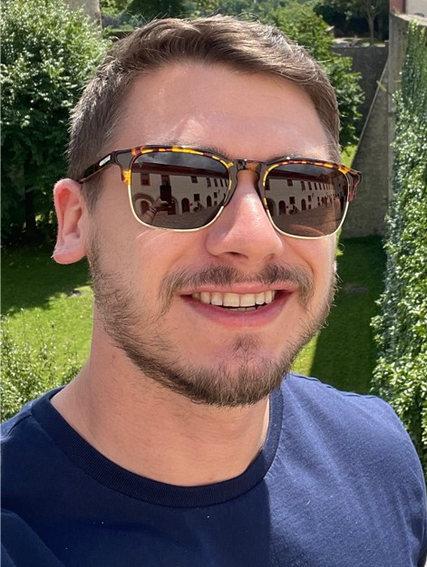
Malware involvement at Battlefields
Ashu Sharma
Ryan Estes

Slide 2
Agenda
Introduction
How It Started
Wat is Virtual war?
Threats
A New battlefield
Timeline of Russian and Ukraine War
Major Malware involved
Risk and Losses
Timeline of Russian and Ukraine War
Detective measures
Yara Rules
Recommendations
Threat Hunting Directions; Virus total queries
IOC’s
Dark Webs directions
Threat Actors
References
Q&A

Slide 3
Introduction

Slide 4
How new era of warfare started
A customer in Iran reported arbitrary BSODs and computer reboots and Responded with a Windows OS misconfiguration.
Observed persistence.
58% of devices in Iran were infected and Nobody knew what this code was intended to do.
Highly skilled hackers used Zero-day vulnerabilities.
Notes:
The Man Who Found Stuxnet – Sergey Ulasen
Blue screen of death
#https://www.youtube.com/watch?v=U_7CGl6VWaQ
#https://eugene.kaspersky.com/2011/11/02/the-man-who-found-stuxnet-sergey-ulasen-in-the-spotlight/
#https://www.wilderssecurity.com/threads/rootkit-tmphider.276994/#post-1712134

Slide 5
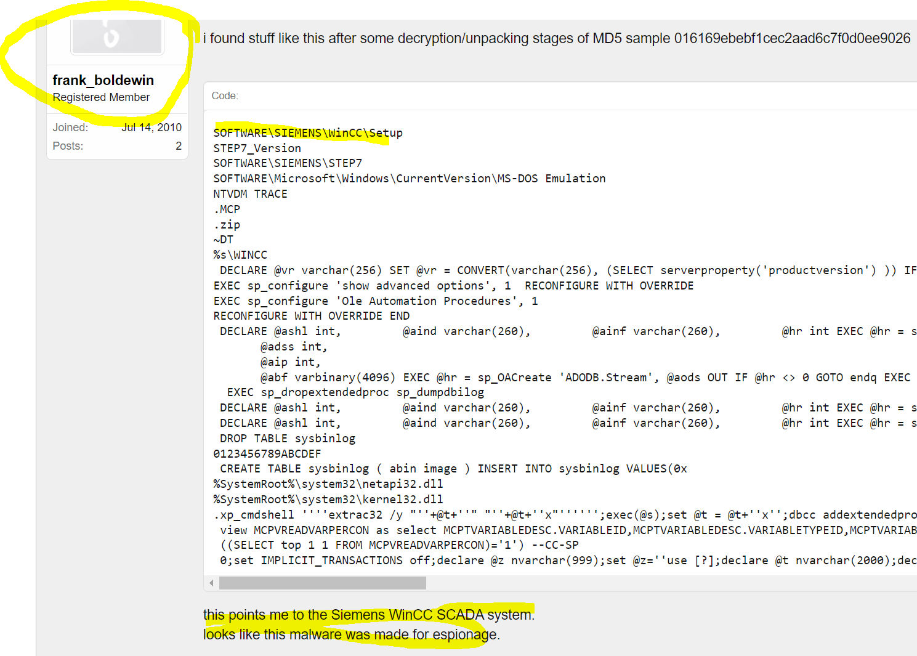
How new era of warfare started

Slide 6
How new era of warfare started
The Stuxnet drivers were signed with genuine digital certificates from respected companies.
Said; It was a third option.
And then Estates comes in business.
Detections were delayed.
Pay Exploit hackers; buy exploits and keep zero days.
Notes:
The Man Who Found Stuxnet – Sergey Ulasen

Slide 7
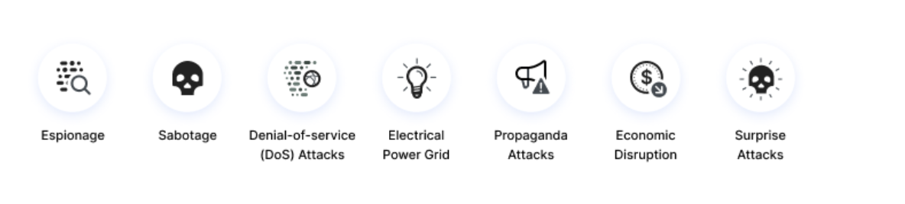
Why Virtual war?
#https//www.imperva.com/learn/application-security/cyber-warfare/#~text=Cyber%20warfare%20is%20usually%20defined,and%20even%20loss%20of%20life.

Slide 8
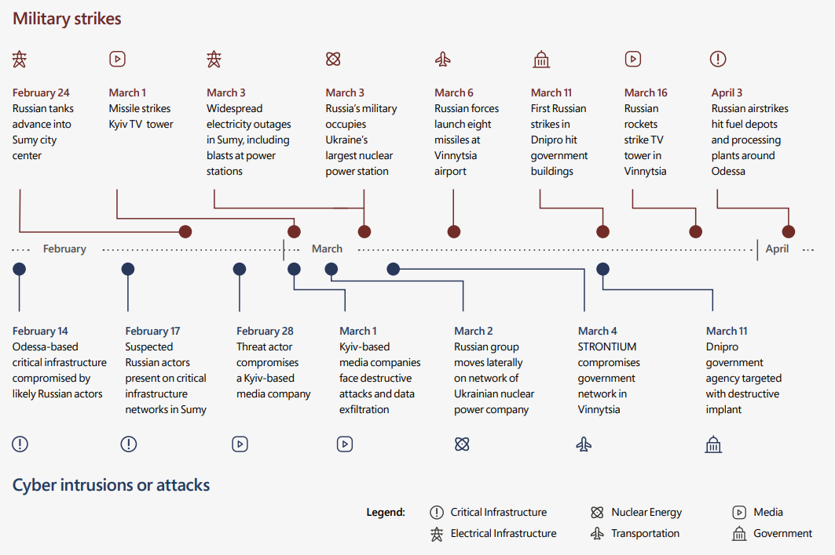
How it become now
https//query.prod.cms.rt.microsoft.com/cms/api/am/binary/RE4Vwwd

Slide 9
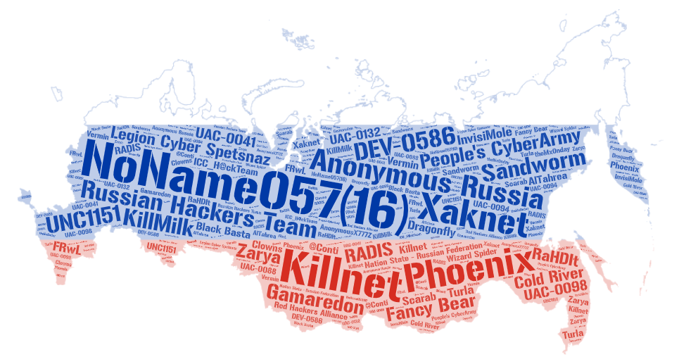
Threats
Allegiance to Russia
Name | Type | Country | Attacks
NoName057(16) | Collective | Russia | 171
Anonymous Russia | Nation State | Russia | 100
Killnet | Collective | Russia | 85
People's CyberArmy | Collective | Russia | 64
Russian Hackers Team | Collective | Unknown | 19
Phoenix | Collective | Russia | 18
Sandworm | Nation State | Russia | 16
Xaknet | Individual | Russia | 14
DEV-0586 | Collective | Russia | 10
Legion Cyber Spetsnaz | Collective | Russia | 8
Fancy Bear | Collective | Russia | 8
UNC1151 | Collective | Belarus | 7
Gamaredon | Collective | Russia | 6
Nation State - Russian Federation | Collective | Russia | 5
Cold River | Collective | Russia | 3
KillMilk | Collective | Russia | 3
RADIS | Cybercriminal | Unknown | 3
UAC-0098 | Unknown | Russia | 2
UAC-0041 | Collective | Russia | 2
Zarya | Collective | Russia | 2
ICC_H@ckTeam | Collective | Russia | 2
Many more … | Collective | … | …

Slide 10
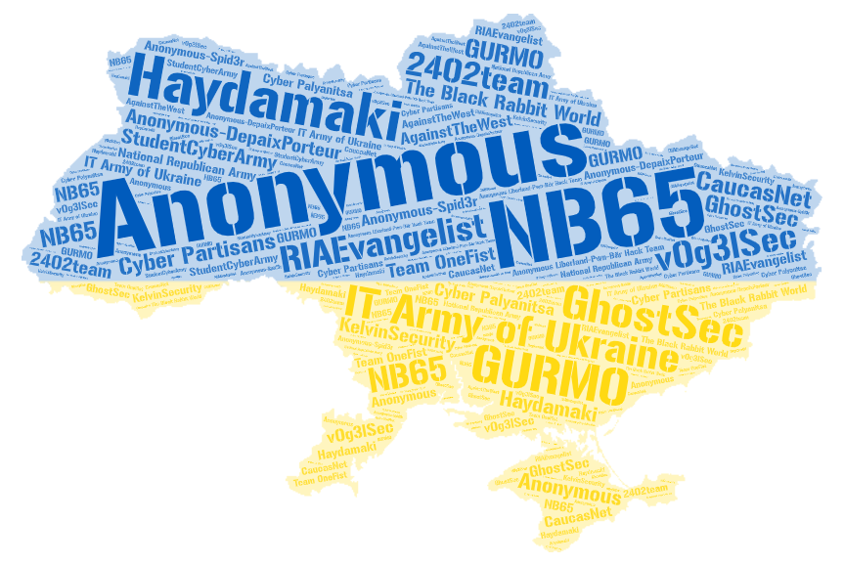
Threats
Allegiance to Ukraine
Name | Type | Country | Attacks
Anonymous | Collective | Unknown | 55
IT Army of Ukraine | Nation State | Ukraine | 39
NB65 | Collective | Unknown | 9
Haydamaki | Collective | Ukraine | 9
GhostSec | Collective | USA | 4
Anonymous-DepaixPorteur | Collective | Unknown | 3
GURMO | Nation State | Ukraine | 2
RIAEvangelist | Individual | USA | 2
The Black Rabbit World | Collective | Unknown | 2
StudentCyberArmy | Collective | Ukraine | 2
v0g3lSec | Collective | Unknown | 2
Cyber Partisans | Collective | Belarus | 2
2402team | Collective | Unknown | 1
Cyber Palyanitsa | Collective | Ukraine | 1
National Republican Army | Collective | Russia | 1
AgainstTheWest | Collective | Unknown | 1
KelvinSecurity | Cybercriminal | Unknown | 1
CaucasNet | Unknown | Unknown | 1
Team OneFist | Collective | Ukraine | 1
Anonymous-Spid3r | Collective | Unknown | 1
Anonymous Liberland-Pwn-Bär Hack Team | Collective | Unknown | 1

Slide 11
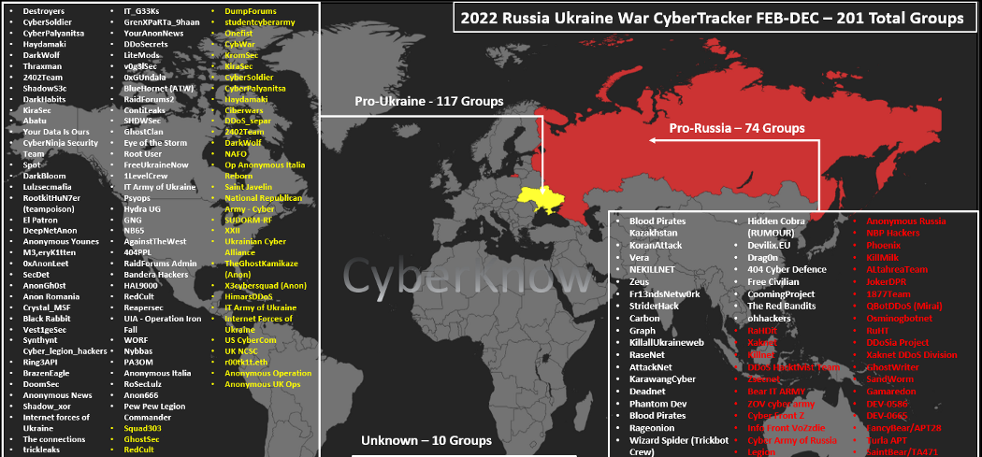
Threats

Slide 12
Timeline of various attacks executed in War

Slide 13
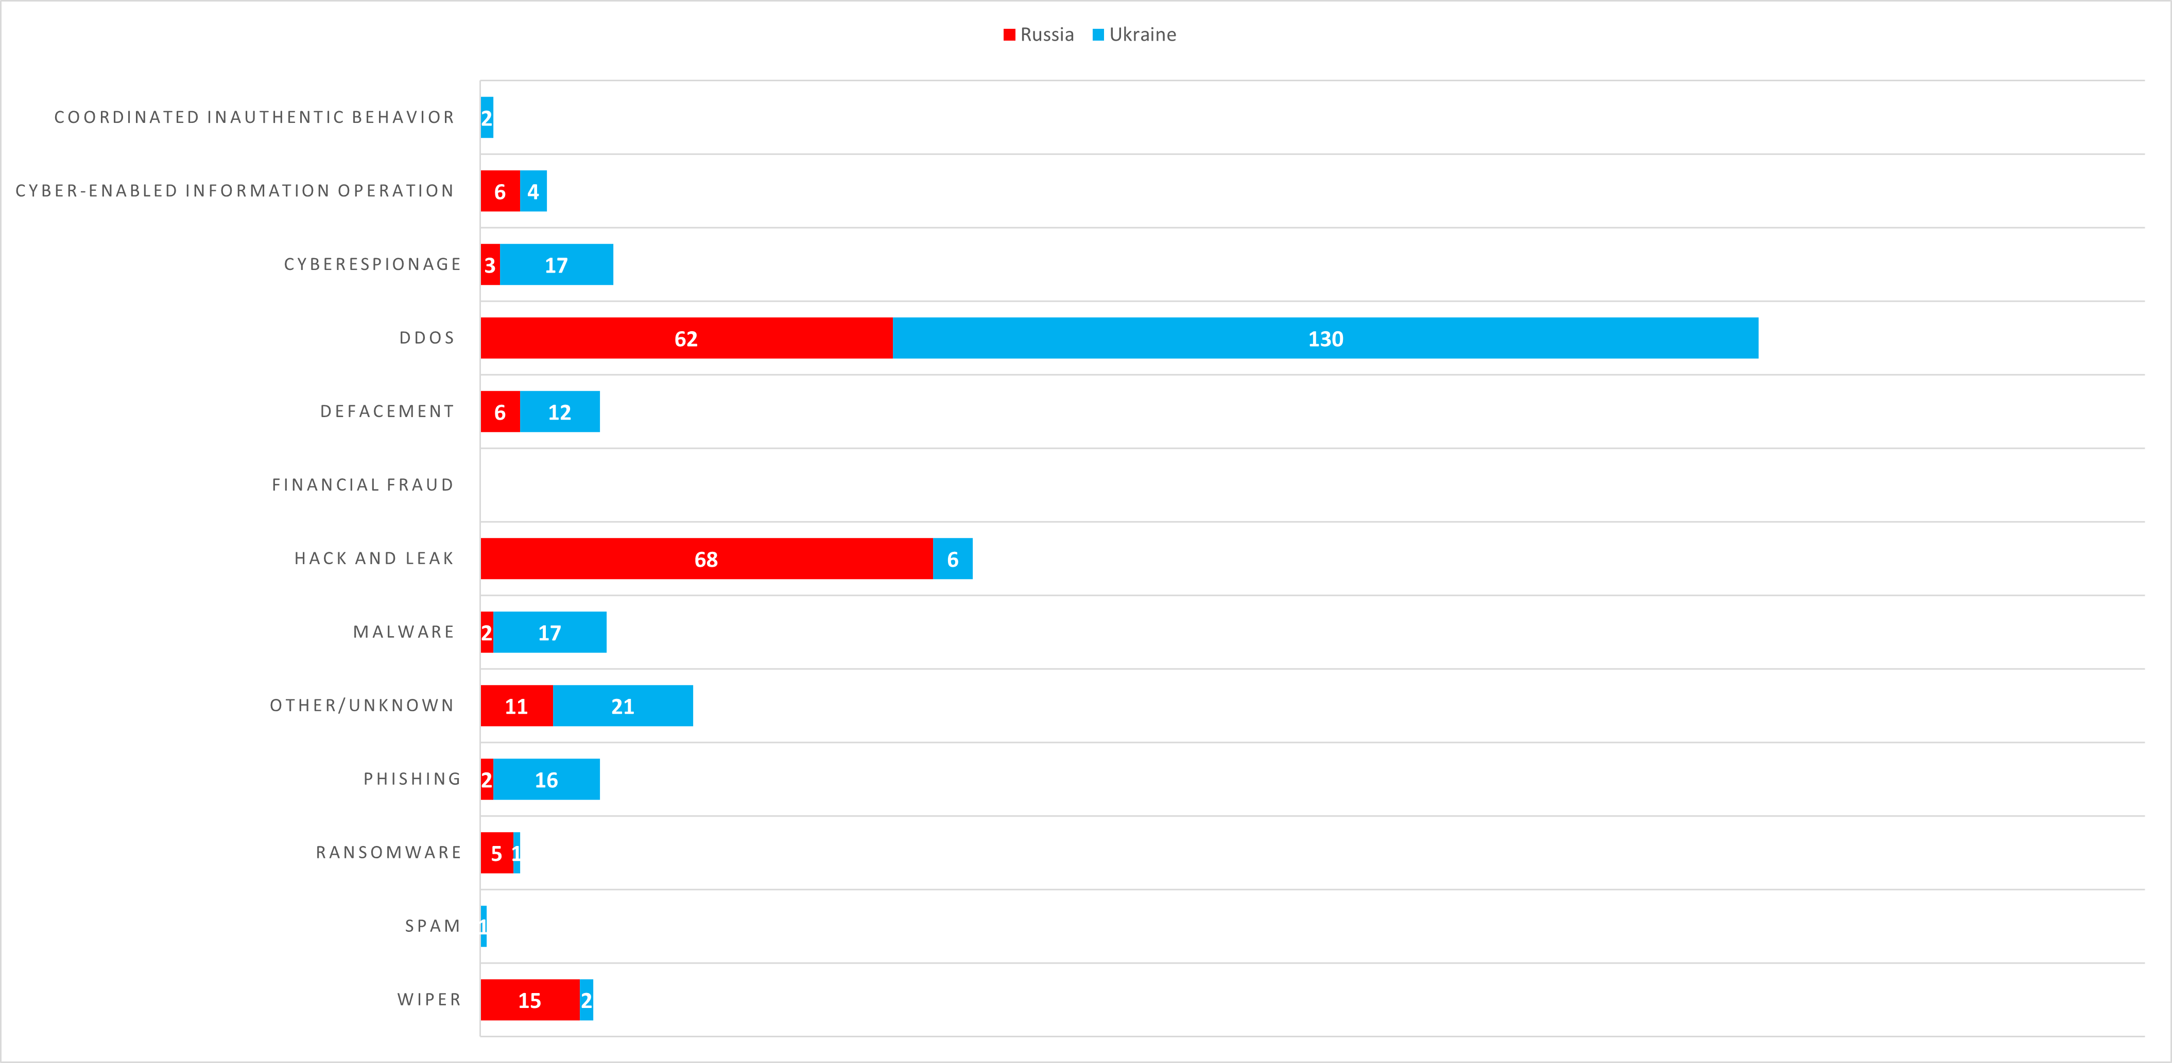
Types of attacks used in the War-time

Slide 14
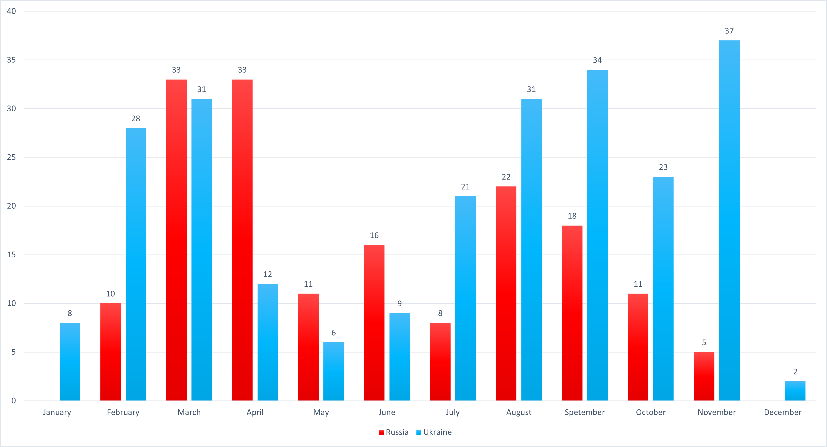
Reported Incidents

Slide 15
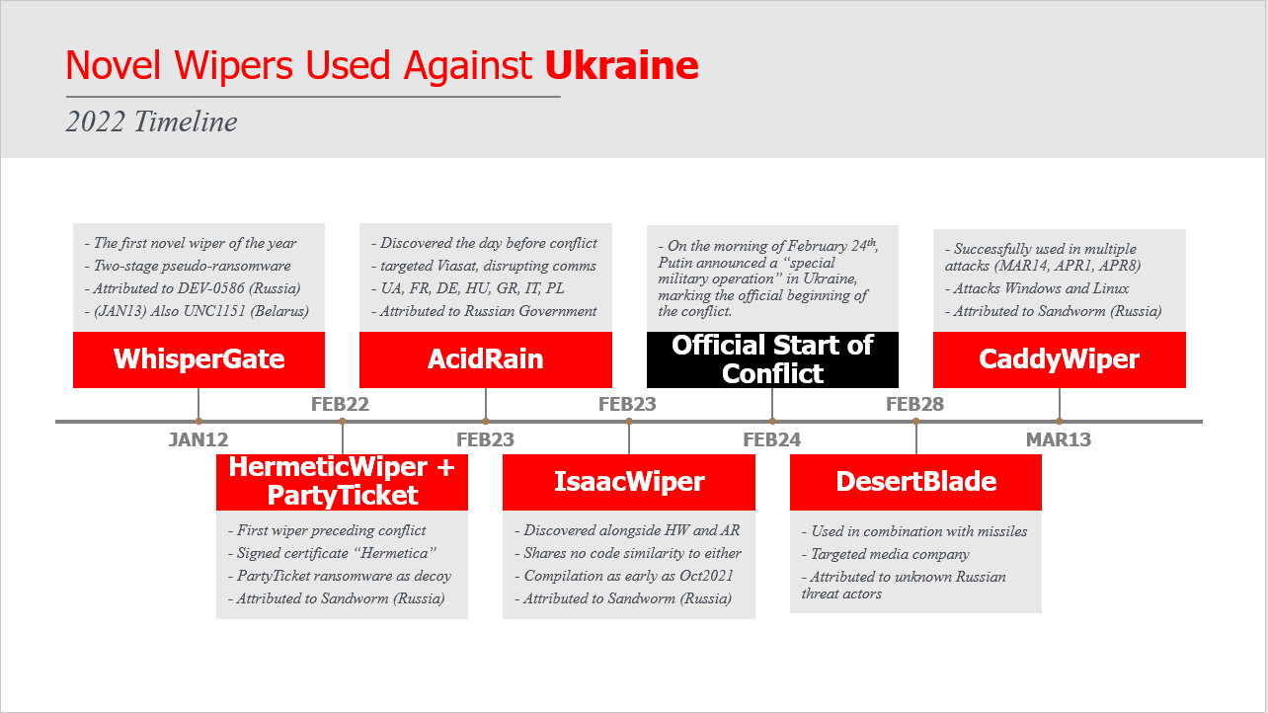

Slide 16
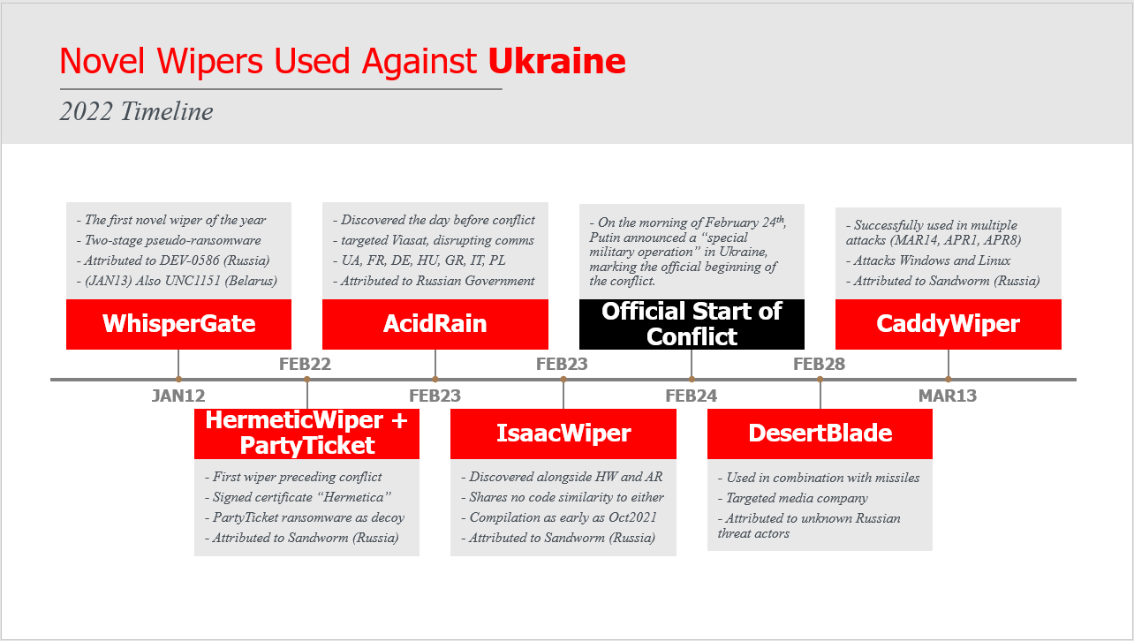

Slide 17
Consequences
Most strategically impactful cyber operation in wartime history.
Ability to paralyze Ukrainian decision-making and critical infrastructure
Signs of coordination between Russian kinetic and cyber operations
Cyber operations intended to disrupt, destroy, or manipulate data or systems.

Slide 18
Learning for us
Ukrainian President Volodymyr Zelensky accused Russia of ‘energy terrorism’ and said that about 4.5 million Ukrainian consumers were temporarily disconnected from the power supply.
Also referred to the water shortages.
includes a hack, which the White House blamed on the Kremlin, that disrupted satellite internet communications in Ukraine on the eve of Russia’s invasion.
2017;NotPetya that wiped computer systems at companies across Ukraine before spreading around the world; The incident cost the global economy billions of dollars by disrupting shipping giant Maersk and other multinational firms.
Groups are working right now on some high-complexity attacks that we will observe later on.

Slide 19
Detective measures

Slide 20
Defence techniques
_import "pe"
rule ransomware_ZZ_azov_wiper {
meta:
description = "Detects original and backdoored files with new and old versions of azov ransomware - polymorphic wiper"
author = "Jiri Vinopal (jiriv)"
date = "2022-11-14"
hash_azov_new = "650f0d694c0928d88aeeed649cf629fc8a7bec604563bca716b1688227e0cc7e"
hash_azov_old = "b102ed1018de0b7faea37ca86f27ba3025c0c70f28417ac3e9ef09d32617f801"
strings:
// Opcodes of allocating and decrypting shellcode routine
$unpacking_azov_new = { 48 83 ec ?? 58 48 01 c8 48 81 ec ?? ?? ?? ?? 48 83 ec ?? 40 80 e4 ?? c6 45 ?? 56 c6 45 ?? 69 c6 45 ?? 72 c6 45 ?? 74 c6 45 ?? 75 c6 45 ?? 61 c6 45 ?? 6c c6 45 ?? 41 c6 45 ?? 6c c6 45 ?? 6c c6 45 ?? 6f c6 45 ?? 63 c6 45 ?? 00 48 89 74 24 ?? 48 83 ec ?? 48 83 c4 ?? 48 8b 4c 24 ?? 48 8d 55 ?? ff d0 48 83 ec ?? 48 c7 04 24 ?? ?? ?? ?? 48 83 c4 ?? 48 8b 4c 24 ?? 48 c7 c2 ?? ?? ?? ?? 49 c7 c0 ?? ?? ?? ?? 49 c7 c1 ?? ?? ?? ?? ff d0 48 c7 c1 ?? ?? ?? ?? 4c 8d 0d ?? ?? ?? ?? 48 ff c9 41 8a 14 09 88 14 08 48 85 c9 75 ?? 48 c7 c1 ?? ?? ?? ?? 41 b9 ?? ?? ?? ?? 41 ba ?? ?? ?? ?? 48 ff c9 8a 14 08 44 30 ca 88 14 08 41 81 ea ?? ?? ?? ?? 45 01 d1 41 81 c1 ?? ?? ?? ?? 41 81 c2 ?? ?? ?? ?? 41 d1 c1 48 85 c9 }
$unpacking_azov_old = { 48 01 c8 48 05 ?? ?? ?? ?? 48 81 c1 ?? ?? ?? ?? 48 81 ec ?? ?? ?? ?? 48 83 ec ?? 40 80 e4 ?? c6 45 ?? 56 c6 45 ?? 69 c6 45 ?? 72 c6 45 ?? 74 c6 45 ?? 75 c6 45 ?? 61 c6 45 ?? 6c c6 45 ?? 41 c6 45 ?? 6c c6 45 ?? 6c c6 45 ?? 6f c6 45 ?? 63 c6 45 ?? 00 48 83 e1 ?? 48 01 f1 48 8d 55 ?? ff d0 48 83 ec ?? 48 c7 04 24 ?? ?? ?? ?? 48 83 c4 ?? 48 8b 4c 24 ?? 48 c7 c2 ?? ?? ?? ?? 49 c7 c0 ?? ?? ?? ?? 49 c7 c1 ?? ?? ?? ?? ff d0 48 c7 c1 ?? ?? ?? ?? 4c 8d 0d ?? ?? ?? ?? 48 ff c9 41 8a 14 09 88 14 08 48 85 c9 }
condition:
uint16(0) == 0x5a4d and pe.is_64bit() and any of ($unpacking_azov_*)
}

Slide 21
Recomendations

Slide 22
Threat Hunting
VirusTotal query – Azov-related samples
(behaviour:'Local\\\\Kasimir_*’
OR behaviour:'Local\\\\azov’)
AND
(behaviour_files:'RESTORE_FILES’
OR behaviour_registry:'rdpclient.exe’)
AND
detectiteasy:"Compiler: FASM*"

Slide 23
IOC’s
DesertBlade: a196c6b8ffcb97ffb276d04f354696e2391311db3841ae16c8c9f56f36a38e92 dcbbae5a1c61dbbbb7dcd6dc5dd1eb1169f5329958d38b58c3fd9384081c9b78
RU_Ransom: 107da216ad99b7c0171745fe7f826e51b27b1812d435b55c3ddb801e23137d8f 1f36898228197ee30c7b0ec0e48e804caa6edec33e3a91eeaf7aa2c5bbb9c6e0 610ec163e7b34abd5587616db8dac7e34b1aef68d0260510854d6b3912fb0008 696b6b9f43e53387f7cef14c5da9b6c02b6bf4095849885d36479f8996e7e473 8f2ea18ed82085574888a03547a020b7009e05ae0ecbf4e9e0b8fe8502059aae 979f9d1e019d9172af73428a1b3cbdff8aec8fdbe0f67cba48971a36f5001da9
CaddyWiper: a294620543334a721a2ae8eaaf9680a0786f4b9a216d75b55cfd28f39e9430ea
DoubleZero: 3b2e708eaa4744c76a633391cf2c983f4a098b46436525619e5ea44e105355fe 30b3cbe8817ed75d8221059e4be35d5624bd6b5dc921d4991a7adc4c3eb5de4a
Prestige Ransomware: 5dd1ca0d471dee41eb3ea0b6ea117810f228354fc3b7b47400a812573d40d91d 5fc44c7342b84f50f24758e39c8848b2f0991e8817ef5465844f5f2ff6085a57 6cff0bbd62efe99f381e5cc0c4182b0fb7a9a34e4be9ce68ee6b0d0ea3eee39c
Azov Ransomware: b102ed1018de0b7faea37ca86f27ba3025c0c70f28417ac3e9ef09d32617f801 650f0d694c0928d88aeeed649cf629fc8a7bec604563bca716b1688227e0cc7e
Somnia Ransomware: 100c5e4d5b7e468f1f16b22c05b2ff1cfaa02eafa07447c7d83e2983e42647f0 ac5e68c15f5094cc6efb8d25e1b2eb13d1b38b104f31e1c76ce472537d715e08 156965227cbeeb0e387cb83adb93ccb3225f598136a43f7f60974591c12fafcf e449c28e658bafb7e32c89b07ddee36cadeddfc77f17dd1be801b134a6857aa9
RansomBoggs: F4D1C047923B9D10031BB709AABF1A250AB0AAA2 021308C361C8DE7C38EF135BC3B53439EB4DA0B4
WhisperGate: a196c6b8ffcb97ffb276d04f354696e2391311db3841ae16c8c9f56f36a38e92 44ffe353e01d6b894dc7ebe686791aa87fc9c7fd88535acc274f61c2cf74f5b8 dcbbae5a1c61dbbbb7dcd6dc5dd1eb1169f5329958d38b58c3fd9384081c9b78
HermeticWiper: 5a300f72e221a228e3a36a043bef878b570529a7abc15559513ea07ae280bb48 2d29f9ca1d9089ba0399661bb34ba2fd8aba117f04678cd71856d5894aa7150b a259e9b0acf375a8bef8dbc27a8a1996ee02a56889cba07ef58c49185ab033ec 1bc44eef75779e3ca1eefb8ff5a64807dbc942b1e4a2672d77b9f6928d292591 2c10b2ec0b995b88c27d141d6f7b14d6b8177c52818687e4ff8e6ecf53adf5bf 3c557727953a8f6b4788984464fb77741b821991acbf5e746aebdd02615b1767 0385eeab00e946a302b24a91dea4187c1210597b8e17cd9e2230450f5ece21da 06086c1da4590dcc7f1e10a6be3431e1166286a9e7761f2de9de79d7fda9c397 b6f2e008967c5527337448d768f2332d14b92de22a1279fd4d91000bb3d4a0fd fd7eacc2f87aceac865b0aa97a50503d44b799f27737e009f91f3c281233c17d b01e0c6ac0b8bcde145ab7b68cf246deea9402fa7ea3aede7105f7051fe240c1 e5f3ef69a534260e899a36cec459440dc572388defd8f1d98760d31c700f42d5 23ef301ddba39bb00f0819d2061c9c14d17dc30f780a945920a51bc3ba0198a4 2c7732da3dcfc82f60f063f2ec9fa09f9d38d5cfbe80c850ded44de43bdb666d 8c614cf476f871274aa06153224e8f7354bf5e23e6853358591bf35a381fb75b 96b77284744f8761c4f2558388e0aee2140618b484ff53fa8b222b340d2a9c84
PartyTicket Ransomware: 4dc13bb83a16d4ff9865a51b3e4d24112327c526c1392e14d56f20d6f4eaf382
AcidRain: 9b4dfaca873961174ba935fddaf696145afe7bbf5734509f95feb54f3584fd9a
IsaacWiper: 13037b749aa4b1eda538fda26d6ac41c8f7b1d02d83f47b0d187dd645154e033 7bcd4ec18fc4a56db30e0aaebd44e2988f98f7b5d8c14f6689f650b4f11e16c0 abf9adf2c2c21c1e8bd69975dfccb5ca53060d8e1e7271a5e9ef3b56a7e54d9f afe1f2768e57573757039a40ac40f3c7471bb084599613b3402b1e9958e0d27a

Slide 24
Recommendations for users & organizations
Know what your critical assets are and what software is running on them.
Keep your software up to date. Prioritize patching critical and high vulnerabilities that allow remote code execution.
Enforce Multifactor Authentication (MFA) to the greatest extent possible.
Require the use of a password manager to generate strong and unique passwords for each separate account.
Backup all the essential files on the cloud and external drives and regularly maintain them.
Train your employees to recognize phishing emails, suspicious websites, infected links or other abnormalities to prevent successful compromise of email accounts.

Slide 25
References
03, B.T.M.R.M. et al. (2022) Cyberattacks are prominent in the Russia-Ukraine conflict, Trend Micro. Available at: https://www.trendmicro.com/en_us/research/22/c/cyberattacks-are-prominent-in-the-russia-ukraine-conflict.html (Accessed: December 22, 2022).
CERT-UA (no date) cert.gov.ua. Available at: https://cert.gov.ua/article/2724253 (Accessed: December 22, 2022).
Cyber War and Ukraine (2022) Cyber War and Ukraine | Center for Strategic and International Studies. Available at: https://www.csis.org/analysis/cyber-war-and-ukraine (Accessed: December 22, 2022).
Eset (no date) Malware-IOC/ua_wipers at master · eset/malware-IOC, GitHub. Available at: https://github.com/eset/malware-ioc/tree/master/ua_wipers (Accessed: December 22, 2022).
Flash notice: Hermeticwizard, Hermeticransom, and Isaacwiper Target ukraine (no date) Avertium. Available at: https://www.avertium.com/blog/hermeticwizard-hermeticransom-isaacwiper-target-ukraine (Accessed: December 22, 2022).
Horejsi, B.J. et al. (2022) New Ruransom Wiper targets Russia, Trend Micro. Available at: https://www.trendmicro.com/en_us/research/22/c/new-ruransom-wiper-targets-russia.html (Accessed: December 22, 2022).
Industroyer2 - i.blackhat.com (no date). Available at: https://i.blackhat.com/USA-22/Wednesday/US-22-Cherepanov-Industroyer2-Sandworms-Cyberwarfare-Targets-Ukraines-Power-Grid-Again.pdf (Accessed: December 22, 2022).
Microsoft special report on Ukraine cyberactivity via Russia - (no date). Available at: https://query.prod.cms.rt.microsoft.com/cms/api/am/binary/RE4Vwwd (Accessed: December 22, 2022).
Pulling the curtains on Azov ransomware: Not a skidsware but polymorphic wiper (no date) Pulling the Curtains on Azov Ransomware: Not a Skidsware but Polymorphic Wiper – Check Point Research. Available at: https://research.checkpoint.com/2022/pulling-the-curtains-on-azov-ransomware-not-a-skidsware-but-polymorphic-wiper/ (Accessed: December 22, 2022).
Russia's war on Ukraine: Timeline of cyber-attacks - european parliament (no date). Available at: https://www.europarl.europa.eu/RegData/etudes/BRIE/2022/733549/EPRS_BRI(2022)733549_EN.pdf (Accessed: December 22, 2022).
Ukraine: A timeline of cyberattacks (2022) CyberPeace Institute. Available at: https://cyberpeaceinstitute.org/ukraine-timeline-of-cyberattacks/ (Accessed: December 22, 2022).

Slide 26
Thank you!
Open for Q&A
Ashu.Sharma@watchguard.com
Ryan.Estes@watchguard.com

Slide 27
Major Malware involved
1-12-2022 – WhisperGate / Whisperkill By: Russia
Victim: Ukraine
Type: Wiper
Targets: Government, ICT, and non-profits
Purpose: Destruction
Impact: WhisperGate wiper was found on some of the IT company's systems and had overwritten the master boot records on those machines. The company took the systems down to rebuild from scratch.
Confidence: Probable
Threat Actor: Dev-0586
References: Recorded Future, Zero Day, Microsoft
1-13-2022 – WhisperGate / Whisperkill By: Russia
Victim: Ukraine
Type: Defacement
Targets: ICT
Purpose: Disruption
Impact: On January 14, 2022, Orthodox New Year, over 70 Ukrainian government websites were defaced with political imagery and a statement in Russian, Ukrainian, and Polish before going down temporarily. Most sites were restored within hours. The attack crippled much of the government’s public-facing digital infrastructure, including the most widely used site for handling government services online, Diia. Diia also has a role in Ukraine’s coronavirus response and in encouraging vaccination. It also crippled the sites of the Cabinet of Ministers and the ministries of energy, sports, agriculture, veterans’ affairs, and ecology. The Ukrainian company Kitsoft also confirmed that it found the WhisperGate malware on some of its systems. At least 50 of the 70 sites targeted for defacement were developed and maintained by Kitsoft. Kitsoft was compromised, which allowed the hackers to gain access to Kitsoft’s administrator panel and use the company’s credentials to deface customer websites. The purpose of such attacks is reportedly: to destabilize the internal situation in the country. - to spread chaos and despair in society.
Confidence: Confirmed
Threat Actor: UNC1151
References: Ukraine Center for Strategic Communications, New York Times, BBC, Zero Day

Slide 28
Major Malware involved
2-22-2022 – HermeticWiper / FoxBlade By: Russia
Victim: Ukraine
Type: Wiper
Targets: Government, ICT, Financial, and Energy
Purpose: Destruction
Impact: Hundreds of systems spanning multiple government, information technology, financial sector, and energy organizations were impacted.
Confidence: Confirmed
Threat Actor: Sandworm
References: Wall Street Journal, SC Media, Microsoft(2), Broadcom, Microsoft(1), ESET WeLiveSecurity
2-23-2022 – AcidRain By: Russia
Victim: Ukraine
Type: Wiper
Targets: ICT
Purpose: Destruction
Impact: Internet access offline for more than 2 weeks. - Nearly 9,000 subscribers of a satellite internet service provider were deprived of the internet in France. - Around a third of 40,000 subscribers of another satellite internet service provider in Europe (Germany, France, Hungary, Greece, Italy, Poland) were affected. - A major German energy company has lost remote monitoring access to over 5,800 wind turbines. - Impacted several thousand customers located in Ukraine and tens of thousands of other fixed broadband customers across Europe.
Confidence: Confirmed
Threat Actor: Nation State - Russian Federation
References: The Record, SecurityWeek, France24, The Stack, REVERSEMODE, Viasat, SentinelLabs, Council of the EU, Reuters, Washingtonpost

Slide 29
Major Malware involved
2-23-2022 – IsaacWiper By: Russia
Victim: Ukraine
Type: Wiper
Targets: Government
Purpose: Destruction
Impact: ESET identified a further wiper in Ukrainian government networks, affecting organizations that had not been attacked by HermeticWiper and does not share any code similarity with it. On February 25, the attackers dropped a new version of IsaacWiper with debug logs, indicating that the attackers were unable to wipe some of the compromised machines. The malware was developed/employed at least since October 19, 2021.
Confidence: Confirmed
Threat Actor: Sandworm
References: ESET WeLiveSecurity

Slide 30
Major Malware involved
2-24-2022 – Official Invasion of Ukraine
2-28-2022 – DesertBlade By: Russia
Victim: Ukraine
Type: Wiper
Targets: Media
Purpose: Disruption
Impact: Suspected Russian threat actor launched "DesertBlade" malware against a major broadcasting company on March 1, the same day that the Russian military announced its intention to destroy “disinformation” targets in Ukraine and directed a missile strike against a TV tower in Kyiv. The intent was the loss of access to a key source of information for the Ukrainian public.
Confidence: Probable
Threat Actor: Unknown
References: Microsoft
3-13-2022 – CaddyWiper By: Russia
Victim: Ukraine
Type: Wiper
Targets: Unknown
Purpose: Destruction
Impact: ESET researchers have uncovered yet another destructive data wiper that was used in attacks against a limited number of organizations in Ukraine. No code similarities to either HermeticWiper or IsaacWiper were identified. There’s evidence to suggest that the threat actors behind CaddyWiper infiltrated the target’s network before executing the wiper.
Confidence: Confirmed
Threat Actor: Sandworm
References: ESET, Bleeping Computer

Slide 31
Major Malware involved
3-14-2022 – CaddyWiper Deployment of CaddyWiper against a Ukrainian bank
3-16-2022 – DoubleZero By: Russia
Victim: Ukraine
Type: Wiper
Targets: Unknown
Purpose: Destruction
Impact: On March 17, CERT-UA discovered several ZIP archives of a destructive malware dubbed “DoubleZero.” The activity is tracked by the UAC-0088 identifier and is directly related to attempts to violate the regular mode of operation of information systems of Ukrainian enterprises.
Confidence: Confirmed
Threat Actor: UAC-0088
References: CERT-UA, SOC Prime
4-1-2022 – CaddyWiper Deployment of CaddyWiper against a Ukrainian governmental entity
4-8-2022 – CaddyWiper Deployment of CaddyWiper on some Windows machines and of Linux and Solaris destructive malware at the energy provider
All malware below was part of a single attack by Sandworm (Russian APT) on a Ukrainian energy system.
https://www.welivesecurity.com/2022/04/12/industroyer2-industroyer-reloaded/
-------------------------------------------------------------------------------------------------------------------------------

Slide 32
Major Malware involved
4-8-2022 – Industroyer2 The second iteration of Industroyer malware used to destroy and disrupt energy ICS systems
4-8-2022 – ORCSHRED Linux and Solaris wiper used with Industroyer2
4-8-2022 – AWFULSHRED Linux and Solaris wiper used with Industroyer2
4-8-2022 – SOLOSHRED Linux and Solaris wiper used with Industroyer2
4-8-2022 – CaddyWiper Deployment of CaddyWiper on some Windows machines and of Linux and Solaris destructive malware at the energy provider

Slide 33
Major Malware involved
10-11-2022 – Prestige Ransomware By: Russia
Victim: Ukraine
Type: Ransomware
Targets: Polish and Ukrainian logistics companies.
Purpose: Destruction
Impact: Unknown
Confidence: Very Likely
Threat Actor: IRIDIUM (Sandworm)
References: Microsoft
10-27-2022 – Azov Ransomware By: Russia
Victim: Ukraine
Type: Wiper
Targets: Unknown
Purpose: Destruction
Impact: Unknown
Confidence: Probable
Threat Actor: Unknown
References: Bleeping Computer
Azov Ransomware samples VirusTotal Query:
(behaviour:'Local\\\\Kasimir_*' OR behaviour:'Local\\\\azov') AND (behaviour_files:'RESTORE_FILES' OR behaviour_registry:'rdpclient.exe')
Over 17k samples of Azov submitted to VT since late October.

Slide 34
Major Malware involved
11-11-2022 – Somnia Ransomware By: Russia
Victim: Ukraine
Type: Pseudo-Ransomware (Wiper)
Targets: Unknown
Purpose: Destruction
Impact: Disruption of some systems.
Confidence: Confirmed
Threat Actor: FRwL
References: CERT-UA
11-25-2022 – RansomBoggs By: Russia
Victim: Ukraine
Type: Ransomware
Targets: Unknown
Purpose: Destruction
Impact: Unknown
Confidence: Probable
Threat Actor: Sandworm
References: ESET WeLiveSecurity, Twitter
Estonia is helping Ukraine combat and establish a cybersecurity posture. This may explain the reduction in cyber-attacks recently as seen by the monthly incident graph:
https://www.politico.com/news/2022/12/07/estonia-ukraine-cybersecurity-russian-hackers-00072925

