Slide 1
AzovRansomware

Slide 2
Technical Analysis: Highlights
Manually crafted in assembly using FASM
Using anti-analysis and code obfuscation techniques
Multi-threaded intermittent overwriting (looping 666 bytes) of original data content
Polymorphic way of backdooring 64-bit “.exe” files across the compromised system
“logic bomb” set to detonate at a certain time. The sample analyzed below was set to detonate at 10-27-2022 10:14:30 AM UTC
No network activity and no data exfiltration
Using the SmokeLoader botnet and trojanized programs to spread
Effective, fast, and unfortunately unrecoverable data wiper

Slide 3
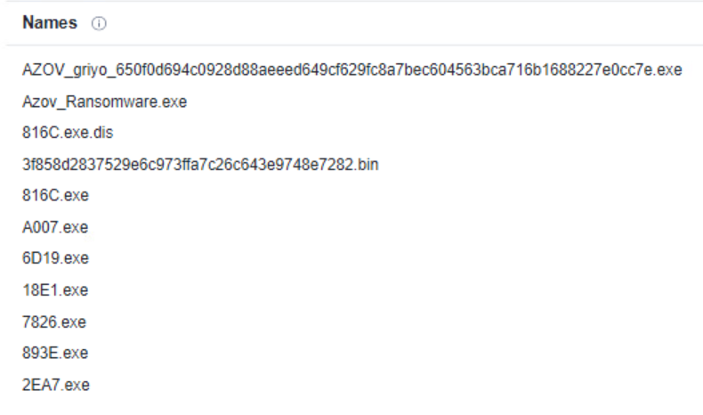
Found in wild
Notes:
The Man Who Found Stuxnet – Sergey Ulasen
Blue screen of death
#https://www.youtube.com/watch?v=U_7CGl6VWaQ
#https://eugene.kaspersky.com/2011/11/02/the-man-who-found-stuxnet-sergey-ulasen-in-the-spotlight/
#https://www.wilderssecurity.com/threads/rootkit-tmphider.276994/#post-1712134

Slide 4
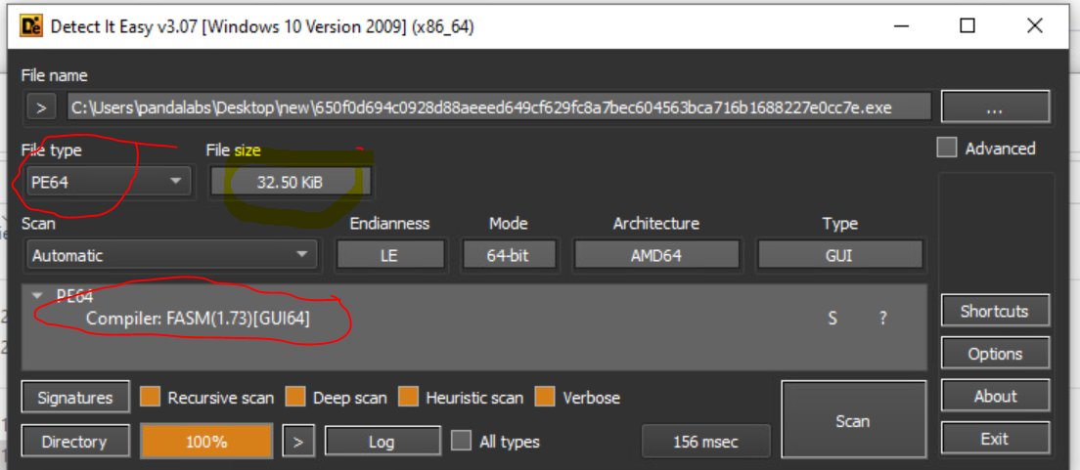
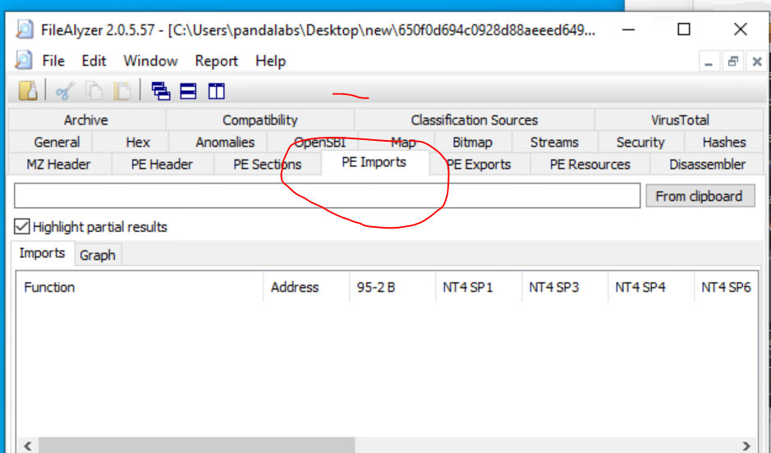
Unique Sample

Slide 5
The .code section has three parts, which are most easily seen by looking at its entropy.
First, there is a high-entropy part containing the encrypted shellcode.
It is followed by plain code implementing the unpacking routine,
and then the last part, with very low entropy, appears to consist of plain strings used to construct the ransom note.

Slide 6
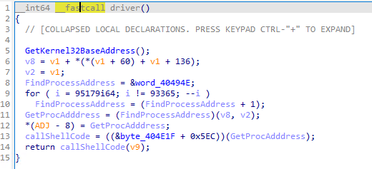
Driver

Slide 7
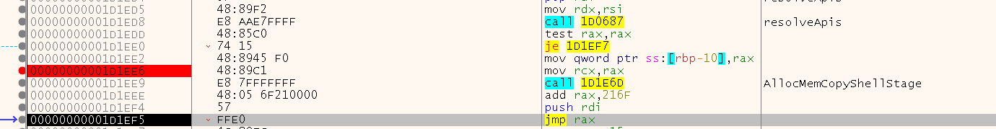

Slide 8
Basic components of malware
Decrypt shellcode to unpack malware
Unpack malware have two routines
1st wiper
2nd Backdoor drop

Slide 9
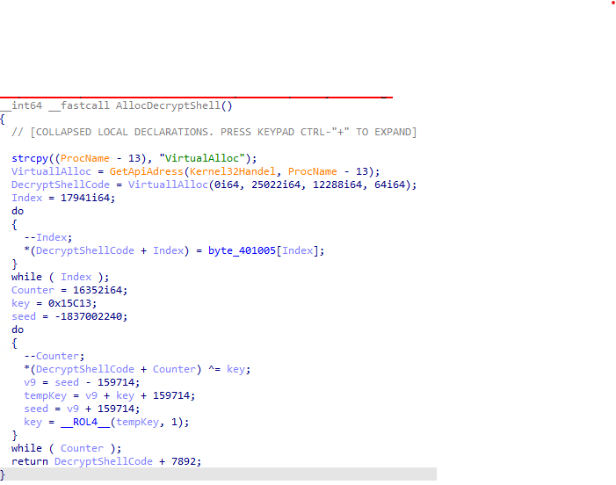
Decrypt Shell code

Slide 10
We covered some anti-analysis and code obfuscation techniques that make #Azov stand out from ordinary ransomware authors: - Preventing software breakpoints
- Opaque constants
- Syntactic confusion
- Junk code
- Opaque predicates
- Call-Return abuse
- Volatile Homebrew IAT

Slide 11
The .code section has three parts, which are most easily seen by looking at its entropy. First, there is a high-entropy part containing the encrypted shellcode. It is followed by plain code implementing the unpacking routine, and then the last part, with very low entropy, appears to consist of plain strings used to construct the ransom note.

