Slide 1

CENTRE FOR ADVANCE STUDIES (DR . A .P . J. Abdul Kalam Technical University , U.P, Lucknow ) PRESENTED BY: SHIKHA M.TECH (Ist SEM)

Slide 2
Greedy Algorithm with Knapsack Problem

Slide 3
CONTENTS
What is algorithm.
What is Greedy algorithm
GREEDY Approach
Application
Knapsack Problem

Slide 4
What is algorithm
An algorithm is a finite set of instruction that accomplishes a particular task.
Criteria:
Input
Output
Each instruction must be clear & unambiguous.
Finiteness
effectiveness

Slide 5
What is Greedy algorithm
A greedy algorithm always makes the choice that looks best at the moment.
Works with Two properties:
Greedy choice property.
Optimal substructure

Slide 6
Greedy choice property: It makes a locally optimal choice in the hope that this choice will lead to globally optimal solution.
Optimal substructure: optimal solution contains optimal sub solution.

Slide 7
Example:1
Local optimal choice A→B=4
A→D=3
A→C=7
Local optimal best choice = 3
Total weight A to C=3+1=4
Global optimal solution=4
“A to C”<==4
BEST SOLUTION IS 4
B
4
1
A
C
7
3
1
D

Slide 8
Example:2
Local optimal choice
A→B=4
A→D=3
A→C=10
Local optimal choice=3
Total weight=3+5=8
Global optimal solution=4+1=5
Local optimal solution=8
“A to C”←8
Best solution is 5.
B
1
4
A
C
10
3
5
D

Slide 9
Application
The greedy method is quite powerful and works well for a wide range of problems.
Many algorithms can be viewed as applications of the Greedy algorithms
Minimum Spanning Tree
Dijkstra’s algorithm for shortest paths from a single source

Slide 10
Knapsack Problem
Given a list of items,we have to pack the knapsack (bag) in such a manner as to get the maximum (optimum) total value.
Total weight that we can carry is not more than fixed weight W.
Weights and values of items are positive integers.
w =(w₁,w₂,w₃…………..w_{n})
V=(v₁,v₂,v₃………………..v_{n}).

Slide 11
Verients
0/1 Knapsack problem
Fractional knapsack problem

Slide 12
0/1 Knapsack problem
This problem is said 0/1 knapsack problem Because the item is
either accepted or rejected.
Example: knapsack with 30
ITEAM | w _{i} | v _{i}
1 | 4 | 3
2 | 6 | 6
3 | 7 | 5
4 | 8 | 9
5 | 10 | 12

Slide 13
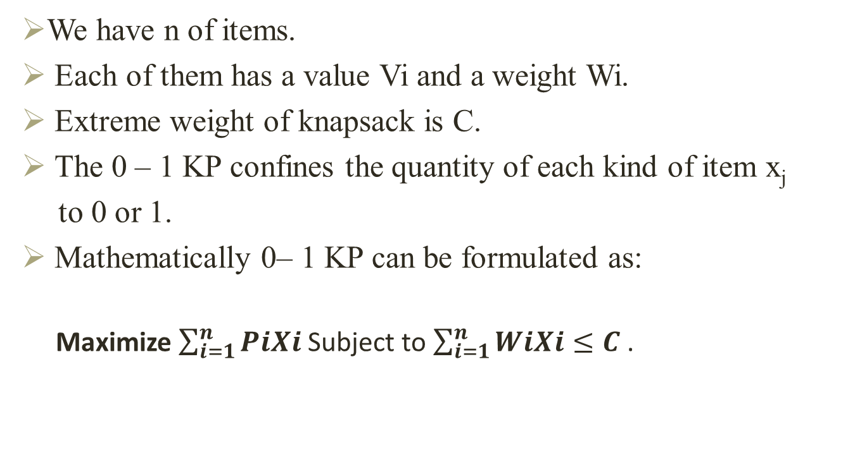
Knapsack Problem
We have n of items.
Each of them has a value Vi and a weight Wi.
Extreme weight of knapsack is C.
The 0 – 1 KP confines the quantity of each kind of item x_{j}
to 0 or 1.
Mathematically 0– 1 KP can be formulated as:
Maximize $\sum_{i=1}^{n}{PiXi}$ Subject to $\sum_{i=1}^{n}{WiXi≤C}$ .

Slide 14
EXAMPLE
Two goals :
Fill it to get the greatest benefit.
Knapsack capacity i.e 22 pounds.
Items | 1 | 2 | 3 | 4 | 5 | 6 | 7
Profit | 10 | 8 | 9 | 15 | 7 | 7.2 | 5.5
Weight | 12 | 8 | 6 | 16 | 4 | 5 | 8

Slide 15
Approach: by Greedy Algorithm
A greedy algorithm is a straight forward design technique.
used to make a greedy decision. which leads to a feasible solution that is may be an optimal solution.
A greedy algorithm can be applied on problems those have ‘N’ number of inputs.
we have to choose a subset of these input values those satisfy some preconditions.
Notes:
Precondition:1 item are arranged by value vi ==max value 6 ,w 5 but optimal value is 9.
2.By weight wi ==1,wi1=4 then W-Wi1=7-4 then get v=9
3 by profot ratio pi=vi/w
Ex: I W v knapsack capacity W==7
i1 5 6
i2 4 5
i3 3 4
BUTIF WE CHANGE VALUE OF ITEM I3 TO 10 THEN NOT GET THE OPTIMAL VAL,

Slide 16
0/1 Knapsack applications
Different spaces where the problem shows up are:
1. budget control
2. network flow
3. journals for a library

Slide 17
Greedy strategy
1.Item arrange by their value.
2.Item arrange by their weight.
3.Item arrange by their benefit/profit ratio.

Slide 18
knapsack capacity w=9
Iteam no(i) | Weight(i) | Value(i)
1 | 2 | 3
2 | 3 | 7
3 | 4 | 2
4 | 5 | 9

Slide 19
knapsack capacity W =9 TABLE: st.1, arrange by value
Iteam no(i) | Weight(i) | Value(i)
1 | 5 | 9
2 | 3 | 7
3 | 2 | 3
4 | 4 | 2
Selected values are v1,v2--→9,7= 16
Corresponding weights are 5,3=8<W I.e 9

Slide 20
EXAMPLE: knapsack capacity W =9 TABLE : st.2, arrange by weight
Iteam no(i) | Weight(i) | Value(i)
1 | 5 | 9
2 | 4 | 2
3 | 3 | 7
4 | 2 | 3
Selected items , weight are 2,3,4, => 5+4=9=W
Values are 3,7,2 => 3+7+2=12
z

Slide 21
Fractional knapsack problem
1. Knapsack capacity W.
2. There are n items and i^{th} Item has value v_{i ,} weight w_{i}
3. Goal:
a. find xi such that for all 0≤x_{i}≤1 ,
where i=1,2,3……..
b.∑ w_{i} x_{i} ≤ W and ∑ v_{i} x_{i} maximum
4. w← W- w_{i} x_{i}

Slide 22
Example
EXAMPLE : knapsack capacity W=50
Iteam i | w_{i} | v_{i} | Profit p_{i=} v_{i}/w_{i}
1 | 10 | 60 | 6
2 | 20 | 100 | 5
3 | 30 | 120 | 4
Knapsack capacity W=50
I1 select w=10,v=60 W-10 = 50-10=40 and V1=60 I2 select w=20,v=100 W-20 =40-20=20 and V2=100
I3 select partially ,
x= 50-10+20=20
v(x)= 80
Total optimal value=240

Slide 23
Thank
You

