Slide 1

CENTER FOR ADVANCE STUDIES DR. A.P.J. ABDUL KALAM TECHNICAL UNIVERSITY, LUCKNOW
Presentation
On
PETYA RANSOMWARE ATTACK
MONIKA
M.TECH(CS-CYS)

Slide 2
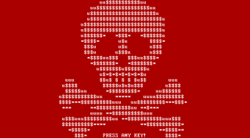
Are you aware of Petya Ransomware?

Slide 3


What is Petya?
Petya is a family of ransomware which blocks access to a computer or its data, encrypts files and demands money to release it.

Slide 4
How does a Petya executes its attack?
Petya spreads itself is by exploiting the MS17-010 vulnerability, also known as Eternal-Blue which is an exploit generally believed to have been developed by the U.S. National Security Agency (NSA).
It can also spread by acquiring user names and passwords and spreading across network shares.

Slide 5

Is Petya Infectious?
Infection of Petya ransomware is much more powerful than the infection done by WannaCry.
In case of WannaCry it encrypts only files, but Petya not only encrypts files, it also locks the entire disk, making it basically unusable until the infection is removed.

Slide 6
Petya infects Master Boot Record (MBR). Infected MBR encrypts hard disk on next reboot.
Once rebooting starts, it shows CHKDSK display on screen which is actually its encryption process running in the background.

Slide 7
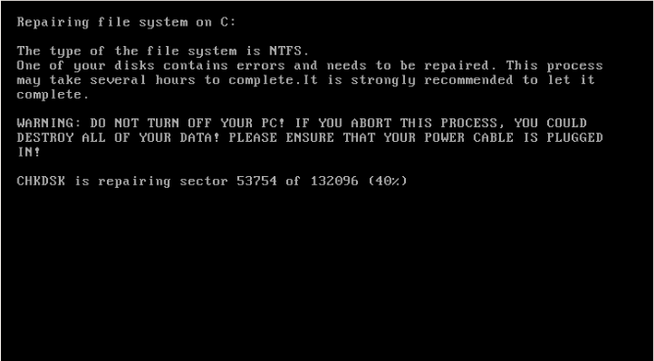
Note:- Users are advised to power off their system as soon as they view this screen.

Slide 8
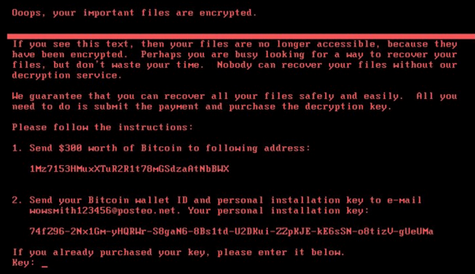
What is the Ransom note when asked for Payment?
A Ransom note asking for payment through Bitcoin is shown as below:

Slide 9
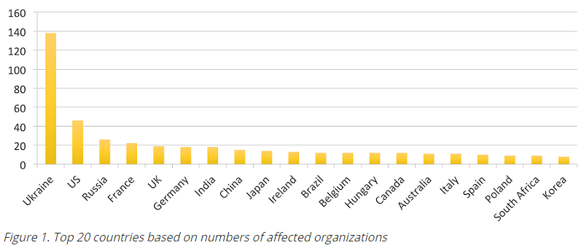
A new strain of the Petya ransomware started propagating on June 27, 2017, infecting many organizations.

Slide 10
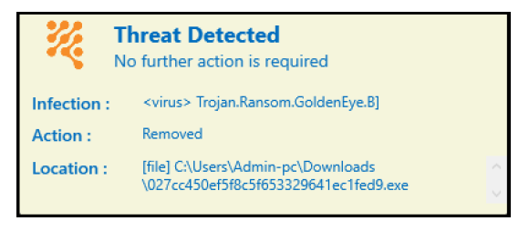
How to detect and remove Petya?
Reve Antivirus detects this ransomware as Trojan.Ransom.GoldenEye.B and removes it.

Slide 11
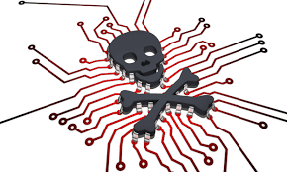
How to avoid such attacks?
Users are advised to always keep their OS and other software updated.
Always keep a backup of your important data on any external location.

Slide 12

Abstain from clicking any malicious links or attachments.
Best Antivirus software helps to detect and remove these kind of threats.

Slide 13
Thank You!

