Slide 1
CryptXXX
PRESENTED BY-
SHIKHA
17MCS12

Slide 2
CryptXXX Ransomware
The CryptXXX ransomware first appeared at the end of March 2016 anddiscovered by Kafeine (Proofpoint) quickly grew into one of the most popular ransomware families delivered via exploit kit.
Currently, CryptXXX is primarily delivered via web exploitation kits using compromised websites and malware-infected advertisements.
CryptXXX is now primarily delivered via the Neutrino exploit kit, which targets vulnerabilities in three different Windows applications:
Adobe Flash
Microsoft Silverlight
Java and Java Runtime Environment (JRE)
CryptXXX also does more than just encrypt the files on a victim machine. Because the initial deployments used the Angler exploit kit and Bedep Loader, the CryptXXX

Slide 3
What is the CryptXXX Ransomware?
CryptXXX is a Windows ransomware infection that was discovered by Kafeine (Proofpoint) in the middle of April 2016. This ransomware infection will affect all versions of Windows, including Windows XP, Windows Vista, Windows 7, Windows 8, and Windows 10. When a victim is infected they will have their files encrypted and then a ransom of about 2.4 bitcoins, or approximately $1,000 USD, will be demanded in order to receive the decryption key.
When CryptXXX infects your computer it will scan all the drive letters for targeted file types, encrypt them, and then append the .crypt extension to them. Once these files are encrypted, they will no longer able to be opened by your normal programs. When CryptXXX has finished encrypting the victim's files, it will change the desktop wallpaper to an image that acts like a ransom note. It will also display a HTML ransom note in your default browser. These ransom notes include instructions on how to connect to the CryptXXX Decrypt Service where you can learn more about what happened to your files and how you can make a CryptXXX ransom payment

Slide 4
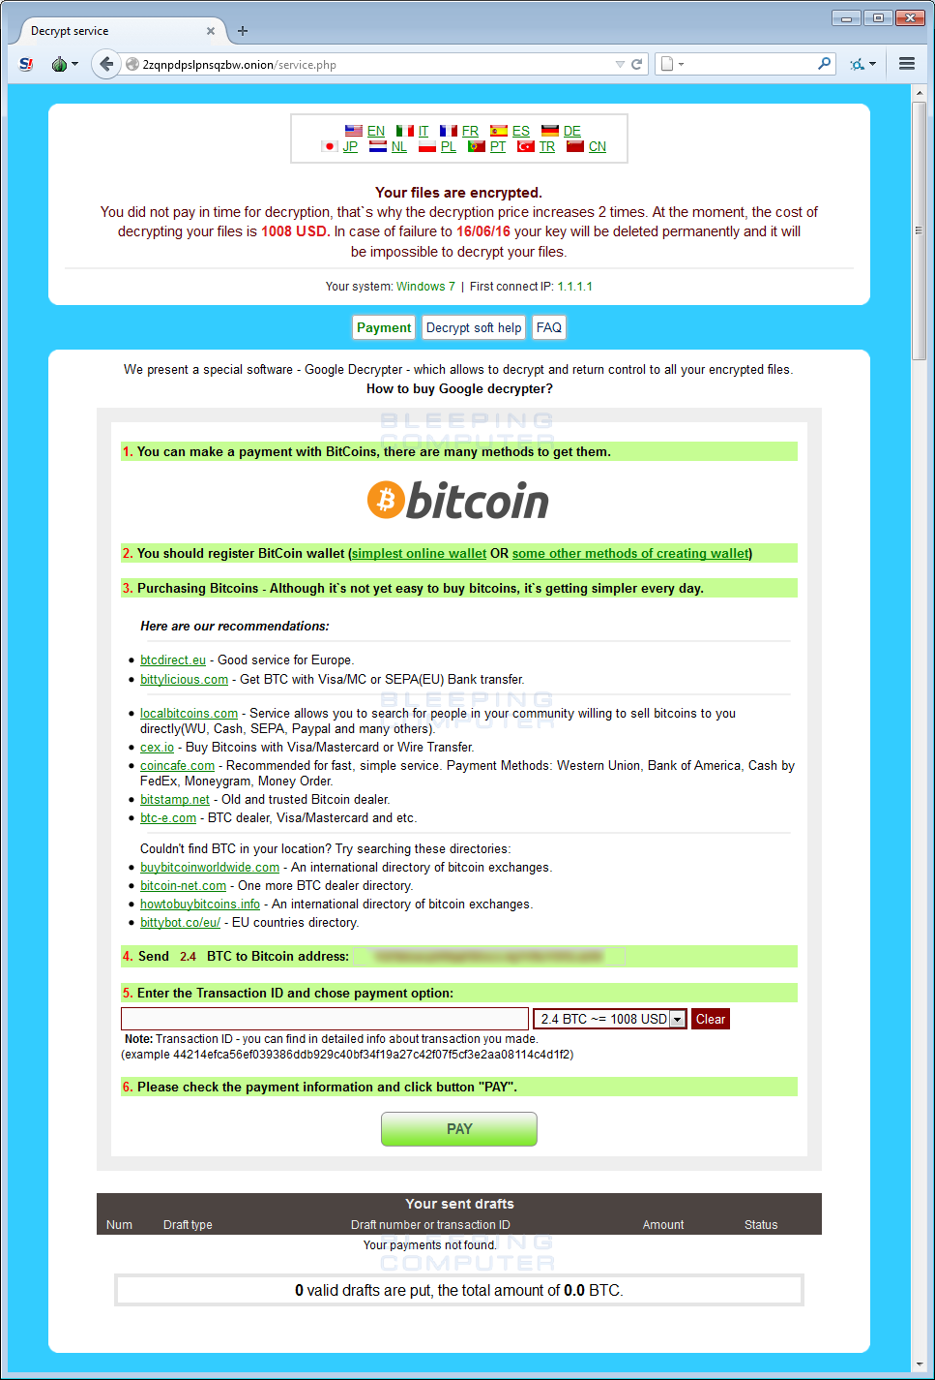
The !Recovery_[victim_id].html ransom note is displayed below

Slide 5
How the CryptXXX Ransomware encrypts your files
When CryptXXX is first installed it will scan the computer's local, removable, and mapped drives for file types that it targets for encryption. The extensions targeted by CryptXXX are:
3DM, .3DS, .3G2, .3GP, .7Z, .ACCDB, .AES, .AI, .AIF, .APK, .APP, .ARC, .ASC, .ASF, .ASM, .ASP, .ASPX, ASX, .AVI, .BMP, .BRD, .BZ2, .C, .CER, .CFG, .CFM, .CGI, .CGM, .CLASS, .CMD, .CPP, .CRT, .CS, .CSR, .CSS, .CSV, .CUE, .DB, .DBF, .DCH, .DCU, .DDS, .DIF, .DIP, .DJV, .DJVU, .DOC, .DOCB, .DOCM, .DOCX, .DOT, .DOTM, .DOTX, .DTD, .DWG, .DXF, .EML, .EPS, .FDB, .FLA, .FLV, .FRM, .GADGET, .GBK, .GBR, .GED, .GIF, .GPG, .GPX, .GZ, .H, .H, .HTM, .HTML, .HWP, .IBD, .IBOOKS, .IFF, .INDD, .JAR, .JAVA, .JKS, .JPG, .JS, .JSP, .KEY, .KML, .KMZ, .LAY, .LAY6, .LDF, .LUA, .M, .M3U, .M4A, .M4V, .MAX, .MDB, .MDF, .MFD, .MID, .MKV, .MML, .MOV, .MP3, .MP4, .MPA, .MPG, .MS11, .MSI, .MYD, .MYI, .NEF, .NOTE, .OBJ, .ODB, .ODG, .ODP, .ODS, .ODT, .OTG, .OTP, .OTS, .OTT, .P12, .PAGES, .PAQ, .PAS, .PCT, .PDB, .PDF, .PEM, .PHP, .PIF, .PL, .PLUGIN, .PNG, .POT, .POTM, .POTX, .PPAM, .PPS, .PPSM, .PPSX, .PPT, .PPTM, .PPTX, .PRF, .PRIV, .PRIVAT, .PS, PSD, .PSPIMAGE, .PY, .QCOW2, .RA, .RAR, .RAW, .RM, .RSS, .RTF, .SCH, .SDF, .SH, .SITX, .SLDX, .SLK, .SLN, .SQL, .SQLITE, .SQLITE, .SRT, .STC, .STD, .STI, .STW, .SVG, .SWF, .SXC, .SXD, .SXI, .SXM, .SXW, .TAR, .TBK, .TEX, .TGA, .TGZ, .THM, .TIF, .TIFF, .TLB, .TMP, .TXT, .UOP, .UOT, .VB, .VBS, .VCF, .VCXPRO, .VDI, .VMDK, .VMX, .VOB, .WAV, .WKS, .WMA, .WMV, .WPD, .WPS, .WSF, .XCODEPROJ, .XHTML, .XLC, .XLM, .XLR, .XLS, .XLSB, .XLSM, .XLSX, .XLT, .XLTM, .XLTX, .XLW, .XML, .YUV,.ZIP, .ZIPX

Slide 6
When a file is encrypted it will have the .crypt extension appended to the normal file name. For example, a file named accounting.doc, will be renamed to accounting.doc.crypt.
While your computer's data is being encrypted it will create ransom notes in every folder that a file was encrypted, in the C:\ProgramData folder, and on the Windows desktop. These ransom notes are named:CryptXXX Ransom Note Names
The [victim_id] is a unique string associated with your computer that identifies you in the malware developer's payment system.
Name | Location
[victim_id].html | C:\ProgramData
[victim_id].bmp | C:\ProgramData
!Recovery_[victim_id].bmp | Desktop and All Encrypted Folders
!Recovery_[victim_id].html | Desktop and All Encrypted Folders
!Recovery_[victim_id].txt | Desktop and All Encrypted Folders

Slide 7
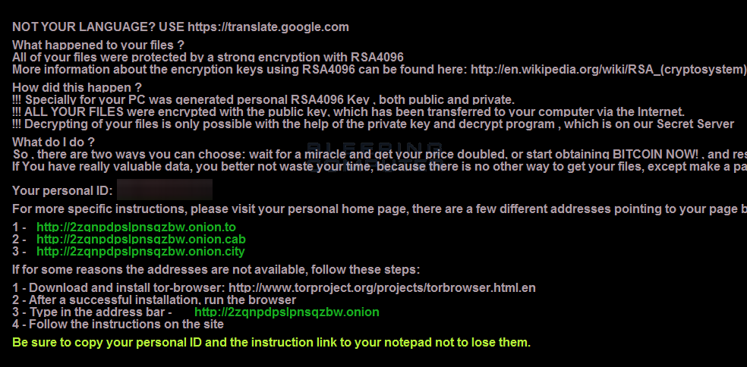
CryptXXX will also change the Windows wallpaper to use the image located at%UserProfile%\AppData\Roaming\Microsoft\Windows\Themes\TranscodedWallpaper.jpg as shown below.

Slide 8
vulnerablities
A user is typically infected by CryptXXX through Exploit Kits and Trojan Downloaders such as Bedep. These exploit kits can be located on hacked sites or through malvertising. When a browser opens one of these exploit kits, it will scan your computer for vulnerable programs and attempt to exploit them to install and start the ransomware without your knowledge.

Slide 9
Detection name: Trojan.Cryptolocker.AN
Ransom amount: $500 in bitcoin
Discovery: April 2016,
Known infection vectors: Neutrino exploit kit

Slide 10
Technique to defend
Emsisoft Anti-Malware:EAM, has a feature called behavior blocker that has a proven track record of blocking ransomware before it can start encrypting data on your computer. Unlike traditional antivirus definitions, EAM's behavior blocker examines the behavior of a process and if this behavior contains certain characteristics commonly found in malware it will prevent it from running. Using the detection method, behavior blocker detects when a process is scanning a computer for files and then attempting to encrypt them. If it discovers this behavior, it will automatically terminate the process.

Slide 11
HitmanPro:Alert: Alert provides protection from computer vulnerabilities and malware that attempts to steal your data.
Configure Application Whitelisting:A very secure method of preventing a ransomware, or almost any other malware, infection is to use a method called Application Whitelisting. Application whitelisting is when you lock down Windows so that all executables are denied except for those that you specifically allow to run. Since you are only allowing programs you trust to run, if you are infected the malware executable would not be able to run .
Use Software Restriction Policies to block executables in certain file locations:You can use the Windows Group or Local Policy Editor to create Software Restriction Policies that block executables from running when they are located in specific file locations.

Slide 12
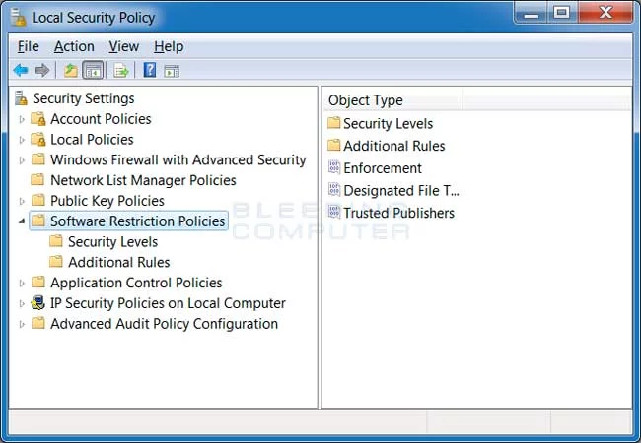
How to manually create Software Restriction Policies to block CryptXXX
Notes:
/www.bleepingcomputer.com/virus-removal/cryptxxx-ransomware-help-information#cryptxxx-encryption

Slide 13
THANK
you

