Slide 1

CENTER FOR ADVANCE STUDIES
DR. A.P.J. ABDUL KALAM TECHNICAL UNIVERSITY, LUCKNOW
Presentation
On
TRANSMISSION MEDIA & SWITCHING
PRATISHTHA SAXENA
MONIKA
M.TECH(CS-CYS)

Slide 2
TRANSMISSION MEDIA

Slide 3

Transmission medium

Slide 4

Classes of Transmission media

Slide 5
GUIDED MEDIA
Guided media, which are those that provide a conduit from one device to another, include twisted-pair cable, coaxial cable, and fiber-optic cable.
Topics discussed in this section:
Twisted-Pair Cable
Coaxial Cable
Fiber-Optic Cable

Slide 6
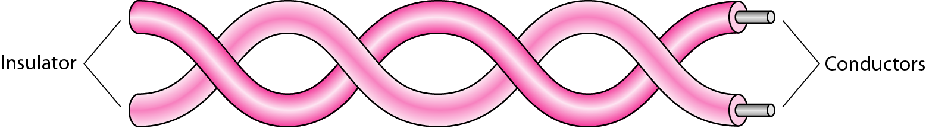
Twisted-pair cable

Slide 7
Unshielded and Shielded TP
Unshielded Twisted Pair (UTP)
  Ordinary telephone wire
  Cheapest
  Easiest to install
  Suffers from external EM interference
Shielded Twisted Pair (STP)
  Metal braid or sheathing that reduces interference
  More expensive
  Harder to handle (thick, heavy)

Slide 8

UTP and STP cables

Slide 9

Coaxial cable

Slide 10

Categories of coaxial cables

Slide 11
Coaxial Cable Applications
Most versatile medium
Television distribution
  Cable TV
Short distance computer systems links
Local area networks

Slide 12

Fiber optics

Slide 13

Optical fiber

Slide 14

Propagation modes

Slide 15

Modes

Slide 16
OPTICAL FIBER - BENEFITS
Greater capacity
  Data rates of hundreds of Gbps
Smaller size & weight
Lower attenuation
Electromagnetic isolation

Slide 17
Optical Fiber - Applications
Long-haul trunks
Metropolitan trunks
Rural exchange trunks
Subscriber loops
LANs

Slide 18

Fiber-optic cable connectors

Slide 19
Comparision
Medium | Cost | Bandwidth/Data rate | Attenuation | EMI | Security
UTP | Low | 3MHz 4Mbps | High 2-10km | High | Low
Coaxial | Moderate | 350MHz 500Mbps | Moderate 1-10km | Moderate | Low
Optical Fiber | High | 2GHz 2Gbps | Low 10-100km | Low | High

Slide 20
UNGUIDED MEDIA: WIRELESS
Unguided media transport electromagnetic waves without using a physical conductor. This type of communication is often referred to as wireless communication.
Topics discussed in this section:
Radio Waves
Microwaves
Infrared

Slide 21

Electromagnetic Spectrum For Wireless Communication

Slide 22

Propagation Methods

Slide 23

Bands

Slide 24

Wireless Transmission Waves

Slide 25
Radio Waves
Radio waves are used for multicast communications, such as radio and television, and paging systems. They can penetrate through walls.
Highly regulated. Use omni directional antennas

Slide 26

Omnidirectional Antenna

Slide 27
Microwaves
Microwaves are used for unicast communication such as mobile phones, satellite networks,
and wireless LANs.
Higher frequency ranges cannot penetrate walls.
Use directional antennas - point to point line of sight communications.

Slide 28

Unidirectional Antennas

Slide 29
Infrared waves
Infrared signals can be used for short-range communication in a closed area using line-of-sight propagation.

Slide 30
SWITCHING

Slide 31
SWITCHING
In the switched network methodology, the network consists of a set of interconnected nodes, among which information is transmitted from source to destination via different routes, which is controlled by the switching mechanism.

Slide 32
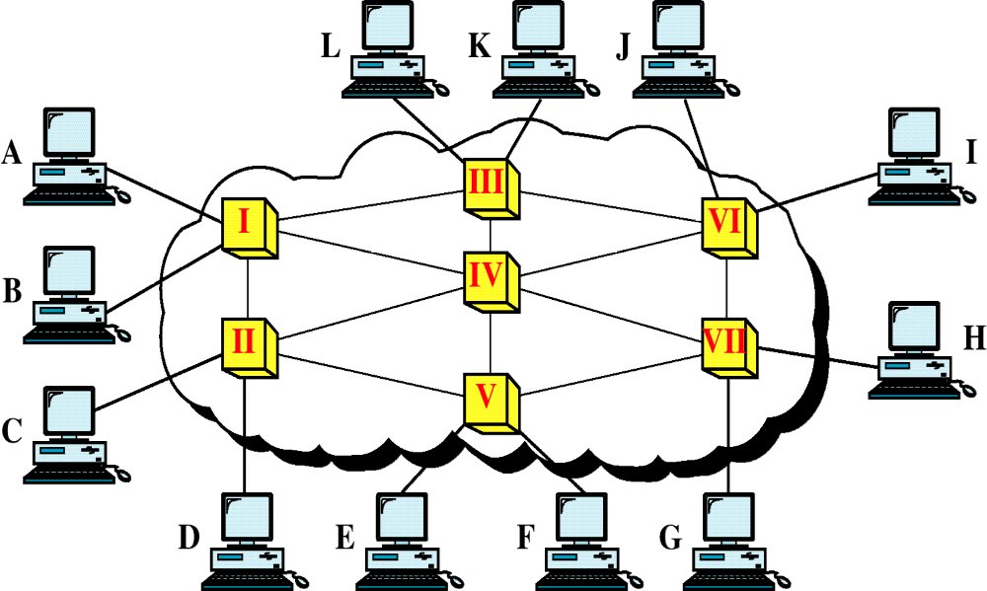
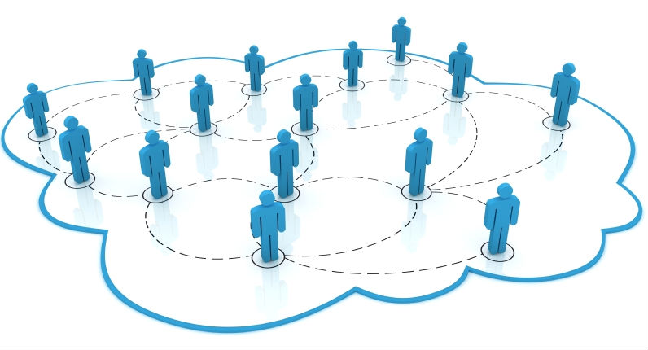
Switched Network

Slide 33
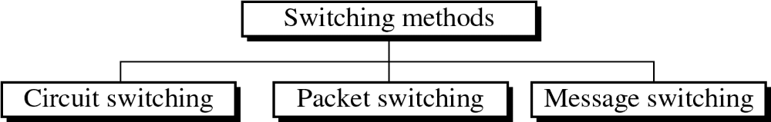
SWITCHING TECHNIQUES

Slide 34
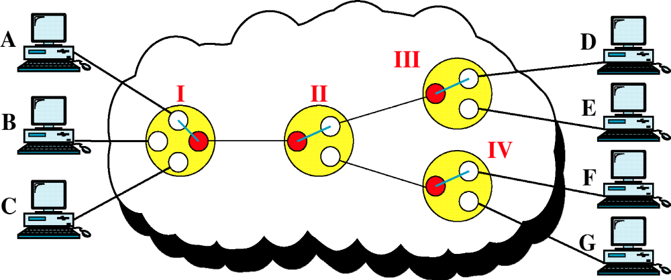
Circuit-Switched Network
Communication via circuit switching implies that there is a dedicated communication path between the two stations.

Slide 35
IT INVOLVED THE FOLLOWING THREE DISTINCT STEPS
Circuit Establishment:
To establish an end-to-end connection before any transfer of data.
Data transfer:
Transfer data is from the source to the destination.
Circuit disconnect:
Terminate connection at the end of data transfer.

Slide 36
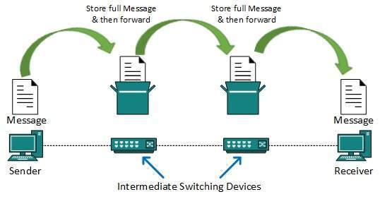
MESSAGE SWITCHING
In message switching, the whole message is treated as a data unit and is switching / transferred in its entirety.
A switch working on message switching, first receives the whole message and buffers it until there are resources available to transfer it to the next hop. If the next hop is not having enough resource to accommodate large size message, the message is stored and switch waits.

Slide 37
Message switching has the following drawbacks:
Every switch in transit path needs enough storage to accommodate entire message.
Because of store-and-forward technique and waits included until resources are available, message switching is very slow.

Slide 38
PACKET SWITCHING
In Packet Switching, messages are broken up into packets and each of which includes a header with source, destination and intermediate node address information. Individual Packets in packet switching technique take different routes to reach their respective destination. Independent routing of packets is done in this case for following reasons:
Bandwidth is reduces by the splitting of data onto different routes for a busy circuit.
For a certain link in the network, the link goes down during transmission the remaining packet can be sent through the another route.

Slide 39
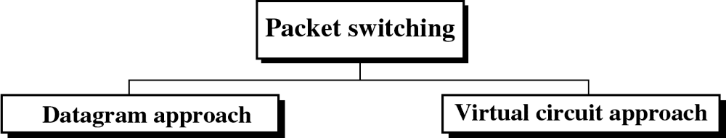
PACKET SWITCHING TECHNIQUES

Slide 40
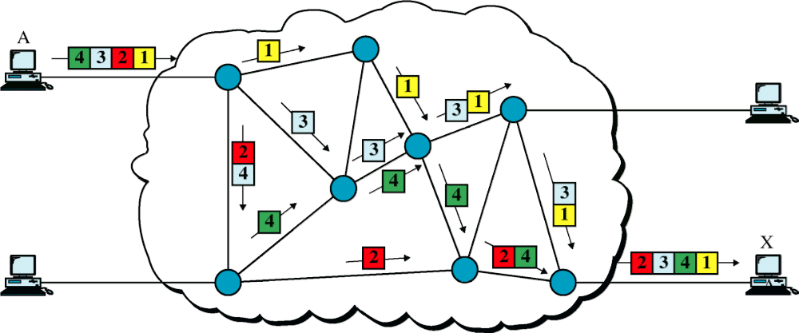
DATAGRAM APPROACH

Slide 41
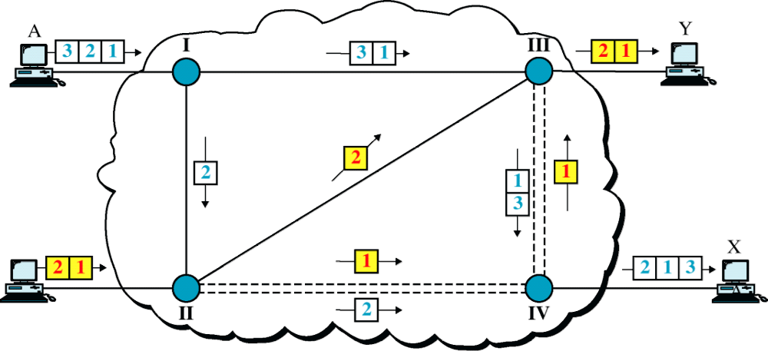
Datagram Approach, Multiple Channels

Slide 42
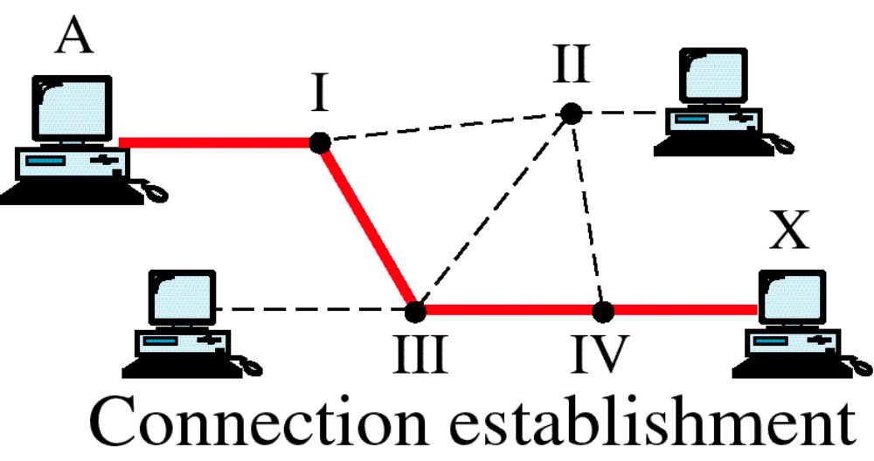
Switched Virtual Circuit

Slide 43
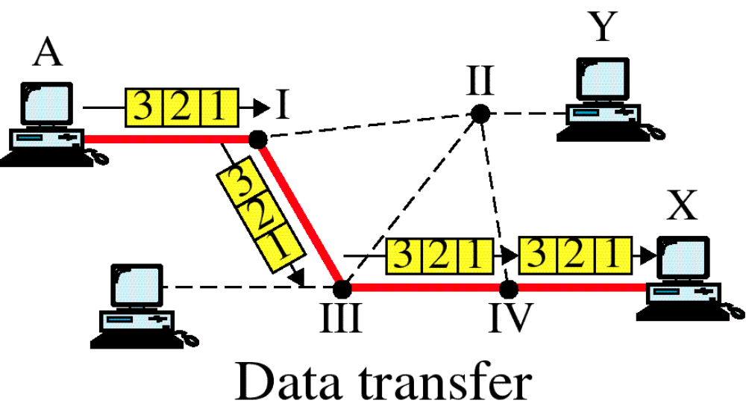
Switched Virtual Circuit

Slide 44
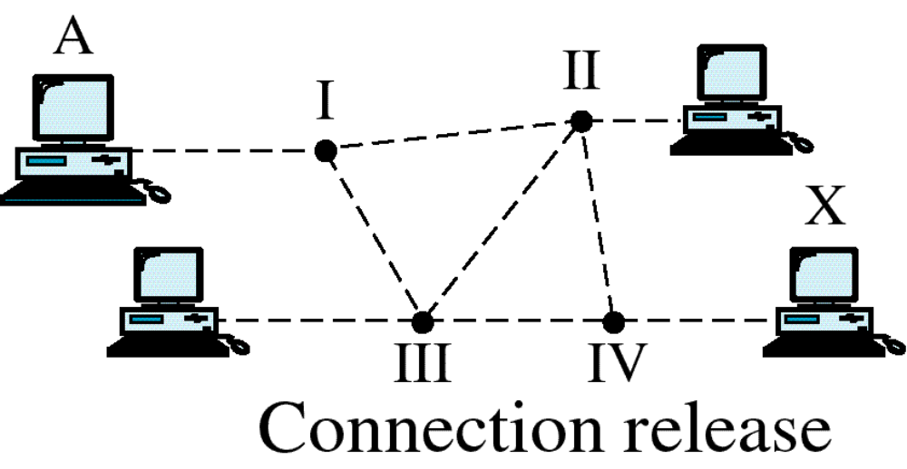
Switched Virtual Circuit

Slide 45
THANK YOU

