Slide 1

Centre for Advance Studies – AKTU
(LUCKNOW)
DFA & NFA
(DETERMINISTIC & NONDETERMINISTIC FINITE AUTOMATA)
SUBMITTED BY: NITESH KUMAR

Slide 2
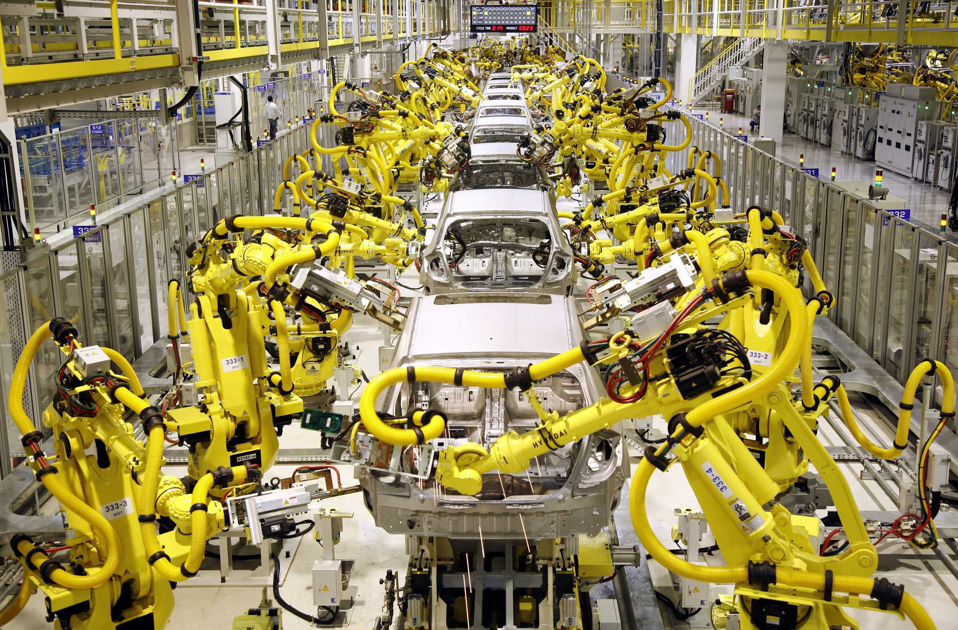
What is automata?
An automaton ( plural: automata or automatons) is a self-operating machine or control mechanism designed to automatically follow a predetermined sequence of operations,

Slide 3
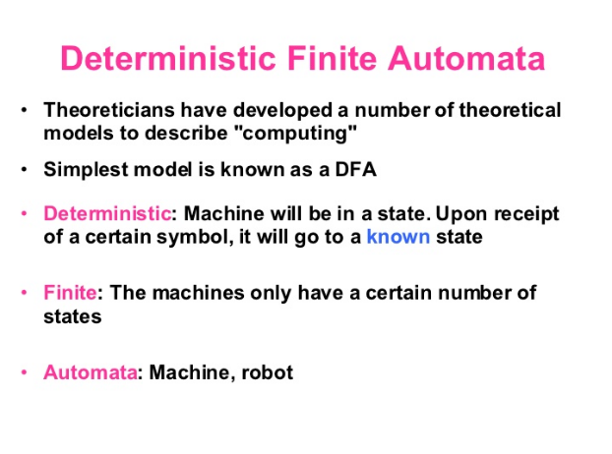

Slide 4
Deterministic Finite Automata (DFA)
: Finite set of states
: input alphabet
: transition function
: Q X Q
: initial state is a member of Q
: set of final states

Slide 5
Transition Function

Slide 6
Formal Definition of NFAs
Set of states.
Input alphabet.
Transition function.
Initial state.
Final states.

Slide 7
Transformation of NFA to DFA
For every non deterministic finite automata, there exist an equivalent deterministic finite automata.
The equivalence is determined in terms of language acceptance.
A NFA is nothing but a finite automata in which zero, one or more transitions on an input symbol is permitted, we can always construct a finite automata which will simulate all the moves of NFA on a particular input symbol in parallel, then get a finite automata in which there will be exactly one transition on every input symbol, hence it will be DFA equivalent to NFA

Slide 8
Convert the following NFA into DFA
b
a, b
start
a
q1
a
q0
q2
a,b
b
q3

Slide 9
Solution: Step1: Seek all the transition from starting state q0 for every symbol in ∑ i.e. (a , b).If we get a set of states for same input, consider the set as a new single state
δ(q0,a)={q0,q1}-------------new state
δ(q0,b)={q0}
Step2: In step1 we are getting a new state {q0,q1}. Repeat step 1 for this new state only i.e. check all transitions of a and b from {q0,q1} as:
δ({q0,q1},a)= δ(q0,a) U δ(q1,a)
= {q0,q1} U {q2}
= {q0,q1,q2}-------------new state
δ({q0,q1},b)= δ(q0,b) U δ(q1,b)
= {q0} U {q1}
={q0,q1}---------------old state

Slide 10
Step 3: Repeat step 2 till you are getting any new state. All those states that consist of any of the accepting state of given NFA as member state will be considered as final states
δ({q0,q1,q2},a)= δ(q0,a) U δ(q1,a) U δ(q2,a)
={q0,q1} U {q2} U {q3}
={q0,q1,q2,q3}-------new state
δ({q0,q1,q2},b)= δ(q0,b) U δ(q1,b) U δ(q2,b)
= {q0} U {q1} U {q3}
={q0,q1,q3}--------new state
δ({q0,q1,q2,q3},a)= δ(q0,a) U δ(q1,a) U δ(q2,a) U δ(q3,a)
={q0,q1} U {q2} U {q3} U {q3}
={q0,q1,q2,q3}----------old state
δ({q0,q1,q2,q3},b)=δ(q0,b) U δ(q1,b) U δ(q2,b) U δ(q3,b)
={q0} U {q1} U {q3} U {q2}
={q0,q1,q3,q2}----------old state

Slide 11
δ({q0,q1,q3},a)=δ(q0,a) U δ(q1,a) U δ(q3,a)
={q0,q1} U {q2} U {q3}
={q0,q1,q2,q3}----------old state
δ({q0,q1,q3},b)=δ(q0,b) U δ(q1,b) U δ(q3,b)
={q0} U {q1} U {q2}
={q0,q1,q2}----------old state
Transition table :
δ/∑ | a | B
q0 | {q0,q1} | {q0}
{q0,q1} | {q0,q1,q2} | {q0,q1}
*{q0,q1,q2} | {q0,q1,q2,q3} | {q0,q1,q3}
*{q0,q1,q2,q3} | {q0,q1,q2,q3} | {q0,q1,q2,q3}
*{q0,q1,q3} | {q0,q1,q2,q3} | {q0,q1,q2}

Slide 12
Transition table for equivalent DFA
A is the initial state and C,D and E are final states since they contain q2 and q3 as member which are final states of NFA
Let us say:
q0----A
{q0,q1}-----B
{q0,q1,q2}-----------C
{q0,q1,q2,q3}---------D
{q0,q1,q3}-----------E
δ/∑ | a | b
A | B | A
B | C | B
*C | D | E
*D | D | D
*E | D | C

Slide 13
b
b
B
start
a
a
A
C
b
b
a
E
a,b
a
D

