Slide 1

A PRESENTATION ON CLOUDBLEED
PRESENTED BY:
SAMARJEET YADAV
17MCS11

Slide 2
CONTENTS
INTRODUCTION
CLOUDFLARE
VULNERABILITY
ADVISED FOR CLIENTS
REFERENCES

Slide 3
INTRODUCTION
WHAT IS CLOUDBLEED?
Cloudbleed is a security bug discovered on February 17, 2017 by TAVIS ORMANDY ,affecting Cloudflare's reverse proxies, which caused their edge servers to run past the end of a buffer and return memory that contained private information such as HTTP cookies, authentication tokens, HTTP POST bodies, and other sensitive data.
As a result, data from Cloudflare customers was leaked out and went to any other Cloudflare customers that happened to be in the server's memory on that particular moment. Some of this data was cached by search engines

Slide 4
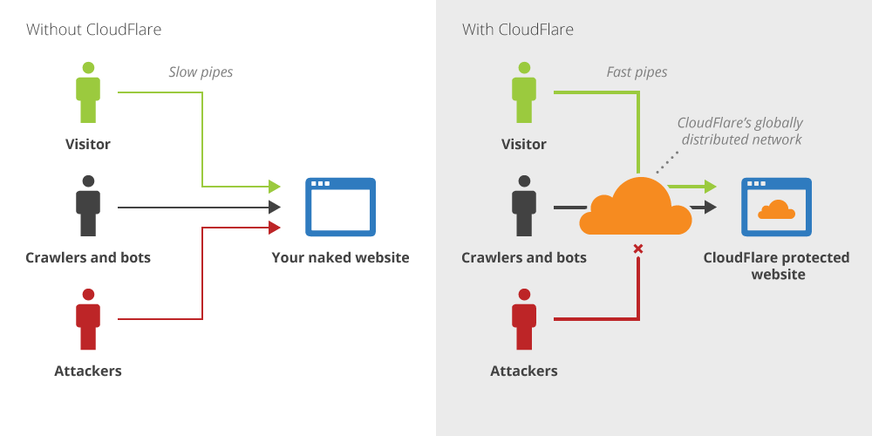
Cloudflare is a U.S. company that provides a content delivery network, Internet security services and distributed domain name server services, sitting between the visitor and the Cloudflare user's hosting provider, acting as a reverse proxy for websites.

Slide 5
VULNERABILITY
CloudFlare, a popular web company which hosts and serves content for many websites, had a vulnerability in their code which was leaking memory, possibly exposing passwords, private messages and other sensitive data from a vast number of sites.

Slide 6
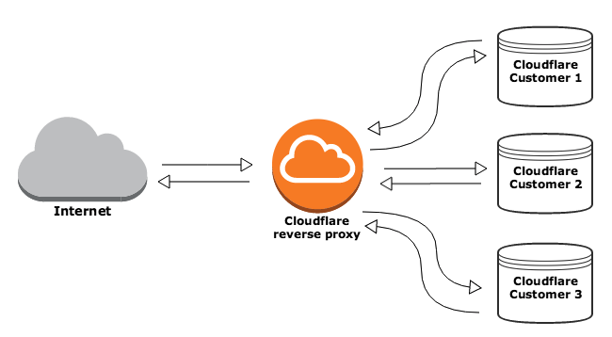

Slide 7
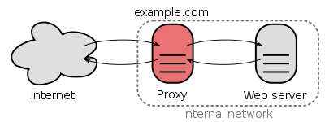

Slide 8
ADVISED FOR CLIENTS
The best thing you can do—as is often the case—is to change your passwords.
Any password used for multiple sites is at the greatest risk of being stolen or exploited, so those are good ones to change, along with the ones you use to protect particularly high-value accounts like bank accounts or password managers.

Slide 9
REFERENCES
INTERNET
1.WIKIPEDIA
2.YOUTUBE

