Slide 1

CENTER FOR ADVANCE STUDIES
DR. A.P.J. ABDUL KALAM TECHNICAL UNIVERSITY, LUCKNOW
Presentation
On
GRAPH TRAVERSING
MONIKA
M.TECH(CS-CYS)

Slide 2
GRAPH TRAVERSING:
BFS & DFS

Slide 3
CONTENTS
Graph terminology
Graph representation
Breadth first search.
Depth first search.
Applications of BFS and DFS.

Slide 4
GRAPH TERMINOLOGY - OVERVIEW
A graph consists of
  set of vertices V = {v₁, v₂, ….. v_{n}}
  set of edges that connect the vertices E ={e₁, e₂, …. e_{m}}
Two vertices in a graph are adjacent if there is an edge connecting the vertices.
Graphs with ordered edges are directed. For directed graphs, vertices have in and out degrees.

Slide 5
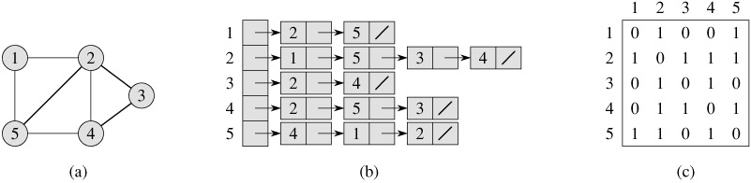
GRAPH REPRESENTATION – UNDIRECTED
Graph
Adjacency list
Adjacency matrix

Slide 6
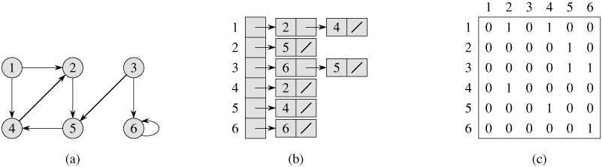
GRAPH REPRESENTATION – DIRECTED
Graph
Adjacency list
Adjacency matrix

Slide 7
BREADTH FIRST SEARCH: BFS
Given
  a graph G=(V,E) set of vertices and edges
  a distinguished source vertex ‘s’
BFS starts traversal from the root vertex & then explore the search in the level by level manner i.e. as close as possible from the root vertex.

Slide 8
BREADTH FIRST SEARCH - CONCEPTS
To keep track of progress, it colors each vertex - white, gray or black.
All vertices start ‘white’.
A vertex discovered first time during the search becomes ‘non-white’.
All vertices adjacent to ‘black’ ones are discovered. Whereas, ‘gray’ ones may have some ‘white’ adjacent vertices.

Slide 9
BFS - ALGORITHM
BFS(G, s) // G is the graph and s is the starting node
1 for each vertex u ∈ V [G] - {s}
2 do color[u] ← WHITE // color of vertex u
3 d[u] ← ∞ // distance from source s to vertex u
4 π[u] ← NIL // predecessor of u
5 color[s] ← GRAY
6 d[s] ← 0
7 π[s] ← NIL
8 Q ← Ø // Q is a FIFO - queue
9 ENQUEUE(Q, s)
10 while Q ≠ Ø // iterates as long as there are gray vertices. Lines 10-18
11 do u ← DEQUEUE(Q)
12 for each v ∈ Adj [u]
13 do if color[v] = WHITE // discover the undiscovered adjacent vertices
14 then color[v] ← GRAY // enqueued whenever painted gray
15 d[v] ← d[u] + 1
16 π[v] ← u
17 ENQUEUE(Q, v)
18 color[u] ← BLACK // painted black whenever dequeued

Slide 10
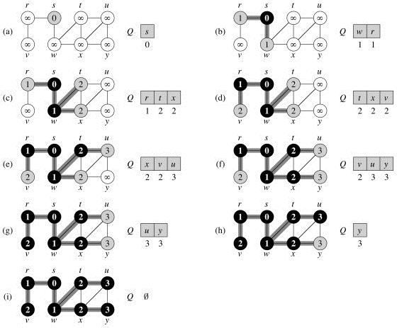
BREADTH FIRST SEARCH - EXAMPLE

Slide 11
DEPTH FIRST SEARCH: DFS
It searches ‘deeper’ the graph when possible.
Starts the traversal from the root node and explore the search as far as possible from the root node i.e. depth wise.
Vertices go through white, blue and black stages of color.
  White – initially
  Blue – when discovered first
  Black – when finished i.e. the adjacency list of the vertex is completely examined.

Slide 12
DEPTH FIRST SEARCH - ALGORITHM
DFS(G)
1 for each vertex u ∈ V [G]
2 do color[u] ← WHITE // color all vertices white, set their parents NIL
3 π[u] ← NIL
4 time ← 0 // zero out time
5 for each vertex u ∈ V [G] // call only for unexplored vertices
6 do if color[u] = WHITE // this may result in multiple sources
7 then DFS-VISIT(u)
DFS-VISIT(u)
1 color[u] ← BLUE ▹White vertex u has just been discovered.
2 time ← time +1
3 d[u] ← time // record the discovery time
4 for each v ∈ Adj[u] ▹Explore edge(u, v).
5 do if color[v] = WHITE
6 then π[v] ← u // set the parent value
7 DFS-VISIT(v) // recursive call
8 color[u] ← BLACK ▹ Blacken u; it is finished.
9 f [u] ← time ← time +1

Slide 13
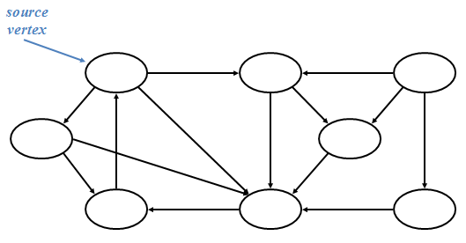
DEPTH FIRST SEARCH – EXAMPLE

Slide 14
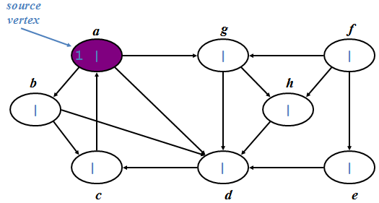


Slide 15
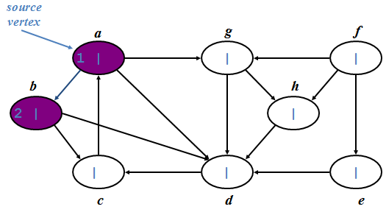
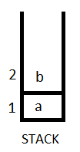

Slide 16
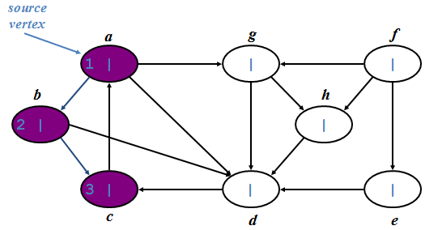
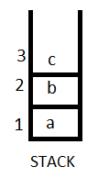

Slide 17
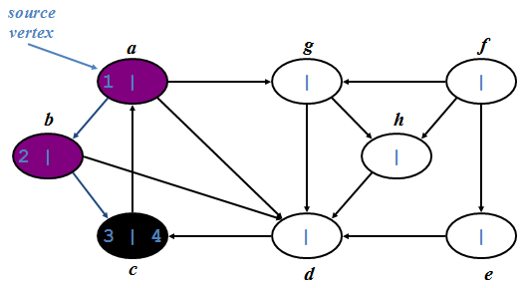

Slide 18
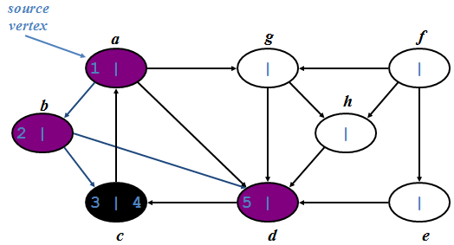
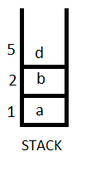

Slide 19
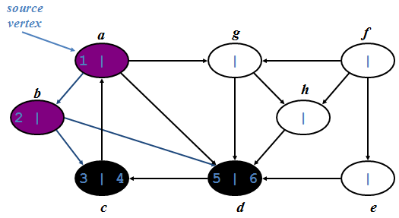

Slide 20
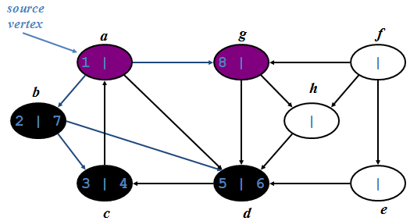
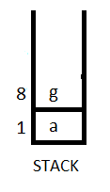

Slide 21
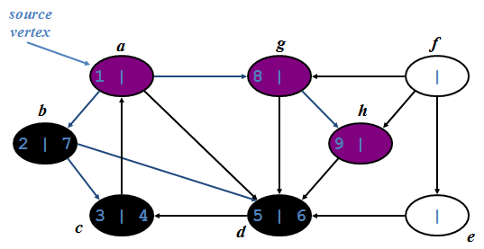
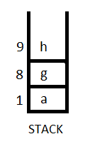

Slide 22
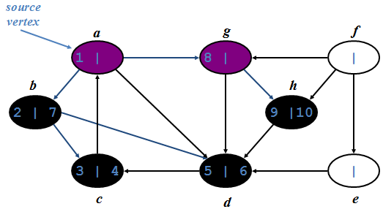

Slide 23
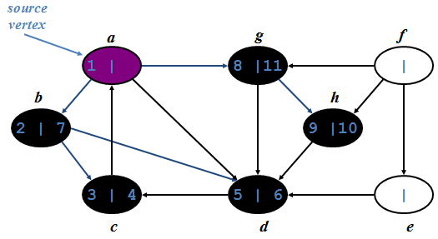

Slide 24
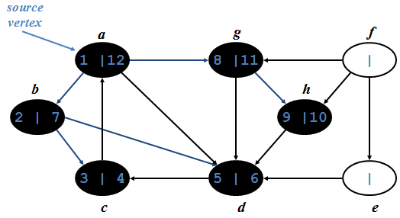


Slide 25
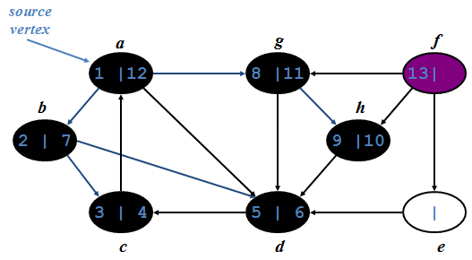


Slide 26
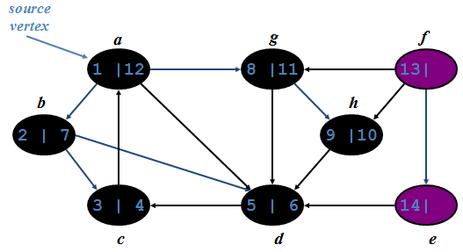
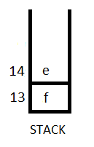

Slide 27
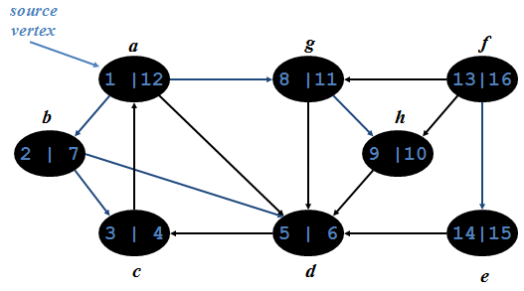


Slide 28
BFS AND DFS – POSSIBLE APPLICATIONS
Applications of BFS:
  GPS Navigation systems, Computer Networks.
  I want to explore all the nearest pizza places and want to go to the nearest one with only two intersections.
  Find distance from my factory to every delivery center.
Applications of DFS:
  To solve puzzle which has one solution
  Minimum Spanning Tree
  Topological sorting

Slide 29
THANK YOU

