Slide 1

Bank Customer Churn Analysis
CRM Insights for Customer Retention
By – Ashutosh Giri

Slide 2
Problem Statement
Objective: Help the bank reduce customer churn, improve service delivery, and enhance overall customer satisfaction
Data provided: Customer demographics, account and transaction details, exit information, and active customer profiles
Core challenge: Identify why customers are leaving and which segments are most at risk
Analysis goal: Uncover the key drivers behind customer attrition through data exploration and segmentation
Expected outcome: Translate findings into actionable, data-backed strategies to retain valuable customers and strengthen long-term relationships

Slide 3
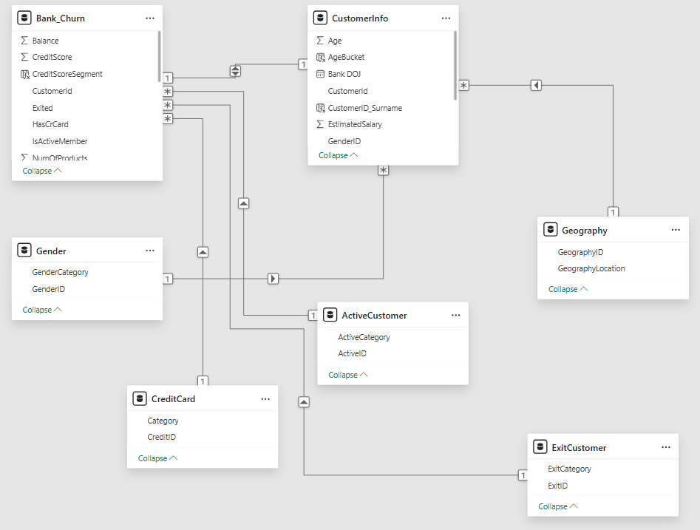
Dataset Overview

Slide 4
Data Description
Bank_Churn: Core fact table with 10,000 records covering CreditScore, Tenure, Balance, NumOfProducts, HasCrCard, IsActiveMember, and Exited status.
CustomerInfo: 10,000 customer profiles with Surname, Age, EstimatedSalary, GeographyID, GenderID, and Bank DOJ (date of joining).
Gender: Lookup table mapping GenderID to Male/Female categories.
Geography: Lookup table mapping GeographyID to France, Spain, and Germany.
CreditCard: Lookup table mapping HasCrCard values to "credit card holder" or "non credit card holder" labels.
ActiveCustomer: Lookup table mapping IsActiveMember values to "Active Member" or "Inactive Member" status.
ExitCustomer: Lookup table mapping Exited values to "Exit" or "Retain" outcome categories.

Slide 5
Key Metrics at a Glance
10,000 — Total Customers
Full customer base analyzed across France, Germany, and Spain
20.37% — Overall Churn Rate
Roughly 1 in 5 customers has left the bank — a significant retention challenge
5,151 — Active Members
Just over half the customer base is actively engaged with the bank
₹76,485.89 — Average Account Balance
Reflects the average value held per customer across all regions
2,037 — Customers Churned
Represents the total number of lost customers, including a disproportionate share of high-balance clients

Slide 6
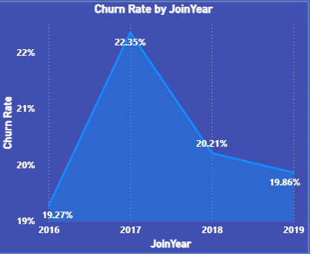
Churn Trend Over Time
"Churn peaked in 2017 at 22.35% and has gradually declined since, but remains close to 20% overall — the underlying churn problem has not been resolved, only stabilized."
Churn rate spiked sharply in the 2017 customer cohort
A gradual improvement followed in 2018–2019, but rates remain historically high
No single year shows churn dropping below ~19% — the problem is persistent, not one-time

Slide 7
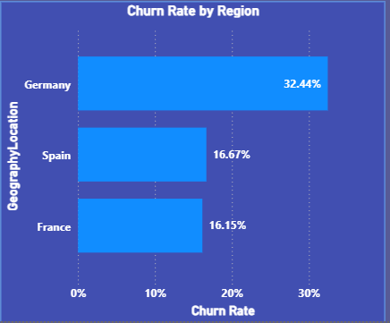
Geographic Risk
"Germany's churn rate is roughly double that of France and Spain — making geography one of the single strongest predictors of customer attrition in this dataset.“
Germany also holds the highest average account balance (₹1,19,730) — meaning the bank isn't just losing more customers there, it's losing its most valuable ones
France has the largest customer base (2,591 active members) and the lowest churn — showing strong retention despite lower average balances
This regional gap suggests Germany-specific factors (competition, pricing, service quality) are driving attrition, not just customer demographics alone

Slide 8
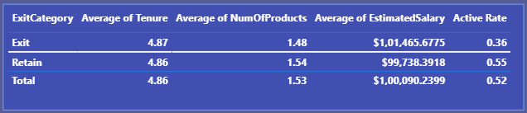
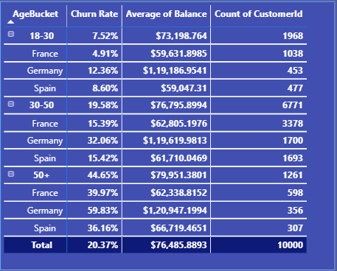
Who Is Most Likely to Churn?
Age is the single strongest demographic risk factor — churn nearly triples between the 18-30 and 30-50 brackets, then doubles again for 50+. This isn't a small trend; it's a near-linear escalation.
Engagement matters as much as demographics — the fact that only 36% of exited customers were active (vs. 55% of retained) shows that disengagement often precedes churn. This means inactivity could serve as an early-warning signal, not just a side effect.
The risk compounds geographically — from your age table, Germany's 50+ segment churns at 59.83%, nearly double France's 50+ rate (39.97%). So age risk isn't uniform across regions — Germany amplifies it further.
Business implication: The bank should treat "inactive + older + German" as a compound red flag, not evaluate these factors independently. A 50+ German customer who becomes inactive is likely a near-certain churn case, and should trigger proactive retention outreach before they leave.

Slide 9
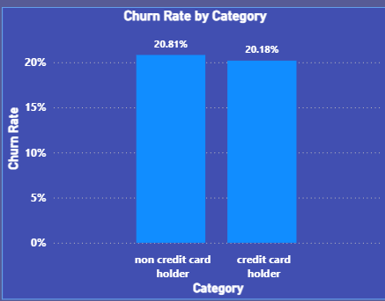
Credit Card Ownership: No Impact on Retention
"Despite being a common product offering, credit card ownership shows almost no measurable effect on customer retention — non-holders actually churn slightly more, but the gap is negligible. This challenges the assumption that more products automatically drive loyalty.“
Retention efforts should prioritize engagement and service quality (which do show real impact, as seen with IsActiveMember) over simply cross-selling more products
The bank's current credit card rewards program isn't functioning as a loyalty lever — worth reassessing whether its benefits actually incentivize continued relationship value

Slide 10
Highest-Risk Segment
"Nearly 6 in 10 of the bank's 50+ German customers — its wealthiest older segment — are leaving. This is the single highest-risk, highest-value customer group in the entire portfolio, representing the bank's most urgent retention priority.“
This segment combines all three major risk factors identified in the analysis: older age + high balance + Germany location
Losing these customers has an outsized financial impact given their high average balance
Recommend a dedicated, high-touch retention program specifically targeting this segment (e.g., relationship managers, personalized retirement/wealth products, proactive outreach before signs of disengagement appear)

Slide 11

DASHBOARD - Customer Demographics

Slide 12

DASHBOARD - Product Engagement

Slide 13

DASHBOARD - Churn Analysis

Slide 14
CONCLUSION
Churn is a persistent, not one-time, problem. The overall churn rate is 20.37%. It peaked at 22.35% for the 2017 cohort and never dropped below ~19% in any year.
Risk is concentrated, not evenly spread. Three factors stand out: older age (50+ customers churn at 44.65%), Germany (32.44% vs ~16% in France and Spain), and inactive engagement. Combined, they push the Germany, 50+ segment to nearly 60%.
Women churn at a higher rate than men. Female customers churn at 25.07% vs 16.46% for male customers, so gender is a clear secondary risk factor.
The bank is losing its most valuable customers. Exited customers hold a higher average balance than retained ones (~91K vs ~73K), and Germany, the highest-churn region, also holds the highest average balance. The financial impact is larger than the raw percentage suggests.
Common assumptions don’t hold. Credit card ownership (20.81% vs 20.18%), salary (19.9% to 21.5% across salary buckets) and tenure (3-7 years in the data, average 4.87 vs 4.86) show little link to churn. Retention built on “more tenure means more loyalty” or “a credit card keeps customers” would miss the mark.
Engagement is the actionable lever. Only 36% of exited customers were active members, against 55% of retained customers. Declining activity is the clearest early-warning signal for proactive intervention.

Slide 15
RECOMMENDATIONS
. Launch a dedicated retention program for Germany, 50+, high-balance customers
This segment churns at ~60%. Assign relationship managers and offer retirement/wealth products, with the highest-balance customers first.
2. Build an early-warning system based on member activity
Only 36% of exited customers were active members, against 55% of retained customers. Flag declining activity and trigger re-engagement offers before customers leave.
3. Investigate Germany-specific root causes
Germany churns at about double the rate of France and Spain (32.44% vs ~16%). Run customer surveys and a competitor analysis on pricing and service.
4. Review retention for female customers
Women churn at 25.07% vs 16.46% for men. Find out why, and design targeted products or service improvements.
5. Redesign the credit card rewards program
Card ownership has no retention benefit (20.18% vs 20.81% churn). Rework the rewards so they reward continued engagement.
6. Extend age-based relationship management
Churn rises with age (7.52% → 19.58% → 44.65%). Add life-stage products and advisory touchpoints before customers reach the highest-risk brackets.

Slide 16
THANK YOU

