Slide 1

Warehouse Copilot From questions to insights
August 11, 2025
[1]

Slide 2





End‑to‑End Flow
Your question travels through a pipeline of context, AI and data to produce actionable insights.
User asks question
RAG fetches schema & docs
Gemini generates SQL & insights
Connector executes query
UI displays results & insights
[2] [3] [4]

Slide 3
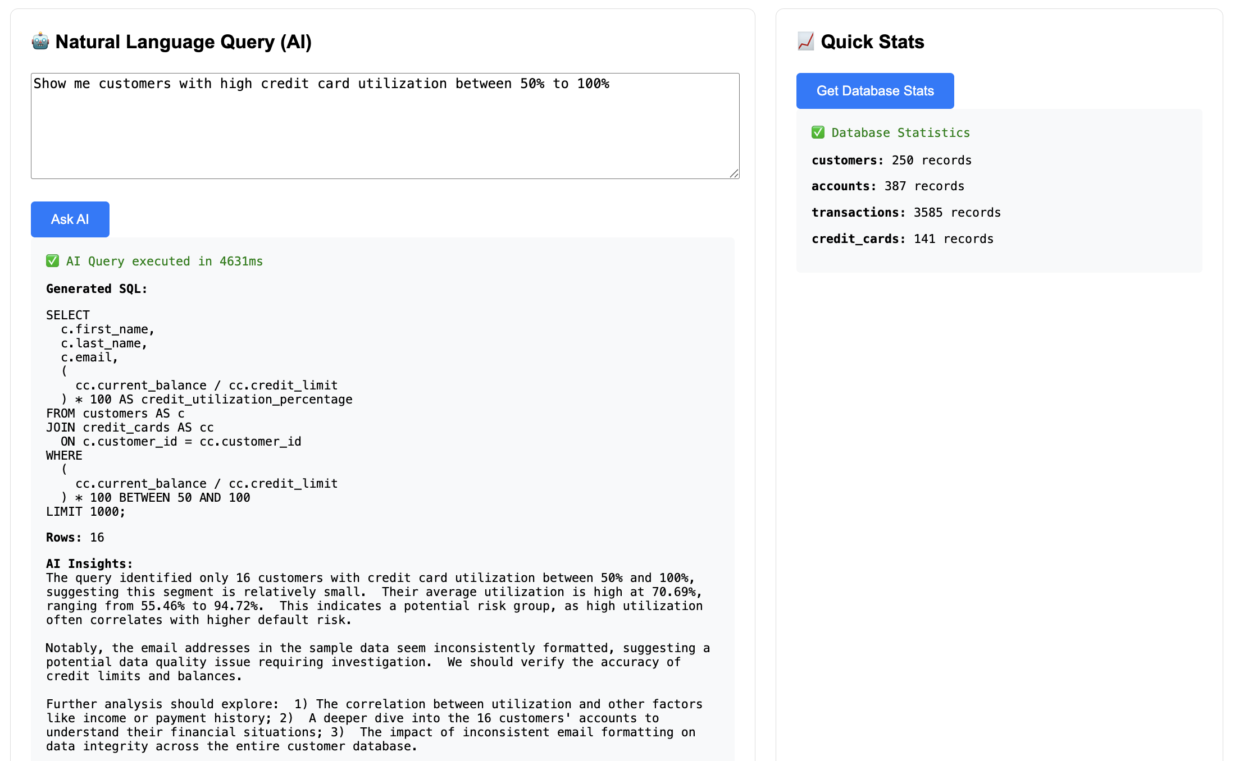
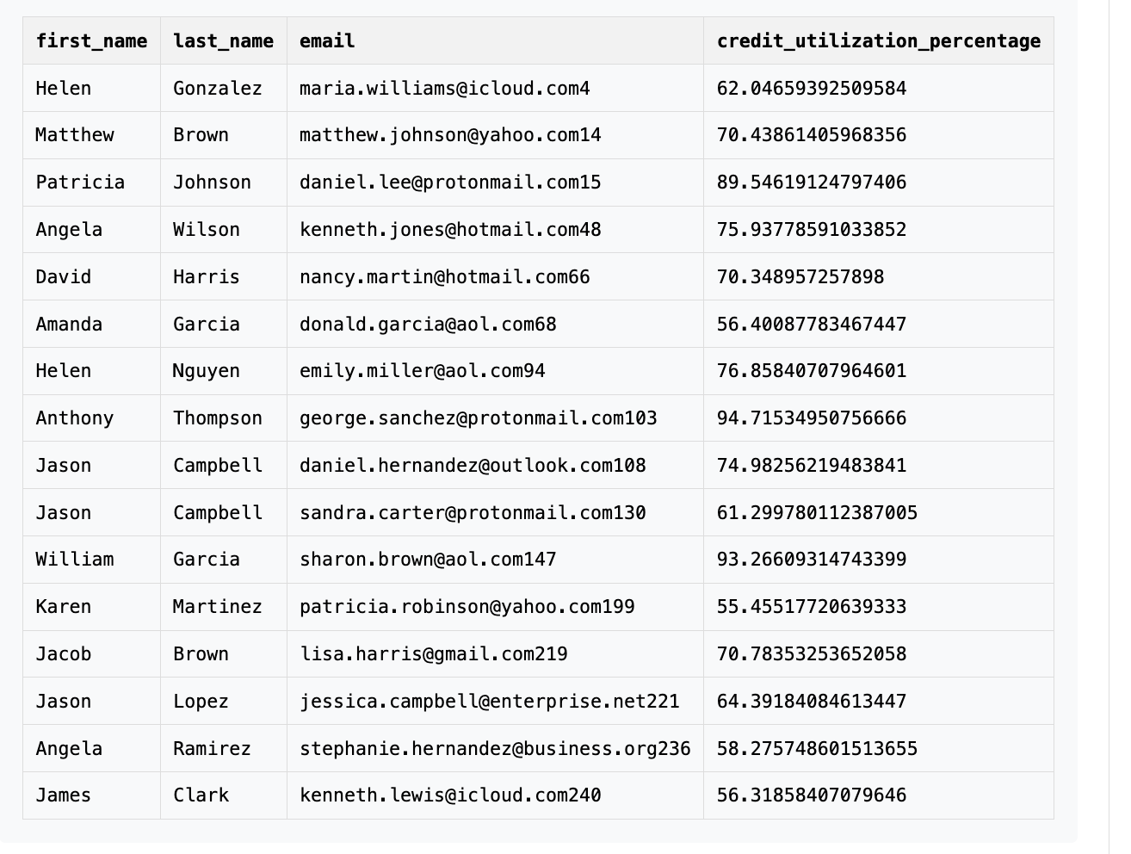
UI – Demo 1

Slide 4
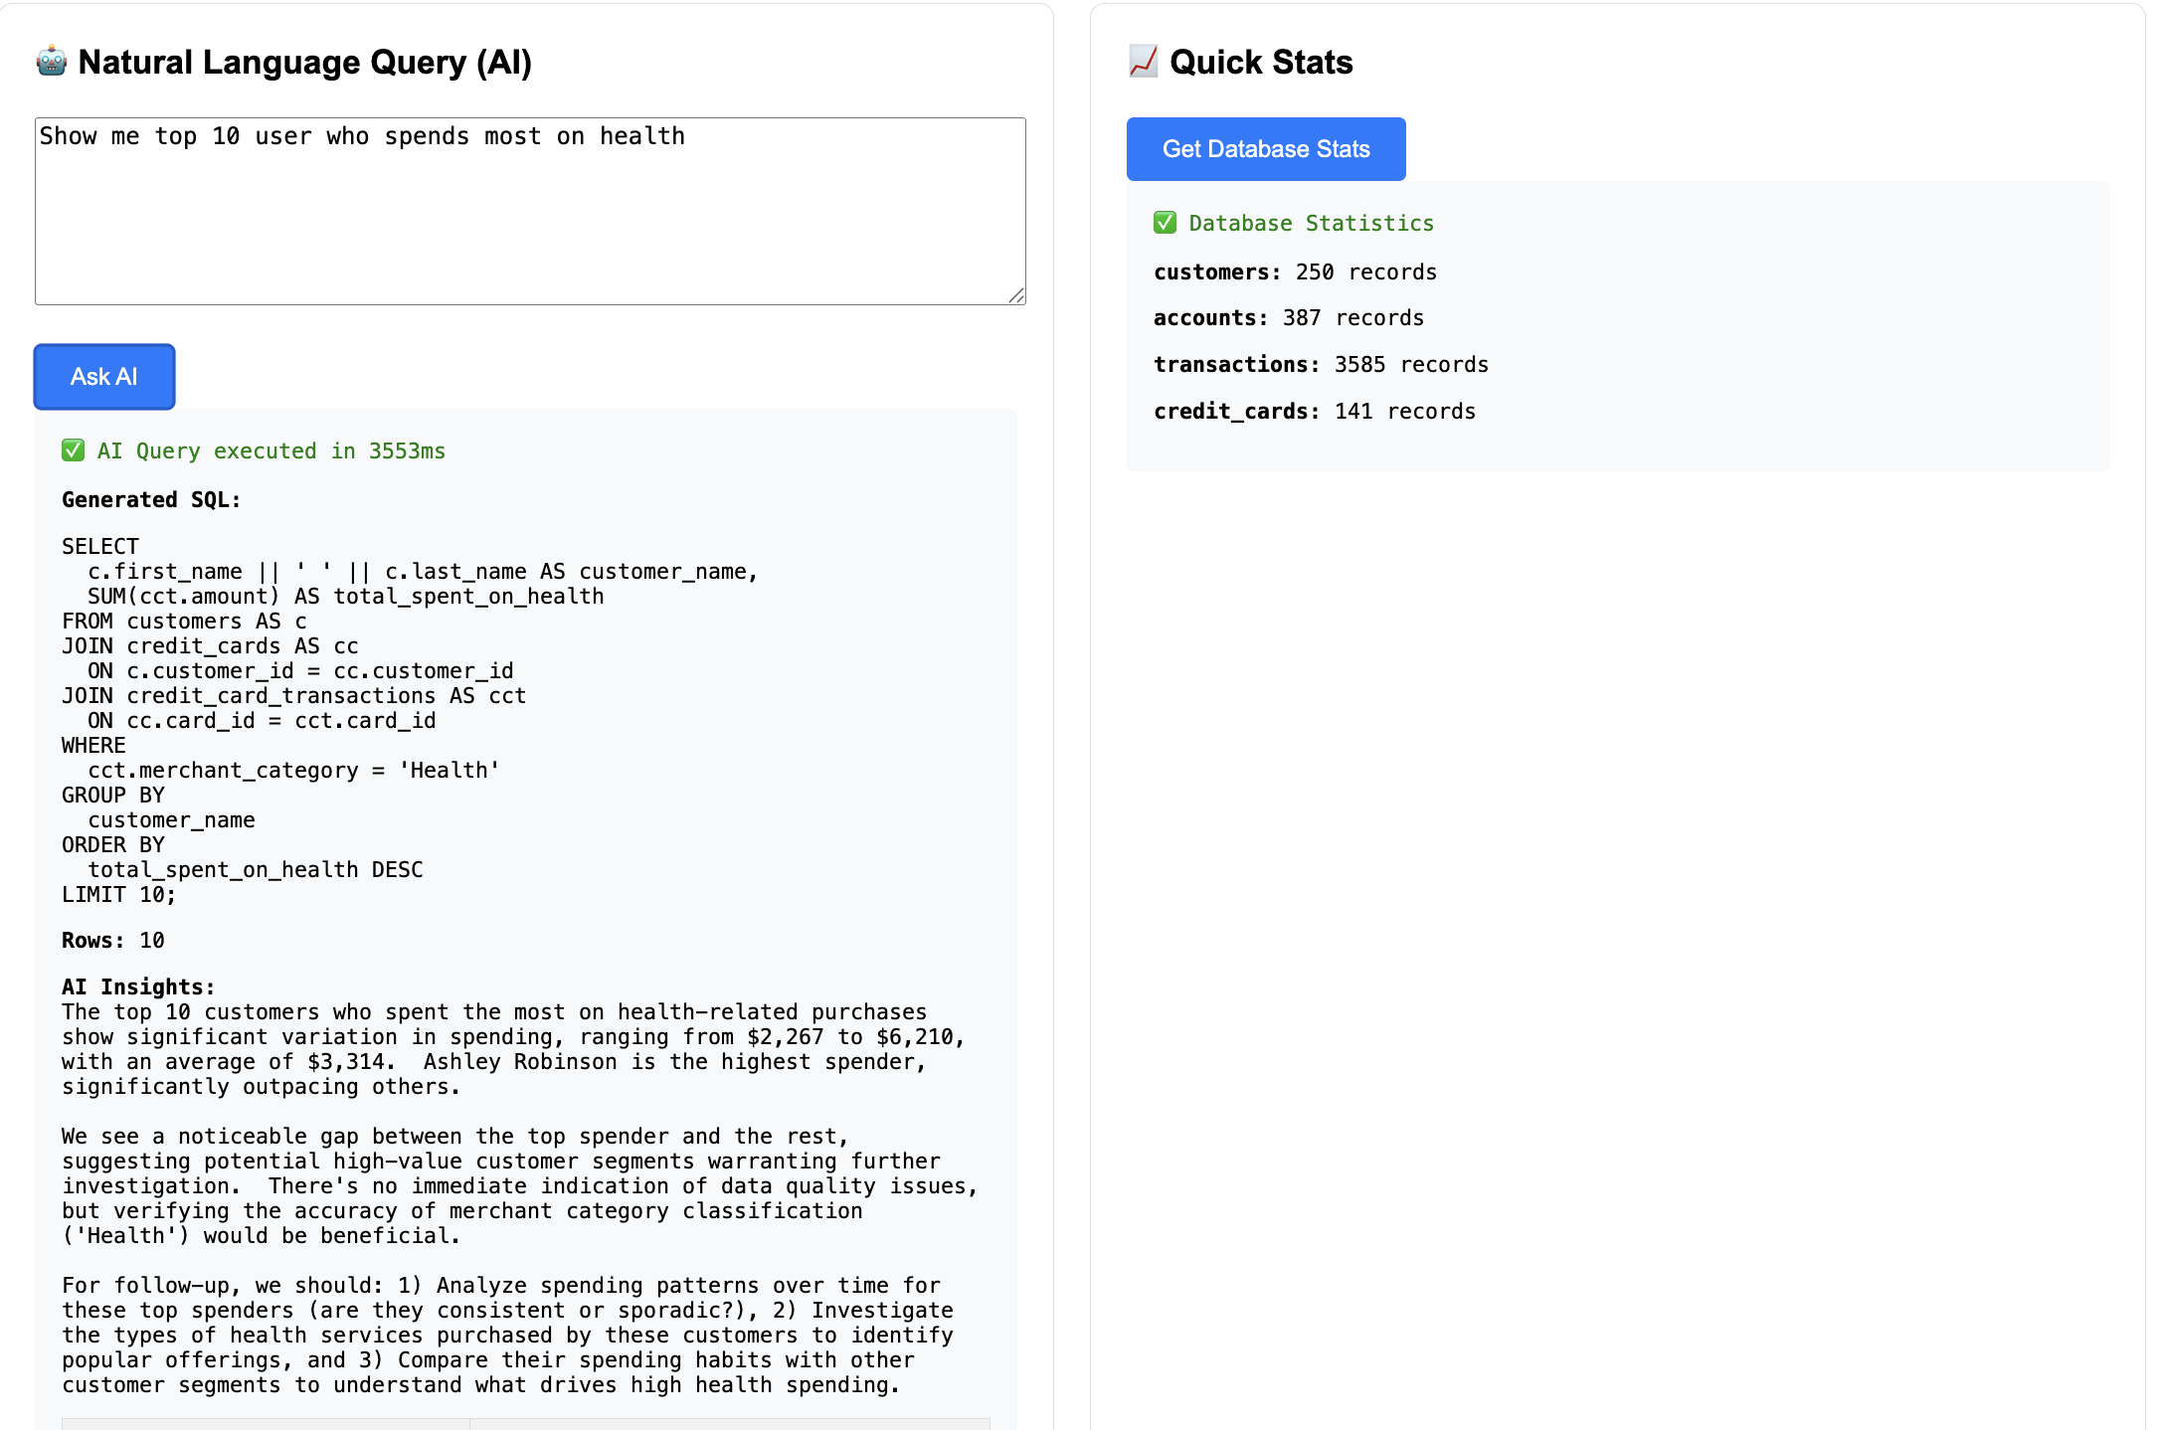
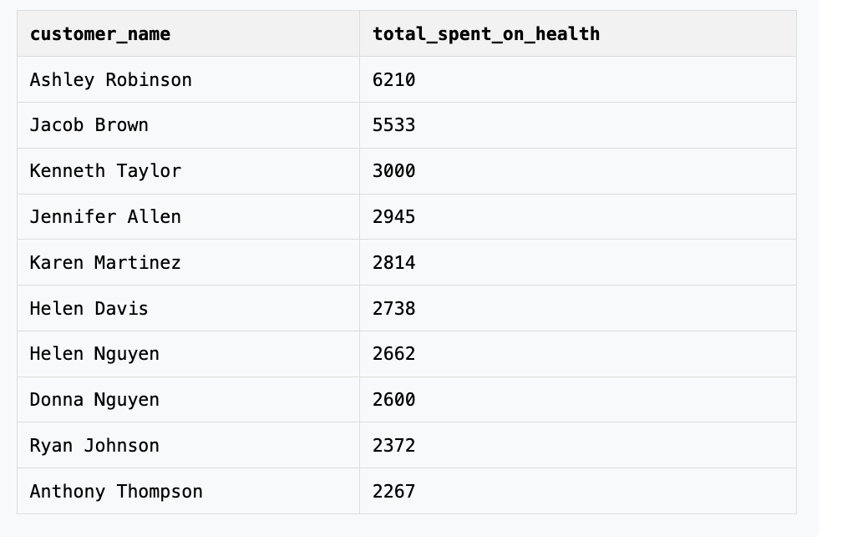
UI – Demo 2

Slide 5
Demo Video Link – Please watch on mute
Loom Video : https://www.loom.com/share/6d5de00719e641f5b991981eb63b3b40?sid=70495587-91e2-425b-b811-7051d25f4fed

