Slide 1
WORK SYSTEM DESIGN LAB (IM29008)
Group 5 Members :
Mridul Gupta 19IM30025
Ashutosh Kumar 19IM30026
Devesh Chaudhary 19IM30027
Aayush Poddar 19IM3FP24
Varshitha P 19IM3FP26
Rishav Dugar 19IM3FP30

Slide 2
PROBLEM STATEMENT
During a pandemic, when Schools and Colleges are closed down, all the classes are being conducted online. Examinations held to evaluate students performance are also conducted in the online mode.
Since most of the students are not monitored during online exams, there are many cases of malpractices, results in distribution of false grades. What can be done to prevent such occurrences?

Slide 3
SOLUTION:
A web application for conducting the online subjective exams
Languages used:
Flask
Python with OpenCV, Numpy, DLib, Face_Recognition packages
HTML, CSS, JavaScript
Live proctoring capability including:
Face Recognition
Smartphone Detector
Multi Person Detector
Head Pose Estimation
Eyeball Tracker

Slide 4
<VIDEO COMES HERE>

Slide 5
FACE RECOGNITION
Our first feature is face recognition to confirm the identity of the student appearing for examinations on a system.
This feature is built and developed in python using the OpenCV and Face Recognition module.
What do we need for face recognition?
We need a picture of student who is giving exam in order to compare with the face captured in webcam.
Then we need to find out the face encodings of both faces(known one and the one captured in webcam).
How does it work?
First we import all the necessary packages required for the code.
Then using video_capture = cv2.VideoCapture(0) the webcam starts.
Image of student is loaded and the face encoding of image is performed.
student_image = fr.load_image_file("student.jpeg")
student_face_encoding = fr.face_encodings(student_image)[0]
known_face_encodings = [student_face_encoding]
known_face_names = ["Mridul"]

Slide 6
Then we run a loop where we capture the video from webcam into frame and then find the faces in that frame and compare with the known_face_encodings.
while True:
ret, frame = video_capture.read()
rgb_frame = frame[:, :, ::-1]
face_locations = fr.face_locations(rgb_frame)
face_encodings = fr.face_encodings(rgb_frame, face_locations)
for (top, right, bottom ,left), face_encoding in zip(face_locations, face_encodings):
matches = fr.compare_faces(known_face_encodings, face_encoding, tolerance=0.5)
name = "Unknown"
face_distances = fr.face_distance(known_face_encodings, face_encoding)
best_match_index = np.argmin(face_distances)
if matches[best_match_index]:
name = known_face_names[best_match_index]
if name == "Unknown":
cv2.putText(frame,"Not recognised",(200,50),cv2.FONT_HERSHEY_SIMPLEX, 1,(255,100,0),2, cv2.LINE_4)

Slide 7
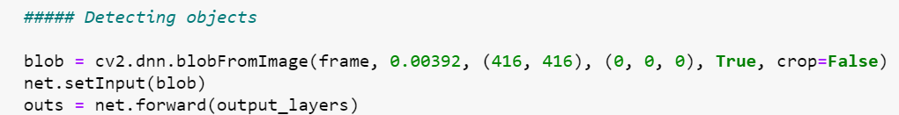
Smartphone and Multiple Person Detection
Our next feature of consideration is the detection of smartphone/multiple persons for a student appearing for examinations on a system.
This feature is built and developed in python using the OpenCV package along with YOLO necessary for image processing and computer vision.
What do we need for smartphone/multiple person detection?
It is done in two steps-(i) Object Detection (ii) Object Classification
A deep learning model or algorithm is needed to generate a large set of bounding boxes spanning the full image (that is, an object localization component) for object detection.
Weight file: it’s the trained model, the core of the algorithm to detect the objects.
Cfg file: it’s the configuration file, where there are all the settings of the algorithm.
Name files: contains the name of the objects that the algorithm can detect.
How does it work?
we can’t use right away the full image on the network, but first we need it to convert it to blob.
Z

Slide 8
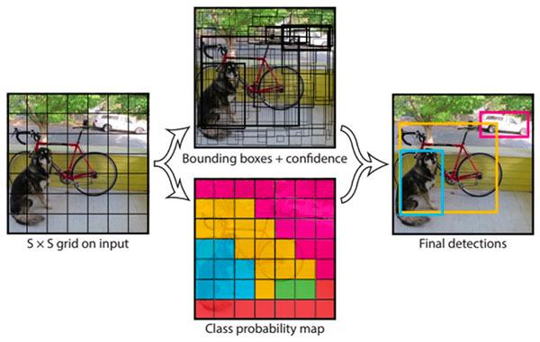
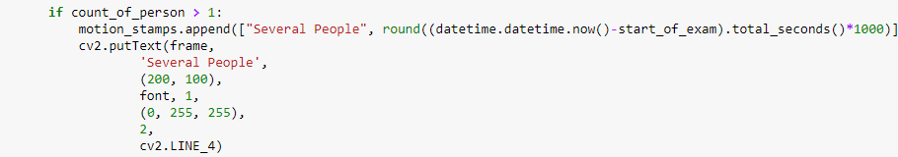
We then loop through the outs array, we calculate the confidence and we choose a confidence threshold. .When we perform the detection, it happens that we have more boxes for the same object, so we should use another function to remove this “noise”.It’s called Non maximum suppression.We finally extract all the informations and show them on the screen.
Box: contain the coordinates of the rectangle surrounding the object detected.Label: it’s the name of the object detected.Confidence: the confidence about the detection from 0 to 1.

Slide 9
HEAD POSE ESTIMATION
Our next feature of consideration is the head pose estimation of the student appearing for examinations on a system.
This feature is built and developed in python using the OpenCV library necessary for image processing and computer vision.
What do we need for pose estimation?
The first and foremost job is to locate 2D points on the face to be monitored, which appropriately defines the entire face. Dlib’s facial landmark detector provides us with many points to choose from, and for our model, we used the tip of the nose, the left corner of the left eye, the right corner of the right eye, the left corner of the mouth, and the right corner of the mouth.
We then defined the euclidean distance between all facial coordinates and the nose coordinate to maintain the estimation’s centrality on obtaining coordinates of necessary facial points.
How does it work?
The next step requires defining two vital parameters: Gaze testing (how stable is the movement of the head in the left and right directions and up to what extent) and Alignment testing (checking alignment of all facial coordinates and examining their variations on the up-down facial movements)
Based on the code’s numerous experimenting for a good and significant head angle change, we decided on a threshold of approximately 0.2 deviations from 1.
On observing variations in gaze testing and alignment ratios, we finally conclude by estimating the direction in which the head is deviating.

Slide 10
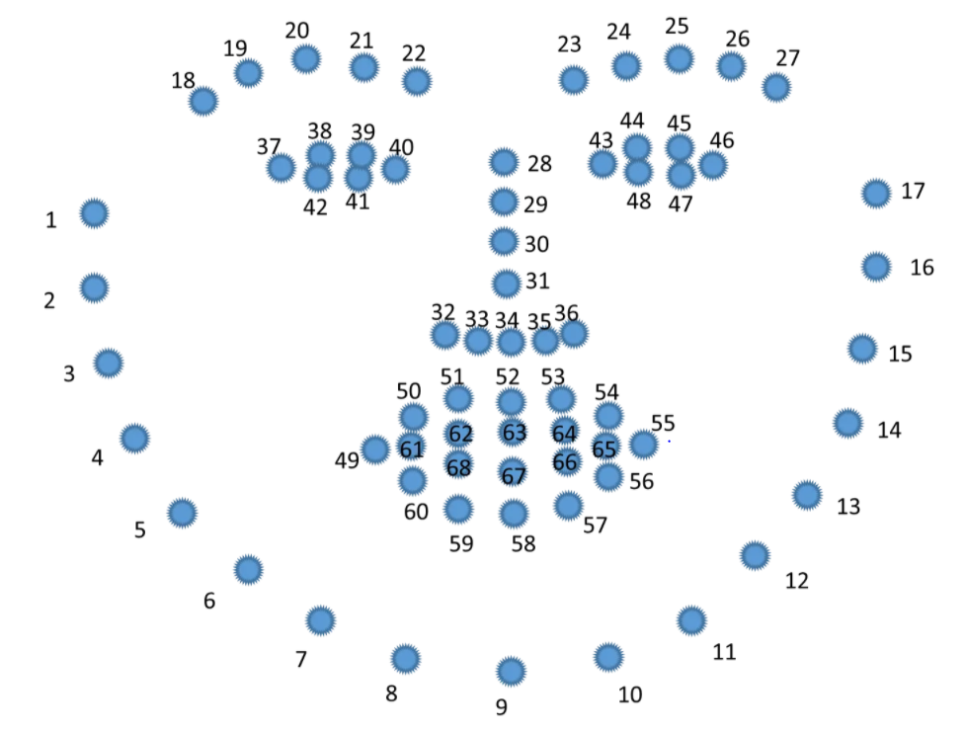
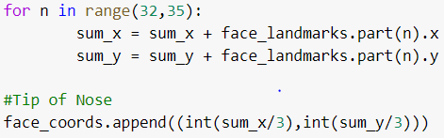
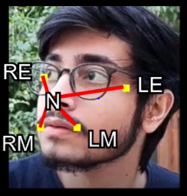
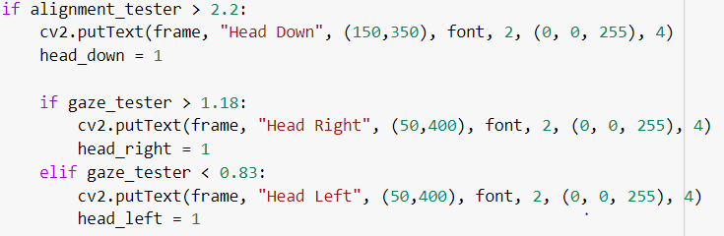
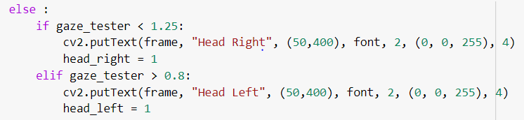
Dlib facial landmark detection
The above snippet give nose tips coordinate, in similar way we can find right and left eye extent and mouth extents
L-R:
U-D:
On head right situation, the right portion would suffice for more perceived length hence the gaze testing ratio is greater than 1. Same is the case for head left position.
On a head down situation, alignment tester ratio would always be greater than 1, since on a head down position, upper alignment would be perceived more.

Slide 11
EYEBALL TRACKING
Our next feature of consideration is the eyeball tracking of the student appearing for examinations on a system.
This feature is built and developed in python using the OpenCV package necessary for image processing and computer vision.
What do we need for eyeball tracking?
The first and foremost job is to locate 2D points on the face to be monitored, which appropriately defines the entire face. Dlib’s facial landmark detector provides us with many points to choose from, and for our model, we used the points that denote the left and right eye.
We then defined the eye aspect ratio to determine whether the eye is closed or not.
How does it work ( provided eye is open for the webcam ) ?
ROI is extracted from the video. Now we wish to apply a whitening vignette that draws attention to only the central portion. Since we wish to keep the image’s brightness and saturation normal at the center and try to reduce this as we go radially outward from the center of the image so we should use a distribution function that assigns more weights to the nearest pixel as compare to the pixel which is far. This is the main reason we will be using Gaussian distribution and since we know that in Gaussian distribution most of the values are effectively close to zero and none zero. So we will be creating a mask of sufficiently large size. For creating 2-d Gaussian function we will be creating two 1-d Gaussian functions and multiply these two. One belonging to X-direction and other to the Y-direction. Since our current kernel matrix large in size so we will be normalizing to reduce the kernel size otherwise cost of applying a filter will be too large.

Slide 12
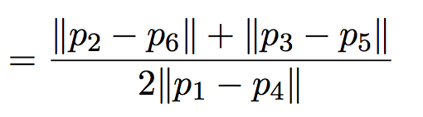
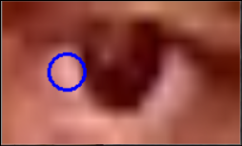
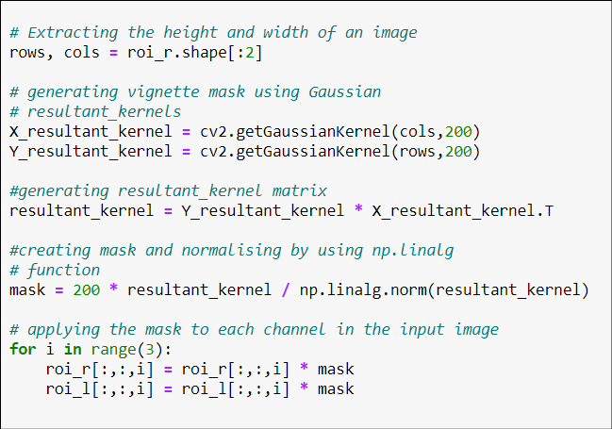
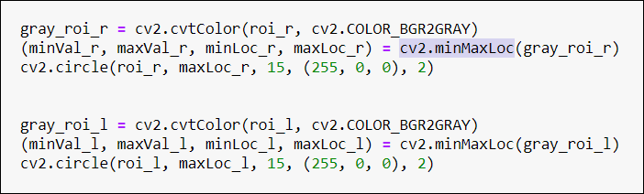
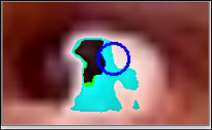
cv2.getGaussiankernel(int size, sigma) is used for this purpose. Size is the number of rows you want ( equal to length or height of image ). Sigma essentially stands for the radius we want to apply the filter on.
Now a mask is generated with a value of 200 * the resultant kernel elements and is applied to the image pixel wise.
This brings attention to the centre portion of the ROI which includes the eyeballs.
cv2.minMaxLoc() function returns the coordinates of the regions in the ROI with highest and lowest intensity based on blacks and whites. Now the white is the brightest part. If it’s in the side the person is not gazing and if it;s in the center the person is.
EYE ASPECT RATIO (EAR)
Applying the Vignette
Finding the brightest and darkest regions

Slide 13
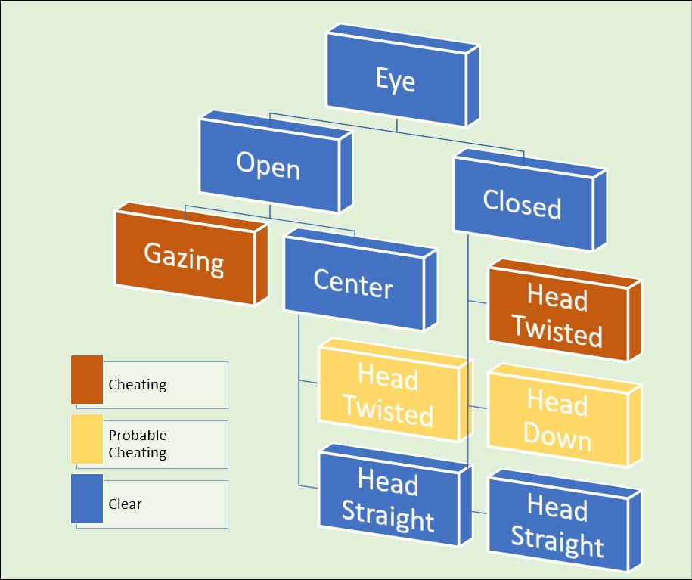
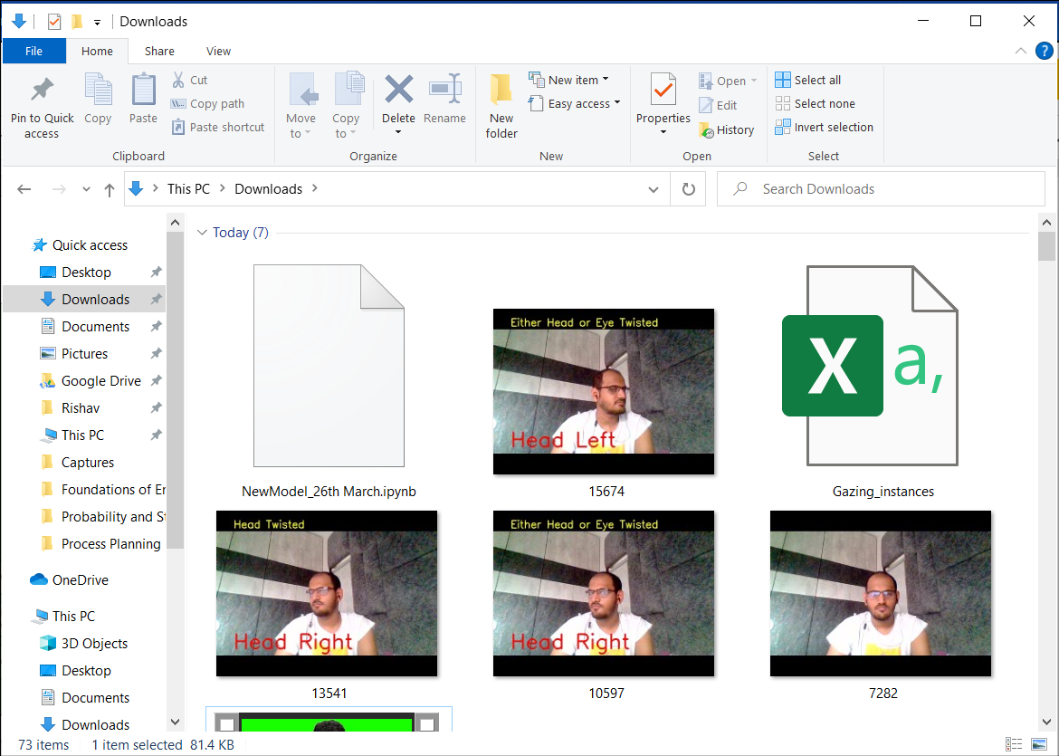
POSSIBLE SCENARIOS
For the probable scenarios
The software takes screenshots of the frame if necessary after 1.5s.
These can be analysed later using physical means or custom software.

Slide 14
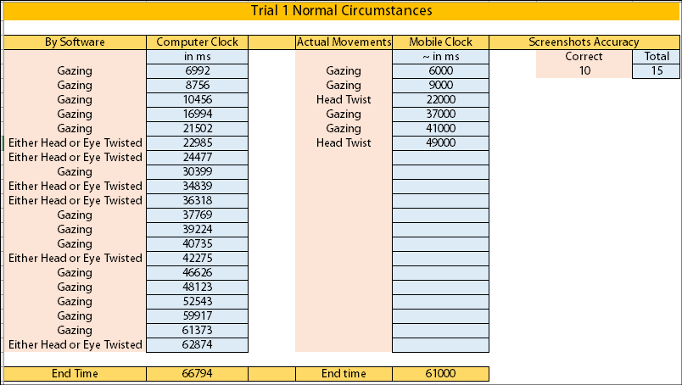
RESULTS OF EXPERIMENTS

Slide 15
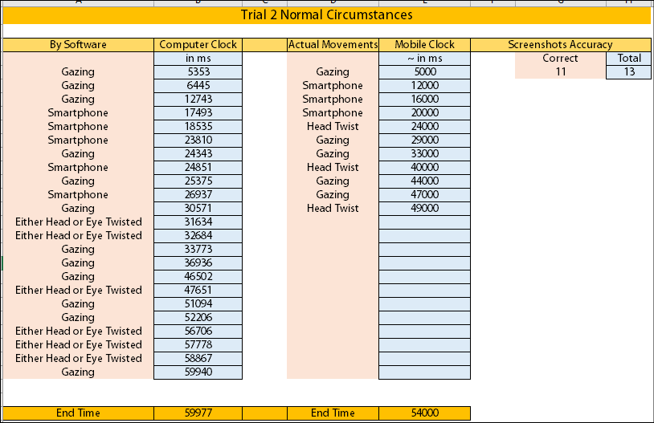
RESULTS OF EXPERIMENTS

Slide 16
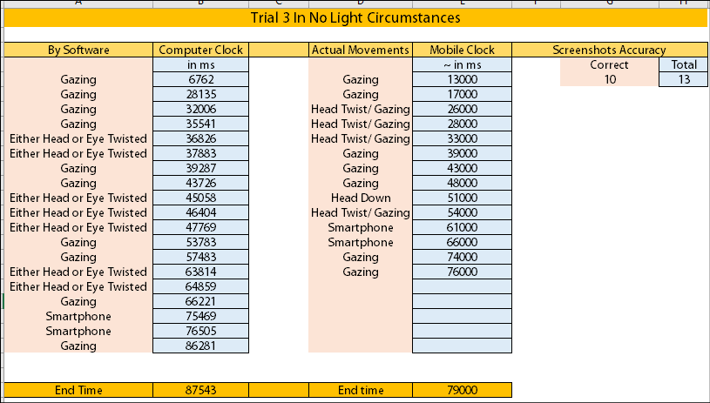
RESULTS OF EXPERIMENTS

Slide 17
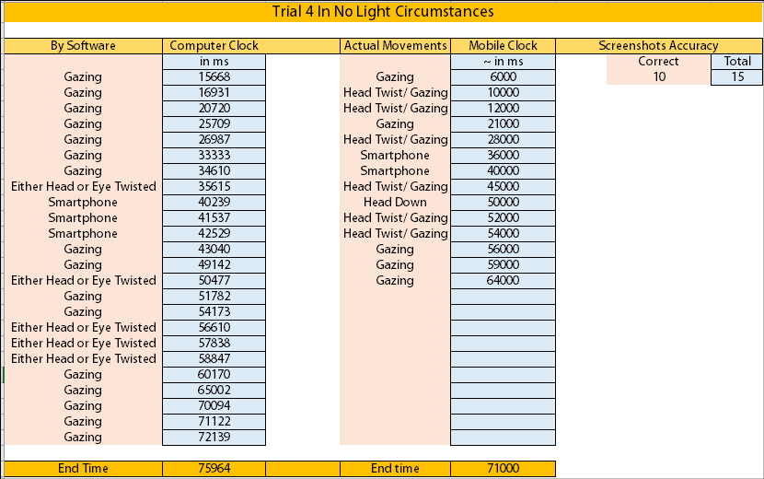
RESULTS OF EXPERIMENTS

Slide 18
RESULTS OF EXPERIMENTS
Inferences Obtained
Out of the 52 observations, 2 smartphone observations (landscape mode) were not detected, 2 long gazes, 7 minor gazes (shorter than 1.5s ) were not detected. This gives a score of 78.8% on the basis of accuracy of detections.
If we neglect minor gazes because no proper viewing can happen in such short spans. The score is 92.3%.
On comparing the picture accuracy of the 4 sets of data we conclude that 72.98% of the readings are correct in catching false practices. The rest are false positives.
Calculations : Considering the duration of exam as an Weight for the probability :
P = ∑ ( Duration * Correct Screenshots ) / ∑ ( Duration * Total Screenshots )
= 0.7298
Final accuracy that a malpractice is detected lies between 57.5% to 67.33% ~ 63%
However probability of being caught still remains 78.8% to 92.3%.

Slide 19
WEBAPP INTEGRATION
<LIVE DEMONSTRATION>

Slide 20
Thank You

