Slide 1

OLYMPIC DATA ANALYSIS
BY
ASHUTOSH MORE
PROJECT GUIDE:
Venkata S. Billa (DE Expert)

Slide 2
Project Description & Objective
The Olympic Games Data Engineering Project aims to create a robust and scalable data infrastructure for managing and analyzing historical data related to the Olympic Games. This project is designed to support researchers, analysts, and sports enthusiasts in gaining valuable insights into the history of the Olympics, tracking athlete performance, and exploring various aspects of this global sporting event.

Slide 3
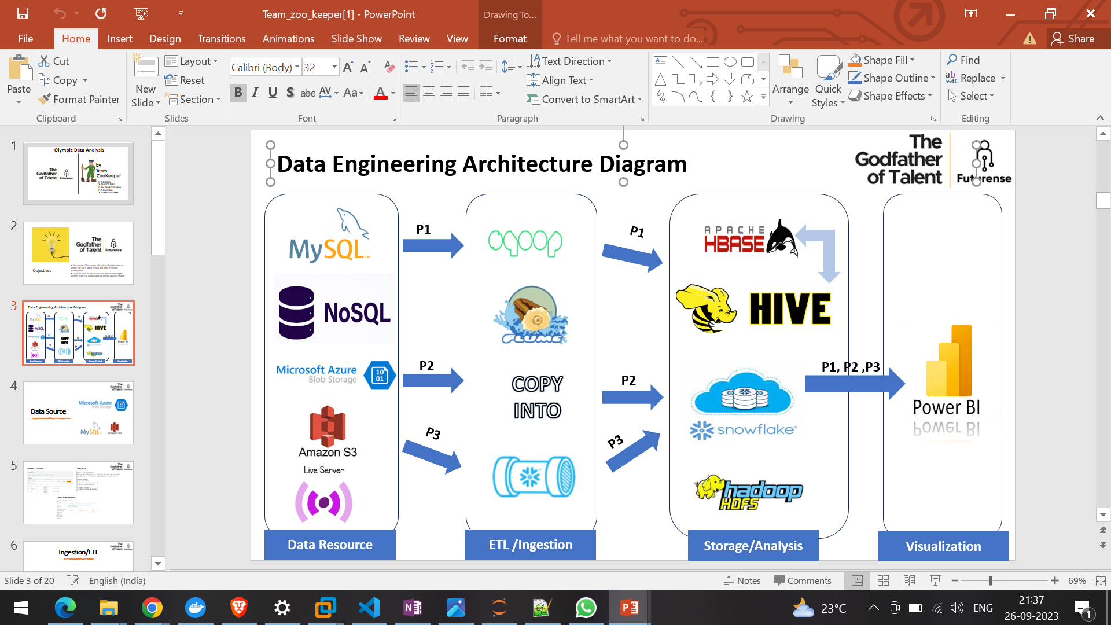









END TO END IMPLEMENTATIONS OF DE PIPELINE
Source
Ingestion / ETL
Storage / Analysis
BI
COPY INTO

Slide 4
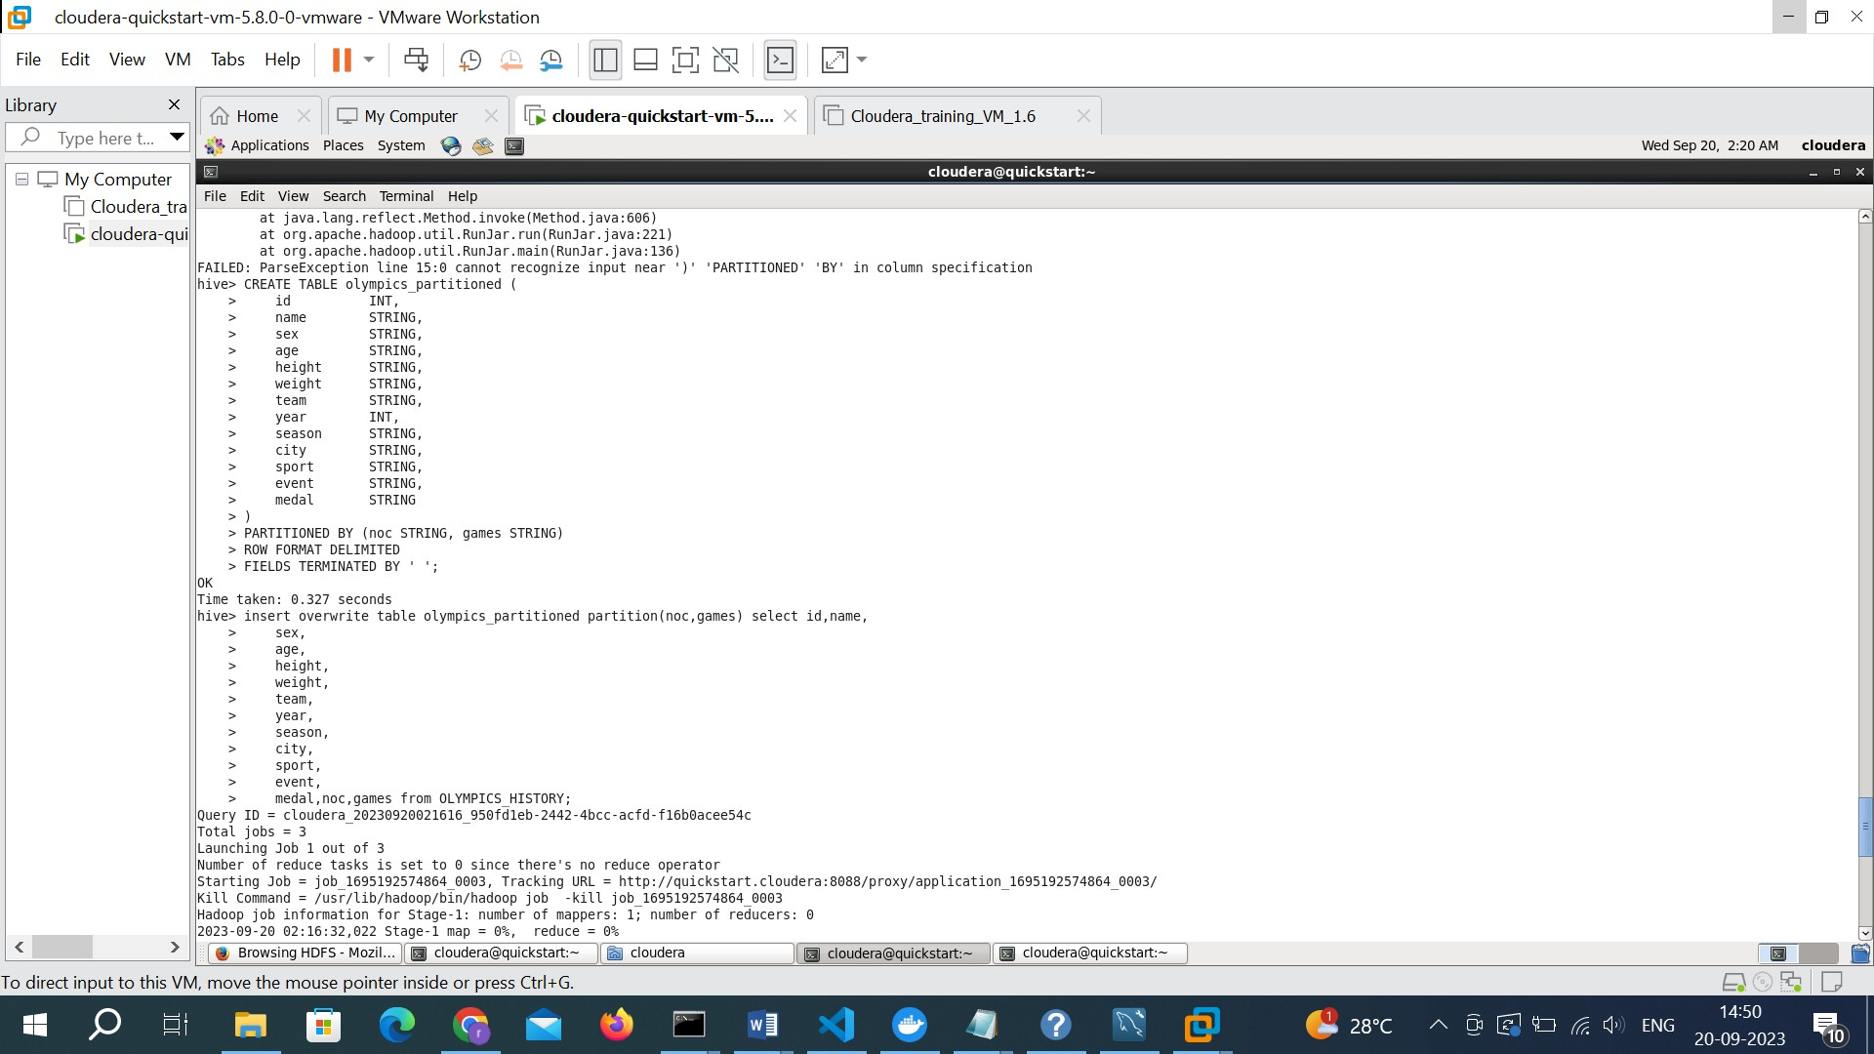
Partitioned table creation in hive for optimized analysis

Slide 5
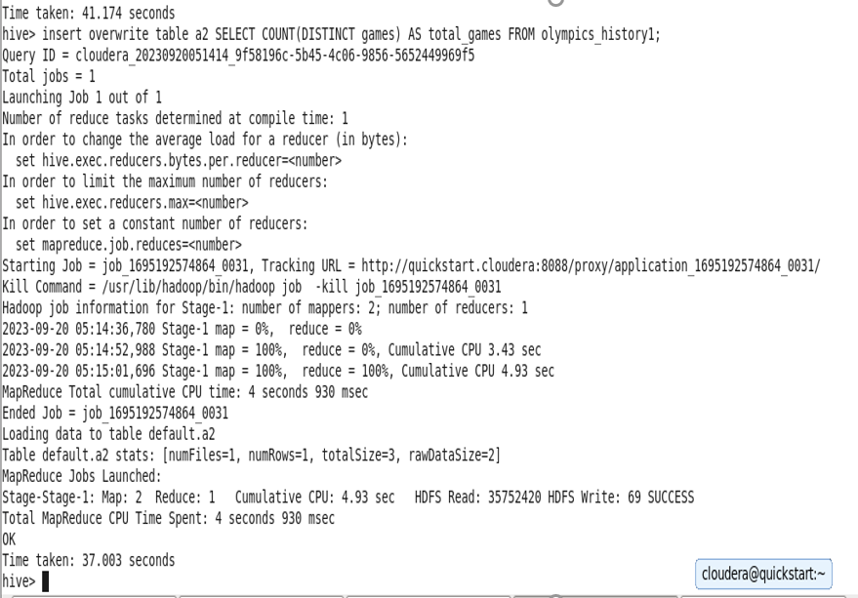
Q. How many Olympics games have been held?
CREATE EXTERNAL TABLE IF NOT EXISTS a2(
answer STRING
)
ROW FORMAT DELIMITED
FIELDS TERMINATED BY ' ‘;
insert overwrite table a2 SELECT COUNT(DISTINCT games) AS total_games FROM olympics_history1;

Slide 6
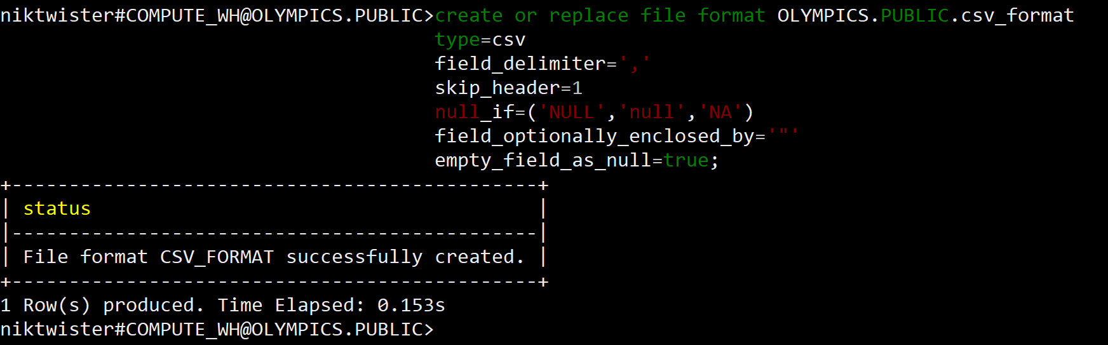
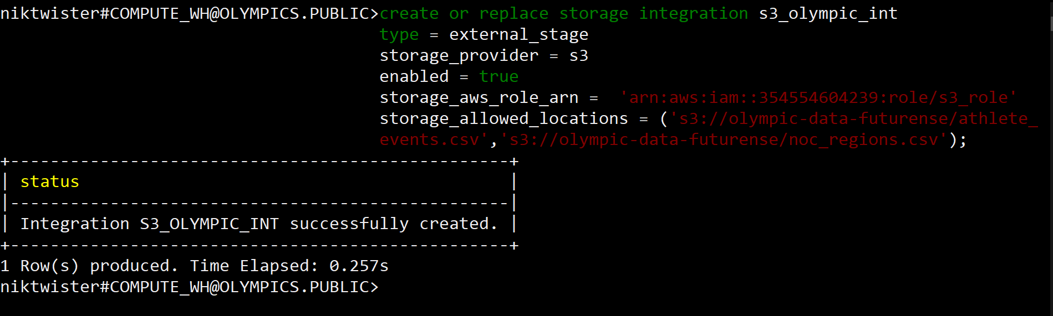
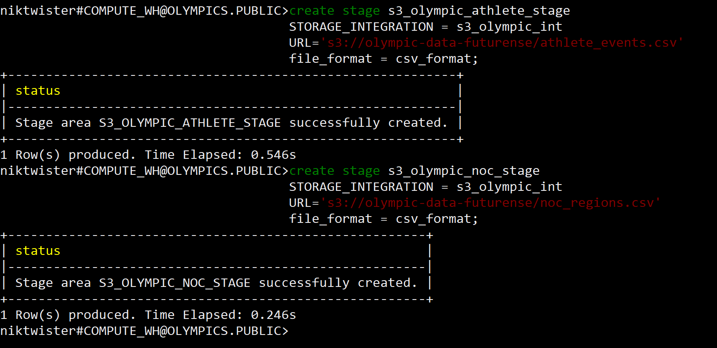
Creating file format
Creating storage integration
Creating stages

Slide 7
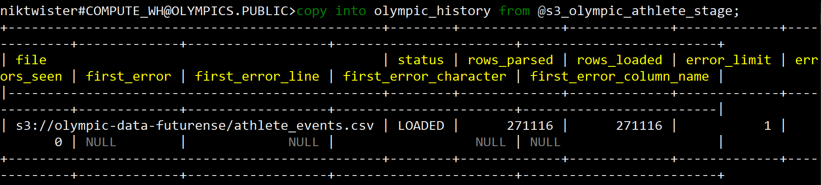
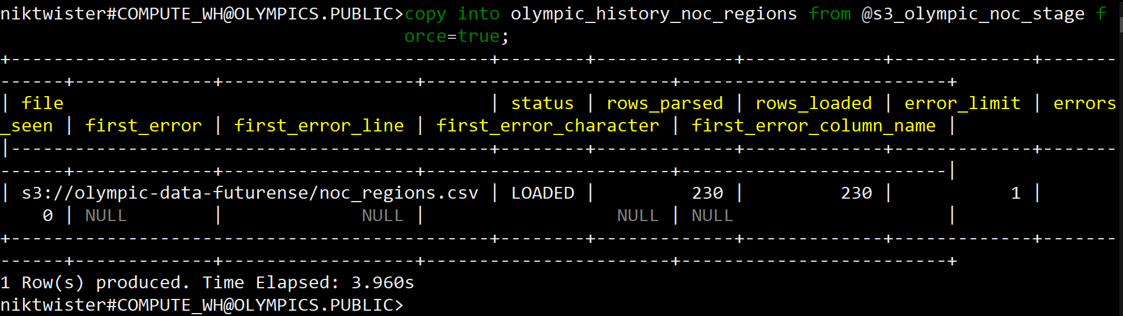
copy into olympic_history
copy into olympic_history_noc_regions

Slide 8
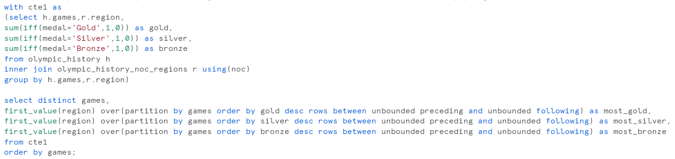
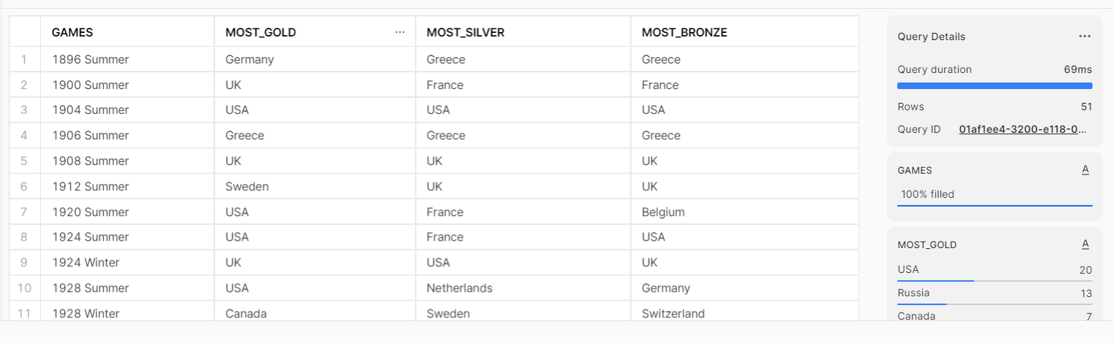
Q. Identify which country won the most gold, most silver and most bronze medals in each olympic games.
Output

Slide 9
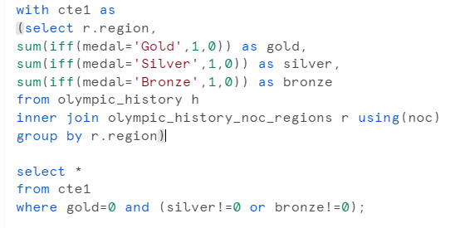
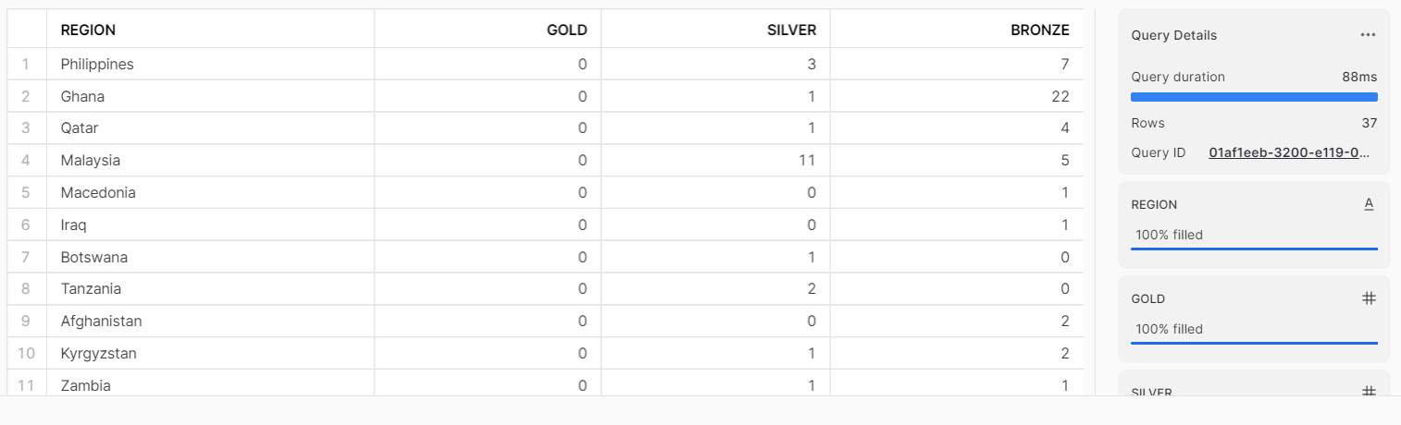
Q. Which countries have never won gold medal but have won silver/bronze medals?
Output

Slide 10
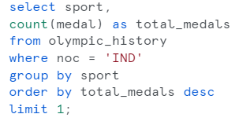
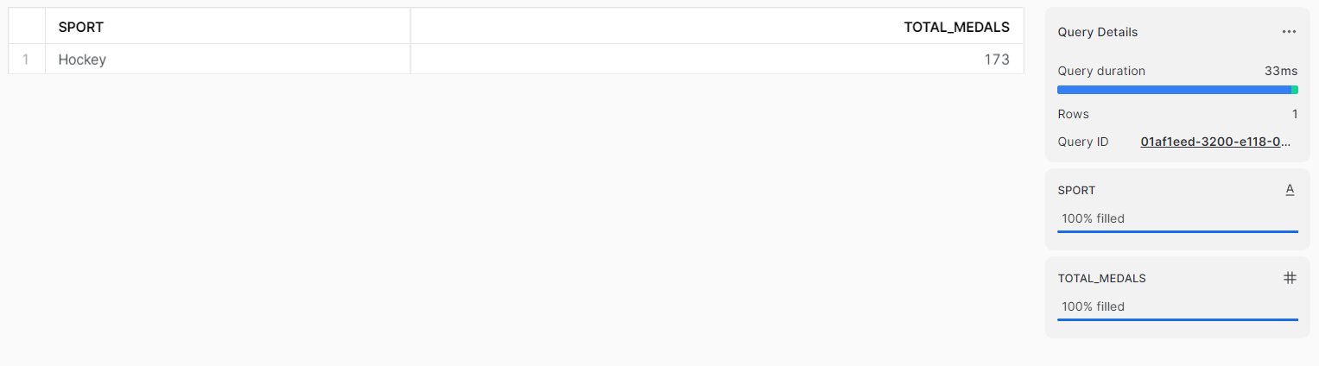
Q. In which Sport/event, India has won highest medals.
Output

Slide 11
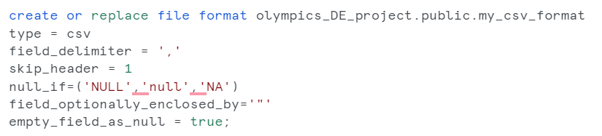
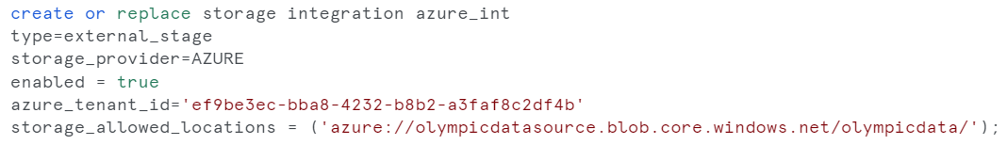
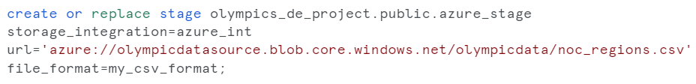
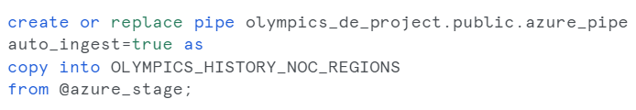
Creating file format
Creating storage integration
Creating stage
Creating snowpipe

Slide 12
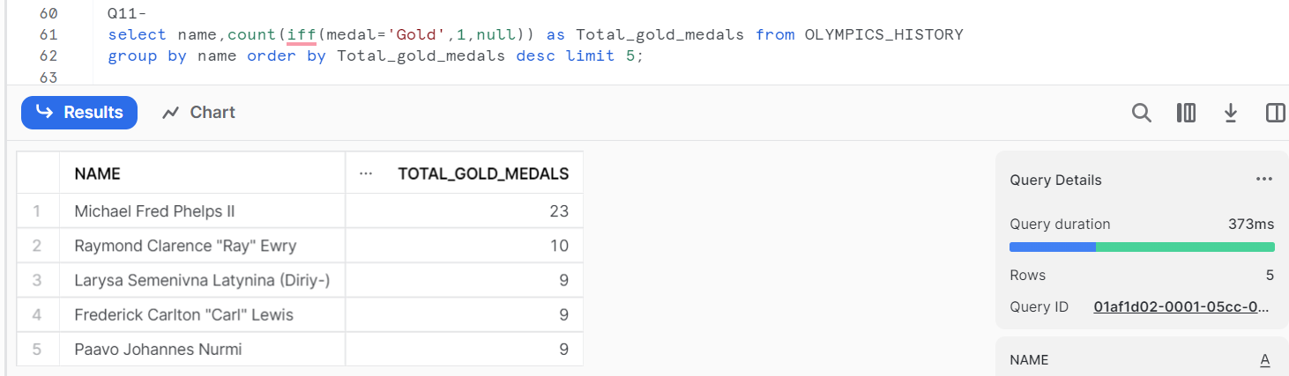
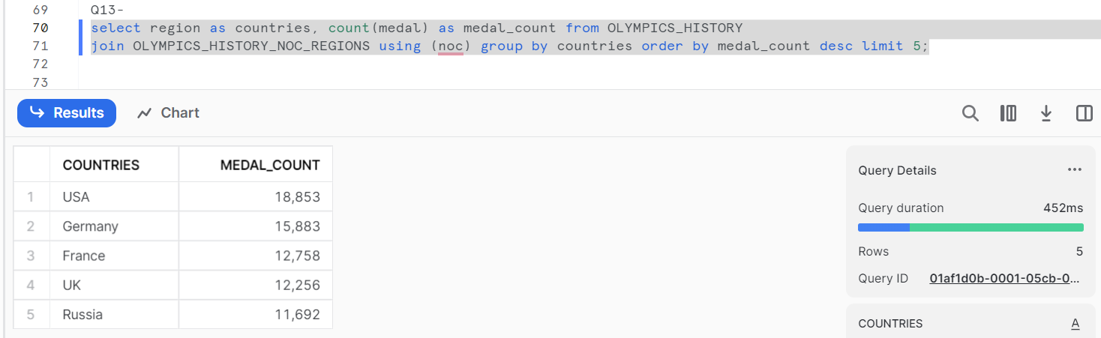
Q. Fetch the top 5 athletes who have won the most gold medals.
Q. Fetch the top 5 most successful countries in Olympics. Success is defined by no of medals won.

Slide 13
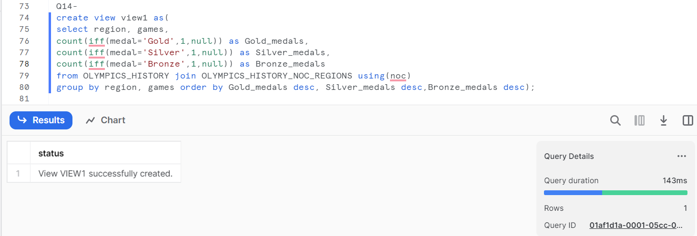
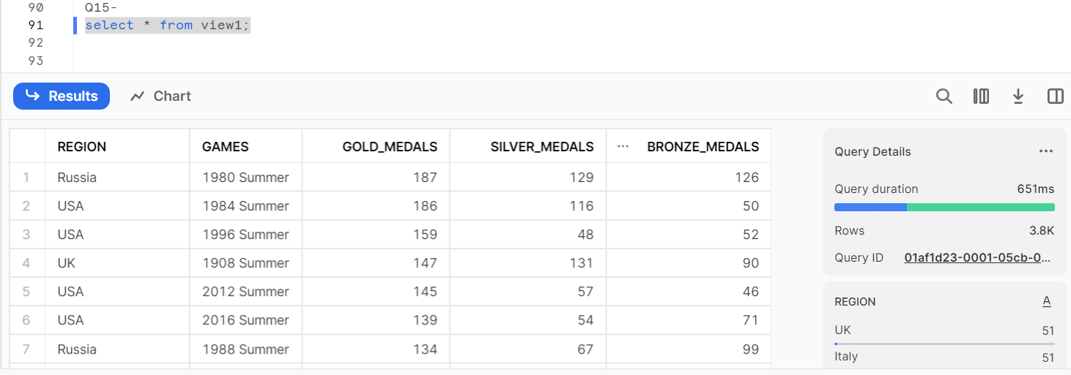
Q. List down total gold, silver and bronze medals won by each country corresponding to each olympic games.
Output

Slide 14
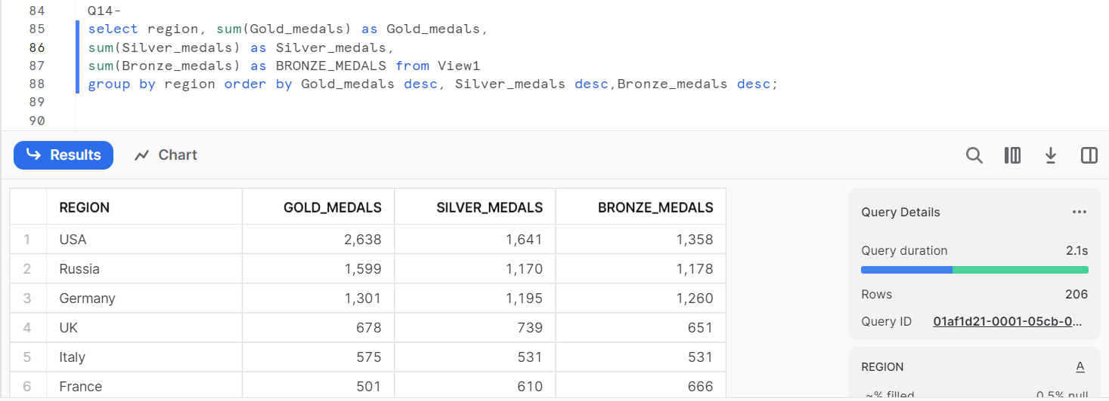
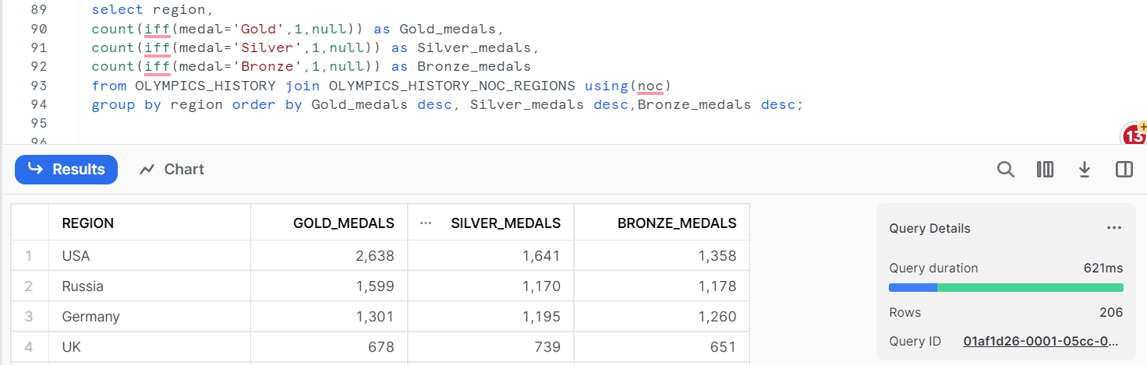
Q. List down total gold, silver and bronze medals won by each country.
Output with previously created view
Output without previously created view

Slide 15
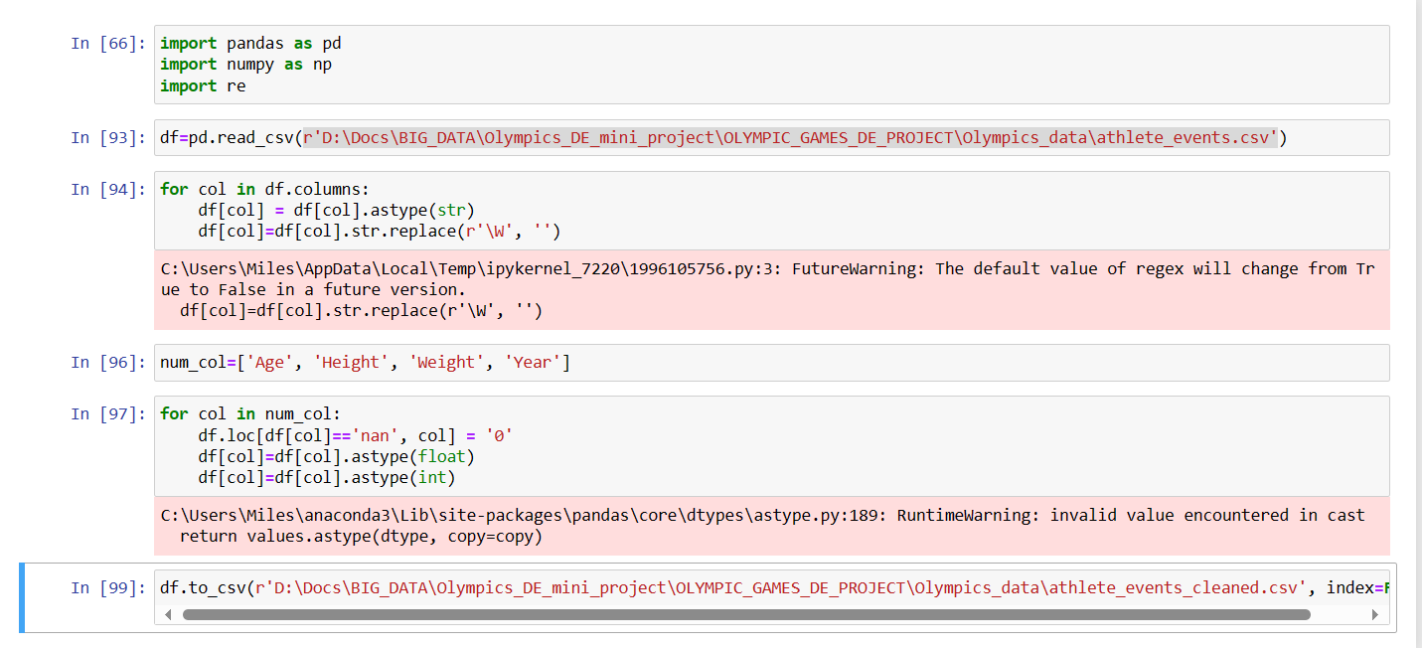
Cleaning Data

Slide 16
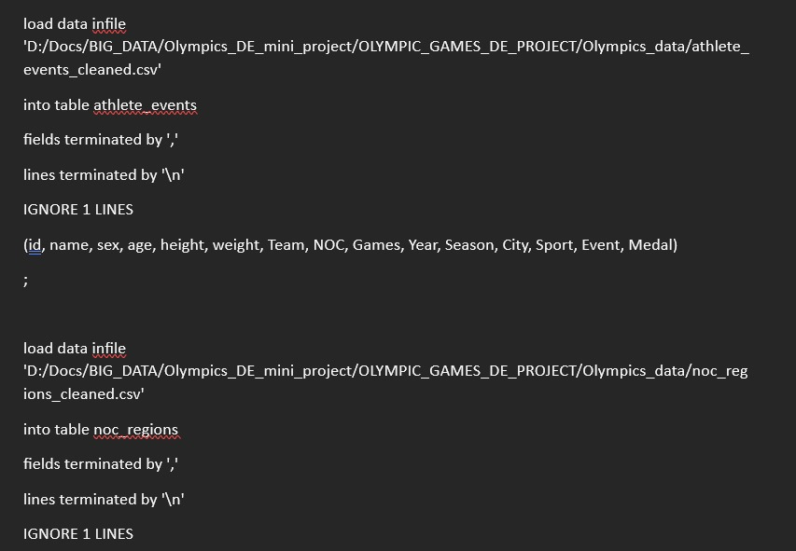
Importing Data into MySQL Server

Slide 17
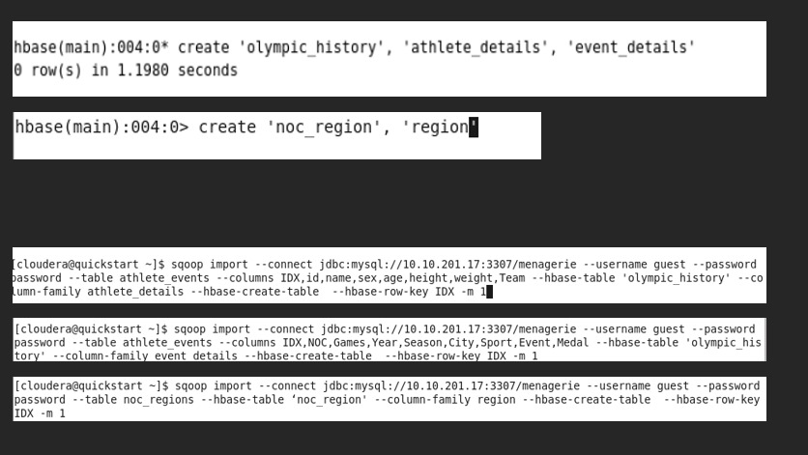
Creating table in HBase and Importing data from remote MySQL server

Slide 18
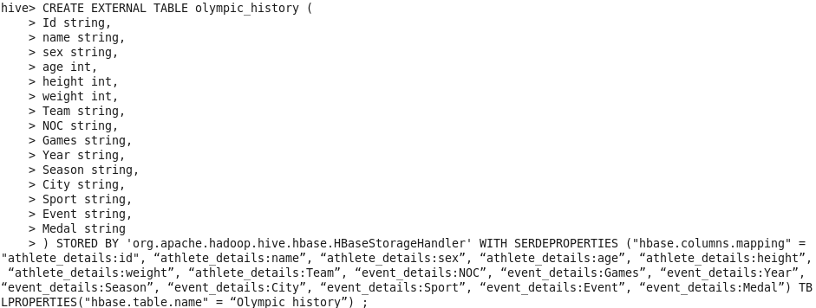
Connecting an HIVE table to already existing HBase table

Slide 19
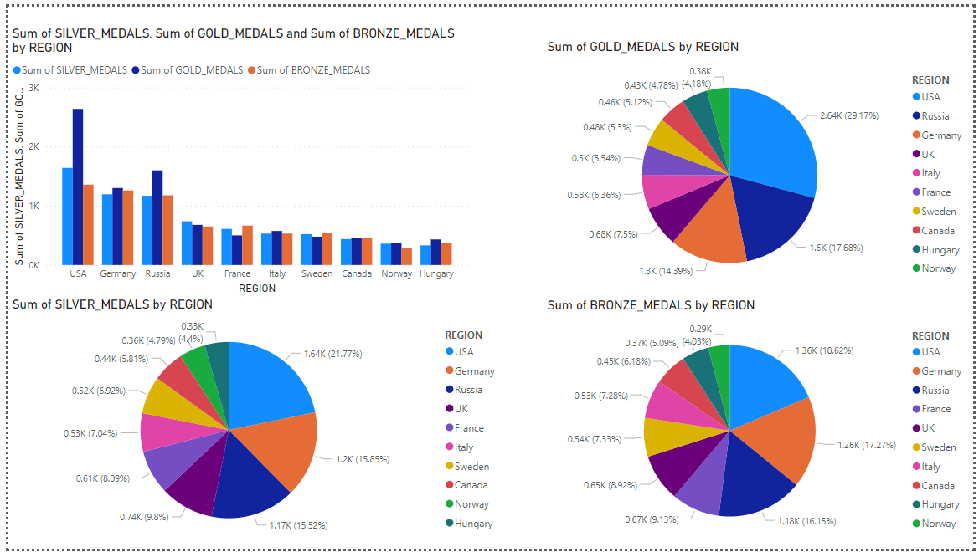
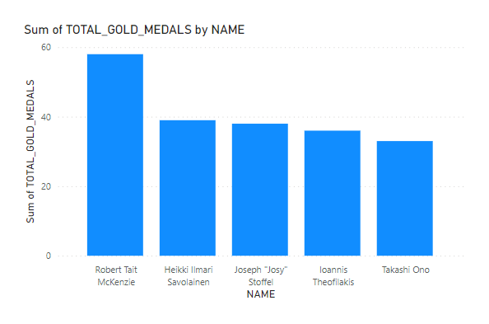
POWER BI DASHBOARD

