Slide 1
CS542 Project - Link State Routing Simulation
FNU Ashutosh
A20377427

Slide 2
Abstract
In the network, the link-state protocol is performed by every switching node. The node are known as routers which forwards the packets. The basic idea behind the Link-state algorithm is that it constructs a graph. The graph displays all the nodes and how all the nodes are connected together in a network. Each node then independently calculates the next best logical path from it to every possible destination in the network.
A routing table is created using the collection of the shortest path from one source or starting node to another node. The main objective of the algorithm is to find out the shortest path from one router to another router in the network topology using the routing table.

Slide 3
Objective
The objective of the projects is to develop a simulator. The simulator implements Link-State Routing Protocol. The project consists of the following functions.
doCaseone – It is the process of generating the network topology by taking the input file in a text format.
doCasetwo – It uses Dijkstra’s algorithm to calculate the interface, optimal path and cost to all the routers in the topology from a source router.
doCaseThree–Itcalculatestheoptimalpathandcosttothedestinationfrom Source router.
doCaseFour–Itmodifiestherouterbydeletingarouterfromthetopology.
doCaseFive–Itfindsthebestbroadcastrouter.
doCaseSix–Itexitstheprogram

Slide 4
Introduction
Link state protocols are based upon the principle of a “distributed map”. They use the Dijkstra’s algorithm to find the shortest path between the routers. All the routers keep the information of its adjacent router. Each router calculates its own best paths to send the packets to reach destination. Link-state routing protocols are one of the two main classes of routing protocols. It is used for communicating the packets in the packet switching networks. Some of the examples of link-state routing protocols are Open Shortest Path First which is also known as OSPF and Intermediate System to Intermediate System which is also known as IS-IS.

Slide 5
Introduction contd.
The basic concept of link-state routing is that every node constructs a map of the connectivity to the network, in the form of a graph, showing which nodes are connected to which other nodes. Each node then independently calculates the next best logical path from it to every possible destination in the network. The collection of best paths will then form the node's routing table.

Slide 6
Experimental Results
Tasks to be performed for Link-State Routing Simulator :
Create a Network Topology
Build a Connection Table
Shortest Path to Destination Router (4) Modify a topology
Best Router for Broadcast
Exit

Slide 7
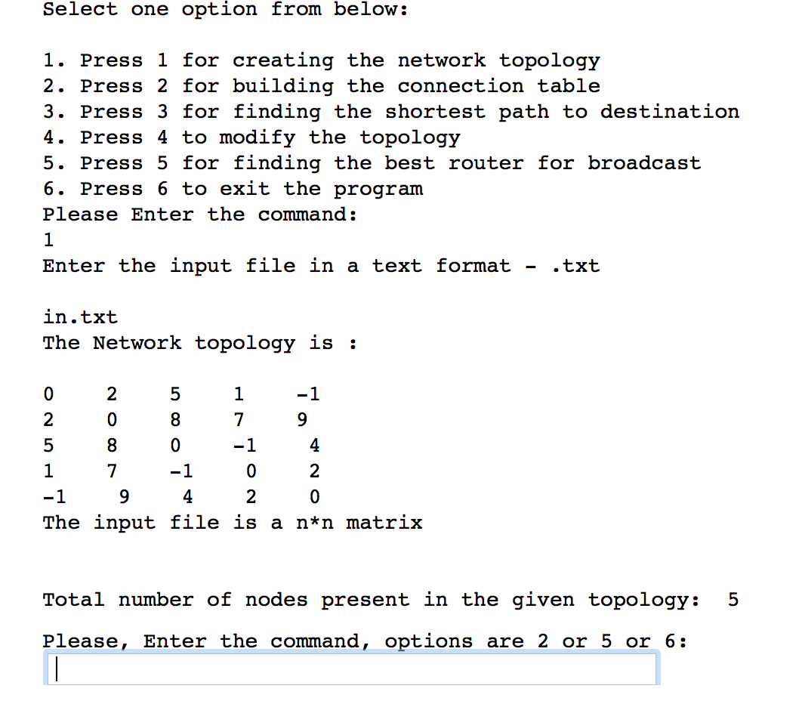
If master command 1

Slide 8
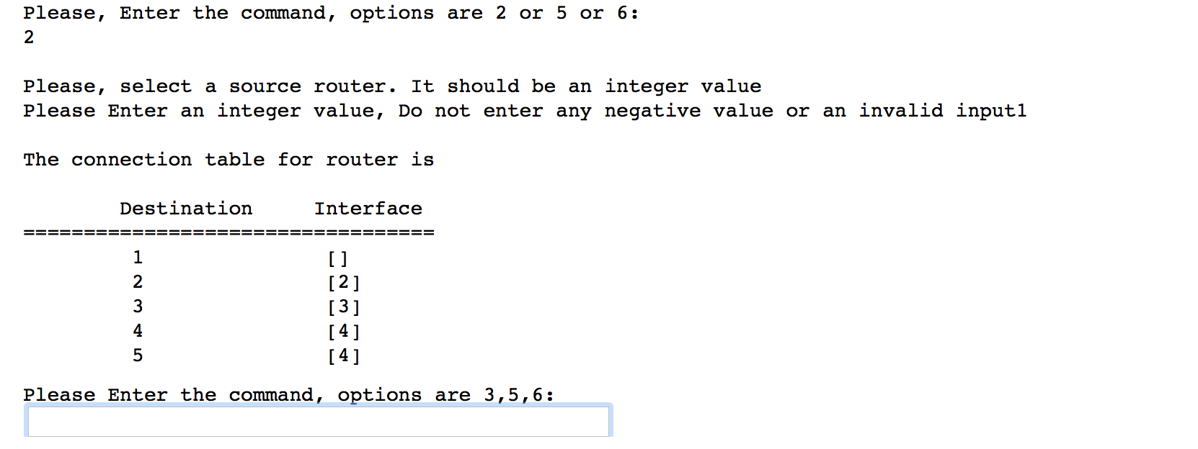
Master command 2

Slide 9
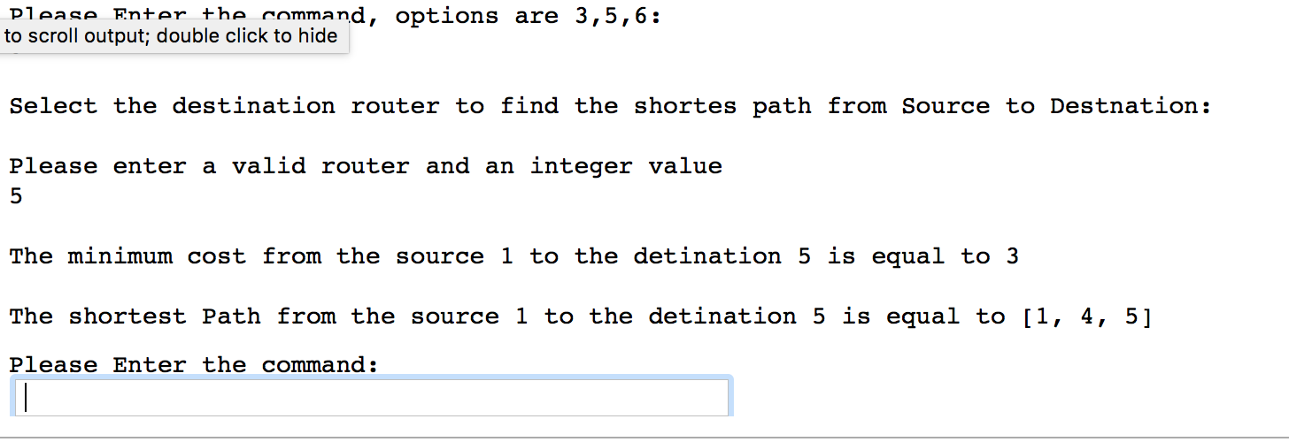
Master Command 3

Slide 10
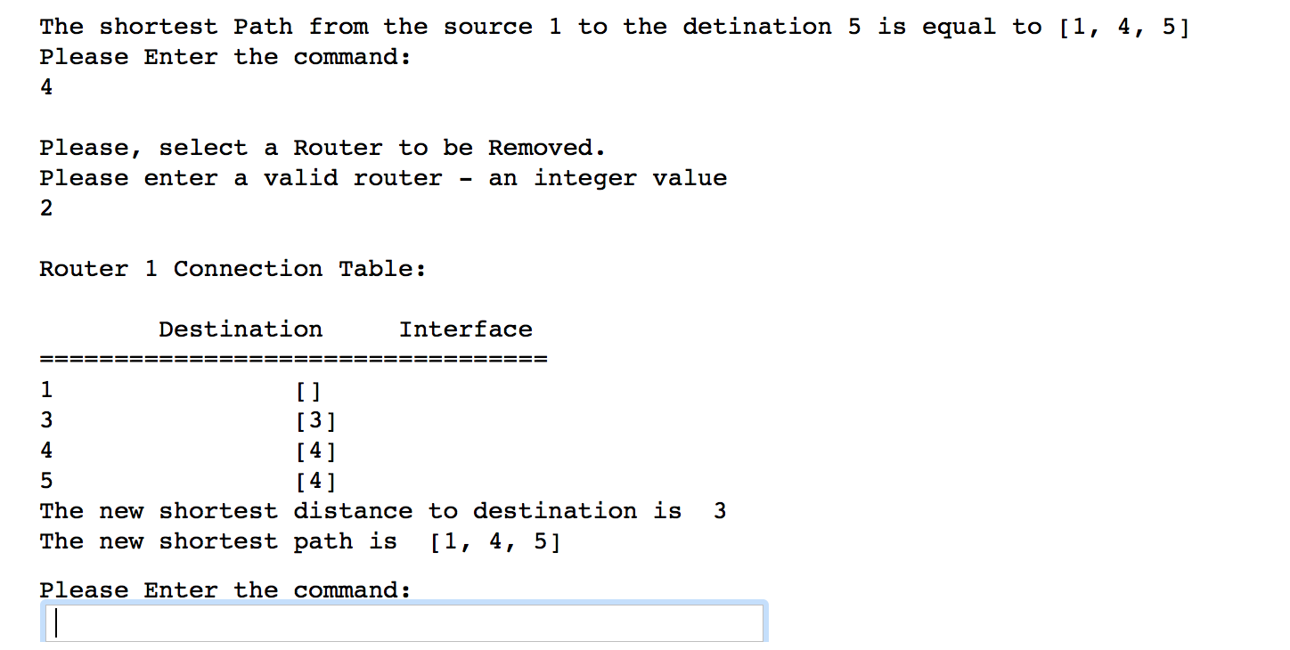
Master command 4

Slide 11
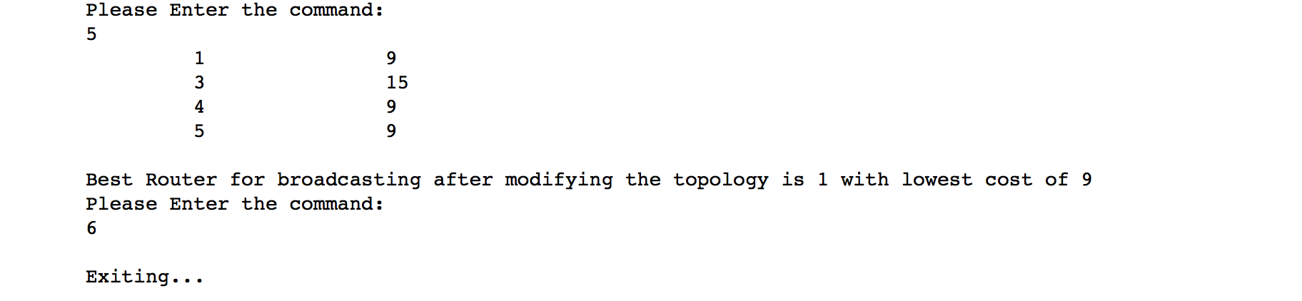
Master command 5 and 6

Slide 12
Additional testcases
If the input is not a n*n matrix, it will ask for a n*n matrix file and it will exit the program.
If the input text file is not a text file or an empty file.
If the input is not an integer, it will raise an error and ask again.
If wrong master command is selected, it will ask again for the command.
If deleted router is a source router.
If the removed router is destination router.
New broadcasting table after the router is deleted.
If the text file does not exist it will raise an error.

Slide 13
Conclusion
Implemented the Link State routing protocol using Dijkstra’s algorithm in an effective and efficient way to find out the optimal path to route the packet from one node to another node with the lower cost. The matrix represents the capacity of links on those routes. Each router is synchronized in such a way that it uses the latest information and produces best routing decisions. Therefore, it is very rare to occur routing loops. The careful network design can be implemented to reduce the link state database sizes. This leads to smaller Dijkstra calculations and faster convergence.

Slide 14
Thank You!

