Slide 1
CSN-341 Computer Networks
Image Captioning
Group Members:
Arjun​ ​Krishna​ ​ (15115030)
A.S.Akil​ ​Arif​ ​Ibrahim​ ​ (15116001)
Ashutosh​​ Parija​ ​ (15116010)
Karan​ ​ (15116028)
Mohit​ ​Chaudhary​ ​ (15116033)

Slide 2
Introduction
The application is basically a functional Google Chrome Extension that generates a caption for an image which describes what is contained in the image. The image captioning is done by a deep learning network which runs on a cloud server(Heroku). The caption generated is converted into speech by JavaScript’s Web Speech API(SpeechSynthesisUtterance API).

Slide 3
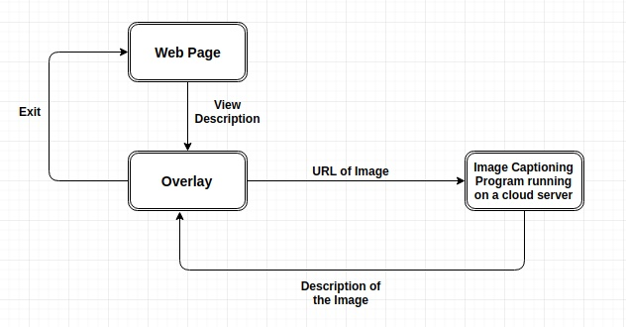
Functioning
The complete architecture of the application can be understood by the following flow diagram

Slide 4
The extension provides an option to view description of an image when the user right clicks an image.
An overlay is displayed when the user right clicks an image and chooses the option to view the description of the image.
If the captioning is successful, the caption is displayed in the overlay, and also audio of the description is generated. Else, an error message is displayed on the overlay.
To exit the overlay, the user has to press Esc.

Slide 5
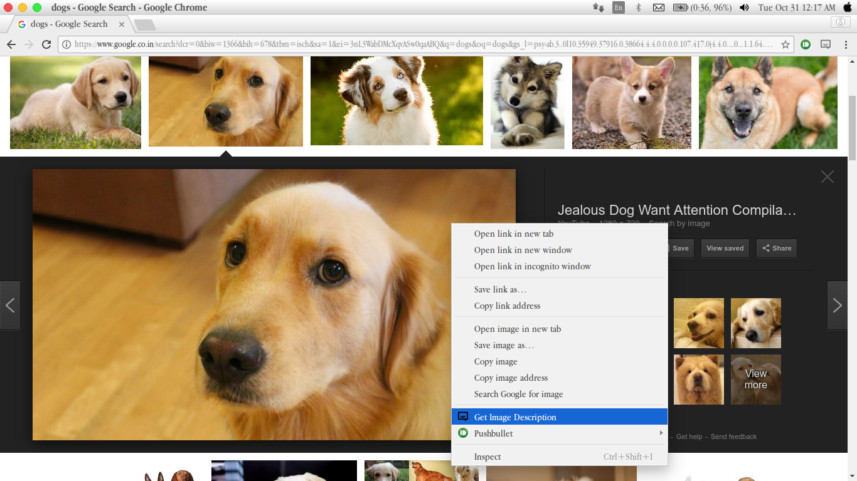
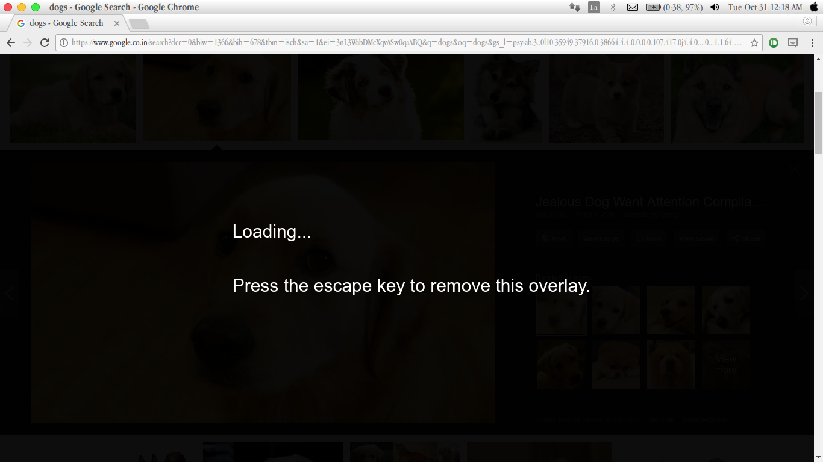
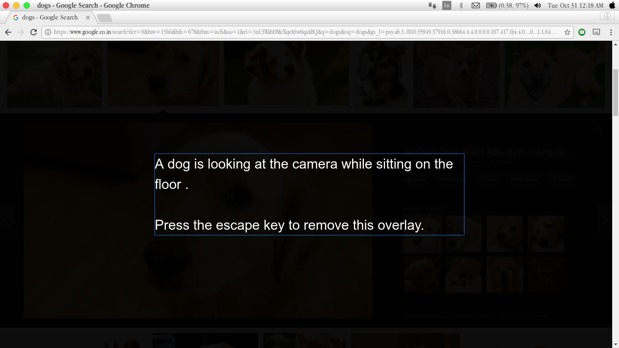
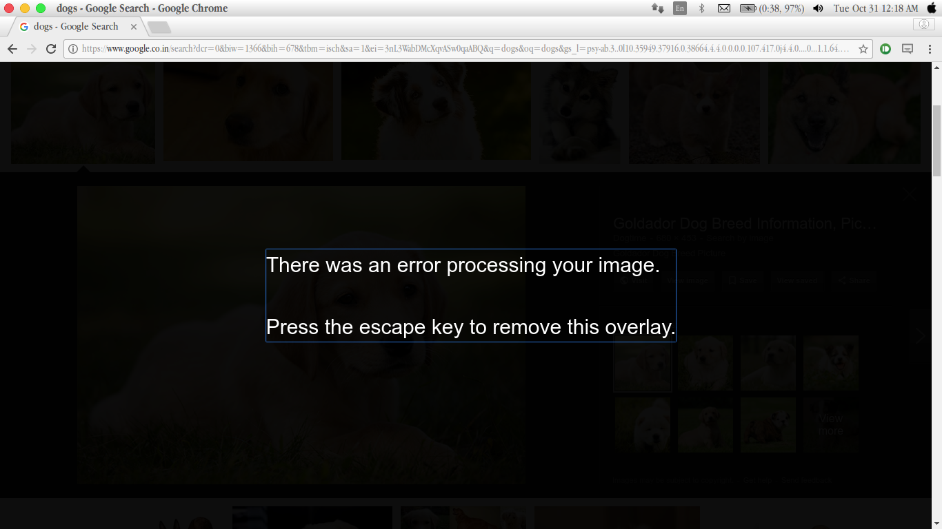
Screenshots depicting the functionalities of the application

Slide 6
Modules
Chrome Extension-
JSON file for manifest
CSS file for styling
JavaScript file which provides the option to view image description only for images
JavaScript file which listens to the event of choosing view image description option, sends url of the image to image caption generator running on a cloud server, receives the description of the image and displays it on the overlay along with the audio of the description.
Image Caption Generator-
Python file which receives the url of the image from the JavaScript file of the extension and captions the image and returns the description of the image.
Python file which contains the Show and Tell model [1].
Dataset which contains image and its description.
[1] Oriol Vinyals, Alexander Toshev, Samy Bengio, Dumitru Erhan, “Show and Tell: A Neural Image Caption Generator”, CVPR2015

Slide 7
Limitations
Improvements in the future
Can't be used for protected images. Example- It can’t be used on the images in facebook as they are protected ones.
The image caption generation also takes a considerable amount of time,the algorithm needs to be optimised in terms of both accuracy and time taken to generate the output.
A better model that is trained on a more comprehensive image set can be used.

