Slide 1

Presented By:
Ashwini Patil
Diamond Price Prediction

Slide 2
Agenda
Problem Statement
Data Visualization
Feature Selection
Model Building & Predictions
Model Deployment
Comparison of Algorithms
Predict target using original and new inputs
Conclusion

Slide 3
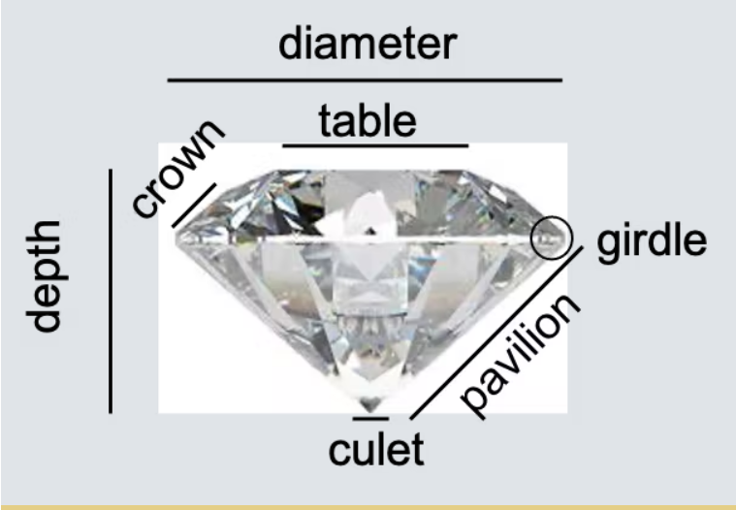
Problem Statement
The Given dataset contains the prices and other attributes of diamond. There are 10 attributes included in the dataset including the target ie. Price Perform Regression Analysis to predict the price of diamond.
Price : price in US Dollars($326-$18,823)
Carat : Weight of Diamond(0.2-5.01)
Cut: Quality of Cut.(Fair,Good,Very Good,Premium,Ideal)
Color: Diamond Color,from J(worst) to D(Best)
Clarity:A measurement of how clean the diamond is.(I1(best),IF(worst)).
X: Length in mm(0-10.74)
Y: Wight in mm(0 - 58.9)
Z: Depth in mm(0-31.80)
Depth: Total Depth Percentage = Z/ mean(x,y) = 2*Z/(X+Y)
Table: Width of top top of Diamond relative to widest point(43 – 95)

Slide 4
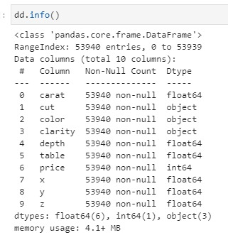
Basic Information:
Shape:(53940,11)
Size:593340

Slide 5
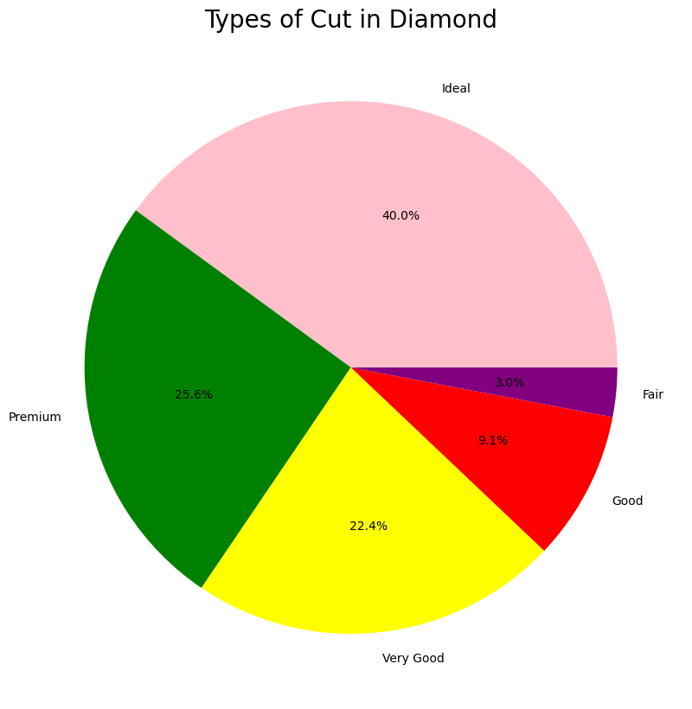
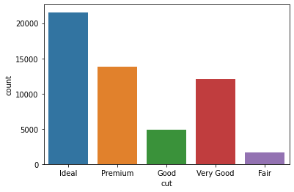
Visualization:-Univariate Analysis
Visualization of categorical Attributes

Slide 6
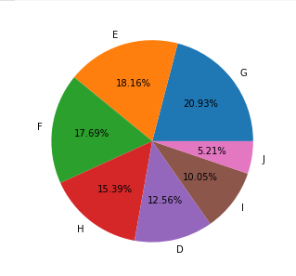
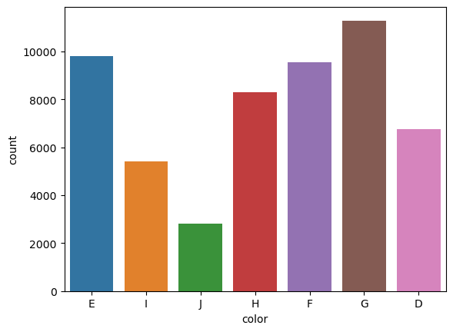

Slide 7
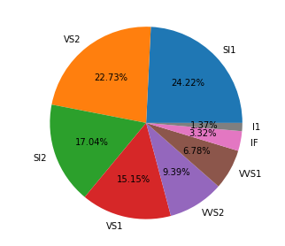
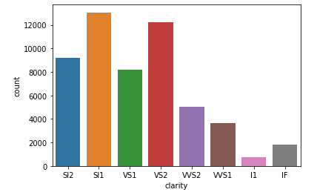

Slide 8
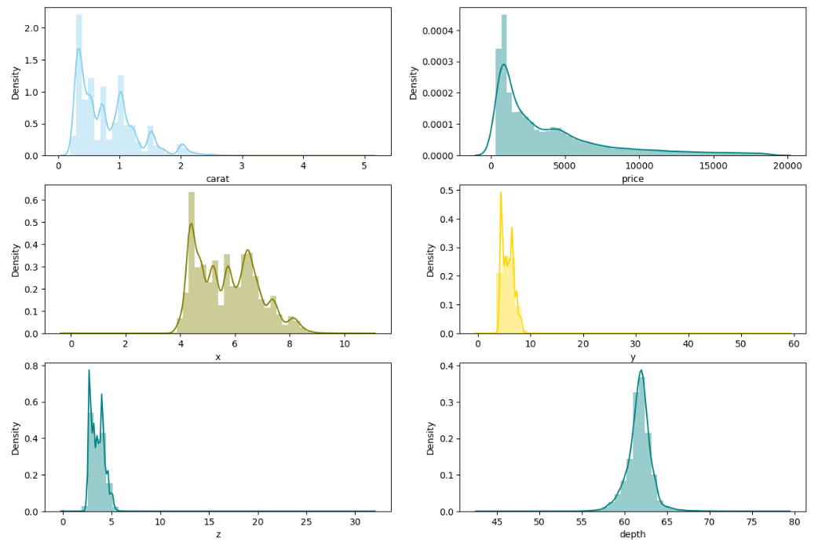

Slide 9
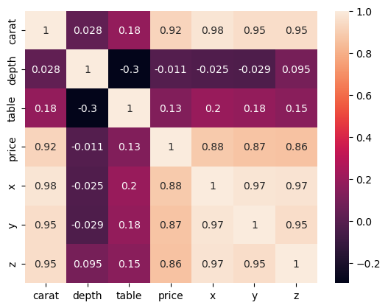
Visualization:-Multivariate Analysis

Slide 10
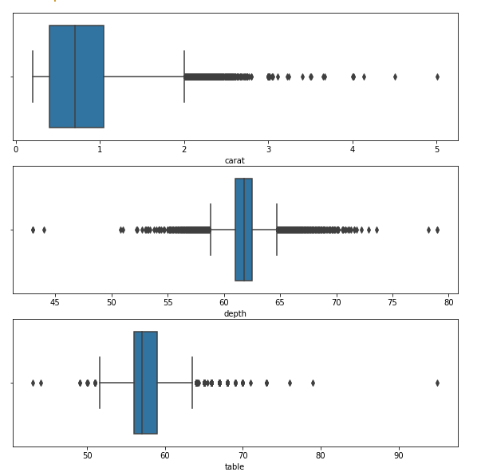
Outlier Handling

Slide 11
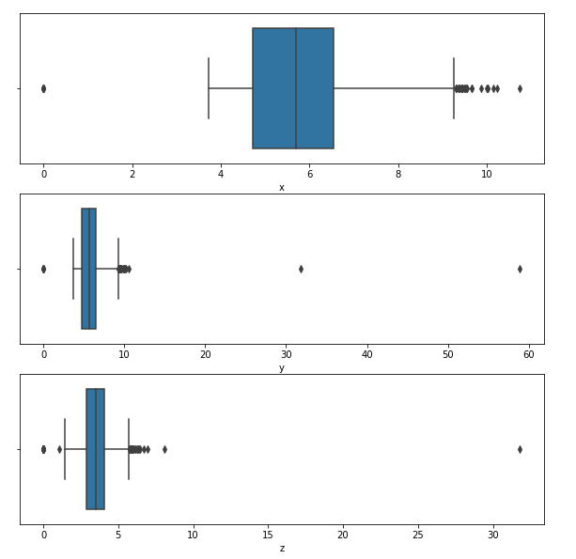

Slide 12
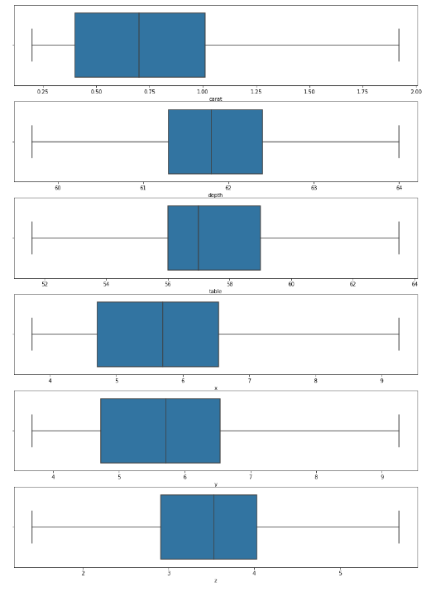
Features After Outlier Handling:

Slide 13
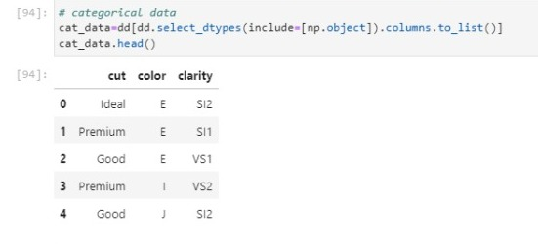
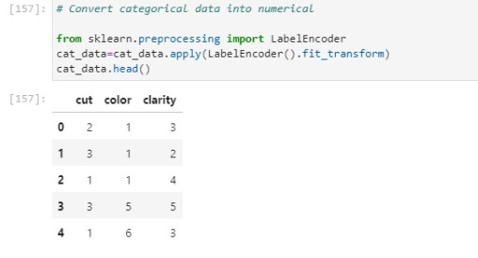
Categorical Data Conversion

Slide 14
Model Building & prediction
We have implemented various machine learning algorithms such as Linear Regression, Decision Tree ,Random Forest and Adaptive Boosting and Voting Regressor in order to identify the most optimal model.
For each of these models R2_Score,MSE,RMSE,MAE were calculated.
Further we found importance and results based on the models we have used.

Slide 15
Simple Linear Regression
Independent Variable: Carat
Dependent Variable: Price
Train & Test size/shape
Train R2_score: 0.5254
Test R2_score : 0.5169
Train Size: 43152
Train Shape:(43152,1)
Test Size: 10788
Test Shape:(10788,1)
After Cross Validation
Train R2_score: 0.56
Test R2_score: 0.54

Slide 16
Multiple Linear Regression
Independent Variables: Carat,X,Y,Z,depth,table,cut, color, clarity
Dependent Variable: Price
Train & Test Size & shape
Train Size: 388368
Train Shape:(43152,9)
Test Size: 97092
Test Shape:(10788,9)
Train R2_score: 0.8431
Test R2_score : 0.8406
After Cross Validation
Train R2_score: 0.8428
Test R2_score: 0.8408

Slide 17

Decision Tree Regressor
Decision Tree Regressor algorithm builds a model in the form of tree structure
In the final prediction is the average of the value of the dependent variable in that particular child node
Train R2_score: 0.9632
Test R2_score: 0.9611
After Cross Validation
Train R2_score: 0.9575
Test R2_score: 0.9547

Slide 18
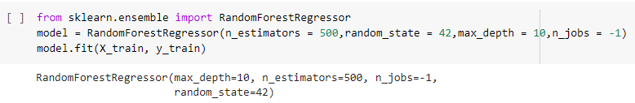
Random Forest Regressor
Random forest is developed version of decision tree regressor
Random forest works on multiple decision tree model which is trained over the same data & averaging the result of each model ultimately finds more powerful predictive result
Train R2_score:0.9801
Test R2_score:0.9748
After Cross Validation
Train R2_score: 0.9739
Test R2_score: 0.9698

Slide 19
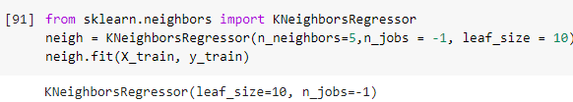
K-Nearest Neighbors Regressor
It is non-parametric method
Averaging the observation in the same nearest neighbourhood
Train R2_score: 0.9754
Test R2_score: 0.9601
After Cross Validation
Train R2_score: 0.9593
Test R2_score: 0.9471

Slide 20

Support Vector Regressor
Train R2_score:0.7324
Test R2_score:0.7332
After Cross Validation
Train R2_score: 0.7307
Test R2_score: 0.6990

Slide 21
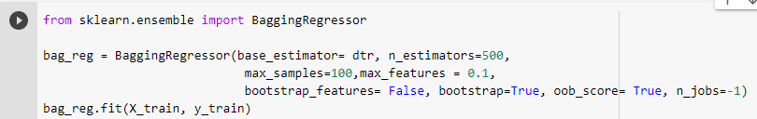
Ensemble Technique
Bagging:
Train R2_score:0.9144
Test R2_score:0.9136

Slide 22
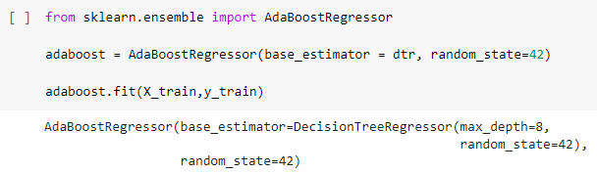
Boosting
Adaptive Boosting
Train R2_score:0.9779
Test R2_score:0.9718
After Cross Validation
Train R2_score: 0.9712
Test R2_score: 0.9677

Slide 23

2. Gradient Boosting
Train R2_score:0.9688
Test R2_score:0.9664
After Cross Validation
Train R2_score: 0.9660
Test R2_score: 0.9654

Slide 24
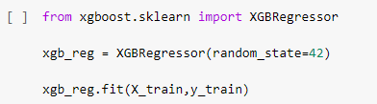
3. Xtreme Gradient Boosting
Train R2_score:0.9901
Test R2_score:0.9786
After Cross Validation
Train R2_score: 0.9778
Test R2_score: 0.9701

Slide 25
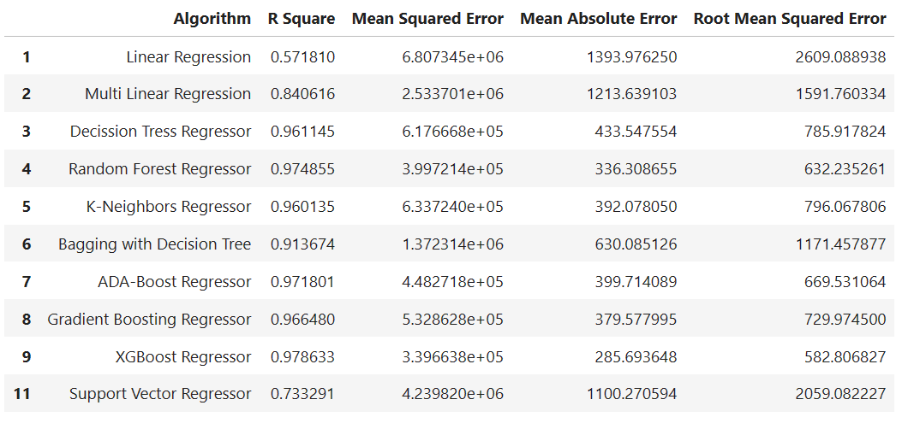
Comparison of Algorithm

Slide 26
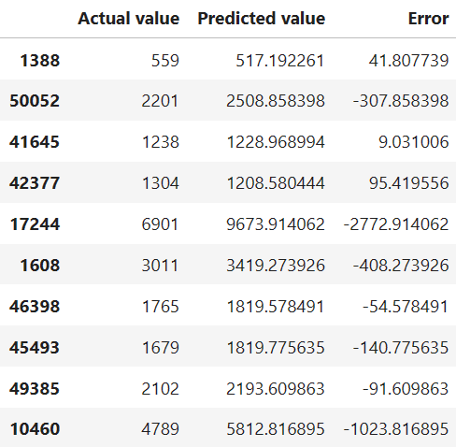
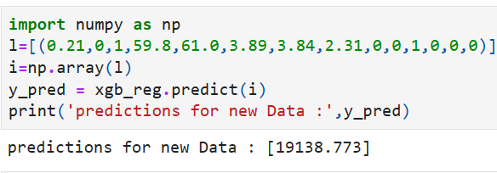
Predict target using original and new inputs

Slide 27
Conclusion
After analyzing all the models we can conclude that predictors X,Y,Z & Carat did played a major role for Diamond Price Prediction
Comparing all the models, XGboost is the best among all the regression models

Slide 28
Thankyou

