Slide 1



DEEPFLOW HPC
TEAM NAME: ALGORITHM AVENGERS
TEAM LEADER:-
  Harshvardhan Singh Shekhawat
TEAM MEMBERS:-
  Ayush Kushwaha
  Ashutosh Pratap Singh
MENTORS:-
  Shashank Sir
  Samrit Kumar Sir

Slide 2

ABOUT THE CODE
  Reference Code
  Started with a baseline reference implementation.
  RAY Framework Implementation
  Converted the reference code into RAY for distributed computing and task parallelism.
  Numba (NJIT) Optimization
  Applied NJIT (Numba Just-In-Time Compiler) to accelerate execution using both serial and parallel processing.
  CUDA Implementation for GPU Acceleration
  Converted the optimized code to CUDA for efficient GPU execution.
  Further Optimization for Maximum Speed
  Applied additional performance enhancements to further improve execution time and efficiency.

Slide 3
SCOPE OF DEEPFLOW HPC
  High-Performance Computing (HPC) Acceleration
  Utilizing DeepFlow HPC to enhance computational efficiency in large-scale data processing and simulations.
  Parallel and Distributed Computing
  Implementing multi-threaded, parallel, and distributed computing techniques to optimize performance.
  GPU Acceleration with CUDA
  Leveraging CUDA for GPU-based processing, enabling faster execution of computationally heavy tasks.
  Scalability & Performance Optimization
  Optimizing algorithms to scale across multiple nodes for improved speed and efficiency.

Slide 4
PRE-HACKATHON POSITION
  Initially, we had only a reference code without any optimization.
  In the reference implementation, parallel execution was slower than serial execution due to inefficient task distribution and overhead.
  The code lacked proper parallelization strategies, leading to performance bottlenecks.
  There was no GPU acceleration, limiting the computational speed for large-scale processing.
  The goal was to optimize the code using Ray, Numba (njit), and CUDA to achieve significant speed improvements.

Slide 5
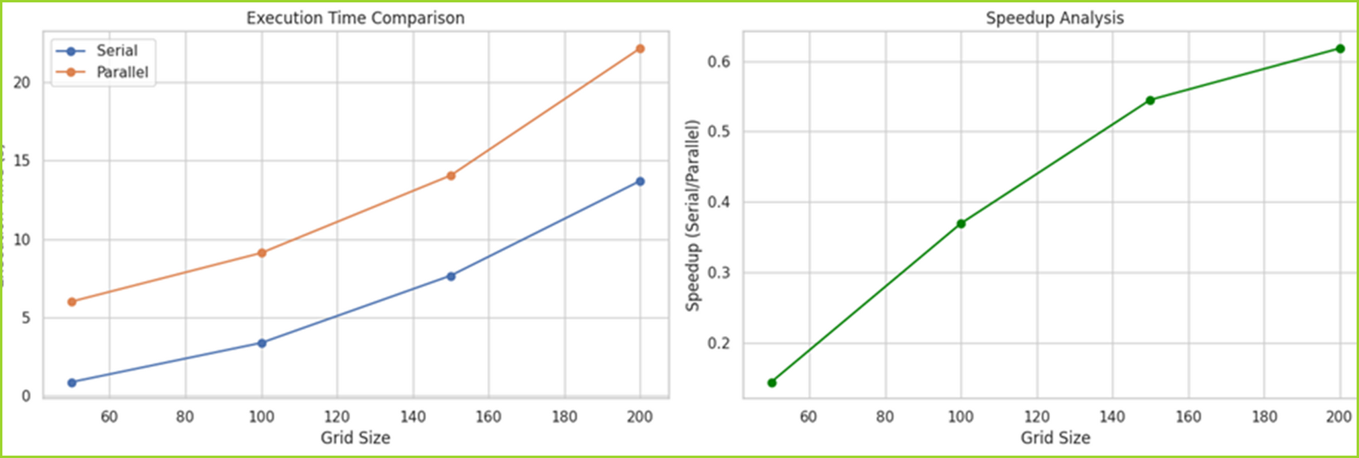
PRE-HACKATHON RESULTS

Slide 6
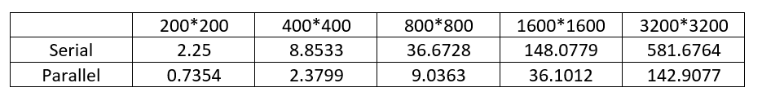
BENCHMARK RESULTS
(RAY FRAMEWORK CODE)
Execution Time for 800 × 800 Grid Size
  Serial Execution: 36.6728 seconds
  Parallel Execution (Ray): 9.0363 seconds
Observations:
  Parallel execution is ~4x faster than serial execution.
  Efficient task distribution using Ray reduces execution time.
  The framework effectively utilizes available CPU cores for optimization.

Slide 7

BENCHMARK RESULTS (NJIT EXECUTION)
Execution Time for 800 × 800 Grid Size
  Serial Execution (NJIT): 104.29 seconds
  Parallel Execution (NJIT): 22.19 seconds
Serial Execution:
Parallel Execution:
Observations::
  NJIT parallel execution significantly improves performance compared to its serial version.
  However, it is still slower than Ray’s parallel execution (9.0363 seconds).
  Further optimizations are required to enhance speed and efficiency.

Slide 8
BENCHMARK RESULTS (CUDA EXECUTION)
Execution Time
  Grid Size: 800 × 800
  Execution on GPU (CUDA): 3.4927 seconds
Observations:
  CUDA execution provided the best performance so far.
  Significant improvement over NJIT parallel (22.19s) and Ray parallel (9.0363s).
  GPU optimization proves to be highly efficient for high-performance computing tasks.

Slide 9
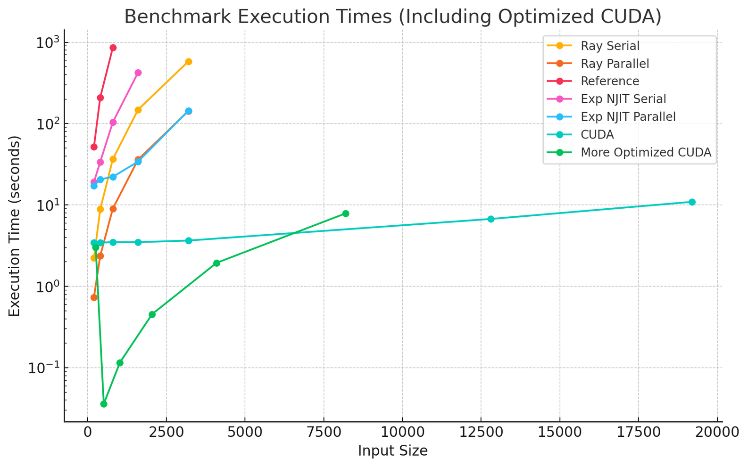
COMPARISON OF EXECUTION TIME FOR ALL THE CODES

Slide 10
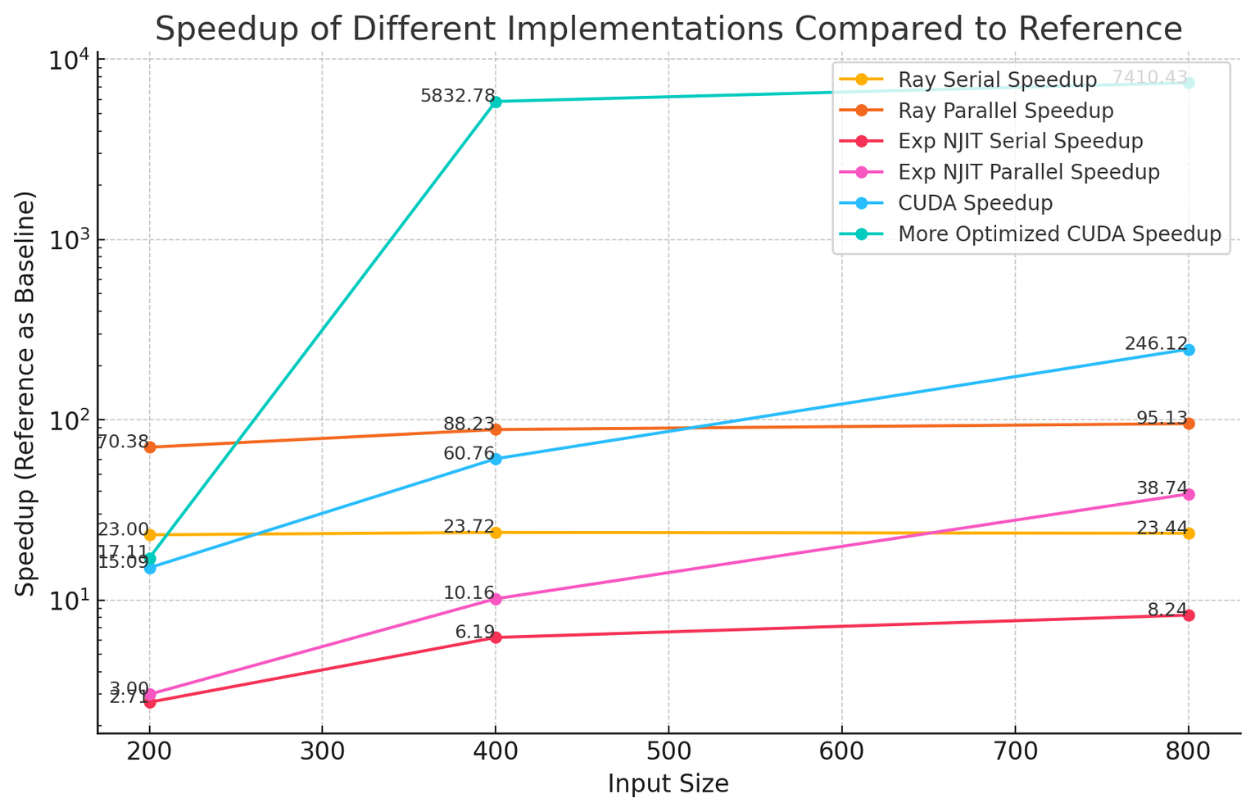
SPEEDUP OF DIFFERENT IMPLEMENTATIONS COMPARED TO REFERENCE

Slide 11
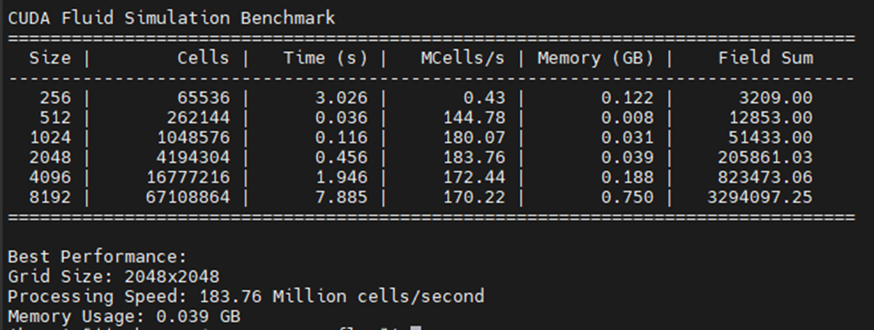
BENCHMARK RESULTS
(OPTIMIZED CUDA EXECUTION)
Content:
  Grid Size: 1024 × 1024
  Execution on GPU (Optimized CUDA): 0.116 seconds
Key Improvements:
  Further optimized CUDA kernel for better memory utilization and thread execution.
  Achieved a massive speedup compared to the previous CUDA execution.
  Utilized efficient memory access patterns, shared memory, and reduced kernel launch overhead.

Slide 12
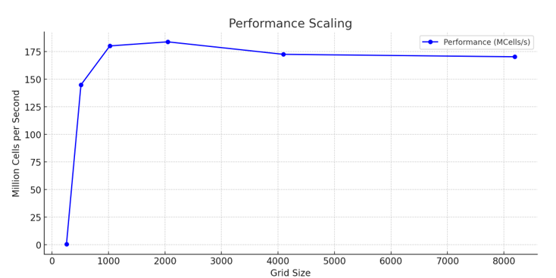
PERFORMANCE SCALING GRAPH
(Optimized CUDA execution)

Slide 13
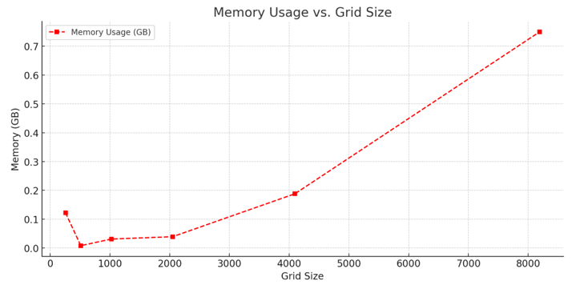
MEMORY USES VS GRID SIZE
(Optimized CUDA execution)

Slide 14
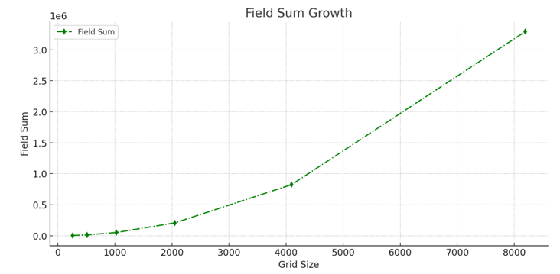
FIELD SUM GROWTH
(Optimized CUDA execution)

Slide 15
CUDA OPTIMIZATION: FIRST VS. OPTIMIZED IMPLEMENTATION
Key Differences:
  Use of Shared Memory for Optimization
    First Code: Uses global memory for all operations.
    Second Code: Uses shared memory to optimize access patterns and reduce redundant memory fetches.
    Advantage: Reduces global memory bandwidth usage, improving performance.
  Advection Scheme
    First Code: Uses a simple upwind scheme (integer-based movement).
    Second Code: Uses a semi-Lagrangian method with bilinear interpolation.
    Advantage: More accurate and stable for larger time steps.
  Projection Step (Pressure Solver)
    First Code: Uses a simple iterative method.
    Second Code: Uses a Jacobi iteration method for solving the Poisson equation.
    Advantage: Jacobi method converges faster with fewer iterations.
  Thread Block Configuration
    First Code: Uses (16,16) threads per block.
    Second Code: Uses (32,32) threads per block, optimized for newer GPUs.
    Advantage: Larger blocks increase computational density.

Slide 16
CUDA OPTIMIZATION
FIRST VS. OPTIMIZED IMPLEMENTATION
5. Boundary Handling
  First Code: Explicitly sets boundary conditions in each kernel.
  Second Code: Uses shared memory for halo regions, improving efficiency.
  Advantage: Avoids redundant reads/writes to global memory.
6. Memory Usage
  First Code: Manages only essential GPU arrays.
  Second Code: Uses psutil and os for memory tracking (not shown in code).
  Advantage: Helps optimize memory usage dynamically.
Final Verdict:
The second implementation is significantly more optimized due to:
  Shared memory utilization
  More accurate semi-Lagrangian advection
  Better projection solver (Jacobi method)
  Improved memory management

Slide 17
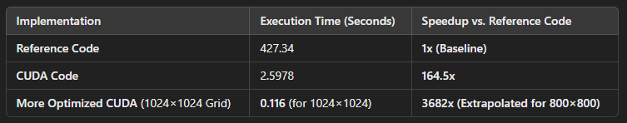
PERFORMANCE COMPARISON & SPEEDUP ANALYSIS
Key Observations:
  CUDA Implementation provides a 164.5x speedup over the reference code.
  More Optimized CUDA achieves an incredible 3682x speedup (considering grid scaling).
  GPU acceleration drastically reduces execution time, making large-scale computations feasible.
Final Verdict:
The optimized CUDA version is highly efficient, leveraging shared memory, better solvers, and improved memory access for maximum speedup.

Slide 18
LEARNINGS FROM THE HACKATHON
During this hackathon, we gained valuable hands-on experience in high-performance computing (HPC) and GPU acceleration. Below are the key learnings:
1. System Setup & Environment Configuration:
  Logged into Param Kamrupa, an in-house HPC system.
  Set up a virtual environment to manage dependencies.
2. Optimization Journey:
Ray Framework:
  Converted reference code into Ray-based parallel execution.
  Understood task distribution & parallel computing.
Numba & NJIT Optimization:
  Implemented @njit for serial and parallel execution.
  Observed performance trade-offs between CPU parallel vs. serial execution.
CUDA Programming:
  Learned CUDA fundamentals and implemented GPU-accelerated code.
  Used 16×16 thread blocks for initial CUDA implementation.
  Optimized further with 36×36 thread blocks, improving memory access patterns.
3. HPC & GPU Computing on Param Kamrupa:
  Understood job scheduling, compute allocation, and login procedures.
  Leveraged GPU acceleration to achieve massive speedups.

Slide 19
FUTURE SCOPE & FURTHER OPTIMIZATIONS
To push the performance even further, we can explore the following future optimizations:
Advanced Profiling & Bottleneck Analysis
  Use Nsight Systems & Nsight Compute for in-depth GPU profiling.
  Identify memory bottlenecks, warp divergences, and cache utilization issues.
Optimized Memory Management
  Implement shared memory tiling for better coalesced memory access.
  Explore register-level optimizations to minimize global memory fetches.
Hybrid CPU-GPU Execution
  Use OpenMP for CPU parallelization alongside CUDA for hybrid execution.
  Optimize data transfer between host (CPU) and device (GPU) using pinned memory & async transfers.
Better Convergence Techniques
  Replace Jacobi Iteration with Multigrid Methods for faster pressure solving.
  Experiment with conjugate gradient solvers for more efficient computations.
Auto-Tuning & AI-Assisted Optimization
  Implement auto-tuning of CUDA parameters (grid/block size) for best performance.
  Use AI-driven heuristics to dynamically adjust computational load based on runtime profiling.

Slide 20
THANK YOU
Algorithm Avengers

