Slide 1




IEEE International Conference on
Intelligent and Sustainable Electronics & Computing Technologies
INSECT 2026
In Association with
Measurement-Driven Latency Analysis of UL/DL Scheduling in DECT-2020 NR
Paper ID | 1617
Author Name | Ashuqullah Alizai
Affiliation of Authors | Mohammad Reza Mousavi and Prof. Stephan Ludwig
Track Name | Communication & Next-Generation Networks

Slide 2
Outline
Motivation
Problem Statement
System Model
Experimental Setup
Measurement Results
Key Findings
Conclusion
References

Slide 3
Motivation
DECT-2020 NR targets low-latency private and industrial wireless networks.
Existing studies mainly report end-to-end latency.
The internal contribution of UL/DL scheduling and RX–TX turnaround is not well quantified.
This is important for short-packet and request–response industrial traffic.
How much latency is caused by RX–TX turnaround in practical DECT-2020 NR systems?
Main Question

Slide 4
Problem Statement and Contribution
Single-transceiver platforms cannot transmit and receive simultaneously.
Each UL/DL direction change requires hardware and firmware reconfiguration.
This creates RX–TX turnaround delay.
Measurement-based RX–TX turnaround analysis.
Evaluation of sequential and grouped UL scheduling.
Identification of hardware-induced latency limits.
Contributions

Slide 5
Latency Components
End-to-end latency is decomposed as:
L_{E2E} = L_{sched} + L_{turnaround} + L_{PHY} (1)
L_{sched}: MAC scheduling and queuing delay
L_{turnaround}: RX–TX switching delay
L_{PHY}: physical-layer transmission time
This work focuses on RX–TX turnaround and scheduling impact.
Focus

Slide 6
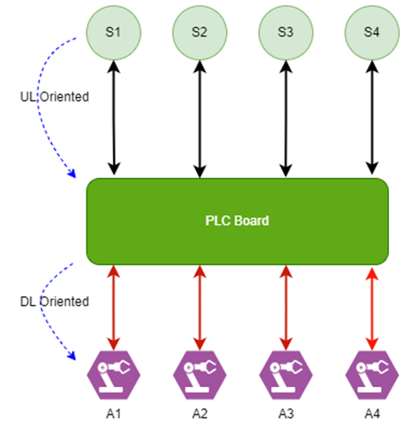
System Model
Figure 1: Industrial sensor–actuator DECT-2020 NR star topology.

Slide 7
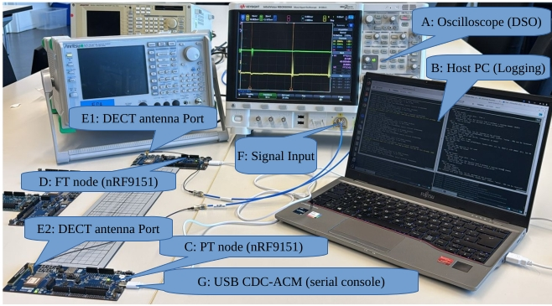
Experimental Setup
One nRF9151 node configured as Fixed Termination (FT)
One nRF9151 node configured as Portable Termination (PT)
GPIO timing marker capture: RX completion TX initiation
DSO used for ground-truth RX–TX turnaround
Figure 2: Laboratory setup using two nRF9151 nodes and DSO measurements.

Slide 8
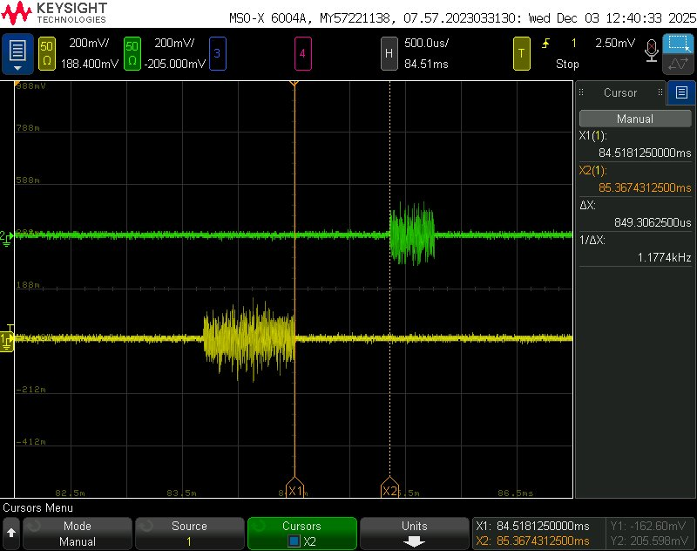
Measurement Result
UL transmission completed at the FT
FT reconfigured from RX to TX mode
Measured RX–TX turnaround:
          T_{RX−TX}≈850 μs
Corresponds to approximately:
2 DECT-2020 NR slots
Figure 3: RX–TX turnaround measured using GPIO timing markers.

Slide 9
Cross-Validation Using Internal Modem Timing
Internal modem timing independently confirms the measured RX–TX turnaround delay.
Idle → RX start = 22118 ticks
RX processing = 12441 ticks
TX start = 29030 ticks
TX completion = 7603 ticks
T_{modem}​=22118+12441+29030+7603=71192 ticks
71192 ticks≈2.47 slots≈850μs
[00:00:00.692,474] <inf> r3phy: DECT NR+ modem latency info (in modem ticks) [1 slot = 28800 modem ticks]:
[00:00:00.693,084] <inf> r3phy: Operation latencies:
[00:00:00.693,115] <inf> r3phy: RX:
[00:00:00.693,115] <inf> r3phy: Idle to RX start latency: 22118
[00:00:00.693,145] <inf> r3phy: RX op end latency: 12441
[00:00:00.693,145] <inf> r3phy: RX op with RSSI end latency: 16588
[00:00:00.693,145] <inf> r3phy: RX op stop request latency: 14169
[00:00:00.693,176] <inf> r3phy: RSSI measurement op end latency: 13132
[00:00:00.693,176] <inf> r3phy: TX:
[00:00:00.693,176] <inf> r3phy: TX start latency: 29030
[00:00:00.693,206] <inf> r3phy: TX end latency: 7603
Validation Summary

Slide 10
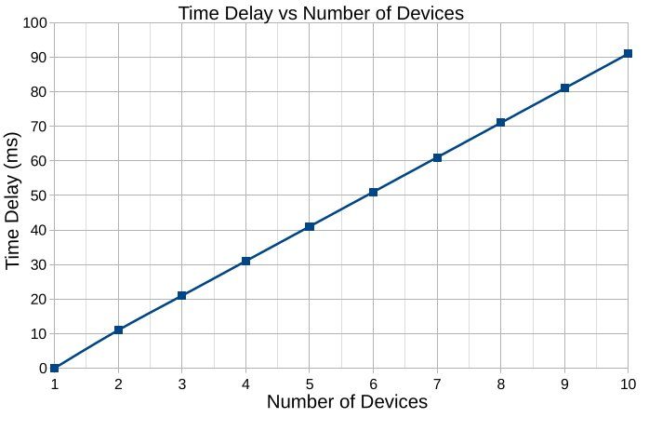
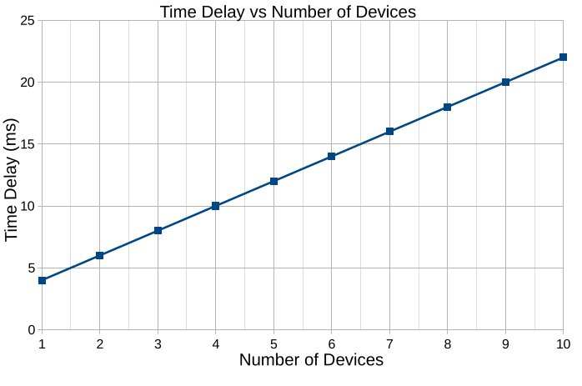
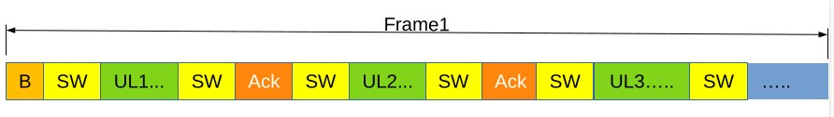
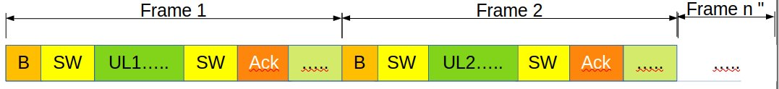


Scheduling Scenarios
Figure 4 Scenario 1 Sequential UL scheduling.
Figure 5: Scenario 2 Grouped UL scheduling.

Slide 11
Key findings
RX–TX turnaround is a significant latency component.
Sequential scheduling accumulates more delay due to frequent UL/DL alternation.
Grouped scheduling helps, but only partially.
On single-transceiver hardware, scheduling alone cannot eliminate the bottleneck.
Latency is strongly constrained by hardware RX–TX turnaround, not only by MAC scheduling.
Main Insight

Slide 12
Conclusion
This work presented a measurement-driven latency analysis of DECT-2020NR.
RX–TX turnaround was measured at approximately 850 μs.
This delay is nearly two DECT-2020 NR slots.
Turnaround dominates short-packet and request–response traffic.
Low-latency DECT-2020 NR design requires hardware-aware scheduling.
Future DECT-2020 NR systems should consider: separate RX and TX chains, UL/DL resource separation, turnaround-aware scheduling, hybrid low-latency operating modes.
Design Implications

Slide 13
References
ETSI, “Dect-2020 new radio (nr); part 1: Overview; release 2,” European Telecommunications Standards Institute, Sophia Antipolis, France,Tech. Rep. ETSI TS 103 636-1 V2.1.1, 2024.
R. Kovalchukov et al., “DECT-2020 New Radio: The Next Step toward 5G Massive Machine-Type Communications,” IEEE Communications Magazine, vol. 60, no. 6, pp. 58–64, Jun. 2022.
H. Holma et al., “Dect-2020 nr: The next step toward 5g massive machine-type communications,” IEEE Communications Standards Magazine, vol. 5, no. 2, pp. 38–45, Jun. 2021.
A. Samuylov et al., “Empowering Near-URLLC IoT with 5G DECT-2020 NR: Current State and the Road Ahead,” IEEE Communications Magazine, vol. 63, no. 4, pp. 130–136, Apr. 2025.
J. Dürre and N. Werner, “DECT-2020 NR for Professional Live Audio:Design Space Exploration and Practical Evaluation,” in 2024 IEEE 5th International Symposium on the Internet of Sounds (IS2). Erlangen, Germany: IEEE, Sep. 2024.
S. Mudriievskyi, F. H. Fitzek, and P. Seeling, “CHEAP 5G: DECT NR+ for Tactile Internet With Human In The Loop Application,” in European Wireless 2024; 29th European Wireless Conference, Sep. 2024.
K. Maliatsos, A. Gotsis, and A. Alexiou, “Evaluation of the IMT-2020 Candidate Radio Interface Technology DECT-2020 NR,” in 2022 14th International Conference on COMmunication Systems & NETworkS (COMSNETS). Bangalore, India: IEEE, Jan. 2022.
ETSI, “Ts 103 636-2 - v2.1.1 - dect-2020 new radio (nr); part 2: Radio reception and transmission requirements; release 2,” European Telecommunications Standards Institute, Tech. Rep., 2024.
A. A. Esswie, K. I. Pedersen, and P. E. Mogensen, “Quasi-Dynamic Frame Coordination for Ultra-Reliability and Low-Latency in 5G TDD Systems,” in 2019 IEEE International Conference on Communications Workshops (ICC Workshops), May 2019.
R. Glazkov and et al., “Improving Near-URLLC Services Performance Over Multi-Hop Topologies in DECT-2020 NR Systems,” in 2025 IEEE 101st Vehicular Technology Conference (VTC2025-Spring). Oslo, Norway: IEEE, Jun. 2025.
S. Andreev et al., “Performance of dect-2020 nr and fcc-based mesh iot systems in dect bands,” IEEE Internet of Things Journal, vol. 10, no. 6, pp. 5120–5132, Mar. 2023.
M. M. Haque, J. Säe, J. Pirskanen, and M. Valkama, “DECT-2020 NR Link Distance Performance in Varying Environments: Models and Measurements,” in 2025 19th European Conference on Antennas an Propagation (EuCAP). Stockholm, Sweden: IEEE, Mar. 2025.
ETSI, “Dect-2020 new radio (nr); part 4: Medium access control (mac) layer; release 2,” European Telecommunications Standards Institute, Sophia Antipolis, France, Tech. Rep. ETSI TS 103 636-4 V2.1.1, 2024.
A. Samuylov et al., “Performance of MAC Layer Mechanisms in DECT-2020 NR mMTC Technology,” in 2024 IEEE 99th Vehicular Technology Conference (VTC2024-Spring). Singapore, Singapore: IEEE, Jun. 2024.

Slide 14
Thank You

